Slide 1




Welcome to the Library MSc Economics
Research and Academic Support Librarians
Jackie Hanes
Research and Academic Support Librarian
@warwicklibrary

Slide 2

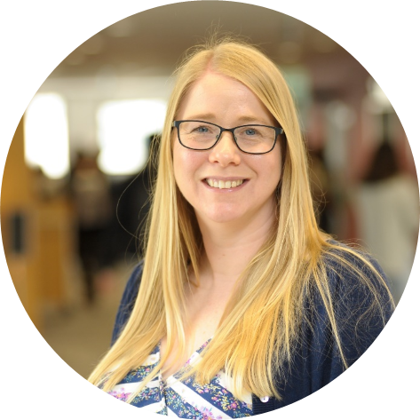


Jackie Hanes
Research and Academic Support Librarians
Jackie.Hanes@warwick.ac.uk
+44 (0)24 765 72588
Chat on Teams | Book Appointment
Advice on all library, research and referencing matters
Appointments available on-campus and online
academicsupport@warwick.ac.uk
@warwicklibrary

Slide 3
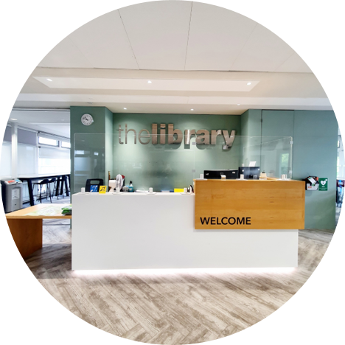



The Library
Open 24/7 (staff 8:30am-9:30pm)
1st floor entrance and helpdesks
University ID card for library entry
warwick.ac.uk/services/library/
library@warwick.ac.uk​
+44 (0)24 765 22026
@warwicklibrary

Slide 4
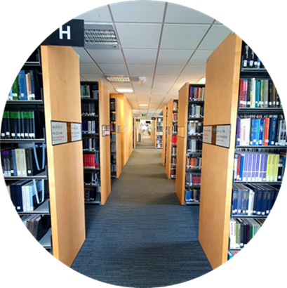
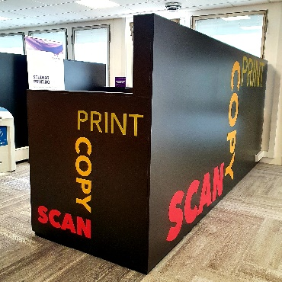
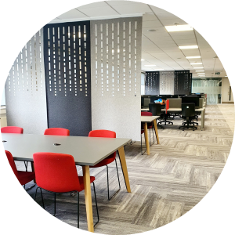
The Library
Places
Study | Collaborate |Relaxation | Computers
People
Librarians | IT Helpdesk | Students | Community
Information
Books | Journals | News | Theses | Databases …

Slide 5
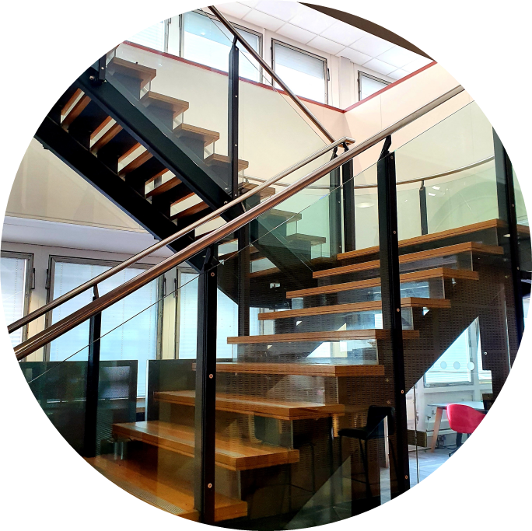
Library floor plan
5: Social Science (H), Economics (HB-HJ), Politics (J)
4: Law (K) & Official Publications
3: Psychology (BF)
2: Teaching rooms: Seminar, Training, Teaching grid, Co-creation
1: Welcome & Helpdesk, Issue/Return, Breathing space, Coffee Bar
G: Library Café, The Eating Place, Toilets

Slide 6

5th floor - Economics
5-H
Social sciences collection of print books & journals:
HA: Statistics
HB-HJ: Economics
HD-HF: Business & Management
HG-HJ: Finance
HM-HV: Sociology & Criminology
J: Politics & International Relations
Digital Library: ebooks, ejournals & databases
including 1,300,000 ebooks & 158,280 ejournals

Slide 7

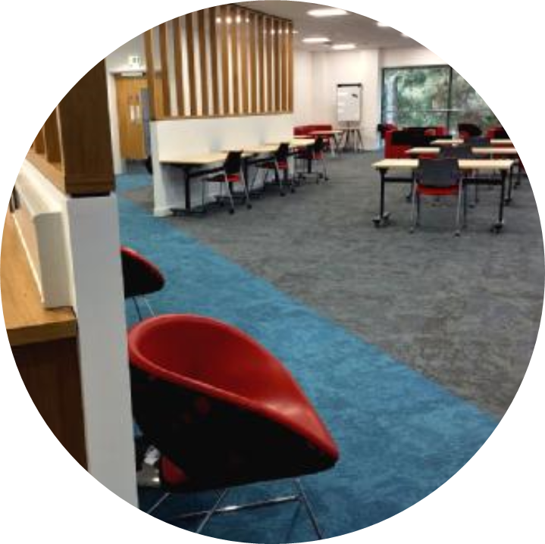
Study spaces for students
Study Zones
Silent & Quiet: individual study
Collaboration: group work
Social: Café & Eating Place
Learning Grids
Open daily 8am-10pm
Available to all students
Rootes (SU): social study space
University House: quiet study space
Postgrad Hub @ The Junction
Open 9am to midnight
Available to PGT & PGR students

Slide 8
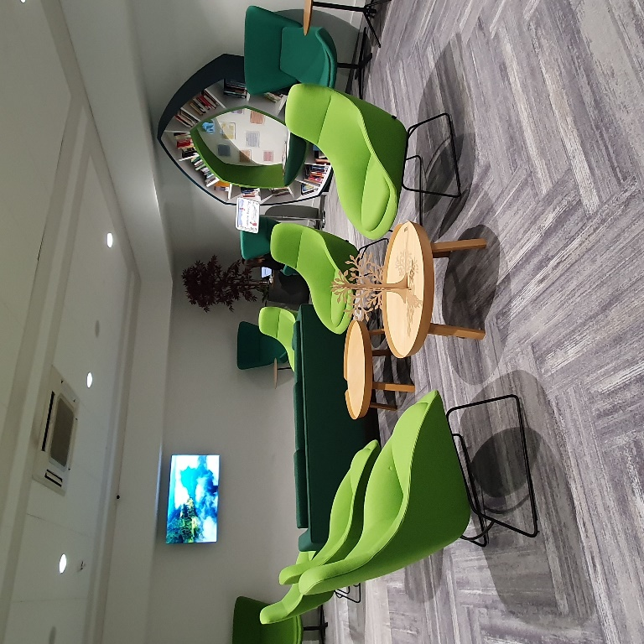
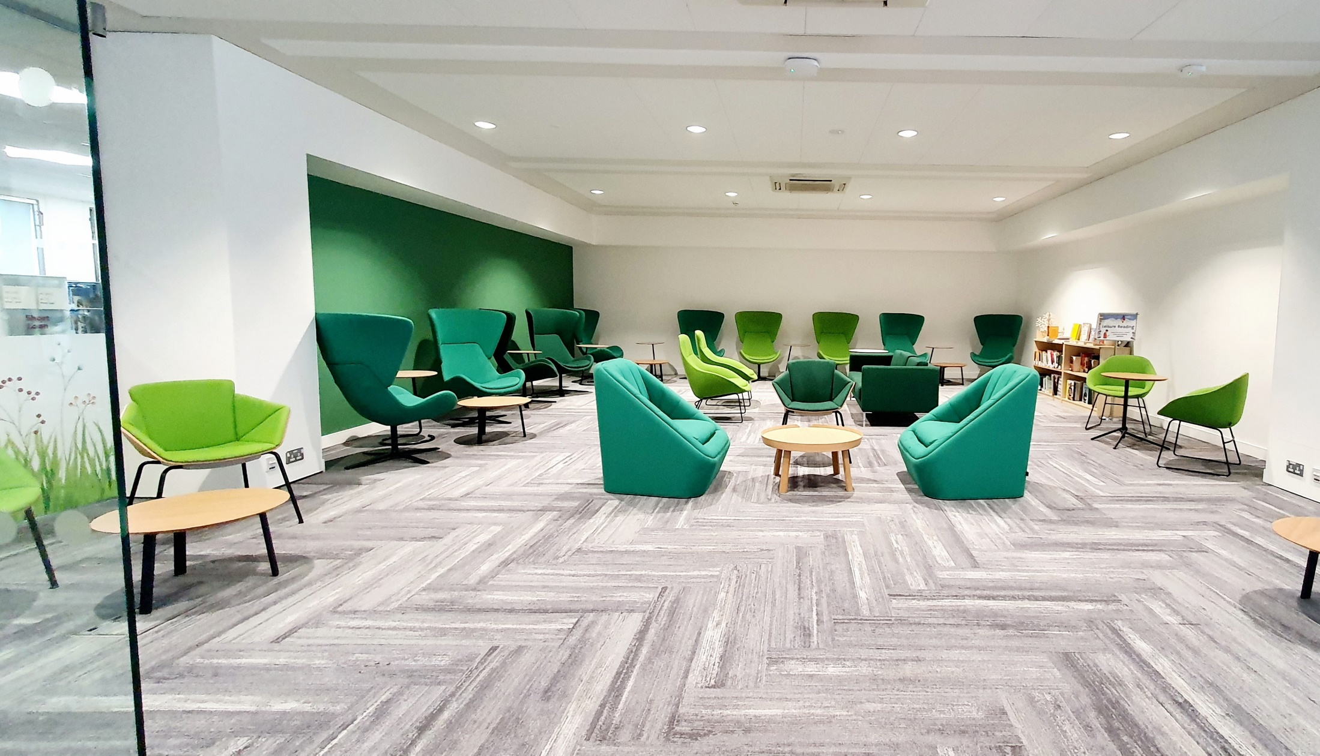
Breathing space
Take a break from your studies in the Breathing Space
A relaxation room on the 1st floor of the library
Refresh and refocus in our tranquil space
Browse the library’s leisure reading and well-being collections

Slide 9

Connect with your
Postgraduate
Community
Library Community Engagement

Slide 10
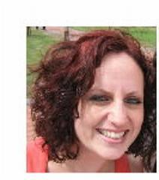
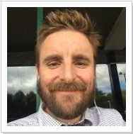
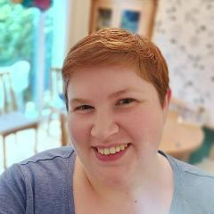
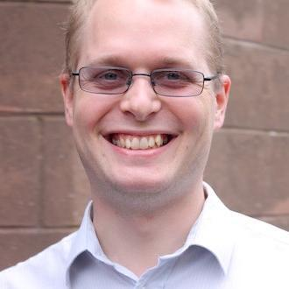

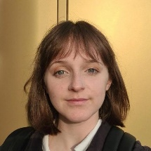
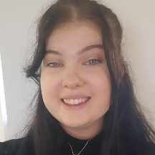
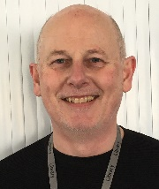
Meet the Team
Phil (he/him), Gemma (she/her), Sam (they/them) and Steve (he/him)
Hannah (she/her), Marie (she/her) and Keiron (he/him)
Notes:
So, to start us off, the Community Engagement team is made up of eight members of staff, all of whom are here to help you. First up we have Phil and Gemma. You may not see a lot of them but they’re both very friendly. We than have Aysa, Sam, (me), Hannah, and Marie. We look after the community events, initiatives, and activities and you’re very likely to see both Hannah and Marie at the events. Lastly, but certainly not least, we also have Steve and Kieron. It’s their job to look after our co-creation space and teaching grid – more info on both of these to come. But, now that you know who we are, who are you? And do you have any fun facts that you’d like to share with us? Or, if you want you can send into chat an emoji that best describes your favourite thing to do in your spare time or your favourite hobby! Thank you so much for sharing with us! Some fun facts about us are that Marie is a twin, Kerion was a college fencing champion, Sam will have participated in four 5ks by the end of 2023 and Hannah has lived in five different cities!

Slide 11
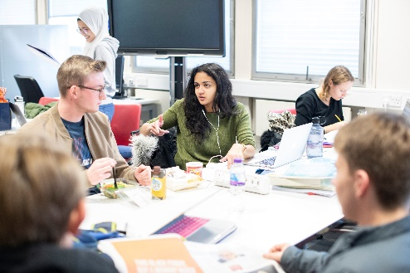
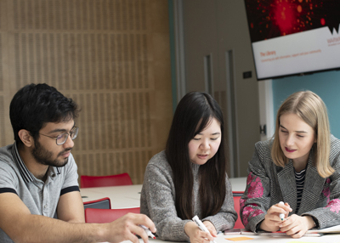
Events
We run a variety of different events at the Library, all of which are designed to support you through your time at the University. Our events focus on connecting you to your peers, helping you to learn and study independently, and ensuring that you’re able to get the support and help you require.
Here are a just two of the events that are open to all students:
Write Here Write Now; a pomodoro style event where you can work alongside fellow students to get your work done.
Sensory Refresh; an event that allows you to explore your senses and learn what senses help you to focus better.
Keep an eye on our website and the WhatsOn Calendar throughout the year.

Slide 12
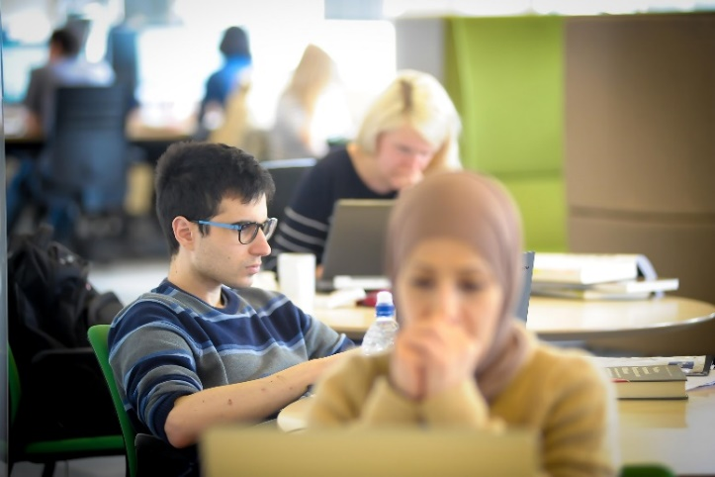
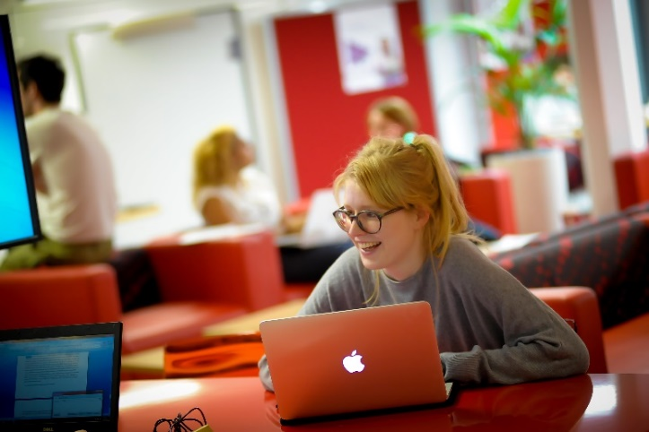
Postgraduate Events
Research Refresh (Wolfson Research Exchange)
Every Thursday from 10.30am – 12pm, we hold Research Refresh, which is a chance for you to meet fellow researchers from different disciplinaries, unwind, play some games, and refuel with some free refreshments.
PG Tips (PG Hub)
Held on Tuesdays from 3pm – 4pm in the PG Hub. This is an event for all postgraduates. It’s a space to meet fellow PGs and includes weekly topics to discuss each week, such as Healthy Study Practices. There are also free refreshments too.

Slide 13

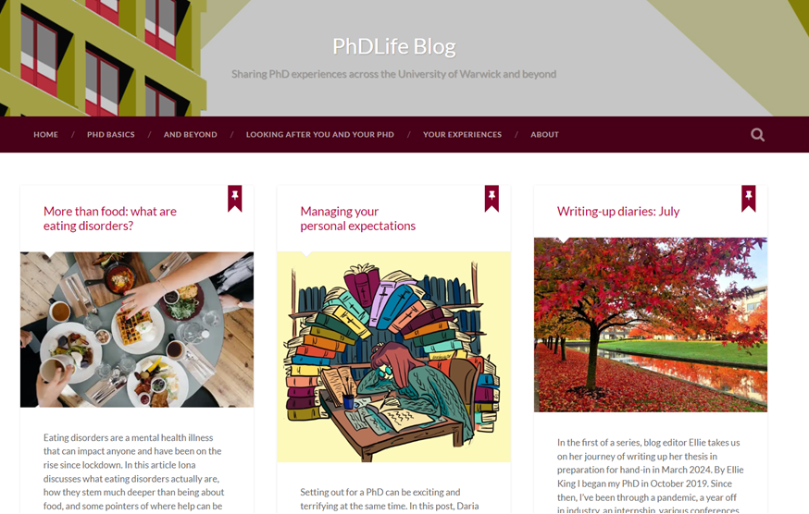
Online
PHDLife Blog and Study Blog
https://phdlife.warwick.ac.uk https://studyblog.warwick.ac.uk
PhD-ing 101
Composing & Writing
Building Relationships
Being Well
Moving On & Transitions
Library Skills
Dissertations
Searching and Databases
Work-Life Balance
Postgrad Realities Moodle
warwick.ac.uk/postgradrealities
Supervisor Relationships
Imposter Syndrome
Expectations
Perfectionism
Culture Shock
Procrastination

Slide 14
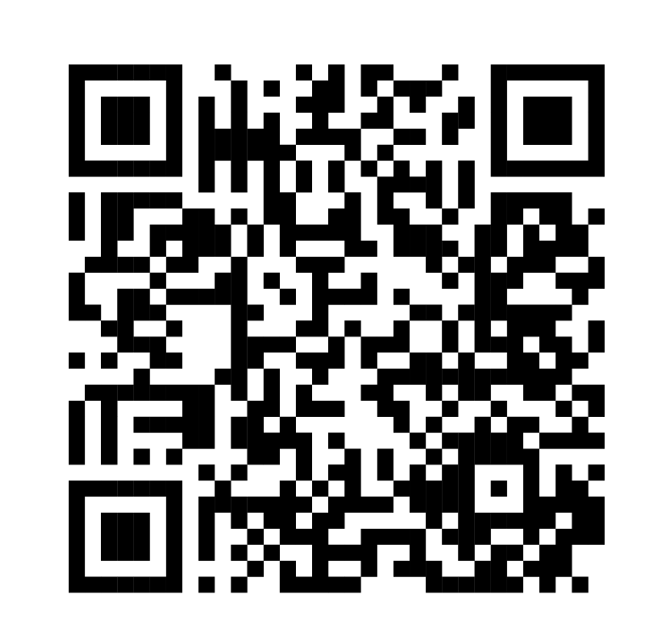




Library Student Partners
Helping us with our events and to help us improve the Library, are our Library Student Partners.
These peers are also here to help connect with you and support you during your time at the University, so if you need help or have any suggestions for making the library a better place, talk to them.
You can also connect with us on Social Media or by emailing us.
@WarwickUniLibrary
lib-community@warwick.ac.uk
@WarwickLibrary
@WarwickLibrary
Notes:
We’re also quite active on social media and we love to connect with our students! You can find us on Facebook, Instagram and Twitter. If you follow us on there, you’ll find up to date information about our offers, initiatives and events and you can also ask us questions too. If you do need to get in touch with us for any other reason, please do feel free to reach out to us at lib-community@warwick.ac.uk.

Slide 15
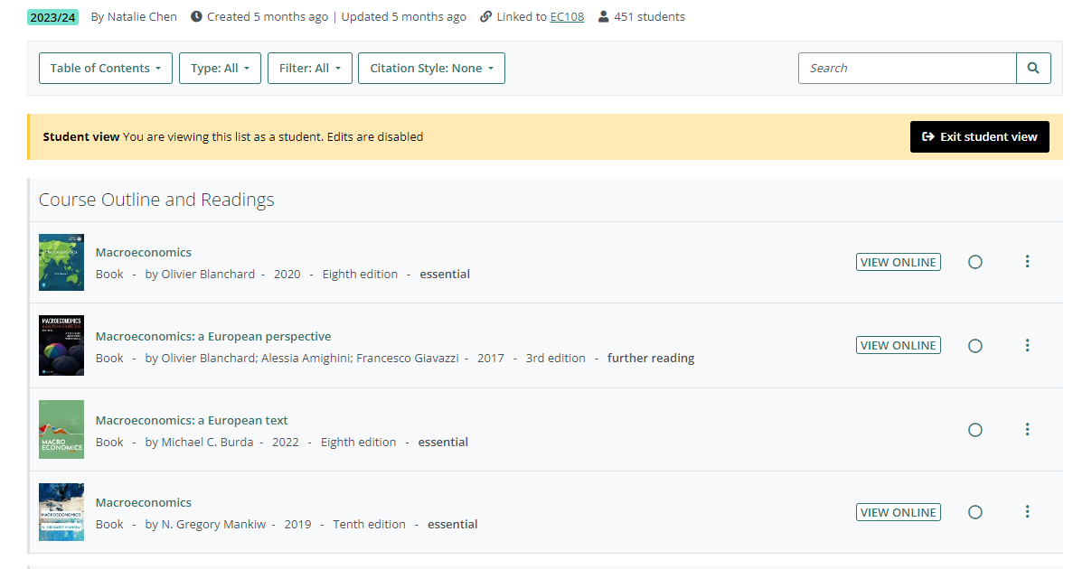
Reading list
warwick.rl.talis.com/
Talis Aspire is the university’s electronic reading list system
Access your reading lists from Moodle or the library website
Find essential, recommended and further reading
Link to digital and print library resources

Slide 16
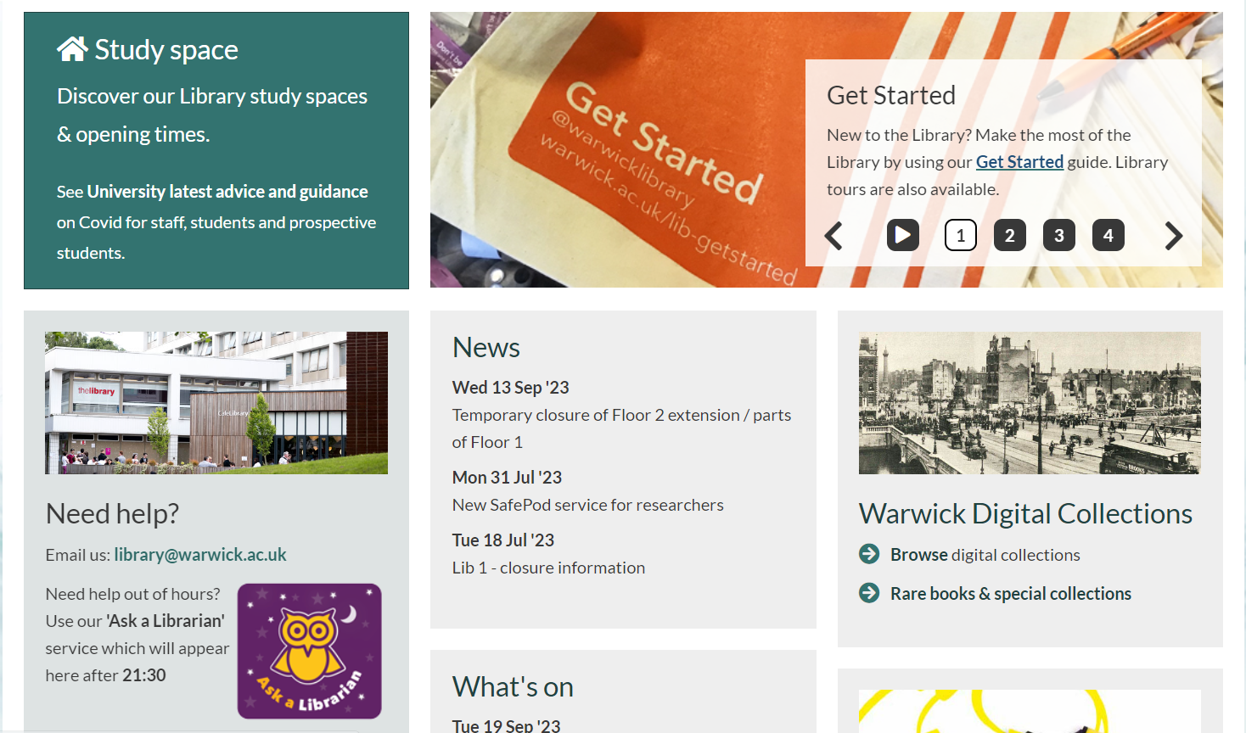
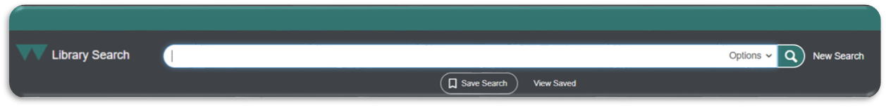
Library Search
warwick.ac.uk/services/library/
Library Search is the library’s search engine or discovery service
Find books/chapters, journals/articles, databases and more
Access library account: view and renew items on-loan
Recall & reserve on-loan items and request click & collect

Slide 17
Finding books
Author (Year) Title of Book. Edition. Place: Publisher.
Harford, T. (2012) The Undercover Economist. 2nd edn. Oxford: Oxford University Press.
Author
(Year)
Title of Book
Edition
Place
Publisher

Slide 18

Print books
Library Search will tell you the copies, location, classmark and availability
The classmark is the subject classification and place on library shelves
You can borrow an almost unlimited number of books (999 items)
The standard loan period is 1 year (except 3 day loan books)
If a book is recalled, it must be returned early (1 week)
If all copies are on-loan, you can recall the book using Click & Collect

Slide 19
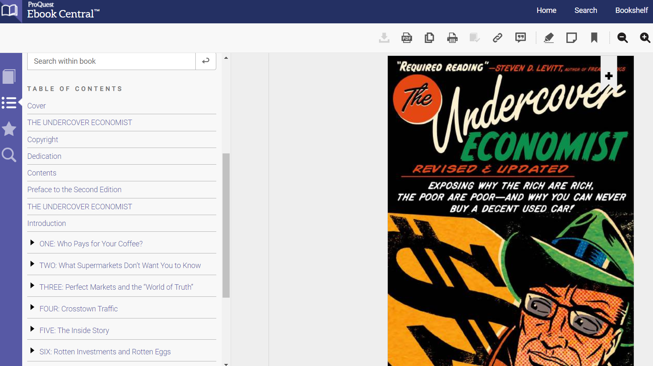
Ebooks
The library has 1.3+ million ebooks from many publishers and platforms
Library Search will connect you to ebooks – click on Full Text Online
Login with your university IT number and password
Restrictions on the use of library ebooks (licensing and copyright):
Copies: single user, multiple user or unlimited users
Printing: 10% pages, 1 chapter in book or unlimited printing
Download: read online only, download PDFs, download to e-reader

Slide 20
Finding articles
Author (Year) ‘Title of Article’, Title of Journal, Volume(Issue), Pages.
Cascaldi-Garcia, D. et al (2023) ‘What is certain about uncertainty?’, Journal of Economic Literature, 61(3), pp. 624-654.
Author
(Year)
‘Title of Article’
Title of Journal
Volume(Issue)
Pages

Slide 21
Ejournals
The library has 1.5+ thousand ejournals from many publishers and platforms
There are 3 ways to find ejournals using Library Search:
Article: search by author and article title
Journal: search by journal title then browse by year/volume/issue
Subject: search by keywords then limit results to ‘journal article’
Quick Look: shows you the article details, keywords and abstract
Click on Full Text Online to access the article/journal
Login with your university IT number and password

Slide 22

Google
Library Search is the best way to access books, journals and databases
If you research with Google, you may be denied access to full-text (paywall)
Look for options to Login via Institution and search for Warwick
You should be prompted to login with your IT username and password
Google Scholar can be personalised to link to the university library
Click on the Menu > Settings > Library Links and search for Warwick
Warwick Access will then appear in Google Scholar search results

Slide 23
Document supply
warwick.ac.uk/services/library/using/get-it-for-me/
Get It For Me is the library’s document supply service
Access to books, chapters and articles not available in the library:
Digitisation: of articles and chapters from another library
Inter-Library Loan: borrow a book from another library
Book Suggestion: request purchase of books for our library
You can also request postal loan of print books held in our library

Slide 24
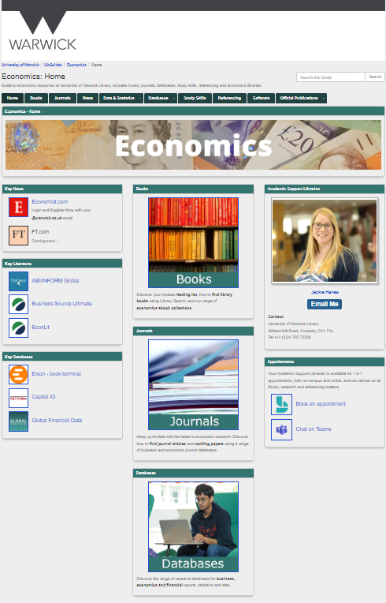
Economics subject guide
Research and Academic Support Librarians
warwick.libguides.com/economics/
A guide to economics books, journals & databases
Data & Statistics: macro, micro, company, financial
Study skills and referencing support
Librarian’s email, telephone and appointments
academicsupport@warwick.ac.uk
@warwicklibrary

Slide 25
Databases
The library has many specialist research databases for economists
Find academic journals + working papers, news, country/industry reports
ABI/INFORM Global: business, economics, finance & management
Business Source Ultimate: business, finance & management
EconLit: economics and finance
Scopus: multidisciplinary inc social sciences & economics
Web of Science: multidisciplinary inc social sciences & economics
APA PsycInfo: psychology including behavioural science

Slide 26



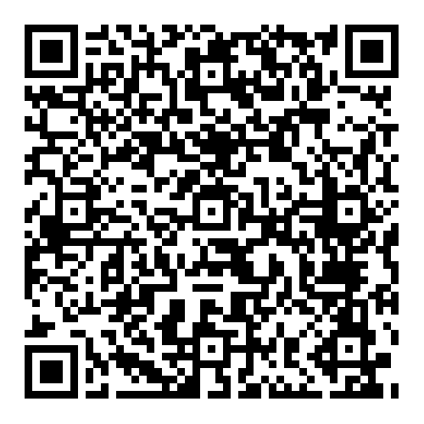

Research and Academic Support Librarians
EconLit with Full Text
Scholarly journals and working papers for economists
Accounting | Banking | Capital Markets | Economics Econometrics | Finance | Labour | Monetary Theory
Public Finance | Quality Management | Systems Theory
600+ full-text journals including American Economic Association
academicsupport@warwick.ac.uk
@warwicklibrary

Slide 27

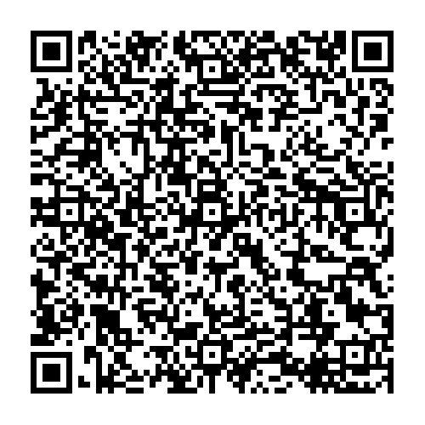
Research and Academic Support Librarians
APA PsycInfo
Scholarly literature in psychological, social & behavioural science
Index, abstract & citations to psychology literature
Articles | Books | Chapters | Dissertations
Link to selected full-text in APA PsycArticles database
Indexed with APA & MeSH subject headings
Database backed by the American Psychological Association
Access
here
academicsupport@warwick.ac.uk
@warwicklibrary

Slide 28

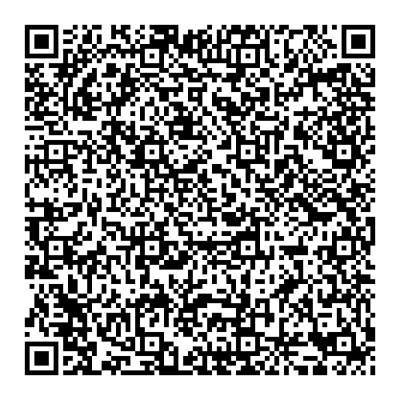
Web of Science
Research and Academic Support Librarians
Search the world’s leading scholarly journals, books and proceedings in the sciences, social sciences & arts and humanities
Business | Economics | Finance | Management
Researchers can access Journal Citation Reports for citation metrics and to follow authors, articles and publication trends
Access
here
academicsupport@warwick.ac.uk
@warwicklibrary

Slide 29

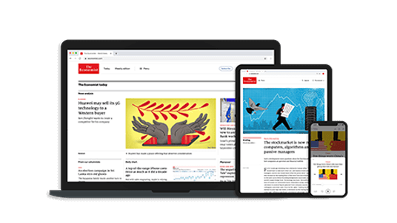
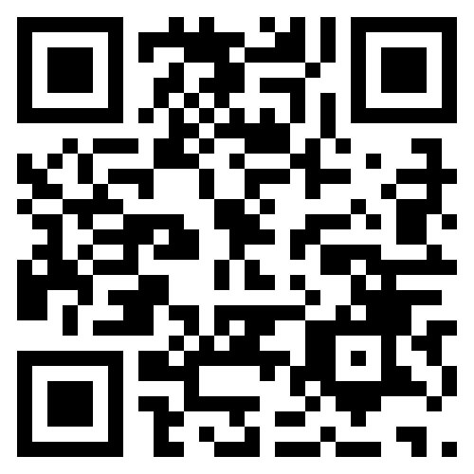
Research and Academic Support Librarians
The Economist.com is a global news service for business, economic and political current affairs
Access at economist.com and login/register with your @warwick.ac.uk email address
Access online or via mobile apps for Apple and Android
Access here
academicsupport@warwick.ac.uk
@warwicklibrary

Slide 30

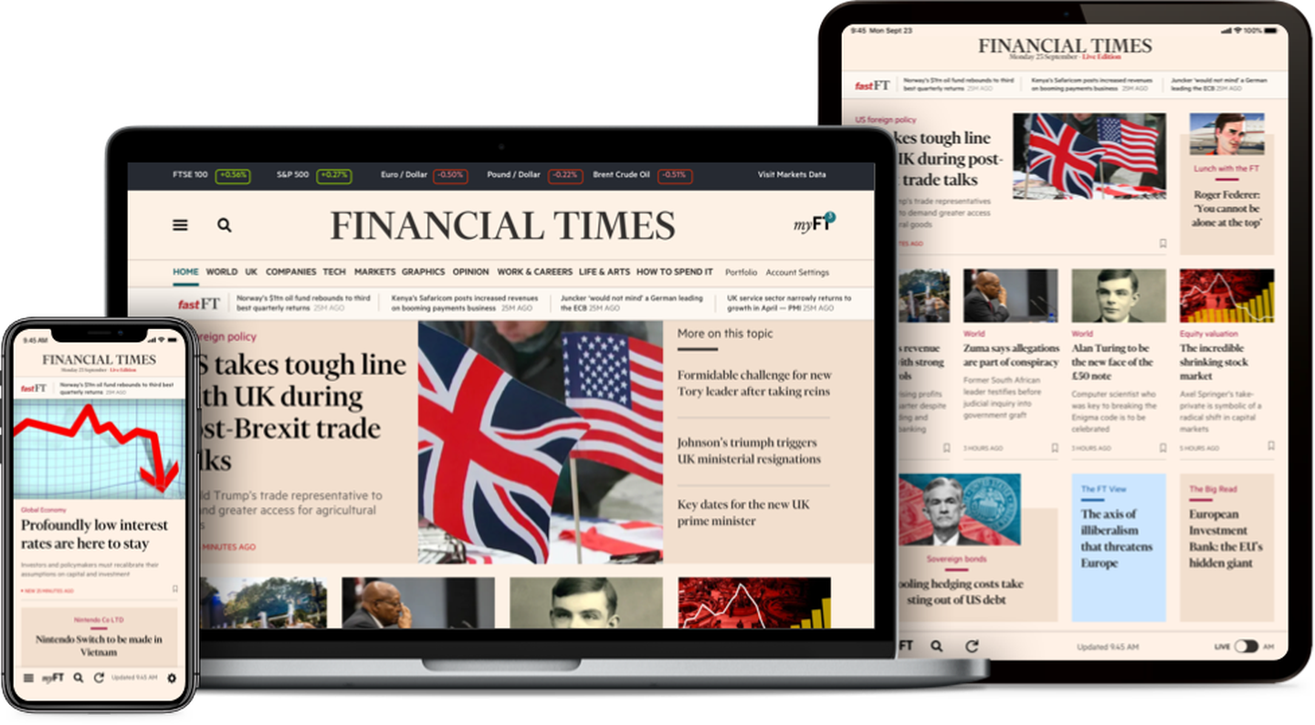
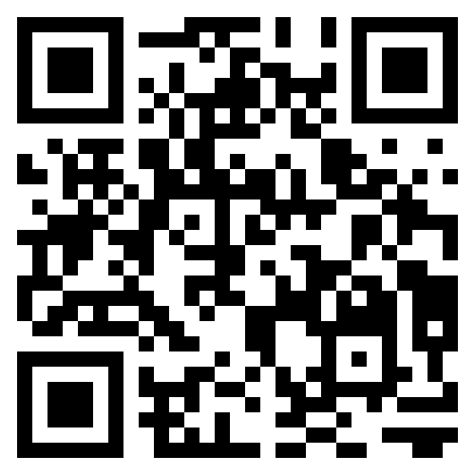
Research and Academic Support Librarians
The Financial Times is British daily newspaper focussing on business and economic current affairs
Access at ft.com/Warwick
Access online or via mobile apps for Apple and Android
Access here
academicsupport@warwick.ac.uk
@warwicklibrary

Slide 31
Economic data
warwick.libguides.com/economics/data
The library has many sources of macro & micro economic data:
ONS: Office for National Statistics (official statistics for the UK)
UKDS: UK Data Service (research data repository)
EuroStat: official statistics about EU members
OECD: official data and publications from OECD members
IMF: global data and reports from the IMF
World Bank: global data from the World Bank

Slide 32
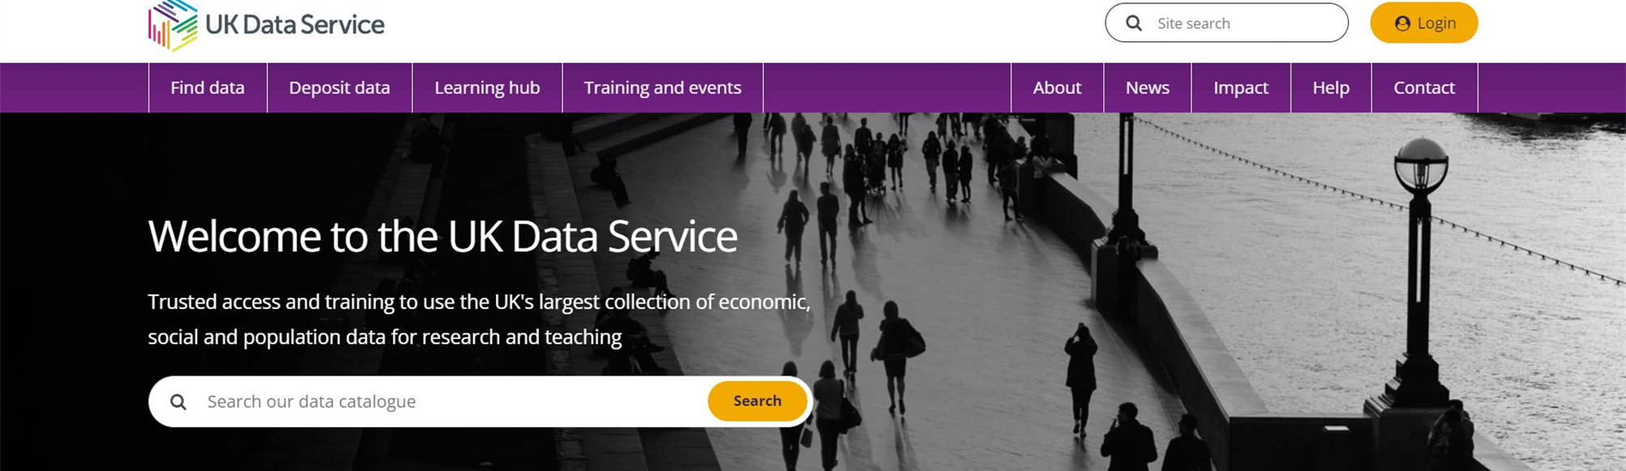
UK Data Service
UK’s national repository of economic, social and population data
Includes macro and micro data from ONS, IMF, OECD and World Bank
Access: register with @warwick.ac.uk email & login to download data
Also offers an excellent range of training courses and webinars

Slide 33
Company, industry & financial data
warwick.libguides.com/economics/data
The library has many company, industry and financial databases:
Fame: company information for the UK Ireland
Orbis & Orbis Bank Focus: global company and banking information
Capital IQ: global company and financial markets information
Refinitiv Eikon: global company and financial markets information
Gale Business Insights: global company and industry information
IBIS World: industry, market research and risk ratings reports
Global Financial Data: global economic and financial time-series data

Slide 34

Refinitiv Eikon
Key international company, industry and financial database
includes Environment, Social and Governance (ESG) data
Only available in the library. Book Refinitiv Eikon terminal online!
Eikon training and certification available via Refinitiv Learning Centre

Slide 35

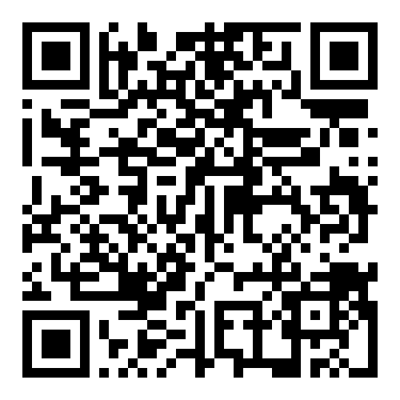
Get Started: library welcome information & events
Essential information, library tours, video guides & FAQs
warwick.ac.uk/services/library/using/help/new-users

