Slide 1
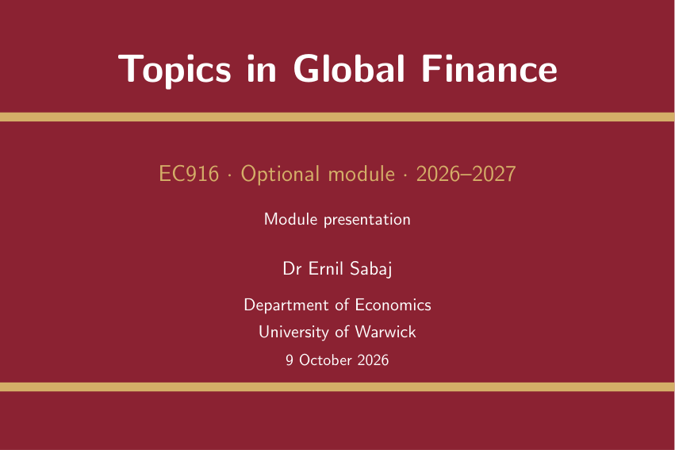

Slide 2
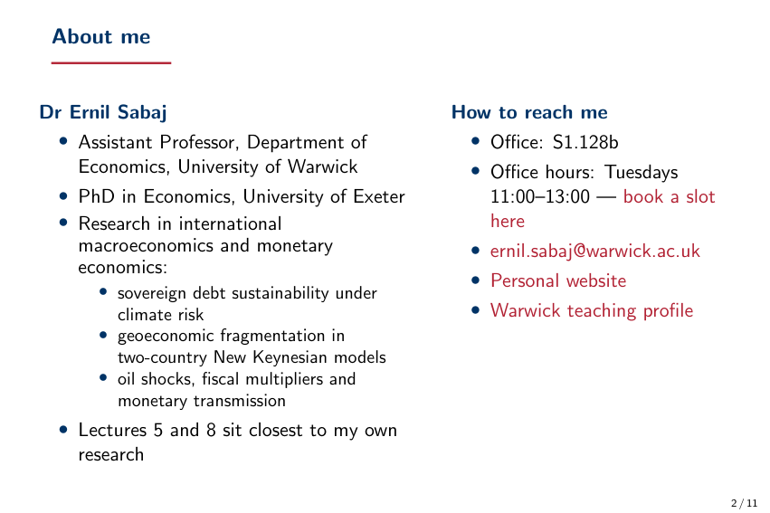

Slide 3
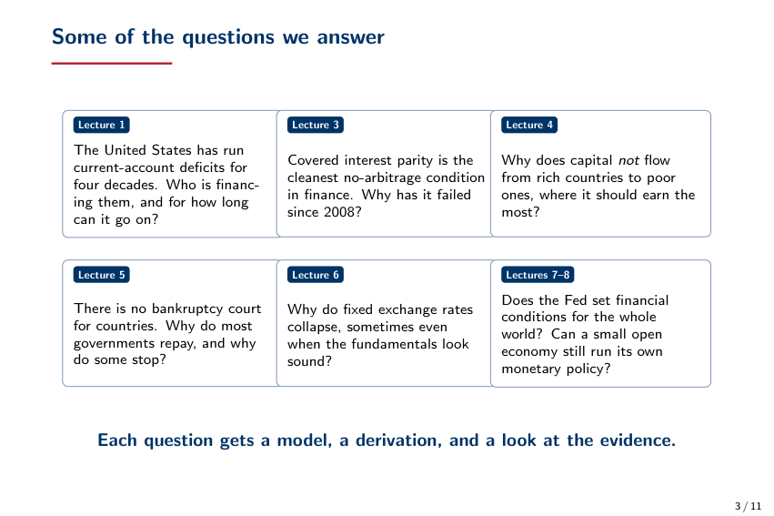

Slide 4
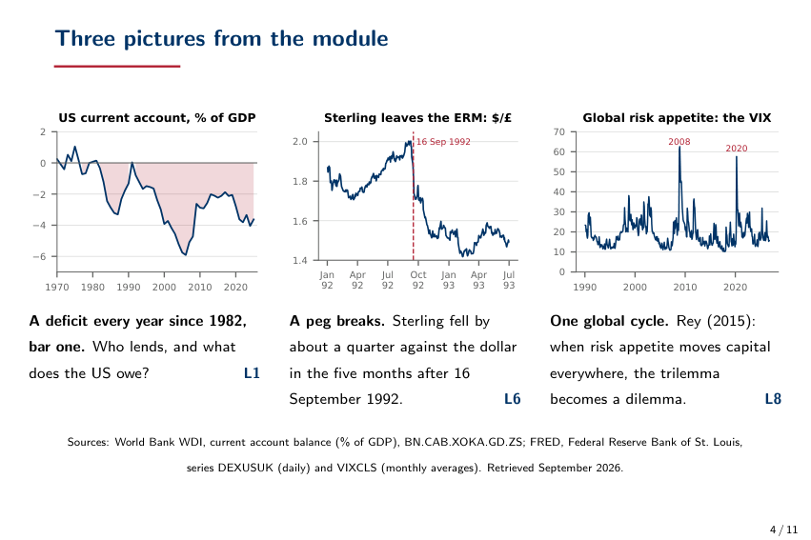

Slide 5
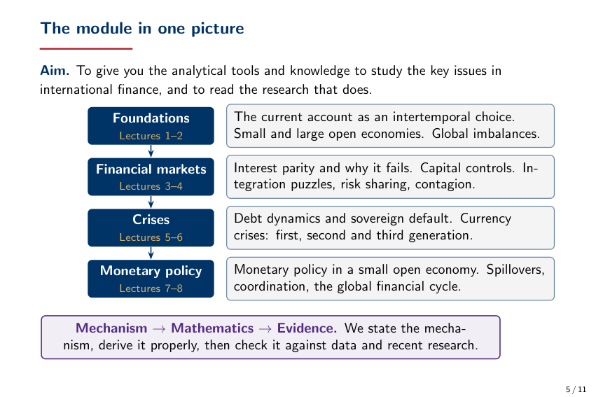

Slide 6
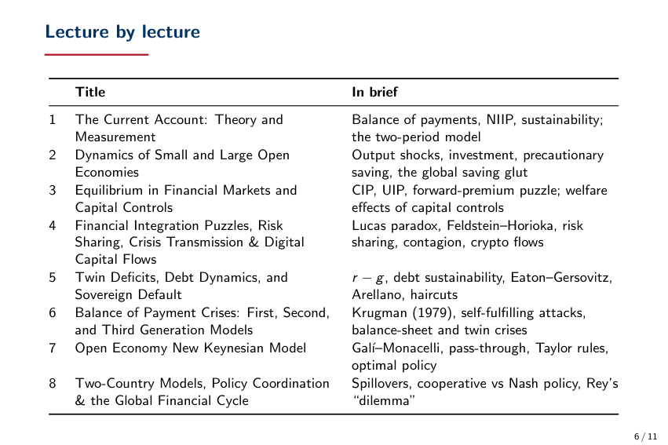

Slide 7
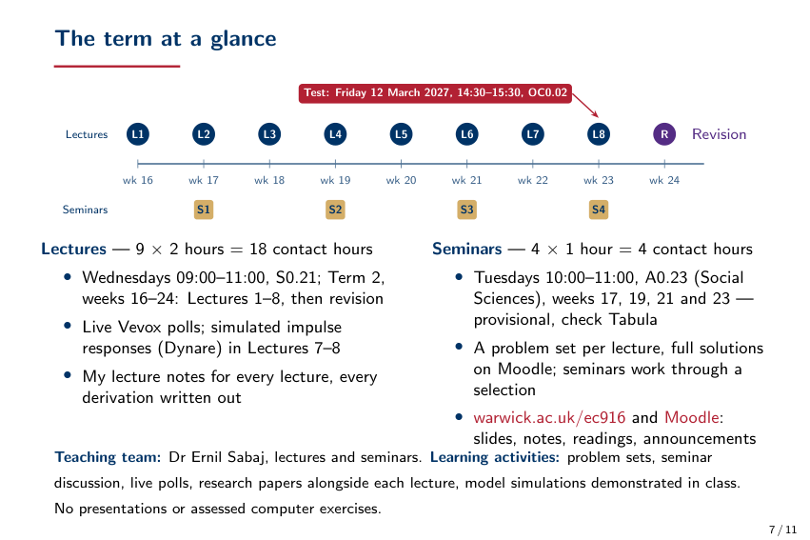

Slide 8
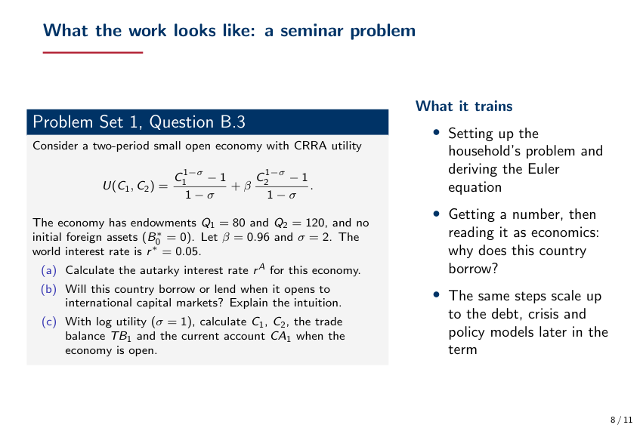

Slide 9


Slide 10
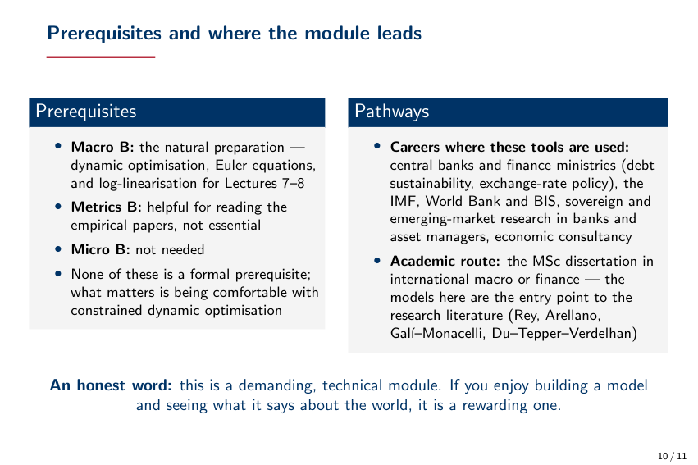

Slide 11
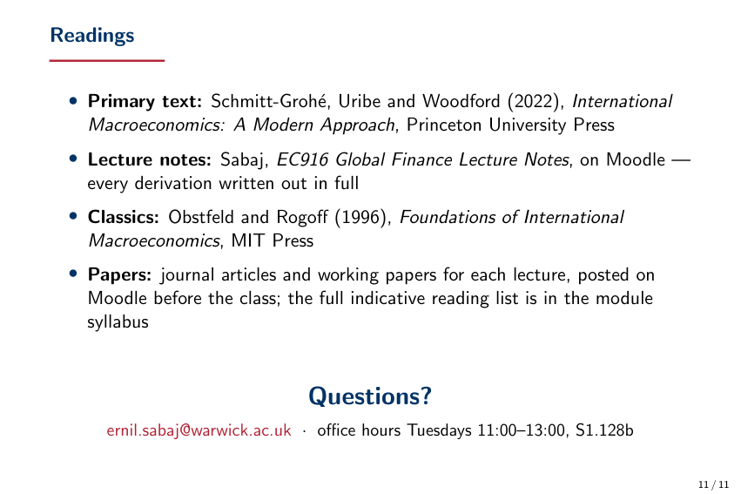

Slide 12
EC982: Development Economics
James Fenske
University of Warwick
1 / 5

Slide 13
How I will teach this module
In this module, I will teach four different types of material:
  Randomized evaluations: … e.g. “Randomized evaluations: Threats.” I will outline core concepts from Glennerster and Takavarasha’s “Running Randomized Evaluations: A Practical Guide,” which I used to use as the main textbook. This book is the guide to program evaluation.
  How to ...: e.g. “How to do pairwise randomization.” In these sections, I will identify a technique used to analyze data from developing countries. Many are mentioned in Glennerster and Takavarasha. I add more math and real examples from papers in development economics.
  Participation: ...: e.g. “Participation: Ghatak and Mookherjee.” In these sections, I will test whether you are learning the material covered in the review articles that I assign. We will proceed at the rate of about one review article and one research article per week.
  A recent paper: ... e.g. “A recent paper: Bertrand et al.” In these sections, I will guide you through a recent research paper.
I will start with a lecture that is 100% How to ..., and will introduce the other types of material as the weeks go on.
2 / 5

Slide 14
Assessment
A replication assignment (25%)
  You will choose a recent paper in the AER or one of the AEJs, replicate it, subject it to robustness checks, and test its external validity.
  You will learn how to teach yourself new techniques and how to understand a journal article.
An essay (i.e. a literature review) (25%), written in groups of 2 or 3.
  You will find a causal question in development, and contrast the evidence from randomized controlled trials with the evidence from natural experiments and other studies.
  You will learn the literature on a topic that interests you, and why not all evidence is equal.
An empirical assignment (25%), written in groups of 2 or 3.
  You will ask a question, construct a dataset (at least part of which must be nonstandard), estimate something, and tell me what we learn from your estimate.
  You will learn new techniques, how to independently improve your skill set, and how to do well on a coding test.
An exam (25%)
  You will write an exam based on the required readings.
  You will learn both general economics knowledge and the content of the papers.
3 / 5

Slide 15
Goals
The interview process for jobs in development, such as with the Abdul Latif Jameel Poverty Action Lab (J-PAL), has several similar components.
A normal interview will assess your knowledge of impact evaluation techniques, general economics knowledge (both concepts and recent papers), soft skills, and understanding of the state of knowledge on a project.
  Impact evaluation is covered by the Randomized evaluations: ... and A recent paper: ... sections of the lectures, and reinforced by the essay and exam.
  General economics knowledge is covered by the Participation: ... and A recent paper: ... sections of the lectures, and is reinforced by all components of the assessment.
  Soft skills are covered by the Participation: ... sections of the lectures, and reinforced by the group assessments.
  Project knowledge can be reinforced by the replication assignment, essay, and empirical assignments if you choose your topics well.
A coding test will evaluate your ability to analyze data.
  The How to ... sections of the lectures, the replication assignment, and the empirical assignment are intended to improve your performance on this part of the interview process.
4 / 5

Slide 16
Want to know more? I’ve already put everything on Moodle and on my personal website:
www.jamesfenske.com
5 / 5

Slide 17
EC931 – International Trade
Carlo Perroni - 9 October 2026

Slide 18
Module Description
Lecturer: Carlo Perroni
Research-oriented module surveying:
• Key contributions and recent developments in the theoretical and empirical literature on international trade
• Applications of the theory to the analysis of trade policy
Assessment is by two-hour exam in May 2027
• Exam format as in previous years (samples available online
Notes:
Do we need this slide here? I think it should be after we introduce the PDM to students.
In any case, for the person presenting this slide:
Please let the students know that they only need to register with Warwick Awards now. Any subsequent communications will be via PDM and the activities they engage with within PDM will give them points towards the award. More details on the conversion will be provided on the Moodle page.

Slide 19
Module Outline
Trade in the competitive (neoclassical) model
• Comparative advantage; factor abundance; scale economies; tastes and product variety
Instruments of trade policy under perfect competition
• Tariffs and subsidies; quotas and other non-tariff barriers; rent seeking; theory of distortions; externalities and
trade
Imperfect competition and international trade
• Oligopoly and trade; trade under increasing returns to scale; trade and geography; strategic trade policy; trade and industry structure; empirical evidence
The political economy of trade policy formation
• Trade and income distribution; endogenous protection
International economic integration
• The theory of customs unions; regional agreements; multilateral liberalization; the WTO
Notes:
Do we need this slide here? I think it should be after we introduce the PDM to students.
In any case, for the person presenting this slide:
Please let the students know that they only need to register with Warwick Awards now. Any subsequent communications will be via PDM and the activities they engage with within PDM will give them points towards the award. More details on the conversion will be provided on the Moodle page.

Slide 20

EC901: Microeconomics
Carlo Perroni - 09 October 2026

Slide 21
Topics
Weeks 2-5 (Michela Redoano)
Consumer behaviour
An introduction to behavioural economics
Choice under uncertainty
General Equilibrium
Weeks 6-9 (Carlo Perroni)
Games in strategic form
Auctions
Extensive-form games
Information economics
Week 10: Revision

Slide 22
Classes
The students taking this course will be divided into several classes, and each class will meet in weeks 3 though 10 of this term. You need to sign up for a class on Tabula. A problem set will be uploaded to the module webpage at least a week before each class with questions for discussion in that class. You are expected to try to solve the problems before the class meets.
Assessment
Two multiple choice tests (5% each) and a final written examination in January (80%).
A or B?

Slide 23
Recommended Reading
The following textbooks are useful for the course:
JR G. Jehle and P. Reny, Advanced Microeconomic Theory, Prentice-Hall (3rd ed., 2011).
HR H. Gravelle and R. Rees, Microeconomics, Longman, 1992 (2nd ed).
HV H. Varian, Microeconomic Analysis, Norton, 1992 (3rd ed).
MW A. Mas-Colell, M.D. Whinston and J.R. Green, Microeconomic Theory, 1995, OUP.
KT D. Kahneman and A. Tversky (ed), Choices, Values and Frames, Cambridge University Press, 2000.
CLR C. Camerer, G. Loewenstein, and M. Rabin, Advances in Behavioral Economics, 2004,
Princeton University Press.
SD S. Dhami, The Foundations of Behavioral Economic Analysis, 2016.
RG R. Gibbons, A Primer in Game Theory, Harvester Wheatsheaf, 1998.
OR M.J. Osborne and A. Rubinstein, A Course in Game Theory, 1994. MIT Press.
All the first four textbooks are useful for this module, and you should probably buy one of them. The module follows JR quite closely and is the book we most strongly recommend. MW is rigorous and comprehensive, but not for those that dislike maths. At the other extreme is HR, which relies much more heavily on diagrams and intuition. The last five books are more specialised and will be used in only parts of the module. In addition to the reading below we will refer to articles that are relevant as we lecture. These articles will be uploaded to the module homepage. The module is based on lecture notes which will be handed out during lectures and will also be available at the module homepage as the term progresses.

Slide 24
DETAILED COURSE OUTLINE
Consumer Behaviour
Preference and utility. Utility maximisation, demand, and indirect utility. The dual approach to consumer theory: expenditure minimization, the expenditure function. Parametric and non-parametric tests of consumer theory. The Slutsky equation. Utility maximization with endowments, with applications to labour supply and savings.
Readings:
HR Ch 3, 4, 5.B-D, 15
HV Ch 6, 7, 8, 9, 10, 12, 19,22
JR Ch 1
MW Ch 2, 2A-3D, 3E-3G,3I
Choi, S., Kariv, S., Müller, W., & Silverman, D. (2014). ‘Who is (more) rational?.’ American
Economic Review, 104(6), 1518-50.
Deaton, A.S. and J. Muellbauer (1980a), ‘An almost ideal demand system’, American Economic
Review, 70, 312–336.
Varian, H. R. (1983). ‘Non-parametric tests of consumer behaviour.’ The Review of Economic
Studies, 50(1), 99-110.

Slide 25
Behavioural Economics: An Introduction
The behavioral economics critique of consumer theory: framing, mental accounting,
reference-dependent utility, non-exponential discounting and self-control problems.
Savings with non-exponential discounting.
Consumer choice with endogenous reference points.
Readings:
KT Ch 1,7,8,10, 12, 14
CLR Ch 1,2,6,7
SD Ch 1,2,3,4,9,10,11

Slide 26
Choice under Uncertainty
Expected utility theory, with applications to portfolio choice and insurance. Prospect theory
and applications.
Readings:
HR Ch 19, 20
HV Ch 11
JR Ch 2.4
MW Ch 6

Slide 27
General Equilibrium
General competitive equilibrium in an exchange economy, the first theorem of welfare economics.
Readings:
MW Ch 15-17, 19
JR Ch 5.1, 5.2, 5.4

Slide 28
Game Theory: Normal-form Games
Strategic-form games of complete information: dominance solvability, pure and mixed strategies, Nash equilibrium. Strategic-form games of incomplete information: Bayesian Nash equilibrium. Applications.
Readings:
MW Ch 7-8
JR Ch 7.1, 7.2
RG Ch 1, 3

Slide 29
Auctions
Sealed bid, English, Dutch Auctions. Revenue equivalence. Auction design in practice.
Readings:
JR Ch 9.1, 9.2, 9.3
P. Klemperer, Auctions: Theory and Practice, Princeton University Press, 2004, especially chapters 1,4,6.

Slide 30
Game Theory: Extensive form games
Extensive-form games of perfect information: backward induction. Extensive-form games of imperfect information: subgame perfection; sequential equilibrium. Repeated games and the Folk Theorem. Applications from amongst Oligopolistic Competition, Bargaining, and Signalling games.
Readings:
MW Ch 7, 9
JR Ch 7.3
RG Ch 2, 4.1

Slide 31
Information Economics
Moral hazard, adverse selection
Readings:
MW Ch 13-14
JR Ch 8
RG Ch 4.1
HV Ch 25.1-25.6

Slide 32
EC9D3: Microeconomics B
MSc Optional Module · 2026-27
Ilan Kremer and Ben Lockwood

Slide 33
Micro B vs Micro A
 | Micro A | Micro B
Content | Covers the basics of microeconomics and game theory | Goes into more detail on some topics e.g. implementation theory, incomplete markets
Teaching style | More informal | More emphasis on precise definitions and proofs

Slide 34
Topics: Part 1
Lecture 1: Consumer Theory I (Individual Preferences, Utility Representation)
Lecture 2: Consumer Theory II (Utility Maximization, Expenditure Minimization, Demand)
Lecture 3: Consumer Theory III (Revealed Preferences, Intertemporal Choice)
Lecture 4: Producer Theory I (Choice under Uncertainty, Production)
Lecture 5: Producer Theory II (Profit Maximization, Cost Minimization and Factor Demand)
Lecture 6: General Equilibrium I (Exchange Economies, Equilibrium Existence)
Lecture 7: General Equilibrium II (Welfare Theorems)
Lecture 8: General Equilibrium III (Production Economies, Externalities, Incomplete Markets)
Lecture 9: Behavioral Economics (Loss Aversion, Hyperbolic Discounting, Reference-Dependent Utility)

Slide 35
Topics: Part 2
Lecture 1: Introduction, Games in normal form, Dominance and Iterated Dominance
Lecture 2: Nash Equilibrium, Best response, Mixed Strategies and Mixed Nash
Lecture 3: Incomplete information, Bayesian games, Bayesian Nash equilibrium
Lecture 4: Extensive form games, Backward induction, Subgame perfect equilibrium
Lecture 5: Perfect Bayesian and Sequential Equilibrium
Lecture 6: Mechanism Design (Introduction, Single Agent / Monopoly)
Lecture 7: Mechanism Design (Standard Auctions / Revenue equivalence)
Lecture 8: Mechanism Design (Optimal Auctions)
Lecture 9: Mechanism Design (VCG mechanisms)

Slide 36
Module requirements and assessments
5%
5%
90%
Multiple Choice Test 1
Multiple Choice Test 2
Final Exam
16 November
9 December
in Summer term
Main Textbooks
Structure and Mode of Delivery
G. Jehle and P. Reny, Advanced Microeconomic Theory, Prentice Hall, 2011
4 hours of lectures every week
2 hours of additional support classes during the term

Slide 37
EC981: Public Economics
MSc Optional Module · 2026-27
Why study Public Economics
Ben Lockwood & Sara Spaziani

Slide 38
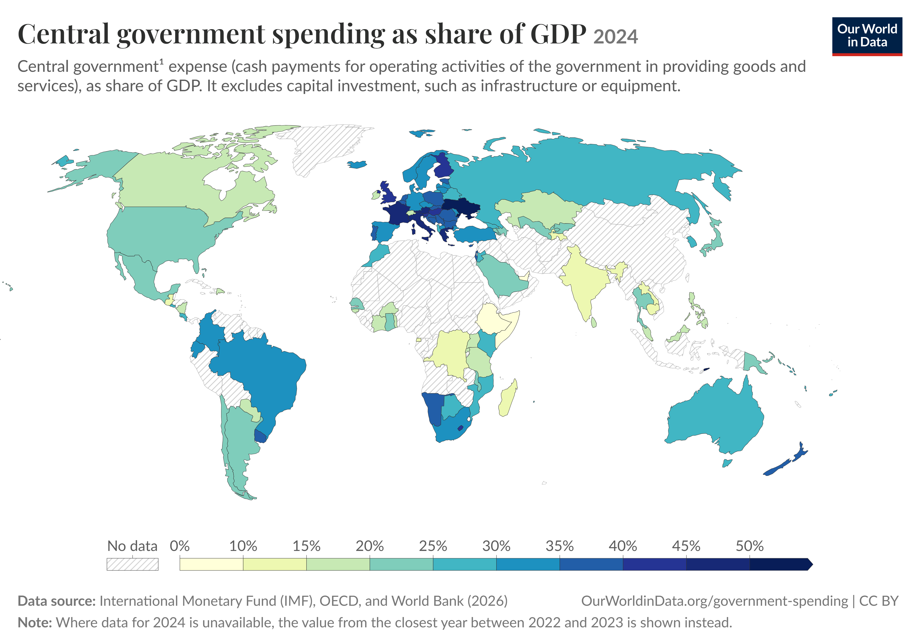
Government plays a huge role in the economy via expenditure & taxation

Slide 39
Expenditure: education, health services, social insurance, defense, etc, etc. But why? And how?
31.5%
of total spending goes to social protection

Slide 40
Taxation: Who actually pays taxes? Which taxes should the government use? And how should it design them?
25.5%
of total tax revenue is social security contributions

Slide 41
Part 1: Introduction and Taxation
First 5 weeks, Ben
Why government intervention?
Types of market failure and government intervention. Regulation vs. government financing vs. government production
1
A Review of Basic Concepts
Types of taxes. Tax incidence and excess burden in partial equilibrium. Tax salience and incidence/excess burden.
2
3
Personal Income Tax
The tax-benefit system and its effects on labor force participation and hours worked.
The design of a linear income tax and the top rate of income tax. The political economy of income taxation. International competition in income taxes.
Indirect and Environmental Taxes
The design of indirect taxes: the Ramsey and inverse elasticity rules. The design of taxes with externalities; the Sandmo additivity result and the double dividend
434
4
Taxation of International Income
Rules for taxation of international personal and corporate income (source, residence, withholding taxes); the incidence of taxes on capital in the open economy. Corporate profit shifting and tax competition; OECD’s global minimum tax proposal
5

Slide 42
Part 2: Expenditure
Last 4 weeks, Sara
Education policy
What are the individual and societal benefits of education? How can we evaluate the effectiveness of schooling? How should we fund schools or pay teachers?
1
Social security, retirement, and household finance
Are people saving enough for retirement? What policies encourage greater saving? How should we design pension systems (e.g.: choose retirement age)?
2
Social Insurance
Why public provision of health and unemployment insurance? How to provide insurance without encouraging overuse?
3
Redistribution
Should governments provide cash or in-kind benefits? Target people or places? What explains low take-up of public programs among eligible groups?
4

Slide 43
Module requirements and assessments
10%
20%
70%
Multiple Choice Test
Policy Report
Final Exam
in week 6
over the Easter break (group work)
in Summer term
Main Textbooks
Structure and Mode of Delivery
Jonathan Gruber, Public Finance and Public Policy. New York, Worth Publishers (6th edition)
Jean Hindriks & Gareth Myles, Intermediate Public Economics, MIT Press (2nd edition)
2 hours of lectures every week
2 hours of additional support classes during the term

Slide 44

EC966 – Labour Economics
Natalia Zinovyeva - 9 October 2026

Slide 45

Module description
In this module, we will study both theoretical and empirical tools that economists use to understand labour markets.
Labour economics builds on microeconomics, macroeconomics, as well as econometrics.
Prerequisites:
Basic knowledge of microeconomic principles
Elementary mathematical methods such as constrained optimisation
Simple statistical methods such as multivariate regression.
Knowledge of panel data techniques and basic microeconometrics would be an advantage.
Notes:
Do we need this slide here? I think it should be after we introduce the PDM to students.
In any case, for the person presenting this slide:
Please let the students know that they only need to register with Warwick Awards now. Any subsequent communications will be via PDM and the activities they engage with within PDM will give them points towards the award. More details on the conversion will be provided on the Moodle page.

Slide 46
Questions that we will address
Labour supply
  Which factors do affect individuals’ decisions on how much to work? to invest in education?
Labour demand
  Which factors do affect firms’ decisions to hire workers?
Equilibrium on the labour market
  How do AI and technological change affect labour markets?
  How does immigration affect the salaries of native workers?
  How does minimum wage regulation affect employment?
Compensating differentials
  In which other ways are workers compensated beyond salaries?
Superstars
  Why are CEOs paid that high salaries?
Unemployment
  Why do we have unemployment?
Discrimination
  Why do some employers discriminate some employees? How do we detect it?
  Which policies may help to address discrimination?
Active Labour Market Policies
  Which active labour market policies do help to reduce unemployment?
Notes:
Do we need this slide here? I think it should be after we introduce the PDM to students.
In any case, for the person presenting this slide:
Please let the students know that they only need to register with Warwick Awards now. Any subsequent communications will be via PDM and the activities they engage with within PDM will give them points towards the award. More details on the conversion will be provided on the Moodle page.

Slide 47

Assessment
Essay (20%)
  1,000 words, referee report style
Exam (80%)
  On-campus Moodle-based test
    8 Multiple-Choice Questions
    Question on one of the papers from the reading list
    Open-book question on the assessment of a hypothetical labour market policy
Notes:
Do we need this slide here? I think it should be after we introduce the PDM to students.
In any case, for the person presenting this slide:
Please let the students know that they only need to register with Warwick Awards now. Any subsequent communications will be via PDM and the activities they engage with within PDM will give them points towards the award. More details on the conversion will be provided on the Moodle page.

Slide 48

EC984
Experimental Economics
Daniel Sgroi
Mahnaz Nazneen

Slide 49
Course Objectives and Lecture Topics
Demonstrate why experiments are now an important part of Economics and when to use them
Introduction and Brief History of Experiments
Understand experimental methodology (in the laboratory and in the field)
Experiment Design and Methodological Issues
Types of Experiments
Critically examine a series of important experimental papers in different sub-topics
Role of Emotion in Experiments
Social and Risk Preferences
Replication, Ethical concerns, and practical issues
Gender Differences in Experiments

Slide 50
Module Overview
Lectures
Small Group Classes
2-hour lectures per week
4 classes
1-hour every two week
Assessment
Final exam in the Summer Term (100% in person exam)

Slide 51
Who should take the module?
Curious about experiments: Want to understand how economists use experiments to answer research questions?
Using experimental evidence: Learn how to critically evaluate and discuss experimental papers.
Writing an MSc dissertation: Gain the tools to incorporate experimental research into your project.
Working with experimental data: Particularly valuable for BES/BDS students undertaking project.
Considering a PhD or research career: Build the foundations for designing and running your own experiments.
A quick clarification: Experimental Economics is not Behavioural Economics. EC984 focuses on the practical and methodological side of experimentation.

Slide 52

EC994 – Applications of Data
Science
Kenichi Nagasawa
Deborah Kim

Slide 53
Definition of Data Science and Module Goals
Use large datasets to answer an empirically relevant question in a domain (Economics).
Coding ability to extract and manipulate (large) new datasets from nonstandard sources.
Use of statistical methods appropriate for prediction and inference with large datasets.
Hence, the module goals are to gain an introductory understanding over collection and use of large datasets (theoretically and with machines), statistical methods appropriate for such data, and how to analyze them accordingly.

Slide 54
ECON 994 – Applications of Data Science:
General Information
Instructor: Kenichi Nagasawa, Deborah Kim
Schedule:
Lectures- Tuesdays, 12:00-14:00 (Weeks 16-24), S0.18
Support- Tuesdays, 14:00-15:00 (Weeks 17, 19, 22, 24), S0.18
Assessment: Exam (100%), with suggested problem sets, class discussion as complements.
Main References:
Grolemund, G and Wickham, H. 2016. R for Data Science.
James, G., Witten, D., Hastie, T., and Tibshirani, R., An Introduction to Statistical Learning with Applications. Springer

Slide 55
For more details
Syllabus
The syllabus may cover, but is not limited to the following areas:
Data Science Use cases (e.g. in academia, business, public sector)
Linear Methods
Naïve Bayes
General Linear models
Model selection
Bootstrapping
Random trees, forests
Dimensionality reduction (Principal Component, Clustering)
Supervised Learning methods
Unsupervised learning
Applications using statistical packages (such as R or others)

Slide 56
For more details
Context
Optional Module L1P6 – Year 1, L1P7 – Year 1
Pre or Co-requisites Probability and statistics as well as basic econometrics and maths (Algebra, Analysis). Programming skills are helpful but not a pre-requisite
Assessment
Assessment Method Online Examination (100%)
Coursework Details Online Examination (100%)
Exam Timing May

Slide 57

EC988 – Investment and the Financial System
Zeynep Kurter – 09 October 2026

Slide 58
Lectures, Seminars, Assessments and Pre-requisites
Lectures: Mondays, 9:00- 11:00 at B2.02
Seminars: No seminars
Additional two hours exercises for exam practice for each part
Assessment: Two-hour written examination (100%)
Pre-requisites: Basic knowledge of calculus and econometrics

Slide 59
Module Content
Weeks 1–5 — Assistant Professor Zeynep Ozde Kurter
Bonds/Yield Curves
Credit Ratings
Credit Default Swap Spreads (CDS) – Fixed Income Derivatives
Stock Market and Investment (CAPM focus)
Systemic Risk in Financial Markets
Weeks 5–10 — Associate Professor Pablo Beker
Empirical Facts of Bonds and Stocks Returns
Microeconomic Foundations for CAPM
Consumption-Based Asset Pricing Models

Slide 60

Why You Should Consider Taking This Module
Real-world applications and help to understand key features of the financial industry.
Developing critical thinking with economic theory and its applications to real-world problems.
Better preparing you for the business and finance world that awaits.
Equipped with our Investment and the Financial System MSc, students should have skills suitable for much wider opportunities in the finance sector globally.

Slide 61
Programming and Learning Resources
We do not assume you have any prior knowledge of programming.
We expect you to be willing to learn or practice a programming language.
Excel - Bond Price Calculations
Stata - CAPM (Capital Asset Pricing Model) Calculations
Lecture Notes / Slides / Main Books / Lecture Capture (only for the first five weeks) will help your study.
Reading List (2026-27) for EC-988 is updated and shared with you. https://rl.talis.com/3/warwick/lists/b316d487-2af9-491b-b959-f9f7ce975c14.html
In addition, we will indicate further additional readings/articles during the course.

Slide 62
OPTIONAL MODULE · 2026–27
EC996
Environmental Economics
Anant Sudarshan
Instructor
OPTIONAL MODULES FAIR · FRI 9 OCT 2026 · LIB 2
Notes:
Optional Modules Fair, Fri 9 Oct 2026, LIB 2 (slot ~10:46). About 2 minutes total — roughly 20–30 seconds per slide.
Hi, I'm Anant Sudarshan, and I teach EC996, Environmental Economics, an optional module for 2026–27.

Slide 63
WHY THIS MODULE
01
Climate change
Possibly the greatest challenge before humanity. Poor countries already face severe environmental barriers to growth.
Why?
Growth and prosperity – across the world – are fundamentally contingent on environmental factors.
02
Fundamentally about economics
Solutions are not just about technology: they depend on incentives, prices, policy, regulation and welfare.
03
Shapes choices, joins fields
Environmental issues deeply influence government and corporate choices. Behavioural, IO, public and development economics converge here.
Notes:
Why take it? Growth and prosperity everywhere depend on the environment. Climate change may be the greatest challenge we face, and poor countries already hit environmental barriers to growth.
The solutions are not just technology — they are about incentives, prices, policy, regulation and welfare. That is economics. And it is where behavioural, IO, public and development economics meet.

Slide 64
WHO TEACHES THIS MODULE
AS
Anant Sudarshan
www.anantsudarshan.com
I did a PhD in engineering, turned into an economist, and work on energy and environment problems in developing countries. A lot of my work involves field experiments in partnership with government.
RESEARCH AREAS
Air pollution
Climate adaptation
Decentralised renewables
Electricity access
Notes:
A bit about me: PhD in engineering, turned economist. I work on energy and environment problems in developing countries, often through field experiments with government — air pollution, climate adaptation, decentralised renewables, electricity access.
More at www.anantsudarshan.com.

Slide 65
COURSE DETAILS · 2026–27
How you are assessed
10%
30%
50%
10%
Weekly written critiques
Data assignment
Group policy brief
Group presentation
No written final exam
Teaching: in person, one 2-hour lecture a week, each on a different topic.
Background: exposure to micro-economics and econometrics, plus at least one statistical package (R, STATA, Python or MATLAB). Some assignment questions need basic data work or running regressions.
Notes:
Assessment for 2026–27: weekly written critiques 10%, a data assignment 30%, a group policy brief 50%, and a group presentation 10%. There is no written final exam.
Teaching is in person, one 2-hour lecture a week. You need some micro and econometrics, and one stats package — R, STATA, Python or MATLAB.
Source: approved 2026–27 weights (Tina Jones, 20 Sep 2026).

Slide 66
EC996 TOPICS
What we cover
HOW IT RUNS
Weekly 2-hour lecture
In person, a different topic each week
Selected readings
No textbook — readings set each week
Check Moodle
No, really — check Moodle.
01
02
03
Intro
Costs
Social Costs of Carbon
04
05
06
Pricing Policy
COP
Corruption and State Capacity
07
08
09
Transport and Trade
Behavioural Environmental Economics
Biodiversity and Ecology
Notes:
What we cover: nine topics, from costs and the social costs of carbon through pricing policy, COP, corruption and state capacity, transport and trade, behavioural environmental economics, and biodiversity and ecology.
Selected readings each week, no textbook — and please check Moodle. Happy to take questions.

Slide 67
EC979 – Health Economics
Kobi Glazer– 09 October 2026
Meeting with Glazer, Kobi-20251008_125940-Meeting Recording.mp4

Slide 68
EC9D5 – Macroeconomics B
Arthur Galichère – 09 October 2026

Slide 69
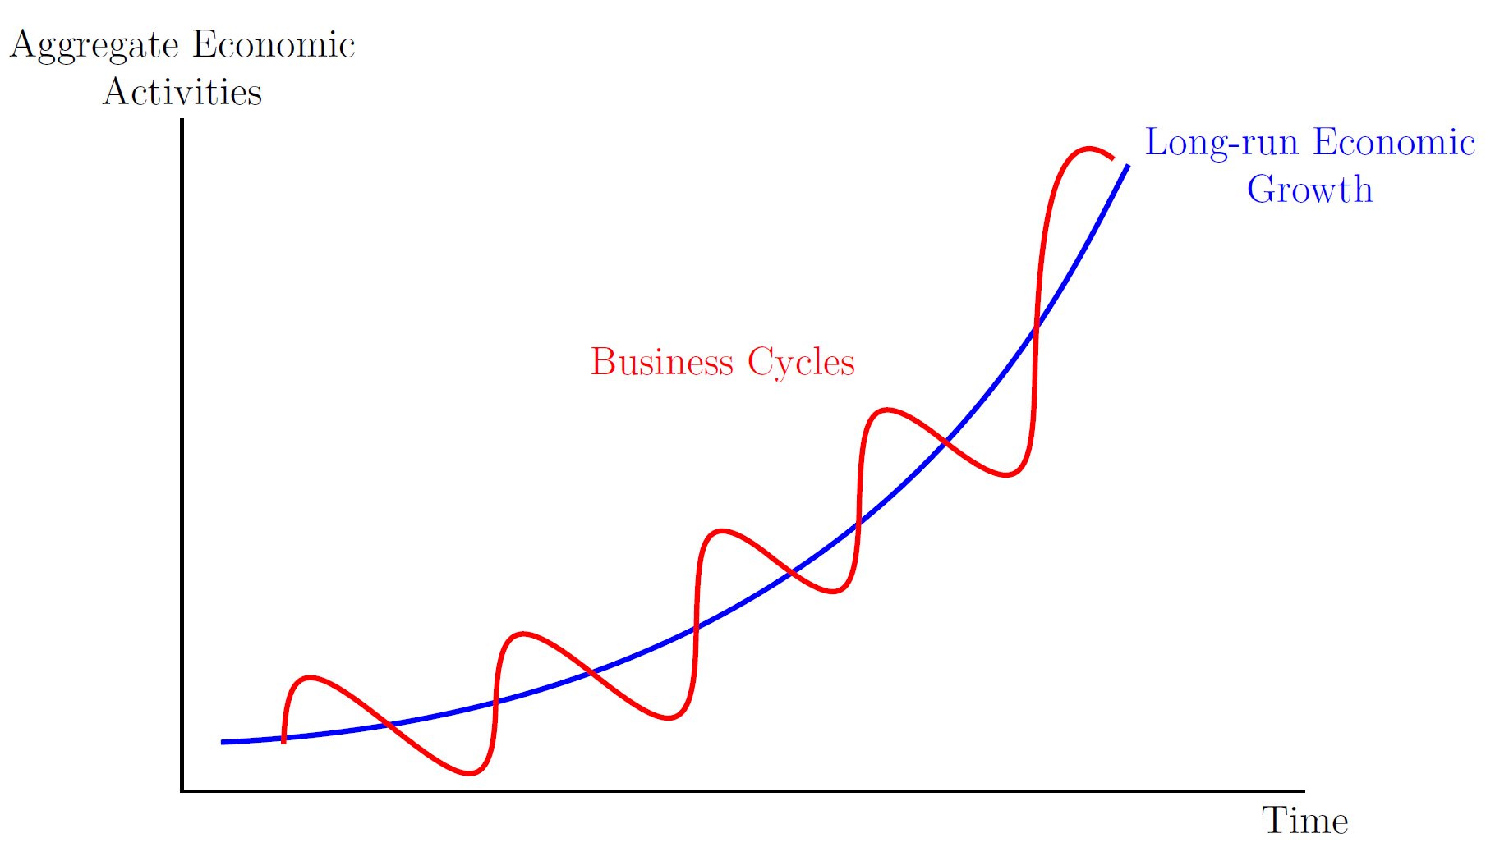
Intended Learning Outcomes

Slide 70
Message from Professor Omer Moav
“Generally, I find that the B level modules in Macro, Micro, and Metrics tend to be more
challenging.
However, if you are considering further studies after completing your MSc, these modules can be very beneficial. They also play a role in how we [i.e. academics] write reference letters for future opportunities.
In my area, I teach both the A and B levels of economic growth. The key difference is that in the B level, we sometimes delve deeper into the topics, and you will also encounter more problem sets”

Slide 71
Who is the Macro B Module for?
Does not require advance maths, but it is still mathematically demanding
  - It has optimisation problems similar to those in microeconomics; requires taking derivatives and solving systems of equations
For students from Warwick or similar institutions, it is the natural continuation of previous studies in macroeconomics
Suitable for students with an interest in macroeconomics, whether they plan to pursue a PhD or a career in policy or industry
Strongly recommended for students taking Monetary Policy module next term
If you are curious about macro, wish to develop various skills, and are ready to invest effort and time will find Macro B a rewarding and valuable module

Slide 72
Assessment
Coursework (20%) + In Person Examination (80%):
Test 1 Macro B (10%)
Test 2 Macro B (10%)
In person Examination (80%)

Slide 73
We hope this helps you in making an informed
decision about your module choices!

Slide 74

EC9D4: Macroeconomics A
Helios Herrera - 09 October 2026
5 Min Online Presentation of the Course with Recording 1.mp4

Slide 75
EC902: Econometrics A
Manuel Bagues- 09 October 2026
video - EC902 - Econometrics A.mp4

Slide 76

EC910 – Econometrics B
Han Zhang – 09 October 2026

Slide 77

Outline
Overview of EC910/EC987
Who’s it’s for
Econometrics A vs B
Module Structure
Term 1 Syllabus
Term 2 Syllabus
Notes:
Do we need this slide here? I think it should be after we introduce the PDM to students.
In any case, for the person presenting this slide:
Please let the students know that they only need to register with Warwick Awards now. Any subsequent communications will be via PDM and the activities they engage with within PDM will give them points towards the award. More details on the conversion will be provided on the Moodle page.

Slide 78
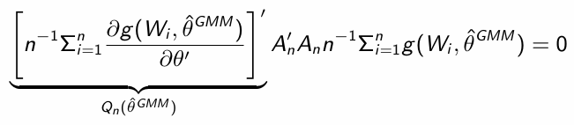
Overview of EC910/EC987
Who’s it’s for
You may considering taking this module if
you are considering doing a PhD
you have a strong background in Econometrics, Statistics, or Mathematics
(including, Physics and Engineering)
and you wish to explore more in the Econometric theory
your favourite question is ”why” and proofs help you sleep
last but not the least, you love Greek letters, e.g.
Notes:
Do we need this slide here? I think it should be after we introduce the PDM to students.
In any case, for the person presenting this slide:
Please let the students know that they only need to register with Warwick Awards now. Any subsequent communications will be via PDM and the activities they engage with within PDM will give them points towards the award. More details on the conversion will be provided on the Moodle page.

Slide 79
Expected Learning Outcome
By the end of this academic year, you should be able to:
Discuss and prove the properties of common estimators, and demonstrate these properties using simulations
Compute various estimators using experimental and observational data
Accurately interpret and discuss the results of empirical research output
Engage more confidently with technical Economics research
Notes:
Do we need this slide here? I think it should be after we introduce the PDM to students.
In any case, for the person presenting this slide:
Please let the students know that they only need to register with Warwick Awards now. Any subsequent communications will be via PDM and the activities they engage with within PDM will give them points towards the award. More details on the conversion will be provided on the Moodle page.

Slide 80
Econometrics A vs B
Econometrics B:
Assumes familiarity with basic material.
Term 1 requires:
t and F tests for linear restrictions
Heteroskedasticity
Estimation
Dummy variables
Exogeneity and Endogeneity
Term 2 requires:
Stationary ARMA models
Unit root and Cointegration
Central limit theory
Matrix Algebra
More methodological, including proofs
Theory focused
Applications in seminars
Notes:
Do we need this slide here? I think it should be after we introduce the PDM to students.
In any case, for the person presenting this slide:
Please let the students know that they only need to register with Warwick Awards now. Any subsequent communications will be via PDM and the activities they engage with within PDM will give them points towards the award. More details on the conversion will be provided on the Moodle page.

Slide 81
Module Scructure
2-hour lecture per week (starting week 2)
Term 1: Thu 14.00- 16.00 in OC0.02, Juliana Carneiro (Module lecturer)
Mon 12.00- 14.00 in OC1.09, Han Zhang (Module leader)
1-hour seminar per week (starting week 3, sign up on Tabula)
Term 1: Carolina Kansikas
Term 2: Han Zhang
Assessments
 | EC910 | EC987
Pre-sessional Maths & | 10% | 20%
Mid-term Test | 10% | 20%
Project (group) | 25% | -
Exam | 55% (3hr) | 60% (2hr)
Notes:
Do we need this slide here? I think it should be after we introduce the PDM to students.
In any case, for the person presenting this slide:
Please let the students know that they only need to register with Warwick Awards now. Any subsequent communications will be via PDM and the activities they engage with within PDM will give them points towards the award. More details on the conversion will be provided on the Moodle page.

Slide 82
Syllabus of Term 1 – EC910/EC987
Classical Linear Regression Model
Properties of Estimators
OLS and Generalised Method of Moments (GMM)
GMM special cases: IV, 2SLS
Testing Linear Restrictions
Discrete Choice Models
Program Evaluation Methods/Causal Inference
Reference:
A.C. Cameron & P.K. Trivedi. Microeconometrics: Methods and Applications, 2005, Cambridge University Press.
M. Verbeek, A Guide to Modern Econometrics, 5 th edition, Wiley.
F. Hayashi, Econometrics, Princeton University Press, 2000. (for GMM)
Notes:
Do we need this slide here? I think it should be after we introduce the PDM to students.
In any case, for the person presenting this slide:
Please let the students know that they only need to register with Warwick Awards now. Any subsequent communications will be via PDM and the activities they engage with within PDM will give them points towards the award. More details on the conversion will be provided on the Moodle page.

Slide 83
Syllabus of Term 2 – EC910
The Maximum Likelihood Framework: The Maximum likelihood properties; hypothesis testing.
Stationary Time Series: Autoregressive moving average (ARMA) models; Vector ARMA (VARMA) processes; the Wold Theorem; Maximum likelihood estimation.
VAR Analysis: Lag order selection; Hypothesis testing; Impulse response analysis; Structural models.
Nonstationary Time Series: Deterministic and stochastic trends; Brownian motion; OLS estimation in the AR(1) model.
Unit Root Testing: Model specification; Methods of detrending; Dickey-Fuller tests; M tests; the treatment of serial correlation.
Cointegration: Cointegration and the vector error correction model (VECM); Estimation; Distribution theory; Cointegration rank testing.
Nonlinear Time Series: Threshold models; bilinear models; Markov switching models; nonparametric autoregression; Properties of asset returns; GARCH models; Stochastic volatility models.
Reference: F. Hayashi, Econometrics, Princeton University Press, 2000.
Notes:
Do we need this slide here? I think it should be after we introduce the PDM to students.
In any case, for the person presenting this slide:
Please let the students know that they only need to register with Warwick Awards now. Any subsequent communications will be via PDM and the activities they engage with within PDM will give them points towards the award. More details on the conversion will be provided on the Moodle page.

Slide 84
EC989 Behavioural Economics
Lory Barile

Slide 85


EC989 Behavioural Economics: Lecturers and Scope
Lecturers:
Lory Barile (module leader)
Matthew Ridley
An introduction to the wide spectrum of topics in Behavioural Economics
Aim: complement benchmark microeconomic approaches by exploring the psychological foundations of economic behaviour and experience in explicit contrast to standard rational choice models
A young and exciting field! And increasingly influential in academia and policymaking
Delivery: 9 x 2 hour lectures; 4 x bi-weekly seminars (details TBC)

Slide 86
EC989 Behavioural Economics: Course Structure
Introduction
Prospect Theory and Reference-dependent Preferences
Present Bias and Procrastination
Social Preferences and Economic Behaviour
Behavioural Public Policy
Non-Standard Beliefs
The Psychology of Poverty
Subjective Well-being and Utility
Behavioural Market Failures and Policy

Slide 87
EC989 Behavioural Economics: Assessment and Contact
Further Reading (no set textbook)
Kahneman and Tversky (2000) Choice, Values and Frames – seminal collection of papers
Wilkinson and Klaes (2012) An Introduction to Behavioural Economics
Assessment:
2 hour exam in May, 2 questions from 4 (each specific to one of the 8 topics)
Further details:
Email: Lory.Barile@warwick.ac.uk
Advice and Feedback hours: time TBC.

Slide 88
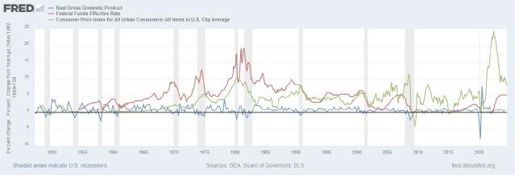
EC924: Monetary Economics
Marija Vukotic
Alexander Karalis Isaac
Oct 2026
Vukotic & Karalis (Warwick)
EC924
Oct 2026 1 / 5

Slide 89
Aims and learning outcomes
Aims
I To enable you to replicate key findings in monetary economics
I To enable you to undertake your own research
I To support a future in macro-oriented policy careers
Learning outcomes
I Maths skills; ‘metrics skills; introduction to Dynare; stata skills
I Thorough understading of Basic New Keynesian model
I Thorough knowledge of Structural VAR methods
I Introduction to large DSGEs, solution methods, advanced topics
Vukotic & Karalis (Warwick)
EC924
Oct 2026 2 / 5

Slide 90
Core topics
Gali (2008) Monetary Policy, Inflation and the Business Cycle
A classical monetary model
I In a market without frictions money is ‘supernuetral’
I Technology shocks are the source of aggregate fluctuations
The New Keynesian Response
I What are the rigidities which amplify shocks?
I Money is no longer nuetral
I Understand the model in detail; modern central banking
I Derivation and properties of these models; solving and simulating
model; evaluation of model
I Analyse economic response to policy shocks
Vukotic & Karalis (Warwick)
EC924
Oct 2026 3 / 5

Slide 91
Core topics
Optimal Policy
I How should policy makers use this power?
I Observation, information and policy in baseline model
I Real imperfections and policy with a trade off
* Discretion versus committment
I Expectations, indexation, lags and policy debate
The data
I Discover and understand key ‘stylized facts’
I Identify shocks and model economic dynamics: VARS
I Modern identification: SVARs, news shocks, financial data
I Estimating models
I Evaluating models, evlauating policy and transmission mechanisms
NB: These topics subject to staff and student interests, the speed of course etc.
Vukotic & Karalis (Warwick)
EC924
Oct 2026 4 / 5

Slide 92
Delivery and Assessment
Lecturers: Marija Vukotic and Alex Karalis Isaac
Ddelivery:
I Lecture mterial 2 hrs per week, weeks 16-24
I Problem sets are provided; discussed in 4 x seminars
Assessment:
I 2x 15% term-time assessed problem sets
I 70% final exam
Pre-requisite: UG: intermediate macro and econometrics. PG: Econ Analysis: Macro B is preferred; Econometrics - B preferred.
Lecture notes provided; useful text books inc. Walsh, C.E. Monetary Economics, Gali, J. Monetary Policy and Wickens, M. Macroeconomic Theory; Killian and Lutkepohl Structural VARs
Vukotic & Karalis (Warwick)
EC924
Oct 2026 5 / 5

Slide 93


EC943 Industrial Economics
Sinem Hidir & Kobi Glazer
S.hidir@warwick.ac.uk J.Glazer@warwick.ac.uk

Slide 94
EC943 Background Knowledge
Perfect Competition
Monopoly
Monopolistic Competition
Oligopoly and Game Theory
Cournot
Bertrand
Stackelberg
Pricing implications
Equilibrium concepts
Product differentiation

Slide 95
EC943 Module Content
Weeks 1 – 5 Jacob Glazer
Vertical relations
Outsourcing
Vertical Differentiations and Quality Games
Judo Economics and Exit
Week 9 Review and Assessment Support (1 hour) additional class

Slide 96
EC943 Module Content
Weeks 1 – 5 Jacob Glazer
Vertical relations
Outsourcing
Vertical Differentiations and Quality Games
Judo Economics and Exit

Slide 97
EC943 Module Content
Weeks 6-9: Sinem Hidir
Strategic entry, entry deterrence and exit,
Price discrimination and market segmentation
Competition policy and regulation, mergers, antitrust
Innovation and digital markets
Term 3: revision course

Slide 98
EC943 Module Teaching
In-person weekly lectures (Tuesdays 17.00-19.00). Lecture slides.
Revision lecture in term 3
Book: Belleflamme, Paul and Martin Peitz (2015) Industrial Organization: Markets and Strategies 2nd ed., Cambridge.
Additional article references provided before course.

Slide 99
EC943 Assessment Details
Completion of problem set 1 (10% marks)
Completion of problem set 2 (10% marks)
Final examination (80% marks)

