Slide 1

BES (Economics Track)
Introductory Meeting
Alex Karalis Isaac, 8 October 2026

Slide 2

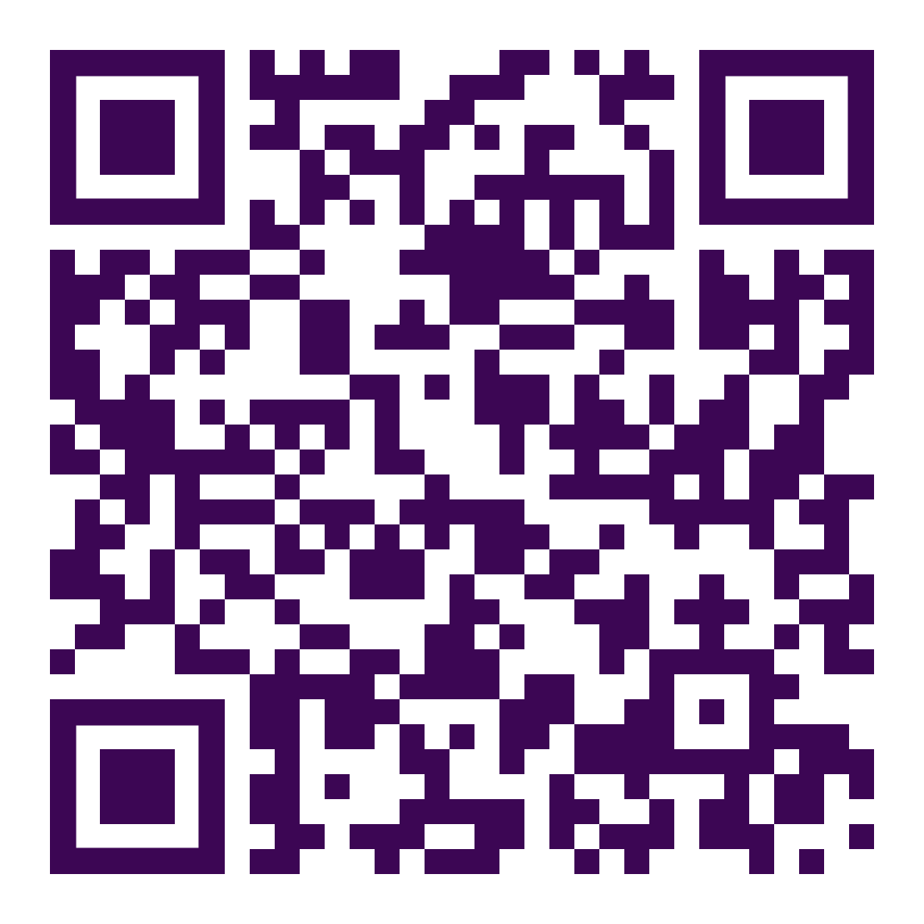
Economics in Numbers
We ranked
1st
in the Good University Guide 2026
We ranked
2nd
in the UK in the most recent Research Excellence Framework (REF) 2021
We ranked
25
in QS World University Subject Rankings
View more
key statistics

Slide 3


What’s special about Warwick
Focus on research, research-led teaching
World renowned University, Faculty, Alumni
Interdisciplinary
International
Location (ask me more!)
Courses taught at the highest levels

Slide 4
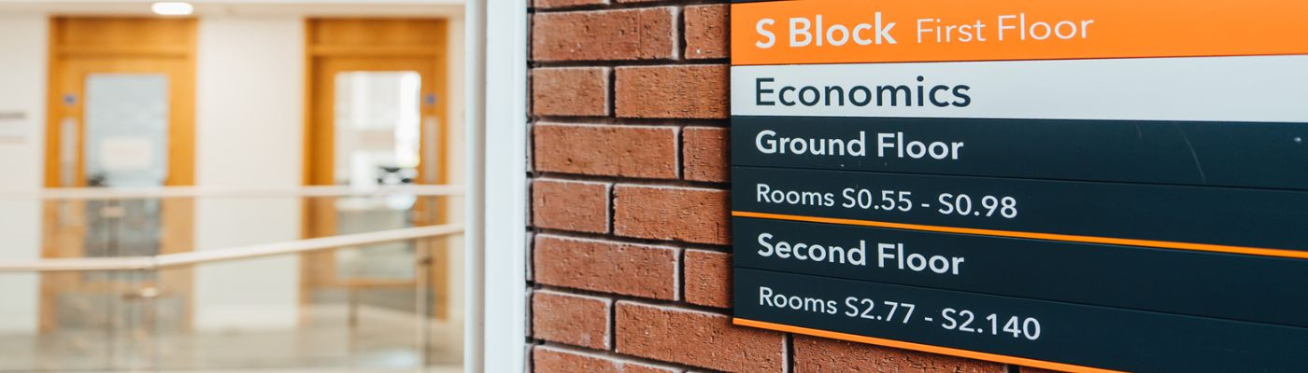
The Department of Economics
World-leading Research and Teaching & Learning,
with the aim of improving people’s lives
1200 Undergraduate students
140 MSc students
65 PhD students
86 members of academic staff, including 23 professors

Slide 5
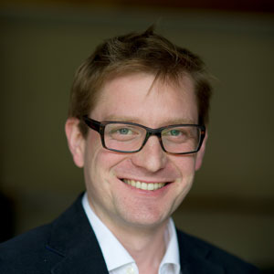
About me
Alex Karalis
Applied macroeconomist with particular interest in the non-Gaussian behaviour of economic systems
Director MSc EIFE, BES & Econ & PGT Director of Studies
A&F hours: You can book an appointment here.
Contact me:
a.karalis-isaac at warwick.ac.uk

Slide 6
Course Objectives
Master the core content and cutting edge of behavioural science, and develop a theoretical understanding of key models and results in behavioural economics and economic psychology.
Learn how to engage the primary literature.
Develop general skills in writing, presenting, and programming.
Gain proficiency in designing and deploying a research project and/or an intervention.
This is a collaborative course between Psychology and Economics.

Slide 7
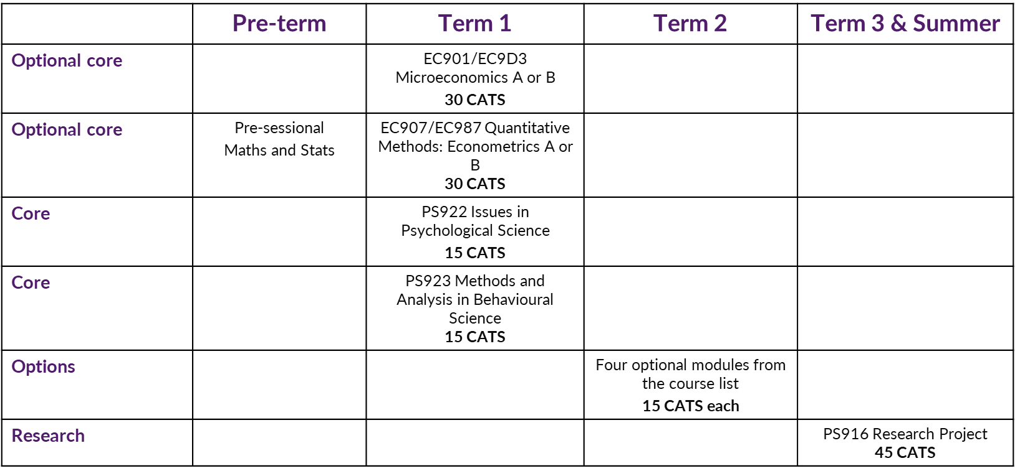
MSc BES

Slide 8

Microeconomics A or B
The Microeconomics module will develop your understanding of advanced economic analysis.
There is an applied version (A) and a more theoretically oriented and technical version (B).
A variants
You have done a reasonable amount of Microeconomics previously (as in a typical undergraduate module)
B variants
You have strong analytical skills or are intending to complete to a PhD degree after your MSc course. The pre-requisites will normally be (the equivalent of) a First-class mark (70%) from your undergraduate degree and a strong performance in your pre-sessional tests.

Slide 9
Optional Modules Term 2
At least one module from:
EC984 Experimental Economics
EC989 Behavioural Economics
Two or three modules from:
EC994 Applications of Data Science
EC996 Environmental Economics & Sustainable Development
PS918 Psychological Models of Choice
PS919 Behavioural Change: Nudging and Persuasion
PS931 Bayesian Approaches to Behavioural Science
PS941 Computational Behaviour and Social Science
IB9AN Principles of Cognition
IB9ZC Behavioural Ethics
More information is available in your Handbook
Module registration:
eVision Module Registration (eMR)
Deadline: Monday 19 October 2026.
We will send more info about registering modules

Slide 10
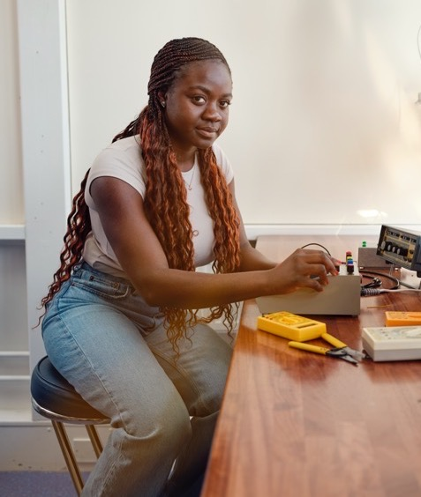
Optional Modules
Presentation of Optional Modules session
Friday 10 October, 9.00 – 12.00, Lib 2
Note: EC992 and Interdisciplinary Modules not presented. Econ modules only.
Personal Academic Tutor session
Friday 9 October 13.00
H0.03 with Mahnaz Nazneen
Module Registration deadline is Friday 19 October
(you cannot make any changes after this date until the beginning of term 2)

Slide 11
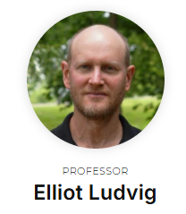
Psychology Project PS916
Project leader
Elliott Ludwig
https://warwick.ac.uk/fac/sci/psych/students/bes/
January: Topics/supervisors released
February: Preferences due
Early March : Allocations made
March – August: Work on project

Slide 12
PS916 Project
The BES PS916 project page
Past Project Page
Previous projects:
Will Random Factors Decouple Risk Type from Final Rewards?
Exploring affect heuristic in perceiving wild pet keeping phenomenon in Indonesia: Implications for policy support
The effect of gain and loss-framed messaging on language learning performance and engagement
Cashout in Sports Betting: How Cashout Affect Gambling Decisions on Real Sports Events
Submission of project – week 48

Slide 13


Where do I find info?
my.wbs.ac.uk
  Module Info
  Submissions
  Marks and Feedback
Module Info for Psych/Econ:
  Syllabi
  Schedules
  Readings
  Videos
For Psych/Econ
  Submissions
  Marks and Feedback
Personal Tutor
Timetable
Check your Warwick email daily

Slide 14
Skills Development
Student Opportunity: Skills - offers a wide range of online resources, workshops, 1:1 support, advice and guidance as well as specific development programmes
IDG Learning Resources - in-house training in Microsoft applications and academic software
Warwick Global Academy – Academic English Enhancement Programme. Free modules to help you succeed. Registration opens 21 – 30 September 2026
Post Grad Library Support- the Library has a range of resources and support to help you thrive during your time at the University. With Postgraduate Only Spaces, dedicated Research Support, peer written resources in our Student Toolkit, and Research and Academic Support Librarians who offer specialised subject support.

Slide 15
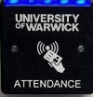
Attendance
Card Scanning
You are expected to attend all your lectures and classes.
Your monitoring point scheme is published in your handbook:
If you do not meet monitoring points you could be removed from your course by the University.
If you are a visa student, your visa could be revoked.
Attendance is recorded using the University's Automatic Attendance Data Capture system.
tap your University ID card on the card reader for all sessions.
Your attendance will be automatically recorded in Tabula.
It is your responsibility to bring your University ID card to all classes and tap it on the card reader each time you attend.
Your tutor will review the attendance data during or after the class and make any necessary amendments.
Late arrival (more than 15 minutes after the start of the class) will result in an absence being recorded by your tutor.
If you have been recorded as absent, a flag will appear on your Tabula page next to the relevant class.
If there is a valid reason why you could not attend, you must provide evidence to explain your absence by sending an email to the Postgraduate Office, ideally before the event.

Slide 16

Monitoring Points (term 1)
Enrolment event
Personal Academic Tutor event
EC902/EC910 Econometrics class
EC902/EC910 Econometrics class
EC902/EC910 Econometrics class
Submission of module evaluation
See Tabula attendance tab in case of changes

Slide 17
How do I submit?
Econ/Psych Submission is through Tabula;
WBS is through myWBS.
Deadline = 12:00 noon (usually not always!)
Late penalty rules: 5 points per day or part of a day.
Automatically applied so 3 seconds late = -5 points.
Don’t leave it to the last minute to submit! Problems with upload will not be accepted as mitigation.

Slide 18

Events
There will be events throughout the year – keep an eye on your emails

Slide 19

SSLC
SSLC are your student voice.
Nominations are open now to represent your course.
Deadline to nominate yourself is 9 October.
We need EIFE representation!
https://warwick.ac.uk/fac/soc/economics/current/msc/resources/gsslc

Slide 20
Further Resources (Non-Comprehensive List)
University level
Wellbeing and Student Support (including counselling)
University Library (including staff, online resources)
IT Services (now called IDG)
University of Warwick Health Centre
Department level
Maths and Statistics Drop-in Sessions, Stata HelpDesk/Software/IT Support.
Advice and Feedback Hours
Wellbeing Drop-In Sessions.
Skills Development and Career Support

Slide 21
Key Dates
Term 1 (Autumn Term) week 1-10
Module registration closes 19 October
Christmas Party 11 December 2026
Term 2 (Spring Term) weeks 15 – 24
Jan exam period (Micro & Macro) 11 – 15 January 2027
Module registration open 4 – 15 January
Term 3 (Summer Term) weeks 30 - 39
May/summer exam period week 32 – week 33
Summer Social Fri 21 May (TBC)
Summer vacation (weeks 40 – 52)
Resit and deferral exam period TBC (usually last week of August and first week of Sept)
Project submission week 48

Slide 22

Questions & Answers
What marks do I need to earn the MSc degree?
Where do BES students find jobs?
How many hours do we need to study each week?
What if my computer breaks down? Does the department offer any help?

Slide 23

Questions or problems
MSc Handbook
PG Office: Tina Jones, Andrea Wyld, Marion Nicholson.
Academic Personal Tutor
Student Support & Progression Officer: Jess Proudlock
Senior Tutor (pastoral support): Han Zhang
Director of Student Experience and Progression (academic support): Ghasan Asbool
PG mentors: http://www.warwick.ac.uk/services/library/pghub/mentorship/
University support services (wellbeing, counselling, mental health, disability, international students)

Slide 24
And finally
Don’t forget to:
  Work hard
  Have fun! Attend the department events so you can meet other members of your cohort.
  Contact economics.pgoffice@warwick.ac.uk if you have any queries.

