Slide 1

MSc EIFE
Introductory Meeting
Alex Karalis Isaac, 8 October 2026

Slide 2

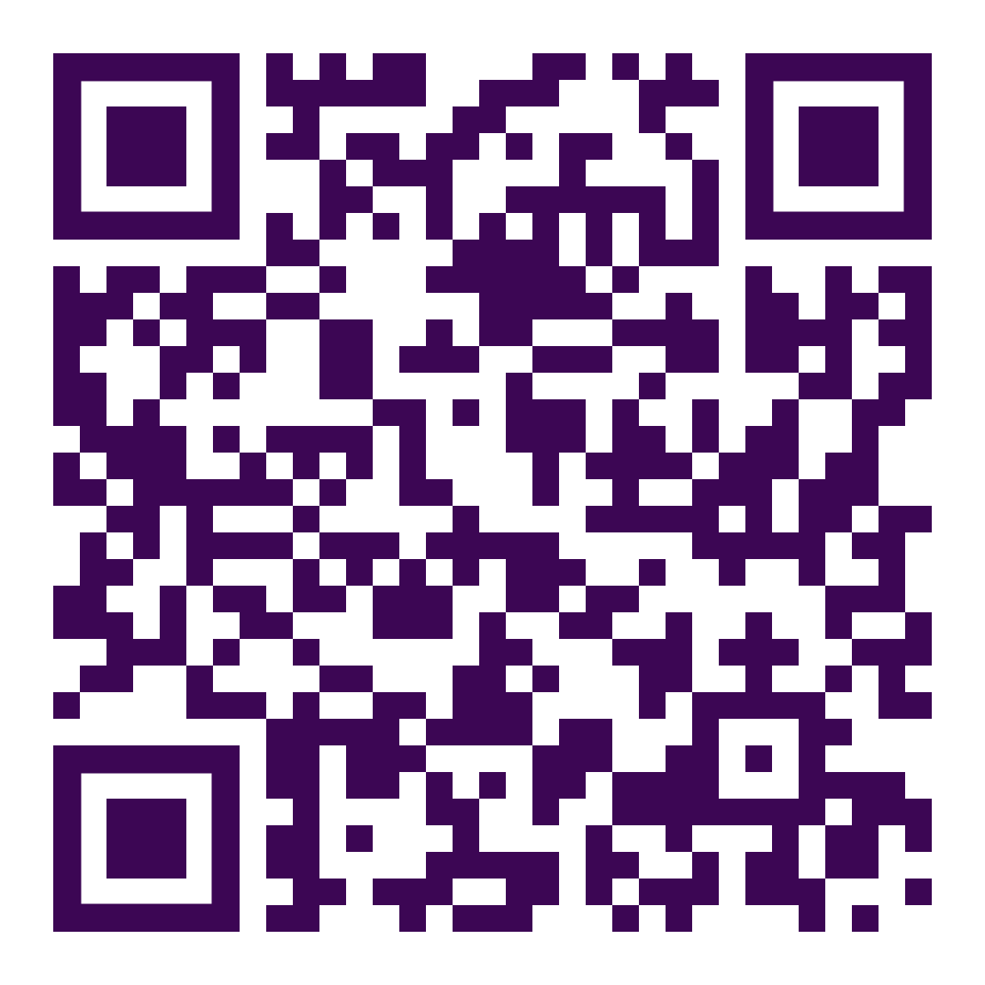
Economics in Numbers
We ranked
1st
in the Good University Guide 2026
We ranked
2nd
in the UK in the most recent Research Excellence Framework (REF) 2021
We ranked
25
in QS World University Subject Rankings
View more
key statistics

Slide 3
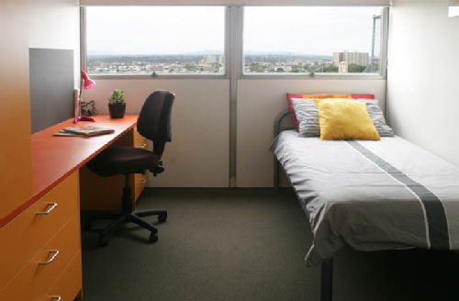
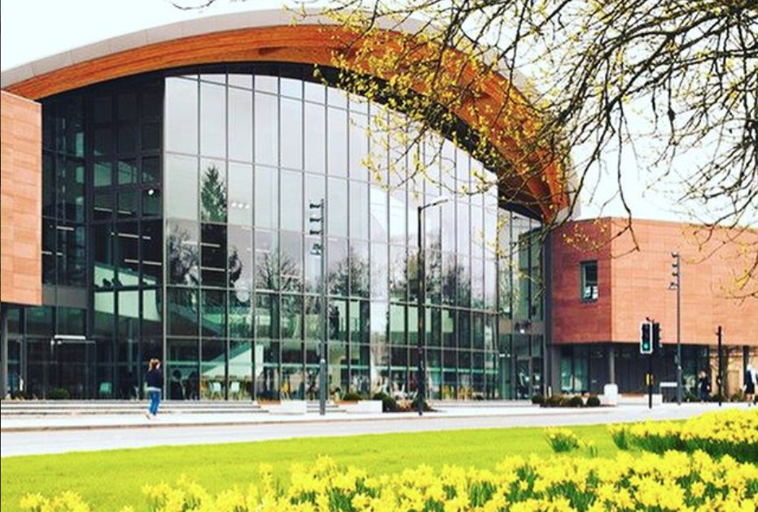
What’s special about Warwick
Focus on research, research-led teaching
Course taught at a high level
There is quite a bit of maths
Interdisciplinary
International

Slide 4
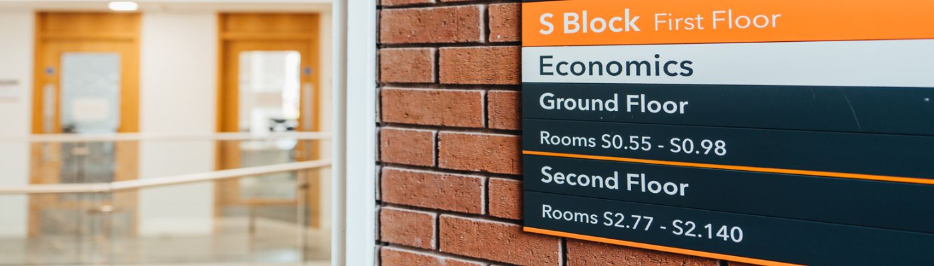
The Department of Economics
World-leading Research and Teaching & Learning,
with the aim of improving people’s lives
1200 Undergraduate students
140 MSc students
65 PhD students
86 members of academic staff, including 23 professors

Slide 5
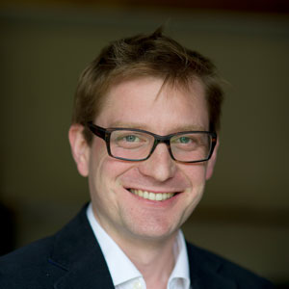
About me
Alex Karalis
Applied macroeconomist with particular interest in the non-Gaussian behaviour of economic systems
Director MSc EIFE, BES & Econ & PGT Director of Studies
A&F hours: You can book an appointment here.
Contact me:
a.karalis-isaac at warwick.ac.uk

Slide 6

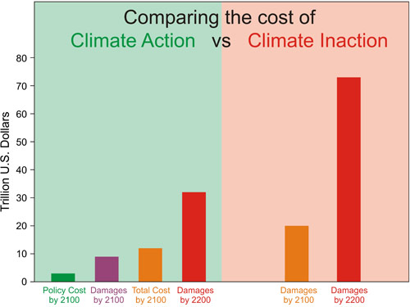
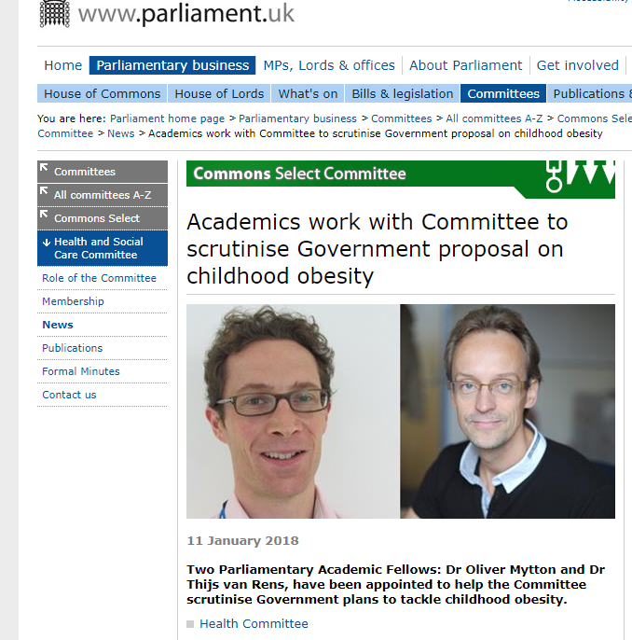

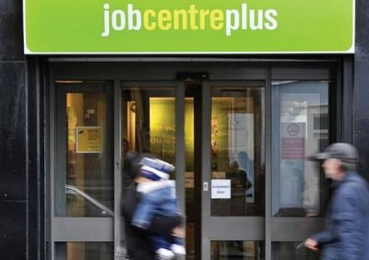

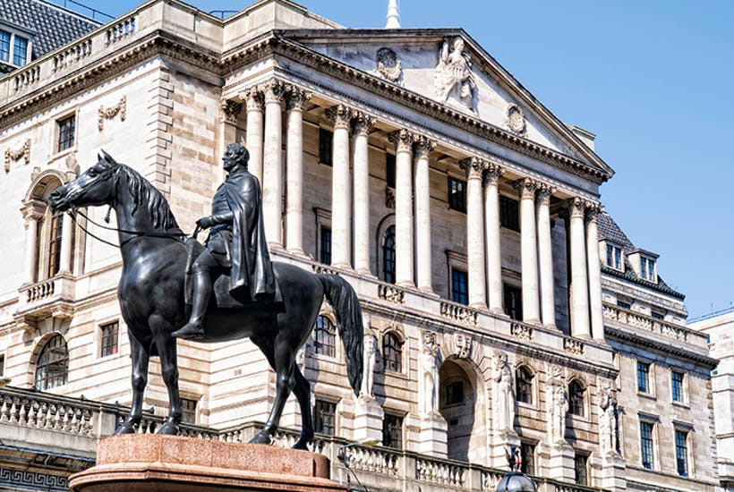
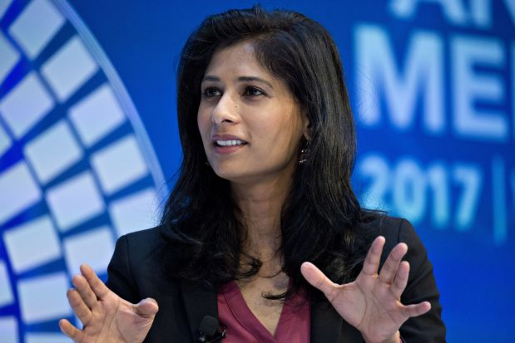
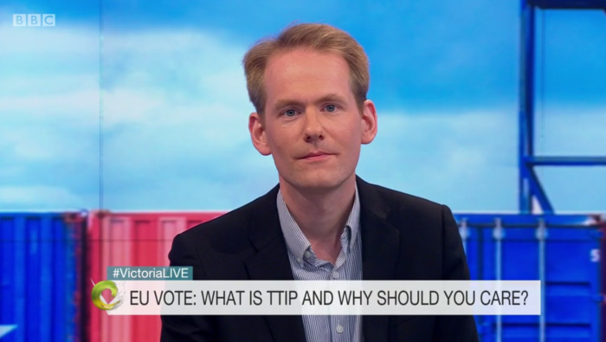
Economics is a very broad field

Slide 7
MSc EIFE
 | Pre-Term | Term 1 | Term 2 | Term 3 and summer
Optional cores | Pre-sessional Maths and Stats | EC901 Micro A EC9D3 Micro B
Core |  | EC9D4 Macro A EC9D5 Macro B
Core |  | EC902 Econometrics A or EC910 Econometrics B
Optional modules |  |  | 3 optional modules
Research |  |  | Research methods | EC959 Dissertation

Slide 8

Microeconomics and Macroeconomics A or B
The Microeconomics and Macroeconomics modules will develop your understanding of advanced economic analysis.
There is an applied version (A) and a more theoretically oriented and technical version (B).
A variants
You have done a reasonable amount of Microeconomics previously (as in a typical undergraduate module)
B variants
You have strong analytical skills or are intending to complete to a PhD degree after your MSc course. The pre-requisites will normally be (the equivalent of) a First-class mark (70%) from your undergraduate degree and a strong performance in your pre-sessional tests.

Slide 9
MSc Economics and International
Financial Economics (EIFE)
Focus on global finance, otherwise similar to MSc Economics
Why?
  Signal to potential employers in the financial sector
  Create a network of students with similar interests
What makes you special?
  Optional module choices
  Dissertation topic
  Bonding with your fellow MSc EIFE students (network)

Slide 10
Optional Modules
Three modules to be taken in term 2. See your handbook for your list of optional modules. They include:
Global Finance, Monetary Economics, Economics of Financial Markets, International Trade, Industrial, Labour, Public, Development, Experimental , Investment, Behavioural, Data Science, Environmental.
Warwick Business School modules (at most one module)
IB9X7 - Derivative Securities
IB9Y2 - Behavioural Finance
IB9Y4 - International Financial Management
*Limited places. Please be aware that the Warwick Business School modules are challenging technical courses. You should have a strong mathematics and statistics or econometrics ability.

Slide 11
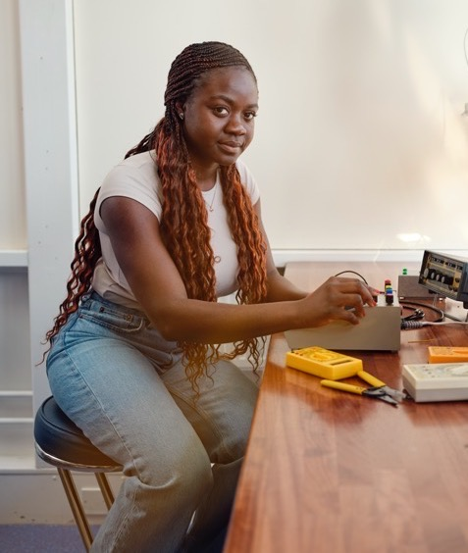
Optional Modules
Presentation of Optional Modules session:
Friday 9 October 9.00 – 12.00 Lib 2
Personal Academic Tutor session
Friday 9 October 13.00
OC1.07
Ghasan Asbool
Module Registration deadline is Friday 19 October
(you cannot make any changes after this date until the beginning of term 2)

Slide 12


Dissertation
Submission deadline: week 50
Proposal: week 39
Proposed title and supervisor: week 28
(must be approved by Director MSc Econo mics and Data Science)
Start thinking about a topic: Now!
This can be through modules, classes, conversations with peers, professors, reading materials, etc.

Slide 13
Dissertation: Examples of titles
Topic must be in (international) financial economics
The impact of RMB exchange rate volatility on Chinese foreign exchange reserves
The spillover effects of U.S. quantitative easing on BRICS countries
Regulation of cryptocurrencies
Financial development and income distribution : The case of the US bank branch deregulation
The impact of third-party internet payments on the money multiplier
The impact of the EU debt crises on Chinese FDI inflows
The impact of electronic payment on banking performance in Thailand
The effect of information disclosure on the cost of equity financing
An early-warning model of sovereign default

Slide 14
Dissertation: Examples of titles
International financial economics, broadly defined …
The impact of tax policy on foreign direct investment and economic performance of EU countries
Real estate pricing in Hong Kong under a fixed exchange rate
Pollution and international trade
The development of e-commerce and the transformation of foreign trade in China
Do developing countries rely heavily on remittance payments?
The performance of Taylor Rule in the UK after 1993
The monetary transmission mechanism via the housing channel: Consumption evidence from the UK

Slide 15
Dissertation: Examples of titles
But there are limits! Other topics are possible, but must be approved
The impact of reverse offshoring on technological innovation:
An empirical study of China’s mechanical and electrical Industry
The impact of visa regimes on international trade and investment
The impact of female employment on economy growth
The influence of two-child policy on urban and rural migration in China
P2P downloading and CD sales, cannibalizing or complementing?
The impact of income inequality on crime
The survival of Michelin-star restaurants

Slide 16
Dissertation workshop (from week 6, time TBA)
Purpose of the workshop
  Help you find a dissertation topic
  e.g. speakers on contemporary topics in (international) finance
  Help you to develop your dissertation
  e.g. student presentations
  Support your career development
  e.g. practice presentation skills, external networking, speakers from potential employers
Complements other resources available to you:
  Field seminars and workshops
  Research methods EC959

Slide 17
Dissertation workshop Fri 27 Nov & Fri 4 Dec 2026
Themed group meeting with experienced academic for advice on "finding a topic and a supervisor".
Sign up for a short 1 to 1 meeting with this person in Term 2 to discuss your ideas.
You will be able to select the session you attend, based on your research interests:
Potential topics:
Finance
Macro
Development and international trade
Data Science
Applied micro; Environment, health and wellbeing
It is vital that you engage with these sessions. We will send further information later in the term.

Slide 18

Attendance
Card Scanning
You are expected to attend all your lectures and classes.
Your monitoring point scheme is published in your handbook:
If you do not meet monitoring points you could be removed from your course by the University.
If you are a visa student, your visa could be revoked.
Attendance is recorded using the University's Automatic Attendance Data Capture system.
tap your University ID card on the card reader for all sessions.
Your attendance will be automatically recorded in Tabula.
It is your responsibility to bring your University ID card to all classes and tap it on the card reader each time you attend.
Your tutor will review the attendance data during or after the class and make any necessary amendments.
Late arrival (more than 15 minutes after the start of the class) will result in an absence being recorded by your tutor.
If you have been recorded as absent, a flag will appear on your Tabula page next to the relevant class.
If there is a valid reason why you could not attend, you must provide evidence to explain your absence by sending an email to the Postgraduate Office, ideally before the event.

Slide 19

Monitoring Points (term 1)
Enrolment event
Personal Academic Tutor event
EC902/EC910 Econometrics class
EC902/EC910 Econometrics class
EC902/EC910 Econometrics class
Submission of module evaluation
See Tabula attendance tab in case of changes

Slide 20

How do I submit?
Econ/Psych Submission is through Tabula;
WBS is through myWBS.
Deadline = 12:00 noon (usually not always!)
Late penalty rules: 5 points per day or part of a day.
Automatically applied so 3 seconds late = -5 points.
Don’t leave it to the last minute to submit! Problems with upload will not be accepted as mitigation.

Slide 21
Skills Development
Student Opportunity: Skills - offers a wide range of online resources, workshops, 1:1 support, advice and guidance as well as specific development programmes
IDG Learning Resources - in-house training in Microsoft applications and academic software
Warwick Global Academy – Academic English Enhancement Programme. Free modules to help you succeed. Registration opens 21 – 30 September 2026
Post Grad Library Support- the Library has a range of resources and support to help you thrive during your time at the University. With Postgraduate Only Spaces, dedicated Research Support, peer written resources in our Student Toolkit, and Research and Academic Support Librarians who offer specialised subject support.

Slide 22
Further Resources (Non-Comprehensive List)
University level
Wellbeing and Student Support (including counselling)
University Library (including staff, online resources)
IT Services (now called IDG)
University of Warwick Health Centre
Department level
Maths and Statistics Drop-in Sessions, Stata HelpDesk/Software/IT Support.
Advice and Feedback Hours
Wellbeing Drop-In Sessions.
Skills Development and Career Support

Slide 23
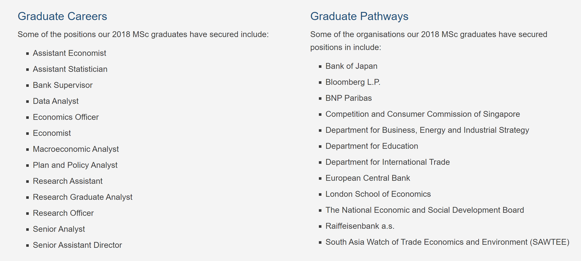
Placement (first jobs) of MSc EIFE graduates
https://warwick.ac.uk/fac/soc/economics/prospective/msc/careers

Slide 24

SSLC
SSLC are your student voice.
Nominations are open now to represent your course.
Deadline to nominate yourself is 9 October.
We need EIFE representation!
https://warwick.ac.uk/fac/soc/economics/current/msc/resources/gsslc

Slide 25
Key dates
Term 1 (Autumn Term) week 1-10
Module registration closes 19 October
Christmas Party 11 December 2026
Term 2 (Spring Term) weeks 15 – 24
Jan exam period (Micro & Macro) 11 – 15 January 2027
Module registration open 4 – 15 January
Term 3 (Summer Term) weeks 30 - 39
May/summer exam period week 32 – week 33
Summer Social Fri 21 May (TBC)
Summer vacation (weeks 40 – 52)
Resit and deferral exam period TBC (usually last week of August and first week of Sept)
Dissertation submission week 50

Slide 26

Questions & Answers
What marks do I need to earn the MSc degree?
How many hours do we need to study each week?
What if my computer breaks down? Does the department offer any help?

Slide 27
Questions or problems
MSc Handbook
PG Office: Tina Jones, Andrea Wyld, Marion Nicholson economics.pgoffice@warwick.ac.uk
Academic Personal Tutor (Ghasan Asbool)
Student Support & Progression Officer: Jess Proudlock
Senior Tutor (pastoral support): Han Zhang
Director of Student Experience and Progression (academic support): Ghasan Asbool
PG mentors: http://www.warwick.ac.uk/services/library/pghub/mentorship/
University support services (wellbeing, counselling, mental health, disability, international students)

Slide 28


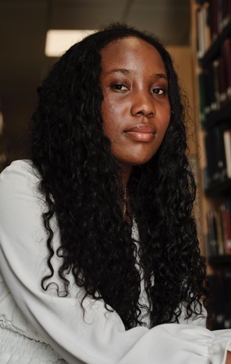
Don’t forget
  Start thinking of a dissertation topic
  Work hard
  Have fun! Attend the department events so you can meet other members of your cohort.
  Contact: economics.pgoffice@warwick.ac.uk if you have any queries.

