Slide 1
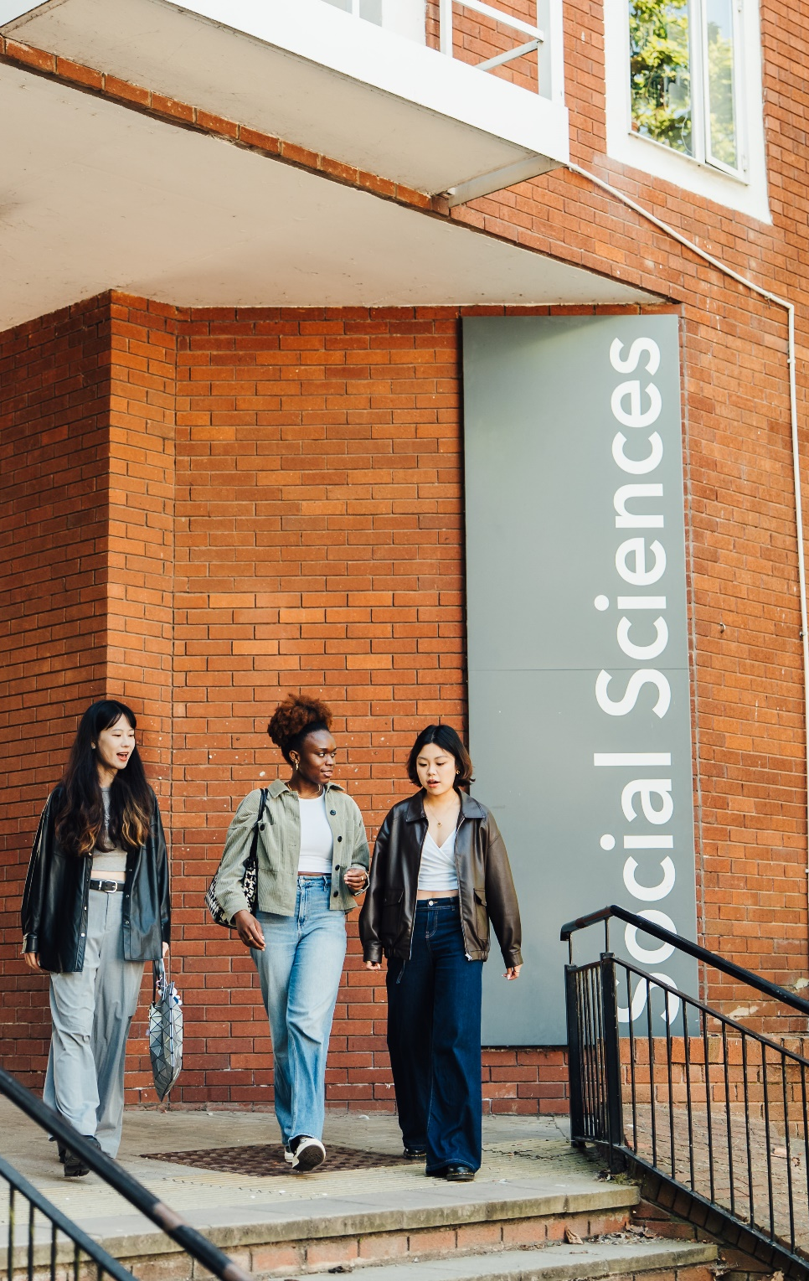
MSc Welcome and Introduction
Dr Alex Karalis Isaac
2026-2027

Slide 2

This presentation
Introductions
Introductory Maths and Statistics
MSc programmes
Course structure and module choices
Assessment, feedback and exams
Supporting you
Beyond study
This session is being recorded and will be made available to watch online at any time
The slides have also been uploaded on our induction website.

Slide 3
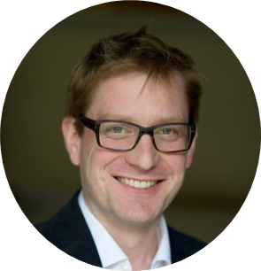
Introductions
Dr Alex Karalis Isaac
Director of Graduate Studies
(Taught Degrees)
a.karalis-isaac@warwick.ac.uk
Teaching
Research interests

Slide 4
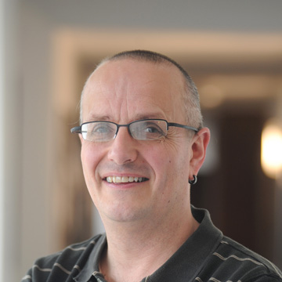
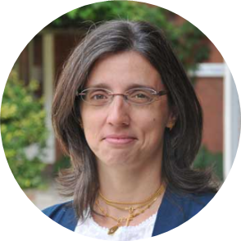
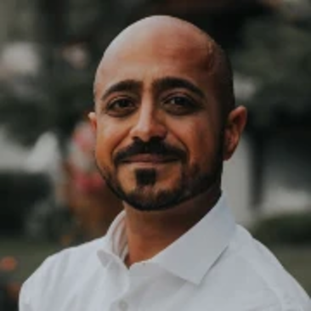
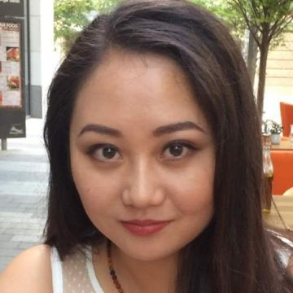
Introductions
Professor
Jeremy Smith
Head of Department
Dr Claudia
Rei
Deputy HoD (Teaching & Learning)
Dr Ghasan Asbool
Director of Student Experience
Dr Han
Zhang
PGT Senior
Tutor

Slide 5
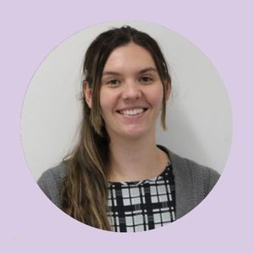
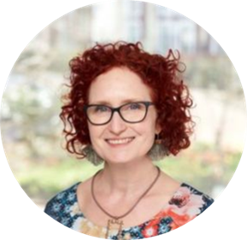
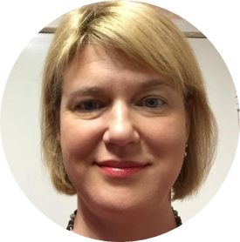
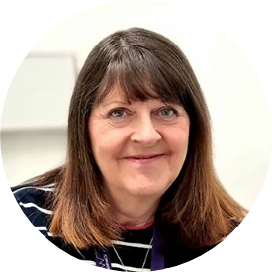
Introductions
Tina Jones
Programmes Manager PGT
Andrea Wyld
Programmes Coordinator (MSc)
Katie Wilson
Student Experience Coordinator
Marion Nicholson
Programmes Administrator

Slide 6
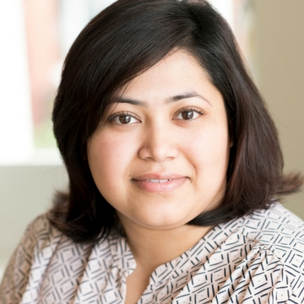
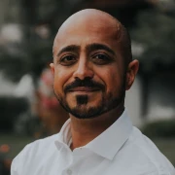
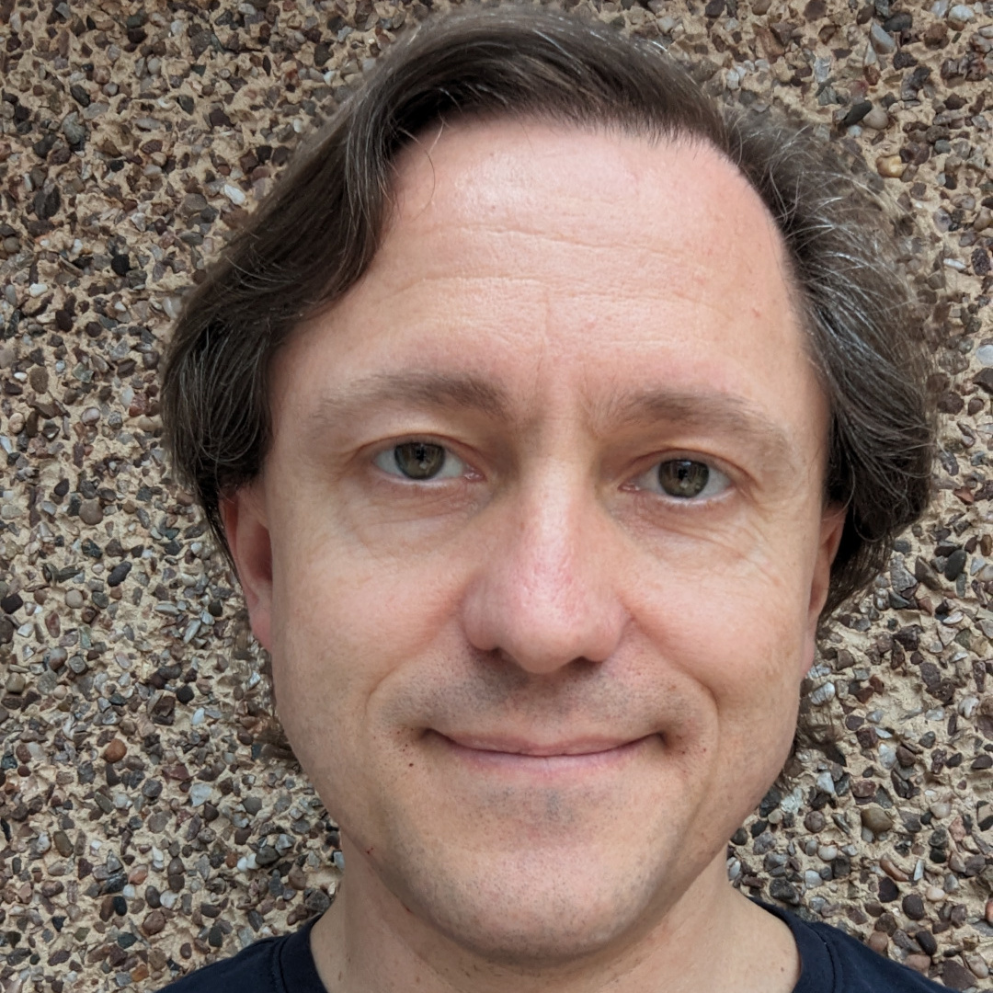
Academic Personal Tutor
To support with all academic matters and concerns:
Reference writing; academic concerns; workload; procedure for illness, mitigation etc.
Guidance on module selection
Weekly drop-in sessions ; or email for an appointment
Dr Mahnaz Nazneen
Dr Ghasan Asbool
Dr Nicholas Jackson
Meet you tutor:
Group session: Friday 9 October 13.00 (this is a monitoring point). See Tabula for your room and tutor.
DSEP Drop In
Monday 28 Sept 4pm S1.137 with Ghasan (open to all).
Notes:
Ghasan meeting: serious concerns/mitigation that might affect the year; all assessments; RAs. ALSO : studying effectively

Slide 7
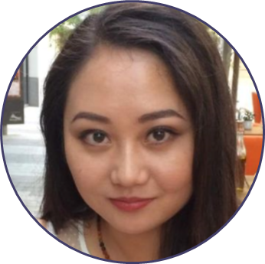
Senior Tutor
If you have a concern or problem that is perhaps more serious, it is a good idea to go straight to the Postgraduate Senior Tutor for MSc Students.
To support with more serious concerns or problems:
• Illness that is affecting or might affect significant coursework or exams
• Family or personal circumstances that are affecting or might affect your coursework, tests or exams
Support with Departmental procedures; signposting to specialist support
You can contact by email han.zhang.5@warwick.ac.uk
Dr Han Zhang

Slide 8
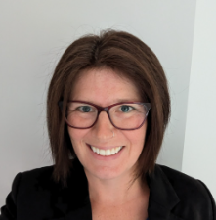
Student Support and Progression Officer
If you have a concern or problem that is perhaps more serious, it is a good idea to go straight to the Postgraduate Senior Tutor for MSc Students. For any pastoral issues you can also contact Jess.
To support with all pastoral and wellbeing issues:
Weekly drop-in sessions
Signposting to specialist support
Monitoring attendance and progression
Supporting mitigation claims
Room S0.91, or you can reach them via email on economics.pastoral@warwick.ac.uk or visit https://warwick.ac.uk/fac/soc/economics/current/msc/resources/wellbeing/
Jessica Proudlock
Student Support and Progression Officer

Slide 9

General Enquiries:
How to contact us
Email economics.pgoffice@warwick.ac.uk or visit the Postgraduate Office in room S1.130
Visit our Get in Touch page for frequently asked questions
When writing emails, please use professional language and academic titles where appropriate
Allow sufficient time for a reply and avoid making last minute requests
Please don’t send the same message to different email addresses as this duplicates work and causes confusion.

Slide 10

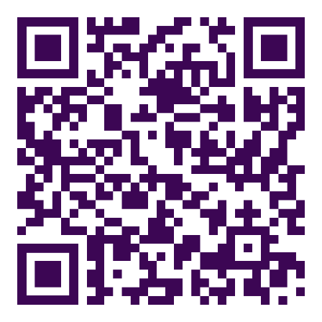
Economics in Numbers
We ranked
1st
in the Good University Guide 2026
We ranked
2nd
in the UK in the most recent Research Excellence Framework (REF) 2021
We ranked
25
in QS World University Subject Rankings
View more
key statistics

Slide 11
We focus on
Delivering outstanding teaching and learning that benefits society
Delivering innovative research that extends the frontiers of the discipline
Producing policy-relevant research that enhances wellbeing
Building a diverse and inclusive community in which all staff and students can reach their full potential
Creating an environment based on respect, integrity and accountability for one’s actions

Slide 12

Things to do during induction
Look at the induction timetable
Read the induction checklist for guidance on the key things to do in your first few weeks
Check out our MSc web pages
Look at My.Warwick
Spend some time reading the MSc Student Handbook

Slide 13

Welcome Week
Welcome week runs from 28 September – 2 October and is a programme of events and activities to help settle in and adapt to life at Warwick.
Although the week is primarily aimed at students not taking a pre-sessional course, you are very welcome to sign up for events during the weekends and in your free time next week.
Further details are given at: Welcome Week | University of Warwick

Slide 14

Introductory Maths & Statistics
Lectures take place in this room (or MS.01) from 2.00-5.00pm today and then from 10.00am-1.00pm tomorrow.
Classes will start from 2.00pm-5.00pm tomorrow
Your allocated class will be published in Tabula at 5.00pm this afternoon.

Slide 15
Introductory Maths & Statistics
Test weighting in the Econometrics modules | Component weight in the Econometrics module
Course | Test 1 | Test 2
MSc Economics MSc EIFE MSc DatSci | 4% | 8%
MSc BES | 8% | 12%
There will be online multiple-choice (MCQ) tests in Moodle
Test 1 on Monday 28 September (12.00-1.00pm)
Optional second attempt for Test 1 on Monday 5 October (12.00-1.00pm).
We will use your highest mark.
Test 2 on Wednesday 7 October (9.00-12.00pm)

Slide 16

Introductory Maths & Statistics
If you are eligible for extra time for tests/exams due to reasonable adjustments, please register with Disability Services
This will officially enable us to give you the required extra time.
Please also let the Postgraduate Office know so they can arrange with IT to give you extra time for the online tests in the meantime (economics.pgoffice@warwick.ac.uk).

Slide 17

Your MSc Programmes
MSc Economics
MSc Economics and International Financial Economics
MSc Economics and Data Science
MSc Behavioural and Economic Science (Economics Track)
SSLC Representation: look around – it could be you?!
Notes:
Show of hands; looks around.

Slide 18
Overview of the year
Autumn Term
Focusing on core modules
Microeconomics
Macroeconomics (Econ/EIFE/DatSci)
or Psychology modules (BES)
Econometrics (continues in Spring - Econ/EIFE/DatSci)
Spring Term
Applying skills and exploring deeper ideas
Dissertation Prep (Econ/EIFE/DatSci)
Optional modules
Summer Term onwards
Developing the skills needed to carry out original research in economics
Dissertation (Econ/EIFE/DatSci)
Submission deadline 15 Sept 2027
Proposal 28 June 2027
Proposed title and supervisor: April 2027
Start thinking about a topic: Now!
Project (BES)
Submission by 1 September 2027 (TBC)

Slide 19

Teaching and Learning
The year will go by very fast!
Research-led teaching
Moodle will be used to share resources and for some quizzes and tests
Many modules have a sign-up resource to help you form study groups
15 CATS module means 150 hours of study consisting of contact hours and independent study
Delivery of Teaching and Learning & exams
Teaching will be in-person via weekly​ lectures ​and weekly/bi-weekly classes
Your exams will be in-person (economics only)

Slide 20
Course structure: MSc Econ & MSc EIFE
 | Pre-term | Term 1 | Term 2 | Term 2 | Term 3 & Summer
Optional core |  | EC901 Microeconomics A or EC9D3 Microeconomics B 30 CATS
Optional core |  | EC9D4 Macroeconomics A or EC9D5 Macroeconomics A 30 CATS
Optional core | Pre-sessional Maths and Stats | EC902 Quantitative Methods: Econometrics A or EC910 Quantitative Methods: Econometrics B 45 CATS
Options |  |  | Three optional modules (list varies between courses) 15 CATS each
Research |  |  | Preparation Lectures |  | EC959 Dissertation 30 CATS

Slide 21
Course structure: MSc Econ & Data Science
 | Pre-term | Term 1 | Term 2 | Term 2 | Term 3 & Summer
Optional core |  | EC901 Microeconomics A or EC9D3 Microeconomics B 30 CATS
Core |  | EC9D8 Foundations of Data Science 30 CATS |  | EC9D7 Machine Learning & Big Data in Economics 15 CATS
Core | Pre-sessional Maths and Stats | EC910 Quantitative Methods: Econometrics B 45 CATS
Options |  |  | Two optional modules (list varies between courses) 2 x 15 CATS each
Research |  |  | Preparation Lectures |  | EC959 Dissertation 30 CATS

Slide 22
Course structure: MSc BES (Econ track)
 | Pre-term | Term 1 | Term 2 | Term 3 & Summer
Optional core |  | EC901/EC9D3 Microeconomics A or B 30 CATS
Optional core | Pre-sessional Maths and Stats | EC907/EC987 Quantitative Methods: Econometrics A or B 30 CATS
Core |  | PS922 Issues in Psychological Science 15 CATS
Core |  | PS923 Methods and Analysis in Behavioural Science 15 CATS
Options |  |  | Four optional modules from the course list 15 CATS each
Research |  |  |  | PS916 Research Project 45 CATS

Slide 23

Optional Core Modules
A variants cover demanding post graduate material in micro, macro and econometrics.
B variants push beyond the usual level of MSc courses.
A variants understand that people use economics in policy, policy evaluation, applied research in business/finance.
B variants understand that some economists work directly with research models; in consultancy, central banking, and academia. They emphasise technical excellence and methodology.

Slide 24

Optional Core Modules
Register for Micro A and Macro A if you have studied typical undergraduate modules in Micro/Macro
Take Micro B and Macro B if:
You intend to pursue a technical career or a PhD
You have a first-class undergraduate degree
You have strong Maths ability (>65% on EC961 Test 2)
You can take a combination of AB/BA

Slide 25
Optional Core Modules
Econometrics A covers fundamental econometric research skills and applications in policy evaluation.
Econometrics B will supplement the development of these key professional skills by looking at more advanced topics.
Take Econometrics B if you are already familiar with (or are prepared to fill in any gaps on your own):
  t and F tests of linear restrictions;
  Heteroskedasticity and Serial correlation;
  Estimation – in the presence of above problems;
  Dummy variables;
  Exogeneity vs Endogeneity.
B is more concerned with theoretical developments, advancing technical skills, reading theoretical literature; therefore useful for independent research (inc. applied research where self-teaching new methods)

Slide 26
Optional Core Modules
See Handbook and the MSc webpage for available options.
Provisionally choose modules from your list (differs between courses).
Then, you must register your provisional option choices with University via eMR. The system opens on 30 September 2026.
Follow the onscreen instructions and see the registration guidance
Deadline: 19 October 2026.
Module choices automatically update on Tabula when choices approved.
  (You can revise optional module choices in 1st 3 weeks of Term II)

Slide 27
IB9AN-15
IB9ZC-15
WBS Modules
  For courses with option to take WBS modules:
  IB9X7 Derivative Securities
  IB9Y2 Behavioural Finance
  IB9Y4 International Financial Management
  IB9AN Principles of Cognition (BES only)
  IB9ZC Behavioural Ethics (BES only)
You must register for one of these WBS modules on eMR (and MyWBS) if you are interested
BUT: numbers on these may be capped, random selection used in the case of excess demand! If you are selected, you can’t then change your mind.

Slide 28

WBS Modules
WBS modules are challenging technical courses.
EC modules 62% average mark – WBS 54%.
To take these modules, you must have a strong mathematics and statistics/econometrics ability, and have studied relevant topics at UG level e.g. Asset Pricing/ Corporate Finance.
If you have done little maths or stats/econometrics before your MSc, please avoid these modules.
If, by Monday 5 October, you realise you have struggled in Maths/Stats or the Term 1 core modules, do not sign up for these modules

Slide 29
Further module information
Attend the Presentation of Options meeting to hear from those teaching Economics modules on Friday 9 October.
Information on MSc BES optional modules in Psychology and WBS can be found in the module catalogue. This also applies to MSc DatSci modules in Computer Science and Psychology.
The PG Office can make changes on eMR for you during first three weeks of the Spring Term (apart from IB-coded modules).
It is possible that an option might not run due to low numbers.
EC941 Game Theory is not running in 26/27.

Slide 30

Assessments
Modules are assessed by a mix of methods in the form of formal examinations and coursework, including:
Problem Sets
Essays
Modelling and Data Analysis
Class Presentations
Research Projects

Slide 31
Feedback
Coursework
Marks returned within 20 days with written individual feedback
Generic feedback is given for larger modules, including a CDF showing the mark distribution
Exams
Marks released in February and June
Aim to release generic exam feedback after each exam period
Those resitting will see their exam script (some exceptions)
Other feedback sources
Problem set solutions
Support and Feedback classes
Advice and Feedback hours
Revision classes

Slide 32
Marking and Exam Schemes
The pass mark for modules is 50%
The mean mark for our core modules is typically around 65%
To obtain a mark of 70%, your work needs to be very good
Although we do use the full marking scale of 0% to 100%, in practice marks of above 80% are quite rare (<10%, typically).
You need to pass at least 150 CATS, including all required core modules, and achieve at least 40% in any failed module(s)
Progression to dissertation is not automatic: you need to meet progression requirements.

Slide 33
Degree classification
Degree classification is based on your weighted award average
  ≥ 70.0% Distinction
  60.0-69.9% Merit
  50.0-59.9% Pass
  ≤ 49.9 Fail
This marking scale is typical for the UK, but might be unexpected for anyone who has studied abroad. Please become familiar with it.

Slide 34
Attendance
You are expected to attend all your lectures and classes.
We want to be sure that you are coping with your work and not falling behind.
We ask that you meet 17 Monitoring Points.
You will be contacted should we become concerned about your missed Monitoring Points or class attendance record.
You can submit a maximum of 2 self-cert absences per year because of short-term illness using the self-certify sickness form.
Email completed forms to economics.pgoffice@warwick.ac.uk

Slide 35
Supporting you
Personal Academic Tutors; your allocated tutor will be shown in Tabula
Senior Tutor is Dr Han Zhang
Academic & Pastoral Support Drop-in sessions during induction (see timetable for details)
Wellbeing drop-in sessions in term time
If you are having problems on a module, see the lecturer or class tutor first
Then, bring it up with your student representatives on SSLC

Slide 36
Mitigating Circumstances
If you need to miss an exam or test due to illness or personal problems, please use the Personal Circumstances portal in Tabula to inform us.
Read about self-certification for deadlines.
Specific coursework extension requests (with supporting evidence) can also be submitted through Tabula.
These are subject to approval by your Student Support and Progression Officer.

Slide 37
Institutional Support
Wellbeing Support Services
The University Health Centre
  Please register with a GP before you get sick
  NHS 111 service: dial 111 for non-emergency fast help
The Students’ Union
  Nightline service: 9pm to 9am student-run listening service
  02476522199
Student Information Centre
  Enquiries about Student Records, Student Finance and Accommodation
  Community Safety
  We recommend that you download the SafeZone app from your app store

Slide 38
Academic Support
Induction sessions
  Academic study skills
  Expectations session
Refresher Maths for Economics
Moodle: Introduction to STATA
Personal Academic Tutors
Advice and Feedback Hours
Dissertation Helpdesks
Economics Librarian
Compulsory training courses
  Introduction to Referencing
  Avoiding Plagiarism
https://warwick.ac.uk/services/library/students/library-online-courses/
Full details are given on our webpage

Slide 39

IT Support
Guide for new students
For help contact the IT Services Help Desk or Economics IT support
Keep your files safe in the cloud or your H:Drive. Don’t save your work on your laptop
Use OneNote for lecture notes and other material
STATA - both Econometrics A and B use it exclusively
Introductory Moodle courses:
  STATA, LaTeX, R

Slide 40

Study Facilities
Department of Economics
Study Rooms S1.138, S1.139 & S1.140
Kitchen - S1.129
Common Room - S1.131 & S1.133
Group Work - S1.135 (book in advance)
Bloomberg - S0.55 (book in advance)
University
PG Hub and Library

Slide 41

International Students
There is a webpage for international students, which includes immigration advice
Adapting to Life in the UK for international students on Wednesday 7 October 1-2pm OC0.02
Student visa holders:
  Limited to working 20 hours per week
  Full time jobs or internships in the vacation periods are not permitted
  Change of study location: Students should remain in the UK until the end of the Summer Term.

Slide 42
In The Department – Beyond Study
Warwick Economics Lecture Series
Social Events ​(Christmas and summer social)
Student Societies
Student Opportunity
Graduate Student Staff Liaison Committee (GSSLC): please consider nominating yourself as a student representative
Notes:
.

Slide 43
Preparing for Life after Warwick
Careers
Check out our website and Student Careers
Attend the Careers Sessions on Weds 7 and Thurs 8 October
Finance roles: Sept/Oct deadline
Internship Scheme (WISE)
Job vacancies advertised via MS Teams (details to follow)
Employability
Networking: mentoring and LinkedIn Groups
Key skills from your degree are explained in the handbook
Look at the Warwick Award
IT skills training
English Language pre-sessional and in-sessional english
Foreign language

Slide 44
Postgraduate Taught Experience Survey: PTES
PTES
Conducted by the University in conjunction with Advance HE
We value your contribution. It means we can continue to enhance the experience of our students.
Have a look at our We have acted on your feedback page.
Usually opens in April.
Result 2026
93% of Economics Students would recommend the Department
92% of our students are highly satisfied with their overall experience
95% of our students report good access to library resources, on-campus IT facilities and user-friendly learning platforms.
94% of students felt that their course had developed their skills as an independent learner.

Slide 45
Finally
You must be fully enrolled to attend any teaching
If you have not already done, please go to the to The Learning Grid in the Rootes building complete your University enrolment. Open daily 9.30 – 16.00.
Today
Lectures: 2.00-5.00pm
Welcome Reception: 5.00-6.00 pm in the Street (Zeeman)
Tuesday-Friday
Lectures: 10.00am-1.00pm
Classes 2.00-5.00pm (see Tabula for details)

Slide 46
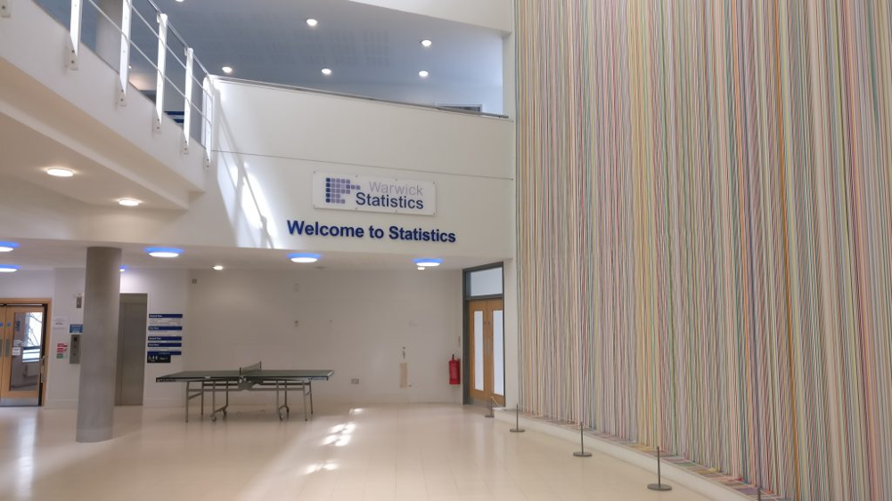
Thank you, any questions?
We look forward to seeing you at 5pm just outside in ‘the Street’.
Notes:
Question – what is the event? Drinks? Food?

