Slide 1
MSc EIFE Introductory Meeting
Alex Karalis Isaac, 9 October 2025

Slide 2
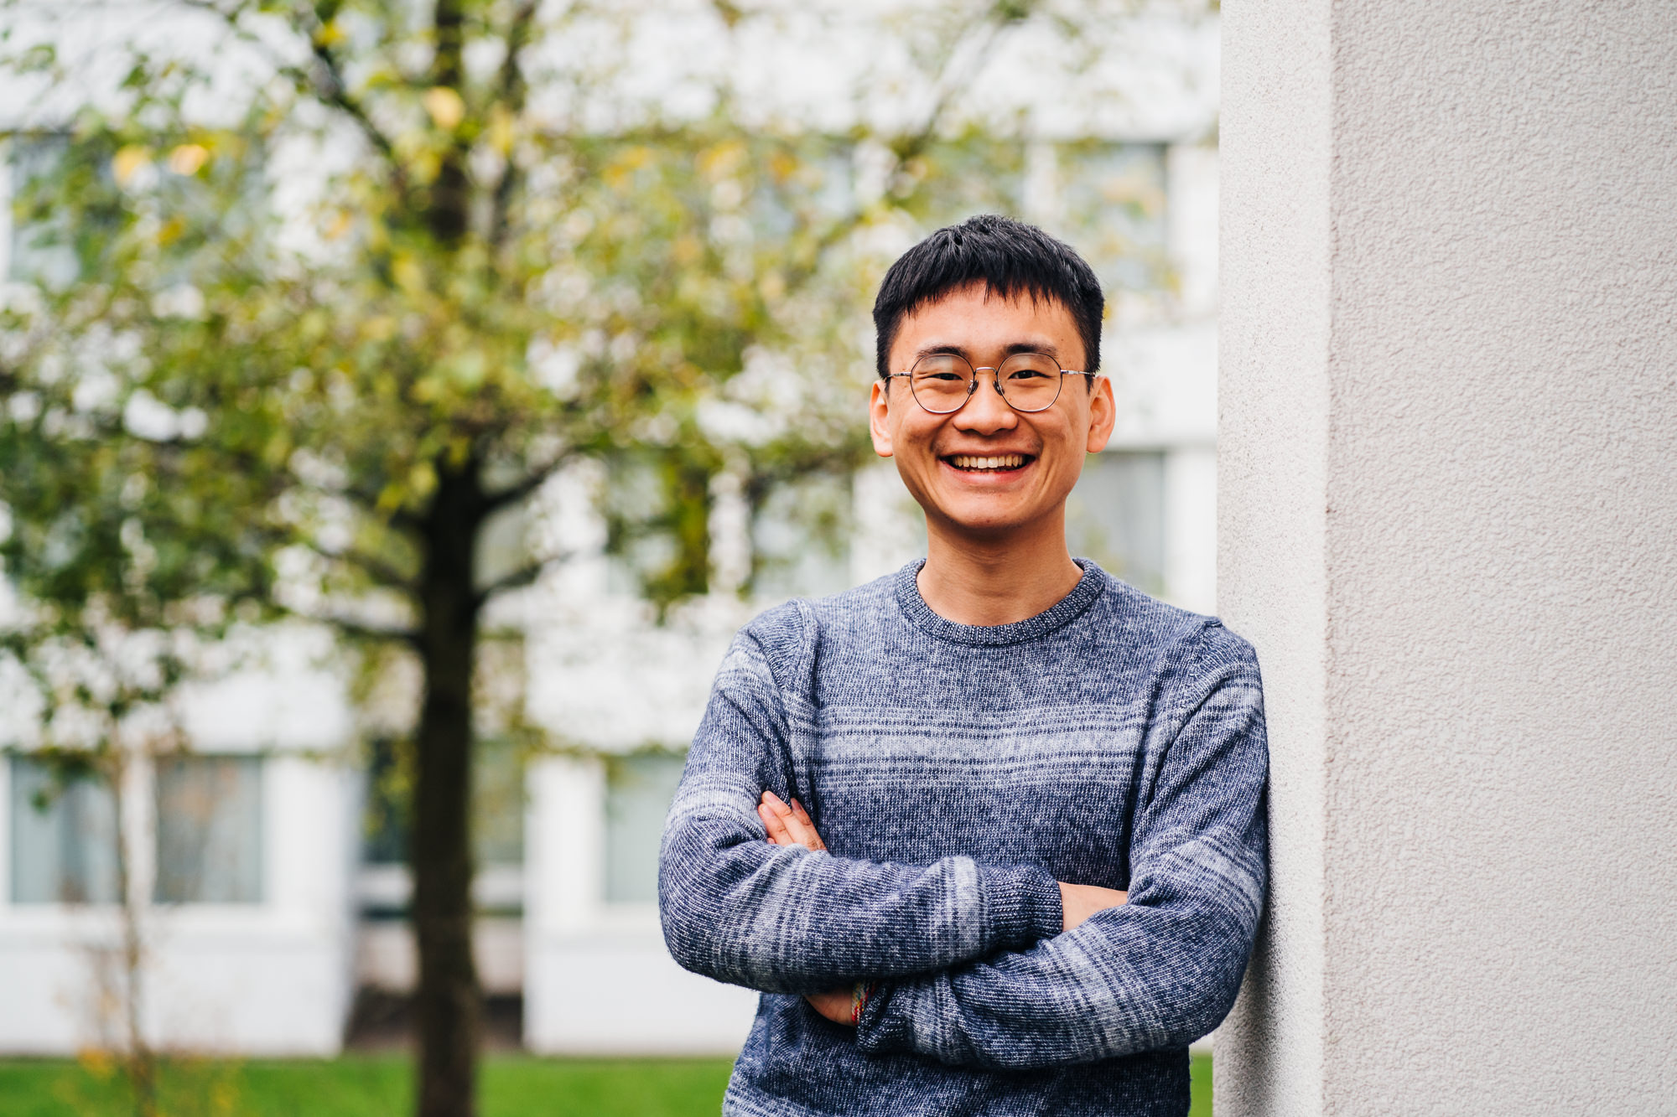



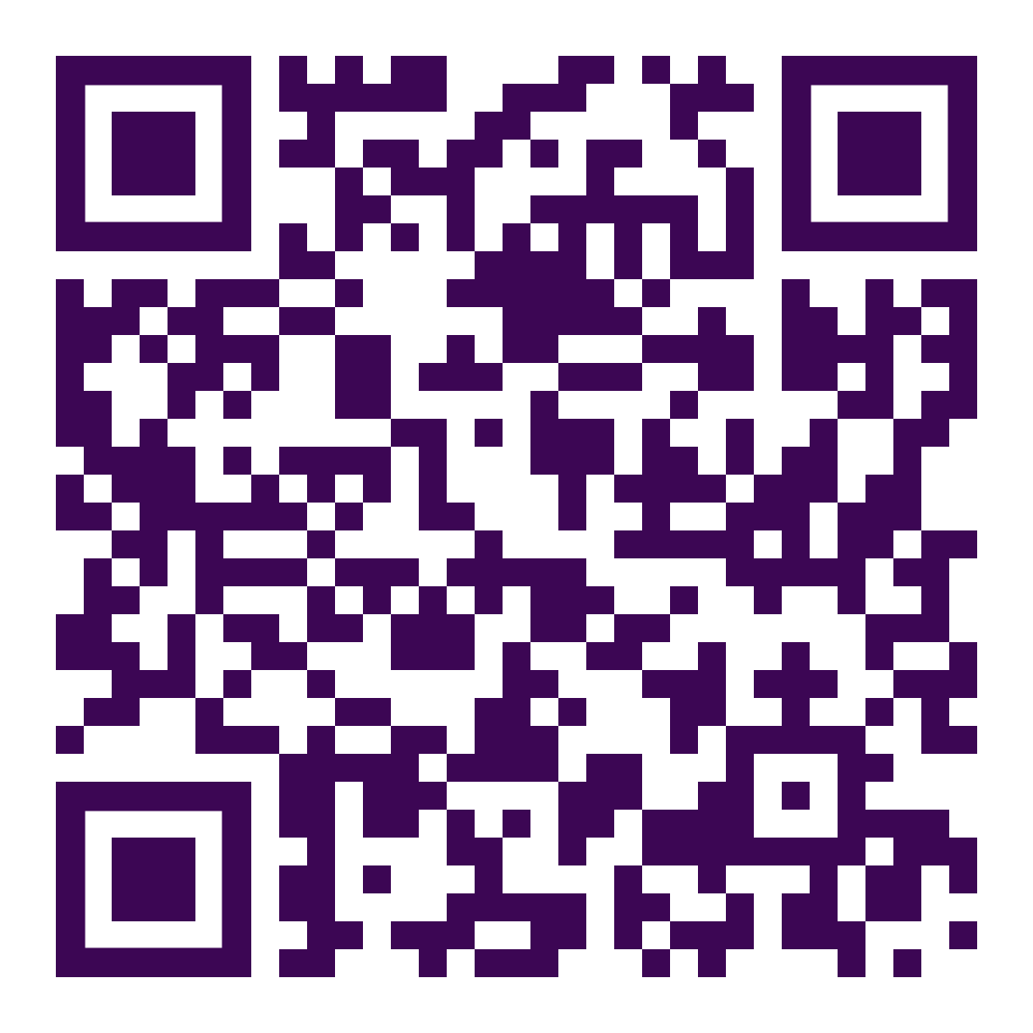
Economics in Numbers
We ranked
1st
in the Good University Guide 2026
We ranked
2nd
in the UK in the most recent Research Excellence Framework (REF) 2021
View more key statistics
Notes:
Updated 2024-25
1st in The Good University Guide in subject rankings. Overall Warwick ranked 9th.

Slide 3

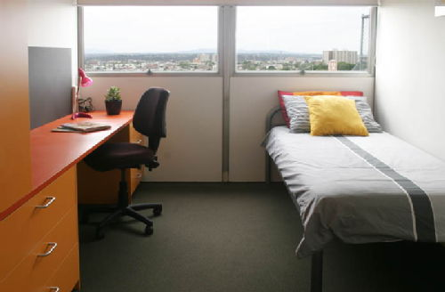
What’s special about Warwick?
Focus on research, research-led teaching
Course taught at a high level
There is quite a bit of maths
Interdisciplinary
International

Slide 4
The Department of Economics
World-leading Research and Teaching & Learning, with the aim of improving people’s lives.
1200 Undergraduate students
140 MSc students
65 PhD students
86 members of academic staff, including 23 professors

Slide 5
MSc EIFE
Don’t forget
Start thinking of a dissertation topic
Work hard
Have fun! Attend the department events so you can meet other members of your cohort.
Contact economics.pgoffice@warwick.ac.uk if you have any queries.

Slide 6
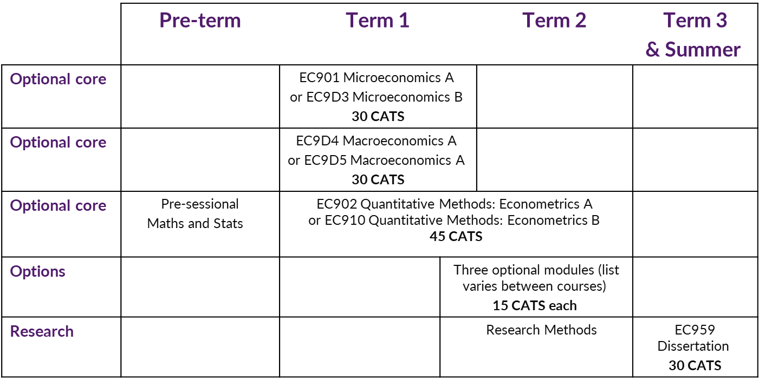
MSc EIFE

Slide 7

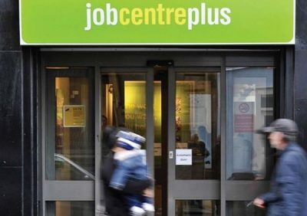

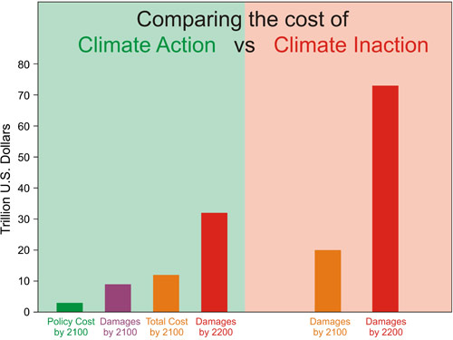
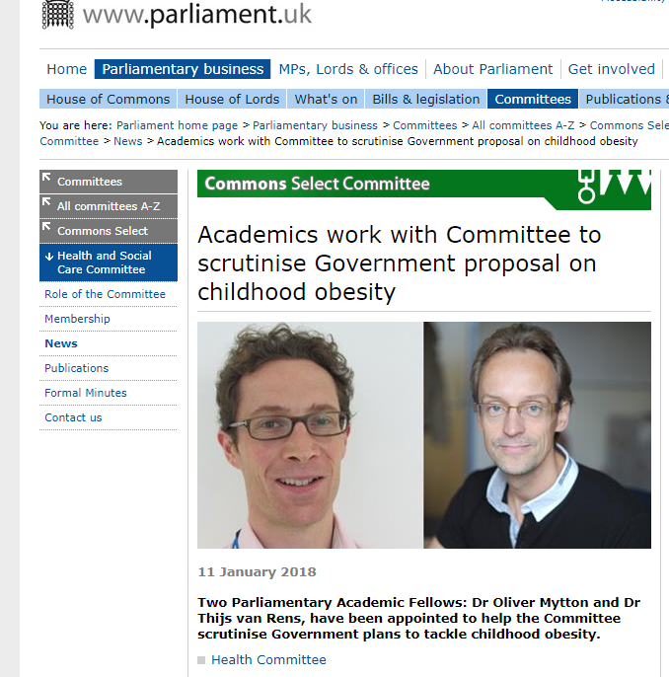

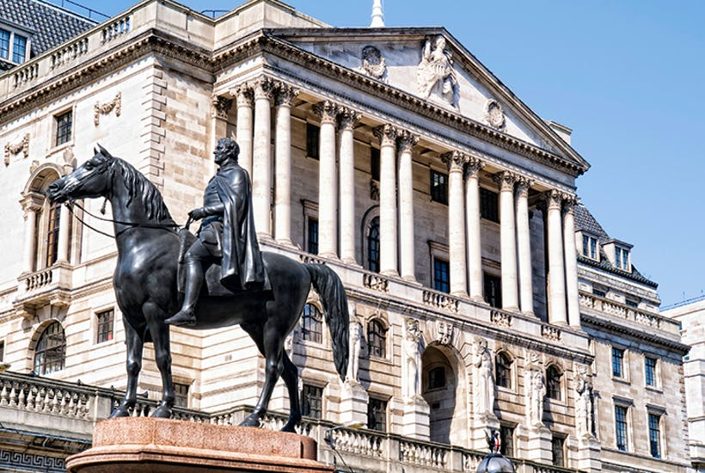
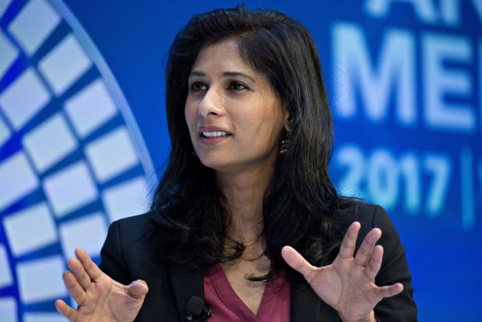
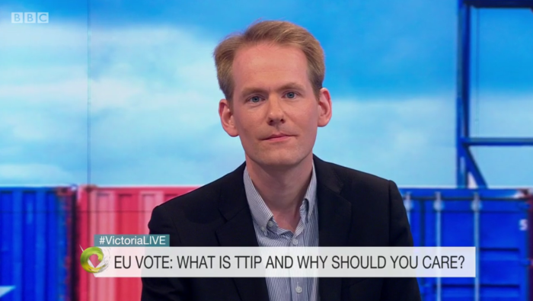
Economics is a very broad field

Slide 8
MSc Economics and International Financial Economics (EIFE)
Focus on global finance, otherwise similar to MSc Economics
Why?
Signal to potential employers in the financial sector
Create a network of students with similar interests
What makes you special?
Optional module choices
Dissertation topic
Bonding with your fellow MSc EIFE students (network)

Slide 9
Optional modules
Three modules to be taken in term 2. See your handbook for your list of optional modules. They include:
Global Finance, Monetary Economics, Economics of Financial Markets, Game Theory, International Trade, Industrial, Labour, Public, Development, Experimental , Investment, Behavioural, Data Science, Environmental.
Warwick Business School modules (at most one module)
IB9X7 - Derivative Securities
IB9Y2 - Behavioural Finance
IB9Y4 - International Financial Management
Limited places. Please be aware that the Warwick Business School modules are challenging technical courses. You should have a strong mathematics and statistics or econometrics ability.
Notes:
Three modules (15 CATS), and no more than one IB-coded module, from: EC916 Topics in Global Finance
EC924 Monetary Economics
EC931 International Trade
EC941 Game Theory
EC943 Industrial Economics
EC966 Labour Economics
EC981 Public Economics
EC982 Development Economics
EC984 Experimental Economics
EC988 Investment and the Financial System
EC989 Behavioural Economics
EC990 Topics in Applied Macroeconomics
EC994 Applications of Data Science
EC996 Environmental Economics & Sustainable Development
PS931 Bayesian Approaches to Behavioural Science
IB9X7 Derivatives Securities*
IB9Y2 Behavioural Finance*
IB9Y4 International Financial Management*
* Limited places. Please be aware that the Warwick Business School modules are challenging technical courses. You should have a strong mathematics and statistics or econometrics ability.

Slide 10
Optional modules
Presentation of Optional Modules session
Friday 10 October 9.00 – 12.00 Lib 2
Academic Personal Tutor session
Friday 10 October 13.30 -14.30 OC1.07 Subham Kailthya
Module Registration deadline is Monday 20 October (you cannot make any changes after this date until the beginning of term 2)

Slide 11
Dissertation
Submission deadline: 16 September 2026
Proposal: 29 June 2026
Proposed title and supervisor: 13 April 2026 (must be approved by Director MSc EIFE)
Start thinking about a topic: Now!

Slide 12
Dissertation: examples of titles
Topic must be in (international) financial economics
The impact of RMB exchange rate volatility on Chinese foreign exchange reserves
The spillover effects of U.S. quantitative easing on BRICS countries
Regulation of cryptocurrencies
Financial development and income distribution : The case of the US bank branch deregulation
The impact of third-party internet payments on the money multiplier
The impact of the EU debt crises on Chinese FDI inflows
The impact of electronic payment on banking performance in Thailand
The effect of information disclosure on the cost of equity financing
An early-warning model of sovereign default

Slide 13
Dissertation: examples of titles
International financial economics, broadly defined …
The impact of tax policy on foreign direct investment and economic performance of EU countries
Real estate pricing in Hong Kong under a fixed exchange rate
Pollution and international trade
The development of e-commerce and the transformation of foreign trade in China
Do developing countries rely heavily on remittance payments?
The performance of Taylor Rule in the UK after 1993
The monetary transmission mechanism via the housing channel: Consumption evidence from the UK

Slide 14
Dissertation: examples of titles
But there are limits! Other topics are possible, but must be approved
The impact of reverse offshoring on technological innovation: An empirical study of China’s mechanical and electrical Industry
The impact of visa regimes on international trade and investment
The impact of female employment on economy growth
The influence of two-child policy on urban and rural migration in China
P2P downloading and CD sales, cannibalizing or complementing?
The impact of income inequality on crime
The survival of Michelin-star restaurants

Slide 15
Dissertation workshop (from week 6, time TBA)
Purpose of the workshop
Help you find a dissertation topic e.g. speakers on contemporary topics in (international) finance
Help you to develop your dissertation e.g. student presentations
EIFE network building e.g. social events, invite former EIFE students, joint events with WBS students
Support your career development e.g. practice presentation skills, external networking, speakers from potential employers
Complements other resources available to you:
Field seminars and workshops
Research methods EC959

Slide 16
Dissertation Workshops Fri 28 Nov & Fri 5 Dec
Themed group meeting with experienced academic for advice on "finding a topic and a supervisor".
Sign up for a short 1 to 1 meeting with this person in Term 2 to discuss your ideas.
You will be able to select the session you attend, based on your research interests:
Finance
Macro
Development and international trade
Data Science (TBC)
Applied micro; Environment, health and wellbeing
It is vital that you engage with these sessions. We will send further information later in the term.

Slide 17
Attendance
You are expected to attend all your lectures and classes.
Your monitoring point scheme is published in your handbook:
If you do not meet monitoring points you could be removed from your course by the University.
If you are a visa student, your visa could be revoked.

Slide 18
Term 1 Monitoring Points
1. | Attendance at Departmental Registration event | Week 52
2. | Attendance at Academic Personal Tutor event | Week 1
3. | Attendance at class EC902/EC910 | Week 3
4. | Attendance at class EC902/EC910 | Week 5
5. | Attendance at class EC902/EC910 | Week 7
6. | Submission of Economics module evaluation (online) | Week 9-10

Slide 19

Questions or problems
MSc Handbook
PG Office: Tina Jones, Andrea Wyld, Chau Ho, Marion Nicholson.
Academic Personal Tutor
Student Support & Progression Officer: Suky Cheema
Senior Tutor (pastoral support): Han Zhang
Director of Student Experience and Progression (academic support): Subham Kailthya
PG mentors: http://www.warwick.ac.uk/services/library/pghub/mentorship/
University support services (wellbeing, counselling, mental health, disability, international students)

Slide 20
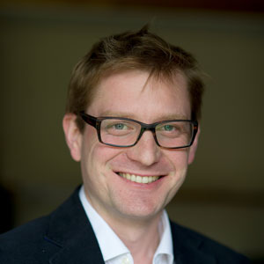
About me
Alex Karalis
Applied macroeconomist with particular interest in the non-Gaussian behaviour of economic systems
Director MSc EIFE, BES & Econ & PGT Director of Studies
A&F hours: You can book an appointment here.
Contact me: a.karalis-isaac at warwick.ac.uk

Slide 21
Questions & Answers
What is the difference between MSc EIFE and MSc Economics
Should I take Econometrics A or B?
Optional modules
When do I need to choose? Can I change my mind?
What optional modules should I choose?
Can I take more modules than required?
What marks do I need to earn the MSc degree?
Where do EIFE students find jobs? (particularly international students)
How many hours do we need to study each week?
What if my computer breaks down? Does the department offer any help?
Notes:
MSc EIFE versus MSc Economics: answers in this presentation!
Econometrics: Take econometrics B only if have done a good amount of econometrics already, covering OLS and IV, including t-, chi2- and F-tests, dummies, endogeneity, and standard errors (heteroskedasticity, autocorrelation).
Optional modules:
You need to confirm your optional module choices (through eVision Module Registration) by 14 October. You can make changes at the start of the spring term before week 17 (week 3 of Term 2). Please think carefully about your choice, because it is not possible to change your mind later after 24 January!
What optionals to choose: Go to the module presentations (online this year, tomorrow), and browse the module and lecturer websites.
More than required: No. But you can audit as many as you like (but be careful that it does not affect your performance!): Sit in once, then ask permission from the lecturer, and inform the PG office.
To earn the MSc degree you need: (1) at least 50 for all core modules, and (2) at least 50 for 2 of 3 optional modules, and at least 40 for the third, and (3) at least 50 for the dissertation. If at any point, you think you may not make these criteria, contact the office immediately!
Placement: See next slide
Depends on the person (and background), of course, but I would say at least watch all lectures, attend all classes, and study 2 hours per module in between. This is if you are efficient about it, and focus on understanding the lecture material and being able to do the class questions. In addition, you will want to prep for exams, of course.
Computer issues: This is essentially the virtual equivalent of a student who lives off-campus and commutes by car but whose car breaks down and they cannot get to their lecture or exam. For lectures: send their apology and an explanation to the office, who may choose to mark their attendance as ‘accepted absence’. For an exam, they submit the details in mitigating circumstances. Central (not university) IT Services would do what they can to help fix the problem. If there is an issue of lack of funds, then the student can apply to the (University’s) hardship fund.

Slide 22
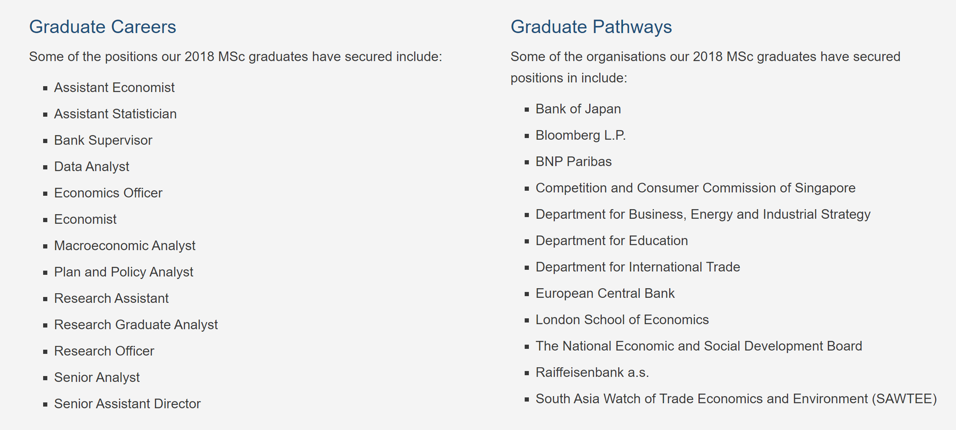
Placement (first jobs) of MSc EIFE graduates
https://warwick.ac.uk/fac/soc/economics/prospective/msc/careers

Slide 23
SSLC
SSLC are your student voice.
Nominations are open now to represent your course.
Deadline to nominate yourself is 10 October.
We need EIFE representation!
https://warwick.ac.uk/fac/soc/economics/current/msc/resources/gsslc

Slide 24
Key Dates
Term 1 (Autumn Term) week 1-10
Module registration closes 20 October
Christmas Party 10 December
Term 2 (Spring Term) weeks 15 – 24
Jan exam period (Micro & Macro) 12 – 16 January
Module registration open 5 – 16 January
Term 3 (Summer Term) weeks 25-29
May/summer exam period 1 May – 22 May
Summer Social 27 May
Summer vacation (weeks 40 – 52)
Resit and deferral exam period TBC (usually last week of August and first week of Sept)
Dissertation submission 16 September 2026

