Slide 1
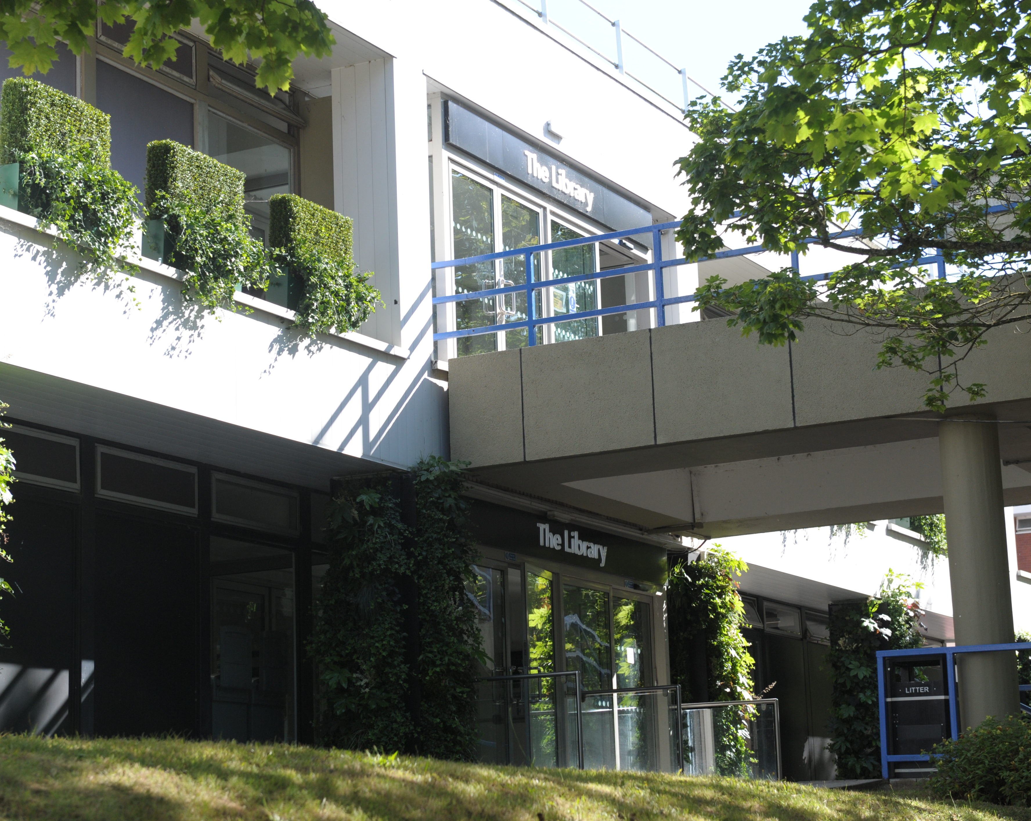
Welcome to the Library
Jackie Hanes
Research & Academic Support Librarian
Jackie.Hanes@warwick.ac.uk

Slide 2

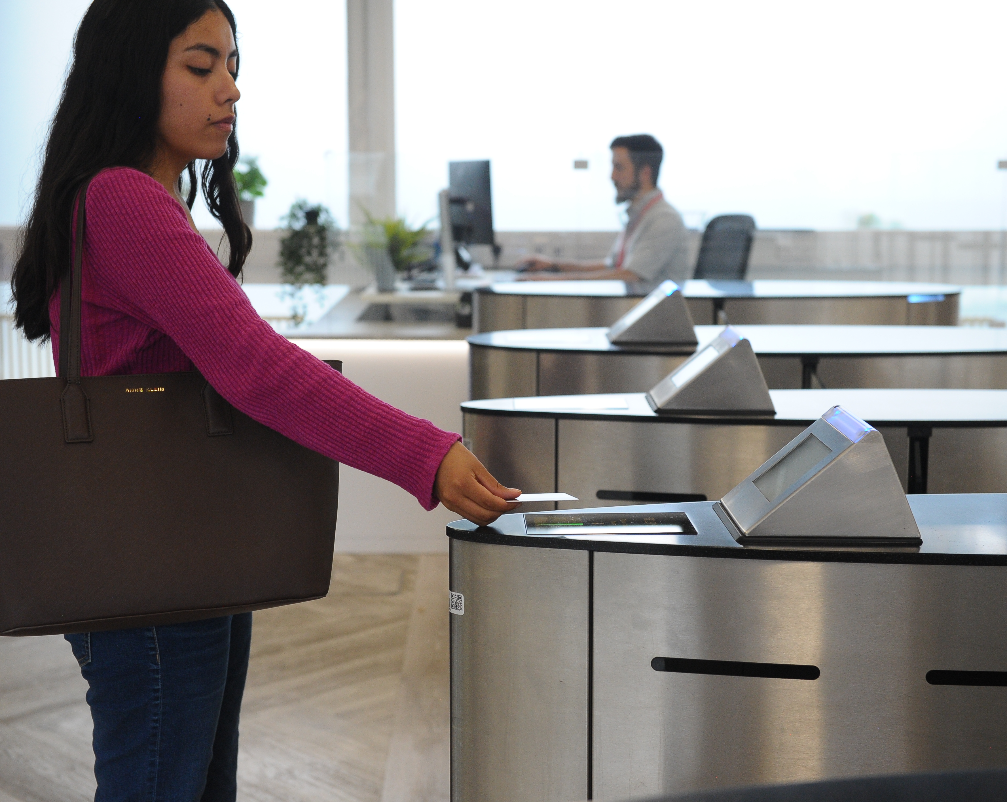


The Library
https://warwick.ac.uk/library
Library open 24/7
1st floor entrance
ID card access

Slide 3
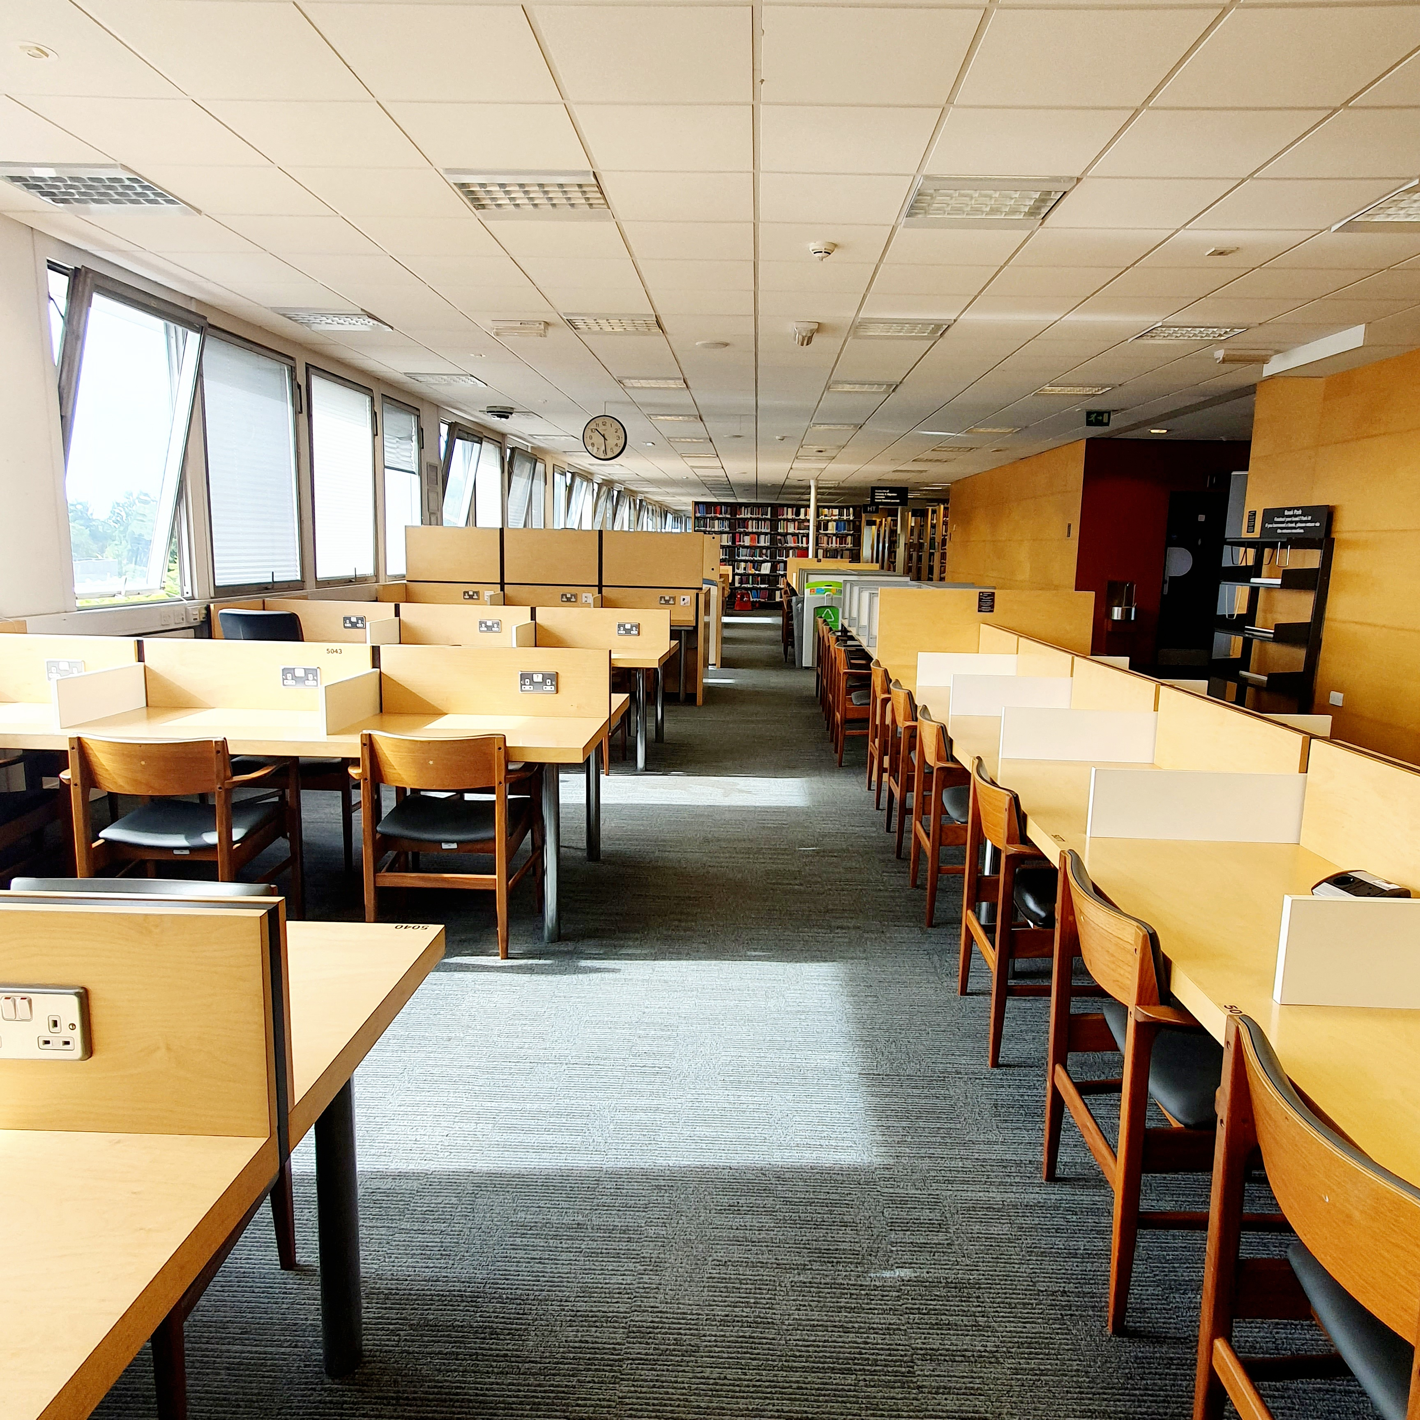


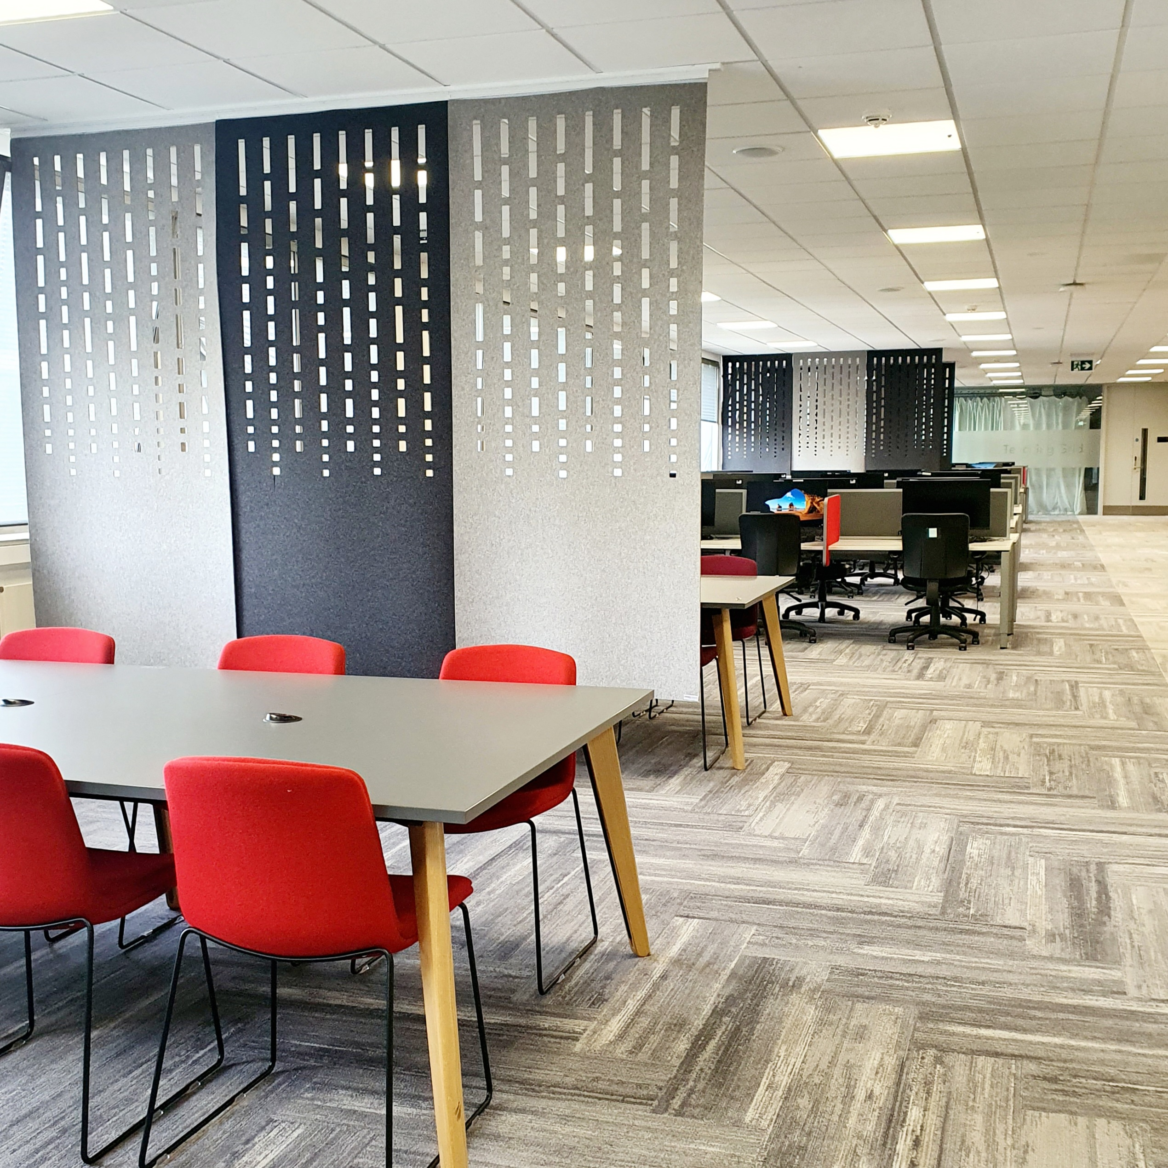


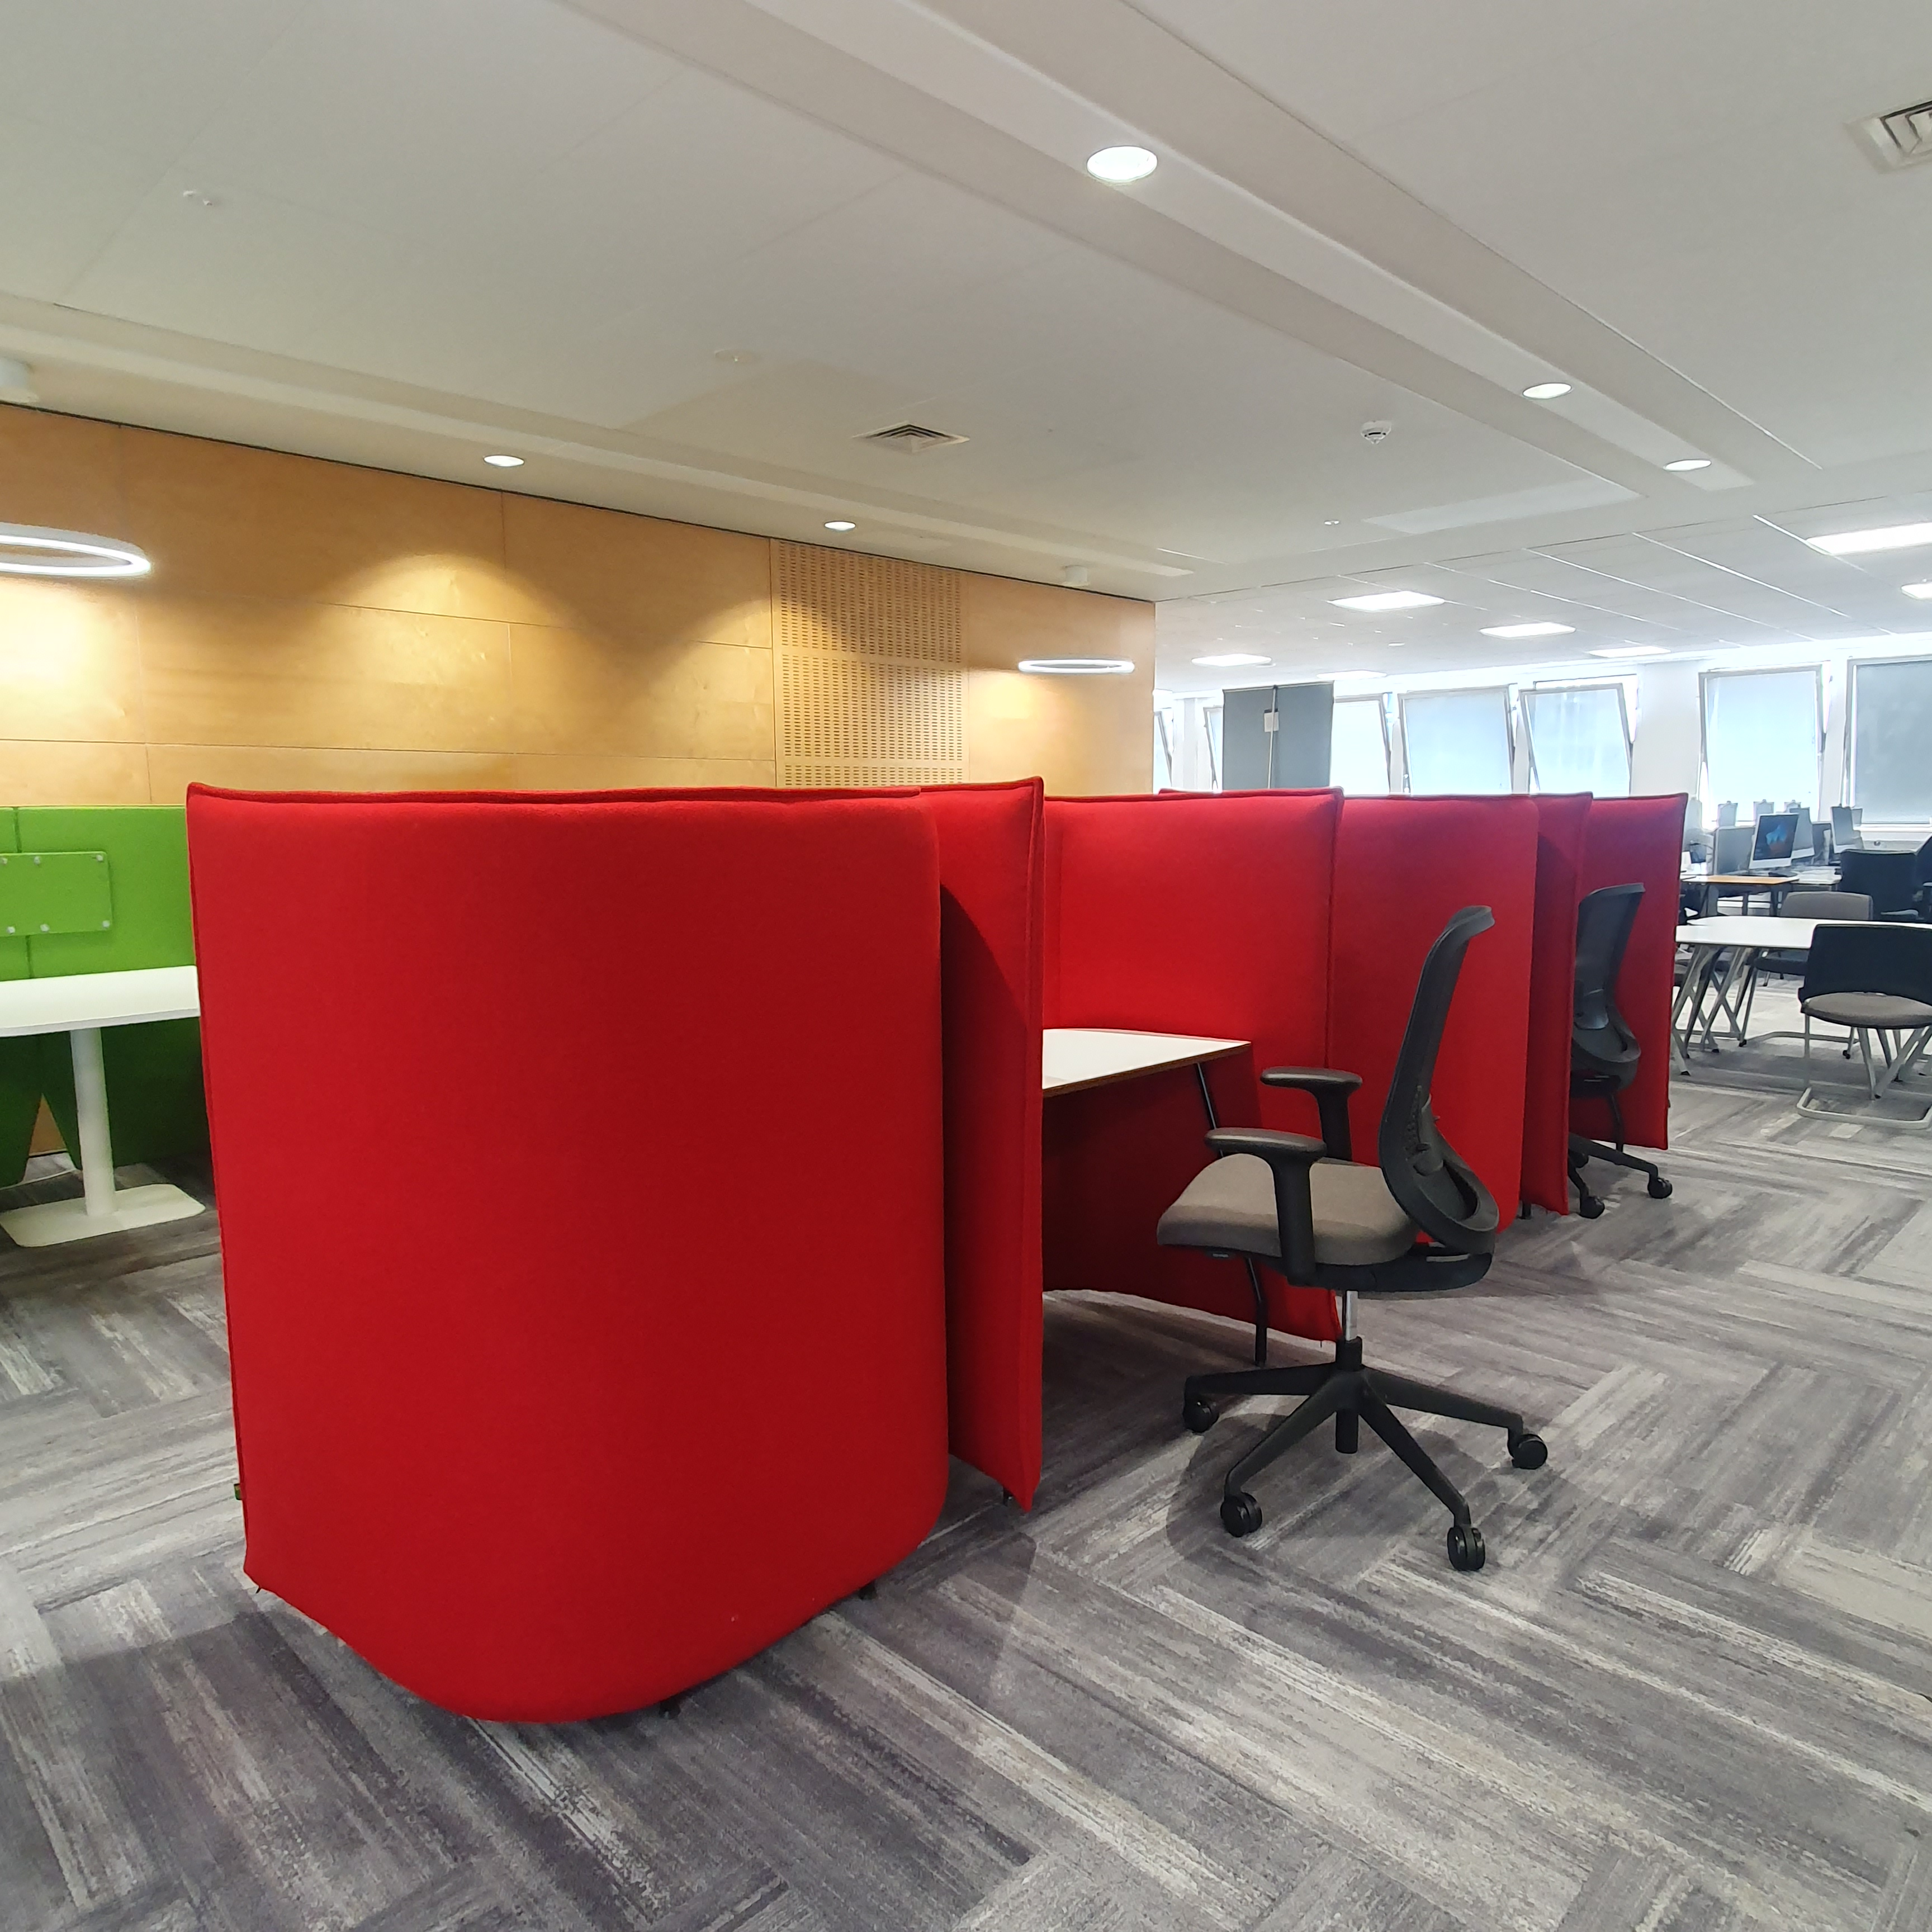

Study spaces
5: Quiet study zone
4: Quiet study zone
3: Quiet study zone
3 extension: Postgraduate study space
2: Teaching & seminar rooms
2 main: Collaboration zone
2 extension: Silent study zone
1: Enter/Exit, Helpdesk, Issue/Return
1: Collaboration zone & Assistive technology

Slide 4
Postgraduate study spaces
https://warwick.ac.uk/services/library/students/postgraduates/
Postgrad Hub @ The Junction
Wolfson Research Exchange
Open to all postgraduate students
MSc, MRes & PhD students
2nd floor, The Junction
Open 8am to 10pm
Open to research students only
MRes & PhD
3rd floor extension, The Library
Open 24/7

Slide 5
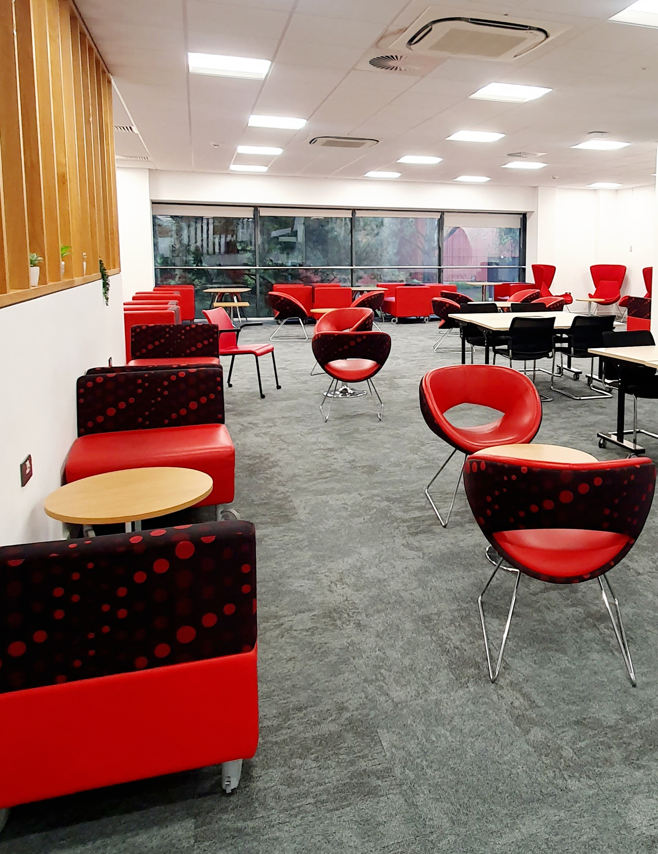
Postgraduate study spaces
https://warwick.ac.uk/services/library/students/postgraduates/
Postgrad Hub @ The Junction
Open to all postgraduate students:
MSc, MRes & PhD students
2nd floor, The Junction
Open 8am to 10pm

Slide 6

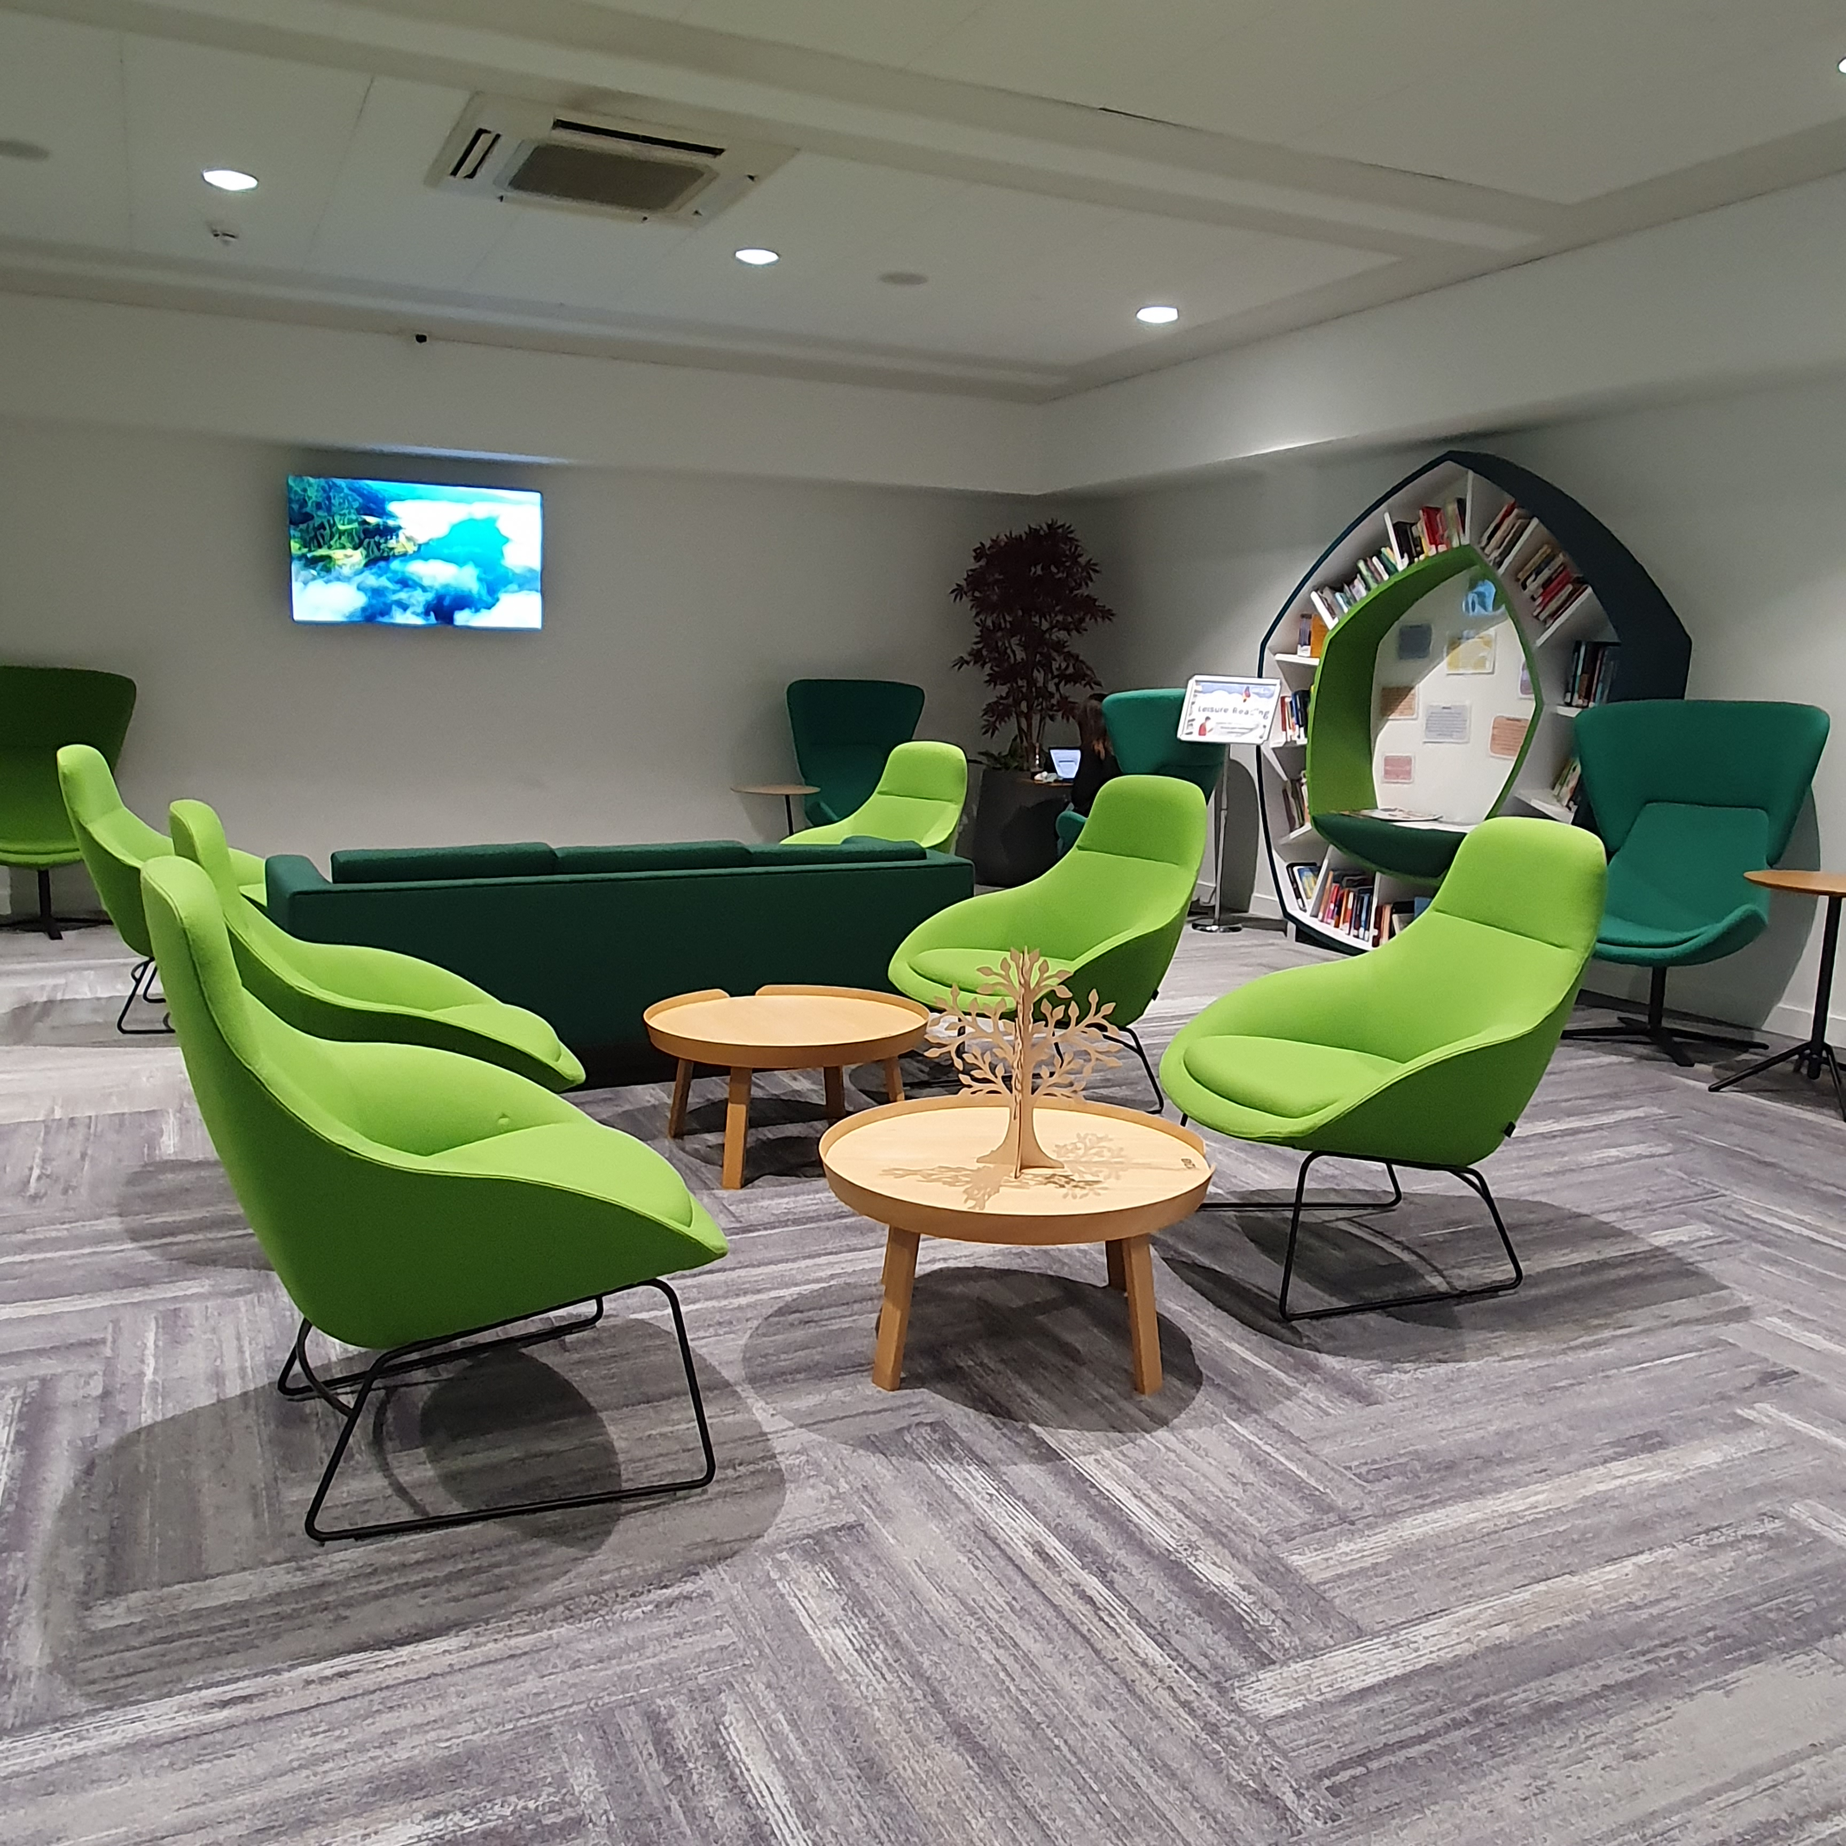
Social spaces
The Library has two cafes:
Café Library: Ground floor – food & drink
Coffee Bar: 1st floor – snacks & drink
To enjoy your own food & drink:
The Eating Place: Ground floor
To relax and unwind:
The Breathing Space: 1st floor
Collections of well-being & leisure reading books

Slide 7
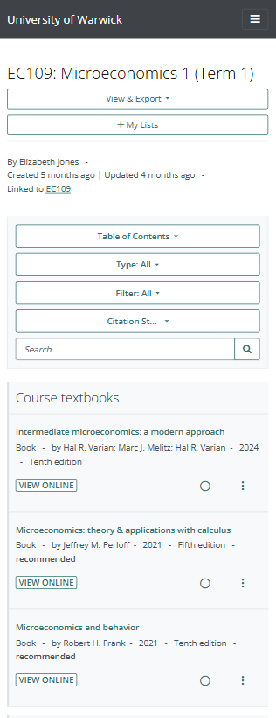
Reading list
http://readinglists.warwick.ac.uk/
Find recommended reading for your modules
Available directly or via Moodle or Library website
Search for reading list by module code or title
Features articles, books, chapters, websites & more
Importance = essential, recommended, further
View Online to access digital library resource
Click on Title to view additional copies & formats
Login to mark reading status and add own notes

Slide 8
Library Search
https://warwick.ac.uk/library
Library Search finds articles, books, chapter, databases, journals and more
Search by author/title for known items, or keyword for items on a topic
Limit search results by resource type, subject and publication data
Quick Look for an overview of the item
Full-Text Online to access via the digital library
Export search results: Save, Email and Cite this item

Slide 9
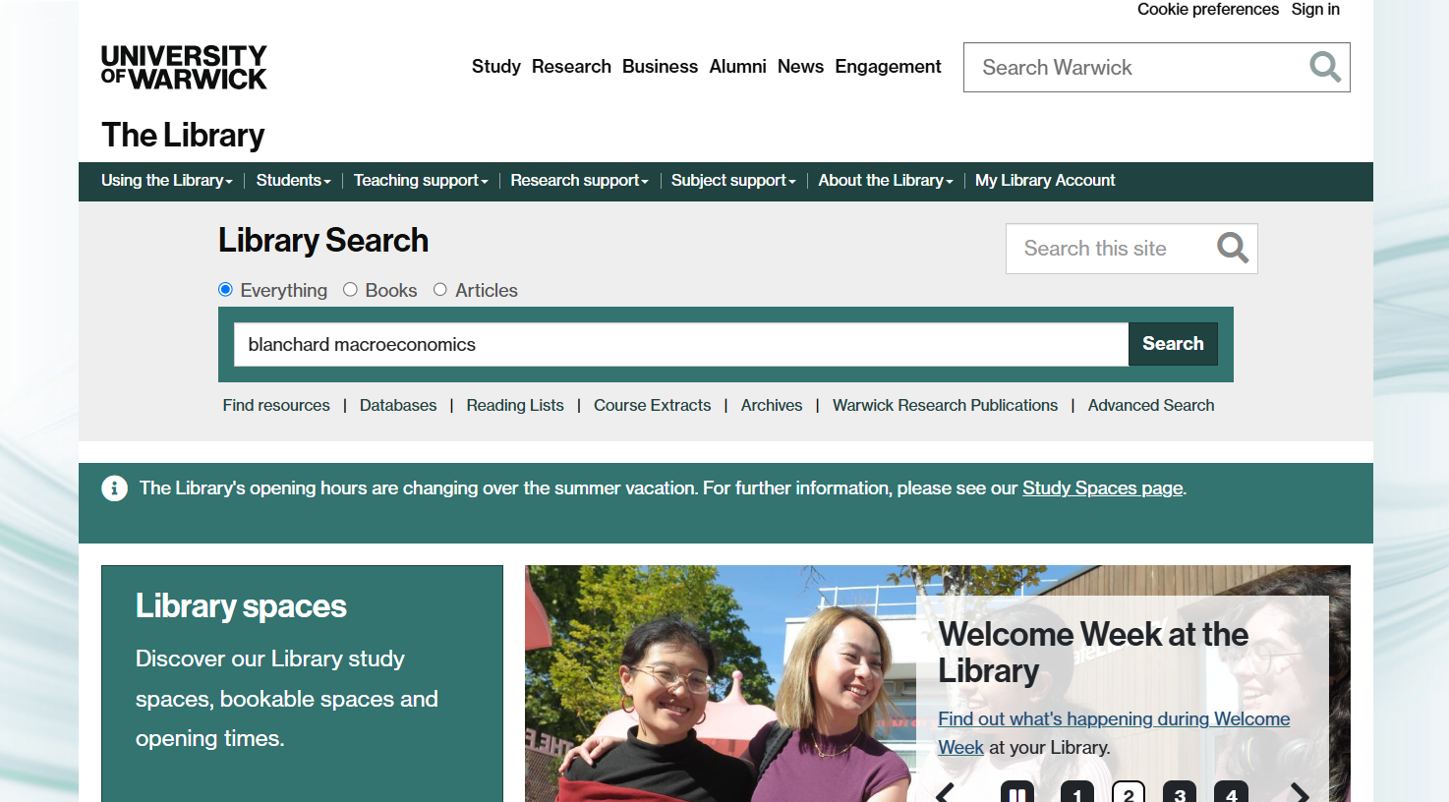
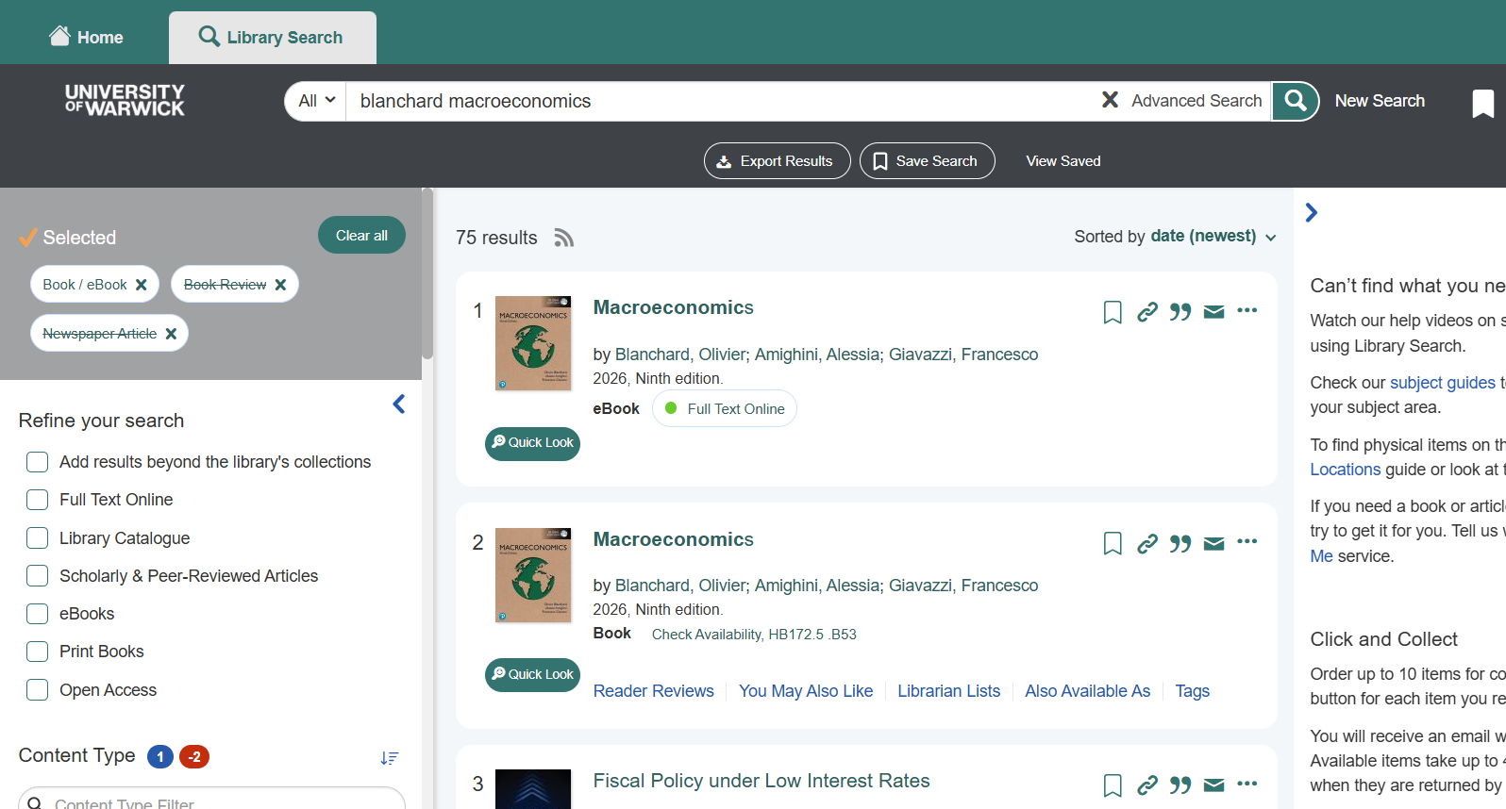
Finding books
Blanchard, O. et al (2026) Macroeconomics
Search
Results

Slide 10
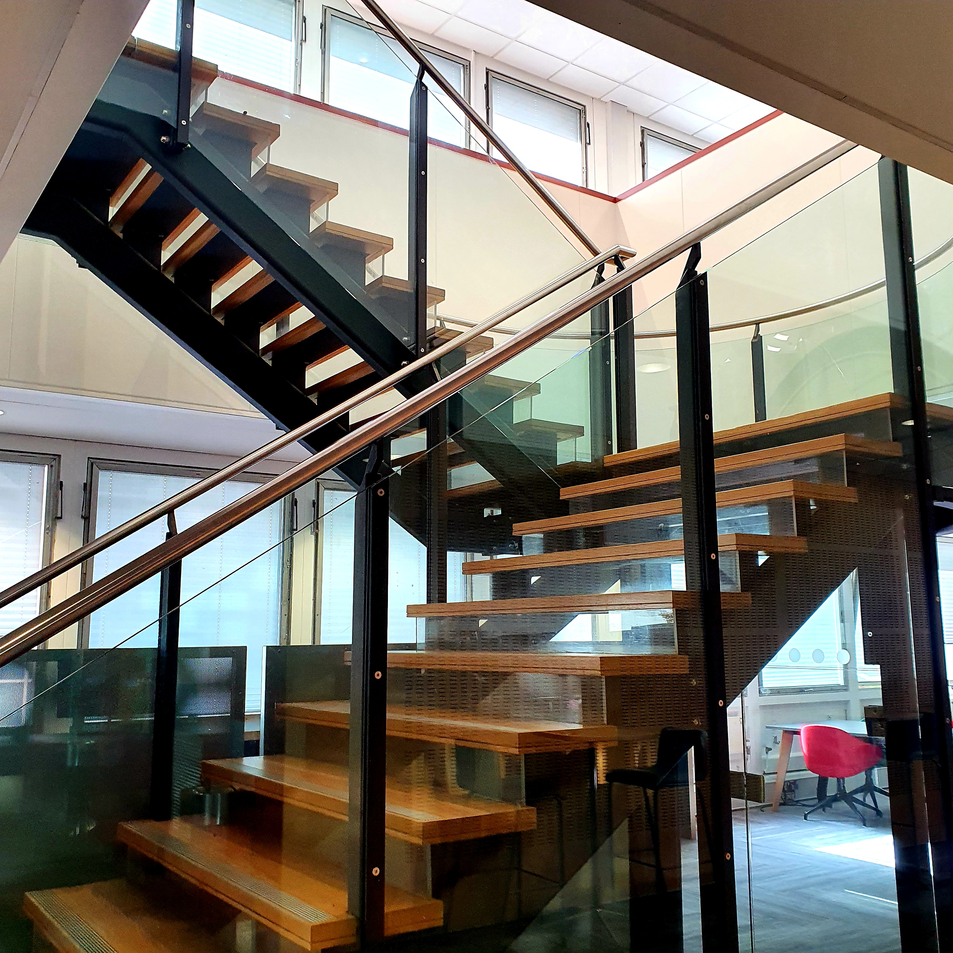
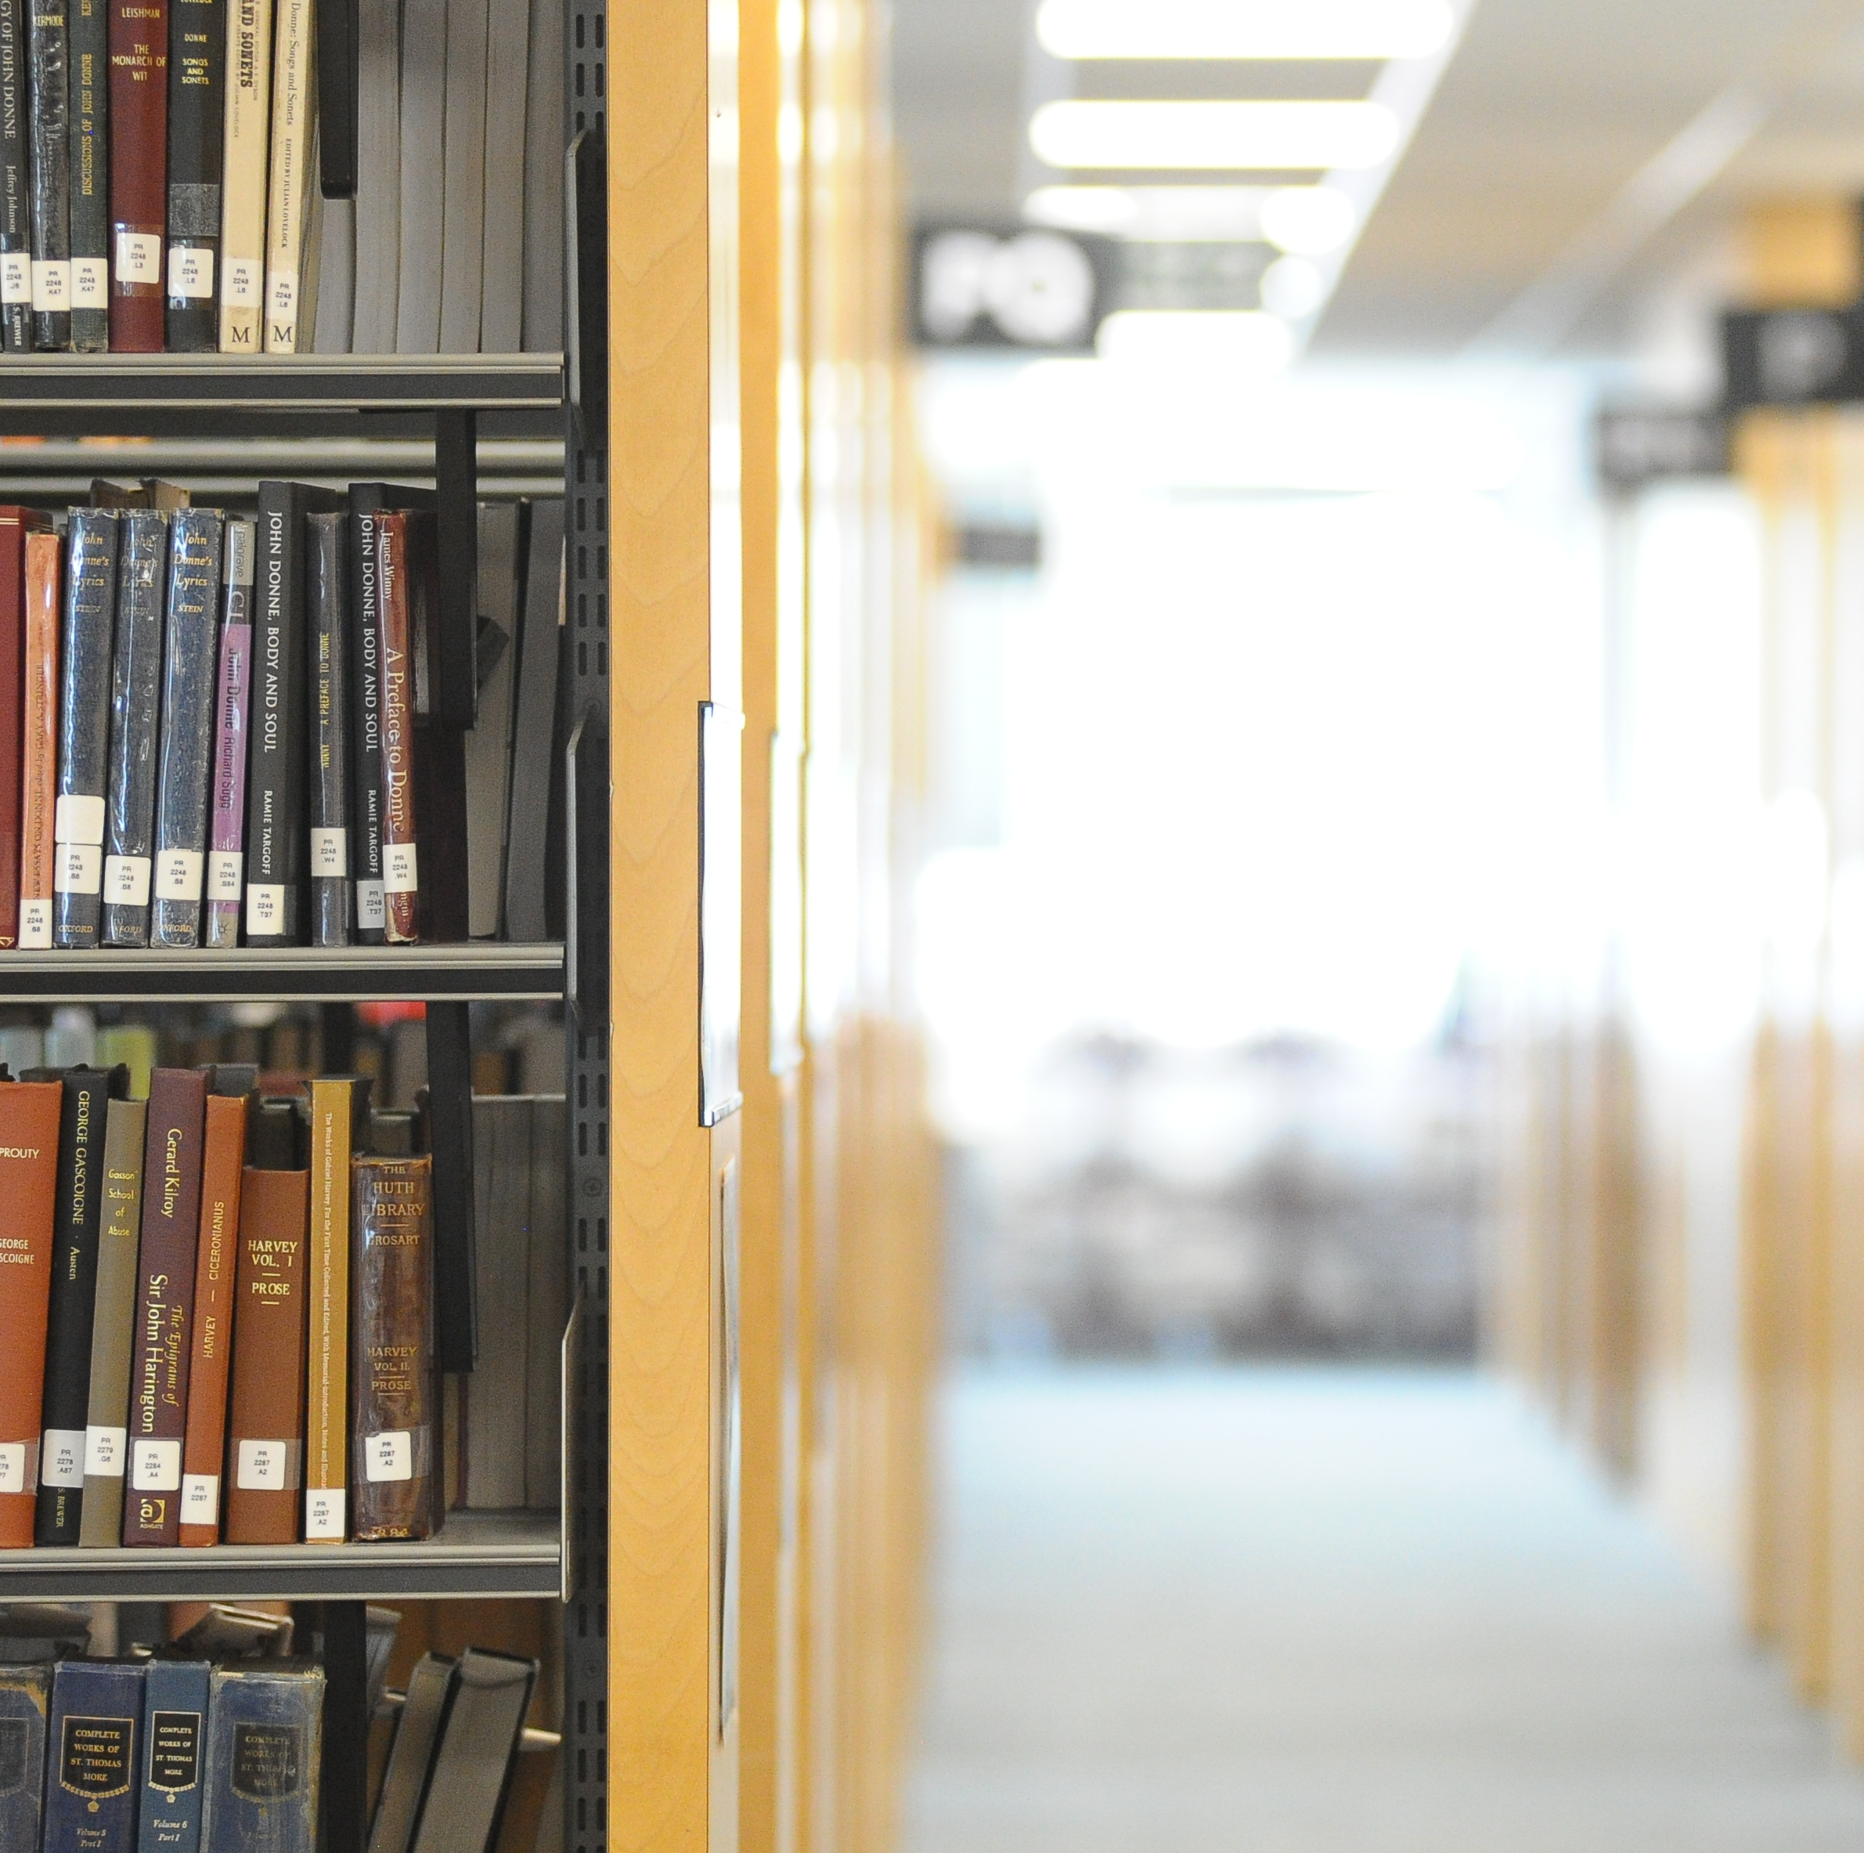
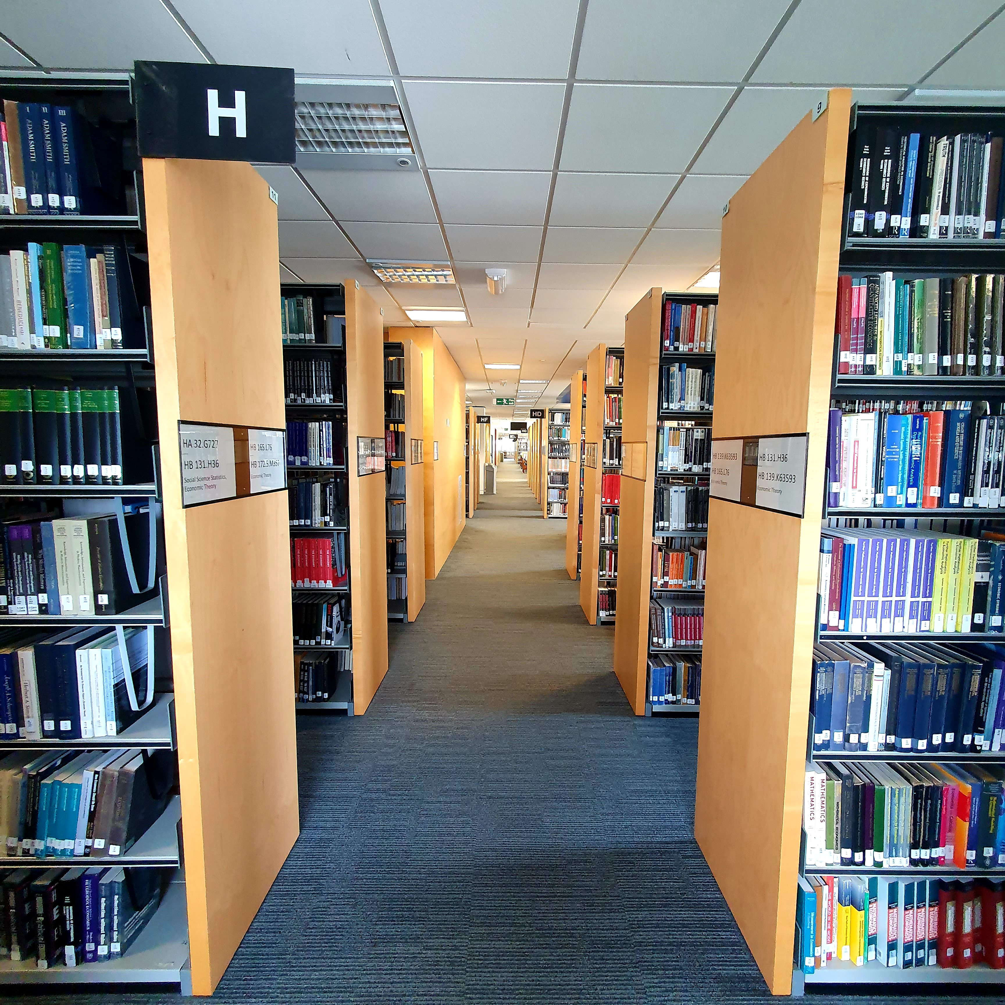
Economics books
5-H
Economics books located on 5th floor in H class mark
Self-issue machines on 1st floor of library
University ID card required to borrow books
Unlimited borrowing (999 items)
1 year loan period (unless recalled)
Click & Collect + Postal Loans services
If all copies of a library book are on-loan, recall a copy using the Click & Collect service on Library Search

Slide 11
Access to digital library resources
Login with your University of Warwick IT user number & password
University Library
Institutional login
Recommended access routes via Reading List, Library Search, Database A-Z or Subject Library Guide
Username = IT user number (u251234)
Password = IT password
If accessing directly, and library resource is not available, look for access via Institutional Login
Institutional = University of Warwick
Username = IT user number (u251234)
Password = IT password

Slide 12
Using digital library resources
Access to and use of library ebooks
Copies of the ebook
Single: 1 copy of the ebook = 1 concurrent user
Multiple: 3 copies of the ebook = 3 concurrent users
Unlimited: unlimited copies of the ebook = access for everyone
Print, copy & download
Use of ebooks is controlled by digital rights management (DRM) technology
Restricted: 1 chapter, 10% of pages, or number of pages
Unrestricted: unlimited print, copy & download (DRM free)

Slide 13
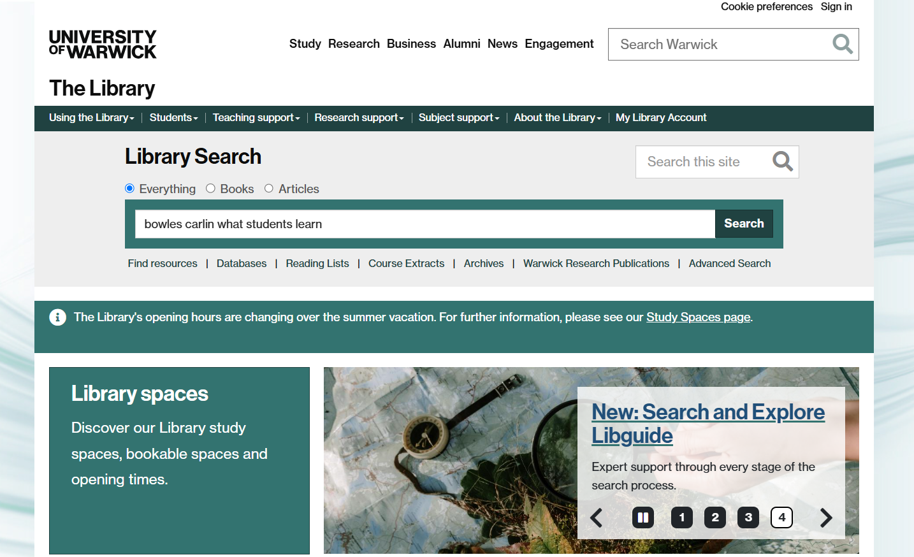
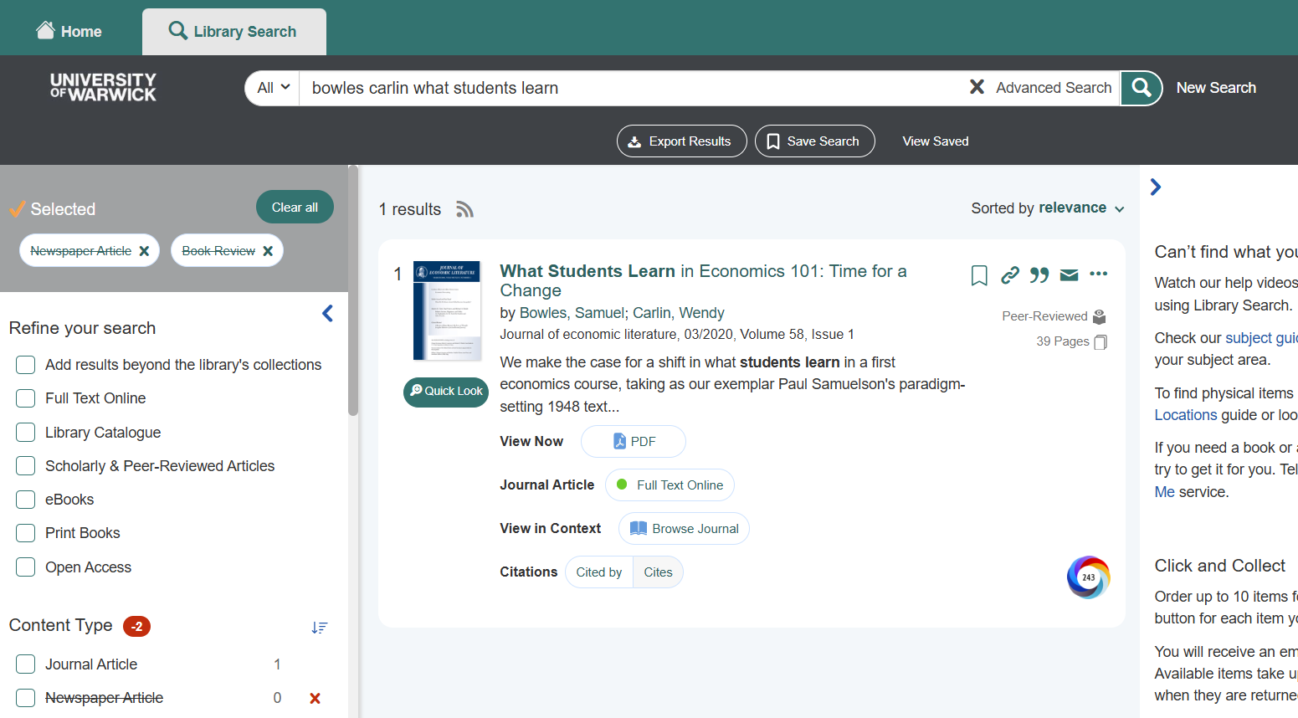
Finding journals (by author & article title)
Bowles, S. and Carlin, W. (2020) ‘What Students Learn in Economics 101’
Search
Results

Slide 14
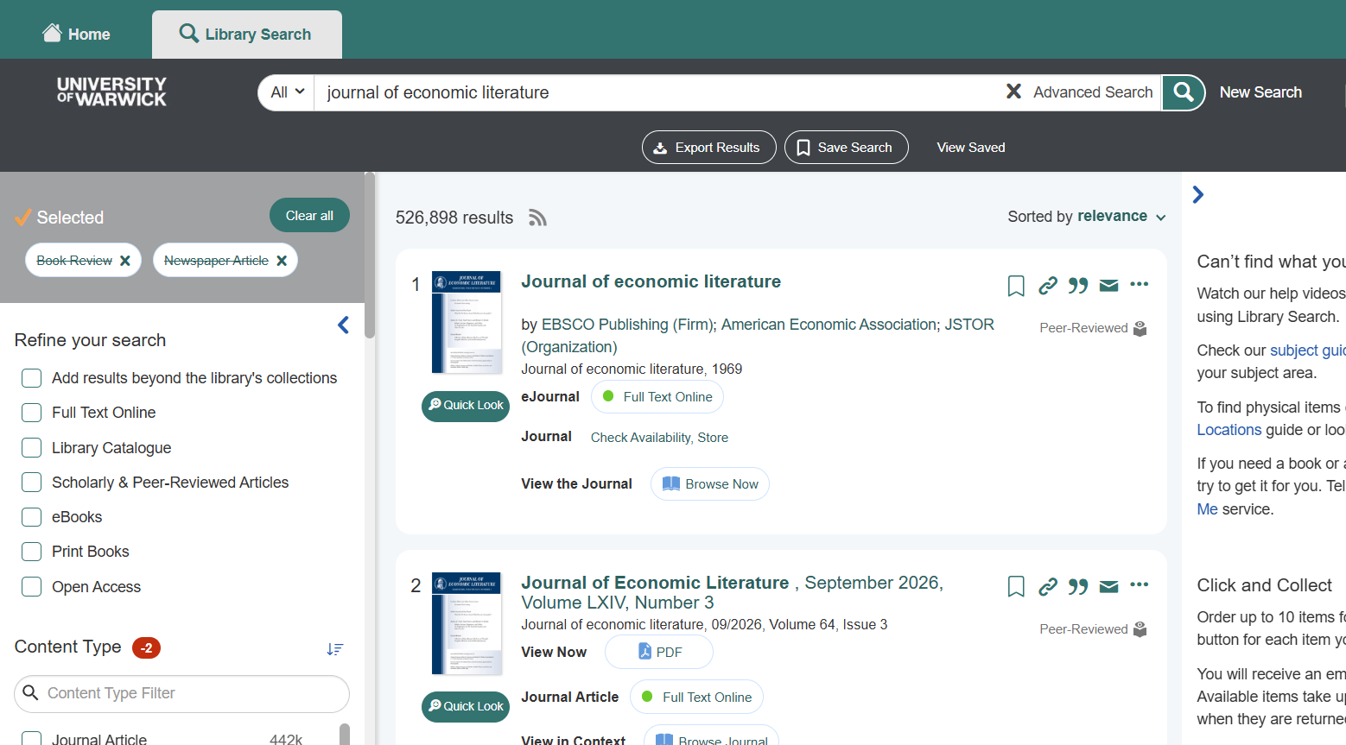
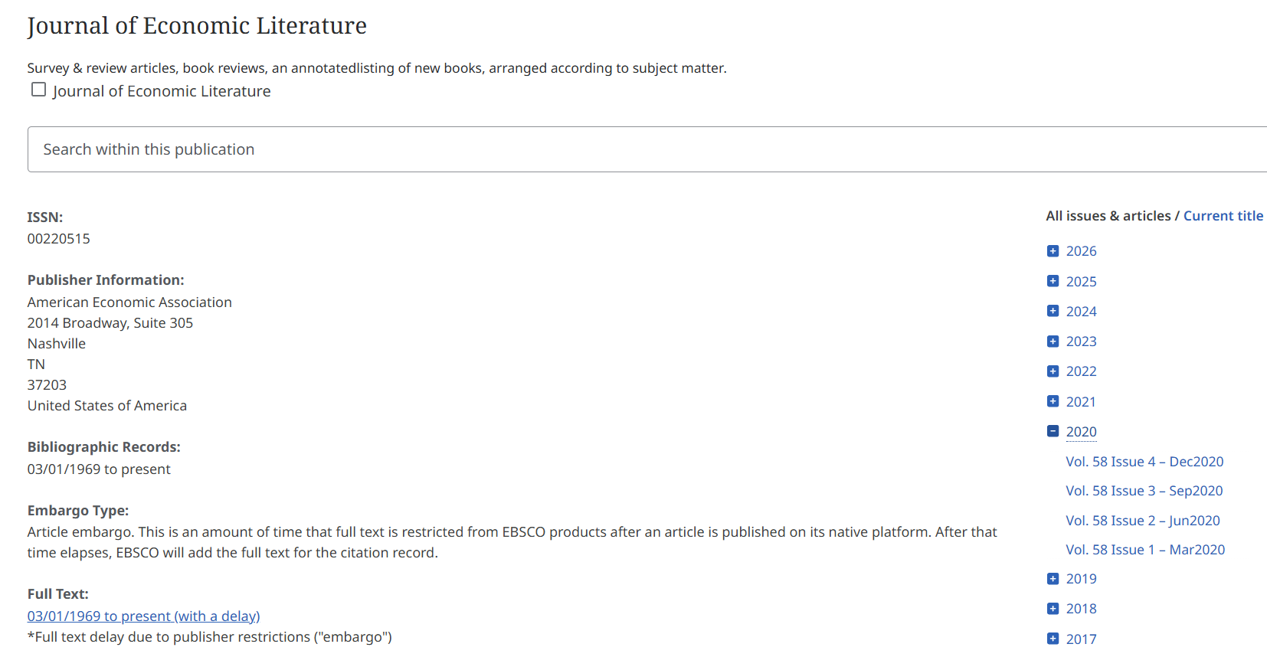
Finding journals (by journal title)
Journal of Economic Literature > 2020 > volume 58 > issue 1 > page 176
Library Search
Journal

Slide 15
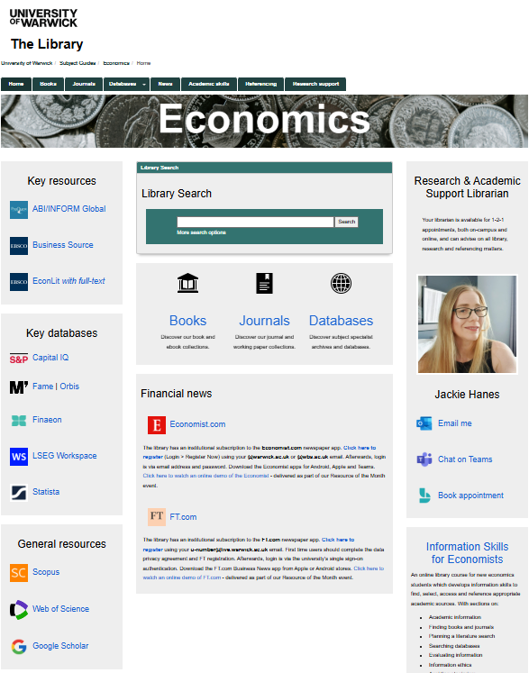
Economics subject guide
https://warwick.libguides.com/economics
A guide to the library resources for economists:
Literature searching databases
Economic & financial newspapers
Economic, financial & company data
Study skills, referencing & research support
Librarian’s email, telephone & appointments

Slide 16


Financial newspapers
The Economist
Financial Times
https://www.economist.com
https://ft.com/Warwick
Register for access then install mobile app:
Go to https://www.economist.com/
Click on Login (not Subscribe)
Enter your @warwick.ac.uk email
Prompted to login via Institutional Login
Access online, via mobile app or Teams app
Register for access then install mobile app:
Go to https://ft.com/Warwick
Complete the online registration
Login with @warwick.ac.uk email
Login via single-sign-on (SSO)
Access online or via mobile app

Slide 17





Literature search databases
https://warwick.libguides.com/economics/journals
EconLit with full-text
NBER: National Bureau of Economic Research
RePEc: Research Papers in Economics
Scopus
Web of Science
Multidisciplinary index, abstract and citation databases
Cover only highest ranking journals in scholarly publishing

Slide 18
EconLit with full-text
Literature search database for economics
EconLit
Full-text articles
EconLit is an index and abstract database to 1,000+ journals and working papers in economics & finance.
Articles are indexed using the AEA’s Journal of Economic Literature (JEL) subject classification.
EconLit has selected full-text publications including American Economics Association (AEA) journals (current issue with no embargo).

Slide 19
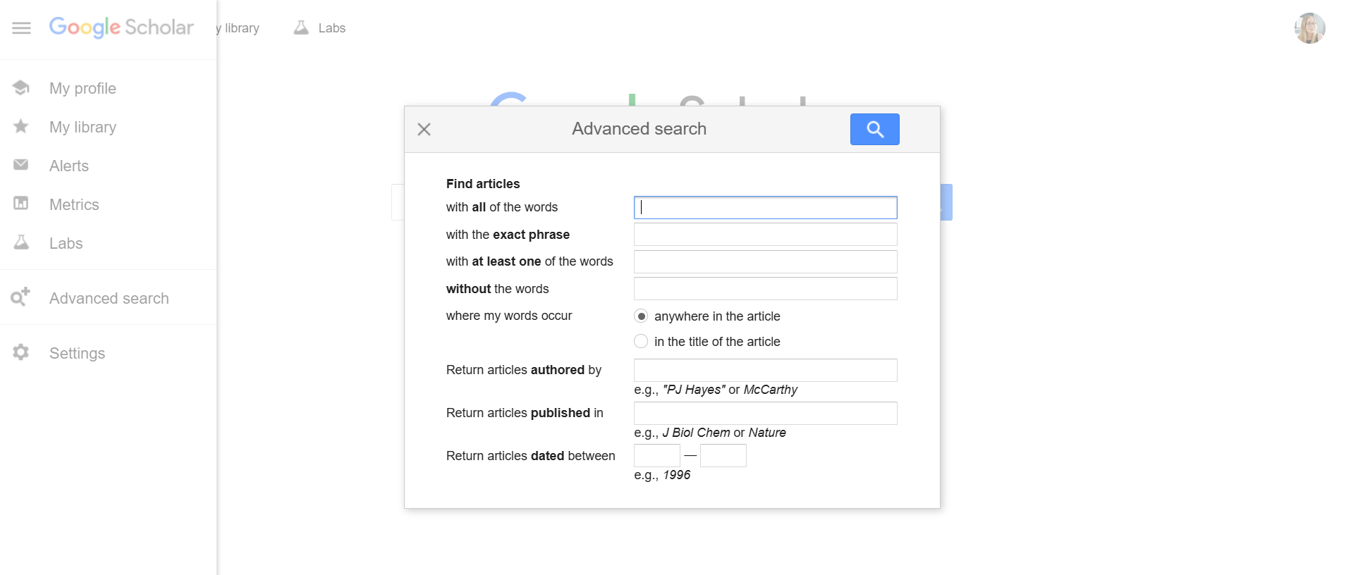
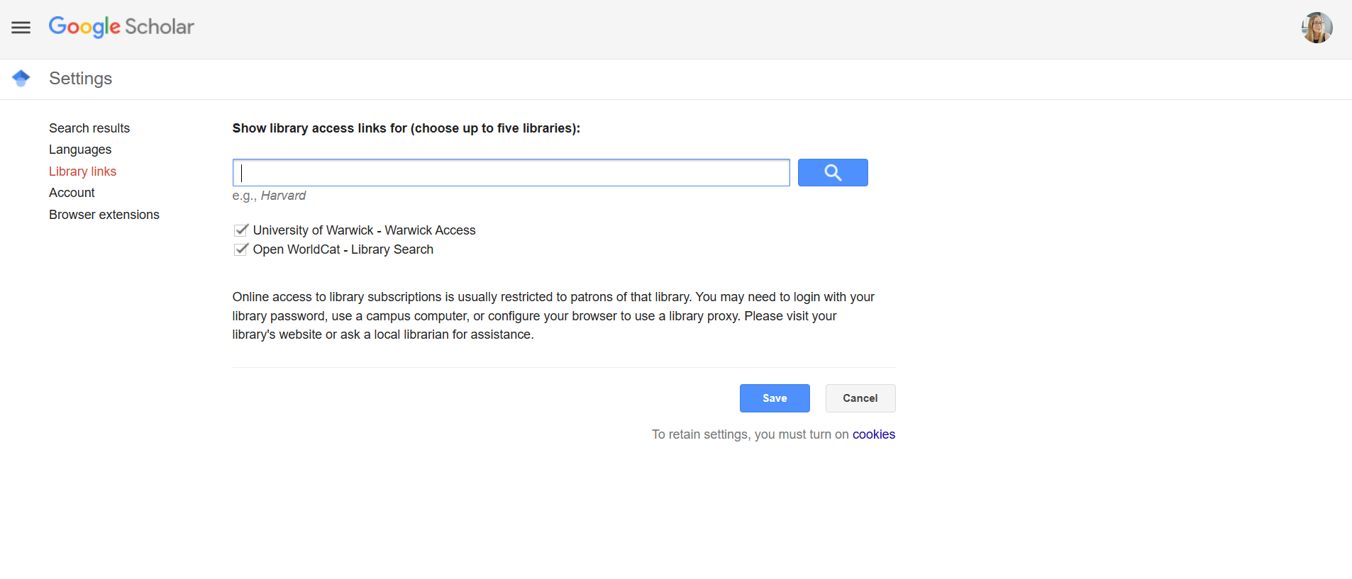
Google Scholar
Free search engine for academic and scholarly literature
Multidisciplinary, broad coverage (no clear selection criteria)
Simple search engine (lacks advanced database functionality)
Advanced Search
Library Links

Slide 20

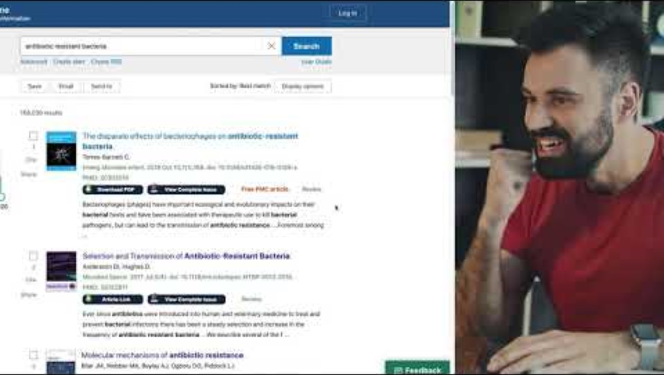
LibKey Nomad
https://thirdiron.com/downloadnomad/
LibKey Nomad is a browser extension that provides access to paywalled articles
Install the internet browser extension
Select your institution (university)
Click on LibKey icon to access
LibKey integrates with Google, Wikipedia and AI e.g. ChatGPT, Claude and CoPilot and provides full-text access to cited research papers

Slide 21

Document supply
https://warwick.ac.uk/services/library/using/get-it-for-me/
Do you need an article, book or chapter that is not available in the library?
Complete the request form and the library will try to supply the item
Digitise an article in a journal or chapter in a book
Borrow a copy from another university library
Purchase a copy of the book for our library

Slide 22

Referencing
https://warwick.libguides.com/economics/referencing
Economics follows the Harvard referencing style
In-text citations (author, year, page) + end of text bibliography
Library Search includes Cite This Item functionality
Click on Quote icon + choose your referencing style
Cite Them Right Online is a complete guide to referencing
Rules and examples for 8 referencing styles inc. Harvard

Slide 23

Reference management
https://warwick.ac.uk/services/library/students/endnote/
Organise references
Add research notes & PDFs
Insert citations
Create a bibliography
EndNote & Zotero are our recommended reference management tools
Attend one of our Researcher Training workshops to find out more

Slide 24
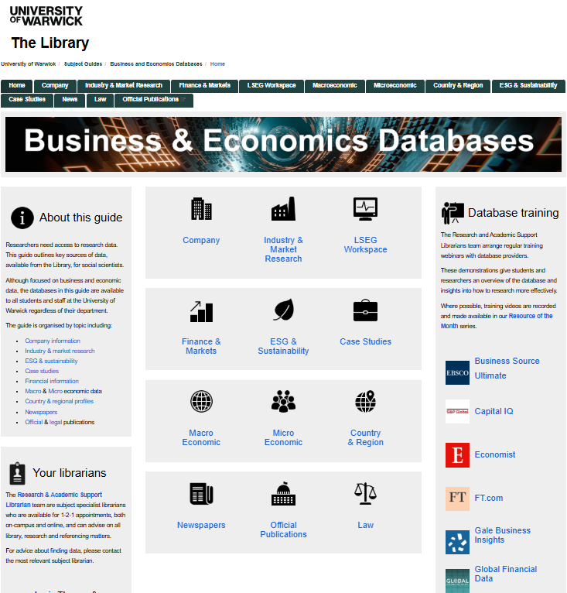






Economics database guide
https://warwick.libguides.com/buseco/
Capital IQ
Fame, Orbis, Orbis Bank Focus
Finaeon (Global Financial Data)
LSEG Workspace
Statista
UK Data Service

Slide 25
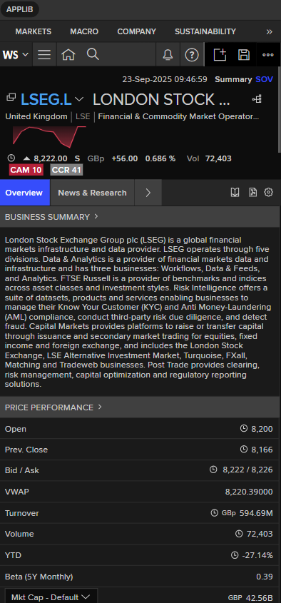
LSEG Workspace
https://warwick.libguides.com/buseco/workspace
LSEG Workspace is a company & financial database
Workspace, Datastream & After Market Research
50 student licenses available for fixed period
Apply for licence via LSEG Self-Registration Portal
If available, licence issued for 7-day period
After licence expires, apply for a new licence
LSEG Workspace Certification
Online training programme and certification test
Industry recognised certificate + LinkedIn badge

Slide 26

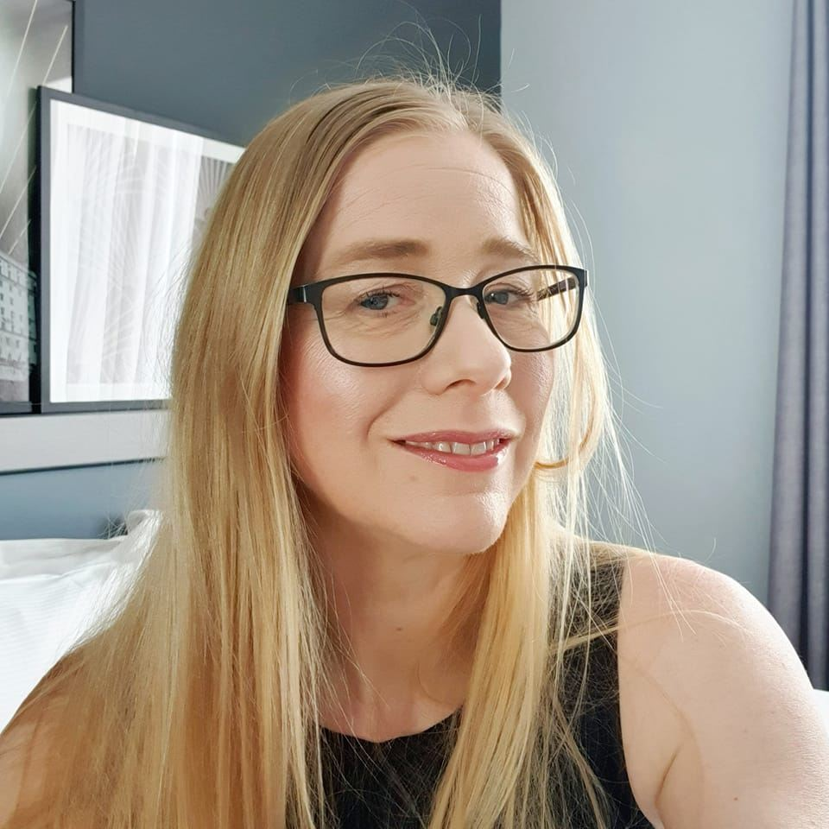


Contact me
https://warwick.libguides.com/economics
Jackie Hanes, Research & Academic Support Librarian
Jackie.Hanes@warwick.ac.uk
+44 (0)24 765 72588
Book Appointment

Slide 27



Contact us
warwick.ac.uk/library
library@warwick.ac.uk
@WarwickUniLibrary
+44 (0)24 76 522026
@warwicklibrary

