Slide 1

Economics masters students
Anna Preston – Senior Careers Consultant a.preston@warwick.ac.uk
Student Careers & Skills
2017

Slide 2
What can we help you with?
I know what I want to do but need help with applications/interviews/assessment centres/psychometric tests
I don’t feel confident about achieving my goals
I want to go on to further study
How do I explain blips in my cv?
I’ve no idea what I want to do after uni

Slide 3
Student Careers & Skills
Workshops
One to one support
Applications advice
Mock interviews
Employer events – fairs and talks
All bookable through myAdvantage
Also, regular drop ins in Oculus

Slide 4
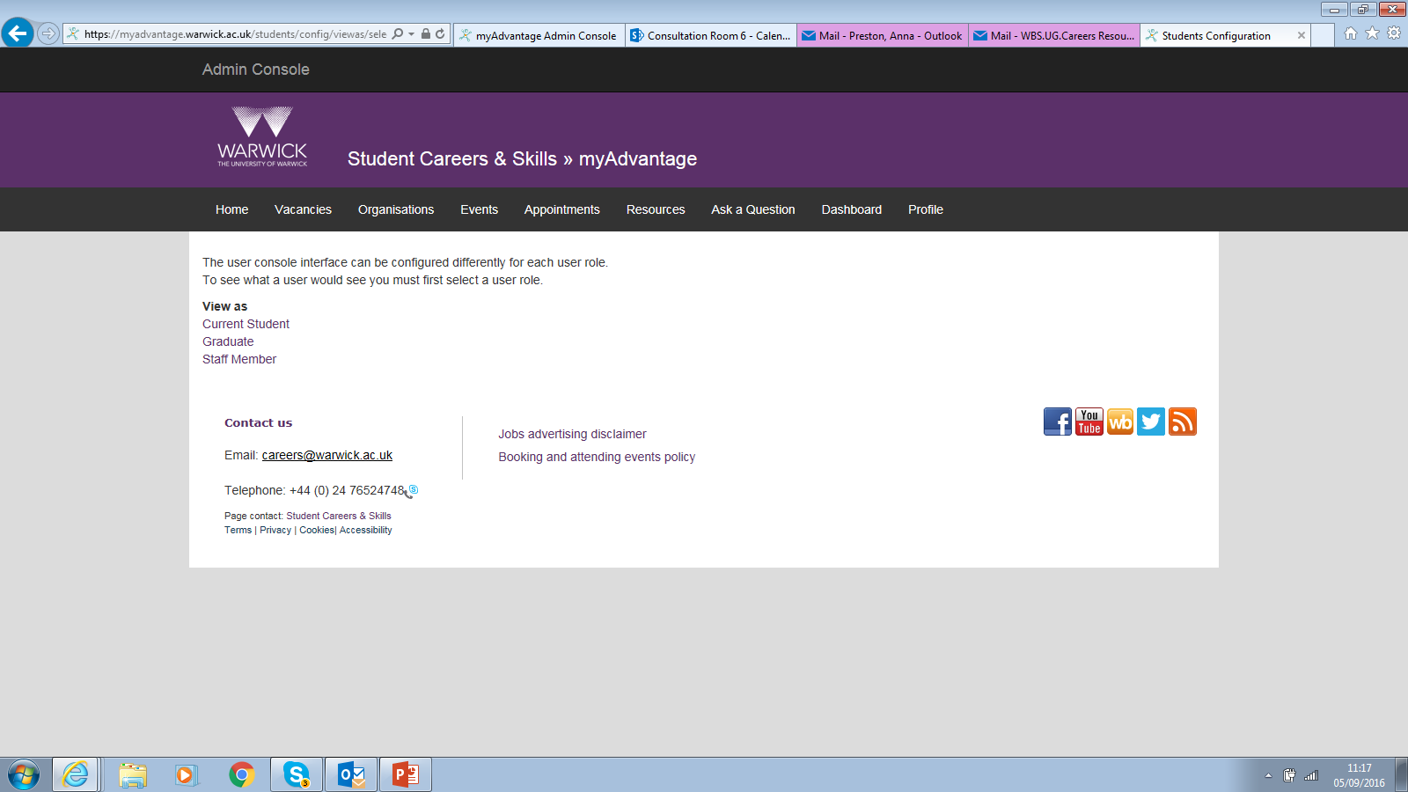
My Advantage
Access to:
Vacancies
Careers Fairs
Employer talks
Sector events

Slide 5

Fairs
Autumn Fair – 12 October 11-4
Business Finance and Consulting – 19 October 11-4
Law – 24 October 1-4
Engineering Science & Technology – 14 November 11-4
Warwick Careers Fair Plus App

Slide 6
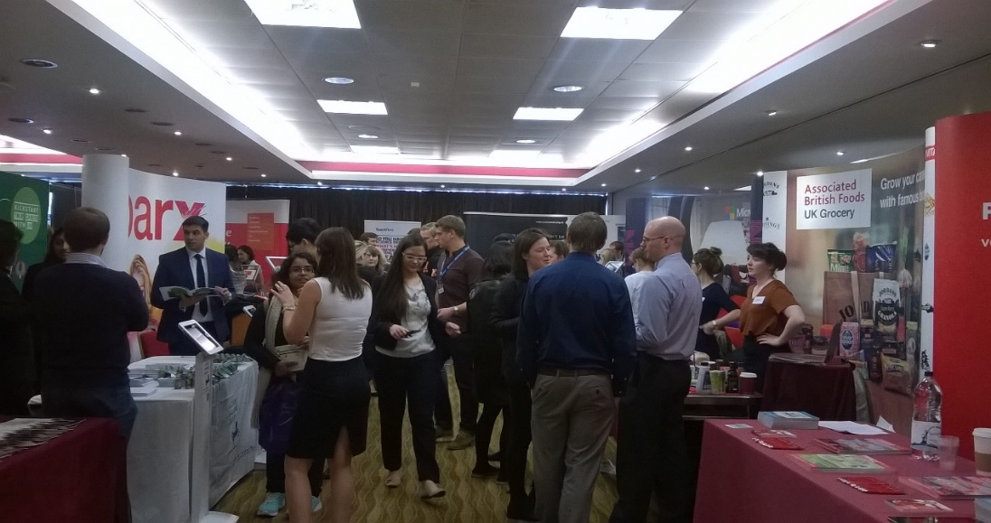
Careers in the Public Sector
31 October (eve)
Investment Banking Uncovered
17 October (eve)
Sector events autumn term
Human Resources 2 November (eve)
Technology in Professional Services
7 November (eve)
Retail
9 November (eve)

Slide 7

Economics careers evening
30 October
4-7pm
Range of employers
Keynote Speakers: Oxera and Stephen Pope
Workshops

Slide 8

Introducing Stephanie Redding

Slide 9

Get involved
We’re here to help!

Slide 10
Personal, Professional and Academic Development for Postgraduates
Autumn 2017

Slide 11

What we do
Student development and academic writing
Enterprise
Careers planning, guidance and support
Face to face, and online
Warwick.ac.uk/skills
Notes:
Point will probably have an additional careers talk so will focus on the skills side

Slide 12
Skills programme- why take part?
Transition to postgraduate-level study
Meet other Warwick postgraduates
Enhance your academic, personal and professional skills
Boost your employability and think about your career

Slide 13
Masters Skills Programme overview
Some co-taught with Undergrad programme, additional dissertation and literature searching support
Personal, Professional and Academic Skills 2 hour workshops
Everything from Critical Thinking to Emotional Intelligence via Project Management
Additional 1:1 skills advice sessions
WSPA
Academic Writing Programme
Notes:
Some schools will have embedded skills options too- these are in addition to this.
Workshops run multiple times per term including in the evening and on Saturday. If you miss one, there will be others
Look out for the On Track programme for dissertation support in term 2&3

Slide 14
Online support
Writing advice via email
Moodle: Preparing for Presentations, Tell your story, Write Right
Skills advice via email or Skype
Recipes for Success top tips
Careersandskills YouTube channel with study skills and career advice videos
WSPA online coaching
Notes:
Know you’re likely to be busy so are gradually putting more options online so can do in odd moments.

Slide 15

So much choice! Where do I start?
Try our simple skills diagnostic and follow the suggested links
Speed Reading
Note Taking
Critical Thinking
Organising yourself and your time
If new to UK HE you might find the Learning at University workshop helpful

Slide 16
You keep mentioning the WSPA…..
The WSPA will give you the opportunity to:
Assess your strengths and development needs in different skill areas
Decide which skills you would most like to develop
Identify workshops to help you develop and improve those skills
Reflect on your learning and progress and think about how you can improve further, with the help of an online coach
Learn how to talk confidently about the skills you have developed
WSPA is a blended online and face to face programme. You’ll submit reflections through moodle and have a choice of face to face, blended, and online workshops to attend

Slide 17
How it works
Complete online “Getting Started” workshop
Attend 3 WSPA workshops
Complete 3 sets of reflections online with your coach
Complete and submit final reflection
Certificate and electronic badges!

Slide 18
Get in touch and find out more
All our events are FREE and OPTIONAL
Find events and book your place on the myAdvantage portal
Explore the Student Careers & Skills website:
Masters Skills Programme: warwick.ac.uk/maskills
Follow us on Twitter: @warwickskills
Send us an email skills@warwick.ac.uk
Talk to us in person:
Student Careers & Skills Helpdesk: Learning Grid, University House
Book a skills advice appointment

