Slide 1
EC981: Topics in Public Finance
Dr. Atisha Ghosh
MSc Optional Module
2019-20

Slide 2
Why study Public Economics/Public Finance
Study of the role of government in an economy
There are certain goods and services for which citizens generally do not tend to contribute voluntarily or are inefficient to fund privately
It deals with the manner in which government objectives are pursued through the means of expenditures, revenues, debt management, and related transactions
Broadly, it tells us how decisions are reached in the public sector and how they are executed and controlled

Slide 3
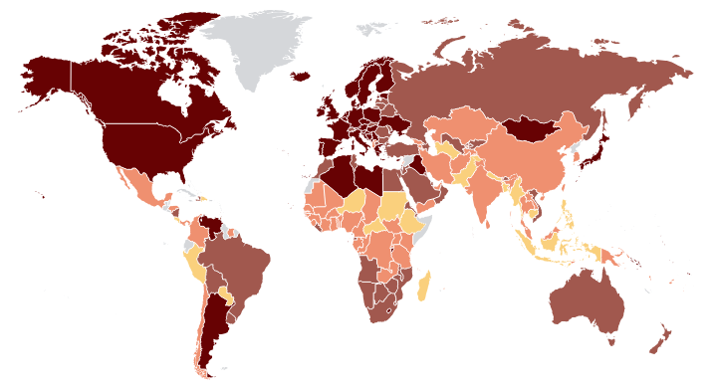
Government Expenditure as a % of GDP, 2011
40 or more
30-40
20-30
10-20
0-10
No data

Slide 4
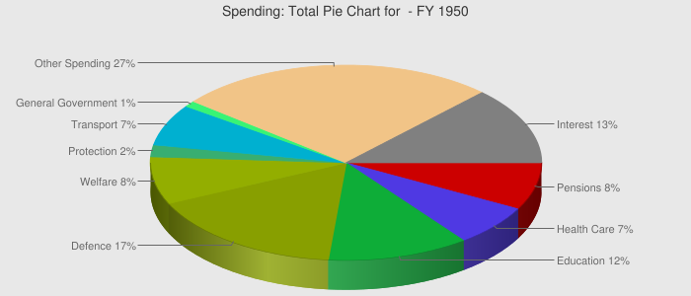
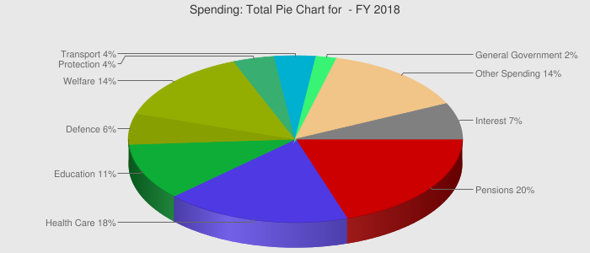
Government Expenditure, by function, UK 2018

Slide 5
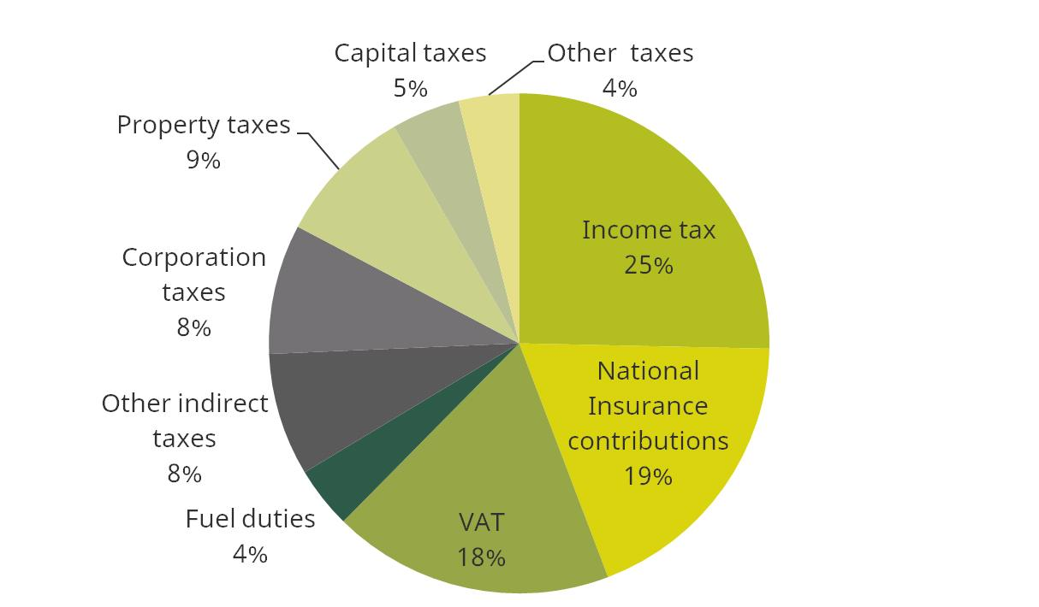
Breakdown of UK tax receipts 2017-18

Slide 6
Objectives of the module
Understand models of market failure and the necessity of government intervention
Introducing application of analytical tools to key policy issues relating to various activities of the government
Understand the importance of externalities and fiscal federalism
Understand the principles of different kinds of taxations and their impact

Slide 7
Module requirements and assessments
Technical module: Students need to be proficient in analytical tools learnt in Microeconomics and Macroeconomics.
Exam/Assessments questions will be problem based: Understanding of concepts is important.
2 assessments, each worth 10% and a final examination worth 80%

