Slide 1
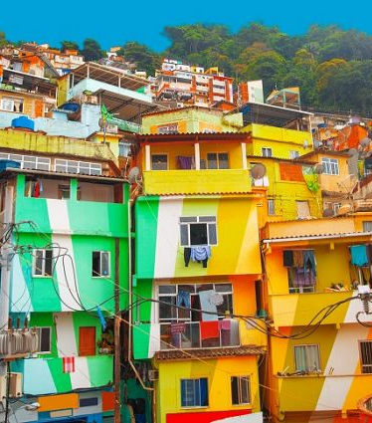
EC993 Public Policy in Developing Countries
Optional Module, MSc Economics
Term 2 2020
Lecturer: Isleide Zissimos

Slide 2
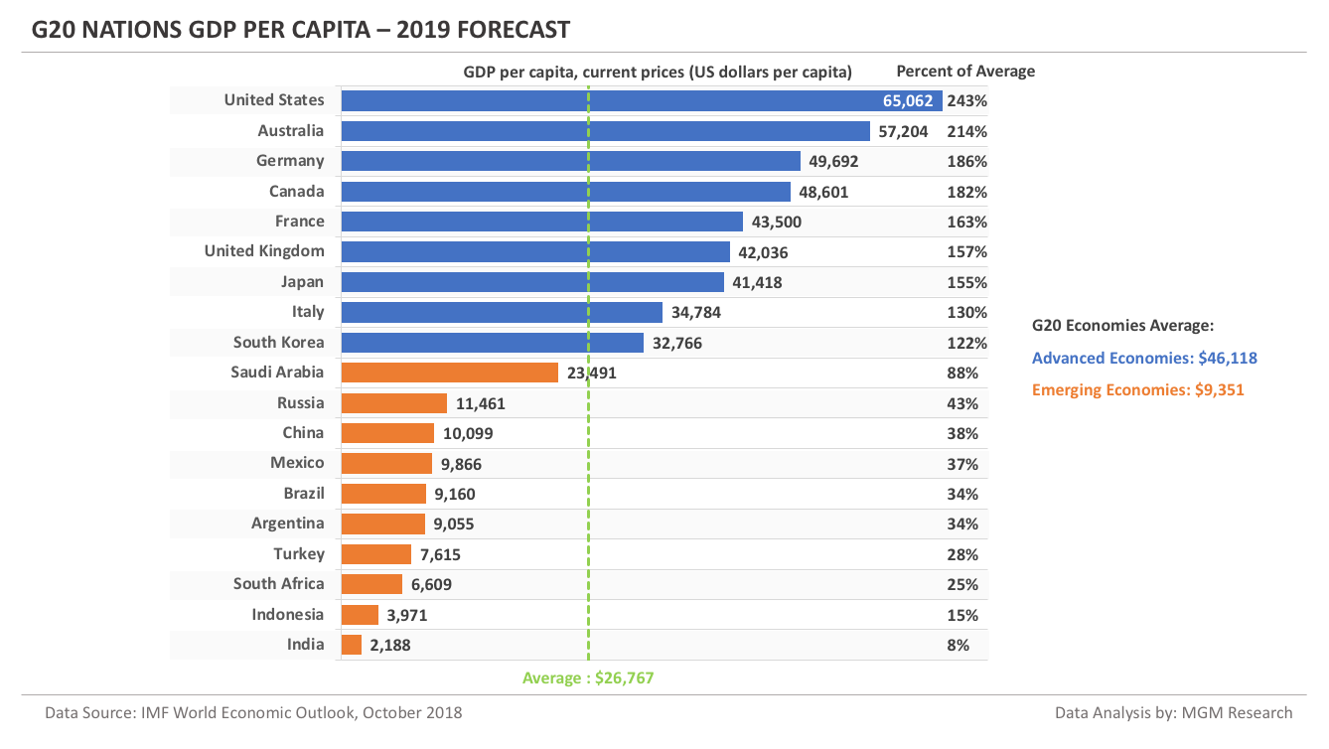
Why are some countries poorer than others?
Notes:
One of the most important questions in the field of economic development is: why some countries are much poorer than others? You might have learned in macroeconomics that differences in income per capita are due to differences in factor accumulation. What helps factors to accumulate? If you studied the Solow model you know that the differences in saving rates help factors to accumulate and if you studied the Romer model the differences in technical progress helps the accumulation of factors. Behind every economic system there is a supporting institution that helps to create the conditions for the increase in savings or technological progress, which lead to factor accumulation: This is institution is the government.

Slide 3
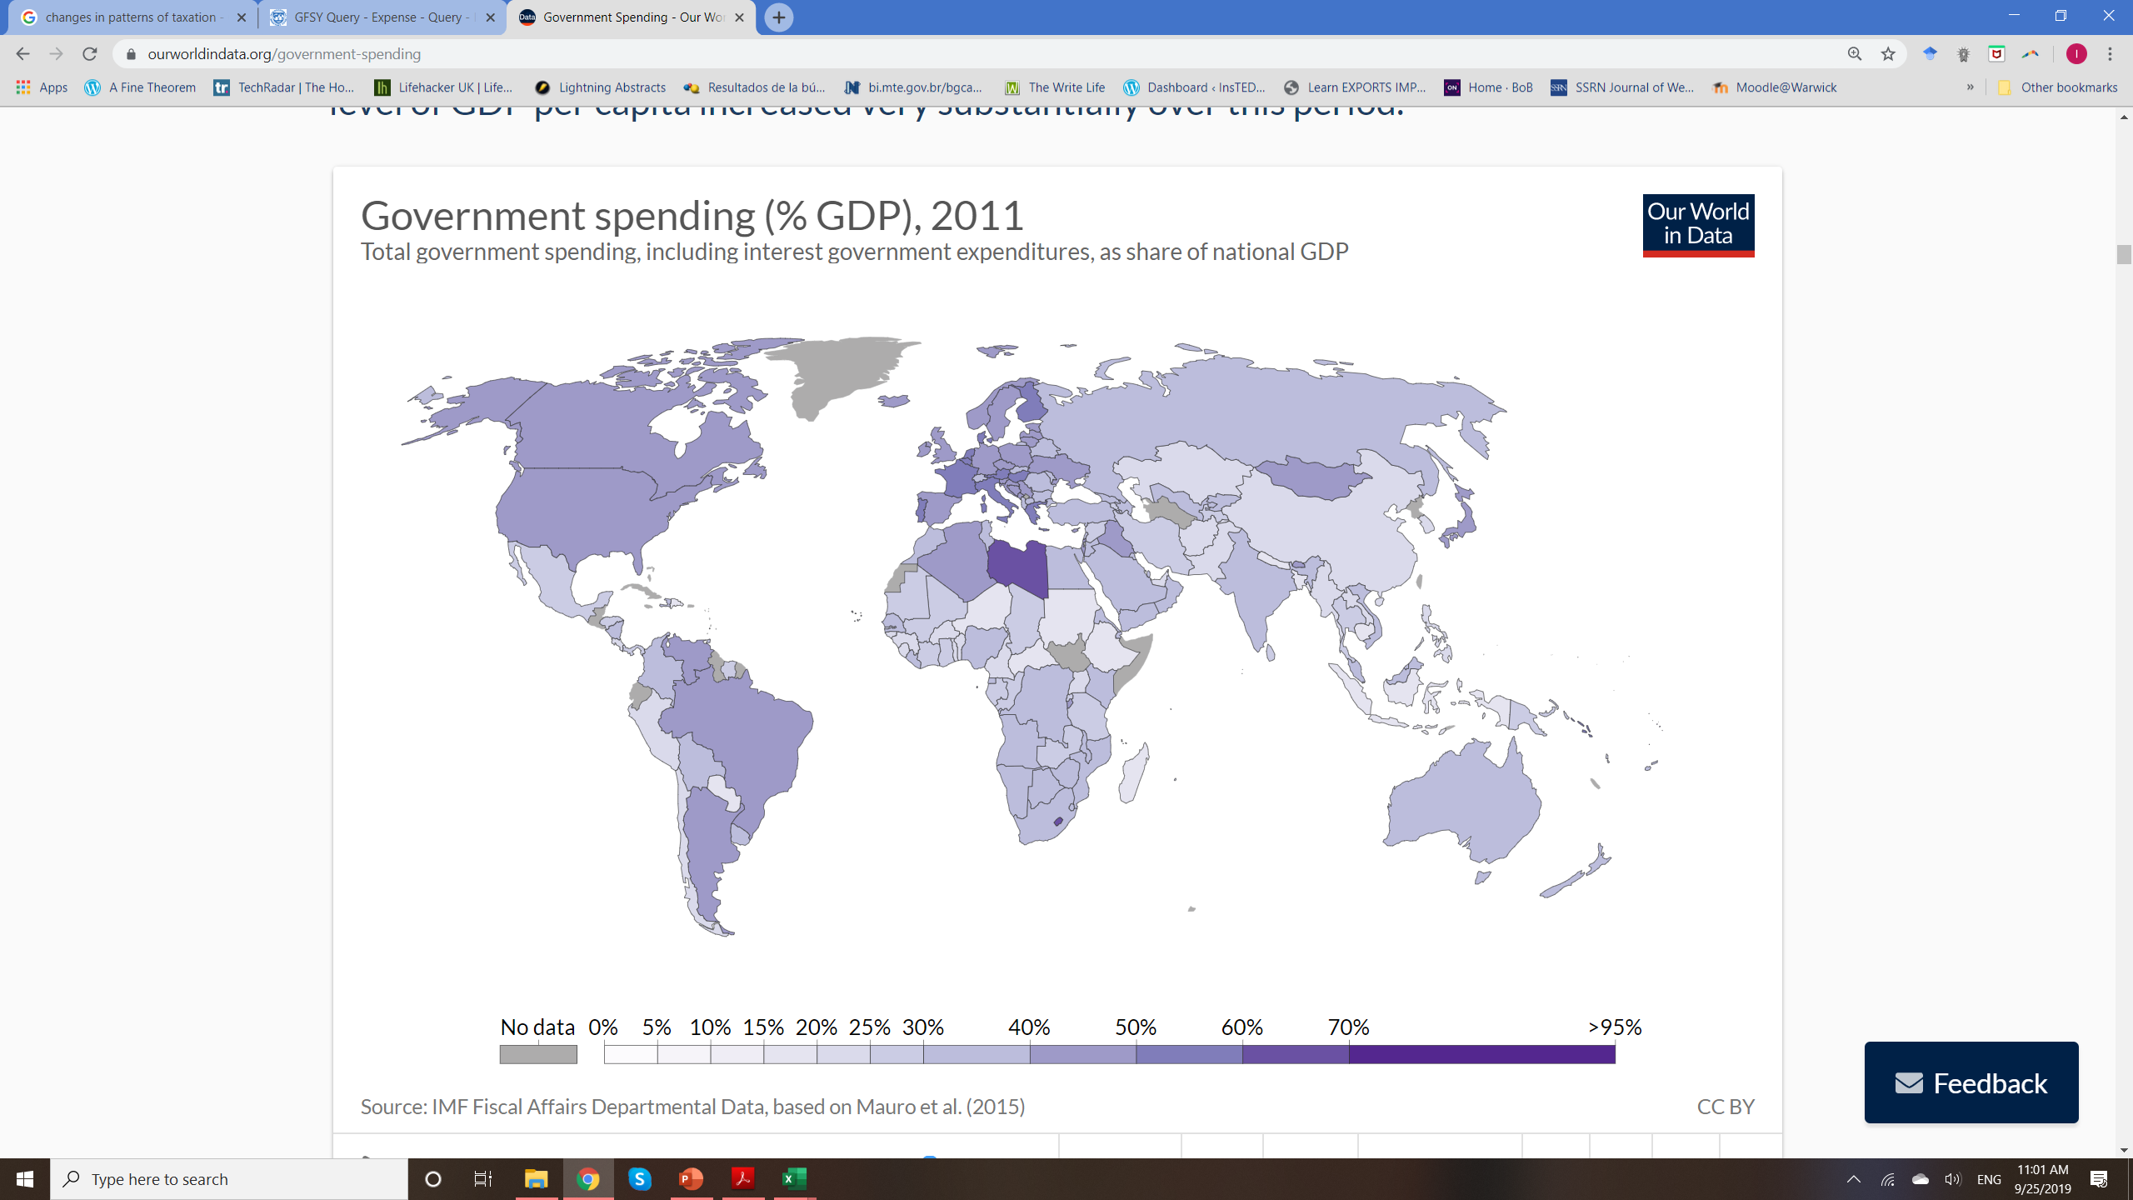
Size of the Government
Notes:
The government supports the economic system through important services: protection of property, enforcement of contracts, health, education, builds infrastructure in exchange for taxes. The map shows differences in the size of government across countries, according to total government spending. The map illustrates the correlation between the size of government and the level of development of a country. This will in turn, reflect to an extent the ability of the government to support the economic system of a country.
Clearly, the way raise the revenues that supports spending is taxation. Taxation is therefore a powerful instrument that government can use to promote the needed capital accumulation in developing countries. Used correctly it would help economies to grow at faster rates. However, in developing countries the government does not work in the same way as it does in developed countries.
Map: https://ourworldindata.org/government-spending

Slide 4
Government in Developing Countries
If governments are important for development → How to construct well-functioning government
Development indicators can be improved by public policy → E.g. Bolsa Familia in Brazil, Oportunidades in Mexico.
Economic development will require the expansion of public policies (health, education)
Government need to grow, tax more

Slide 5
Module Outline
Taxation & Development in the Long Run
Tax Compliance, Evasion, and the Informal Sector
Optimal Tax Policy in LDCs
Corruption
Redistribution and Targeting
Public Goods Provision
Public Sector Management
Notes:
Lecture 1: Taxation & Development in the Long Run
What happens to government size and tax structure as countries develop? Case study: income tax in China vs India
Lecture 2: Tax Compliance, Evasion, and the Informal Sector
What is tax compliance/tax evasion? Measurement & policy. Case studies: evasion in China, informal taxation in Indonesia
Lecture 3: Optimal Tax Policy in LDCs
What is the best way to tax in LDCs? Case studies: corporate taxation in Pakistan, VAT in Chile.
Lecture 4: Corruption
Determinants & policy. Case study: local governments in Brazil
Lecture 5: Redistribution and Targeting
What is the best way to redistribute income? Case studies: targeted transfers in Indonesia and India.
Lecture 6: Public Goods Provision
Externalities and public service deliveries. Case studies: de-worming policy in Kenya, health care in India
Lecture 7: Public Sector Management
Incentives & selection in public sector. Case studies: NGO workers in Zambia, tax collectors in Pakistan.

Slide 6
Pre-requisites?
Having taken public econ/development will help you, but not having followed these courses won't hurt you.
For development econ basics (UG level): Poor Economics, Banerjee and Duflo (see also http://pooreconomics.com/data/country/home), or Ray, Development Economics.
For public econ basics: Economics of the Public Sector, Stiglitz (US focus), Economics of the Welfare State, Barr (UK focus – public spending), Public Finance, Rosen (US focus - taxation).
Maths: derivatives, re-arranging equations.

Slide 7
Thank you!
Isleide Zissimos
Email: isleide.Zissimos@warwick.ac.uk
Office: S0.63

