Slide 1

Exams in May 2024
Briefing for MSc Economists
8 March 2024
Presenter: Alex Karalis Isaac

Slide 2
Topics for today’s briefing
Preparation for online exams
Revision guidance
Mocks (22nd April – 3rd May)
What support you can access
Exam Regulations
Degree classification
Q&A

Slide 3
Online exams for Summer 2024
Exam period: Term 3 week 3 (May Examinations) and week 4 (Summer Examinations)
Exam Timetable scheduled by the Exams Office
Common for students to have two papers on the same day, or papers on adjacent days
Online exams are accessed through WAS
Type your answers directly into editable sections, supplemented by equations and diagrams drawn and uploaded as images into the system
A recording of the December 2023 demonstration on how to use WAS has been uploaded on the Exam Resources page
Please watch the recording before your exams

Slide 4
Exams
Exam preparation
Advice and Feedback hours
Revision lectures
Study groups
Online resources
Exam rubric
Past papers

Slide 5
Exams
Mocks
All students must access the Econometrics Mock Exam Paper to practice:
Typing
Adding short mathematical expressions using the formula keypad/keyboard shortcuts
Uploading images
Submitting your work
The mock exam will be available on your WAS from 22nd April – 3rd May at 9.30am each day.
We will take into account if you did a mock when reviewing claims for mitigating circumstances

Slide 6
Exams
Preparation in advance of the exam
Revision strategies
Preparing for exam writing
Strategies during the exam
Time management
Choosing and answering the question

Slide 7
Exams
Revision process has three or more phases
E.g. 1
Phase 1: Information gathering
Phase 2: Revisit and remodel notes
Phase 3: Past papers
E.g. 2 (metrics)
Prob sets with notes
Prob sets without notes
Past exam questions
Study group compare to solutions

Slide 8
Exams
Before the day / on the day
Check start time
If you have previously arranged it with Disability Services, you will see extra time has been allocated for your exam
Use Google Chrome or Mozilla Firefox to access WAS
Equipment: we advise that you don’t use phones or tablets unless you have an external keyboard because formula shortcuts don’t work with onscreen keyboards
Make sure no computer updates are scheduled
Make sure your laptop is fully charged

Slide 9
Exams
Before the day / on the day
Log into WAS again before the exam starts (the browser will time out after 8 hours and you won’t be able to submit your work)
Read the instructions
Answer the correct number of questions
A PDF question paper can be downloaded once the exam starts

Slide 10
Exams
Before the day / on the day: Academic Integrity
Explain your answers in your own words. Copying text/graphs/equations from any source, including lecture notes or solutions in Moodle, is plagiarism.
You can include graphs you have drawn yourself.
Colluding or being in contact with other students also constitutes a breach of academic integrity.
Using translation websites/AI chat tools is a breach of academic integrity.
Within the WAS you will be asked to declare that you have read and understood our academic integrity expectations
Last year we investigated 35 students for possible misconduct in exams, we applied penalties (reduction in mark) to 26 students.

Slide 11
Exams
Time management in the exam
Plan your time carefully
- e.g. 4 questions in 3 hours (180 minutes):
- 10 minutes choosing questions
- 40 minutes per question
- 10 minutes checking time at the end
Do your time management planning in advance
Write down the finishing time for each question and keep to it
- if necessary come back to the question later

Slide 12
Exams
Time management in the exam
Make sure you used the full 25 minutes to upload images
Clearly label your images so you know where to put them
You can upload as you go or at the end – this will be different for everyone
Save time at the end to make sure you have included all your images
If you have not submitted your work by the deadline then it will be automatically submitted in WAS
We will not mark images sent by email that you have forgotten to include

Slide 13
Exams
Choosing your questions
Read through the whole paper, not just the parts that you think you might be interested in.
Read carefully/ read carefully again/ check after a few minutes.
If you need to answer a question from each section, glance through all the topics to give yourself as wide a choice as possible.
Pay attention to allocation of marks.
Don’t waste too much time choosing questions, but choose carefully – then don’t change your mind!

Slide 14
Exams
What is the question asking?
Read through the information carefully
Identify the problem that needs to be resolved
Select the model/formulae that need to be applied
Accurate working and attention to sequence and detail
Set out clearly and legibly
Generate ideas: e.g. mindmap
Make a plan/structure: Key Words
Identify formulae and equations presented in words
Check you have answered all aspects of the question
If you are asked to make comparisons, don’t simply describe the two approaches. Draw out any similarities or differences

Slide 15
Exams: written answers
What is the question asking?
Introduction: context, your approach (what, how & why), refs
Main Points: all aspects of question / logical order / different points of view (critical approach)
Conclusion: sum up answer – justify your view
Different to writing assignment essays
Need to reference but not to same extent
Less time, therefore less information
Concise structure
Choose any structure that enables you to prove a point (thesis statement)

Slide 16
Exams: typesetting maths?
Large chunks of handwritten text as an image are not acceptable - academic integrity
But derivations and graphs are better as images of handwritten material than typeset text
Time limitation. DON’T snapshot lecture notes/online derivations.
Simple expressions and symbols are available in the formula keypad or via the keyboard shortcuts. The shortcuts shown on the next page have been uploaded to the exam resources webpage. Practice before the exams!

Slide 17
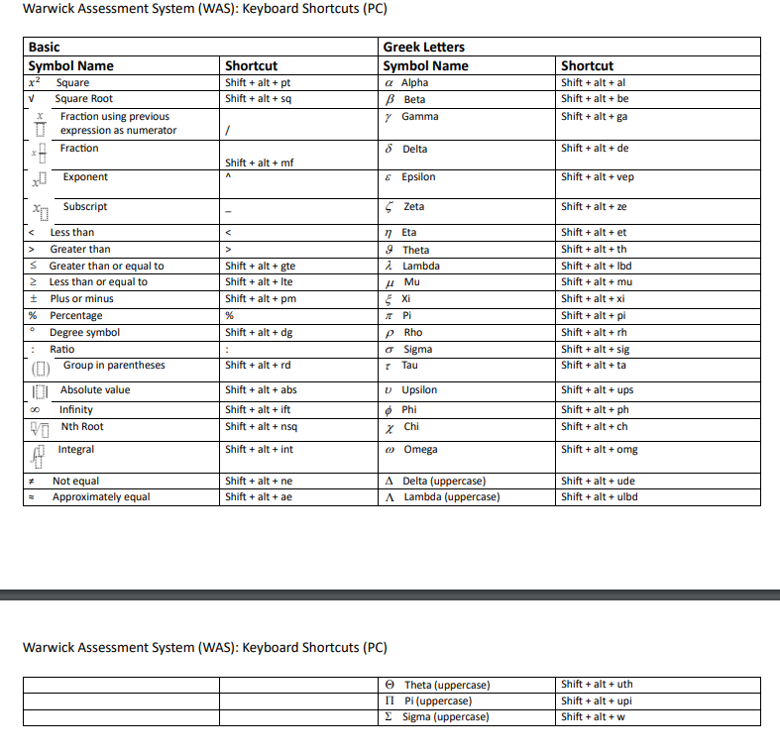

Slide 18
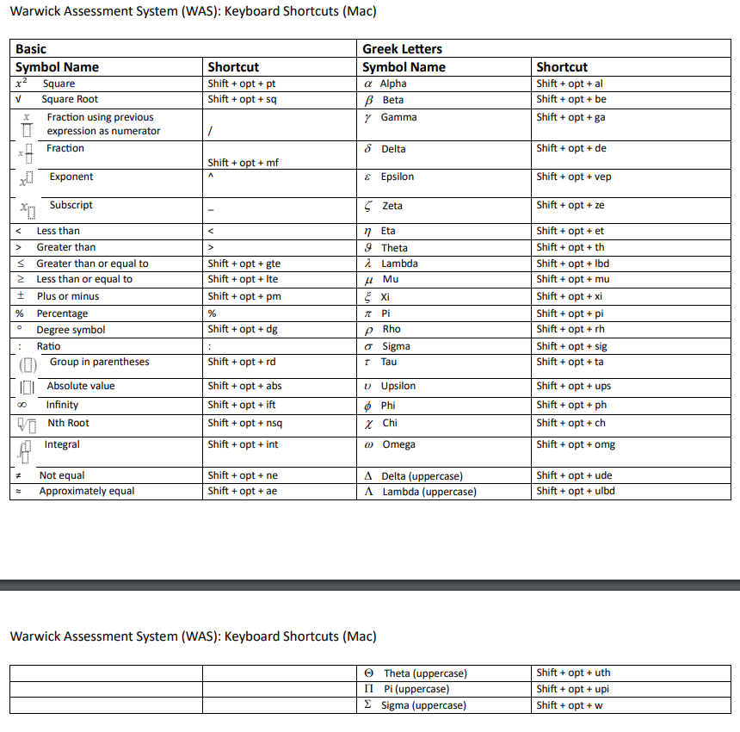

Slide 19
Exams
Some common errors/problems
Poor choice of question
Answers not properly structured
Waffle and repetition
Not answering the question
Not showing a critical approach
Writer’s block
Lack of confidence
Finishing early
Make some time to plan how to avoid these

Slide 20
Exams
Some common errors/problems
Don’t use the 25 minutes upload period to keep working on your exam
Don’t email images to yourself as this can be slow
We have suggested some ways to transfer images in the Exams Briefing (slide 19), or you could photograph handwritten work using your laptop camera
PDF files can’t be uploaded as images in WAS – use JPEG

Slide 21
Exams
Submitting your paper
It is possible to work in WAS without an internet connection, but you must be connected to submit your work
If you have lost your connection at the exam deadline, leave open the WAS browser and your work will automatically submit once the connected is re-established - you won’t be able to change your answers
If auto-submit doesn’t work when you have an internet connection, then:
click the green Download Paper button on the top right-hand side of your screen
log out of WAS and back in again

Slide 22
Exams
Technical issues
If you are unable to finish because of a problem, email economics.pgoffice@warwick.ac.uk before the exam ends and we will extend your deadline by 15 minutes
Requests to extend the time after the end of the exam will not be accepted
Submit a claim via Tabula Personal Circumstances, providing information about the issue and timestamped evidence
Submitting a paper late without supporting evidence could lead to a zero mark
If you cannot submit in the 15 minutes window, or did not tell us you had an issue before the end of the exam, then you will be offered a September resit or further first attempt if the module is failed
Notes:
If you are experiencing technical problems, and are seeking an extension of upload time due to tech issues, YOU MUST CONTACT THE PGO WITHIN THE WAS EXAM TIMEFRAME
This is the only way your upload time can be extended. You must email PGO, not system administrators. At the upload deadline PGO lose the ability to extend uploads and won’t do it for any requests received even 1s after the exam closes.
This means the last 2-3 mins are for the computer. If you realise at the end of the 25min that your uploads are not working we cant help you. Start upload within time and email within time if there is a problem.
Because your upload time is extended, does not mean claim of tech mits has been accepted. Once the script is uploaded you must follow the steps in tabula and we will consider the claim at the board.
In any other way the upload time will finish as normal and you will face FFA or resit as appropriate, depending on mits.
You have to tell us for extensions to uploads, not the WAS system administrators. Priority is inform PGO. (Raise with WAS is helpful for their development processes)

Slide 23
Exams
Some final words of advice
The first 50% of marks is easiest to obtain
Next 25% more difficult
Last 25% most difficult
If you are running out of time, two half answers may be worth more than one whole
Spend last 10 mins checking your work
- numbered all answers
- spelling
- handwriting
- all steps in calculation shown

Slide 24
Exams Support available: Exam Resources web page
The first place to check is our Exams Resources page
Here, you will find a range of useful resources which you should look at in preparation for your exams
It includes:
Exam briefing and WAS demonstration
Student guidance
Keyboard shortcuts
Technical Mitigating guidance
Exam instructions
FAQs on exams

Slide 25
Exams Support available: more sources of support
Your module Moodle pages for module content
Academic Staff via Advice and Feedback hours
Pastoral support sessions
Your Personal Tutor; Senior Tutor (Mahnaz Nazneen)
Wellbeing Support Services
MSc Handbook
The PG Office: economics.pgoffice@warwick.ac.uk
During the exam: links are provided in WAS that enable you to contact the invigilator or access technical support

Slide 26
Exam Regulations
Mitigating Circumstances
All cases must be submitted through personal circumstances in Tabula
Circumstances must be declared at the time they occurred and before the June Exam Board (deadline 24 May 2024)
Claims for technical mitigation must be submitted within 5 working days of an exam with supporting evidence
A second claim for technical mitigating circumstances is unlikely to be accepted because you should already be familiar with the WAS system
Further guidance on mitigating circumstances is available in the MSc Handbook
Notes:
Time stamped evidence is key

Slide 27
Exam Regulations
June Exam Board
Comprises 4 academic staff from Economics, members of academic staff from other departments for joint programmes, and three external examiners
Results will be released towards the end of June
Module pass mark is 50%
Students who have failed an exam, but passed the module, will not need to resit
The mean mark for our core modules is typically around 62%
To obtain a mark of 70, your work needs to be very good
Although we do use the full marking scale of 0% to 100%, in practice marks of above 80 are quite rare (<10%, typically)

Slide 28
Exam Regulations
Resits
28 August - 10 September 2024
For modules with exams the reassessment method is normally 100% examination
Resit module mark is capped at 50%.
If you need to sit/resit an exam in September, then your dissertation can be deferred until March 2025.
Detailed information about the exam schemes is given in the MSc Handbook
To help you reflect on your performance, all students will be provided with generic feedback on the main examinations (January and Summer) after the resits.

Slide 29
Exam Regulations
November Board
The Board determines if you will be:
Awarded the degree
Awarded the degree with Distinction or Merit classification
Permitted to resubmit the dissertation
Awarded a PG Diploma/PG Certificate
Not awarded the degree or an exit award
We also give prizes for the best performance
Graduation for most students will be in January 2025

Slide 30
Degree classification
Classification is to one decimal place
69.8/69.9 is a Merit unless you meet all three of the borderline criteria:
Weighted average within 2 percentage points of the borderline
At least 50% of weighted credits are above the class boundary
EC959 or PS916 total module mark is above the class boundary
Degree | Mark Range
Distinction | M ≥ 70.0%
Merit | 69.9% ≥ M ≥ 60.0%
Pass | 59.9% ≥ M ≥ 50.0%
Fail | M ≤ 49.9%

Slide 31
Thank you
Questions?

