Slide 1
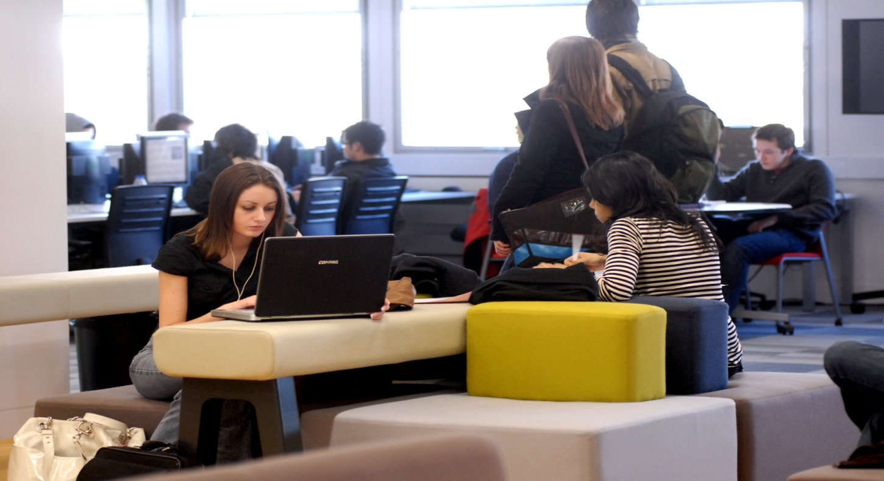
Economics BSc Library induction - Welcome to the Library!

Slide 2
What this induction will cover
Library facilities and services
How to find books and journals – Library Search
Your Library account
Accessing databases

Slide 3

But firstly…

Slide 4
Where can you find help?
Library website
Library Help Desk on Floor 1
IT Services help desk on Floor 1, for help with printing or PC problems
Your Academic Support Librarian – guidance with subject-specific enquiries

Slide 5
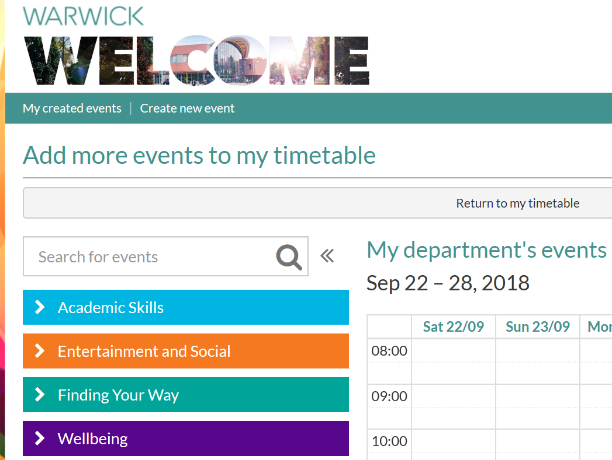
GET STARTED – sign up for a Library tour on the Welcome Week website!

Slide 6
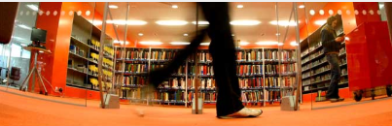
Follow Get Started online when Term has begun https://warwick.ac.uk/services/library/using/help/new-users/

Slide 7
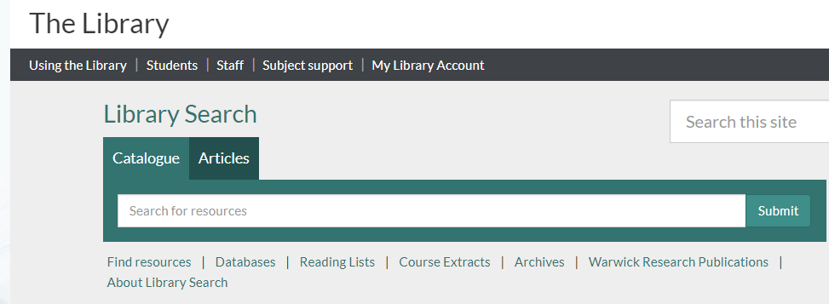
Subject support for Economics students

Slide 8
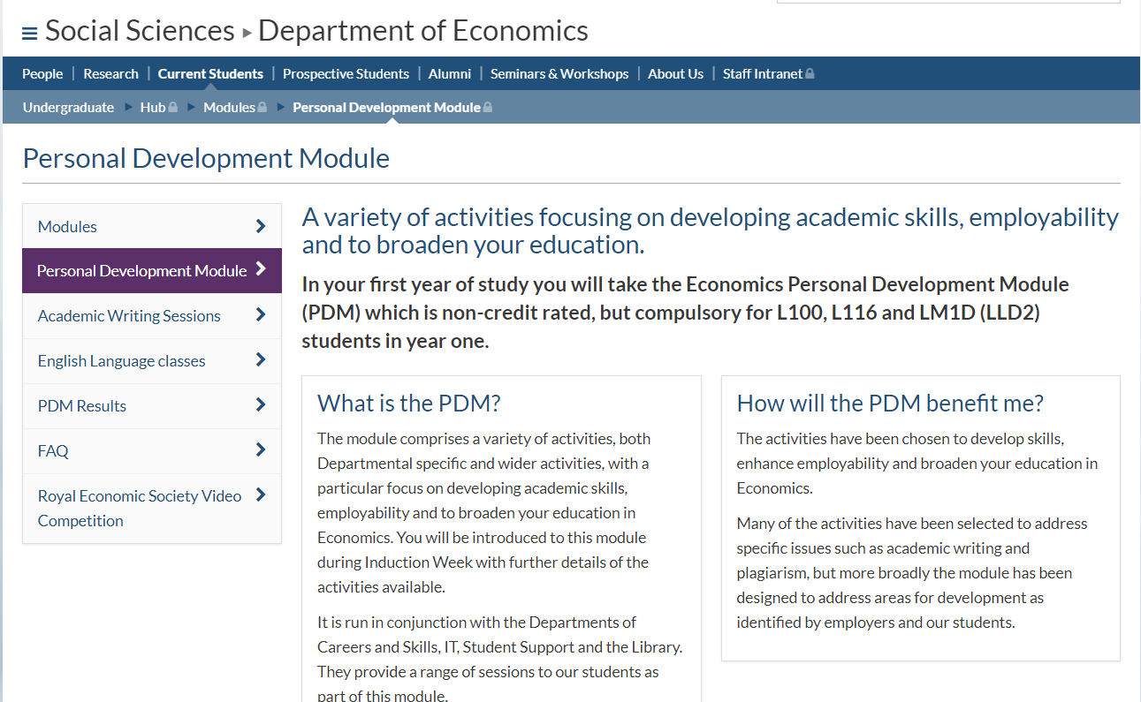
Help with referencing & avoiding plagiarism – see your Personal Development Module

Slide 9
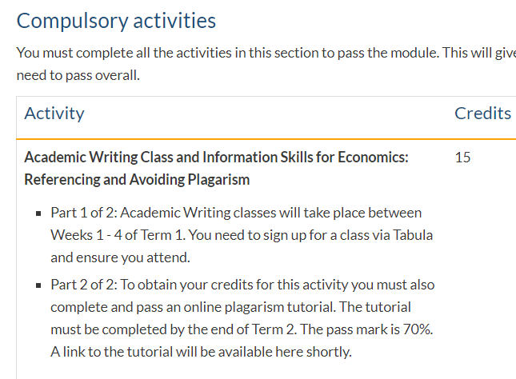
Compulsory, along with an academic writing class

Slide 10

Library facilities
Different study areas to meet your needs
Quiet study areas, and 2 silent reading rooms
Informal group study areas on Floors 1 and 2
PCs and wireless access to the Internet
You may also bring in hot or cold drinks and
cold food

Slide 11
Opening hours?
Main Library open 24/7
Staffed services from 8.30 a.m. to 9.30 p.m.
The Learning Grid in University House, 7 a.m. to 10 p.m. daily
Learning Grid Rootes and Learning Grid Leamington, open in term time

Slide 12
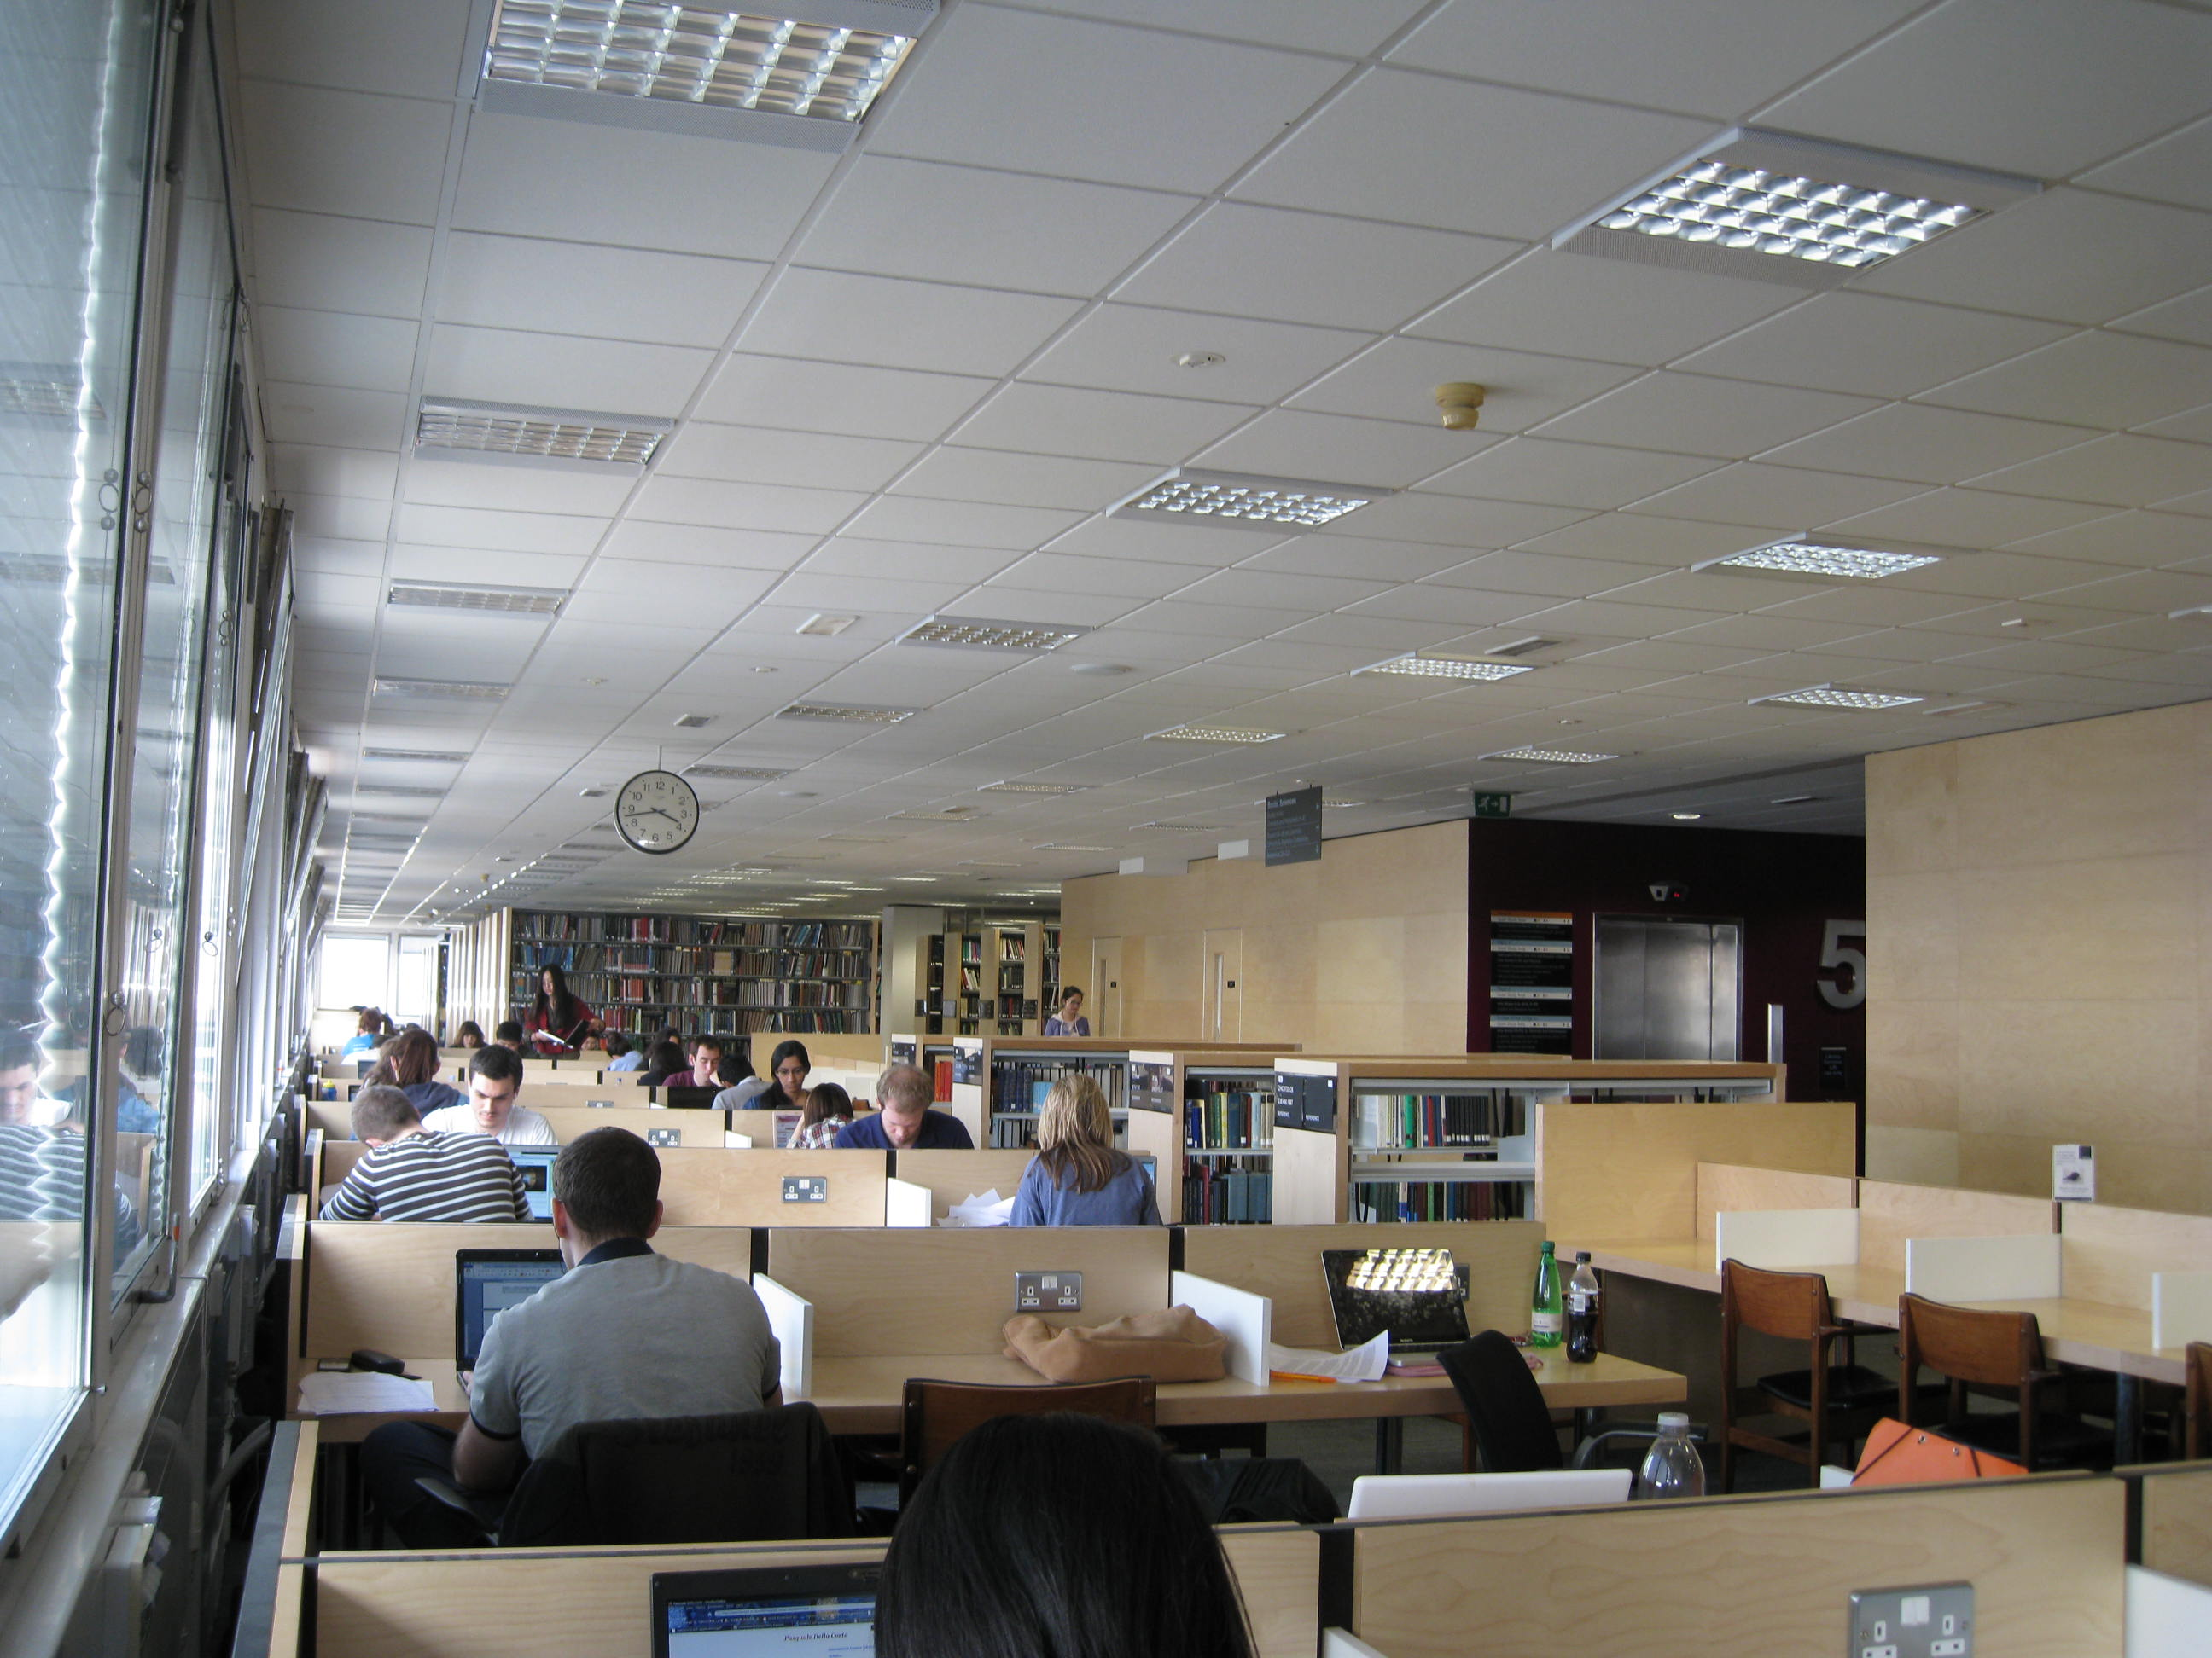
Traditional library areas for quiet study

Slide 13
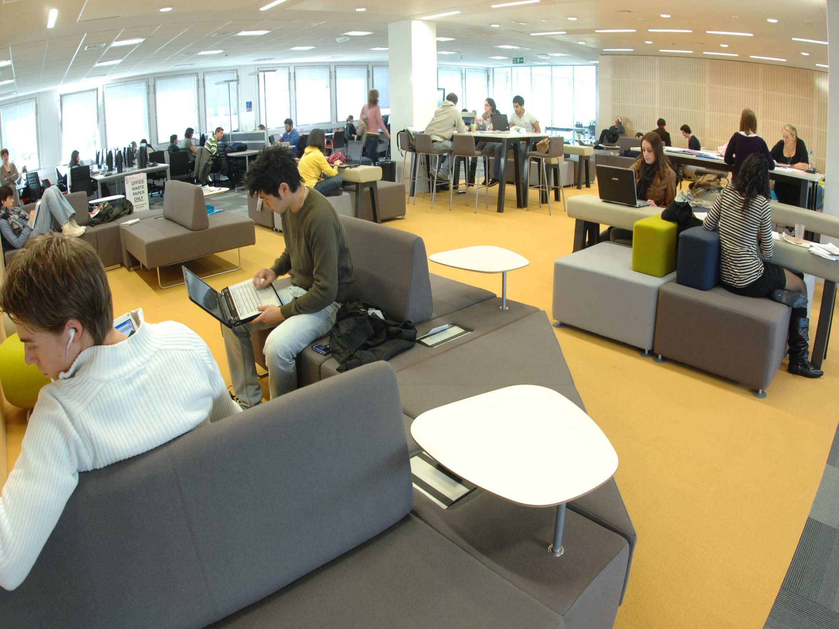
Social areas for group study

Slide 14

Finding and borrowing books

Slide 15
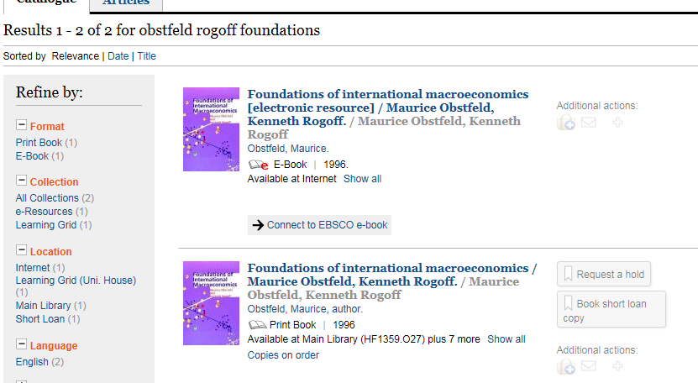
Search the catalogue and select the link to the title you want -

Slide 16
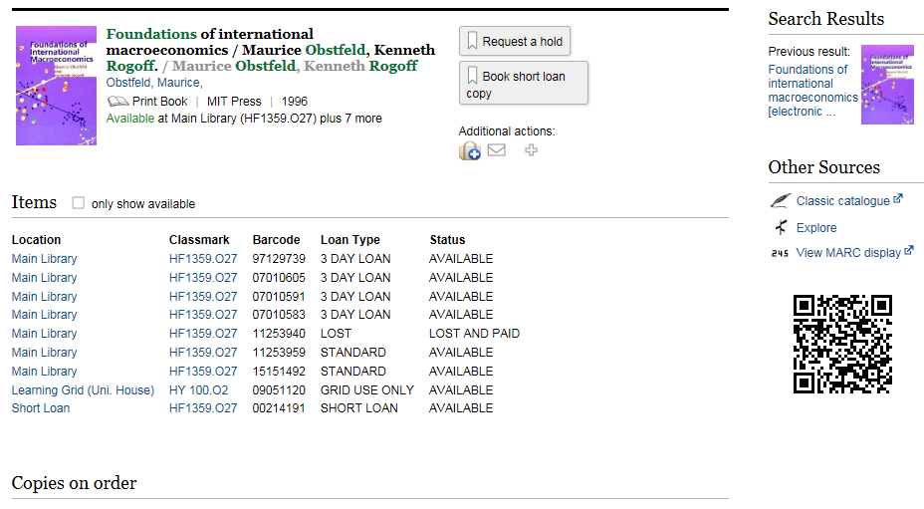
Note the location; the classmark (the number on the spine of the book); loan type and status

Slide 17
Where are the books???
Floor 2 extension – Maths, Science and Medicine
Floor 3 – Arts and Humanities
Floor 4 – Law and Education, plus UK Government publications, the European Documentation Centre and printed statistics
Floor 5 – Social Sciences, including Economics, Business and more!

Slide 18
Reference stock in print
Economics dictionaries and encyclopedias on Floor 5
Economics journals are on Floor 5 with other Social Science titles, arranged by title, A-Z
Journals published before 2000 are in the Library store

Slide 19
Other locations, e.g.
Pamphlets – small books kept in boxes, on the same floor, in a separate section
Oversize - tall books shelved separately, on the same floor
Short Loan – Floor 1
Learning Grid – reference copies of textbooks, in University House
Store – use the online request form to have material fetched
Always check the location details!

Slide 20

Borrowing books - key facts…
You may borrow up to 15 books at one time, (20 in your final year)
Plus 2 from the Short Loan collection (overnight or for a weekend)
Standard loan = 2 weeks; plus copies for 3-day loan
Watch out for fines – it pays to bring books back on time
Short Loan fines are the highest - £1 per hour or part of hour
Please bring the books back on time to avoid
fines!

Slide 21
More tips on borrowing books
Reminders - we will send a message to your Warwick e-mail one day before your book is due back
You can extend a loan by renewing your book online, as long as no other student has placed a hold on it
Recalls – we also e-mail you if another student has placed a hold on a book which you have borrowed – you will have one week to return it, if it is a standard loan copy

Slide 22
What if someone else has the book you need?
You can place a hold on the book, online
We ask the other reader to return it within one week
Check your University e-mails to see when the book is available to pick up
It will be shelved in the Short Loan area for you to collect

Slide 23

Check your University e-mails and your Library account frequently!

Slide 24

Your Library Account
Shows which books you have borrowed and when they are due back
Allows you to renew your loans
Tells you which books you have on hold – reservations
Gives details of any fines owing
Check it regularly and you need never incur a fine at all!

Slide 26
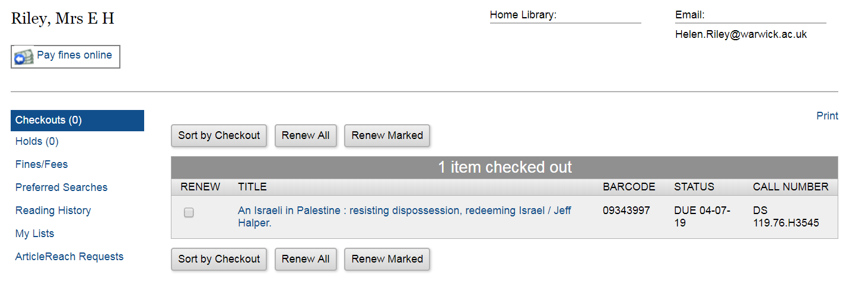

Slide 27
Databases are a great way to find…
Journal articles
Books
Statistical data
Newspapers

Slide 28
Access electronic resources through the Library website with your IT Services login

Slide 29

Top tip - never pay to download an article from an internet site – it can cost £30 or more!
Use Library Search to see if we take the journal in which the article was published
Try Article Reach to obtain it free from another Library
Or contact me to help you find alternative good articles, also completely free

Slide 30
You can always contact your librarian through the Library website ☺
E-mail is the easiest way to contact me
You can also phone or ask staff at the Floor 1 help desk to see if I am free
helen.riley@warwick.ac.uk
Direct phone number 02476 572712
E-mail Library@Warwick.ac.uk for general questions

