Slide 1
Lecture 1: How Deep Are the Roots of Economic Development?
Romain Wacziarg UCLA and NBER (based on joint work with Enrico Spolaore)
Summer School on Economic Growth,
University of Warwick, July 2013

Slide 2
Two Recessions
Peak to trough, US GDP in the Great Recession fell by a cumulative 4%.
PPP Income per Capita in Norway - the richest country in the world - in 2008 was $61,460, according to World Bank data.
PPP Income per Capita in Congo (Zaire) - the poorest country in the world - in 2011 was $340.
“Peak to trough”, that “recession” involves a total income difference of 18,000%.
The problem of development dwarfs the problem many have been worrying about recently, as serious as it seems.
Today I would like to focus attention on the determinants of long run economic growth…

Slide 3
The Perennial Question
What accounts for these vast differences in income per capita?
Decades ago, the emphasis was on the accumulation of factors of production and exogenous technological progress.
Later, the focus switched to policies and incentives endogenously affecting factor accumulation and innovation.
More recently, the attention has moved to the institutional framework underlying these policies and incentives.
The question remains as to why the proximate determinants of the wealth of nations vary across countries.

Slide 4
A Schematic View of Development
Accumulation of factors
Technological innovation or adoption
Geography
Deep history
Policies giving the “right” incentives
Institutions
Development

Slide 5
A Schematic View of Development
(with minor complicating factors)
The exclusion restrictions
Accumulation of factors
Technological innovation or adoption
Geography
Deep history
Policies giving the “right” incentives
Institutions
Development
Reverse causality

Slide 6
Focus of the Session
I survey recent findings on history and development, focusing on a small set of recent empirical contributions.
I employ a unified empirical framework to summarize these findings.
I start with contributions that demonstrate the long run persistence of economic performance.
I argue that the persistence can be understood as the result of the intergenerational transmission of traits that matter for development.
I discuss the mechanisms by which intergenerational transmission can affect economic outcomes.

Slide 7
Two Big Innovations
The Neolithic Revolution
  Agriculture was actually “invented” about 7 times.
  The most significant was the discovery of agriculture in the Fertile Crescent about 7,000-9,000 years BC – source of the Eurasian explosion.
  These discoveries spread through Eurasia, Africa and the Americas.
The Industrial Revolution
  “Invented” only once, in Northwestern Europe, in the late 18th Century (Mokyr, 2005).
  That discovery is still spreading.

Slide 8
Persistence
Technology and productivity tend to be highly persistent even at very long horizons.
The Neolithic advantage continues to have effects on productivity and income per capita in more recent times, consistent with Jared Diamond’s hypothesis.
Countries using the most advanced technologies in the year 1,000 B.C. tend to remain the users of the most advanced technologies in 1,500 and today, particularly if we correct for their populations’ changing ancestry (Comin, Easterly and Gong, 2010).

Slide 9
Central Theme: Ancestry Matters
To explain persistence, ancestry matters.
A growing body of new empirical work has focused on the measurement and estimation of long-term effects of historical variables on contemporary income by explicitly taking into account the ancestral composition of current populations.
Traits affecting development are transmitted from one generation to the next within populations over the long run, explaining why deep historical factors still affect outcomes today.

Slide 10
Main Themes – and Outline
There is a lot of persistence in development outcomes and technological sophistication.
Persistence stems from intergenerational links: ancestry matters.
The mechanisms through which ancestral links matter can take a wide variety of forms and can involve complex interactions between genes and culture.
Persistence can occur because of barriers to the transmission of technologies (broadly understood), an idea that is too often overlooked.

Slide 11
Main References
On long-term effects of geography: Jared Diamond (1997), Olsson and Hibbs (EER, 2005) and Ashraf and Galor (AER, 2011)
On reversal of fortune and role of European colonization: Acemoglu, Johnson and Robinson (QJE, 2002), Easterly and Levine (2012)
On ancestry-adjusted variables: Putterman and Weil (QJE, 2010), Comin, Easterly and Gong (AEJ: Macro, 2010).
On genetic distance, barrier effects and development: Spolaore and Wacziarg (2009, 2011, 2013, 2014) – mostly in the next lecture.

Slide 12
Diamond
  Deals both with the onset and the diffusion of the Agricultural Revolution.
  Both onset and diffusion are linked to geographic characteristics of Eurasia:
    Large land mass, diversity of plant and animal species, larger population (conducive to innovation).
    The horizontal shape of Eurasia facilitates the diffusion of agricultural innovations from their source in the Middle East.
  This explains Eurasia’s long term civilizational “advantage”: greater incomes, ability to conquer others, and ultimately development of industry. This all persists till today.
  The explanation underplays human/cultural factors. Nowhere do the characteristics of human populations enter either on the onset or on the diffusion fronts.

Slide 13
Table 1 – Geography and Contemporary Development
(dependent variable: log per capita income, 2005)
 | (1) | (2) | (3) | (4) | (5) | (6)
Sample: | Whole World | Olsson-Hibbs sample | Olsson-Hibbs sample | Olsson-Hibbs sample | Olsson-Hibbs sample | Old World only
Absolute latitude | 0.044 | 0.052
 | (6.645)*** | (7.524)***
% land area in the tropics | -0.049 | 0.209 | -0.410 | -0.650 | -0.421 | -0.448
 | (0.154) | (0.660) | (1.595) | (2.252)** | (1.641) | (1.646)
Landlocked dummy | -0.742 | -0.518 | -0.499 | -0.572 | -0.505 | -0.226
 | (4.375)*** | (2.687)*** | (2.487)** | (2.622)** | (2.523)** | (1.160)
Island dummy | 0.643 | 0.306 | 0.920 | 0.560 | 0.952 | 1.306
 | (2.496)** | (1.033) | (3.479)*** | (1.996)** | (3.425)*** | (4.504)***
Geographic conditions |  |  | 0.706 |  | 0.768 | 0.780
(Olsson-Hibbs) |  |  | (6.931)*** |  | (4.739)*** | (5.167)***
Biological conditions |  |  |  | 0.585 | -0.074 | 0.086
(Olsson-Hibbs) |  |  |  | (4.759)*** | (0.483) | (0.581)
Constant | 7.703 | 7.354 | 8.745 | 8.958 | 8.741 | 8.438
 | (25.377)*** | (25.360)*** | (61.561)*** | (58.200)*** | (61.352)*** | (60.049)***
Observations | 155 | 102 | 102 | 102 | 102 | 83
Adjusted R-squared | 0.440 | 0.546 | 0.521 | 0.449 | 0.516 | 0.641

Slide 14
Table 2 – Geography and Development in 1500
 | (1) | (2) | (3) | (4)
Dependent Variable: | Years since agricultural transition | Population density in 1500 | Population density in 1500 | Population density in 1500
Estimator: | OLS | OLS | OLS | IV
Absolute latitude | -0.074 | -0.022 | 0.027 | 0.020
 | (3.637)*** | (1.411) | (2.373)** | (1.872)*
% land area in the | -1.052 | 0.997 | 1.464 | 1.636
Tropics | (2.356)** | (2.291)** | (3.312)*** | (3.789)***
Landlocked | -0.585 | 0.384 | 0.532 | 0.702
Dummy | (2.306)** | (1.332) | (1.616) | (2.158)**
Island dummy | -1.085 | 0.072 | 0.391 | 0.508
 | (3.699)*** | (0.188) | (0.993) | (1.254)
Number of annual or | 0.017 | 0.030
perennial wild grasses | (0.642) | (1.105)
Number of domestic- | 0.554 | 0.258
cable big mammals | (8.349)*** | (3.129)***
Years since agriculture |  |  | 0.426 | 0.584
transition |  |  | (6.694)*** | (6.887)***
Constant | 4.657 | -0.164 | -2.159 | -2.814
 | (9.069)*** | (0.379) | (4.421)*** | (5.463)***
Observations | 100 | 100 | 98 | 98
Adjusted R-squared | 0.707 | 0.439 | 0.393 | -

Slide 15
Lessons from Diamond et al.
  The onset of the First Big Innovation is due to geography.
  The long term diffusion of the First Big Innovation was determined by geographic barriers.
  The Agricultural Revolution conferred to Eurasians advantages that propelled them to the World Technology Frontier at least until 1492, and arguably accounts for their continued success thereafter.
  There is persistence in economic success, due to initial geographic factors.
  But…

Slide 16
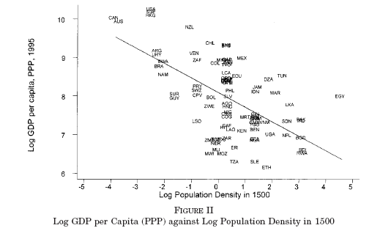
Reversal of Fortune: A Problem for Diamond?
Source: Acemoglu, Johnson, Robinson (QJE 2002)
This picture does not square well with a simple geography story
This is for a sample of former colonies only…

Slide 17
Table 3 – Reversal of Fortune
(dependent variable: log per capita income, 2005)
 | (1) | (2) | (3) | (4) | (5) | (6) | (7) | (8)
Sample: | Whole World | Europe Only | Former European Colony | Not Former European Colony | Non Indige-nous | Indige-nous | Former European colony, Non Indige-nous | Former European colony, Indige-nous
 | With European Countries
Log of pop. density, | 0.027 | 0.117 |  | 0.170 |  | 0.193
1500 | (0.389) | (1.276) |  | (2.045)** |  | (2.385)**
Beta coefficient on 1500 density | 3.26% | 22.76% |  | 22.34% |  | 20.00%
Observations | 171 | 35 |  | 73 |  | 138
R-squared | 0.001 | 0.052 |  | 0.050 |  | 0.040
 | Without European Countries
Log of pop. density, | -0.246 |  | -0.393 | -0.030 | -0.232 | -0.117 | -0.371 | -0.232
year 1500 | (3.304)*** |  | (7.093)*** | (0.184) | (2.045)** | (1.112) | (4.027)*** | (2.740)**
Beta coefficient on 1500 density | -27.77% |  | -47.88% | -3.08% | -32.81% | -11.72% | -51.69% | -26.19%
Observations | 136 |  | 98 | 38 | 33 | 103 | 28 | 70
R-squared | 0.077 |  | 0.229 | 0.001 | 0.108 | 0.014 | 0.267 | 0.069

Slide 18
Ancestry Adjustment
A focus on populations rather than locations helps us understand both persistence and reversal of fortune, and sheds light on the spread of economic development.
The need to adjust for population ancestry is at the core of Putterman and Weil’s contribution, showing that current economic development is correlated with historical characteristics of a population’s ancestors, including ancestors’ years of experience with agriculture, going back, again, to the Neolithic transition.

Slide 19
Putterman & Weil / Easterly & Levine
“History” is summarized by:
  Formal political organization (a supra-tribal state) between year 0 and year 1500 (discounted backwards) - statehist
  Agriculture, measured by the number of years (in thousands) since the country adopted agriculture – agyears.
History so defined has a strong effect on current income per capita
A twist: it is not so much the past history of geographic locations that could matter, but the history of ancestor populations (“history” is adjusted for migration)
Among those, Europeans play a central role.

Slide 20
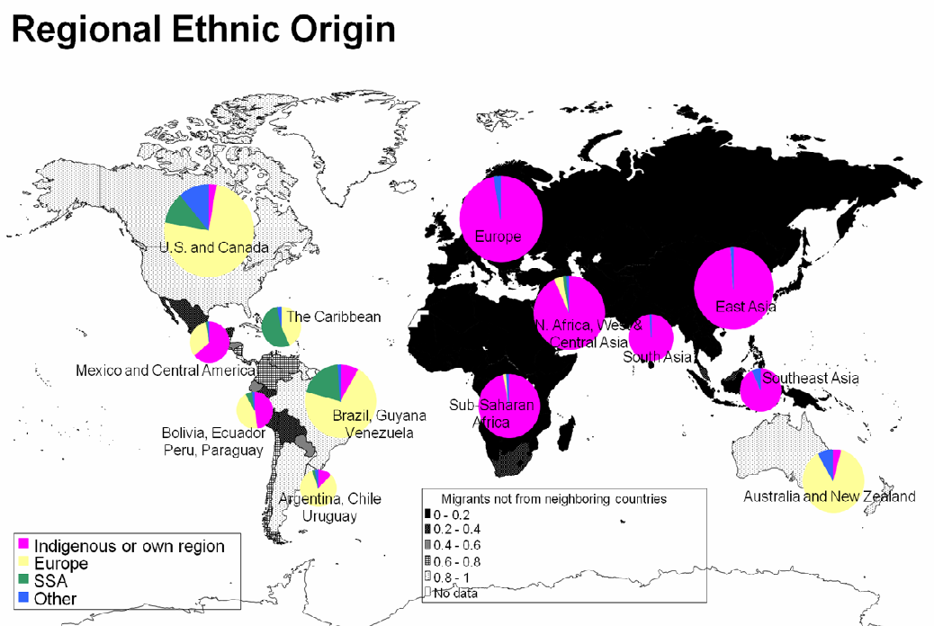
PW’s Twist

Slide 21
Table 4 – Historical correlates of development,
with and without ancestry adjustment
 | Log per capita income 2005 | Years of Agriculture | Ancestry adjusted years of agriculture | State history | Ancestry adjusted state history
Years of agriculture | 0.228 | 1.000
Ancestry-adjusted years of agriculture | 0.457 | 0.817 | 1.000
State history | 0.257 | 0.618 | 0.457 | 1.000
Ancestry-adjusted state history | 0.481 | 0.424 | 0.613 | 0.783 | 1.000

Slide 22
Table 5 – The History of Populations and Economic Development
(Dependent variable: log per capita income, 2005)
 | (1) | (2) | (3) | (4)
Main regressor: | Years of agriculture | Ancestry-adjusted years of agriculture | State history | Ancestry-adjusted state history
Years of agriculture | 0.019
 | (0.535)
Ancestry-adjusted years |  | 0.099
of agriculture |  | (2.347)**
State history |  |  | 0.074
 |  |  | (0.245)
Ancestry-adjusted state |  |  |  | 1.217
History |  |  |  | (3.306)***
Absolute | 0.042 | 0.040 | 0.047 | 0.046
latitude | (6.120)*** | (6.168)*** | (7.483)*** | (7.313)***
% land area | -0.188 | -0.148 | 0.061 | 0.269
in the tropics | (0.592) | (0.502) | (0.200) | (0.914)
Landlocked | -0.753 | -0.671 | -0.697 | -0.555
dummy | (4.354)*** | (3.847)*** | (4.122)*** | (3.201)***
Island | 0.681 | 0.562 | 0.531 | 0.503
dummy | (2.550)** | (2.555)** | (2.216)** | (2.338)**
Constant | 7.699 | 7.270 | 7.458 | 6.773
 | (22.429)*** | (21.455)*** | (22.338)*** | (19.539)***
Beta coefficients on the bold variable | 3.75% | 17.23% | 1.50% | 21.59%
Observations | 150 | 148 | 136 | 135
R-squared | 0.475 | 0.523 | 0.558 | 0.588

Slide 23
Table 6 – Europeans and Development
(dependent variable: log per capita income, 2005)
 | (1) | (2) | (3) | (4) | (5)
Main regressor: | Share of Europeans | Sample with less than 30% of Europeans | Control for years of agriculture | Control for state history | Control for genetic distance
Share of Europeans descendants, | 1.058 | 2.892 | 1.079 | 1.108 | 0.863
per Putterman and Weil | (4.743)*** | (3.506)*** | (4.782)*** | (5.519)*** | (3.601)***
Ancestry-adjusted years of |  |  | 0.105
agriculture, in thousands |  |  | (2.696)***
Ancestry-adjusted state history |  |  |  | 1.089
 |  |  |  | (3.108)***
Fst genetic distance to the USA, |  |  |  |  | -4.576
weighted |  |  |  |  | (2.341)**
Constant | 8.064 | 7.853 | 7.676 | 7.195 | 8.637
 | (24.338)*** | (17.030)*** | (21.984)*** | (21.594)*** | (20.941)***
Observations | 150 | 92 | 147 | 134 | 149
R-squared | 0.526 | 0.340 | 0.580 | 0.656 | 0.545
(Geography controls included, not reported)

Slide 24
Lessons from Putterman-Weil (1)
Historical factors – experience with settled agriculture and with formal political institutions, going back thousands of years – predict current income per capita.
It is a population’s history, not a location’s history, that matters most.
Having a large population of European ancestry confers a strong advantage in development:
  A variable capturing the extent of European ancestry accounts for 41% of variation in per capita income.
This helps reconcile some of Diamond’s observations with the observation that there has been a reversal of fortune among former colonies.

Slide 25
Lessons from Putterman-Weil (2)
Quoting PW:
  “people who moved from one region to another carried the human capabilities built up in that area with them”
  “Europeans and to some extent East and South Asians carried their historically bequeathed human capital with them to the Americas, Australia, Malaysia, and elsewhere”
Human ancestry matters,
Factors conducive to development are transmitted along genealogical lines.

Slide 26
Comin, Easterly and Gong
CEG present a dataset of technology adoption in 1,000 BC, 0 AD, 1,500 AD and the current period.
For 1,000 BC, 0 AD technological adoption is measured along the extensive margin, for 11 separate technologies (e.g. writing, pottery, metal work, bronze or iron weapons…).
For 1,500 AD technological adoption is also measured along the extensive margin, for 24 separate technologies (e.g. muskets, wheel, compass, block printing…).
For 10 current technologies, adoption is measured along the intensive margin relative to the US (frontier) – electricity, internet, cellphones, etc…

Slide 27
Findings
Past technological advancement (as far as 1,000 BC) is strongly associated with current economic development.
Past technological advancement (as far as 1,000 BC) is strongly associated with current technological advancement, but only if controlling for settlement by Europeans.
“once we control for the most obvious historical example of replacement of the indigenous technology by technologies brought by new settlers, technology in ancient times becomes an even more significant predictor of development today.”
1,500 AD technological advancement is significantly related to current advancement, whether or not European involvement is controlled for. What happened to reversals of fortune?
Let’s look at some actual regressions…

Slide 28
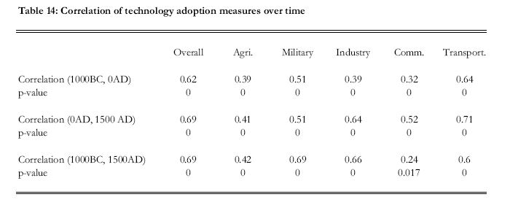
Technology is Very Time Persistent
(correlations would be smaller with technology adoption in the current period – we’ll discuss why later – as a preview, it has to do with the Industrial Revolution)

Slide 29
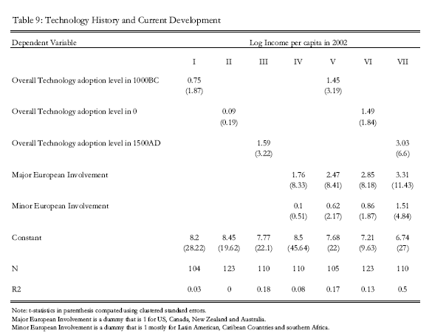

Slide 30
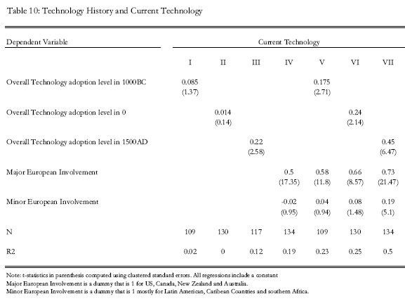

Slide 31
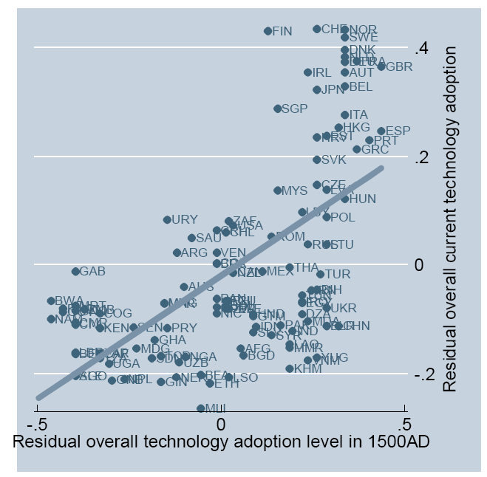
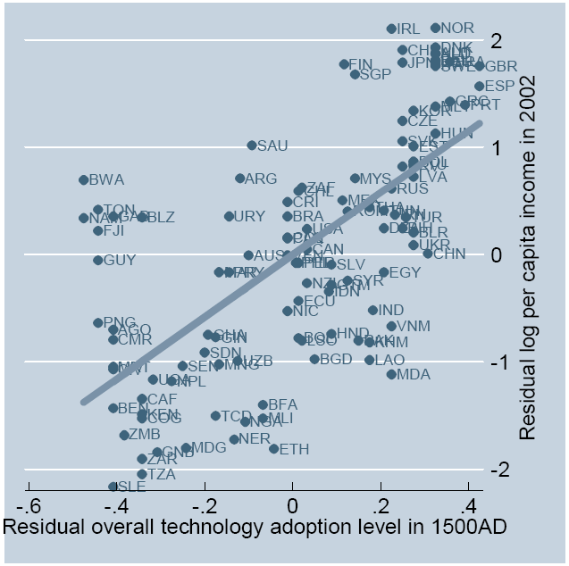
CEG in a Nutshell
Similar relationships exist, though less strongly, for 1000 BC and 0 BC technologies.
Similar relationships exist, though less strongly, when not partialing out the effect of European settlement.

Slide 32
Lessons from CEG
Technological advancement is persistent through millenia.
The relationship is strongest between 1500 AD technology and current technology. i.e. technological advancement before and after the industrial revolution are strongly correlated.
Controlling for ancestry and/or European settlement reinforces the relationship, as Europeans tended to settle in locations that were technologically backward in the deep historical past (Americas, Oceania), and brought with them advanced technologies.
The first observations lend credence to Diamond’s conjecture that the Neolithic advantage translates into a current advantage.
The last observation is entirely consistent with Putterman and Weil’s findings: ancestry matters to explain persistence.

Slide 33
Mechanisms
Intergenerational transmission can take place through different inheritance systems: biological, cultural, or dual (gene-culture interaction)
The effects of inherited traits on productivity and other economic outcomes may be direct or operate as barriers to the transmission of productivity-enhancing innovations
We provide a general taxonomy to discuss different channels through which inherited human characteristics may impact economic development.

Slide 34
A Taxonomy
 | Direct Effect | Barrier Effect
Biological (genetic or epigenetic) | e.g. Galor-Moav (2002), Clark (2007) | e.g., Spolaore and Wacziarg (2009)
Cultural (behavioral or symbolic) | e.g. Max Weber and many others (Bisin-Verdier, Tabellini, Alesina-Giuliano, ..)
Dual (gene-culture interaction) | e.g., Boyd and Richerson
Mechanism of impact
Type of transmission

Slide 35
Taking Stock
Technology and development are very persistent (Diamond, Comin, Easterly and Gong).
This persistence exists particularly across populations rather than locations (Putterman and Weil).
Advantages obtained from the adoption of an old technological breakthrough (agriculture) can help with the onset of a new major innovation (industry).

Slide 36
Policy pessimism?
Long-term history, while very important, is not a deterministic straightjacket.
  In Putterman and Weil, the R-squared on state history, agriculture adoption and the fraction of European descent jointly does not exceed 60%.
  In CEG, R-squares are at best 20-25% depending on the specification.
There have also been significant shifts in the technological frontier, with populations at the periphery becoming major innovators, and former frontier societies falling behind.
There is much scope for variations, exceptions and contingencies: Mokyr.
The impact of historical factors changes over time. There may not be any change in deep rooted factors, but the effect of deep-rooted factors can change.
Another source of optimism may come from barriers approach.

