Slide 2
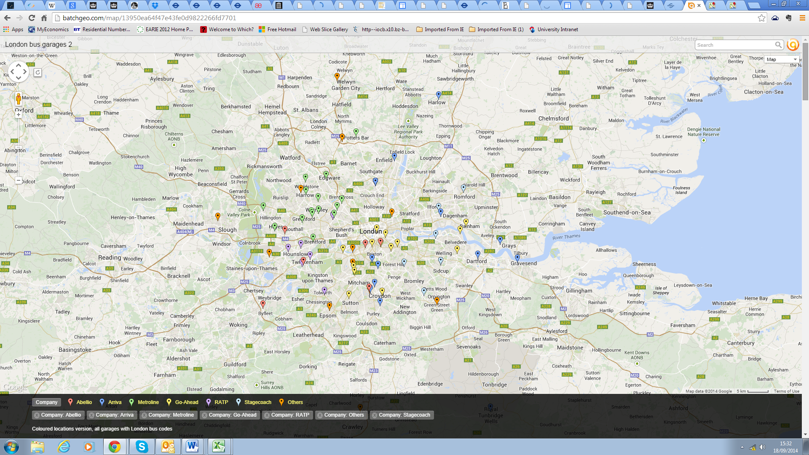
London bus garage locations:
Each colour represents a different operator’s garages
Notes:
Each colour represents a different operator.

