Slide 1
Reducing debt levels without austerity: a Eurobond swap
Marcus Miller
University of Warwick
May 2012

Slide 2
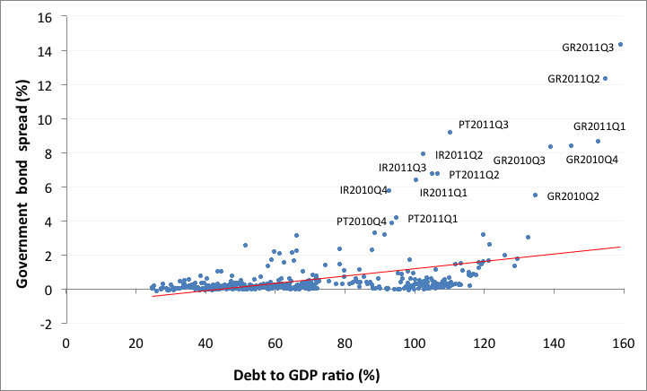
Evidence of self-fulfilling crises ( Multiple Equilibria)
Spreads and debt to GDP ratio in Eurozone (2000Q1-2011Q3)

Slide 3
When debtors threaten corporate survival:
a debt equity swap with Chapter 11 bankruptcy
Debt D
Capitalised earnings
S
L
Chapter 11
Chapter 11
D(0)
Debt equity swap
Debt service cost
Scrap Value
r
Earnings X

Slide 4
Daniel Cohen’s model of Sovereign Debt and Taxes
Sovereign debt D
Solvency
“Drowning in Debt”
“Growing out of debt”
Liquidity
D(0)
r-g-π
r
O
X= ΘτY
Note X here is fiscal resources for debt service

Slide 5
Problems from excessive debt
Debt
Solvency
Insolvency
High
Illiquidity
Liquidity
Low
No problem!
O
X(0)
X= ΘτY

Slide 6
A self-fulfilling rise in spreads can lead to insolvency
and involuntary write down: multiple equilibria
D
S’
S
L
Insolvency
L’
Rising Spreads
D
Write Down
D’
O
X(0)
X = ΘτY

Slide 7
The logic of austerity
First speaker:
output in the UK would be £50 bn (3% GDP) more without any cuts in government spending...
Second speaker:
doubtless present output in the UK would be £50 bn more without any cuts...
But without the cuts, bigger debt would be passed on.
And if the increased probability of our ending up in a Greek-like situation by 10%, is it not be worth the price?
But what happens if all countries take the advice of speaker two?

Slide 8
Fiscal austerity as a way of pleasing creditors:
a prisoners dilemma?
 | Output stabilisation | Fiscal Austerity
Output stabilisation | 1,1 | -1,2
Fiscal Austerity | 2,-1 | 0,0
Entries are growth rates for row and column countries respectively
The Nash equilibrium for this game is fiscal austerity for everyone!

Slide 9
A bond swap to solve a liquidity problem
D
Solvency Constraint
“Growing out of debt”
Liquidity Constraint
D
‘Debt Equity’ Swap*
D’
Liquidity Problem
O
X₀
X = ΘτY
*Replacing ‘plain vanilla’ debt by growth bonds

Slide 10
Problems with austerity as existing ‘solution’ to the liquidity problem
D
Solvency Constraint
Liquidity Problem
Liquidity Constraint
D
Risk of increased spread due to creditor panic
O
X₀
Aim is to increase taxes for debt service
X = ΘτY
Reduced output due to cuts

Slide 11
Problem of multiple equilibria: Investors holding sovereign bonds - are prone to switches driven by panic
Private
Investors
Lucky
Sovereigns
Unstable – multiple equilibrium
Unlucky
Sovereigns

Slide 12
An SPV to issue stability bonds and hold some growth bonds:
Private
Investors
Stability and Growth Fund
Stability
bonds
Lucky
Sovereigns
Unlucky
Sovereigns
Growth bonds
SGF pools sovereign debt to avoid multiple equilibria - and diversifies bonds available for sovereign debtors.

Slide 13

Cato the Elder
the Roman statesman, was famous for ending every speech with the words:
Cartago delenda est
Carthage must be destroyed!
I would like to end on a more positive note:
let Europe enhance the Growth and Stability Pact by creating a European Growth and Stability Fund.

Slide 14
References
Griffith-Jones, S. & Sharma, K. (2006), “GDP Bonds – Making it Happen,” DESA Working Paper 21.
Miller, M. & Stiglitz, J. (2010), “Leverage and Asset Bubbles: Averting Armageddon with Chapter 11?” Economics Journal, 120, pp. 500-518.
Miller, M. & Zhang, L. (2012), “Issuing growth and stability bonds: a super Chapter 11 for Europe?” (for more information please email marcus.miller@warwick.ac.uk)
Rogoff, K. (1999), “International institutions for reducing global financial instability”, Journal of Economic Perspectives, 13(4), pp.21-42.
Shiller, R. (2003), The New Financial Order. Princeton NJ: Princeton University Press.

