Slide 1
What went wrong? Is the euro crisis a crisis of success?
Good bye Capital Controls in Europe.
Hello Multiple Equilibria - and crisis!
Marcus Miller
University of Warwick
May 2012

Slide 2
First some history: when Germany was debtor
After World War I, when Germany faced huge war debts, a young UK Treasury official looked for principles for managing such debts.He concluded:
There are limits to what debtor could pay; trying to enforce greater payment politically counterproductive.
Both creditors and debtors should share the task of getting economies out of holes they had jointly dug.
Recommended a round of debt cancellation. Plan was rejected. Allies insisted on debt repayments.
Official quit his job and wrote a book.

Slide 3
What was the book?
The Economic Consequences of the Peace
by J.M Keynes (1919)
Since then much water has passed under the bridge.
What have we learned?

Slide 4
Today, the tables have turned
Now, of course, Germany is the creditor: so what is its advice to European debtors: Austerity (-just like David Cameron!)
Germany believes that resolving debt problems is the sole responsibility of the debtor.
The results are clear: Europe has essentially stopped growing – and there is little hope of growth resuming in the near term.
Nor have the debt problems been solved.

Slide 5
Political risks of Austerity
European countries have avoided a repeat of the Great Depression after the banking crisis
But are now heading into the blind cul-de-sac that led to extremism in that earlier disaster.
Germans remember the hyperinflation of 1920-23:
But it was deflation and the Great Depression that brought Hitler to power in 1933.

Slide 6
Lessons of history
Sovereign debts must be managed in ways that do not destroy either the economy or the political centre ground.
Europe has plenty of financial expertise.
Let’s put this to use helping governments shake off their paper shackles to reduce debt without austerity. But how?
Let’s consider debt restructuring.

Slide 7
Problem of multiple equilibria: Investors holding sovereign bonds are prone to switches driven by panic
Private
Investors
Lucky
Sovereigns
Unstable – multiple equilibria
Unlucky
Sovereigns

Slide 8
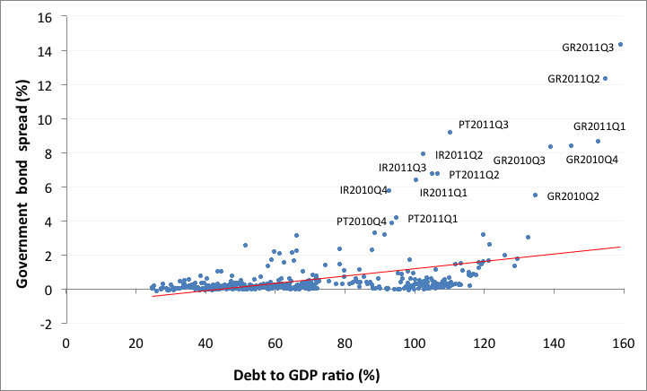
Evidence of self-fulfilling crises ( Multiple Equilibria)
Spreads and debt to GDP ratio in Eurozone (2000Q1-2011Q3)

Slide 9
An SPV to issue stability bonds and hold some growth bonds:
Private
Investors
Stability and Growth Fund
Stability
bonds
Lucky
Sovereigns
Unlucky
Sovereigns
Growth bonds
SGF pools sovereign debt to avoid multiple equilibria - and diversifies bonds available for sovereign debtors.

Slide 10
When debtors threaten corporate survival:
a debt equity swap with Chapter 11 bankruptcy
Debt D
Capitalised earnings
S
L
Chapter 11
Chapter 11
D(0)
Debt equity swap
Debt service cost
Scrap Value
r
Earnings X

Slide 11
Daniel Cohen’s model of Sovereign Debt and Taxes
Sovereign debt D
Solvency
“Drowning in Debt”
“Growing out of debt”
Liquidity
D(0)
r-g-π
r
O
X= ΘτY
Note X here is fiscal resources for debt service

Slide 12
Problems from excessive debt
Debt
Solvency
Insolvency
High
Illiquidity
Liquidity
Low
No problem!
O
X(0)
X= ΘτY

Slide 13
A self-fulfilling rise in spreads can lead to insolvency
and involuntary write down: multiple equilibria
D
S’
S
L
Insolvency
L’
Rising Spreads
D
Write Down
D’
O
X(0)
X = ΘτY

Slide 14
Fiscal austerity as a way of pleasing creditors:
a prisoners dilemma?
 | Output stabilisation | Fiscal Austerity
Output stabilisation | 1,1 | -1,2
Fiscal Austerity | 2,-1 | 0,0
Entries are growth rates for row and column countries respectively
The Nash equilibrium for this game is fiscal austerity for everyone!

Slide 15
A bond swap to solve a liquidity problem
D
Solvency Constraint
“Growing out of debt”
Liquidity Constraint
D
‘Debt Equity’ Swap*
D’
Liquidity Problem
O
X₀
X = ΘτY
*Replacing ‘plain vanilla’ debt by growth bonds

Slide 16
Problems with austerity as existing ‘solution’ to the liquidity problem
D
Solvency Constraint
Liquidity Problem
Liquidity Constraint
D
Risk of increased spread due to creditor panic
O
X₀
Aim is to increase taxes for debt service
X = ΘτY
Reduced output due to cuts

Slide 17
Conclusion
As Miquel Iceta has emphasized:
“No one can stop an idea whose idea has come”. Victor Hugo
A key idea is debt restructuring.
Let the Growth and Stability Pact be enhanced by creating a European Growth and Stability Fund.
Stability for creditors: growth for debtors

Slide 18
References
Cohen, D. & Sachs, J. (1986), “Growth and external debt under risk of debt repudiation” European Economics Review, 30, pp. 529-500.
Griffith-Jones, S. & Sharma, K. (2006), “GDP Bonds – Making it Happen,” DESA Working Paper 21.
Miller, M. & Stiglitz, J. (2010), “Leverage and Asset Bubbles: Averting Armageddon with Chapter 11?” Economics Journal, 120, pp. 500-518.
Miller, M. & Zhang, L. (2012), “Issuing growth and stability bonds: a super Chapter 11 for Europe?” (for more information please email marcus.miller@warwick.ac.uk)
Rogoff, K. (1999), “International institutions for reducing global financial instability”, Journal of Economic Perspectives, 13(4), pp.21-42.
Shiller, R. (2003), The New Financial Order. Princeton NJ: Princeton University Press.

