Slide 1

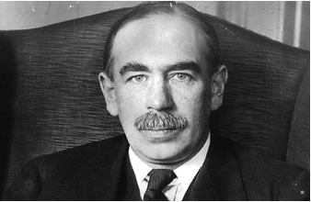
Fiscal consolidation: Dr Pangloss meets Mr Keynes
Marcus Miller and Lei Zhang
19th June 2013

Slide 2
Debt unsustainability and measure to correct this
Variables used may be defined as follows:
Parameter | Definition
b | Level of debt/capacity output
g | Government expenditure/capacity output
θ | Tax revenue as a fraction of capacity output
r | Real rate of interest, taken as exogenous
γ | Rate of capacity growth, taken as exogenous

Slide 3


Debt sustainability and government expenditure
b
B
Bond Accumulation $\dot{b}=(r−γ)b+g−θ$
$$\dot{b}=0$$
Tax take
b₀
A₀
A
A₁
A₂
b*
E
r-γ
B
g*
θ
g

Slide 4
From a point such as A₁, where the sum of expenditure and growth-adjusted interest charges exceeding the tax base, debt will grow unsustainably unless some action is taken. Such action may include:
reducing expenditure or raising tax rates;
debt reduction via inflation or explicit repudiation;
financial repression, i.e. lowering the rate of interest paid;
increasing the growth rate
a debt equity swap
or some combination of the above.

Slide 5
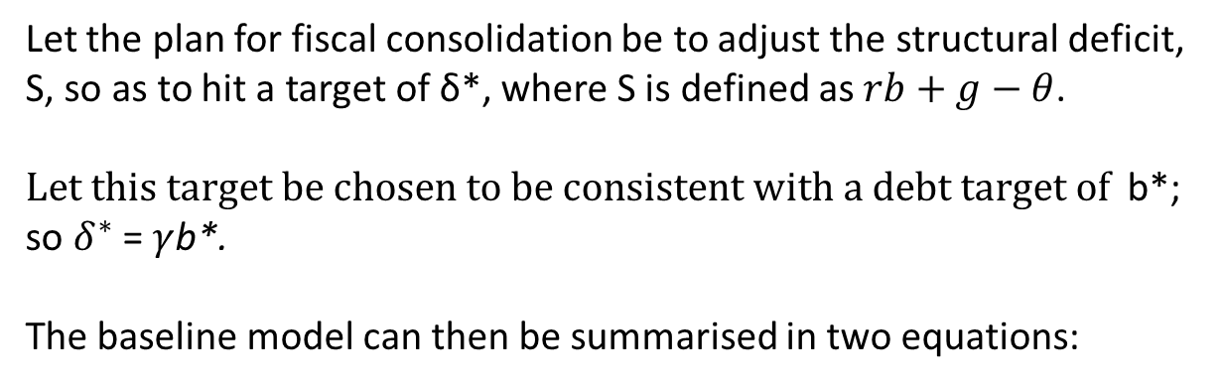
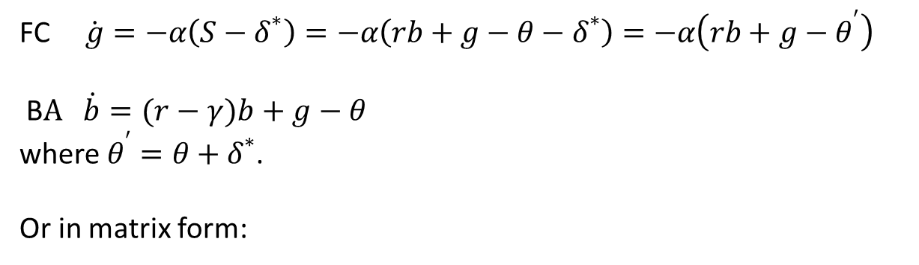
Let the plan for fiscal consolidation be to adjust the structural deficit, S, so as to hit a target of δ*, where S is defined as $rb+g−θ$.
$Let this target be chosen to be consistent with a debt target of$ b*; so $δ^{∗}$ = $γ$b*.
The baseline model can then be summarised in two equations:
FC $\dot{g}=−α\left(S−δ^{∗}\right)=−α\left(rb+g−θ−δ^{∗}\right)=$ $−α\left(rb+g−θ^{′}\right)$
B$A \dot{b}=(r−γ)b+g−θ$
where $θ^{′}=θ+δ^{∗}$.
Or in matrix form:
$\left[\begin{aligned}\dot{g} \\ \dot{b}\end{aligned}\right]=\left[\begin{matrix}−α & −αr \\ 1 & r−γ\end{matrix}\right]\left[\begin{aligned}g \\ b\end{aligned}\right]+\left[\begin{matrix}αθ^{′} \\ −θ\end{matrix}\right]$

Slide 6



Fiscal consolidation with capacity output: the baseline model
b
B
$$\dot{b}=0$$
F
r
Tax take
A'
A
b*
E
r-γ
$$\dot{g}=0$$
B
F
g*
θ
θ'
g
δ*

Slide 7
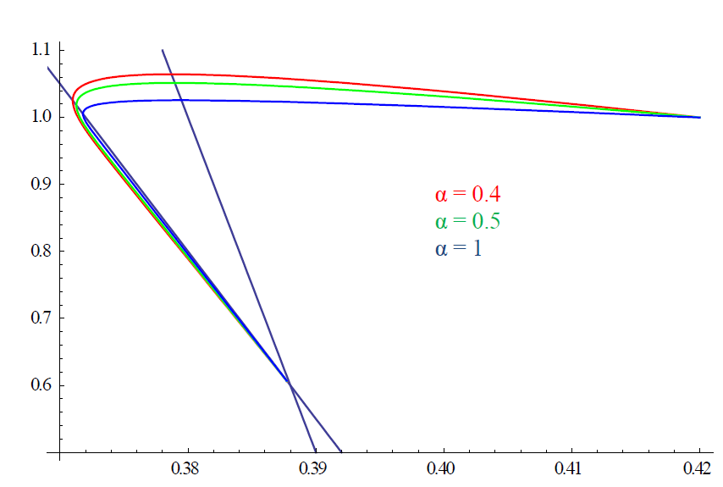
Different speeds of consolidation

Slide 8





Fiscal fatigue defines an upper debt limit
b
B
“Fiscal fatigue” of Barr et al.
$$\dot{b}=0$$
$$\overline{b}$$
Tax take
F
r
A'
A
b*
E
r-γ
$$\dot{g}=0$$
B
F
$$\underline{g}$$
g*
θ
θ'
g
δ*

Slide 9



Fiscal stabilisation works, but with temporary recession
b
B
M
Recession
No Recession
B′
Higher debt with lower tax take
$$\dot{b}=0$$
F
r
C
A
Tax take at capacity output
b*
E
r-γ
$$\dot{g}=0$$
M
F
B
g*
θ
θ′
g
δ*

Slide 10
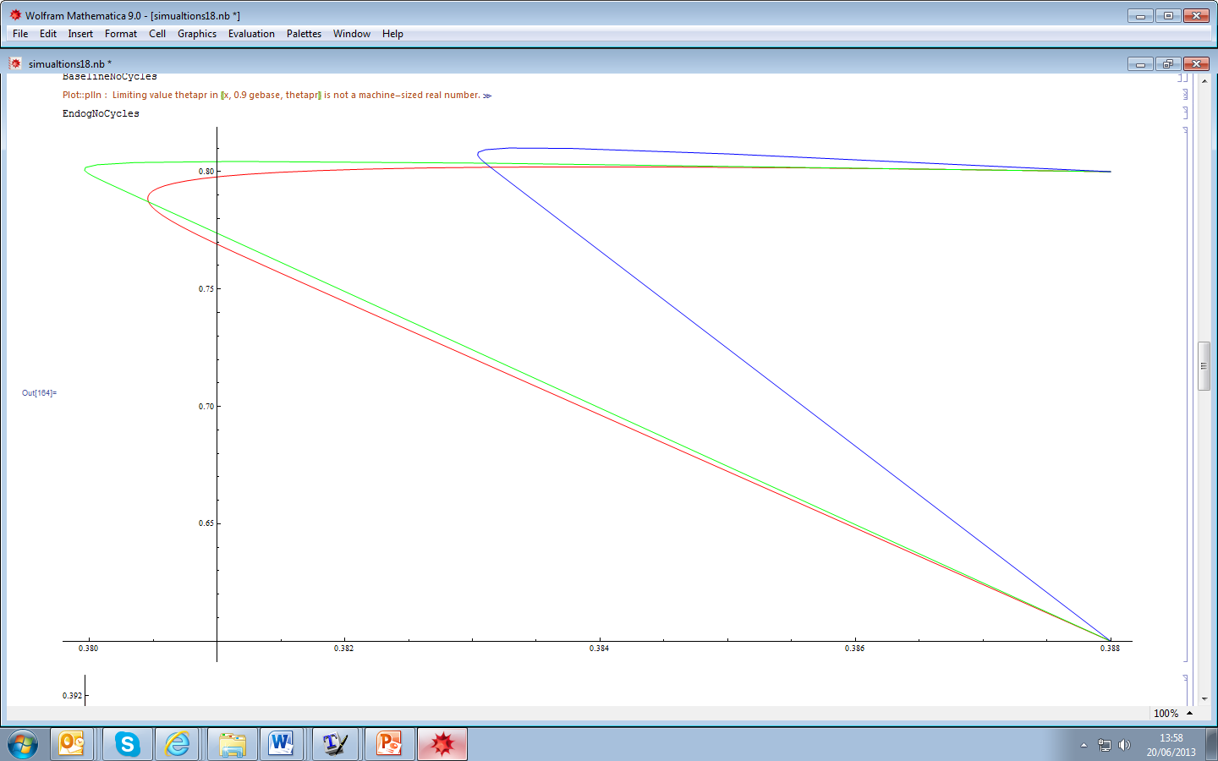
Simulation results which converge to full employment in the long-run
With endogenous
taxes
Non-cyclically adjusted
Baseline case

Slide 11
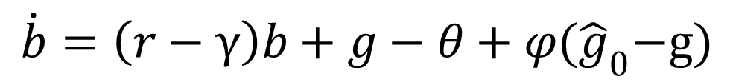
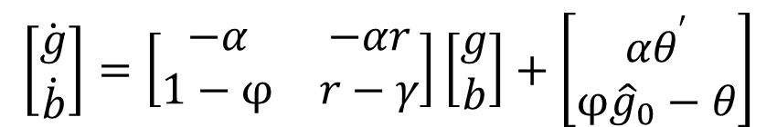
Fiscal consolidation with endogenous income and taxation: flattens BB to left of MM so equilibrium shifts up FF.
$$\dot{b}=\left(r−γ\right)b+g−θ+φ{(\hat{g}}_{0}−g)$$
$$\left[\begin{aligned}\dot{g} \\ \dot{b}\end{aligned}\right]=\left[\begin{matrix}−α & −αr \\ 1−φ & r−γ\end{matrix}\right]\left[\begin{aligned}g \\ b\end{aligned}\right]+\left[\begin{matrix}αθ^{′} \\ φ{\hat{g}}_{0}−θ\end{matrix}\right]$$

Slide 12


Fiscal consolidation – waiting and hoping
b
B
Regime switches
D
M
Temporary recession
No recession
$$\dot{b}=0$$
F
r
Tax take at capacity output
A'
E'
C
A
b*
E
X
r-γ
$$\dot{g}=0$$
D
M
B
F
g*
θ
θ'
g
δ*

Slide 13
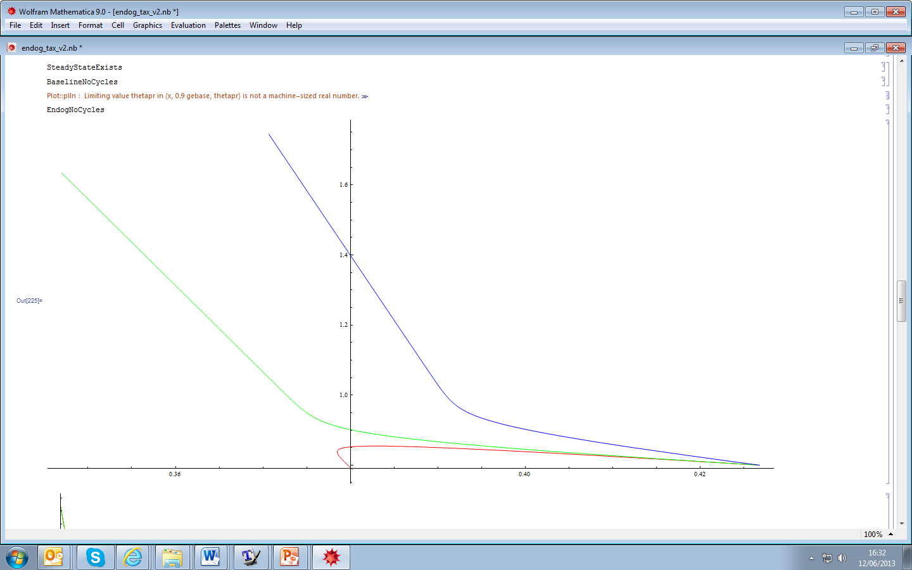
Simulations during the period of waiting and hoping
With endogenous taxes
Non-cyclically adjusted
Baseline case

Slide 14

Tightening fiscal policy to hit the debt target, b*
b
B
M
Recession
No Recession
B'
F
r
Tax take at capacity output
F'
E'
b*
E
E_{D}
B'
M
B
F'
F
g_{D}
g*
θ
θ'
g
δ*

Slide 15
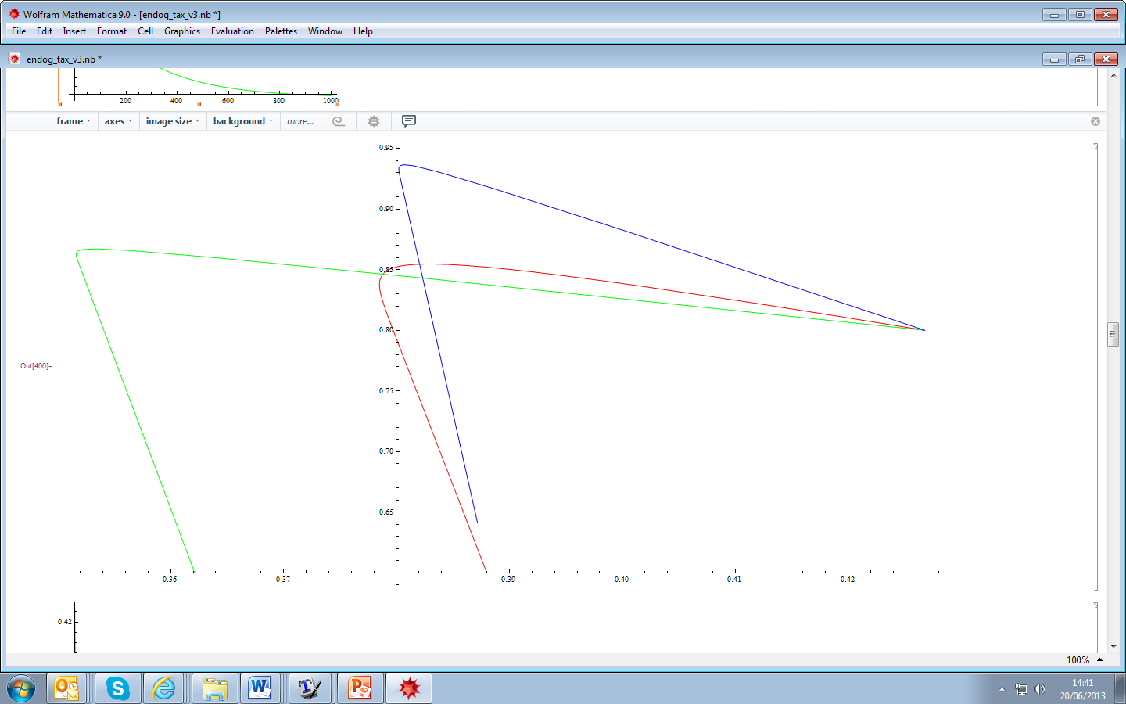
Simulations showing the effect of the tightening of structural deficits
Non-cyclically adjusted
With endogenous taxes
Baseline case

Slide 16




Fiscal consolidation defeated by high interest rates
b
U
F
Explosive path of debt
r
$$\dot{g}=0$$
B′
$$\dot{b}=0$$
S
A
E
S
U
F
B′
θ
θ′
g
δ*

Slide 17




Failed attempts to stabilise
b
F
M
$$\dot{g}=0$$
$$\dot{b}=0$$
Z
B′
A
$$b_{0}$$
S
Z
b*
E
S
$$\frac{r−γ}{1−φ}$$
M
F
g*
θ
θ′
g
δ*

Slide 18



DeLong and Summers: stabilisation delays fiscal consolidation
b
B
M
D
$$\dot{b}=0$$
F
C
r
A
b**
E´
F
b*
E
r-γ
$$\dot{g}=0$$
M
B
F
g*
θ
θ′
θ′′
g
δ*

Slide 19
Different types of stability bonds
Name | Concept
Euro-bonds | Issue of common bonds to replace all debt
“Blue bonds” | Issue of common bonds up to 60% of GDP
“Elite” bonds | Common bonds only for AAA rated countries
Debt retirement fund | New entity that pools all debts above 60% of GDP, issues its own common bonds. Countries have a credible commitment to amortise the debt in a certain time frame

Slide 20
BEFORE: Investors holds sovereign bonds - but are prone to switch
Private
Investors
Lucky
Sovereigns
“Flight to safety”
Unlucky
Sovereigns
Unlucky sovereigns face high spreads

Slide 21
AFTER: Stability and growth fund pools sovereign debt - and diversifies types of bond
Private
Investors
Stability and Growth Fund
Stability
bonds
Lucky
Sovereigns
Growth bonds
Unlucky
Sovereigns

Slide 22
Balance sheet of SPV
Assets | Liabilities
Sovereign bonds: Plain vanilla (b) Growth and GDP-linked | Euro stability bonds Equity base

