Slide 1

Target zones and monitoring bands : a bird’s eye view
Marcus Miller
University of Warwick

Slide 2
A short history of time …

Slide 3
Exchange Rates in a Target Zone:
Paul Krugman’s opening Shot
Exchange rate
F
Free float
Upper limit of target zone
Fundamental
S curve
Lower limit of target zone
F
John Williamson’s reaction: “If one believes the market is forward-looking and rational, then one would not want to intervene at all: free floating is the preferred policy”

Slide 4
George Akerlof’s culinary warning: economists like French chefs!
‘ Economic theorists, like French chefs in regard to food, have developed stylized models whose ingredients are limited by some unwritten rules…
I disagree with any rules that limit the ingredients in economic models’.

Slide 5
Akerlof’s hints for new ingredients?
“The absence of psychological–anthropological-sociological behaviors in economic theory allows a whole new field of potential interest .. [where ] the economic theorist [can] ask what the consequences of these behaviours will be for the usual economic results.”

Slide 6
How traders in FX markets behave: four parables in the literature
Stop-loss traders (Krugman and Miller)
Noise Traders (Jeanne and Rose)
Chartists and Fundamentalists (Kubelec and De Grauwe and Grimaldi)
Bulls and Bears(Corrado et al.)

Slide 7

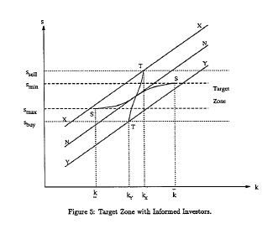
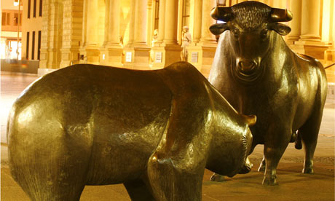
FX Markets: take a closer look!
Stop Loss
traders
Noise traders
Exchange Rate
O
Bulls
Bulls and Bears
Bears
P
O
Fundamental
P
Fihing.

Slide 8
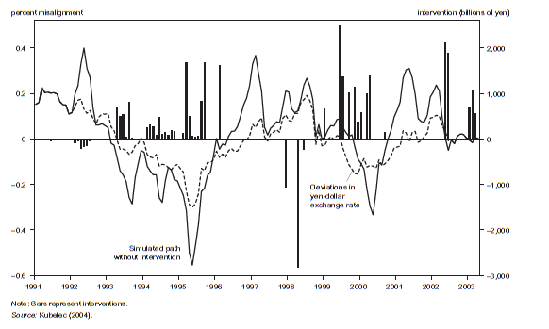
‘We have the biggest stash of cash in Asia’ claims Mr Sakakibara.
Chris Kubelec calibrates success of Mr Yen

Slide 9
Breaking news: Joe Gagnon of PIIE denies doctrine of ‘Impossible Trinity’.
Doctrine of the ´impossible trinity´ claims that with perfect capital mobility, one has to choose between an independent monetary policy and exchange rate management.
But, given failure of Efficient Market Theory , Gagnon argues, you can have both!

Slide 10
Joe Gagnon rejects false dilemma: endorses Monitoring Bands
Sterilized exchange rate intervention is seen as a separate policy tool.
“As long as monetary policy is free to pursue the stabilisation of output and inflation”, the logic goes, ”there is no reason not to use this policy lever to do some good.”
Monitoring zone proposal ‘ helpful in reducing and stabilizing volatile risk premiums’

Slide 11
Finally: the future of macroeconomics?
 | Possible developments | John’s score? | Why
1 | More eclectic theory, not just DSGE* | **** | Rejection of Efficient Markets
2 | Attention to facts rather than prior assumptions | **** | Focus on markets and institutions
3 | Use of other disciplines | ***** | Study of actual behaviour
* DSGE = Rational Expectations + Representative Agent + Efficient Markets

Slide 12
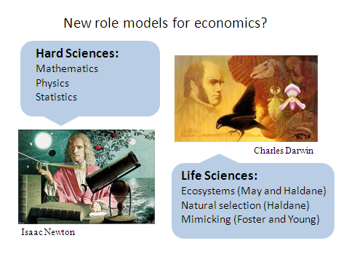

Slide 14
A target zone to ‘stop loss stoppers’
Figure 2. Target Zone with Informed Investors.

Slide 15
Bulls, Bears and excess volatility
Exchange Rate
O
Bulls
P
Bears
O
Fundamental
P
Figure 4. Excess volatility with repeated switching.

Slide 16
Bulls and bears in a monitoring band
Exchange Rate
O
F
Bulls
P
Upper Edge
of band
Bears
Fundamental
Lower Edge of Band
O
F
P
Figure 5. Bulls and bears in a monitoring band.

