Slide 1
Riding for a fall? Concentrated banking with hidden tail risk
Marcus Miller, Lei Zhang and Han Hao Li
University of Warwick

Slide 2
Independent Commission on Banking (ICB): background and mandate
‘The global financial crisis that began in 2007 has exposed fundamental weaknesses in banking systems and related financial markets. Major financial institutions, including in the UK, were saved from failure only by massive government support schemes. Others were taken over by competitors, or collapsed. ‘
‘Securing a stronger and better functioning financial system is the goal of a range of public policy initiatives.’
ICB established June 2010 to make recommendations by Sep 2011 on ‘measures to promote stability and competition in banking for the benefit of consumers and businesses

Slide 3
ICB :Call for Evidence
Warwick group of 5 – including Sayantan Ghosal, Peter Hammond and Michael Waterson as well as two of the current authors - responded to the ‘Call for Evidence’ last year.
150 Submissions available on ICB website.
What follows is based on the paper attached to our Evidence - revised for presentation at RES Conference in April.
Comments and suggestions welcome !

Slide 4
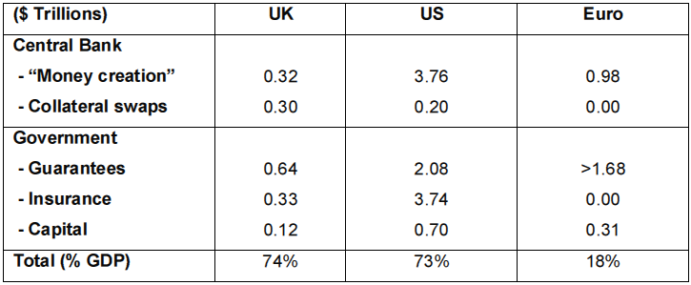
Financial crisis and support packages, Haldane (2009)
UK GDP in $ is $2.28 trillions approx.
Exchange rates used: FSR Euro / US dollar exchange rate of 0.710. Sterling / US dollar exchange rate of 0.613.

Slide 5
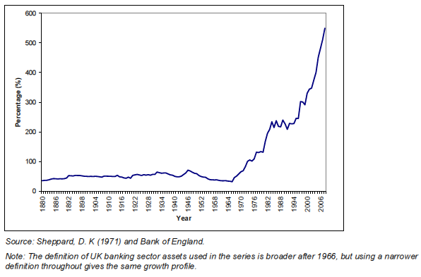
How UK banking sector grew from half to five times annual GDP

Slide 6
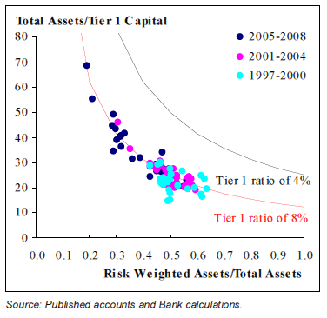
How leverage has increased from 20 to 40

Slide 7
Evidence of a “productivity miracle” in finance?
The share of banking in Gross Value Added rose from 5% in 1970 to 8% in 2008, but the share of profits in economy-wide profits rose 10 fold (from 1.5% to 15%).

Slide 8
Outline of argument
UK Banks
Excess risk-taking (‘gambling’)
Concentration
?
Franchise Value
‘Skin in the game’
Capital buffers + Competition
Too Big To Fail

Slide 9
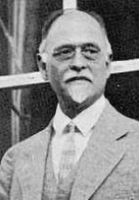
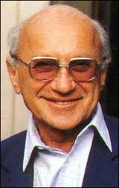
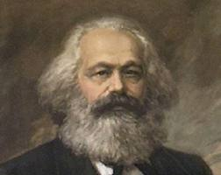
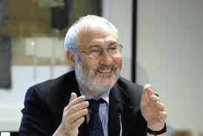
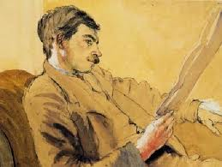
Money Matters – how and why?
I. Fisher 1847-1947
K. Marx 1818-1883
M. Friedman 1912-2006
J. Stiglitz, born 1943
J. M. Keynes 1883 – 1946

Slide 10
Diamond & Dybvig / Allen & Gale
workhorse model of competitive banking – and bank runs

Slide 12


Slide 13
Monopoly bank that does not gamble but widens its spread on intermediation

Slide 14
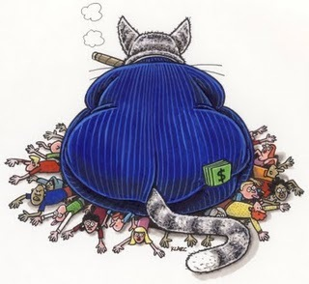

Slide 15
Monopoly bank: comparative statics

Slide 16
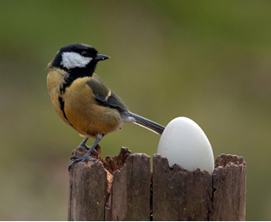
A positive productivity shock!

Slide 17
Monopoly bank that gambles with “fake alpha” investment*
* As in Rajan (2005, 2010), and Foster and Young (2010).

Slide 18

A productivity ‘mirage’: monopoly banking with tail risk

Slide 19
Mixture of miracle and mirage

Slide 20
Rising incomes in financial services and inequality

Slide 21
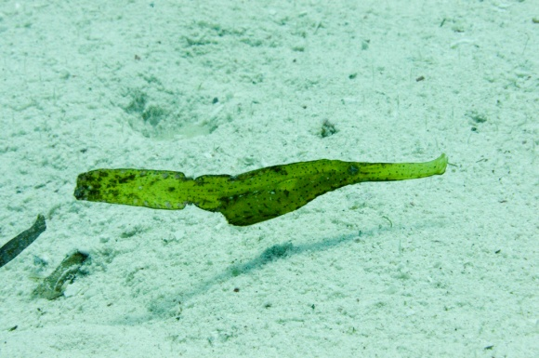
No Gambling Condition: and ‘mimicking’ as in Foster and Young (2010)

Slide 22
Capital Buffers, Franchise Value and Gambling

Slide 23
Impact of “Too Big To Fail”

Slide 24
Steps to promote competition and stability

Slide 25
Martin Hellwig et al. (2010)
Banks’ high leverage, and the resulting fragility and systemic risk, contributed to the near collapse of the financial system. Basel III is far from sufficient to protect the system from recurring crises. If a much larger fraction, at least 15%, of banks’ total, non-risk-weighted, assets were funded by equity, the social benefits would be substantial. And the social costs would be minimal, if any.

Slide 26
David Miles et al (2010)
It is remarkable to note that our central estimate for the marginal cost and benefit of higher capital suggests an optimal capital ratio of about 50% of risk weighted assets – which might mean a capital to total assets ratio of around 17% and leverage of about 6. This would be about 5 times as much capital – and one fifth the leverage – of banks now.
(Setting aside risk of GDP fall, our central estimate of optimal capital is 19% of risk-weighted assets. )

Slide 27
Need for reform: Diane Coyle (2011).
‘The truth is that banks are again doing well out of banking, but businesses and consumers are not... Bonuses are back... they are a measure of monopoly rents in the business, it does not take great talent to make a profit by taking excessive risk, safe from effective competition and sure of a bail-out if needed.’

Slide 28
Haldane on the history of banking*
‘In the Middle Ages… the biggest risk to the banks were from the sovereign. Today, perhaps the biggest risk to the sovereign comes from the banks.’
Andrew Haldane is Director of Financial Stability at the Bank of England
*P. Alessandri and A. Haldane (2010) ‘Banking on the state’, Bank of England

Slide 29
Structure of paper
 | Usual assumptions (DD&AG) | Market conditions | This paper
Market structure | Competition | Concentration | Competition – and monopoly
Information | Symmetric | Asymmetric | Symmetric – and Asymmetric
Liabilities | Retail Deposits: short and long | Deposits: retail and interbank deposits | Retail Deposits: short and long
Assets | Loans | Retail lending (Household and SME) and Wholesale | Retail or wholesale
Market failure: multiple equilibria | Bank runs | Bank runs (e.g. Northern Rock) | Bank runs
Market failure: agency problem | N/A | Excessive risk taking | Gambling with asymmetric information
Policy | N/A | Low capital buffers, insolvency followed by bailout and/or nationalisation | Insolvency, bailouts and capital buffers
Footnote: liquidity problems sidestepped

Slide 30
Banks v Hedge Funds : battle of the giants

Slide 31
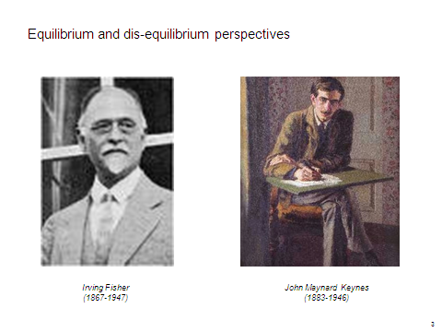

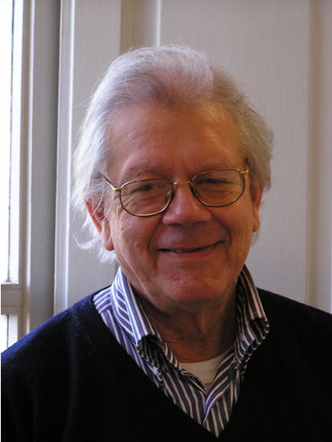
Karl Marx
Mike Artis

