Slide 1
RES Annual Conference
April 4th 2013
Fiscal consolidation:
austerity and alternatives
Marcus Miller and Lei Zhang
University of Warwick

Slide 2
a ‘methodological moment’
David Hendry once proposed a double duty on those advancing a a new econometric model: not only should it fit the facts, it should also account for why previous researchers got things wrong.
Maybe the same applies for policy analysis?
As well as offering constructive alternatives,
the framework chosen should show why previous policies – here austerity – got it wrong

Slide 3
Overview: Fiscal consolidation Four things that have gone wrong?
Assume Demand = Supply
From basic dynamics of debt accumulation, fiscal consolidation looks straightforward, but
What there ifthere is ‘fiscal fatigue’ as in Barr et al (2012)
And financial panic as in Calvo(1988)
Let Demand < Supply
Need to allow for initial recession and income effects of consolidation
And for hysteresis as in DeLong and Summers (2012)

Slide 4
Overview: alternatives to austerity? Four things that might help
First is the Draghi put to calm panic
Then,using the same framework, consider fiscal, financial and institutional alternatives…
(I) Fiscal stabilisation as in DeLong and Summers(2012)
(II)Financial: Chapter 11 style debt/equity swap as in Barr et al (2012): after QE comes EQ?
(III)Institutional: Role for an SPV to inaugurate financial innovation

Slide 5
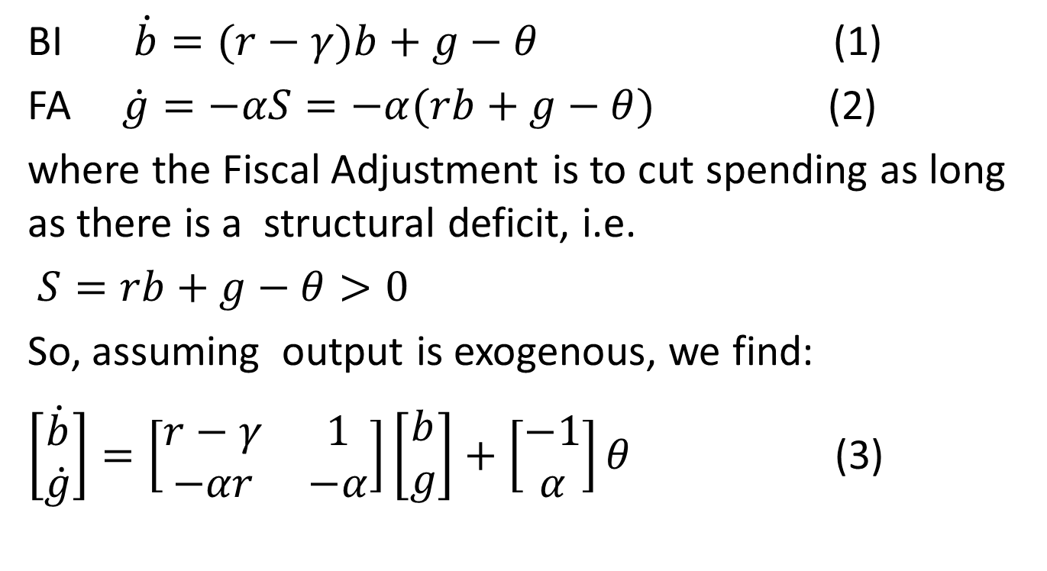
Basic Framework : Debt accumulation and fiscal adjustment, assuming D =S
BI $\dot{b}=(r−γ)b+g−θ$ (1)
FA $\dot{g}=−αS=−α(rb+g−θ)$ (2)
where the Fiscal Adjustment is to cut spending as long as there is a structural deficit, i.e.
$S=rb+g−θ>0$
So, assuming output is exogenous, we find:
$\left[\begin{aligned}\dot{b} \\ \dot{g}\end{aligned}\right]=\left[\begin{matrix}r−γ & 1 \\ −αr & −α\end{matrix}\right]\left[\begin{aligned}b \\ g\end{aligned}\right]+\left[\begin{matrix}−1 \\ α\end{matrix}\right]θ$ (3)

Slide 6
Fiscal consolidation:it looks so easy…
Figure 1

Slide 7
but with‘fiscal fatigue’ default can threaten ( Barr et al.2012)
Figure 2

Slide 8
and what of the risk of self-fulfilling default equilibria, as in Calvo (1988)?
What if agents panic and raise interest rates?
Panic swivels the line of stationarity for debt down
And twists the trajectory for debt up
So debt can exceed the maximum level, leading to partial default
Role for the ECB? (Draghi put)

Slide 9
Self-fulfilling solvency crises:Calvo style
Figure 3

Slide 10
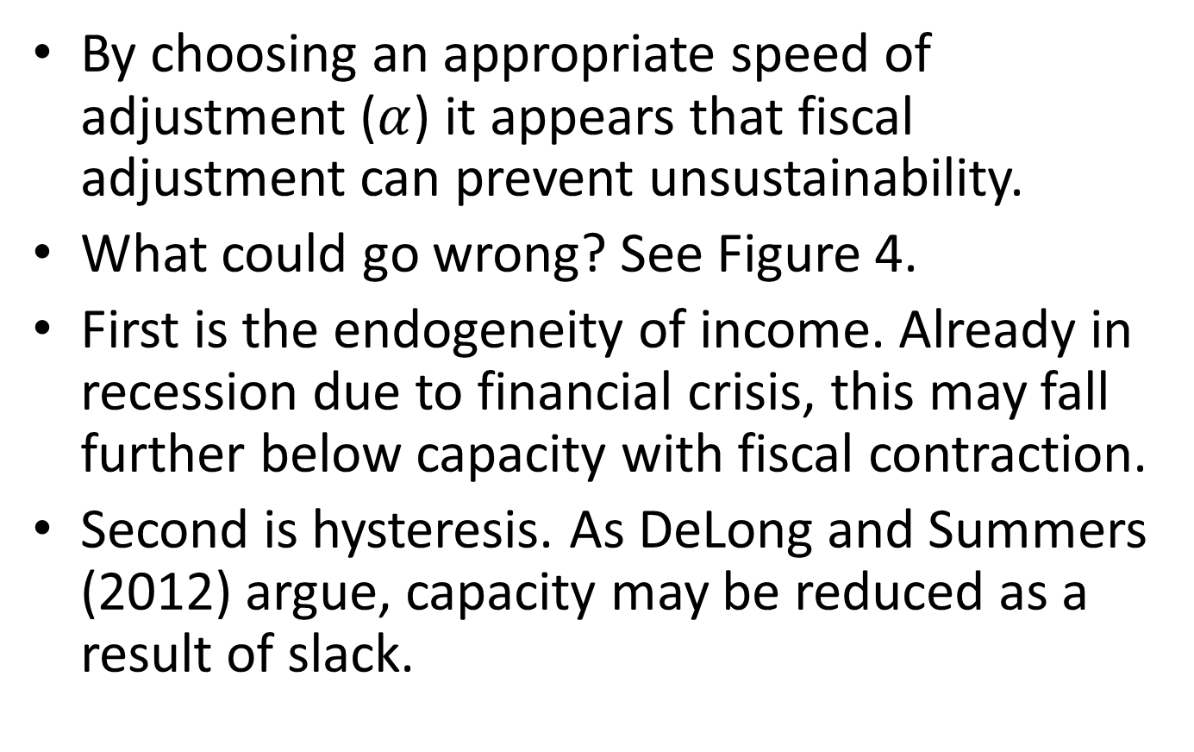
Now allow D<S:Endogenous income and hysteresis
e

Slide 11
Revised dynamics
The mechanical effect of recession, where income lies below potential, is to increase the ratio of debt and government spending to income, shifting the initial point North East from E to A.
The impact of fiscal adjustment is to further reduce income due to Keynesian multiplier effects; so the trajectory moves sharply North-West as shown in Figure 4.
Hysteresis implies that when the recession ends the compensating shift South West is reduced.

Slide 12
Recession, consolidation and hysteresis
Figure 4

Slide 13
“Self-defeating austerity”
As can be seen from Figure 4, the immediate effect of the consolidation, in the absence of spontaneous recovery, will be to reduce national income and increase the debt-income ratio.
According to simulations at the National Institute, as a result of coordinated fiscal consolidation in Europe, amounting to about 2% of GDP in the euro area as a whole, the effect was to increase the debt-GDP ratio by approximately 5% (Holland and Portes 2012, pp. F8-9).
Even when recovery takes place, the debt-income ratio may be little changed from what is was at the beginning of the exercise. Compare C and A.

Slide 14
Alternative Policy 1
Pending economic recovery, which is assumed to come from the private sector, DeLong and Summers (2012) argue for state-contingent public spending, on maintenance and new investment.
While stabilising income, this policy will of course increase the debt-income ratio;
but the extra interest cost can be met by a rise in taxation ex post. See Figure 3.

Slide 15
Alternative I : DeLong and Summers
Figure 5

Slide 16
Ken Rogoff on lessons from earlier debt crises
"Junk" country debt plays too large a role, given the lack of an effective international bankruptcy system. In an ideal world, equity lending and direct investment would play a much bigger role.
…
With a better balance between debt and equity, risk-sharing would be greatly enhanced, and financial crises sharply muted.”
(Rogoff 1999 ‘International Institutions for reducing global financial instability’ . pp. 40)
Applies to sovereigns too?

Slide 17
Alternative policy 2: Debt equity swap
Barr et al. (2012) consider the effect of swapping plain vanilla sovereign debt for state-contingent GDP bonds
“The debt’s redemption value is linked to the level of GDP, which means that if a sovereign issues only GDP-linked bonds, its entire debt stock will adjust in proportion to GDP. The interest rate on the bond is defined as a fixed percentage of this principal, so it too adjusts with GDP…Shocks to GDP growth no longer enter into this debt dynamics equation.” (Barr et al. 2012 p.17)
Effect of recession can be seen in Figure 4. Move East from E!

Slide 18
GDP bonds check effect of recession on debt and reduce the measured structural deficit
Figure 4
repeated

Slide 19
If investors in sovereign bonds are prone to panic, to help ECB …
Private Investors
Lucky Sovereigns
“Flight to safety”
Unlucky Sovereigns
Unlucky sovereigns face high spreads

Slide 20
Alternative 3: Institutional innovation
Stability and growth fund to pool sovereign debt - and diversify types of bond
Private Investors
Stability and Growth Fund
Stability bonds
Lucky Sovereigns
Growth bonds
Unlucky Sovereigns

Slide 21
Balance sheet of SPV
Assets | Liabilities
Sovereign bonds: Plain vanilla Growth and GDP-linked | Euro stability bonds Equity base

Slide 22
Summary
Austerity policies involve fiscal consolidation; typically with plain vanilla bonds.
Alternatives include:
The ECB to handle panics via OMT
B) GDP bonds
C) Postponing fiscal adjustment until recovery takes place so as to allow for stabilisation
D) An SPV

Slide 23
References
Barr, D., Bush, O. and Pienkowski, A. (2012) “GDP-Linked Bonds and Sovereign Default”, presentation at Universidad Nacional de Cordoba.
Calvo, G. (1988), “Servicing the Public Debt: The Roles of Expectations” American Economic Review, 78(4), pp.647-61, September.
Delong, B. and Summers, L. (2012). ‘Fiscal Policy in a Depressed Economy’, Brookings Papers on Economic Activity, March.
Holland, D. and Portes, J. (2012), “Self-defeating Austerity?” National Institute Economic Review, No. 222, October.
Rogoff, K. (1999), “International Institutions for Reducing Global Financial Instability”, The Journal of Economic Perspectives, Vol. 13, No. 4. pp. 21-42.

Slide 24
GDP bonds
“The debt’s redemption value is linked to the level of GDP, which means that if a sovereign issues only GDP-linked bonds, its entire debt stock will adjust in proportion to GDP. The interest rate on the bond is defined as a fixed percentage of this principal, so it too adjusts with GDP…Shocks to GDP growth no longer enter into this debt dynamics equation.” (Barr et al. 2012 p.17)

