Slide 1
EC107 Economics 1 2019-20
Social Interactions
This Lecture follows closely CORE: Unit 4
Context
So far, our models of choice and decision-making have not taken account of others’ decisions. In this lecture, we allow for social interactions in modelling choices. For example, how my choices might influence your choices and how I might therefore want to take account of your choices when making my own decisions. To study this, we will introduce concepts from Game Theory.
We will also consider the assumption that individuals are motivated by self-interest and examine situations in which society benefits from this and other situations in which self-interest can be harmful to society.

Slide 2
EC107 Economics 1 2019-20
We will use the tools of game theory to model social interactions and explain social dilemmas
Social dilemma
A situation in which actions taken independently by self-interested individuals result in a socially suboptimal outcome
e.g. climate change, traffic jams.
Social dilemmas occur when people do not fully account for the effects of their actions on others.
Tragedy of the Commons: Common property or common resources are often over-exploited
Free riding: One person or party bears all the costs while everyone enjoys the benefits
How can altruism and government policy resolve social dilemmas?

Slide 3
EC107 Economics 1 2019-20
Social and Strategic Interactions
Social interaction: A situation involving more than one person/party, where one’s actions affect both their own and other people’s outcomes.
Strategic interaction: A social interaction where people are aware of the ways that their actions affect others.
Strategy: Action(s) that people can take when engaging in a social interaction.

Slide 4
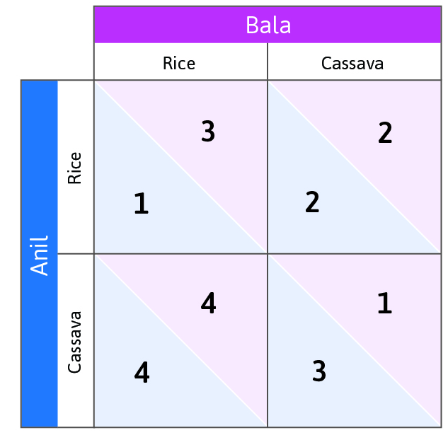
EC107 Economics 1 2019-20
Games and Strategies
A game describes a social interaction:
Players – who is involved in the interaction
Feasible strategies – actions each player can take
Information – what each player knows when choosing their action
Payoffs – outcomes for every possible combination of actions

Slide 5
EC107 Economics 1 2019-20
Example of a strategic interaction:
Crop choice
Two farmers decide which crop to specialize in.
They interact only once (one-shot game).
Players – Anil and Bala.
Feasible strategies – Rice or Cassava
Information – Each farmer does not know what the other will choose
Payoffs – depend on market prices and quality of land.

Slide 6
EC107 Economics 1 2019-20
Crop choice with Optimal decision-making
Suppose you are Anil
What is your best response strategy if Bala chooses Rice?
What is your best response strategy if Bala chooses Cassava?
Do you have a dominant strategy?
Does Bala have a dominant strategy?

Slide 7
EC107 Economics 1 2019-20
Crop choice with Optimal decision-making
Best response: Strategy that yields the highest payoff, given the other player’s strategy
Dominant strategy: A best response to all possible strategies of the other player (does not always exist!)
Dominant strategy equilibrium: An outcome of a game in which everyone plays their dominant strategy
What can you say about the equilibrium in this game?

Slide 8
EC107 Economics 1 2019-20
Crop choice with Optimal decision-making
Best response: If Bala grows rice, Anil’s best response is to grow cassava. If Bala grows cassava, Anil’s best response is to grow cassava.
Dominant strategy: Anil’s dominant strategy is to grow cassava. Bala’s dominant strategy is to grow rice.
Dominant strategy equilibrium: When Anil and Bala each play their dominant strategy, the outcome is (Cassava, Rice).

Slide 9
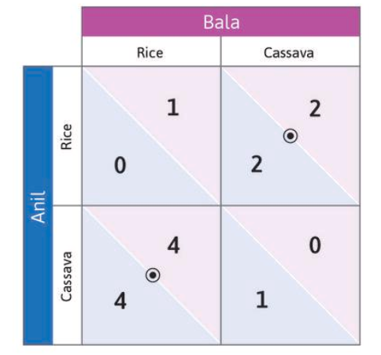
EC107 Economics 1 2019-20
Nash equilibrium
Different pay-offs
Note how we have changed the payoffs in the payoff matrix
What do you think is the new equilibrium?
Is Cassava (by Anil) and Rice (by Bala) still an equilibrium?
[Previously, it was the unique (dominant strategy) equilibrium.]
What about Cassava (by Bala) and Rice (by Anil)? Might this now also be an equilibrium?

Slide 10
EC107 Economics 1 2019-20
Nash equilibrium
Different pay-offs
Nash equilibrium: A set of strategies (one per player), such that each player’s strategy is the best response to the strategies chosen by everyone else.
In a Nash equilibrium, no player has an incentive to deviate unilaterally.
NOTE: There may be more than one Nash equilibrium in a game.

Slide 11
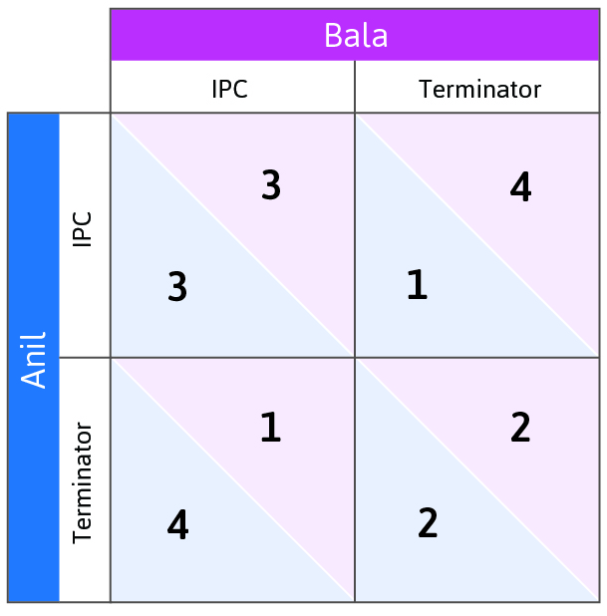
EC107 Economics 1 2019-20
Resolving Social Dilemmas
Anil and Bala are choosing between two alternative pesticides, IPC and Terminator.
What would be the socially optimal outcome (where the social optimum is the outcome which maximises the sum of the payoffs of the two agents)?
And what would be the strategy choices of the two agents and hence the equilibrium?

Slide 12
EC107 Economics 1 2019-20
Resolving Social Dilemmas
Prisoner’s Dilemma = A game with a
dominant strategy equilibrium, in which
playing the dominant strategy
yields lower individual and total payoffs compared to other strategies
The socially optimal outcome is not achieved
Pesticide example: Both farmers choose to use the more harmful pest control (T).

Slide 13
EC107 Economics 1 2019-20
What assumptions drive the failure to achieve the social optimum?
1. Players only care about their own payoffs.
Possible solution: Introduce social preferences
2. Nobody could make players pay for the consequences of their actions on others.
Possible solution: Introduce repeated games, social norms, and peer punishment
3. Players could not coordinate their actions beforehand
Possible solution: Change the rules of the game (institutions and policies)

Slide 14
EC107 Economics 1 2019-20
Understanding preferences
Economists sometimes use experiments to learn about preferences.
1. Lab experiments:
Can control participants’ decisions and their outcomes.
Can create a control/treatment group for comparison.
Results can be replicated.
Can control for the possible influence of other variables.
2. Field experiments:
Lab experiments may not predict real-world decision making.
More realistic context in which people make decisions.

Slide 15
EC107 Economics 1 2019-20
Social preferences: the case of altruism
Social dilemmas arise when players only care about their own payoffs.
However, in experiments, many players show altruism by choosing the dominated strategy.
Altruistic preferences affect the shape of indifference curves…

Slide 16
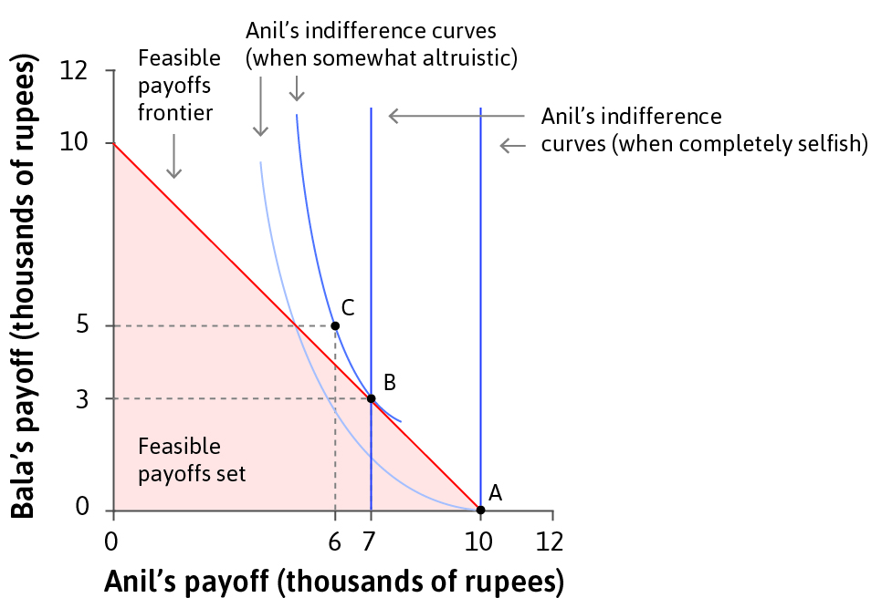
EC107 Economics 1 2019-20
Social preferences: the case of altruism
Altruistic preferences affect the shape of indifference curves…
Consider Anil’s preferences over two goods X and Y where:
X is Anil’s payoffs
Y is Bala’s payoffs
If Anil is completely self-regarding (or ‘selfish’), what do their ICs look like?
Hence what payoff would they choose?

Slide 17
EC107 Economics 1 2019-20
Social preferences: the case of altruism
Altruistic preferences affect the shape of indifference curves…
If, instead, Anil cared about Bala’s payoffs, then Anil’s ICs would be downward-sloping (check that you are confident you follow the reasons for this).
Hence, Anil will choose outcomes like B, which is now on a higher IC than A (whereas A was chosen over B by a selfish version of Anil).

Slide 18
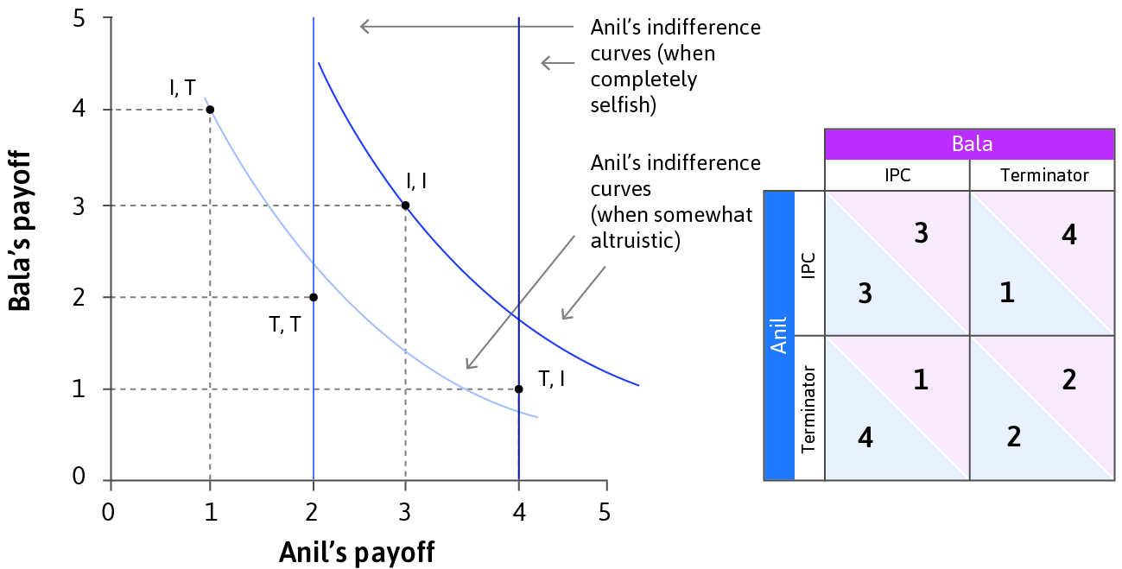
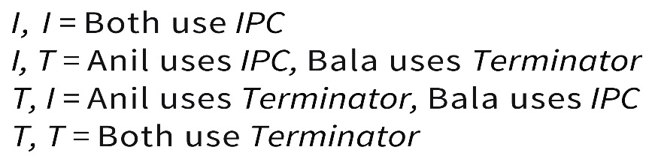
EC107 Economics 1 2019-20
Resolving the prisoners’ dilemma
Payoffs as before=> PD
Pesticide example: If Anil is somewhat altruistic, then his dominant strategy is I instead of T.

Slide 19
EC107 Economics 1 2019-20
Other forms of Social Preferences
Inequality aversion: Disliking outcomes in which some individuals receive more than others
Reciprocity: Being kind/helpful to others who are kind/helpful, and vice versa.
Kantian Imperative: pursuing a duty to do that which if universalized would lead to the social optimum
We evaluate whether others have been ‘kind’ or ‘helpful’ according to social norms (common understanding of how to act in situations when one’s actions affect others).
These motives can affect outcomes in the public goods game and the ultimatum game.

Slide 20
EC107 Economics 1 2019-20
Repeated Games
We have so far looked at one-shot games, in which the agents interact just once.
Better outcomes can arise in repeated interactions due to social norms, reciprocity, and peer punishment.
Behaving selfishly in one period has consequences in future periods, so it may no longer be a dominant strategy.

Slide 21
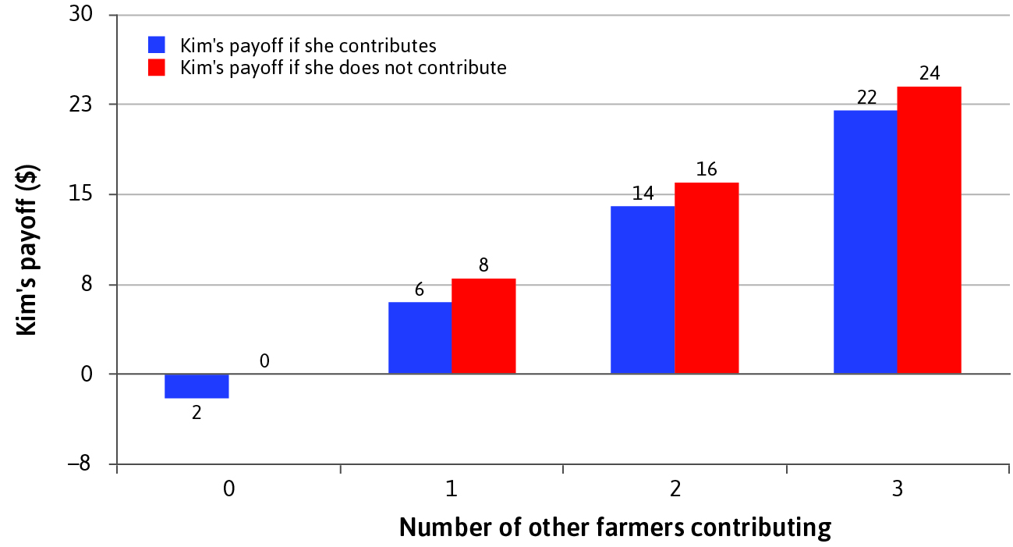
EC107 Economics 1 2019-20
Public goods game: farming example
There is a group of farmers.
Each farmer decides whether to contribute to the public good (e.g. irrigation project).
Contributing has a personal cost, but everyone benefits.
Prisoner’s dilemma with more than two people: Not contributing (free riding) is a dominant strategy.

Slide 22
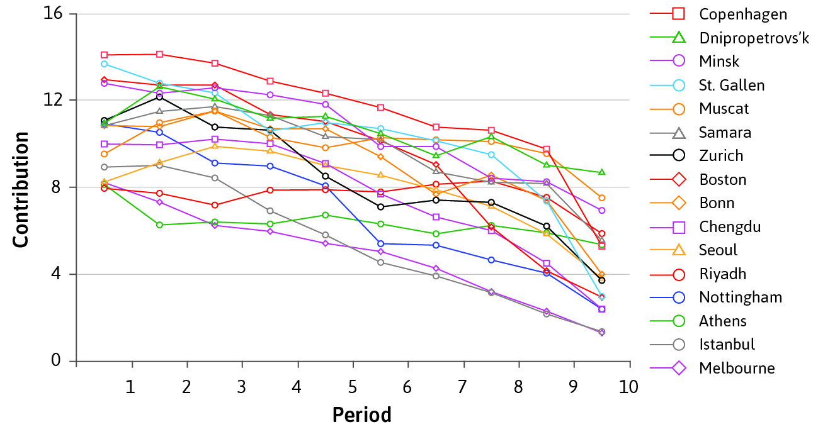
EC107 Economics 1 2019-20
Reciprocity and Social Norms
In public goods experiments, people were happy to contribute as long as others reciprocate. Contributions differ according to social norms.

Slide 23
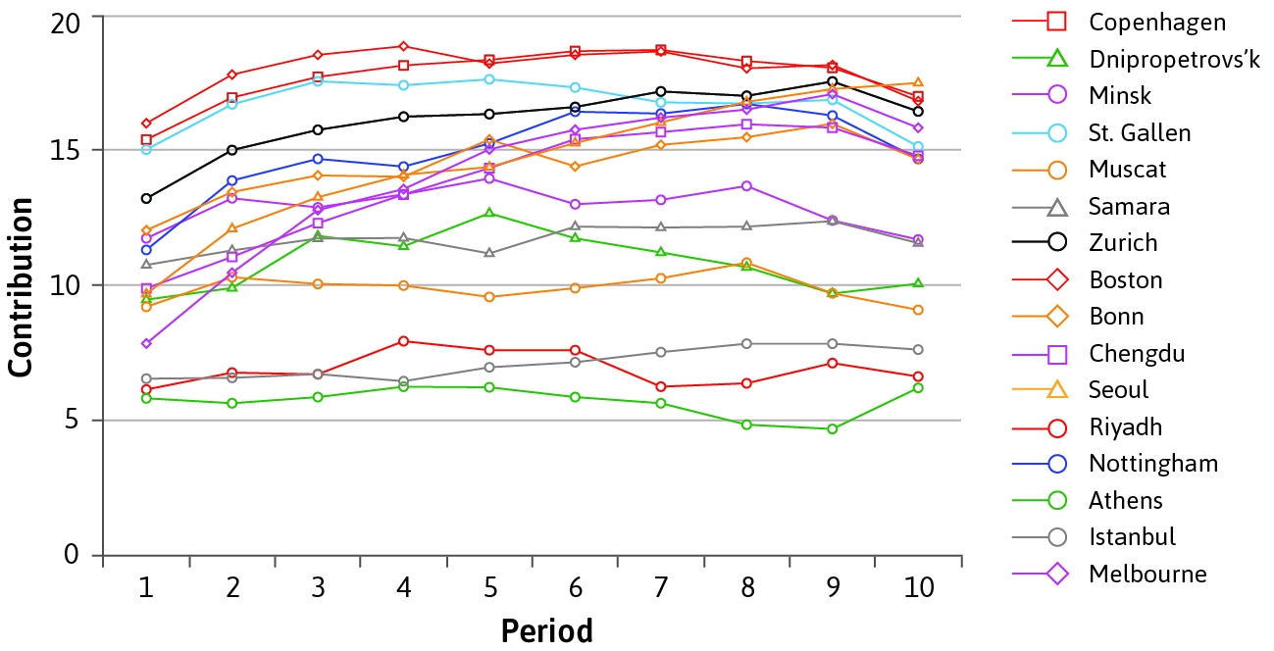
EC107 Economics 1 2019-20
Reciprocity with Peer Punishment
The ability to identify and punish free-riders
also increases individual contributions.

Slide 24
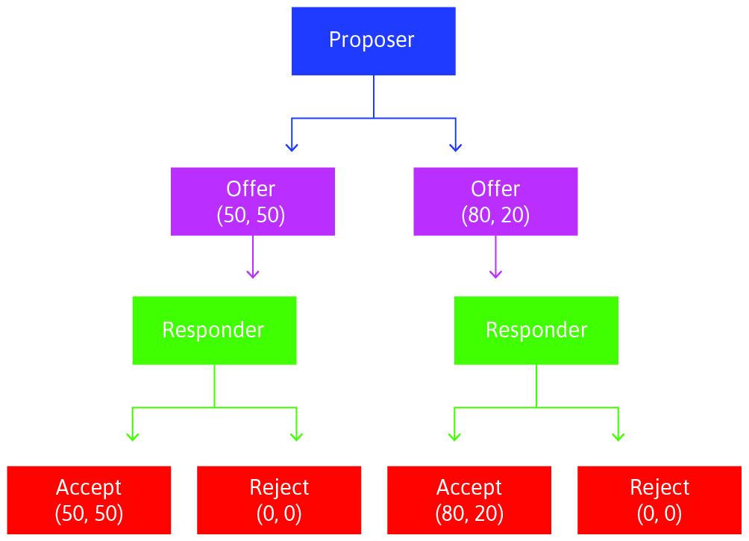
EC107 Economics 1 2019-20
Bargaining and sharing rents: The Ultimatum Game
A sequential game where players choose how to divide up
economic rents e.g. cash prize
The proposer’s offer may be motivated by altruism,
fairness (50-50 split),
inequality aversion,
social norms, or reciprocity.
But what is the ‘Rational’ offer from the proposer? Play the Ultimatum Game with your neighbour…

Slide 25
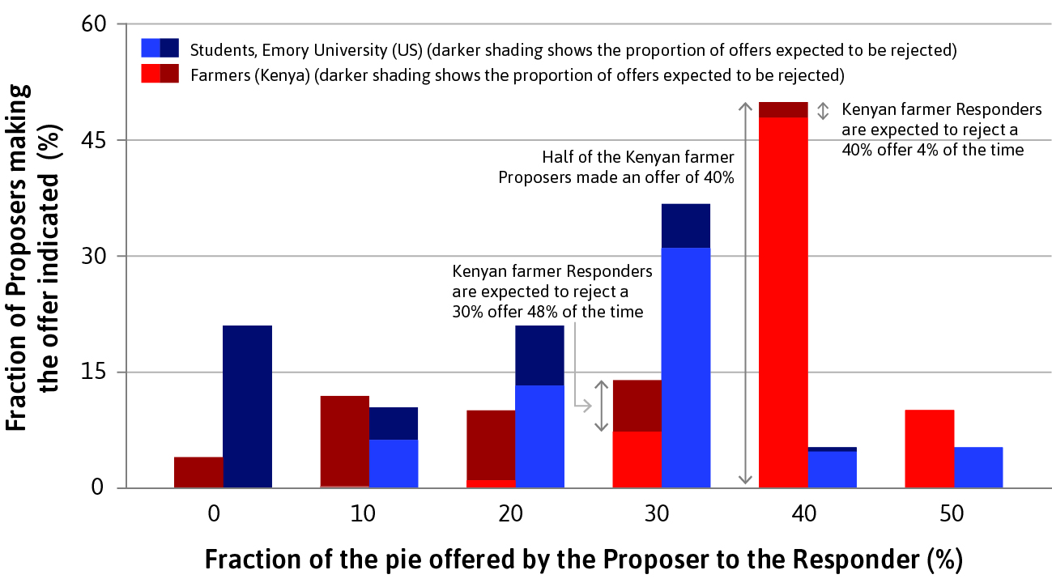
EC107 Economics 1 2019-20
The Ultimatum Game: an experiment
Offers are consistent with social preferences, but also with expected payoff maximization

Slide 26
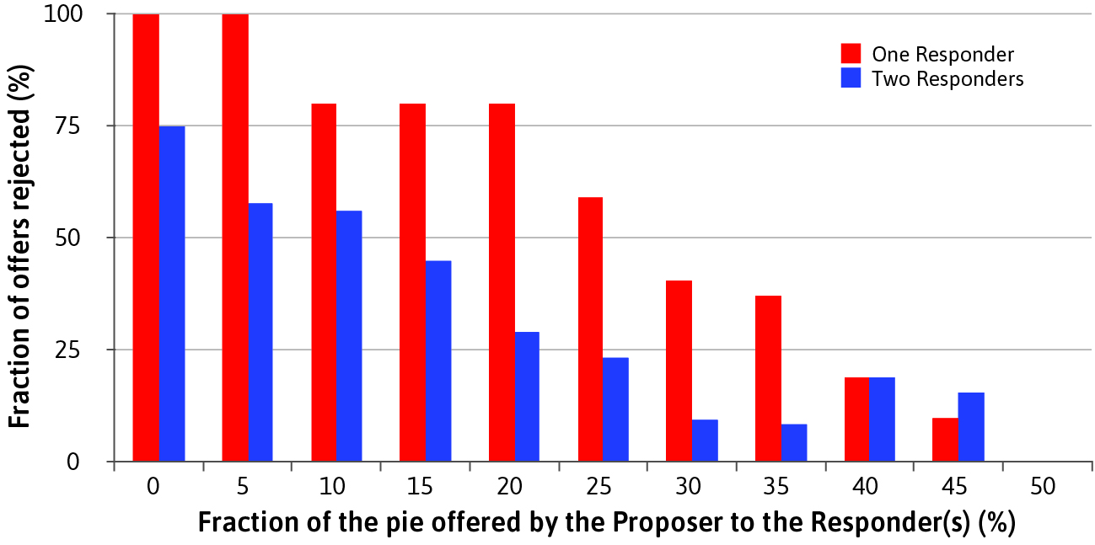
EC107 Economics 1 2019-20
The Ultimatum Game: with competition among responders
Introducing competition between responders moves outcomes closer to the self-interested outcome.
The Rules of the Game matter.

Slide 27
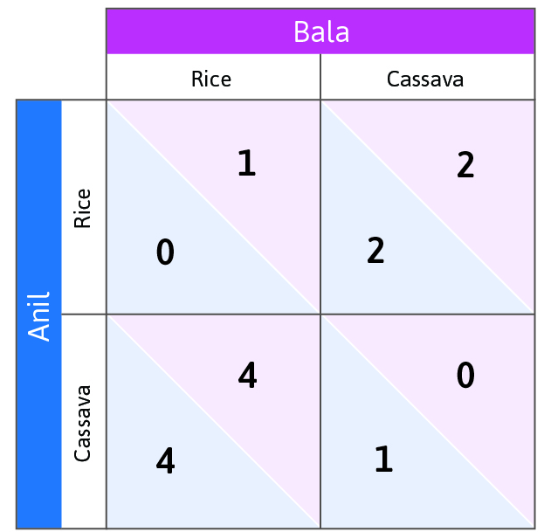
EC107 Economics 1 2019-20
Coordination Issues
When there is more than one Nash equilibrium and individuals choose independently, the socially optimal outcome may not be selected.
Society could be “stuck” in a suboptimal outcome since there is no incentive to unilaterally change one’s action.
Communication or a Summit of some kind might be needed in order for the different parties to be able to ‘jump’ to the socially optimal outcome.
What applications can you think of for this problem of coordination?

Slide 28
EC107 Economics 1 2019-20
Summary of Lecture 4
1. Social interactions can be modeled as games
Players choose best responses to others’ strategies
2. Social dilemmas e.g. prisoners dilemma can be resolved by social preferences, peer punishment, or binding agreements
The rules of the game also matter for outcomes
3. Multiple Nash equilibria can cause coordination problems
Economic and political institutions can help achieve socially optimal outcomes

