Slide 1
EC107 Economics 1 2019-20
Property and Power: Mutual Gains and Conflict
This Lecture follows closely CORE: Unit 5
Context
Institutions (the rules of the game) matter for social outcomes (see Unit 4).
Institutions can affect the income that people receive for their work (see Unit 2).
What other factors determine final outcomes?
What other criteria can we use to evaluate outcomes?
How can we improve final outcomes?

Slide 2
EC107 Economics 1 2019-20
Property and Power: Mutual Gains and Conflict
In this Lecture, we will:
Consider how institutions and power determine outcomes or allocations
Evaluate these allocations using the Pareto-efficiency condition and fairness criteria
Show how policies can improve outcomes

Slide 3
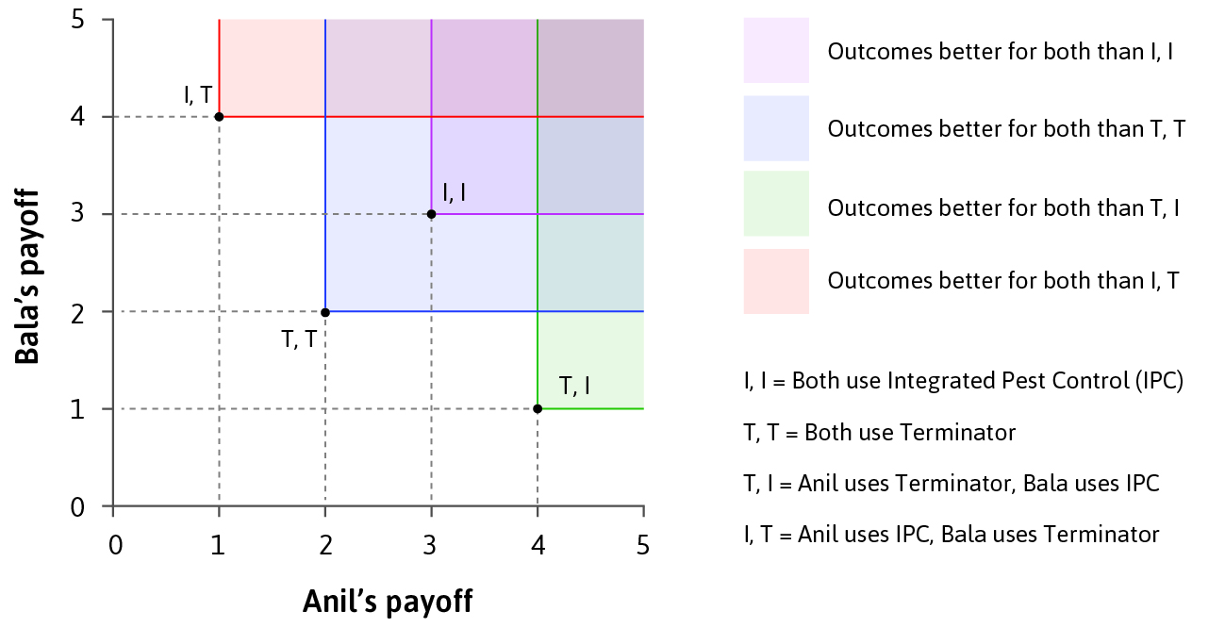
EC107 Economics 1 2019-20
Pareto Efficiency

Slide 4
EC107 Economics 1 2019-20
Pareto Efficiency
Allocation: outcome of an economic interaction. (Describes who does what, and who gets what)
An allocation is Pareto efficient if nobody can be better off without making somebody worse off.

Slide 5
EC107 Economics 1 2019-20
Pareto Efficiency
An allocation is Pareto efficient if nobody can be better off without making somebody worse off.
Pesticide example
Compare just the 4 allocations shown in the Figure:
(I,I) Pareto-dominates (T,T);
(I,I), (I,T), and (T,I) are all Pareto efficient.

Slide 6
EC107 Economics 1 2019-20
Pareto Efficiency: limitations
Often more than one Pareto efficient allocation. Pareto criterion does not help us choose among these allocations.
Pareto efficiency is unrelated to fairness. Many allocations that could be unfair are Pareto efficient e.g. giving to your friend 1 cent of the $100 you found on the street.
At least at first sight, (I, I) looks fairer than (I, T) or (T, I).

Slide 7
EC107 Economics 1 2019-20
Fairness
Allocations can be considered unfair for two reasons:
1. Inequality of final outcome (e.g. wealth, well-being)
Substantive judgement of fairness
2. How they came about (e.g. force vs. fair play, equal opportunity, conforming to social norms)
Procedural judgement of fairness
Hence we need to evaluate the rules of the game as well as the outcome.
Note Rawls’ “Veil of ignorance”, for taking an impartial perspective

Slide 8
EC107 Economics 1 2019-20
Fairness and Economics
Economics does not provide judgments about what is fair.
But economics can clarify:
How institutions (rules of the game) affect inequality
Tradeoffs in the fairness of outcomes e.g. giving up equality of income for equality of opportunity
Which public policies can address unfairness, and how

Slide 9
EC107 Economics 1 2019-20
What determines the nature of allocations?

Slide 10
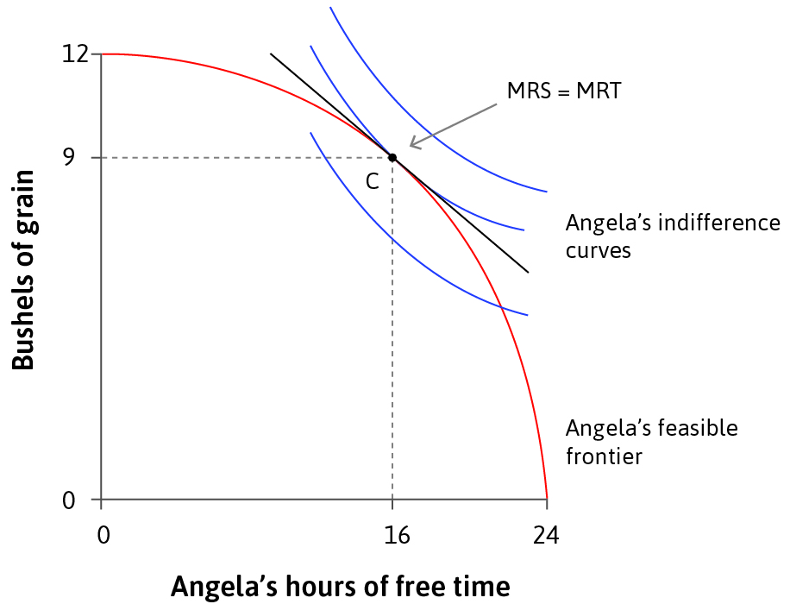
EC107 Economics 1 2019-20
What determines the nature of allocations?
Example: the trade-off between grain and free time
Re-cap from Lecture 3:
Angela faces a tradeoff between grain and free time.
Initially, she farms the land by herself and keeps all the grain.
Recall optimal decision making (Unit 3): allocation is where
MRS = MRT

Slide 11
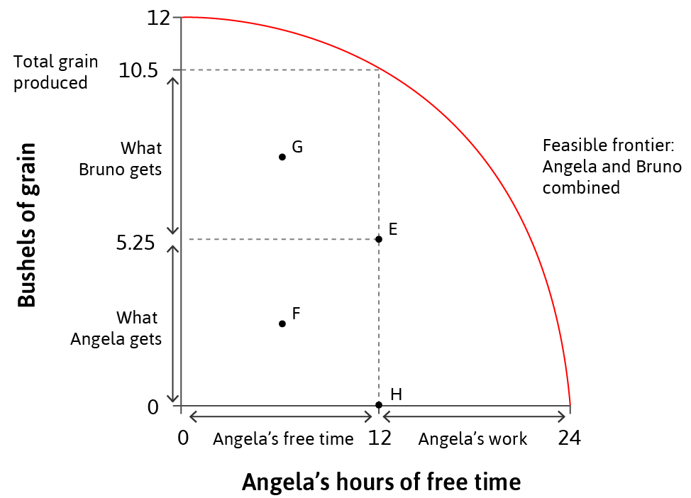
EC107 Economics 1 2019-20
What determines the nature of allocations?
The combined feasible set
Bruno is not a farmer, but makes a claim for some of Angela’s grain. Think of Angela as the farmer and Bruno as a landowner. Angela has no right to use the land unless Bruno chooses to grant her a right in return for a share of the crop Angela produces.
The combined feasible set shows all possible allocations of production between two parties.
The chosen allocation depends on institutions and policies.

Slide 12
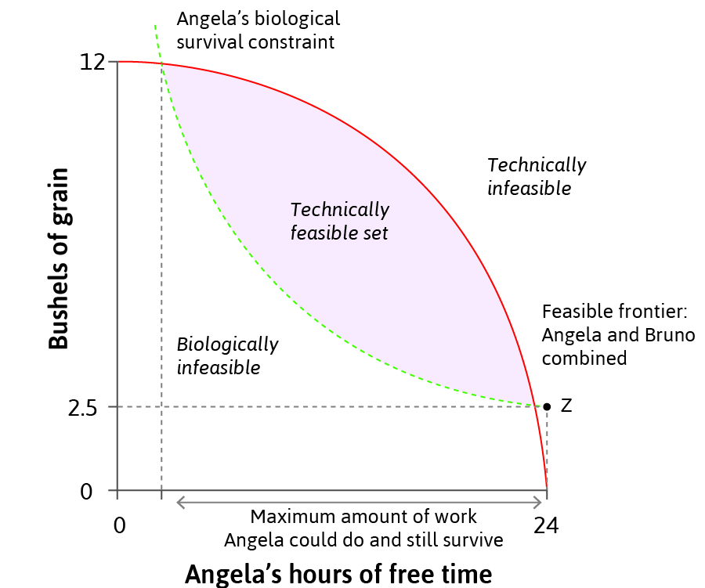
EC107 Economics 1 2019-20
What determines the nature of allocations?
Feasible allocations
The feasible frontier shows
all the technically feasible outcomes (limited by technology and by resources).
The biological survival constraint shows all the biologically feasible outcomes (limited by survival).
Feasible allocations are given by the intersection of these constraints.

Slide 13
EC107 Economics 1 2019-20
What determines the nature of allocations?
The biological survival constraint and ICs
Note how Angela’s biological survival constraint differs from her Indifference Curves.
Notice in particular that Angela has a Reservation Indifference Curve which will differ from biological survival constraint.
The Reservation IC shows combinations of Grain and Free Time which yield the same utility to Angela as not working and hence as having just 2.5 bushels of grain (so it passes through Z).

Slide 14
EC107 Economics 1 2019-20
What determines the nature of allocations?
A specific assumption about ICs
To make our analysis as simple as possible, we are assuming that for any amount of free time she takes, Angela’s MRS is the same regardless of how much grain she has.
So, for example, when Angela has 15 hours of free time, the tangents to each and every one of her ICs are parallel to each other – meaning that her MRS is constant at 15 hours. We assume that this is also true at any number of hours.
The ICs are just ‘vertical translates’ of each other.
Bushels of grain
15
Angela’s hours of free time

Slide 15
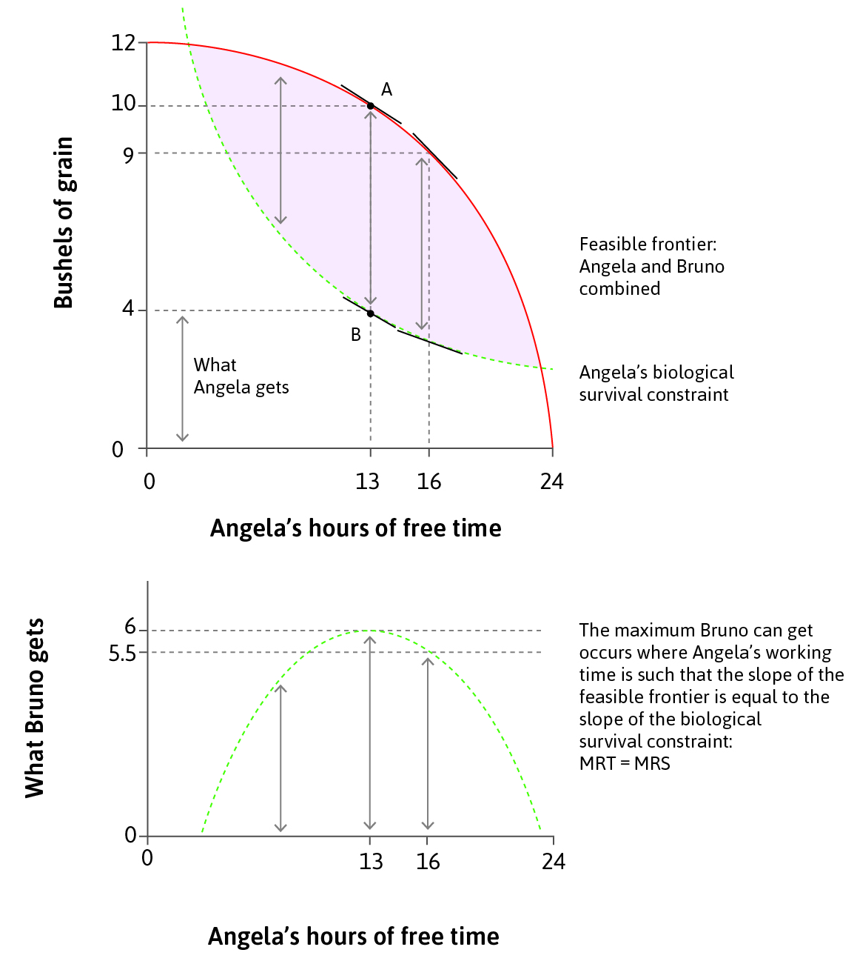
EC107 Economics 1 2019-20
What determines the nature of allocations?
Coercion: Imposing allocations by force
Suppose Bruno can enforce any allocation he wants – in effect, Angela is his property.
The allocation that maximises his economic rent is where the slope of the biological constraint (MRS) equals the slope of the feasible frontier (MRT).
MRS = MRT
Note how this differs from the free choice Angela would choose were she the landowner. Angela’s Preferences (ICs) are irrelevant under coercion: only her biological constraint matters.

Slide 16
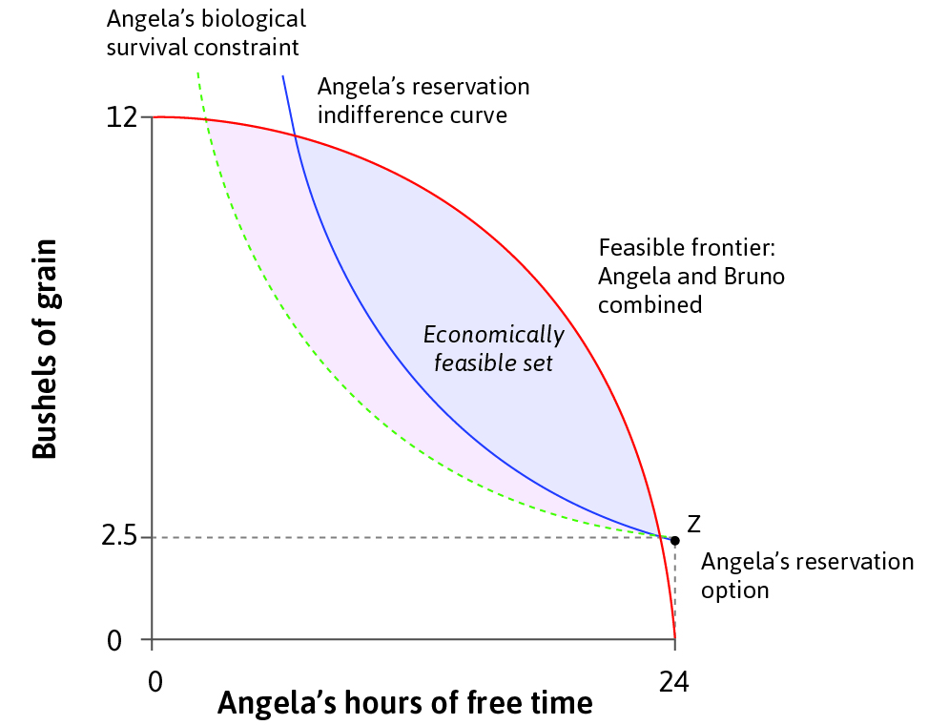
EC107 Economics 1 2019-20
What determines the nature of allocations?
Voluntary exchange: Bargaining
Suppose that Angela and Bruno are now both ‘free agents’: i.e., free from coercion by the other party.
How they divide up the joint surplus (and achieve mutual gains from voluntary exchange) depends on:
Each party’s reservation option
The relative bargaining power between the parties
The economically feasible set shows all possible allocations that benefit both parties.
Technically feasible, but unacceptable to Angel as below her reservation indifference curve

Slide 17
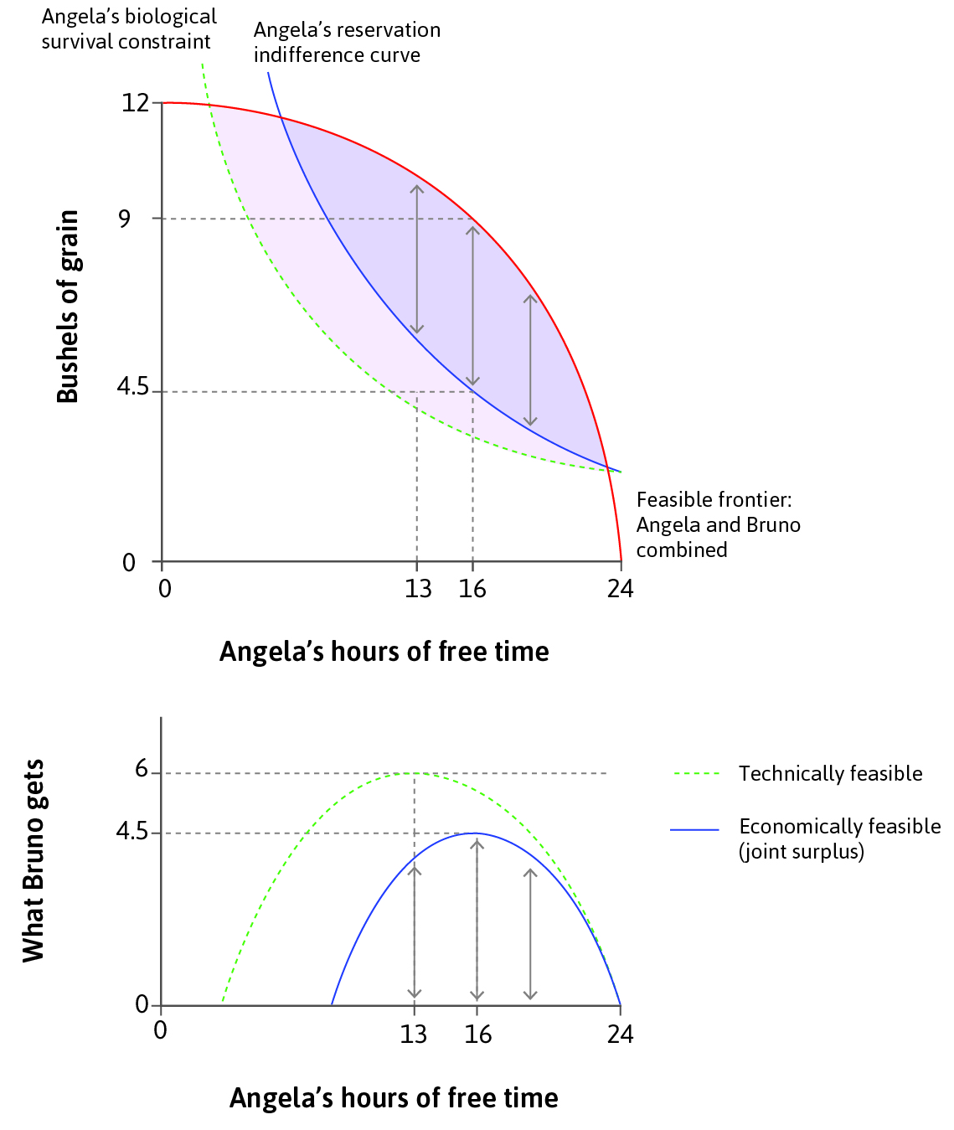
EC107 Economics 1 2019-20
What determines the nature of allocations?
Voluntary exchange: Bargaining
When Angela is free to choose how much free time to take (and hence how much output to produce) in a voluntary contract, the outcome will be within the economically feasible set. Within this set, both Angela and Bruno can be better off than without a deal.
In the diagram, the joint surplus is maximized when the Angela chooses free time (and hence work hours) such that the slope of the feasible frontier (i.e., the MRT) is just equal to the slope of Angela’s reservation indifference curve (i.e., her MRS).

Slide 18
EC107 Economics 1 2019-20
What determines the nature of allocations?
Voluntary exchange: Bargaining
Suppose that legal or other arrangements mean that Bruno has all the ‘bargaining power’ within a voluntary exchange. He would want to offer Angela a contract which she would just be prepared to accept – i.e., that was just on her reservation IC. She wouldn’t accept any outcome on a lower IC as she can choose to walk away from such a deal.
Bruno will choose to offer Angela the outcome at D: the point on Angela’s Reservation IC which maximizes the surplus (the vertical distance CD) accruing to Bruno; with Angela working…
C
D

Slide 19
EC107 Economics 1 2019-20
What determines the nature of allocations?
Voluntary exchange: Bargaining
Bruno will choose to offer Angela the outcome at D: the point on Angela’s Reservation IC which maximizes the surplus (the vertical distance CD) accruing to Bruno with Angela working…
24 – 16 = 8 hours (less than under coercion)
and keeping 4.5 bushels (more than under coercion).
Bruno receives 4.5 bushels (= 9 – 4.5: less than when he was able to coerce Angela, constrained only by her biological survival constraint).
Bruno captures all the surplus, CD.
9
C
4.5
D
16

Slide 20
EC107 Economics 1 2019-20
What determines the nature of allocations?
Voluntary exchange: Bargaining
How might the bargaining and the contracting proceed? For example, what rent will Bruno charge to Angela for the opportunity to farm his land?
We assume that Bruno is aware of Angela’s ICs, including her Reservation IC. Hence, he knows that Angela will choose to work for 8 hours.
He also knows that when she works 8 hours, the minimum she would accept is 4.5 bushels of grain.
So that’s the contract he offers: effectively, he charges her a rent to farm his land. The rent is equal to: 9 – 4.5 = 4.5 bushels of grain.
9
C
4.5
D
16

Slide 21
EC107 Economics 1 2019-20
What determines the nature of allocations?
Coercion vs Bargaining
Under coercion, the allocation chosen is where the slope of the biological constraint equals the slope of the feasible frontier.
Without coercion, joint surplus is maximized where the slope of the reservation indifference curve equals that of the feasible frontier Previous Slide).
Total surplus is lower when both parties have to agree to the proposal. Coercion forces Angela to work more hours than she would choose (and hence produce more output) given the amount of grain she receives (i.e., the bare survival level).

Slide 22
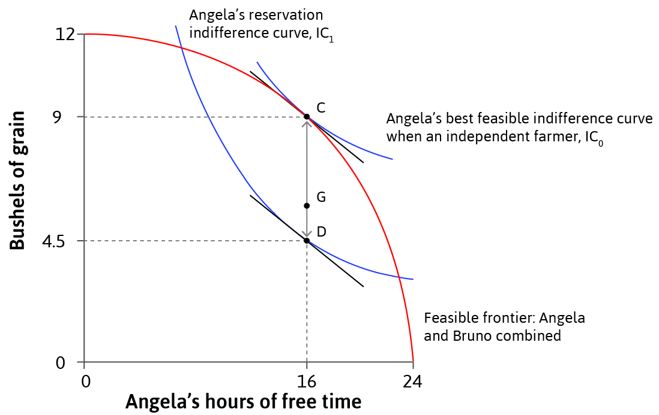
EC107 Economics 1 2019-20
What determines the nature of allocations?
Voluntary exchange: Bargaining
When Bruno can make a take-it-or-leave-it offer, the outcome is at D.
More generally, we have seen that the joint surplus is maximized whenever the outcome is along the section CD in the economically feasible set: i.e., where the slope of the feasible frontier (the MRT) is just equal to the slope of Angela’s reservation indifference curve (her MRS).
CD identifies the ‘contract curve’.

Slide 23
EC107 Economics 1 2019-20
What determines the nature of allocations?
Voluntary exchange: Pareto Efficient Bargaining
The allocation chosen will be on the Pareto efficiency or Contract curve (the line segment CD).
At C, Angela gets all the surplus.
At D, Bruno gets all the surplus.
An any other point on the Contract curve, Angela and Bruno split the surplus, and each will receive an economic rent arising from their voluntary exchange.

Slide 24
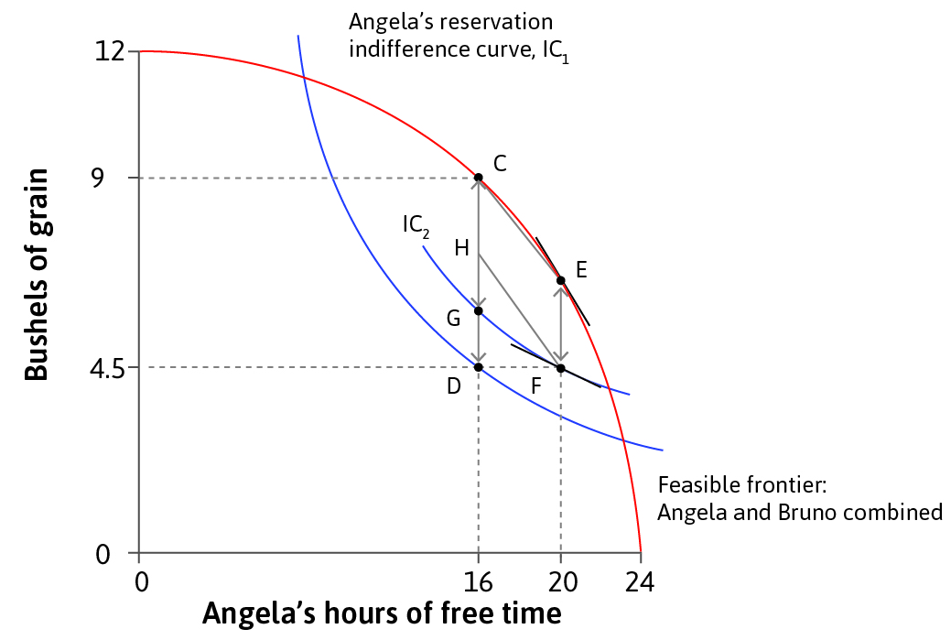
EC107 Economics 1 2019-20
What determines the nature of allocations?
Voluntary exchange: Institutions and Policies
A law that regulates working hours and pay gives Angela more bargaining power.
Suppose that Angela and workers on other farms lobby successfully for a new law which restricts maximum required hours to 4 (i.e., minimum free time to 20), while stipulating a minimum pay of 4.5 bushels.
Angela’s reservation option is now F.

Slide 25
EC107 Economics 1 2019-20
What determines the nature of allocations?
Voluntary exchange: Institutions and Policies
Angela’s reservation option is now F and her new reservation IC is IC₂. Bruno cannot legally enforce on Angela a contract on a lower IC than IC₂. He cannot offer less than 4.5 bushels and he cannot require her to accept less than 20 hours of free time.
Angela cannot be required to work for more than 4 hours, but she is permitted to choose to work for more if that is her free choice.
In order to incentivise Angela to work the surplus-maximizing 8 hours, Bruno must offer her…

Slide 26
EC107 Economics 1 2019-20
What determines the nature of allocations?
Voluntary exchange: Institutions and Policies
…Bruno must offer her …
…at least point G on the CG segment of the Contract Curve: i.e, with Angela retaining 6 bushels of grain (and hence paying a rent of 9 – 6 = 3 bushels).
Allocations must give each party at least as much as their reservation option. Bruno gets 3 bushels (his reservation option is…?). Angela gets 6 bushels and works 8 hours and is just indifferent relative to her new reservation option as she is on IC₂ in both cases.
The new law has made Angela better off and Bruno worse off.
6

Slide 27
EC107 Economics 1 2019-20
What determines the nature of allocations?
Voluntary exchange: Institutions and Policies
We have seen that:
Technology and biology determine which allocations are technically feasible.
Preferences influence which allocations are economically feasible (Pareto-improving). Institutions and policies also determine which allocations are economically feasible.
The allocation which emerges depends on parties’ preferences (what they want) and their bargaining power (their ability to get it) and hence on institutions and policies.

Slide 28
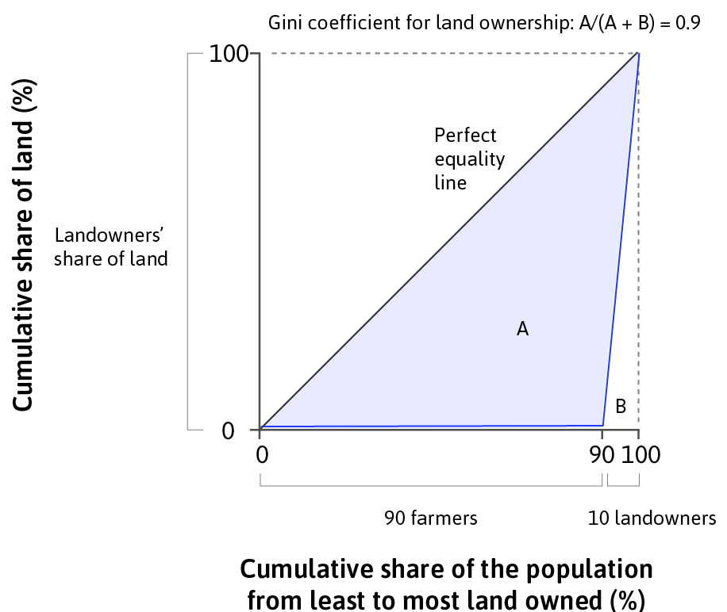
EC107 Economics 1 2019-20
Measuring Inequality
Lorenz curve: Shows the extent of inequality and allows comparison of distributions.
Gini coefficient: Measure of inequality, approximated as the deviation of the Lorenz curve from the perfect equality line.
Ranges from 0 (perfect equality) to 1 (maximum inequality).

Slide 29
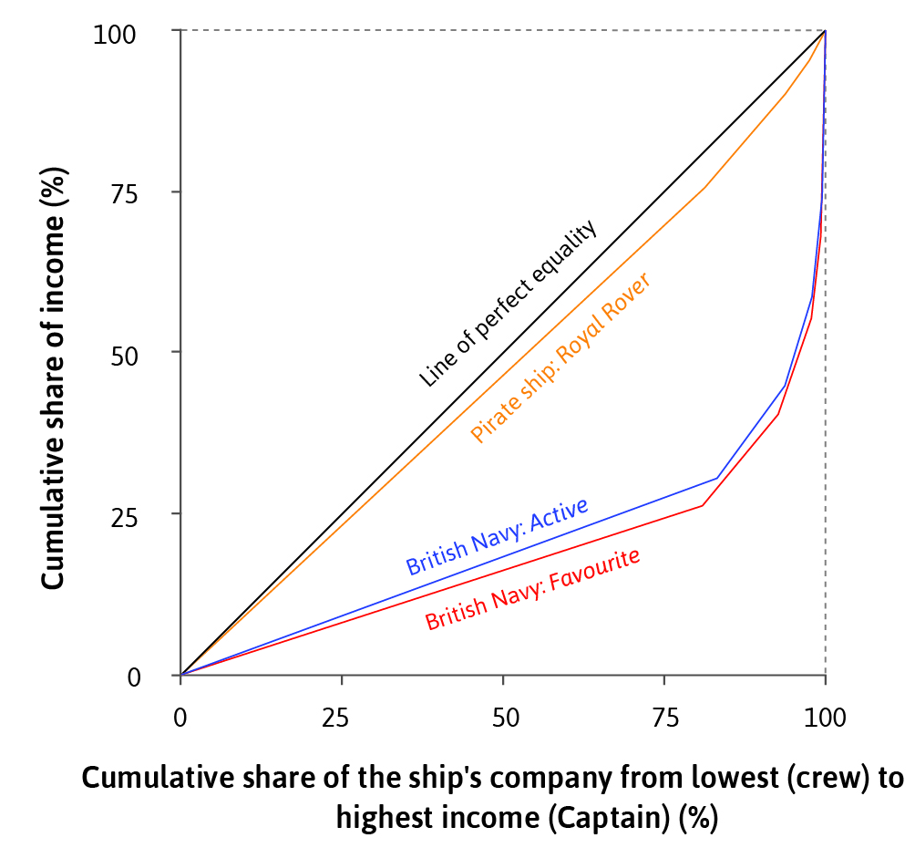

EC107 Economics 1 2019-20
Measuring Inequality: an example
Piracy was surprisingly fair and democratic – unlike in the British Navy, pirates on The Rover distributed their spoils relatively equally between crew members. Why do you think this was?

Slide 30
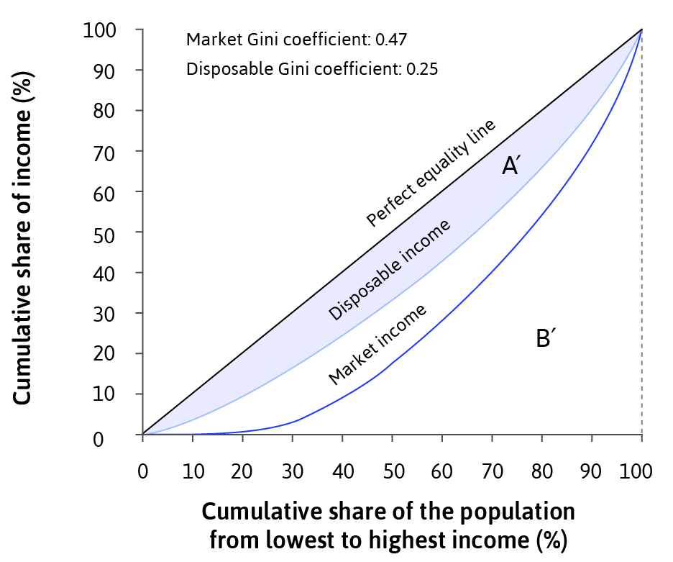
EC107 Economics 1 2019-20
Addressing Inequality
Redistributive government policies (income tax and transfers) can result in a more equal distribution of disposable income.
Differences in inequality in disposable income across countries depends on the effectiveness of these policies.

Slide 31
EC107 Economics 1 2019-20
Addressing Inequality: Operation Barga
Before 1973, land distribution in West Bengal was highly unequal - a few landowners owned all the land.
Sharecroppers usually gave half their crop to the landowners.
Income inequality – 73% rural poverty rate in 1973.

Slide 32
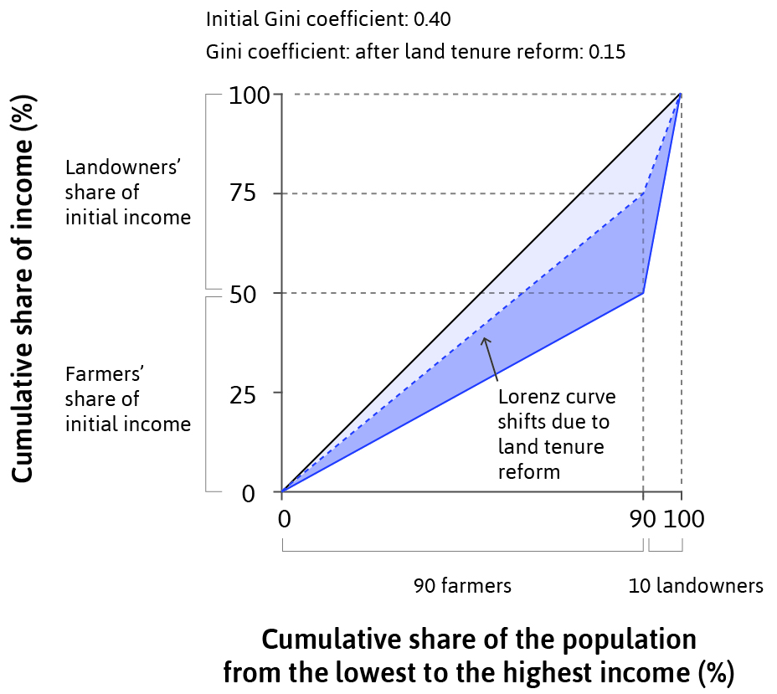
EC107 Economics 1 2019-20
Addressing Inequality: Operation Barga
Land tenure reform allowed farmers to keep a greater share of their crop, and protected them from eviction.
Decreased income inequality.
Work motivation and agricultural productivity also improved.

Slide 33
EC107 Economics 1 2019-20
Summary
1. Two criteria used to evaluate outcomes
Objective: Pareto efficiency
Subjective: Fairness (substantive and procedural justice)
2. Allocations depend on preferences and power/institutions
Institutions can determine reservation options and bargaining power
The Gini coefficient measures the inequality of allocations
Public policies can make allocations more efficient or fairer

