Slide 1
EC107 Economics 1 2019-20
The Firm: Owners, Managers and Employees
This Lecture follows closely CORE: Unit 6
Context
In models of economic interactions, bargaining determines the division of social surplus. (See Lecture 5)
All parties can potentially gain from these interactions, but have conflicting interests over how the gains (profits) are shared.
How are wages determined within firms?
What are the economy-wide effects of firm interactions?

Slide 2
EC107 Economics 1 2019-20
What is a Firm?
Firm = a business organization which:
Employs people
Purchases inputs to produce market goods and services
Seeks to set prices greater than the cost of production
“The firm in a capitalist economy is a miniature, privately owned, centrally planned economy.”

Slide 3
EC107 Economics 1 2019-20
Firms vs Markets
In a capitalist economy, the division of labour is coordinated in two ways: firms and markets.
Coordination within firm differs from coordination via markets:
concentration of economic power in the hands of the owners/managers within firms allows them to issue commands to workers
Power is decentralized in markets, so decisions are autonomous and voluntary

Slide 4
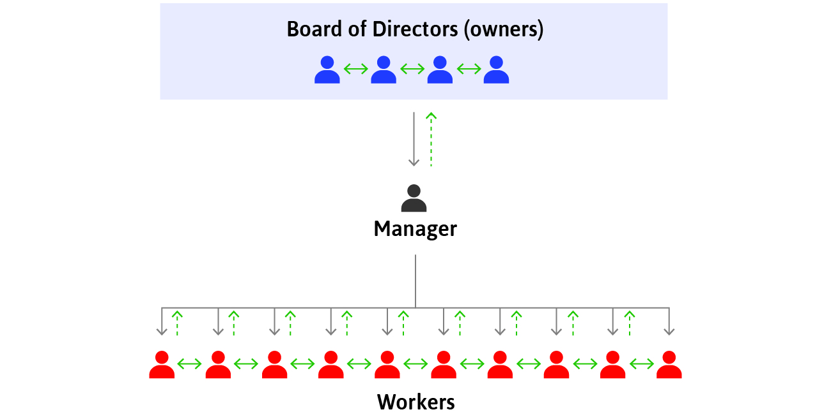
EC107 Economics 1 2019-20
Structure of a Firm
Owners decide on long-term strategy
Managers implement their decisions by assigning tasks to workers and monitoring them

Slide 5
EC107 Economics 1 2019-20
Contracts
Firms and markets differ in the contracts that form the basis of exchange.
Contract = a legal document or understanding that specifies a set of actions that parties to the contract must undertake.
Contracts for products sold in markets permanently transfer ownership of the good from the seller to the buyer.
Contracts for labour temporarily transfer authority over a person’s activities from the employee to the manager or owner.

Slide 6
EC107 Economics 1 2019-20
Relationships within a Firm
Unlike in most market relationships between firms, relationships within a firm may extend over a long period of time.
This enables:
creation of network of colleagues
acquisition of skills necessary for the job
These skills, networks, and friendships are often firm-specific assets.
They are valuable only while the worker remains employed in a particular firm.
When the relationship ends, value is lost to both sides.

Slide 7
EC107 Economics 1 2019-20
Separation of ownership and control
Managers ≠ owners
Separation of ownership and control = when managers decide on the use of other people’s funds.

Slide 8
EC107 Economics 1 2019-20
Separation of ownership and control: conflict of interests
The firm’s profits legally belong to the people who own the firm’s assets.
Managers’ actions have impact on profits
But if profits increase thanks to managers’ work, the managers themselves might not automatically benefit.
This creates a potential conflict of interest between managers and owners.

Slide 9
EC107 Economics 1 2019-20
Separation of ownership and control:
aligning interests
To solve the conflict of interest between managers and owners, owners might:
link the managers’ pay to the performance of the company’s share price
monitor the managers’ performance

Slide 10
EC107 Economics 1 2019-20
Incomplete Contracts
Hiring employees is different from buying other goods and services.
The contract between a firm and its employees is incomplete:
some tasks depend on future (unknown) events
some aspects of the job are difficult to measure and base wages on e.g. effort
An Incomplete Contract does not specify, in an enforceable way, every aspect of the exchange that affects the interests of parties.

Slide 11
EC107 Economics 1 2019-20
Contracts: Piece-rate Pay
Incomplete contracts are not a problem everywhere.
Piece rate work = a type of employment in which the worker is paid a fixed amount for each product made, overcoming the potential problems associated with trying to monitor or enforce effort.
Piece rate pay gives workers an incentive to exert effort.
Nevertheless, they are rarely used in most of today’s firms:
it is difficult to measure output in modern jobs
employees often work as a part of a team

Slide 12
EC107 Economics 1 2019-20
Contracts: Workers’ effort
If piece-rate pay is not appropriate and if firms can’t directly measure effort, why do workers work hard?
work ethic
feelings of responsibility
to reciprocate a feeling of gratitude for good working conditions
benefits for measurable output
promotions
fear of being fired

Slide 13
EC107 Economics 1 2019-20
Contracts: Employment rents
If employees are paid more than their reservation option = they receive employment rent.
Employees are likely to fear getting fired when they receive employment rents.
Employment rent = cost of job loss, which includes:
Risk that their skills will not become as valued in their next best alternative employment
Lost income while searching for a job
Costs required to start a new job e.g. relocation
Loss of non-wage benefits e.g. medical insurance
Social costs (stigma of being unemployed)

Slide 14
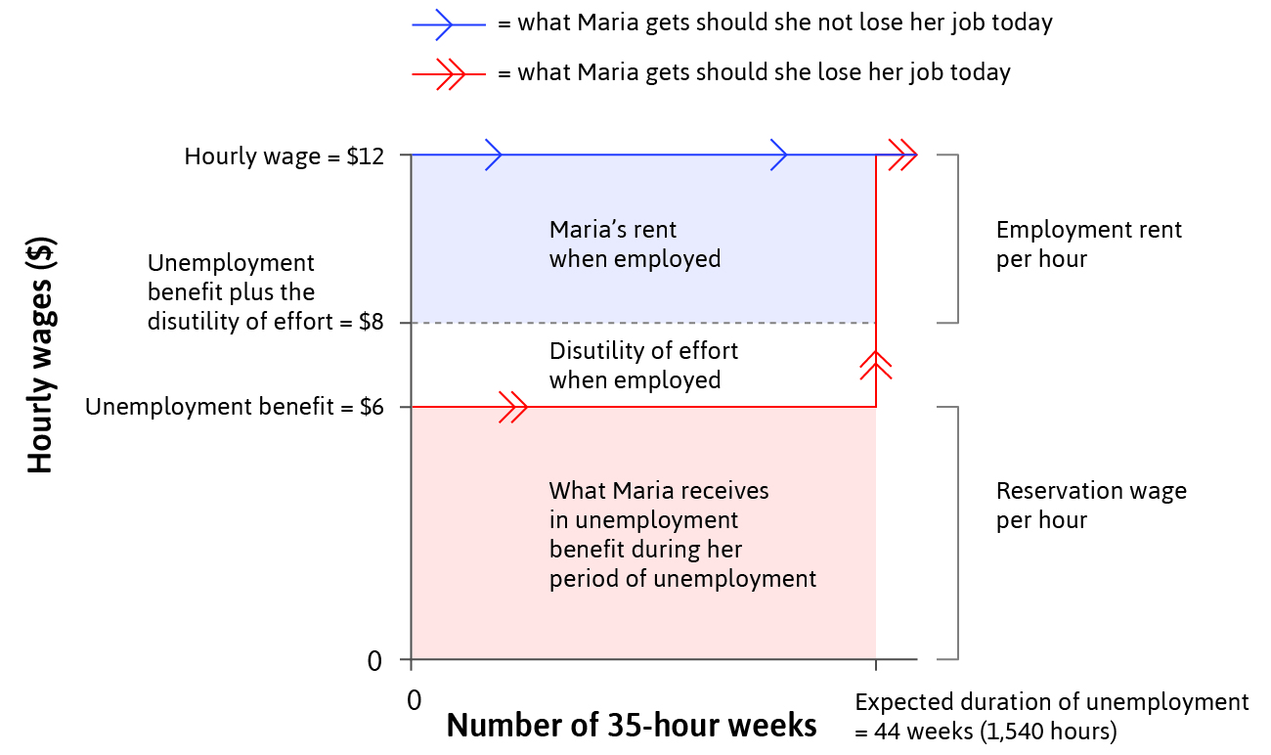
EC107 Economics 1 2019-20
Contracts: Calculating employment rents
Reservation wage = value of next best option (other employment or unemployment benefits).
Suppose Maria’s next best option is to be unemployed (perhaps there are no other jobs available to her), receiving $6 per hour.
Assume in her job, Maria has a disutility of effort equivalent to $2 per hour.
To be indifferent between keeping and losing her job, she would need to be earning $8 per hour. Her employment rent is the excess of her actual wage rate over this $8: hence in this case it is [$12 - $8 = $4] per hour.

Slide 15
EC107 Economics 1 2019-20
Contracts: Calculating employment rents
Of course, were Maria able to ‘shirk’ and expend no effort, she would suffer no disutility of effort.
In this case, to be indifferent between keeping and losing her job, she would need to be earning $6 per hour, her reservation wage.
Her employment rent per hour is now the excess of her actual wage rate over this $6: hence in this case it is [$12 - $6 = $6] per hour.

Slide 16
EC107 Economics 1 2019-20
Contracts:
The Labour Discipline Model of wages and effort
Assumption: The employer cannot directly measure the worker’s effort
If the employee enjoys a large employment rent
Then they will face a large cost of job loss
Hence, the worker will put in more effort to reduce the risk of getting fired
One way to increase the employee’s employment rent and hence the cost of job loss is for the firm to pay higher wages.

Slide 17
EC107 Economics 1 2019-20
Contracts
The Labour Discipline Model: an Employment Game in two stages
Players: The employer (firm) and the employee (worker: Maria).
Strategies: The employer chooses a wage level to offer. The worker chooses their effort level. We assume both agents are fully aware of payoffs to each associated with each possible outcome.
Stages of the Game:
Stage 1 The employer chooses a wage. As long as the worker works hard enough, she will keep her job at the offered wage.
Stage 2 The worker chooses a level of work effort, taking into account the costs of losing her job if she does not provide enough effort.
Payoffs:
Firm: profit = worker's output – wage
Worker: employment rent

Slide 18
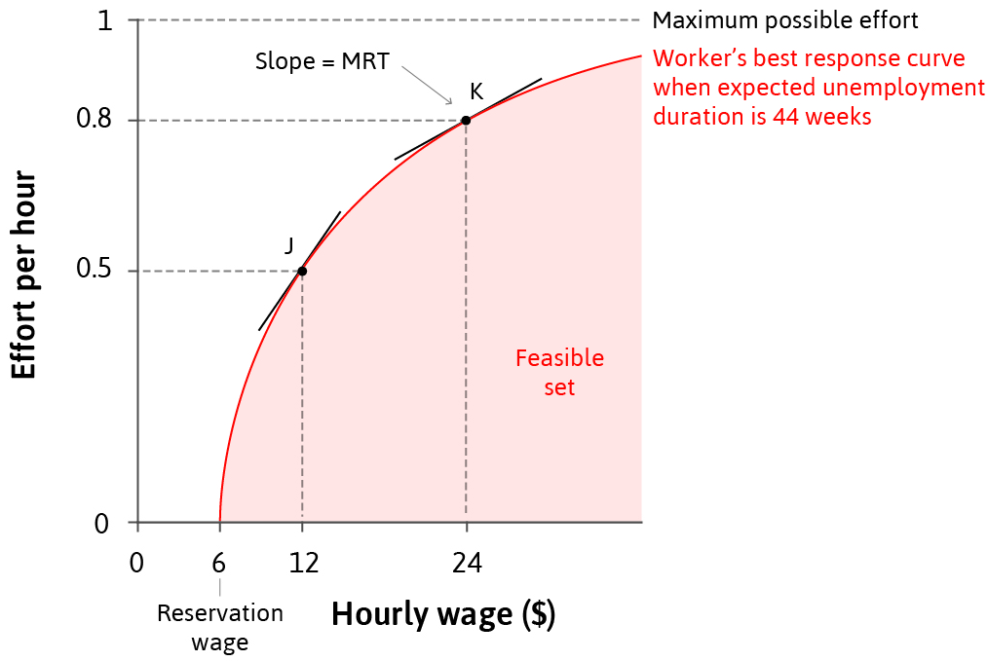
EC107 Economics 1 2019-20
Contracts
The Labour Discipline Model: an Employment Game in two stages
Note how when Maria is offered a wage of only $6 per hour (equal to her reservation wage), she expends no effort in her job. This is because she is indifferent between receiving her reservation wage in the job or losing her job if she is caught shirking. At only $6 per hour, Maria does not vaue the job highly enough to warrant putting in effort to keep the job.

Slide 19
EC107 Economics 1 2019-20
Contracts
The Labour Discipline Model: an Employment Game in two stages
But as the wage offer increases, Maria begins to enjoy employment rents and so will increasingly choose to expend effort to reduce the probability of losing the job.
The Best Response curve shows the optimal amount of effort workers will exert for each wage offered.
From the firm’s perspective, the Best Response curve represents the feasible frontier for wages and effort.
The slope of best response curve = MRT

Slide 20
EC107 Economics 1 2019-20
Contracts
The Labour Discipline Model: an Employment Game in two stages
The slope of best response curve = MRT
In this case, the MRT represents how a higher wage paid by the firm results in higher effort by the worker.
So the MRT captures numerically the trade-off the firm faces between the benefit it gains from higher worker effort and the cost it incurs from paying higher wages. The firm will try to select the profit-maximizing wage-effort combination. How does it do this?

Slide 21
EC107 Economics 1 2019-20
Contracts
The Labour Discipline Model: Iso-cost lines for effort
The firm will try to select the profit-maximizing wage-effort combination. How does it do this?
The wage w is just the cost of hiring a worker for an hour.
But if workers can choose their effort level, the important cost for the firm is the cost not of merely employing the worker for an hour, but the cost associated with obtaining a unit of effort from the worker.
This is w/e. The firm will want to minimize w/e.
Sometimes expressed as the firm will want to minimize the efficiency wage.
Equivalently, it will want to maximize e/w, the effort level per dollar of wage.

Slide 22
EC107 Economics 1 2019-20
Contracts
The Labour Discipline Model: Iso-cost lines for effort
The firm will try to minimize w/e.
In the diagram, if the firm pays a wage rate of $10 the resulting effort will be 0.45.
So w/e = 10/0.45 = 22.2.
One unit of effort costs the firm $22.2.
Suppose the wage were $20.
The firm would be indifferent between the two wage rates so long as effort at $20 were 0.9, as the unit cost of effort would still be $22.2.
Iso-cost line
0.9
Effort per hour, e
0.45
0
10
20
Hourly wage, w($)

Slide 23
EC107 Economics 1 2019-20
Contracts
The Labour Discipline Model: Iso-cost lines for effort
The firm will try to minimize w/e.
The Iso-cost curve shown is the locus of combinations of the wage and the associated effort level which imply a unit cost of effort of $22.2.
The employer would be indifferent between any two points on the iso-cost line. Effectively, we can interpret the iso-cost line as an indifference curve for the firm.
There will be a family of such indifference curves…
Iso-cost line
[w/e = 22.2]
0.9
Effort per hour, e
0.45
0
10
20
Hourly wage, w($)

Slide 24
EC107 Economics 1 2019-20
Contracts
The Labour Discipline Model: Iso-cost lines for effort
Iso-cost line
[w/e = 10/0.9=11.1]
Low cost of effort
The firm will try to minimize w/e.
There will be a set of such indifference curves…
The diagram represents 2 such indifference curves but there will be an infinite number in order to capture all possible combinations of wage rate and effort per hour.
The firm will always want to be on the highest indifference curve attainable in order to maximse the amount of worker effort per dollar of wage (equivalently, to minimise the unit cost of effort).
Iso-cost line
[w/e = 20/0.45=22.2]
High cost of effort
0.9
Effort per hour, e
0.45
0
10
20
Hourly wage, w($)

Slide 25
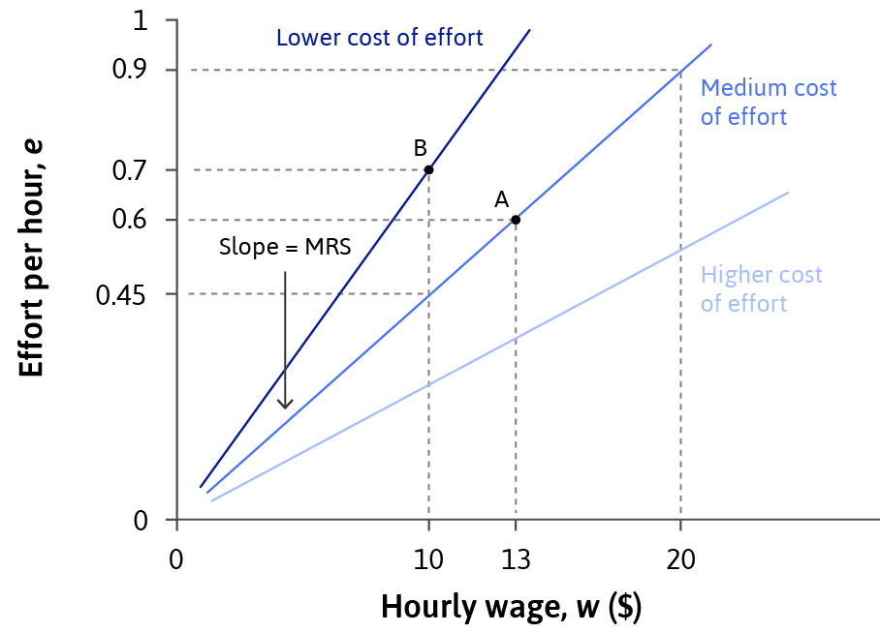
EC107 Economics 1 2019-20
Contracts
The Labour Discipline Model: Iso-cost lines for effort
Summary
The cost of effort is the same at all points on an iso-cost line.
Slope of iso-cost curve = MRS =
the rate at which the employer is willing to increase wages to get higher effort.
The firm would want to be on the highest iso-cost curve attainable, with the lowest possible cost per unit of effort.

Slide 26
EC107 Economics 1 2019-20
Contracts
The Labour Discipline Model: re-cap
Slope of iso-cost curve
= MRS
= the rate at which the employer
is willing to increase wages
to get higher effort.
Slope of the worker’s best response curve
= MRT
= the rate at which the employer
is required to increase wages
to get higher effort.

Slide 27
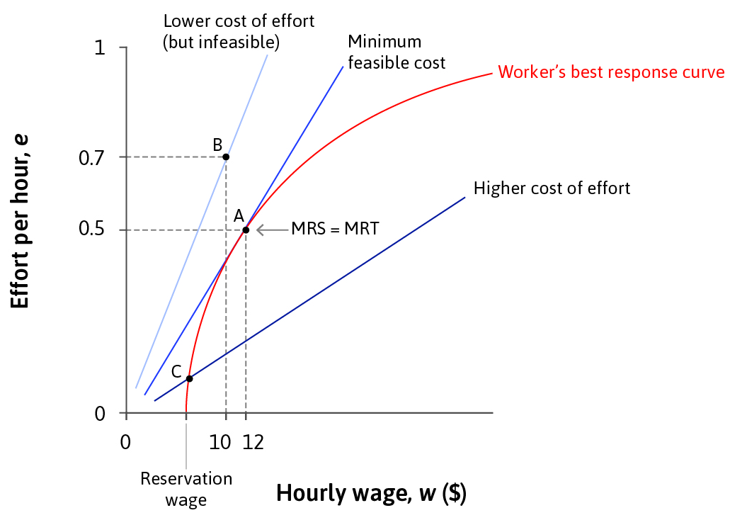
EC107 Economics 1 2019-20
Contracts
The Labour Discipline Model: determining wages
Given the constraint imposed on the firm by the worker’s best-response curve, the most preferred (i.e., profit-maximising) wage-effort choice for the firm is at A, where the firm is on the highest achievable iso-cost line.
MRS = MRT
The firm is paying an Efficiency Wage: the wage rate is set higher than the reservation wage so workers will care about losing the job and hence will provide more effort.

Slide 28
EC107 Economics 1 2019-20
Contracts
The Labour Discipline Model: the story so far…
Firms: owners and managers have power over workers
Contracts are incomplete – do not cover worker effort
Employment rents motivate workers to exert effort
An example of a hidden action problem between a principal (firm) and an agent (worker)
2. Labour-discipline model of wage-setting within firms
Iso-cost curves = firm’s ‘indifference curves’
Best response curve = maximum feasible effort, given wages
Profit-maximising choice: firm’s choose the wage which they anticipate will lead workers to choose an effort level such that MRS = MRT
Involuntary unemployment is a feature of the equilibrium…

Slide 29
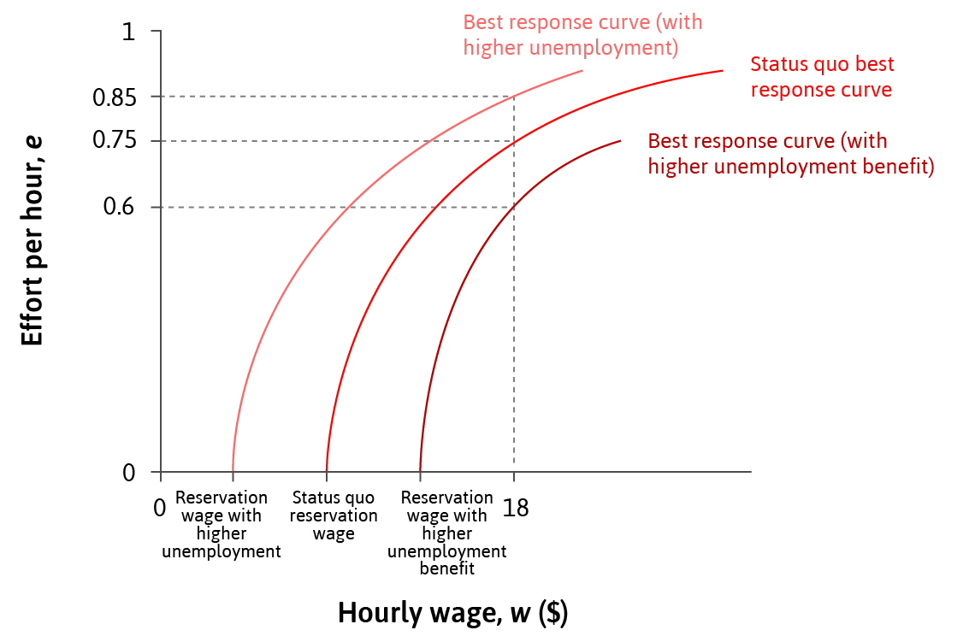
EC107 Economics 1 2019-20
Contracts
The Labour Discipline Model: Involuntary Unemployment
Involuntary unemployment is a feature of the equilibrium…
The wage-effort outcome we saw previously depends on the position and shapes of the iso-cost curves and of the workers’ best response curve.
Various factors might cause the best-response function to shift…

Slide 30
EC107 Economics 1 2019-20
Contracts
The Labour Discipline Model: Involuntary Unemployment
Various factors might cause the best-response function to shift…
The disutility of effort
The reservation wage
The probability of getting fired at each effort level

Slide 31
EC107 Economics 1 2019-20
Contracts
The Labour Discipline Model: Involuntary Unemployment
Various factors might cause the best-response function to shift…
The disutility of effort
The reservation wage
The probability of getting fired at each effort level
A
C
B
Notice how the equilibrium wage-effort outcome varies with the shift in the best-response function.

Slide 32
EC107 Economics 1 2019-20
Contracts
Incomplete contracts more generally
Incomplete contracts do not occur only in employment relationships.
Incomplete contracts arise when:
information is not verifiable
the relationship covers periods of time
there is uncertainty
there are difficulties with measurement
judiciary is absent
there are preferences for omitting some information

Slide 33
EC107 Economics 1 2019-20
Contracts
Principal-agent models
Principal-agent models capture interactions under incomplete contracts
the firm can be treated as the principal and the worker the agent of the firm
An agent might take action that is hidden from the principal, which is why the principal cannot verify it.
A hidden action problem occurs when
there is a conflict of interest between the principal and the agent over some action that may be taken by the agent
and this action cannot be subjected to a complete contract.
The information about the action may be either asymmetric or unverifiable.

