Slide 1
EC107 Economics 1 2019-20
The Labour Market: wages, Profits and Unemployment
This Lecture follows closely CORE: Unit 9
How are the economy-wide wages and employment determined?
How can we improve on these outcomes?
Models price-setting and wage-setting behaviour of firms, which determines economy-wide unemployment rate and real wage
Explains why unemployment exists even in equilibrium
Shows how the government can affect wages and unemployment by its policies
Analyses the role of labour unions

Slide 2
EC107 Economics 1 2019-20
Unemployed workers
The unemployed are the people who:
are not in paid employment or self-employment
are available for work
are actively seeking work

Slide 3
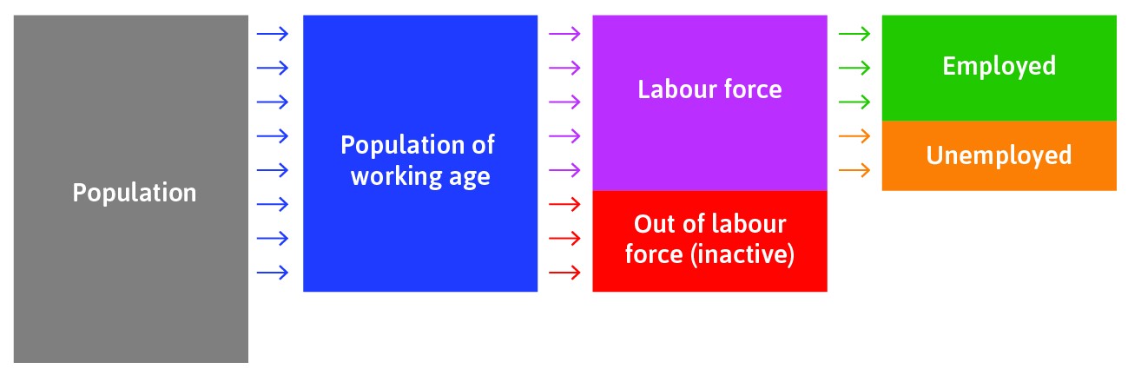
EC107 Economics 1 2019-20
The Labour Market
Can you locate the data on each of these for the UK and any other country of your choice?

Slide 4
EC107 Economics 1 2019-20
Price-setting and Wage-setting
Firms and employees: firms set wage sufficiently high to make job loss costly, in order to motivate employees to work hard in the absence of complete contracts
Firms and customers: firms set a mark-up above the cost of production, to maximise their profits subject to demand.

Slide 5
EC107 Economics 1 2019-20
The Real Wage
The real wage is the nominal wage divided by the price level of the bundle of consumer goods purchased.
Each firm decides on its: wage, price and how many people to hire
Adding up all of these across all firms gives the total employment in the economy and the real wage

Slide 6
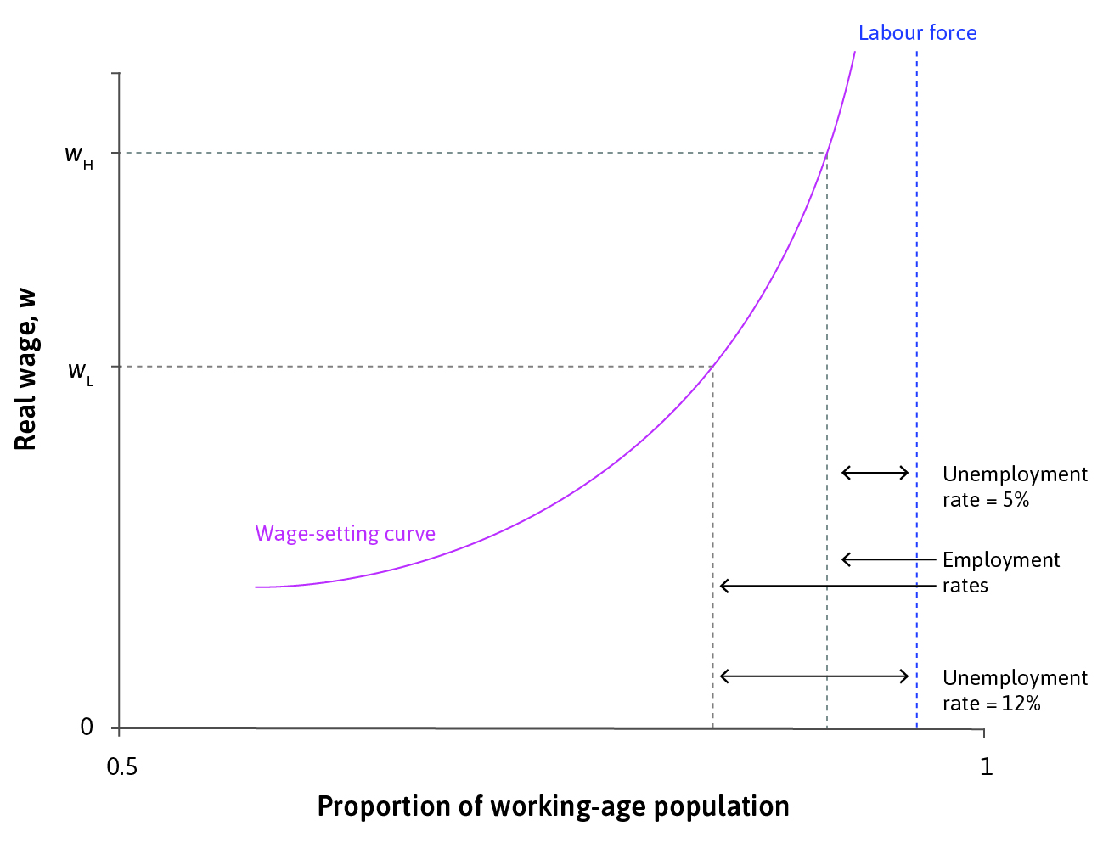
EC107 Economics 1 2019-20
The Wage-Setting Curve
The wage-setting curve = the real wage necessary at each level of economy-wide employment to provide workers with incentives to work hard and well.
This is derived from the Labour Discipline Model of Unit 6…
employed

Slide 7
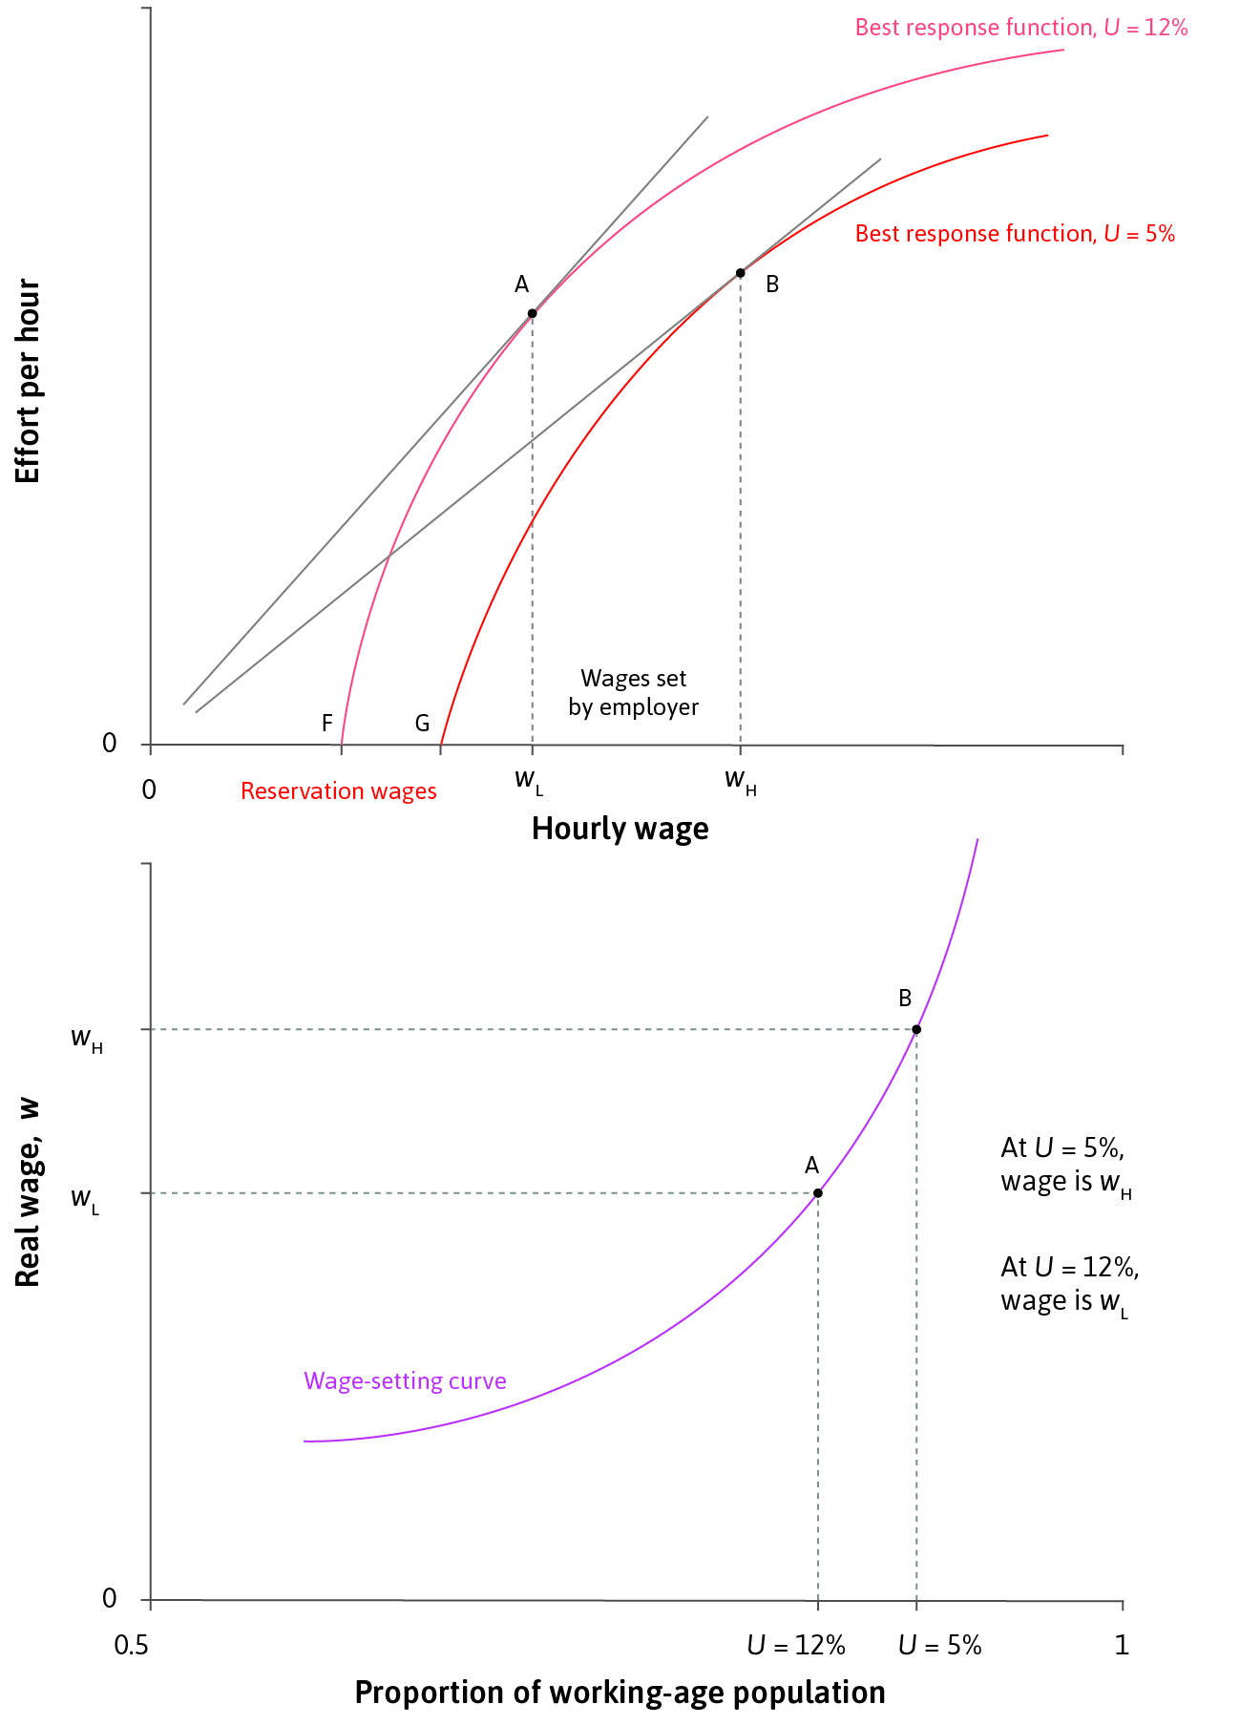
EC107 Economics 1 2019-20
Deriving the wage-setting curve
Lowering the unemployment rate will shift worker’s best response curve down to the right (raising their ‘reservation wage’) and increase the wage
This results in upward-sloping wage-setting curve. This is consistent with the evidence.

Slide 8
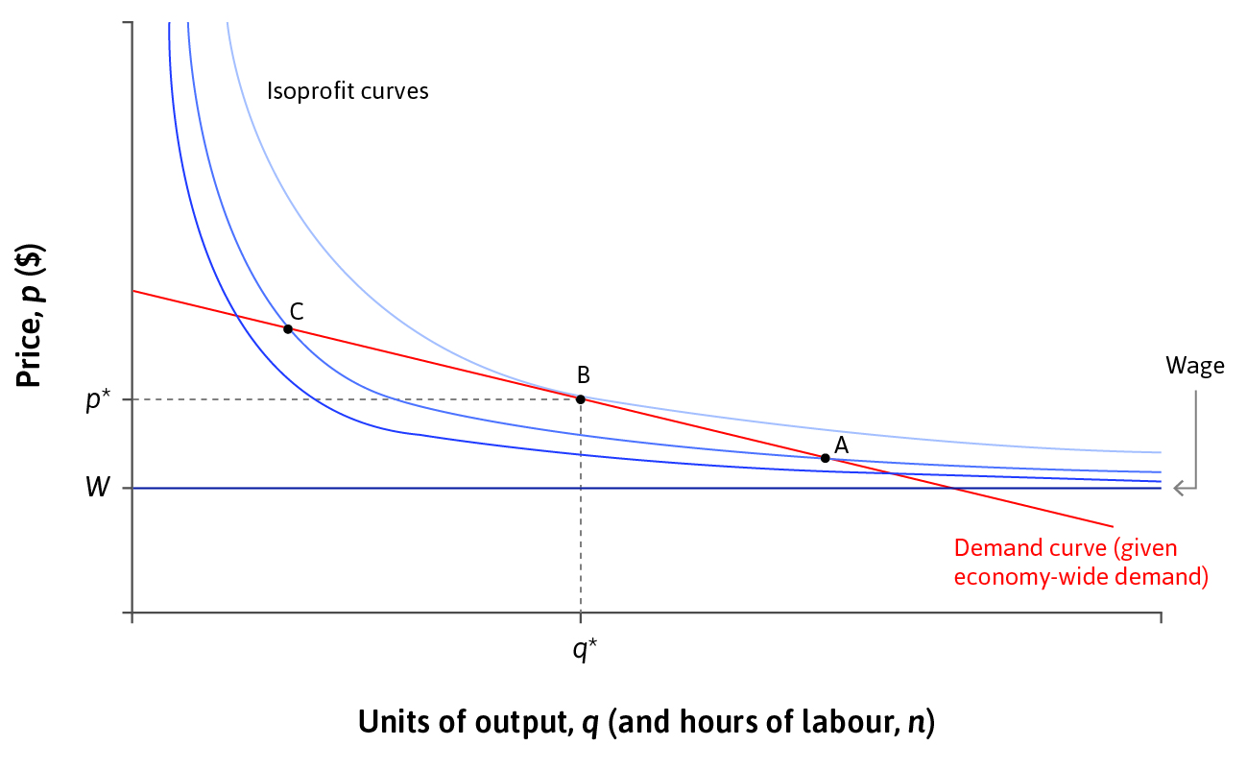
EC107 Economics 1 2019-20
Price-Setting: the profit-maximising price
Firm’s optimal price lies where the demand curve is tangent to an isoprofit curve (unit 7).
The firm then hires a number of employees necessary to produce the quantity of output demanded at that price.
This also determines the firm’s optimal mark-up above the marginal cost of production, W.
For the economy as a whole, this translates into how output is distributed between the firm-owners and the workers: output per worker can be decomposed into the real wage and real profit…
Mark-up
Wage

Slide 9

EC107 Economics 1 2019-20
Deriving the price-setting curve
For the economy as a whole, this translates into how output is distributed between the firm-owners and the workers: output per worker can be decomposed into the real wage and real profit…
Average product of labour
Labour Supply
Average product of labour
(= output/worker)
For a given level of the (nominal) wage, the higher the price set by the firm, the higher will be the mark-up (and the real profit) and the lower will be the real wage…
Employment, N (in the whole economy)

Slide 10
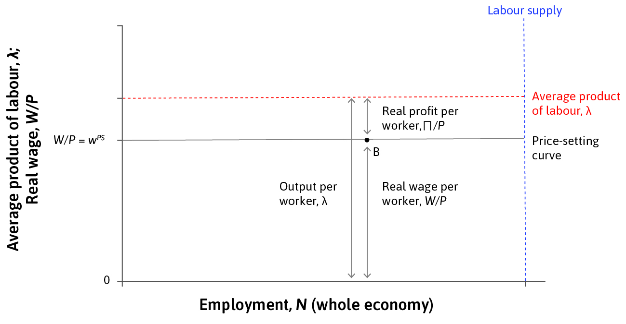
EC107 Economics 1 2019-20
Deriving the price-setting curve
For a given level of the (nominal) wage, the higher the price set by the firm, the higher will be the mark-up (and the real profit) and the lower will be the real wage…
Why don’t firms charge a higher price than that implied at B, thereby lowering the real wage and raising real profit per worker? See next slide…

Slide 11
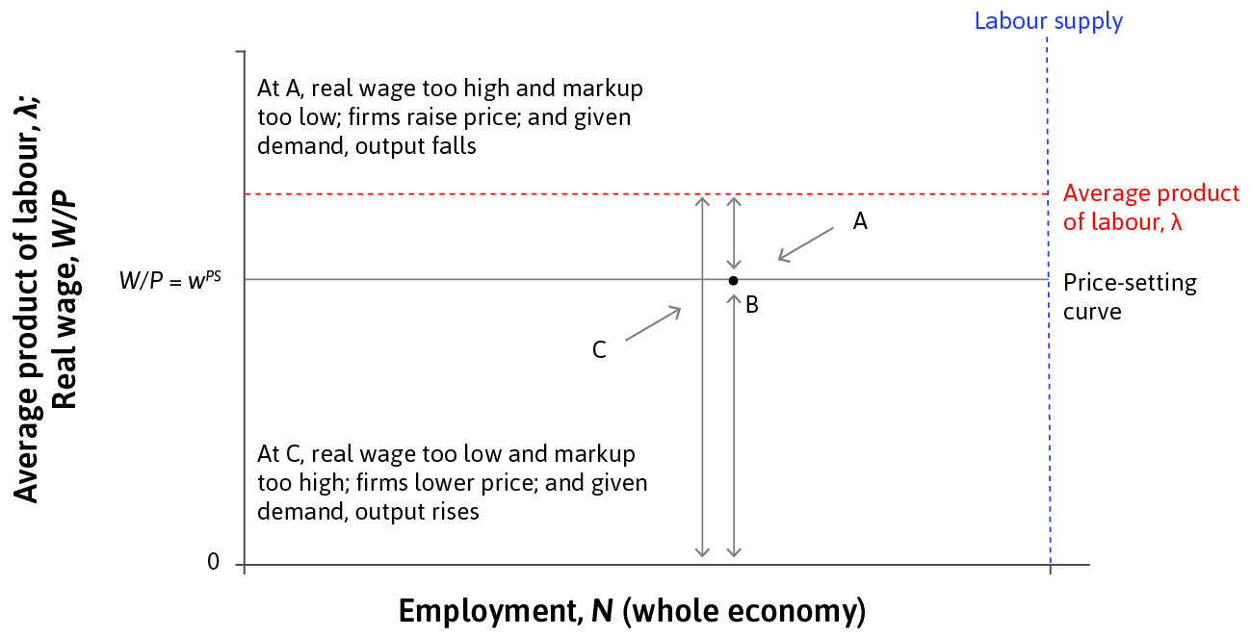
EC107 Economics 1 2019-20
Deriving the price-setting curve
Why don’t firms charge a higher price than that implied at B, thereby lowering the real wage and raising real profit per worker?
If firms charge a price below the profit-maximising price at B (see also Slide 8), the implied real wage will be too high and the mark-up too low. Firms will raise prices pushing the price-setting curve to be as shown in the figure, where it passes through be.
And, conversely, if price is initially set too high firms will have incentives to lower price until profit-maximisation is reached at B.

Slide 12
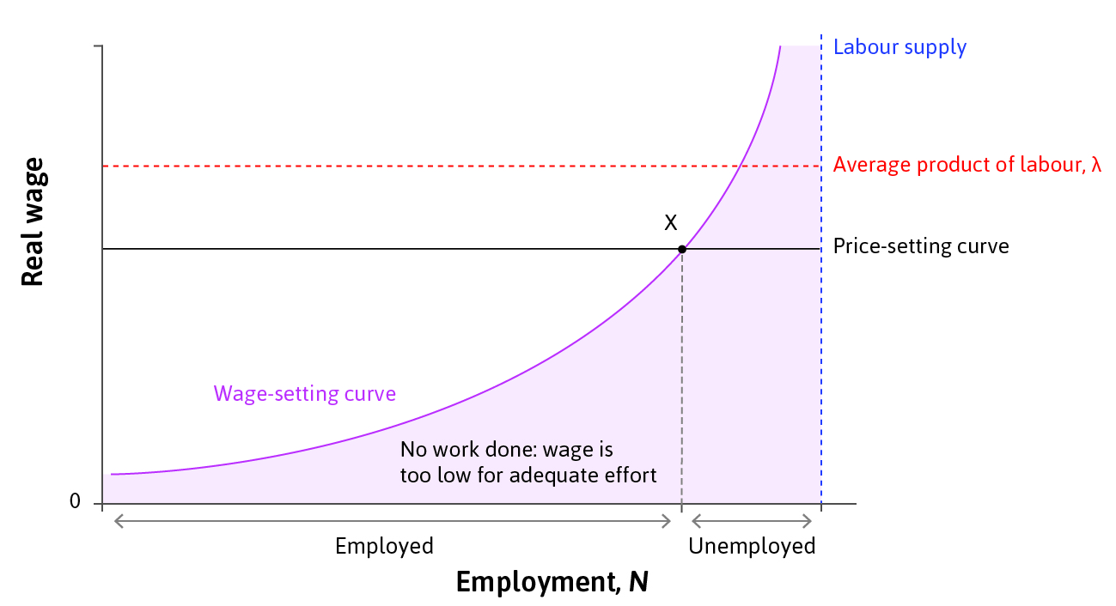
EC107 Economics 1 2019-20
The labour market equilibrium
The Nash equilibrium of the labour market is where the wage-setting and the price-setting curves intersect. All parties are doing the best that they can for themselves, given what everyone else is doing.
Firms have no incentive to change the wage, given the price level: they are offering the lowest wage necessary to ensure workers’ effort.
Firms have no incentive to change the price, given the wage level: it is the profit-maximising price.
Employment is the highest it can be, given the wage.
Those unemployed would like to work at the current wage, but even if they offer to work at a lower wages, firms will not reduce wages because of labour discipline concerns.

Slide 13
EC107 Economics 1 2019-20
Involuntary unemployment
Unemployment = excess supply in the labour market
There will always be unemployment in labour market equilibrium
No unemployment → zero cost of job loss → no effort
Therefore some unemployment is necessary to motivate workers
These are the involuntarily unemployed

Slide 14
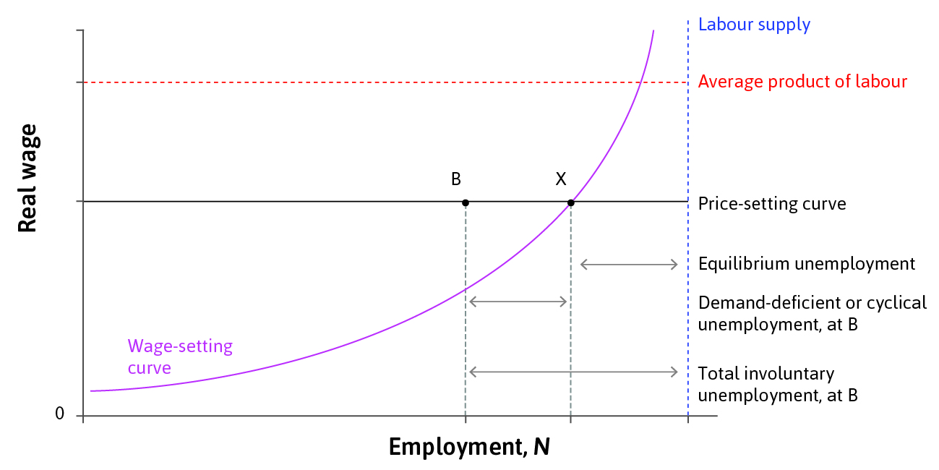
EC107 Economics 1 2019-20
Demand-deficient unemployment
A fall in aggregate demand moves the economy from labour market equilibrium (X) to point B.
But B is not a Nash equilibrium:
Firms could lower wages without worker effort falling (as unemployment is so high)
Lower costs → lower prices → increased demand → Increase output and employment
Equilibrium is restored at X through automatic adjustment … (in theory…)

Slide 15
EC107 Economics 1 2019-20
Automatic adjustment in practice
Real economies do not function so smoothly:
Workers resist cuts to their nominal wage (industrial action, strikes)
Lower wages means people spend less → aggregate demand falls further
Falling prices across the economy may lead consumers to postpone their purchases in hope to get even better bargain later

Slide 16
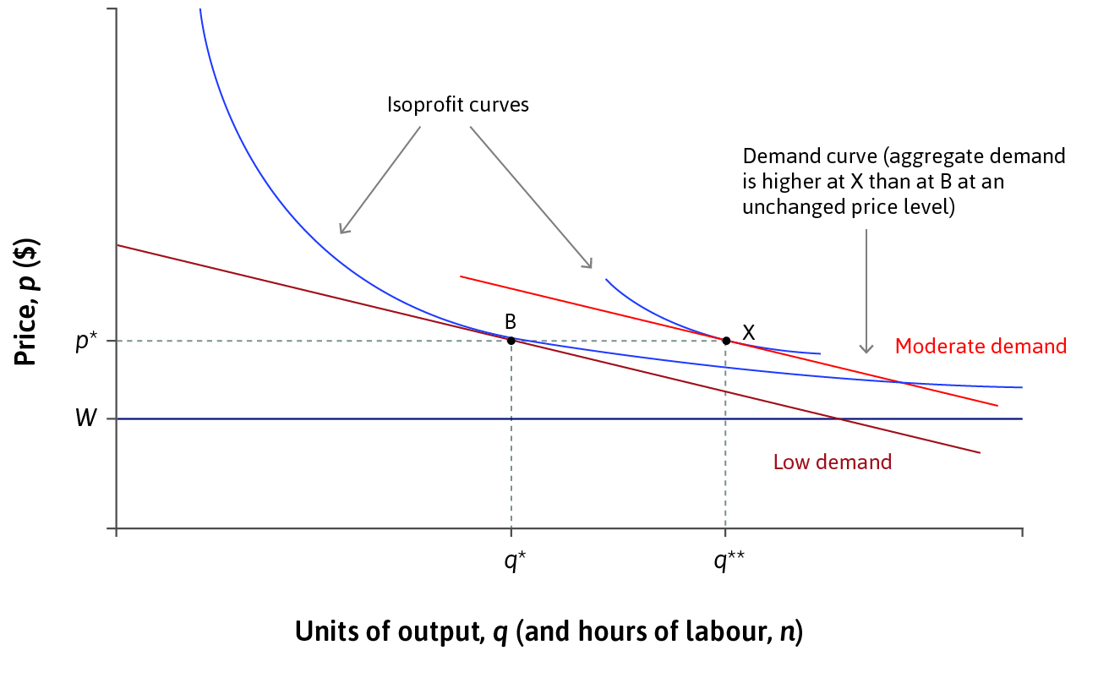
EC107 Economics 1 2019-20
Government intervention
The government could increase its own spending to expand aggregate demand.
monetary policy
fiscal policy
At B, firms would find it optimal to produce more (and hire more workers) instead of reducing wages.

Slide 17
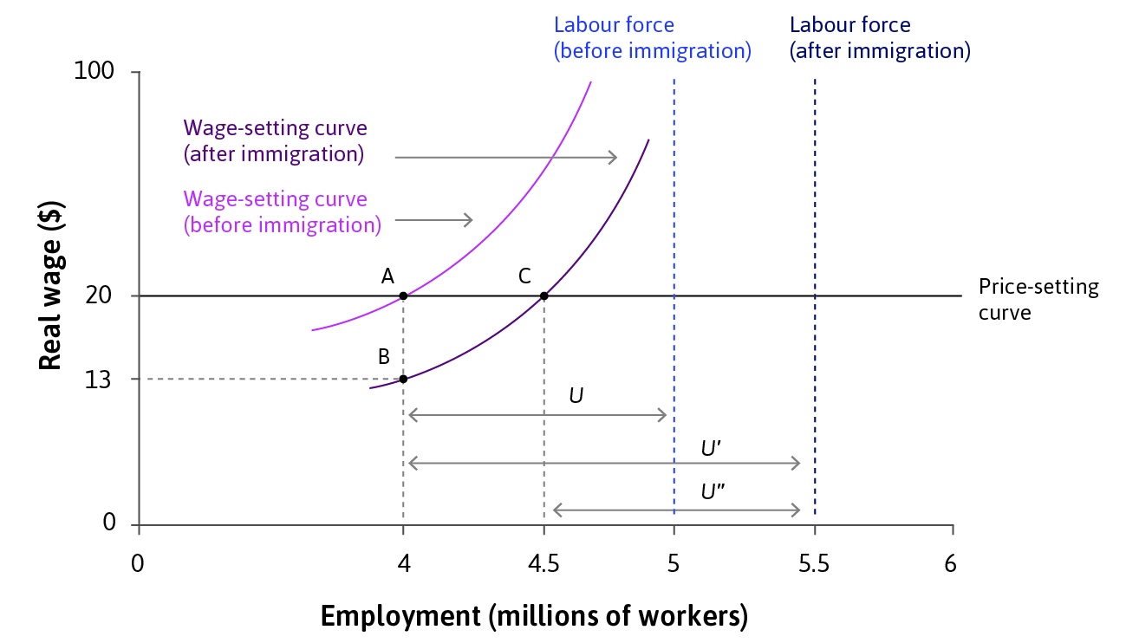
EC107 Economics 1 2019-20
Labour supply
The supply of labour is another important determinant of labour market equilibrium.
An increase in labour supply shifts the wage-setting curve downward/rightward:
The greater pool of unemployed
=> higher employment rents
=> lower wage needed to induce worker effort
-> New equilibrium at C.
Adjustment process: A->B lower wages; B->C firms reduce prices, which raises demand and hence output and employment. In equilibrium, wage-setting and price-setting curves again intersect. No-one has any incentive to change their behaviour.

Slide 18
EC107 Economics 1 2019-20
Summary of Lecture 9
Behaviour of firms sets wages and employment in an economy
The wage-setting curve tracks the combinations of wages and unemployment feasible with workers’ effort
The price-setting curve determines the real wage corresponding to profit-maximising price
There will always be involuntary unemployment
Incomplete contracts
Deficient demand

