Slide 1
Labour Discipline, Monopsony and Employment Effects of a Minimum Wage: A Discussion
‘Free’ Markets
‘Free’ Trade
‘Free’ to Choose
What’s not to like?
But the traditional textbook model of apparently equally free employers and employees is missing the concept of Power. Especially Asymmetric Power.
A steel worker in Scunthorpe informs their employer that they are quitting. It is not national news. Shares in British Steel do not plummet.
British Steel announce that they are closing down production in Scunthorpe and it’s national news: the consequences for each worker and the wider community are devastating…Guardian Newspaper May 22nd 2019…

Slide 2

Sadness and fear in Scunthorpe after British Steel liquidation
The British Steel plant at Scunthorpe employs 5,000 people.
Photograph: Christopher Thomond/The Guardian
There was a sombre mood hanging over Scunthorpe as workers and residents came to terms with the news that
British Steel, the town’s biggest employer, had gone into liquidation.
Jessica Murray, The Guardian
Wed 22 May 2019 19.36 BST

Slide 3
Labour Discipline, Monopsony and Employment Effects of a Minimum Wage: A Discussion
The framework Sam presents corrects this and provides an analysis of MWL in a context of employer power (which has many origins), linking this with the crucial concept of the NSC.
Firms do not have to accept some faceless ‘free market’ perfectly competitive wage rate.
The firm can restrict hiring to sustain a lower wage.
Three Remarks
Minor Point: The order of the narrative
(Slides 2-6)
A link to one of the many reasons why I love CORE: Maximum Hours Legislation (Unit 5)
(Slide 7)
Employer Power: the importance of combining the analysis of Minimum Wage Legislation with Maximum Hours Legislation
(Slides 8->)

Slide 4
Labour Discipline, Monopsony and Employment Effects of a Minimum Wage: A Discussion
ACL
MCL
MCL
MRP
w
ACL (NSC)
w_{MON}
MRPL
n_{MON}
n

Slide 5
Labour Discipline, Monopsony and Employment Effects of a Minimum Wage: A Discussion
Assumption: Firm chooses the level of employment for a given level of effort per hour
Note: let’s start with Case II
Case II
The minimum wage is imposed only a little above the unregulated monopsony level.
ACL
MCL
MCL
MRP
w
ACL
w_{MIN}
w_{MIN}
w_{MON}
MRPL
n_{MON}
n

Slide 6
Labour Discipline, Monopsony and Employment Effects of a Minimum Wage: A Discussion
Assumption: The firm chooses the level of employment for a given level of effort per hour
Note: let’s start with Case II
Case II
The minimum wage is imposed only a little above the unregulated monopsony level.
Consequence
The MCL changes as depicted and the monopsonist raises employment in response to the binding minimum wage.
Interpretation
Sufficiently small increases in the minimum wage reduce the MCL and lead the monopsonist to raise employment.
The greater the minimum wage, the greater the positive employment effect.
For the firm’s chosen effort level, the level of employment is being adjusted to equate the minimum wage with the NSC.
ACL
MCL
MCL
MRP
w
ACL
w_{MIN}
w_{MIN}
w_{MON}
MRPL
n_{MON}
n_{MIN}
n

Slide 7
Labour Discipline, Monopsony and Employment Effects of a Minimum Wage: A Discussion
Assumption: The firm chooses the level of employment for a given level of effort per hour
Note: now let’s consider Case I
Case I
The minimum wage is imposed substantially above the unregulated monopsony level: i.e., beyond the intersection of ACL and MRPL.
ACL
MCL
MCL
MRP
w
ACL
w_{MIN}
w_{MIN}
w_{MON}
MRPL
n_{MON}
n

Slide 8
Labour Discipline, Monopsony and Employment Effects of a Minimum Wage: A Discussion
Assumption: The firm chooses the level of employment for a given level of effort per hour
Note: now let’s consider Case I
Case I
The minimum wage is imposed substantially above the unregulated monopsony level: i.e., beyond the intersection of ACL and MRPL.
Consequence
While for relatively small increases in the regulated wage, the firm responds by setting higher employment to equate the wage to the NSC, for further increases in the minimum wage the firm cuts back on employment, equating the MCL (and hence the wage) with the MRPL (rather than with the NSC)
Interpretation
The minimum wage is so high that the link between firm hiring and the cost of sustaining labour discipline is broken.
The firm pays a wage which exceeds that associated with the NSC at the firm’s profit-maximising employment level.
Hence, the firm has an incentive to raise the No-Shirking effort level, thereby minimising (almost wholly offsetting) the effect of the minimum wage on the cost of a unit of effort and on profitability.
ACL
MCL
MCL
MRP
w
ACL
w_{MIN}
w_{MIN}
w_{MON}
MRPL
n_{MON}
n_{MIN}
n

Slide 9
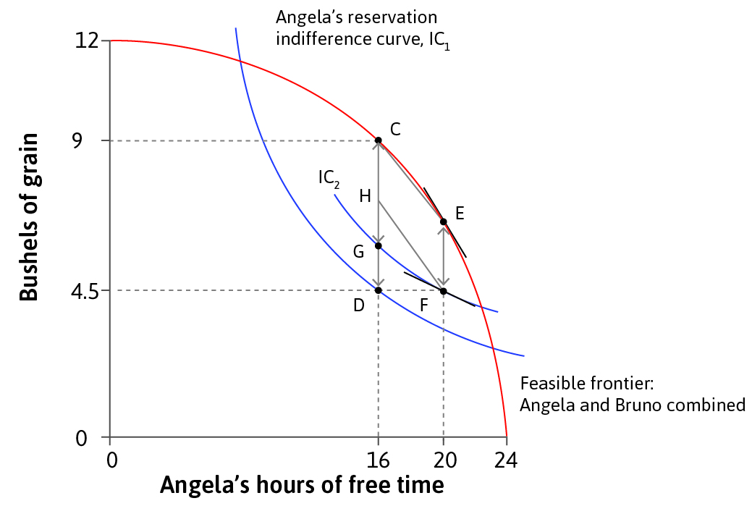
Labour Discipline, Monopsony and Employment Effects of a Minimum Wage: A Discussion
Unit 5: Figure 5.10. The effect of Maximum Hours Legislation
(From Unit 3 on, CORE attaches substantial importance to understanding hours of work)
The unregulated (Voluntary Trade) contract curve is given by CD. Bruno is the landowner and makes a take-it-or-leave-it offer: Angela chooses to work 8 hours at ‘D’. By imposing a Maximum Required Hours limit of 4hrs, Angela’s Reservation IC shifts up through F, relative to which there are Pareto improvements at allocations between G and H.
The analysis is capable of capturing the importance of biology, technology, efficiency and equity and the differences between Coercion, Voluntary Trade and different institutional arrangements relating to property rights and legislative protections.
This is an example of why I love CORE: The Economy!
It is an example of the ‘CORE: The Economy’ approach in which an economic outcome (eg hours of work and share of surplus) is a result of an institutional context-dependent bargain between agents (eg employer and employee)…
… rather than of some ‘magical emergence from a mythical arrangement of perfectly competitive free markets in a perpetual state of idealised equilibrium.’

Slide 10
Labour Discipline, Monopsony and Employment Effects of a Minimum Wage: A Discussion
Bargaining over Wages and Hours under Monopsony: the importance of combining MWL with Maximum Hours Legislation
Monopsony power can be used both:
to sustain low wages and
to sustain long hours of work.
Low paid workers are pushed off their labour supply curves and work longer hours than they would choose at their wage rate.
Evidence: Stewart and Swaffield, Economic Journal, 1997:
No free choice of hours within jobs and limited choice across jobs
Job offers typically have hours constraints bundled with the wage
British employees work longer hours than their counterparts in all other ‘EC’ countries
Over 1/3 of men in Britain work longer hours than they would choose at their current wage rate
Mean of desired hours for manual workers is 4.3 hours per week below actual hours worked
Minimum hours constraints set by firms are an increasing function of the local unemployment rate
The minimum hours constraint is a negative function of the wage
(… the Chair will impose a maximum hours constraint on me, so Jump to Slide 15…)

Slide 11
Bargaining over Wages and Hours under Monopsony: the importance of combining MWL with Maximum Hours Legislation
Labour Discipline, Monopsony and Employment Effects of a Minimum Wage: A Discussion
w
MCH
Worker Indifference curves in (w,H)-space and the MCH
H

Slide 12
Bargaining over Wages and Hours under Monopsony: the importance of combining MWL with Maximum Hours Legislation
Labour Discipline, Monopsony and Employment Effects of a Minimum Wage: A Discussion
w
Iso-profit curves in (w,H)-space and the MRPH
MRPH
H

Slide 13
Bargaining over Wages and Hours under Monopsony: the importance of combining MWL with Maximum Hours Legislation
Labour Discipline, Monopsony and Employment Effects of a Minimum Wage: A Discussion
w
MCH
MRPH
H

Slide 14
Bargaining over Wages and Hours under Monopsony: the importance of combining MWL with Maximum Hours Legislation
Labour Discipline, Monopsony and Employment Effects of a Minimum Wage: A Discussion
w
MCH
CC: the downward-sloping contract curve
Implication:
The greater the bargaining power of the firm over the worker:
The lower the wage and
The greater the number of hours
in the employment contract.
MRPH
CC
H

Slide 15
Bargaining over Wages and Hours under Monopsony: the importance of combining MWL with Maximum Hours Legislation
Labour Discipline, Monopsony and Employment Effects of a Minimum Wage: A Discussion
w
MCH
In (w, H)-space:
Angela’s Reservation Indifference Curve
Bruno’s Iso-profit curves
Contract curves
w_{MON}
MRPH
RIC
IPC
CC
H_{MON}
H

Slide 16
Bargaining over Wages and Hours under Monopsony: the importance of combining MWL with Maximum Hours Legislation
Labour Discipline, Monopsony and Employment Effects of a Minimum Wage: A Discussion
w
MCH
w_{MIN}
Minimum Wage legislation
w_{MON}
MRPH
RIC
IPC
CC
H_{MON}
H

Slide 17
Bargaining over Wages and Hours under Monopsony: the importance of combining MWL with Maximum Hours Legislation
Labour Discipline, Monopsony and Employment Effects of a Minimum Wage: A Discussion
w
MCH
Minimum Wage legislation
Implication:
The effect of the Minimum Wage on the firm’s profits will be partly absorbed by the firm raising hours required in the employment contract, as it pushes the worker along the RIC.
The worker is not made better off by the Minimum Wage.
Unless…
w_{MIN}
w_{MON}
MRPH
RIC
IPC
CC
H_{MON}
H

Slide 18
Bargaining over Wages and Hours under Monopsony: the importance of combining MWL with Maximum Hours Legislation
Labour Discipline, Monopsony and Employment Effects of a Minimum Wage: A Discussion
w
H_{MAX}
MCH
The worker is not made better off by the Minimum Wage.
Unless, the Minimum Wage is accompanied by Maximum Hours legislation…
…with the double protection for the worker then providing the basis for a Pareto-improving adjustment to the contract curve, relative to the legislated endowment.
This can be thought of as extension to the analysis of Figure 5.10.
w_{MIN}
w_{MON}
RIC
MRPH
IPC
CC
H_{MON}
H

Slide 19
Bargaining over Wages and Hours under Monopsony: the importance of combining MWL with Maximum Hours Legislation
Labour Discipline, Monopsony and Employment Effects of a Minimum Wage: A Discussion
w
H_{MAX}
MCH
In the UK, the introduction of MWL coincided with that of the EU Directive on Working Hours.
And the evidence (eg Metcalf, 2007) suggests that firms adjusted not at the extensive margin (employment) but at the intensive margin (hours per works), consistent with this model.
w_{MIN}
w_{MON}
RIC
MRPH
IPC
CC
H_{MON}
H

