Slide 1


Classifications and CASCOT
Ritva Ellison
Institute for Employment Research
University of Warwick

Slide 2
Coding text to a classification
Coding is the process of categorising the range of all possible answers to a pre-defined set of categories.
The full set of categories is termed a classification. Examples are:
SOC 2010 (UK Standard Occupational Classification 2010)
ISCO 08 (International Standard Classification of Occupations 2008)
SIC 2007 (UK Standard Industrial Classification 2007)
Three parts to a classification: the structure, the index and the classification rules

Slide 3
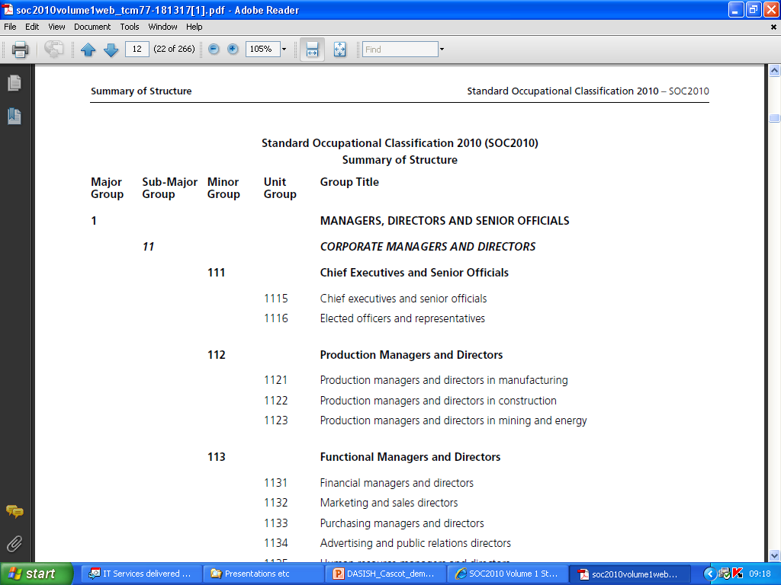
In total 369 Unit Groups
Structure

Slide 4
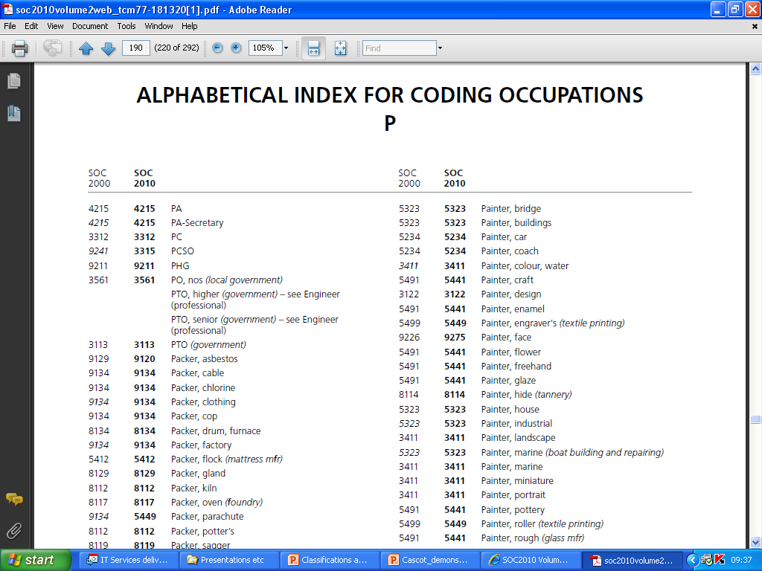
In total 27,738 index entries
Index

Slide 5
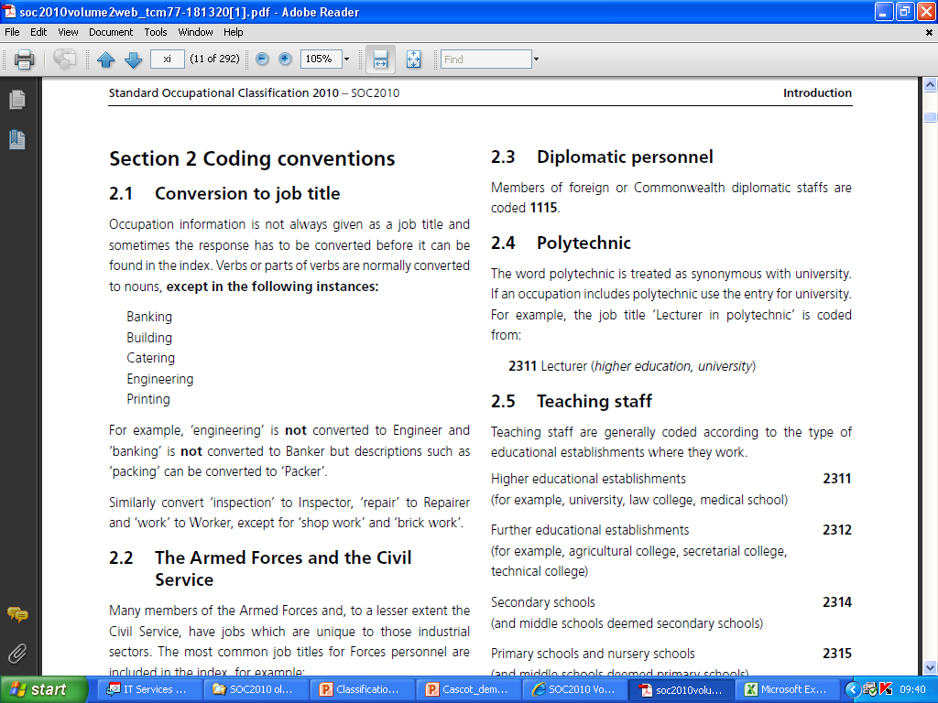
Rules

Slide 6
Manual coding procedures
Manual methods
code books;
temporary labour;
query resolution systems.
No standardised approach, major variations between institutions, companies, etc. in quality of coding.
Time-consuming, expensive.

Slide 7
Computer Assisted Structured Coding Tool CASCOT

Slide 8

Development of software
CASOC: Pascal/C++ text coding software for DOS 1993 – 2001.
CASCOT: Java text coding software for any operating system.
CASOC was ad hoc development, funded from sales revenue.
CASCOT initially funded by ESRC, now funded via sales income.

Slide 9
Occupational coding in practice
Quality of coding reflects quality of text available for coding.
Need rules which specify how to deal problems such as ambiguous job titles (e.g. engineer, teacher).
Need to be aware that machine coding of text can introduce bias.
Need to establish ‘trade off’ between accuracy and cost.

Slide 10
Coding with Cascot
Cascot will provide:
A list of recommendations.
Code, title, best matching index entry, and certainty score
Certainty Score
Approximates the probability that the recommended code is correct.
This is represented by a number in the range 0-100.
People never 100% right. Computer can’t be 100% right.

Slide 11
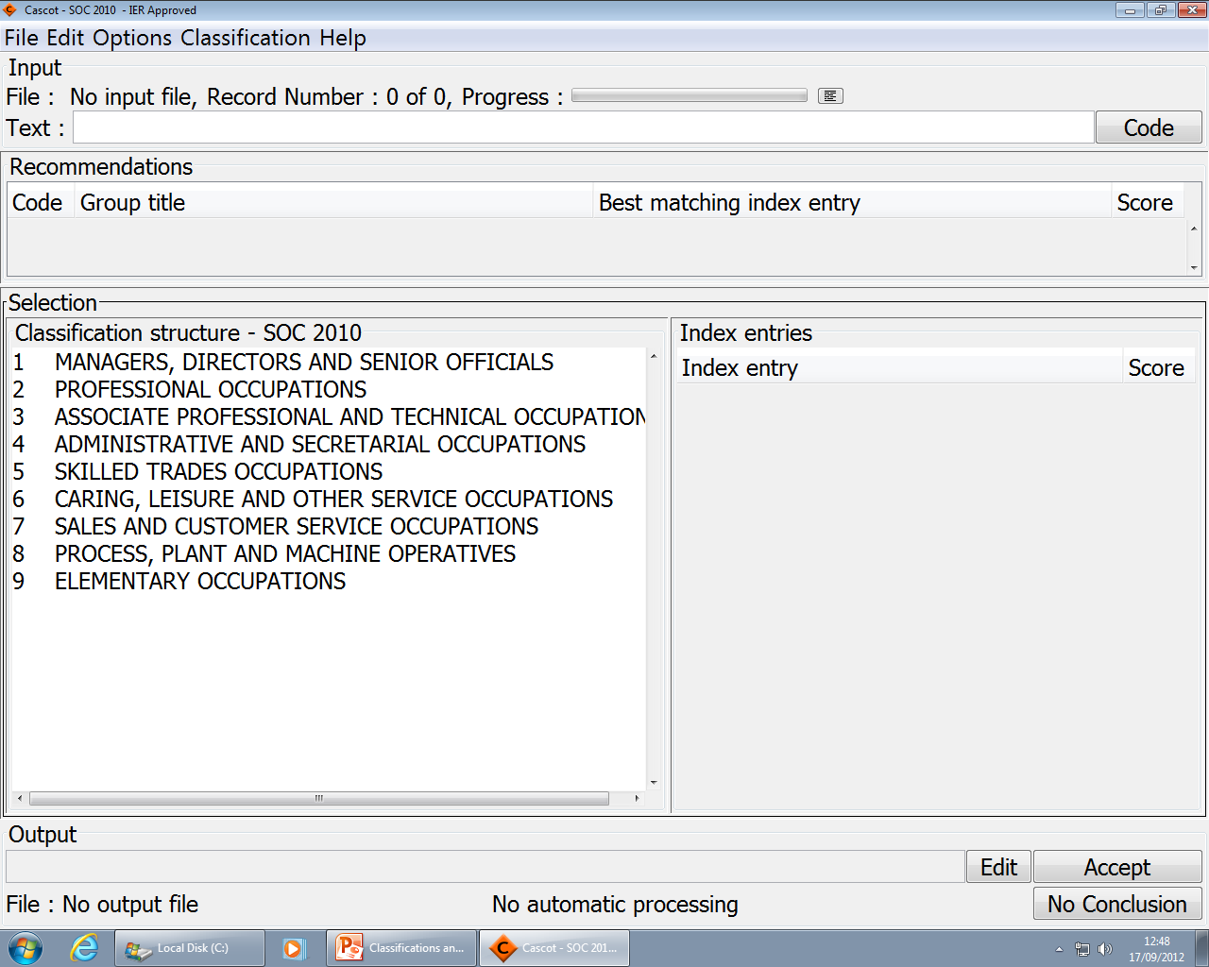
catering manager
Type job title
Press enter, or click ‘Code’ button

Slide 12
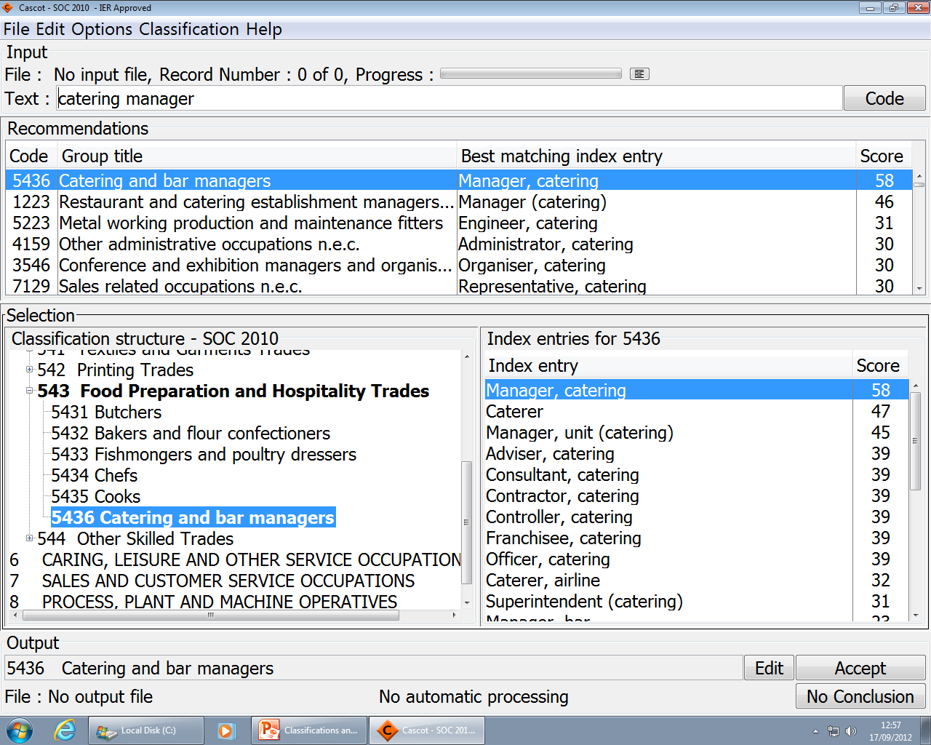
Recommendations Table

Slide 13
Classification Structure

Slide 14
Index Entries

Slide 15
Output

Slide 16
Best recommendation selected automatically
Select another by clicking a different line
OR: Change selection via structure

Slide 17
Accept the selection

Slide 18
Large scale coding
An experienced person can code manually about 100 occupations/hour maintaining a good level of quality
What if they need to code a file of 100,000 occupational texts?
Use input/output files and automated coding

Slide 19
Using files
Instead of typing every job title in, we can read them from a file.
Rather than having to copy the code produced by Cascot we can have Cascot save the codes (and other output) to a file.

Slide 20
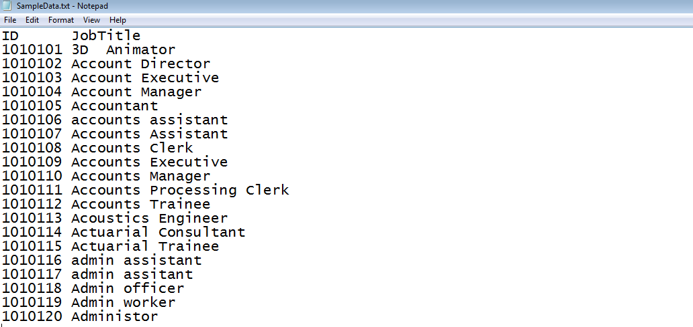
Example: Using Files
Input file (tab delimited).

Slide 21
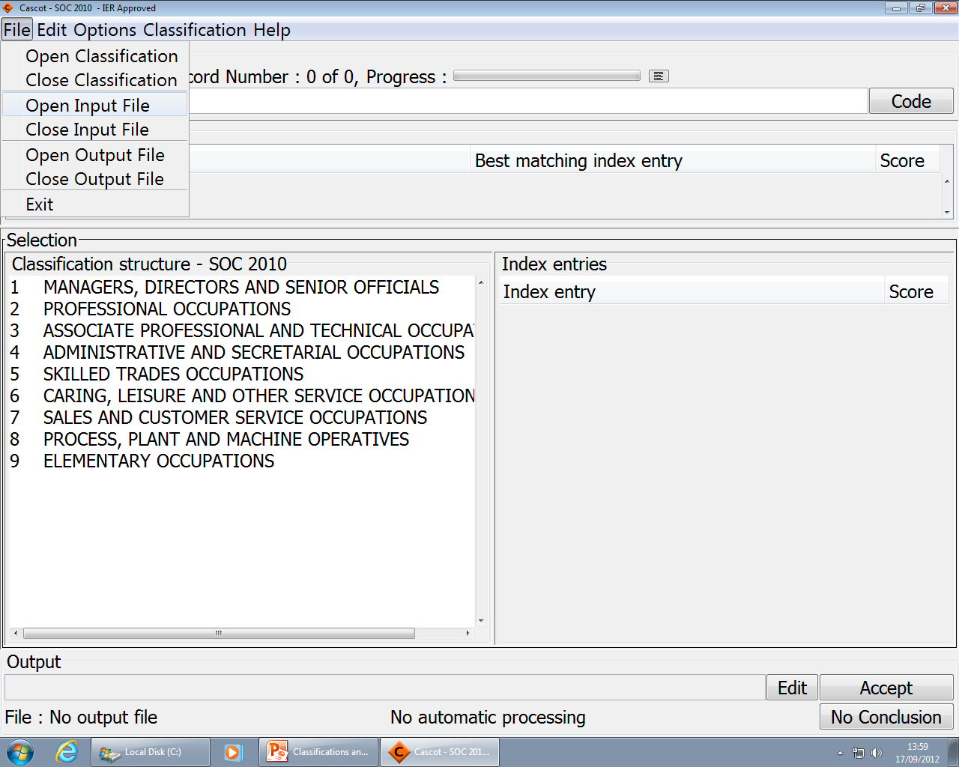

Slide 22
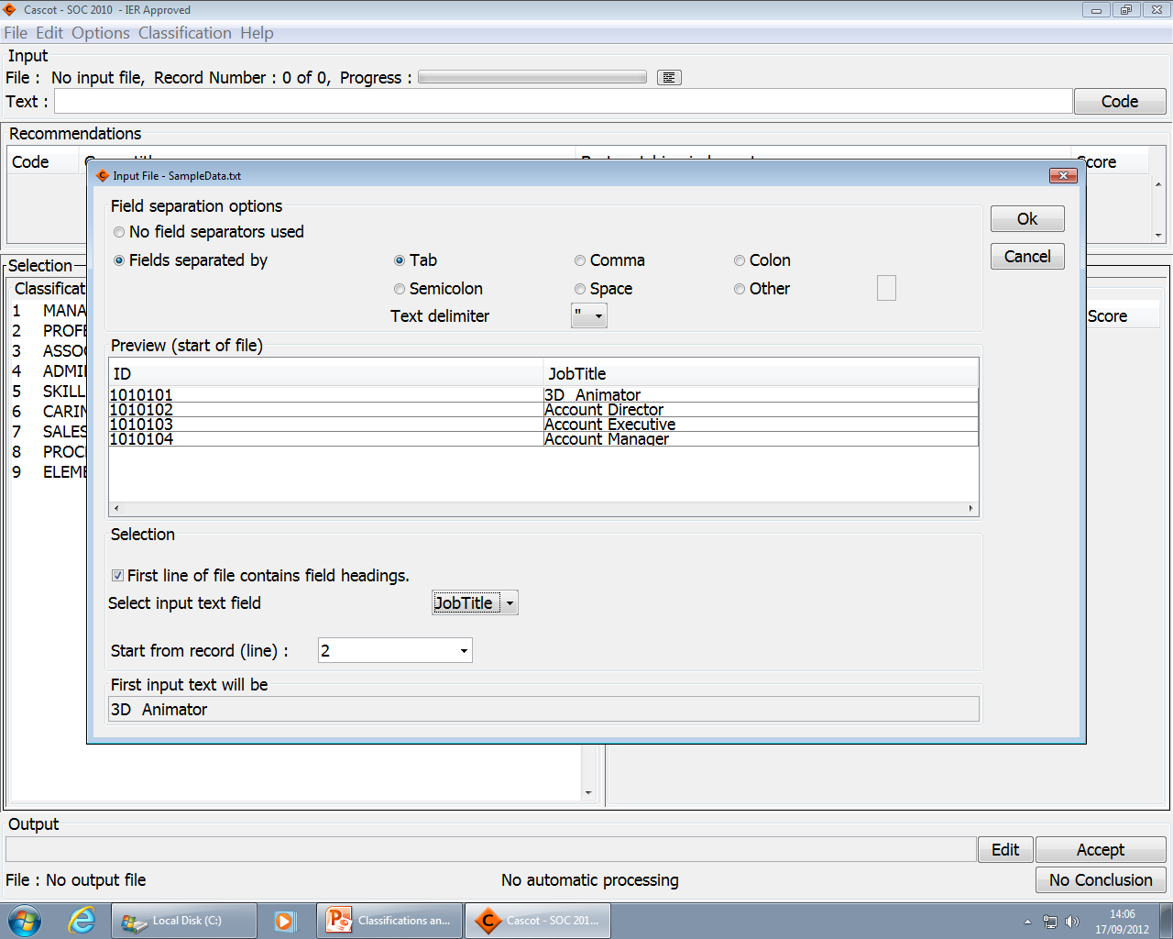

Slide 23
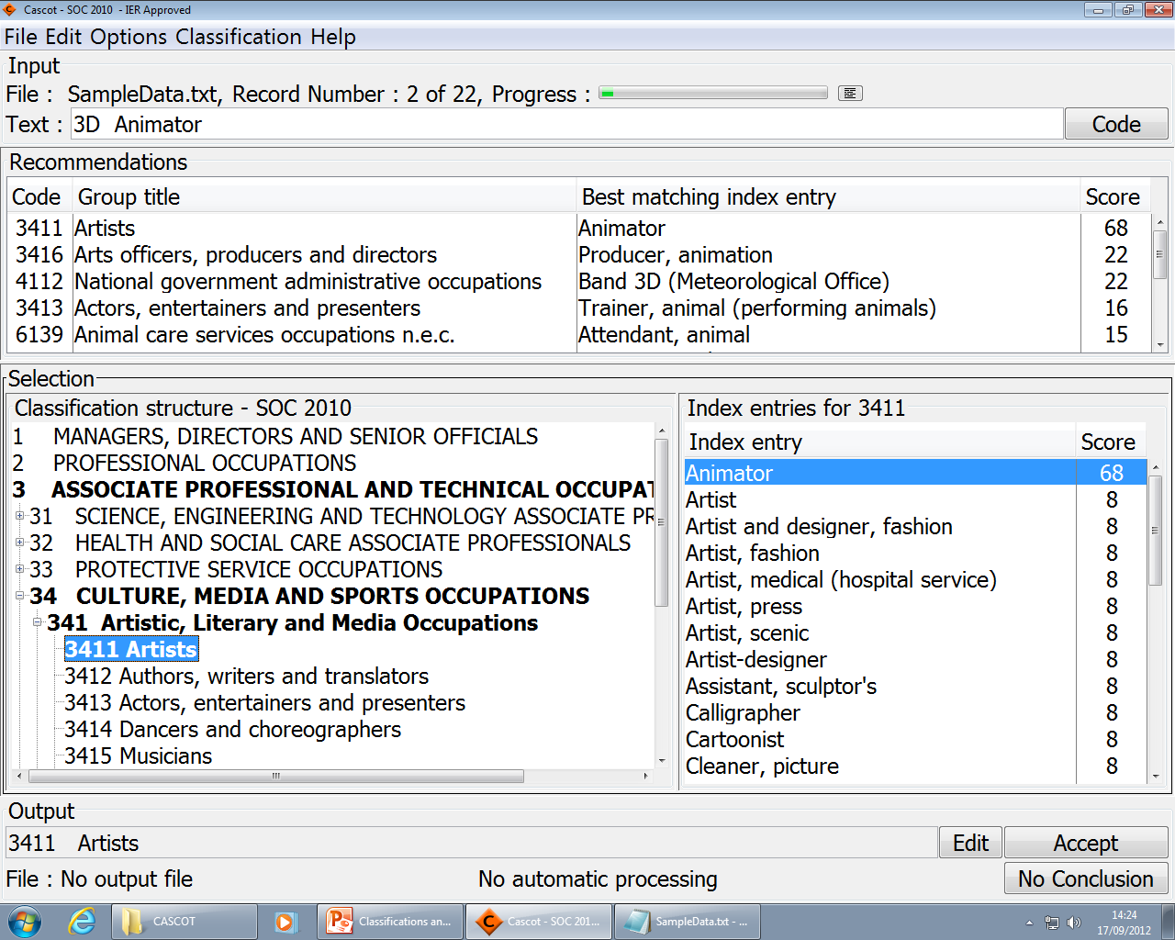
Choose Output Items
Click Edit

Slide 24
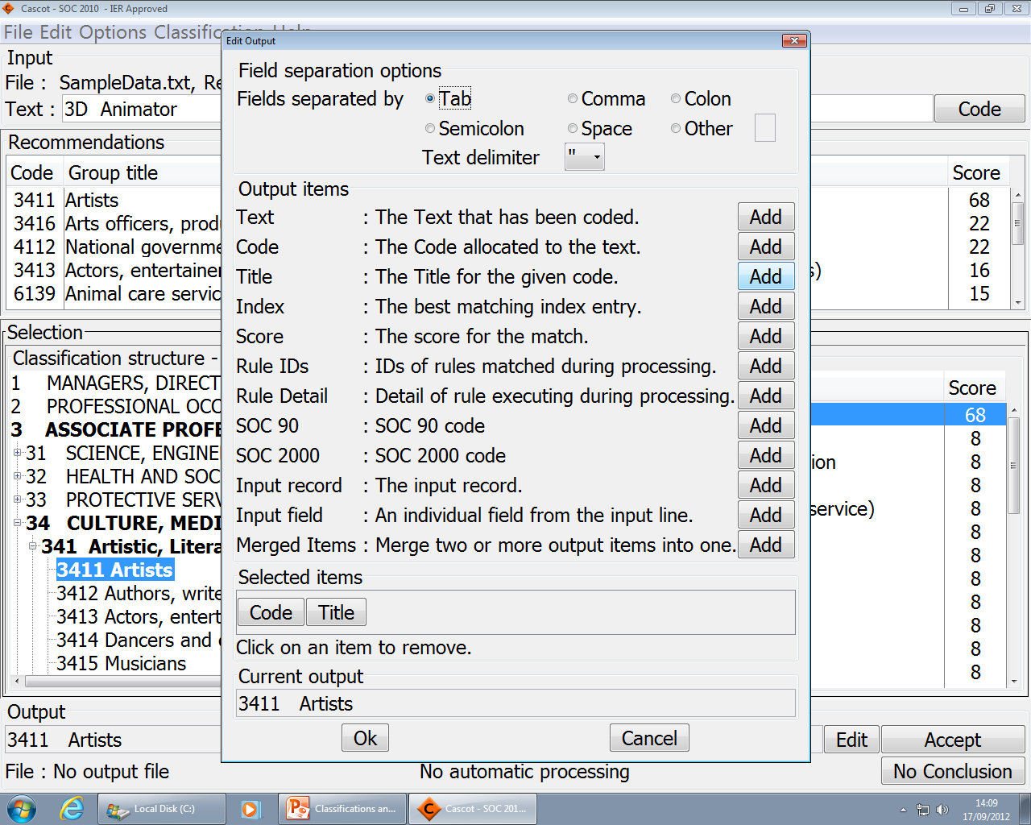
Available Items

Slide 25
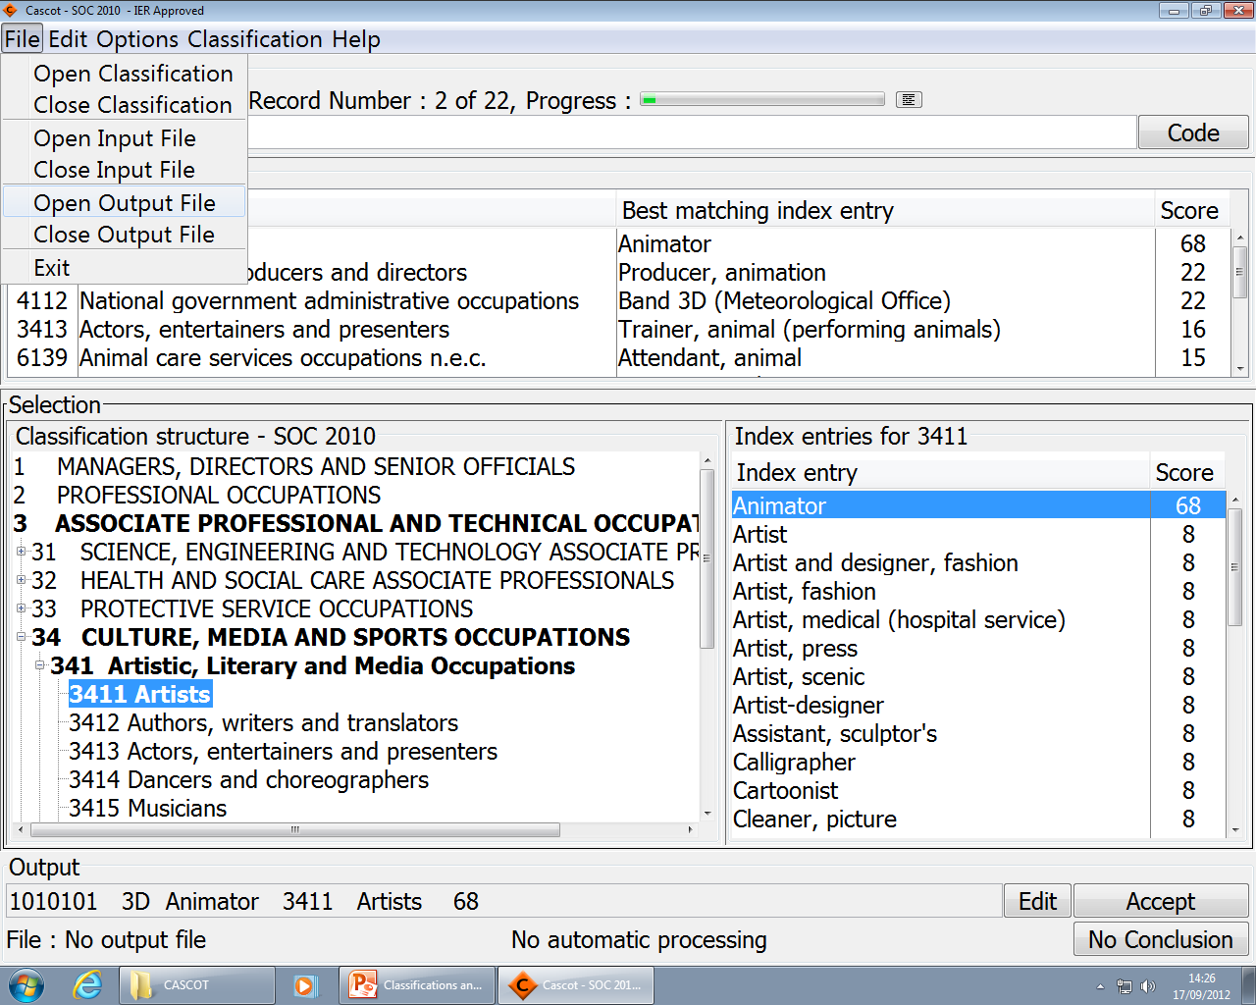

Slide 26
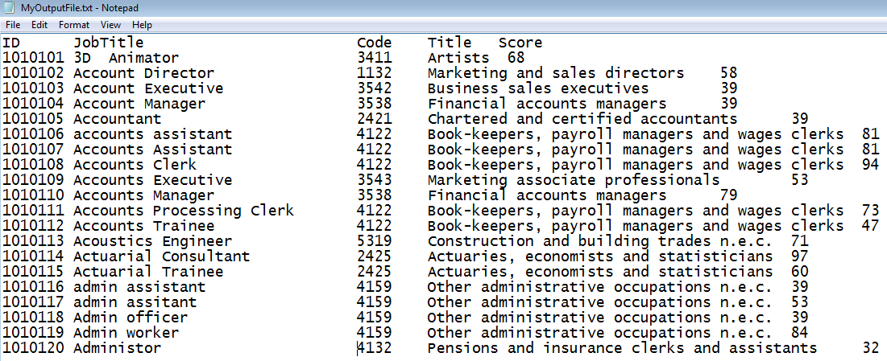
Example: Using Files
Output file (Output items = “Input Record, Code, Title, Score”)

Slide 27
Automated coding
Rather than choosing manually the best recommendation every time we can automate the process
Automation options
fully manual
semi-automatic, select the certainty level (manual coding when score is below the level)
fully automatic

Slide 28
A fully automated run
How good is this?
Example:
19,087 unique job titles
Coded fully automatically, sorted descending by certainty score
Selections from output file shown
Wrong codes coloured with light orange

Slide 29
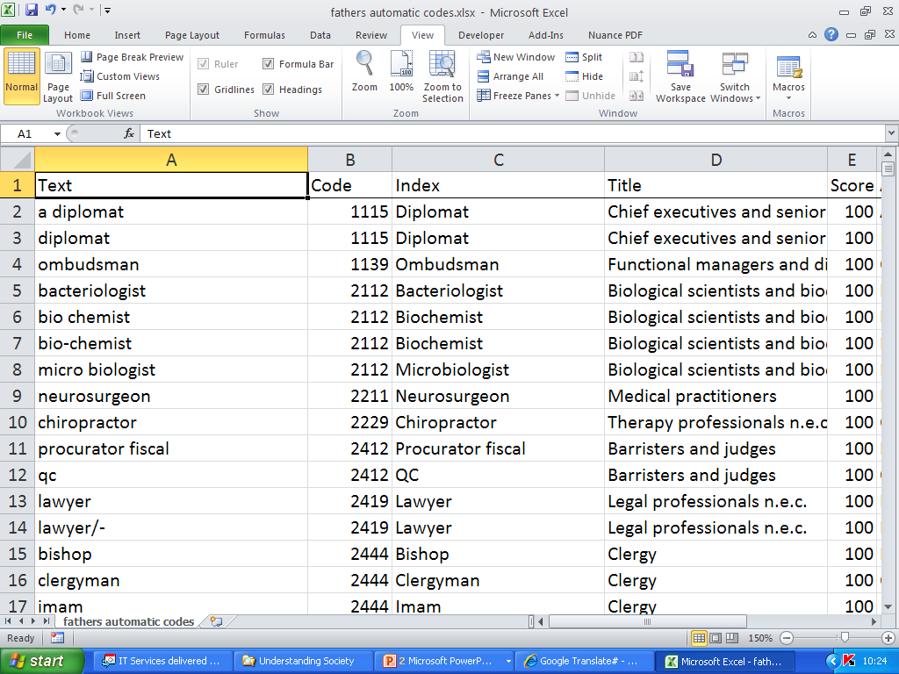

Slide 30
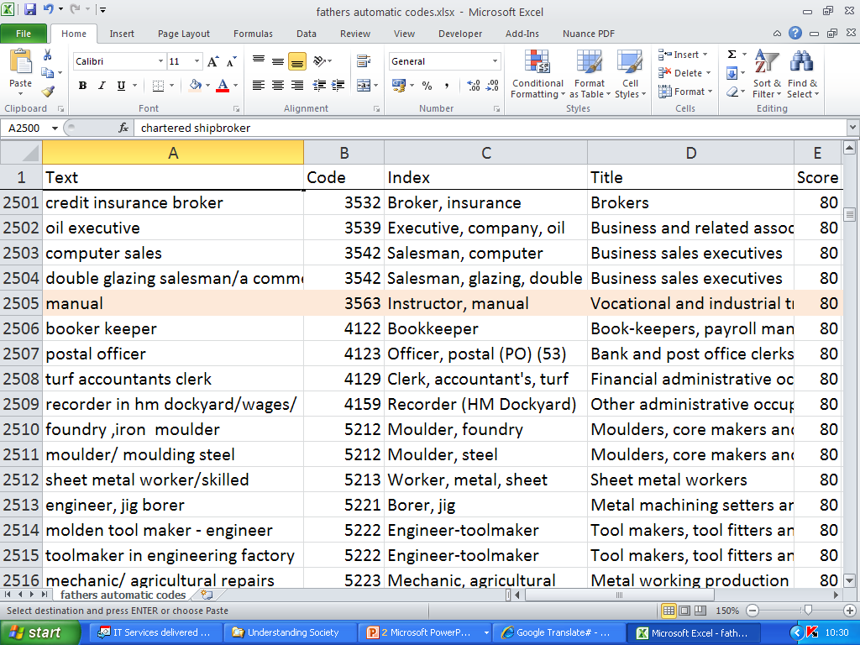

Slide 31
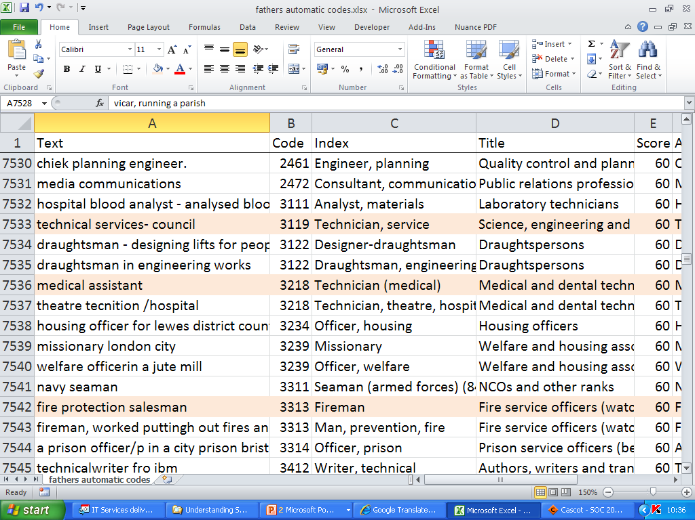

Slide 32
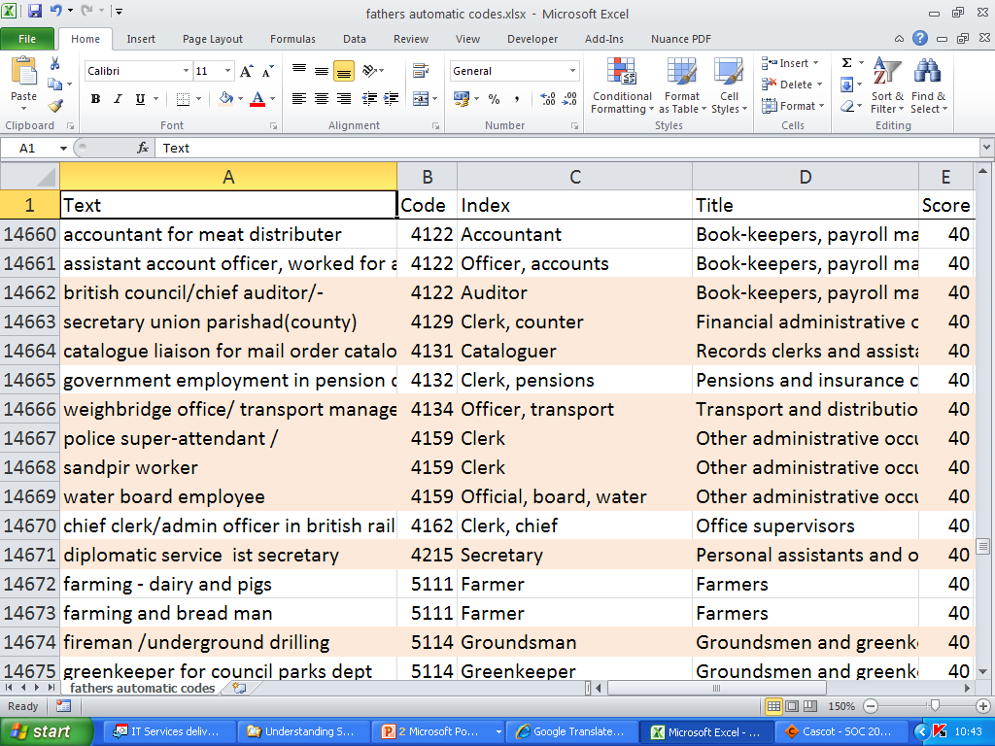

Slide 33
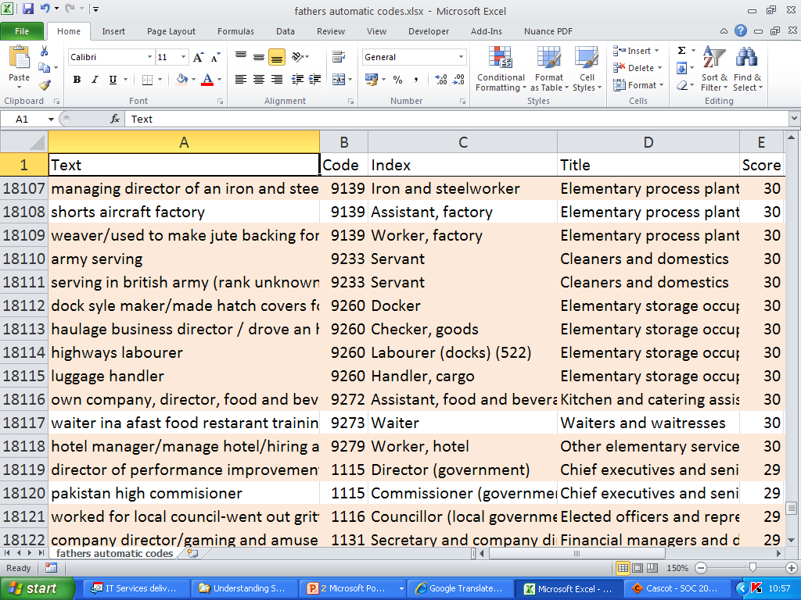

Slide 34
How do I make use of the comparison score?
Tests with large datasets give us an indication of the accuracy of the coding done by Cascot.
Above 80: coding takes place automatically
60 - 80: reasonably sure that the code shown is the correct one to allocate – but need to look at the alternatives shown with slightly lower comparison scores and check against the additional information you have for coding.
40 - 60: there is some ambiguity. Careful consideration of all relevant information is required.
39 and lower: Cascot is struggling to find an appropriate match. More information is necessary before coding can be concluded.

Slide 35
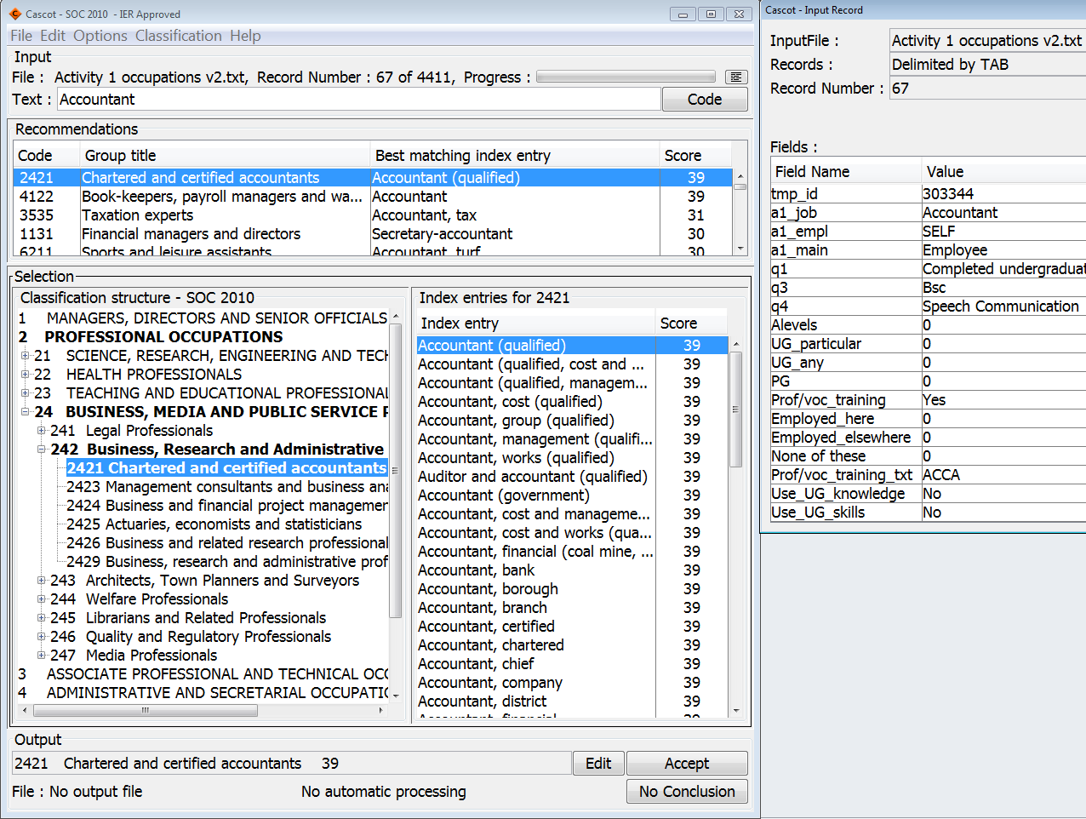
Making use of additional information
Click to see input record

