Slide 1
What is a graduate job?
Dr Charlie Ball
Head of HE Intelligence
Graduate Prospects

Slide 2

Why this debate is important
“Our aim is to … recognise those institutions that do the most to welcome students from a range of disadvantaged backgrounds, support them to remain on their courses (such students are often at a higher risk of dropping out) and help them to progress to further study or a high skilled job”
From the HE Green Paper, November 2015, Page 18
Notes:
The Green Paper and prelude, of course, to TEF

Slide 3
What is a graduate job?
“a job suitable for a graduate”
“a high skilled job”
“a job you need a degree to get”
“a job done by a graduate”
“a job you need a degree to do”
“a job I’d be happy for my kids to do”
Notes:
Some common views of what a graduate job might be from people outside the debate

Slide 4
What is a graduate job?
‘a typical grad scheme, a big company basically'
'A job that you get at the end of your university course, that uses your skills that you have learnt'
'Graduate jobs meaning…the course you've studied…leading you to that job’
'Higher-level skills, jobs that require a degree and pay above 18k'
'Entry-level jobs that don't require experience but require a degree'
Notes:
What do Good Outcomes from HE look like?
Clare Lyonette, Gaby Atfield and Sally-Anne Barnes
October 2016
Also mirrored by comments from pupils in Bolton and by respondents in the work of LJMU on the fragmentation of pre-HE guidance

Slide 5
What is a graduate job?
Of those in employment, the proportion in managerial/professional jobs six months after graduation (SOCs 1 to 3)
Key Information Set definition

Slide 6
But…
“however good the classifier, there will remain an inevitable fuzziness in any simple two-way classification of jobs as graduates or otherwise”
Green and Henseke, IZA Journal of Labor Policy (2016) 5:14

Slide 7
The agenda – why we need a definition
To make strong contribution to public discourse on higher education and increase public trust
There is a need to develop robust measures for TEF
Part of debate on immigration and skills requirements
Ensuring best quality IAG to help students gain best value from costly study
To gain deeper insights into process of labour market change and graduate underemployment

Slide 8
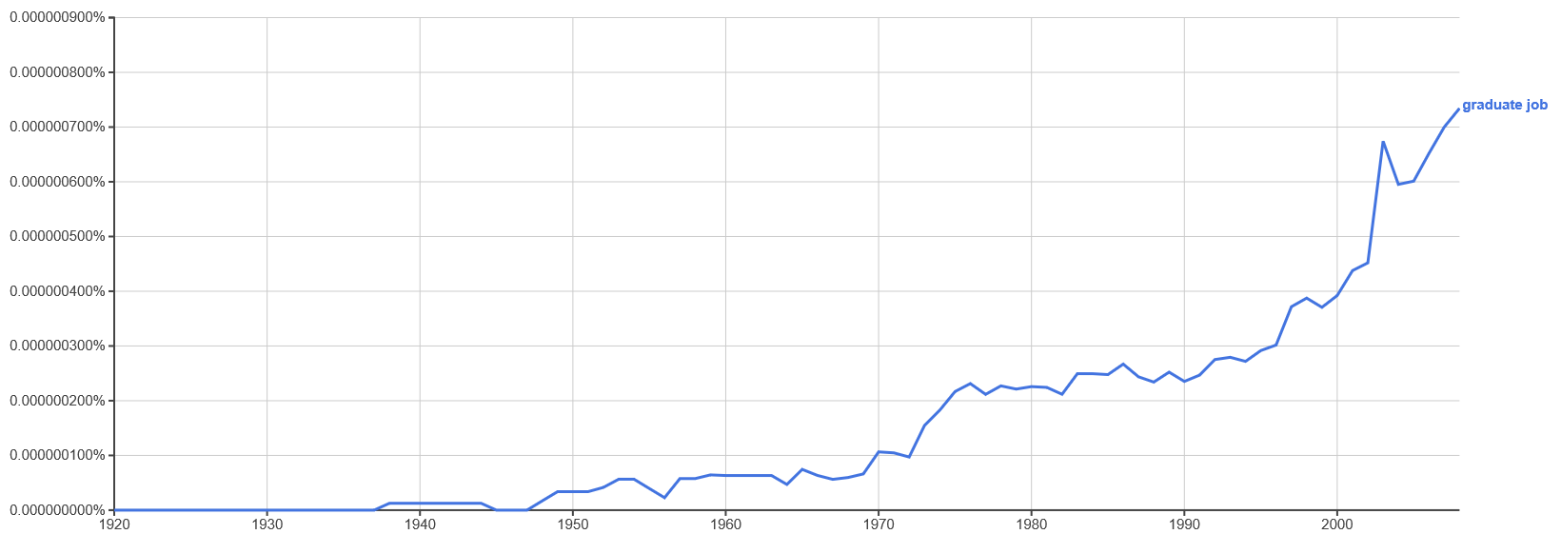
This is not a new debate
Popularity of phrase ‘graduate job’ amongst publications – data from Google Ngram

Slide 9
And concern about graduate underemployment is long-established
“By October 1922 nearly 80 per cent of the BA graduates and 45 per cent of the Science graduates among the ex-servicemen in the entire Midland region were teaching. By contrast, less than 5 per cent of the Midlands engineering students were teaching : over 56 per cent of the latter were employed in industry, compared with 28 per cent of scientists. Only one Arts graduate went near industry, and then only as a rail clerk.”
Leonard Schwarz (2004). Professions, Elites, and Universities in England 1870–1970. The Historical Journal, 47, pp 941-962

Slide 10
And concern about graduate underemployment is long-established
“There were business appointments, but only of a mediocre kind; for the large firms which often apply to the Oxford or the Cambridge Appointments Board for promising young graduates, seem to forget that there are nine other English universities as well.
What remained? For women, secretaryships and librarianships (generally ill-paid), marriage (which a gratifyingly large number of them achieve early) and – teaching. For men – teaching only.”
E. Allison Peers, writing under the name of Bruce Truscot, Red Brick University (London, 1943),
p. 153.
Notes:
On options for Arts graduates

Slide 11
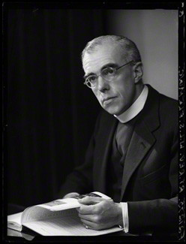
When ‘graduate jobs’ entered the political debate
“Provided that the calibre of university education is adequate, I do not believe that graduates who fail to get what have been commonly regarded as “graduate jobs” will necessarily feel that going to university has therefore been a waste of time.”
Launcelot Fleming, Bishop of Norwich
University Education and National Needs Lords — March 4, 1971
Notes:
First reference to ‘graduate jobs’ in Hansard.
Fleming had originally been a geologist, who made his name as geologist and chaplain on Antarctic expeditions and played a significant role in planning UEA. Shortly after this speech he resigned his see due to ill-health and was appointed the deacon of Windsor and HM’s private chaplain.

Slide 12
…and it’s been part of guidance for some time
“…entry into many occupations is now almost entirely restricted to graduates: teaching, the legal profession, architecture and speech therapy are typical examples”
What Do Graduates Do? 1993

Slide 13
What it means in practice
“A large number of respondents commented on the use of SOC codes for Social (sic) Occupational Classifications of jobs ... The outcome gives a measure of the role that is often used as a proxy for success in obtaining a ‘graduate’ job…. Some respondents expressed a desire for SOC to be updated in line with the changes in the graduate labour market.”
Synthesis of response to HESA consultation on principles and future requirements for the UK’s public data on graduates, HESA, October 2016

Slide 14
What it means in practice
Idea of a ‘graduate job’ crucial driver in development of new outcomes survey from HE
Helps to flesh out idea of ‘good outcomes’ (which may vary by background, sector, aspiration)
Needs to be managed carefully so as not to bring Goodhart’s Law into play – “When a measure becomes a target, it ceases to be a good measure.”

Slide 15
What it means in practice
SOC 2020 is now under development
The majority (78%) of respondents stated that SOC2010 needed updating. Key areas highlighted by respondents were:
the range of the existing groups and occupations are no longer reflective of many roles in the IT/Tech, digital and creative sectors
the current SOC does not reflect some occupations where a degree is now a compulsory requirement or where a university qualification is now a common requirement
a further disaggregation of some SOC groups is needed
Office of National Statistics Consultation on revising the Standard Occupational Classification 2010
Notes:
Note that one of the bodies stating the issue with SOC not reflecting graduate employment was the DoE.

Slide 16
Because the labour market is changing rapidly
Notes:
Note that one of the bodies stating the issue with SOC not reflecting graduate employment was the DoE.

Slide 17
Qualification levels of UK workers 2004-2015
Data from Annual Population Survey to Dec 2015, analysed using NOMIS

Slide 18
Net changes in UK occupational structure 2004-2015 (at primary SOC group level)
Notes:
So, in 11 years, we added about 2.5m graduate jobs.

Slide 19
What it means in practice
A stable idea of a graduate job allows us to:
Contribute in a robust, evidenced way to debate
Develop nuanced LMI to support careers professionals working with current and prospective students
Examine labour market change
Develop effective ways of expressing the purposes and value of higher education to the public at large
Notes:
Note that one of the bodies stating the issue with SOC not reflecting graduate employment was the DoE.

Slide 20
The agenda
To develop a robust, accepted definition of ‘graduate job’ that
Serves the needs of multiple stakeholders within and outside the sector
Describes the experience of graduate employment in a way that is understood by those experiencing and those supplying that employment
Can be effectively applied using available data
Allows planning for workforce skills and training needs
Is simple (parsimonious) and transparent
Notes:
Note that one of the bodies stating the issue with SOC not reflecting graduate employment was the DoE.

