Slide 1

Top Sources of Careers Information for the Energy and Utilities Industries
Module 1
2013

Slide 2
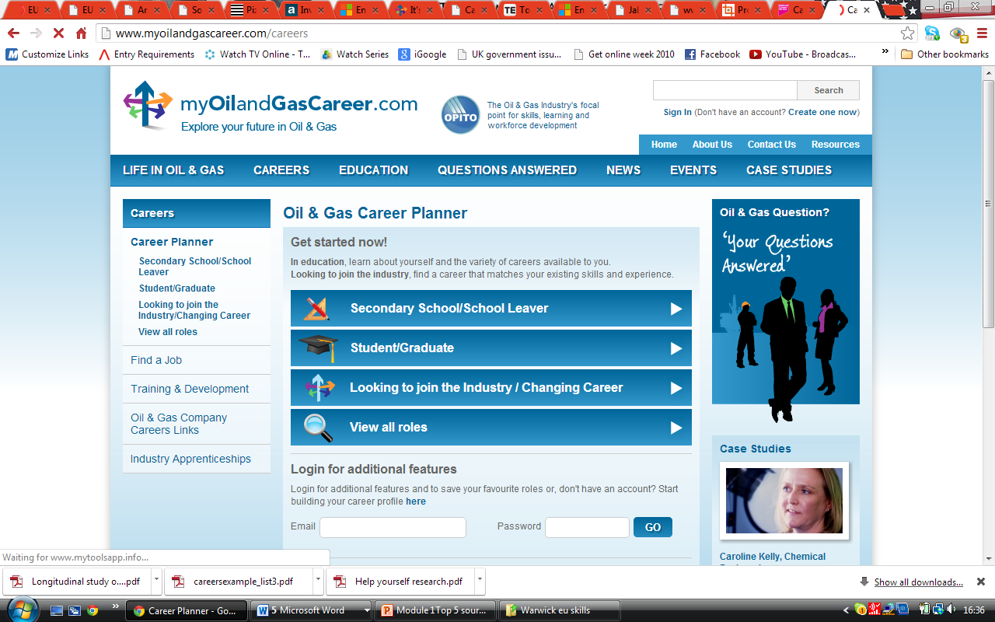
My Oil and Gas Career
Career planner with quick pointers to broad range of suitable careers with info and video case studies
Interactive games zone
Useful FAQs
Curriculum resources
Links to companies
‘Life in oil and gas’ - information

Slide 3
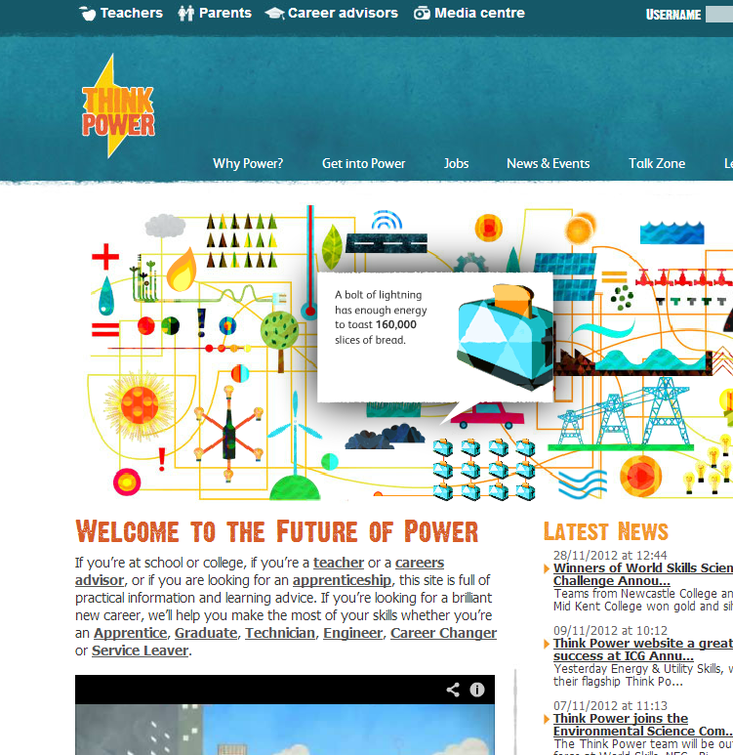
Thinkpowersector.co.uk
You tube video “How to navigate the thinkpowersector website” and more on their you tube channel
Focus on electricity at all levels: apprentice, technician, graduate, returner
Career Planning Tool with job descriptions, preferred qualifications
Video Deck
Jobs Board: live vacancies across the country and links to major employers’ websites
Engaging, interactive features
Sections for teachers, parents and careers advisors including lesson plans and ideas
Links including Think Power Summer School

Slide 4

Information about the industries & curriculum materials
Wide range of profiles with links to further information
Career Fact sheets for Renewables, oil and gas and nuclear
Degree courses accredited by The Energy Institute
across the UK and beyond
www.energyzone.net

Slide 5
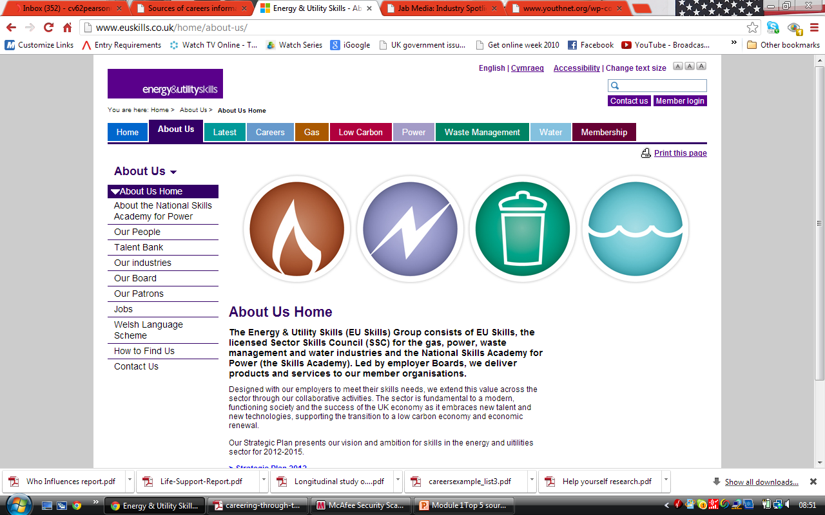


www.euskills.co.uk
Industry descriptors, job profiles , LMI reports and video case studies all available.
Jobs and employers site:

Slide 6
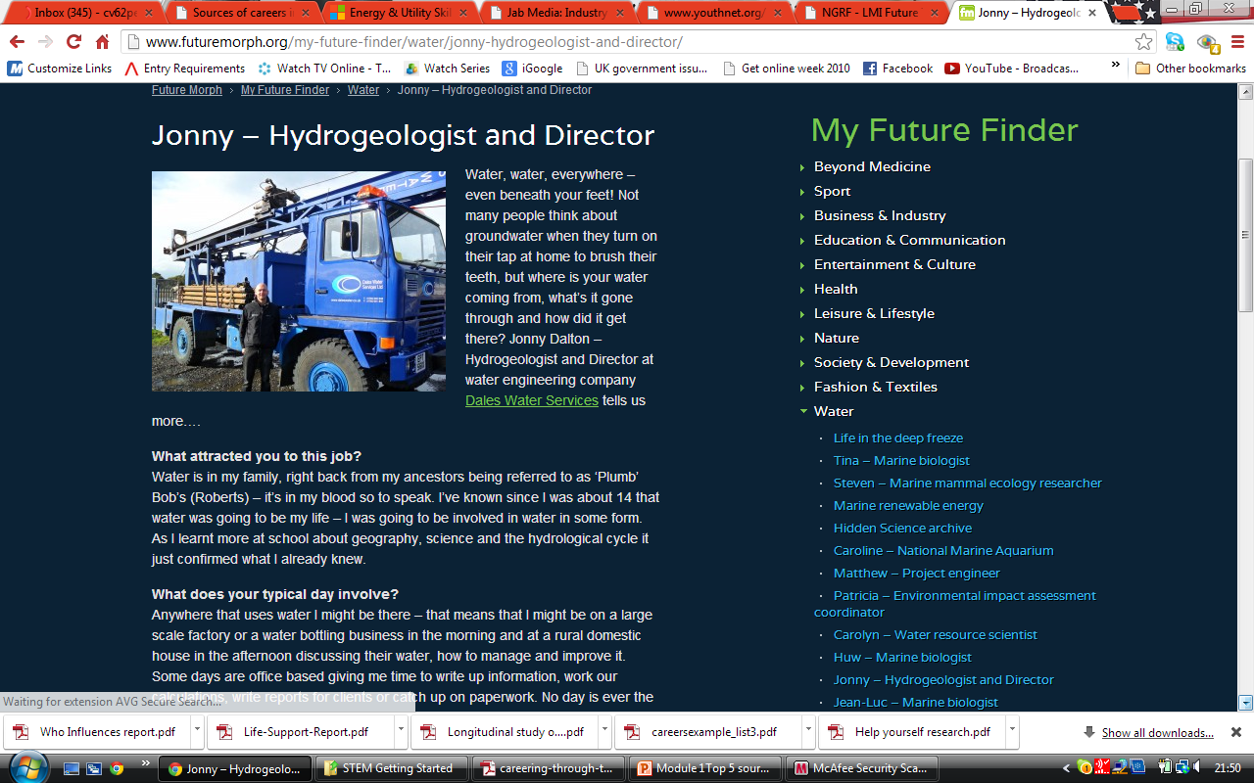
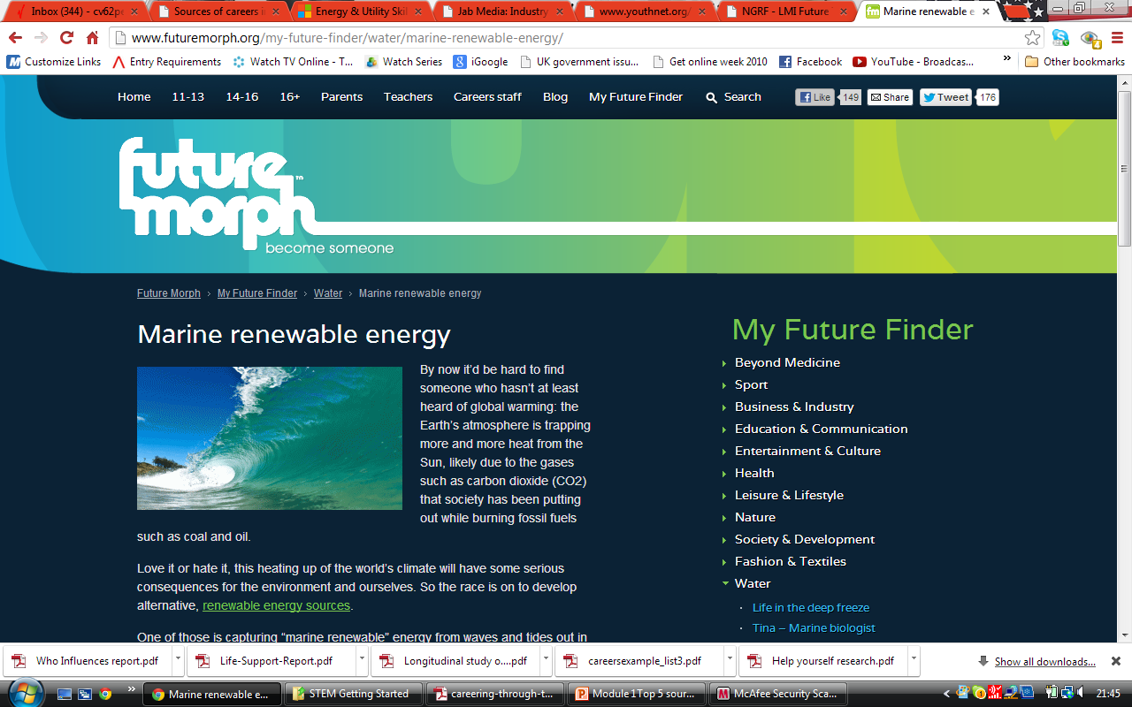
Futuremorph The national website for STEM (science technology engineering and maths) careers
A wide variety of articles and links to job profiles. Lots of inspiration to encourage young people, their parents, teachers and careers advisers to investigate STEM careers and learning.
Industry Focus: The Renewable Energy Industry
Industry Focus: The Nuclear Industry

Slide 7
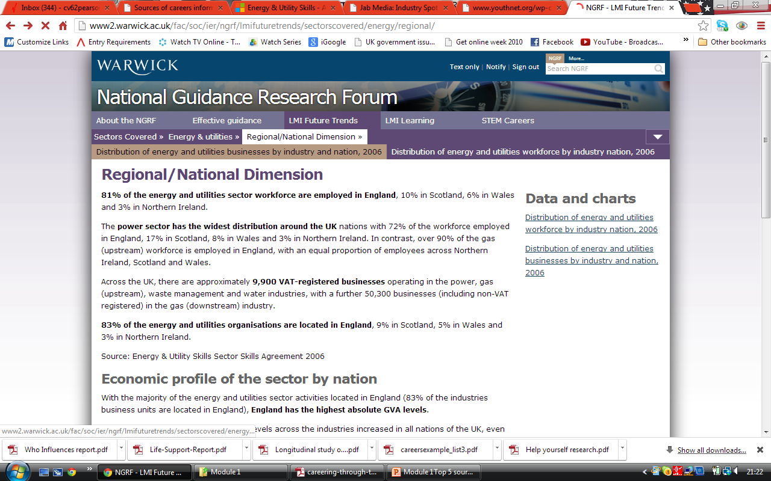
LMI Future Trends
The Energy and Utilities section has up to date LMI on the sector as a whole, regional and national facts, occupational information, equal opportunities, education and training, and links to further sources.

Slide 8
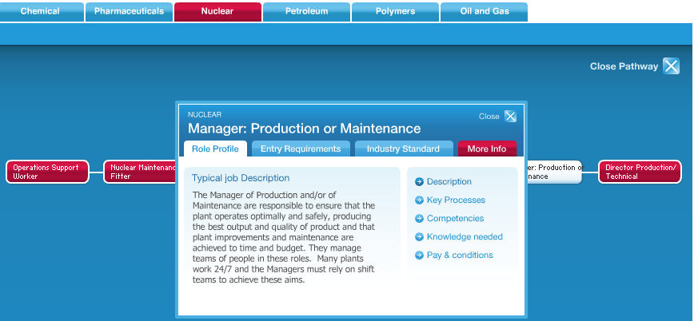
Cogent-careers.com
Sector Skills Council for Chemicals, Nuclear, Oil and Gas, Petroleum and Polymers.
Industry information, role profiles and case studies
Career pathways and Qualification pathways for each industry (see below)

Slide 9
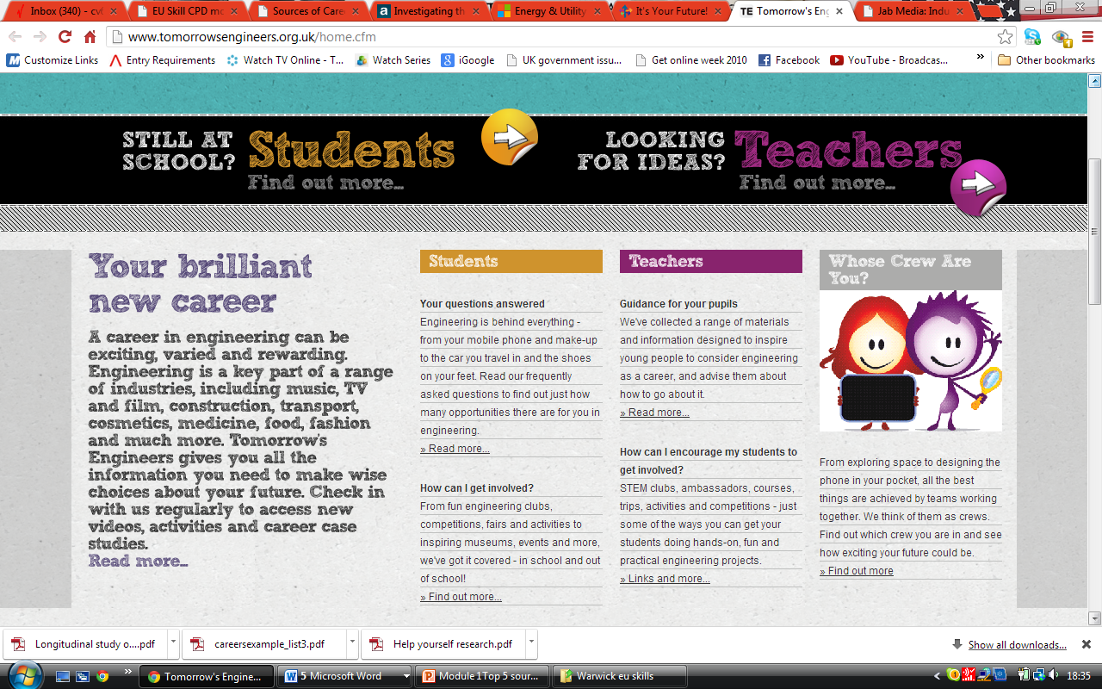
Tomorrow’s Engineers
Covers all branches of engineering
Rich resource for teachers and students
Own you tube channel, free resource pack, PowerPoint on engineering

Slide 10
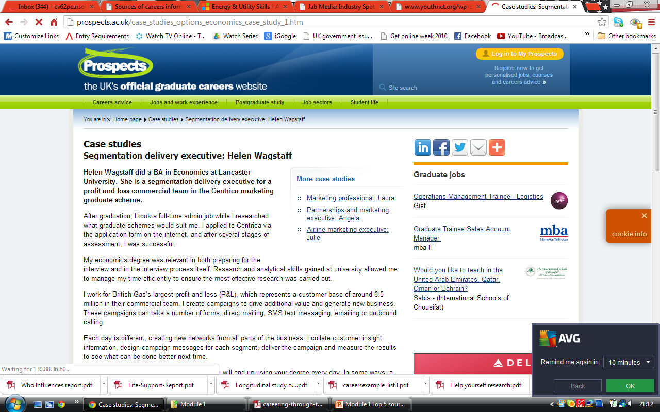
Prospects.ac.uk
Job Sectors: Energy and Utilities. Includes overview of sector, examples of graduate employers, jobs and case studies as well as live vacancies, including courses.
Prospects Planner helps with careers choice.

Slide 11


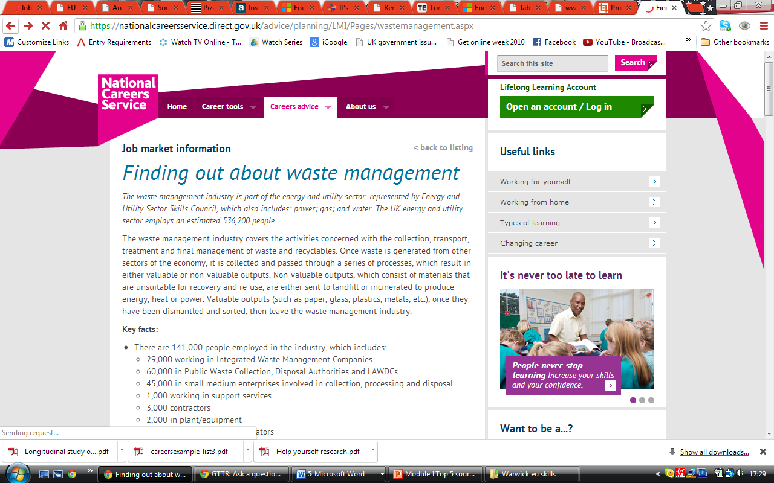

National Careers Websites
All of these sites (logos are links) have a broad range, which includes the energy and utilities industries, of role profiles, careers information, labour market information and live job vacancies:

Slide 12


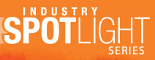
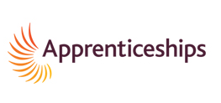
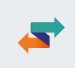
Other sites to try….
including Energy and Utilities
careers stories in film and articles e.g. waste to energy
Industry Spotlight on the Energy Industry
National Apprenticeship Service
Universal Jobmatch

