Slide 1
STEM Learning Routes and Pathways

Slide 2

Overview
Studying STEM can lead to exciting opportunities for young people, accessed through a range of progressive education and training routes
It is important that young people know the implications of studying STEM subjects and leaving ‘the door open’ to STEM careers
What are their choices?

Slide 3

STEM @ School or College
Science and Maths are core subjects at Key Stage 4.
Learners usually choose between Core Single or Core Double awards, or ‘triple’ science (separate GCSEs in Biology, Chemistry and Maths).
The Government is keen that more learners should have access to ‘triple’ science.

Slide 4
Apprenticeships
  Apprenticeships combine on the job training with a nationally recognised qualification
They are offered at 3 levels:
  Intermediate Level Apprenticeships
  Advanced Level Apprenticeships
  Higher Apprenticeships
  Government investment in Apprenticeships is increasing to create more opportunities, particularly at Higher Apprenticeship level.

Slide 5
Rachel Hoyle, Advanced Apprentice in Aerospace Engineering:
“what clinched the apprenticeship for me was the fact I could go and begin a career, learning from people who are experts in their own right. I felt I could get involved in real work while applying my favourite subjects, like maths and physics and continuing to learn.”
www.apprenticeships.org

Slide 6
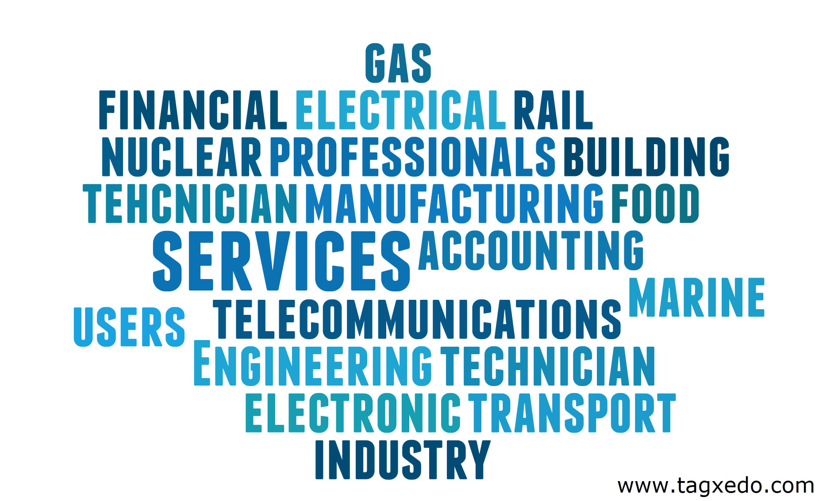
STEM Apprenticeships

Slide 7
Diplomas
Diplomas are a mix of general learning, creative thinking and practical experience, offered in broad employment sectors, at 3 levels:
  Foundation: Level 1
  Higher: Level 2
  Advanced: Level 3

Slide 8

STEM Diplomas
STEM related Diplomas:
• Construction and the Built Environment
• Engineering
• Information Technology
• Business, Administration and Finance
• Manufacturing and Product Design
• Creative and Media
• Environmental and Land Based Studies
• Society, Health and Development
Out of 3,069 young people who completed the two year Higher Diploma in 2010, 871 studied engineering, making it one of the most popular.

Slide 9
STEM @ A Level
Notes:
It is important for young people to be aware that to enter STEM-related degrees with A Level psychology or sports studies, they will also need to take 2 ‘core’ science A Levels as well.
The SCORE Report Choosing the Right STEM Degree Course found that students wishing to gain entry to degrees in STEM would be best advised to attain A levels or equivalent in at least two science-related subjects. The report suggests that there can be flexibility in the third or fourth A level studied. Grades and subjects studies are critical determinants of entry emphasising the importance of effective information, advice and guidance to assist young people with this vital decision. For instance, in order to study a BSc in Chemistry, most universities will expect A Level in Chemistry and in at least one more science/maths A Level.
A useful tool to assist with guidance on subject choice can be found at www.futuremorph.org.uk by searching for Choosing Subject combinations. Students should be encouraged to check acceptable or optimum A level combinations with UCAS or individual institutions. For instance, highly competitive institutions may only accept A levels such as Applied Science or Sports Studies as a fourth subject.

Slide 10

HE STEM
For 2010 entry there were 4,815 STEM qualifications on the UCAS database.
Since 2002, the numbers of applicants to STEM Degrees has grown, except in Engineering (5% fall between 2002 – 2007)
The next slide shows the extent to which Psychology and Sports Science undergraduates outnumber those in other STEM subjects.

Slide 11
Degree Acceptances 2009

Slide 12

STEM Graduate Employability
Despite the lower numbers of STEM graduates, they are more likely to gain employment in the STEM sector. Contrast this with graduates in psychology and sports studies; fewer will get jobs in their, much smaller, employment sectors.
STEM ‘s added value is flexibility – 72% of firms across all sectors employ STEM skilled staff

Slide 13

STEM Careers
Studying STEM subjects maximises career options in not only in the STEM area, but also for careers not related to STEM.

