Slide 1
Equality and Diversity in STEM learning routes and careers
STEM CAREERS LEARNING MODULE: STEM GETTING STARTED

Slide 2
Equality and Diversity: Career Choice
Gender, ethnicity, social and economic background and disability affects choice , possibly because of self limiting effects on:
academic self concept “I’m not good at science”
career identity “I don’t know anyone who does that job”
STEM careers awareness is also limited by:
lack of visibility of breadth of STEM options
stereotyped images and perceptions of people working in traditionally conceived STEM jobs.

Slide 3

STEM Challenges
UK has lowest number of female engineering professionals in Europe.
3.8% of the STEM sector are disabled compared to 5.9% in other sectors.
Low aspirations and poor academic confidence have a disproportionate effect on STEM achievement of working class White British and Black Caribbean boys.
Triple science GCSE improves outcomes at A level, but isn’t widely available in deprived areas.

Slide 4

What should we do?
To maximise individual opportunity and meet economic need, a more diverse STEM workforce is an important goal.
Promote STEM learning routes and careers in a positive way to encourage under represented groups to see the benefits, particularly to women and ethnic minorities

Slide 5

Why Don’t Women Choose STEM?
Where are we?
Why is this the case?
What does this mean?
How can we encourage change?

Slide 6

Where are we?
In 2008 78% of A level physics students were male
6% of girls say science is their favourite subject, compared to 37% of boys
Girls do well at Key Stage 4 but don’t choose to go on further
2008 only 14% of the girls who got A/A* @ GCSE Dual Award science continued beyond this

Slide 7

Why are we here?
Girls’ self belief in their scientific abilities declines as they get older
Teaching has been insensitive to gender
Girls reject stereotypical, masculine images of scientists, often reinforced over many years
Girls have little idea of what STEM occupations offer, so reject them
Parents have a negative perception of STEM industries
Some religious faiths perceive STEM careers as incompatible with women’s role and religious responsibilities

Slide 8
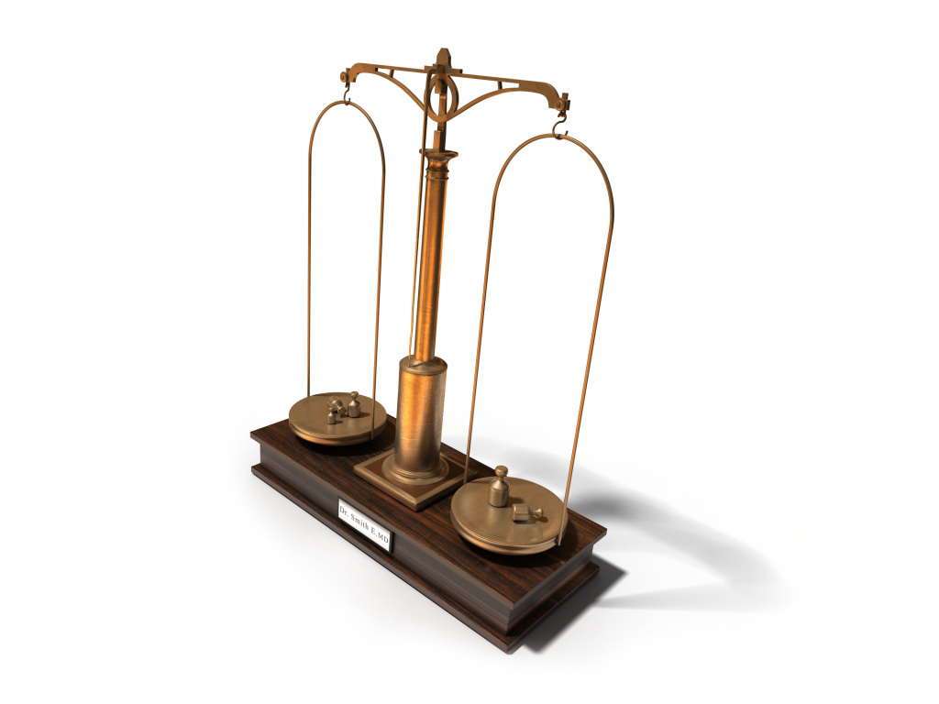
What does this mean?
Gender Imbalance in Occupations
Currently 75% of working women are found in 5 occupational groups.
Can you guess what they are?
(answers on next slide)

Slide 9
75% of women work in the following occupations
Associated professional and technical (nurses)
Admin and clerical
Personal services ( caring for children/elderly)
Sales and customer service
Non skilled manual work
This gender imbalance, pay discrimination and the unequal impact of caring result in the gender pay gap

Slide 10


Gender Pay Gap - STEM
2006 mean annual pay: ICT professionals £39,228 Hair/Beauty Salon Managers/owners £18,661
Apprenticeships : 2007 average weekly wage male £186, girls, £147
The message of better pay in STEM, combined with exciting opportunities may encourage girls to break this cycle of occupational segregation and narrow the pay gap

Slide 11
How Can We Promote Change?
Key Stage 3 is vital - young women need to understand what is available and opt for STEM
Follow curriculum recommendations such as representing science as something people do, not just a body of knowledge.
Make STEM careers advice more female friendly

Slide 12


Why don’t young people from some Ethnic minorities choose STEM?
Where are we?
Why is this the case?
What does this mean?
How can we promote change?

Slide 13

Where are we?
11% of Bangladeshi and 9% of Black Caribbean students are 1 or more SET (Science, Engineering and Technology) A levels
Compare this with 39% Chinese, 37% Indian, Black African 28% and 19% White.
Similar pattern with SET degrees
Situation overall is most acute with Bangladeshi women and Black Caribbean males

Slide 14

Why is this the case?
Strong association between science careers and masculinity.
Mathematicians are usually imagined as middle-aged white men
Engineering is described as an ‘invisible’ career, which, when imagined at all, is often seen as dirty, physical work
50% of secondary pupils view scientists as middle-aged men in white coats. Only a third thought they could be normal and attractive men and women.

Slide 15

What does this mean?
8.9% of UK Chinese population work in SET, 7.2% of Indian population, 5% of White ethnic population, 2.3% of Black Caribbean and 1.6% of Bangladeshi.
Bangladeshi women and Black Caribbean males are underrepresented in the SET workforce so only small number of role models available
Ethnic minority young people are missing out on benefits of working in SET/STEM.

Slide 16

How can we promote change?
Teachers need to know pupil destinations to avoid contributing to stereotypical ideas about aspirations, e.g. Bangladeshi girls aiming only for law/medicine/teaching.
Work experience is key in shaping non-traditional choices, and needs to be monitored to ensure stereotypes are not reinforced.
Careers advice must encompass a wide range of occupations, to avoid limiting ideas and aspirations
Wider use of positive role models

Slide 17

Back to the module for….
A Quick Guide to STEM Work Experience Placements
Top Tips for Equality and Diversity through STEM Careers Advice
The Equality and Diversity Toolkit
And more…..
Note: All statistics used here are referenced in the STEM Choices Pack 2011

