Slide 1
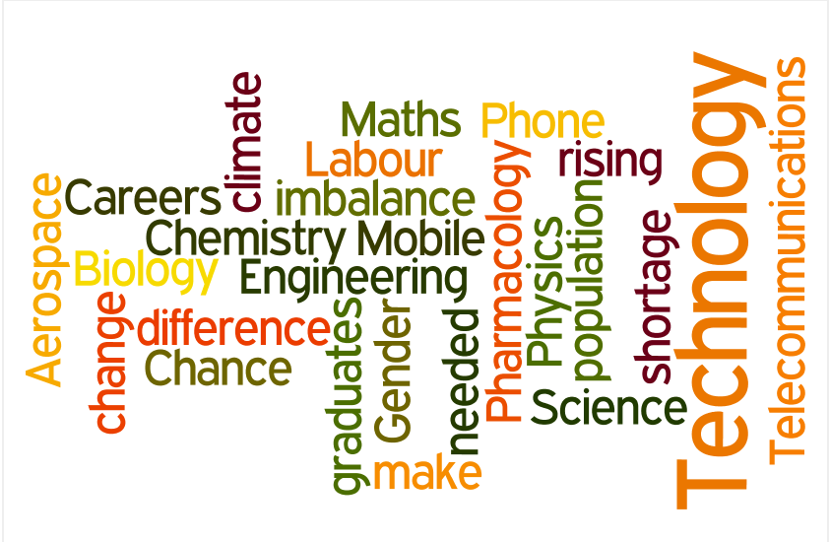
The Rationale for Promoting Science, Technology, Engineering and Maths (STEM) Careers

Slide 2
The future prosperity of the UK is dependent on young people choosing STEM related subjects.

Slide 3


The UK needs to double supply of skilled workers in STEM related jobs in the next 7-10 years.

Slide 4

Females and some ethnic minority groups are currently greatly under represented in those taking STEM subjects and entering STEM jobs.

Slide 5

STEM Labour Market
72% of UK firms employ STEM skilled staff, but not enough people are studying STEM subjects to meet growing demand.
STEM skills are vital to areas of future growth and employment including advanced manufacturing and low carbon industries.
But, 45% of employers are currently having difficulty recruiting STEM-skilled staff, with 59% expecting difficulty in the next 3 years.
Consequently young people need to understand the relevance of STEM knowledge and skills to everyday life.
It is vital that careers practitioners help young people to understand the importance of STEM subject choice and their impact on progression opportunities.

Slide 6

UK STEM
The UK has world class science sectors in Pharmaceuticals, Aerospace, Telecommunications, Mobile Phone Technology and Oil and Gas Exploration
There is also ‘hidden’ science in the high street including:
supermarkets (food and drink, packaging, logistics, IT, finance)
fashion (textile technology, materials, computer aided design, dyes)
the built environment (construction engineering, materials sciences, environmental issues, energy).
Teachers and advisers will be cautious about messages proclaiming growing demand, but there is strong evidence of future need for STEM skills, especially in manufacturing

Slide 7
STEM National Strategy
The National Strategy has 11 action programmes which are part of a 10 year plan aimed at improving take up and achievement in science and maths. They aim to:-
• Get the right people to become teachers and lecturers
• Encourage continuing professional development for teachers and
engage them in technology and engineering
• Bring real-world context and applications of STEM into schools and
colleges to enrich teaching
• Show young people the rich range of career opportunities that
STEM study opens up
• Get the STEM curriculum and infrastructure right including enhancing the quality of practical work

Slide 8

Action 8 is Careers Awareness
This has included:
Communications with young people and parents to improve the take-up of science and maths subjects post-16
The Future Morph website for young people aged 11-18 to help engage them in studying science and maths by demonstrating the huge range of career opportunities available by pursuing these
subjects
A range of careers awareness resources for schools, teachers and careers education and IAG professionals to complement the public facing elements
A Careers Awareness Timeline pilot designed to establish a more coherent structure for young people to learn about careers relating to science and maths. The project has been spearheaded by Kate Bellingham, the National STEM Careers Coordinator.
All of these resources are brought together in this online module

Slide 9
Robert’s Review
In a Government commissioned review in 2002, which helped to prompt the STEM Strategy, Sir Gareth Roberts noted:
‘The views of parents, teachers, careers advisers and society in general towards study and careers in science and engineering can play a significant role in shaping pupil’s choices as to whether to study these subjects at higher levels.
Regrettably, and incorrectly, pupils often view the study of science, mathematics and engineering as narrowing their options, rather than broadening them.
A contributing factor is that careers advisers often have little or no background in the sciences, and that science teachers are often unwilling to advise pupils on future options.’
SET for Success: The Supply of People with Science , Technology, Engineering and Maths Skills

Slide 10

Key Messages
STEM qualifications :
lead to a wide range of opportunities at different levels and are valuable for non-STEM jobs. They keep options open.
can help to address key global challenges such as climate change.
are valued by employers – 40% of businesses prefer STEM degrees when recruiting graduates.
STEM courses and careers are open to all and can help raise aspirations.
STEM helps develops enterprise and employability skills – analytical capabilities, problem solving, creativity.
Many STEM jobs need creativity and design skills in combination with mathematical and scientific abilities. Good salaries are available and locations for work vary, often not a desk or a laboratory

Slide 11

Let’s Grow STEM!

