Slide 1
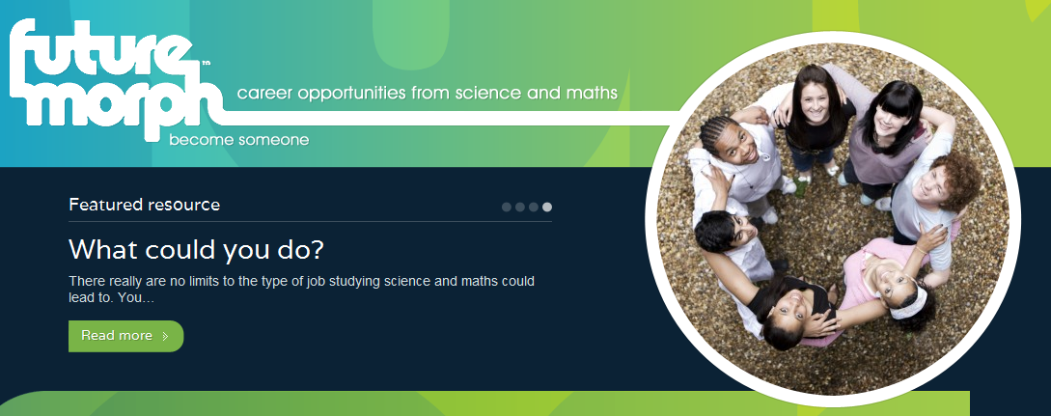
Future Morph: A Introduction
STEM Getting Started On line Learning Module

Slide 2
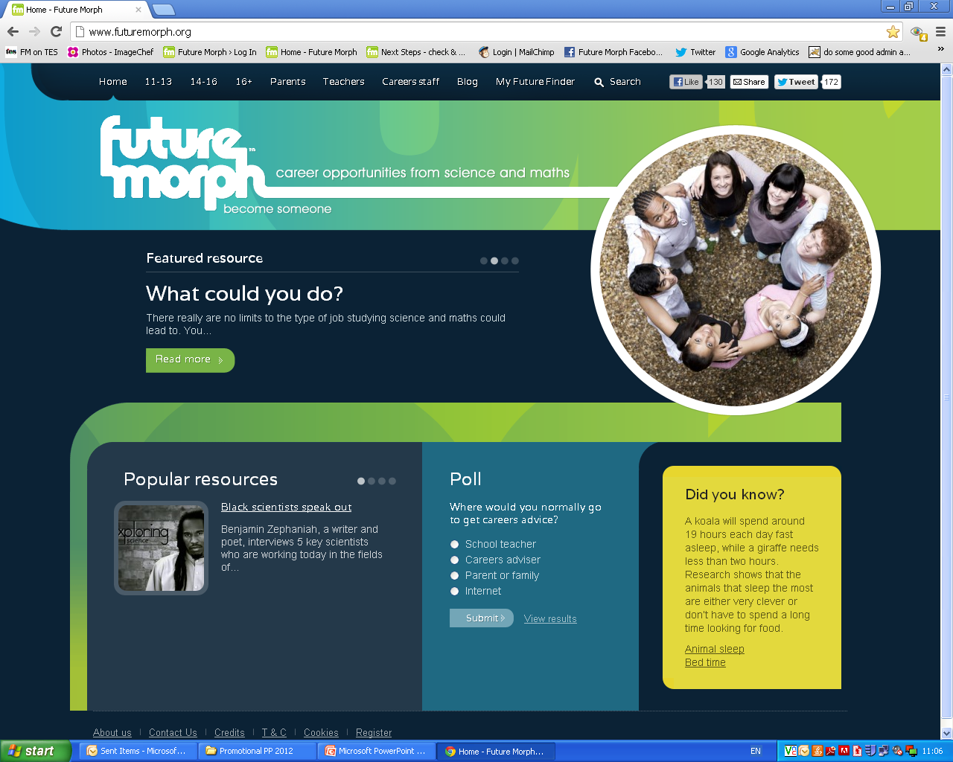
This Presentation…..
Guides you through the different features of the Future Morph website.
Gives hints and tips for using www.futuremorph.org

Slide 3

Why Future Morph?
The Future Morph website shows that studying STEM subjects isn’t a one track road to becoming a scientist or engineer; the skills and knowledge gained are valuable in almost any career and enhance employability at all levels.
Future Morph helps people explore a range of careers and think about where their future might lie. There are useful links and subject specific resources.
It is a central resource in promoting STEM Careers

Slide 4

Who is behind Future Morph?
Future Morph is the Science Council's website designed to provide information for young people, their parents and teachers about careers from studying science and maths.
www.futuremorph.org
The Science Council is an umbrella organisation for societies and professional bodies across science which works to support the professional practice of science at all levels.
Members include Society of Biology, Royal Society of Chemistry, Institute of Physics & Royal Meteorological Society.
www.sciencecouncil.org
For more information see the Future Morph About Us section

Slide 5
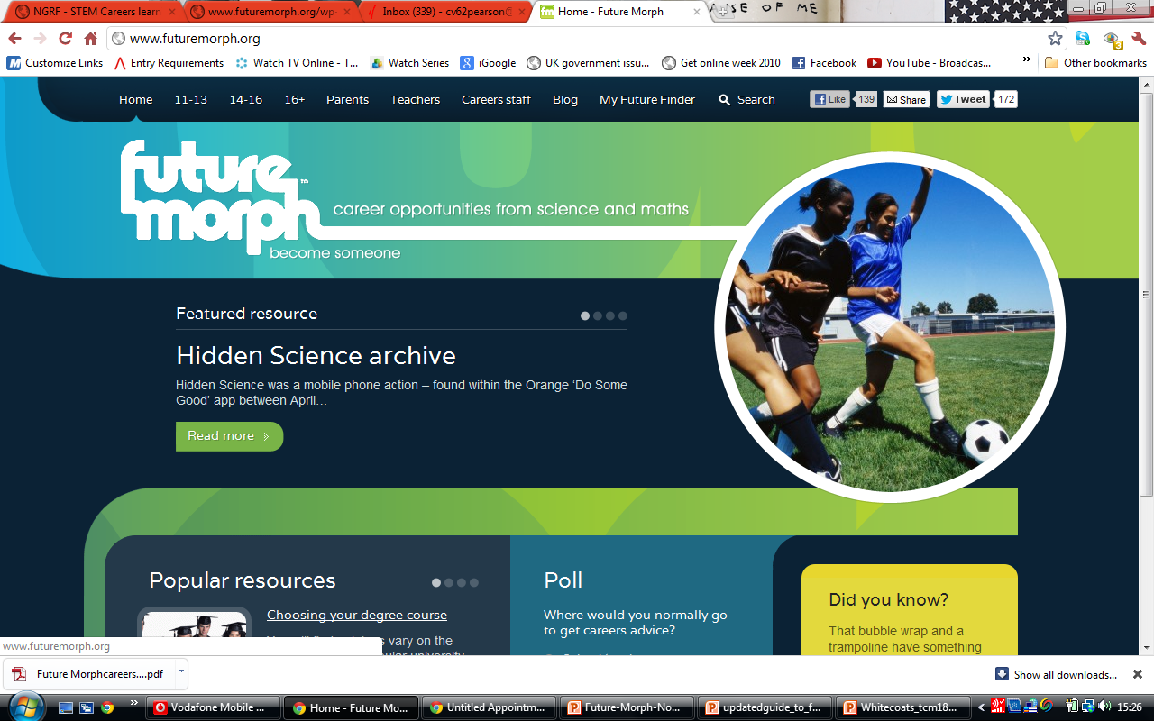
Sections: 11-13, 14-16, 16+, Parents,
Teachers, Careers Staff, Blog and My Future Finder.
Links to Facebook and Twitter.
Home Page is refreshed with Popular and Featured Resources,
a ‘Did you Know?’ science fact and a Poll.

Slide 6
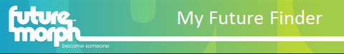
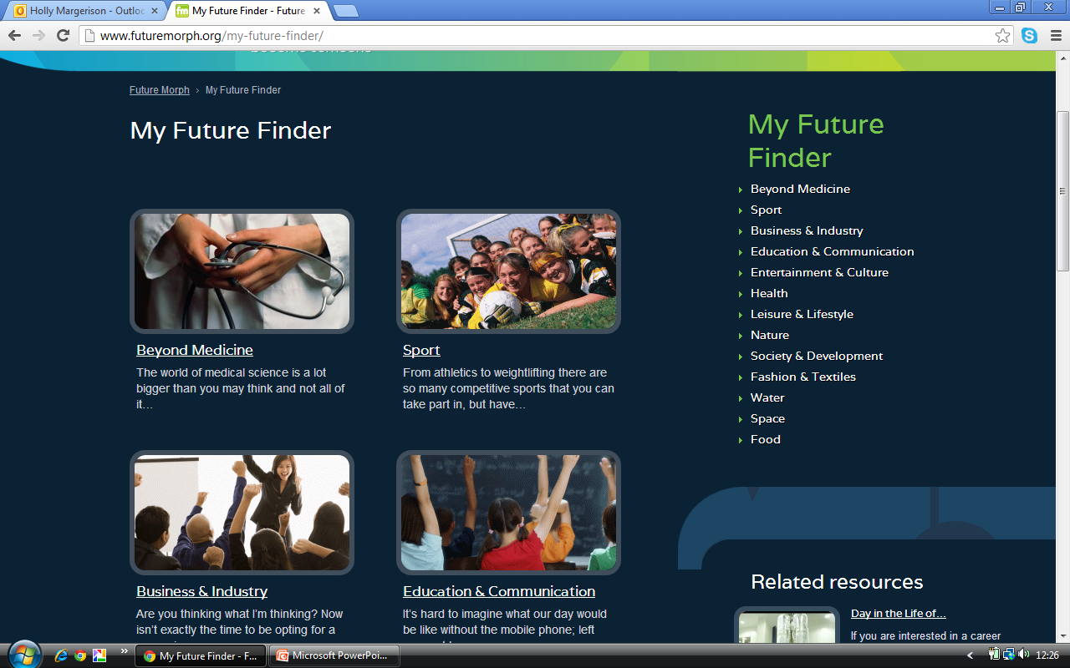
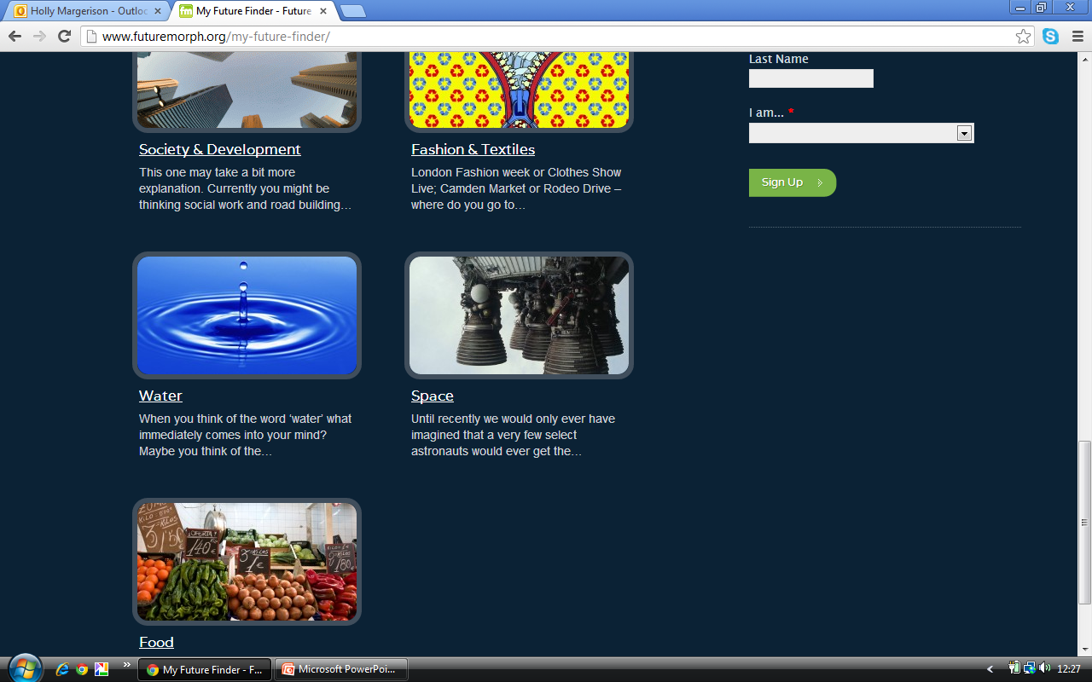
My Future Finder
A wealth of information in the form of articles, links and career profiles in 13 STEM work areas, including; Beyond Medicine, Leisure and Lifestyle, Entertainment and Culture, as well as the more expected Space, Sport and Nature.

Slide 7
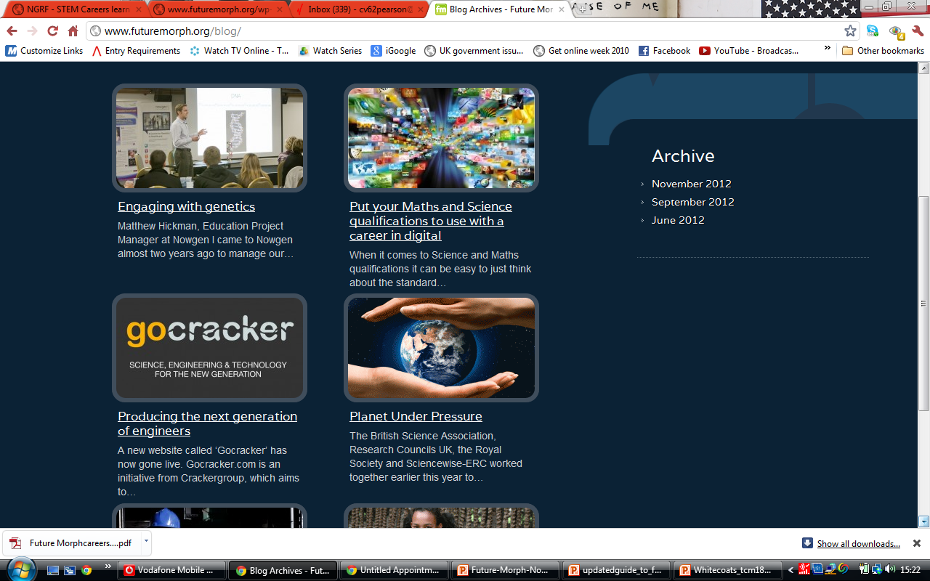
Blog
A regularly updated range of useful news articles about STEM careers, events and resources.

Slide 8
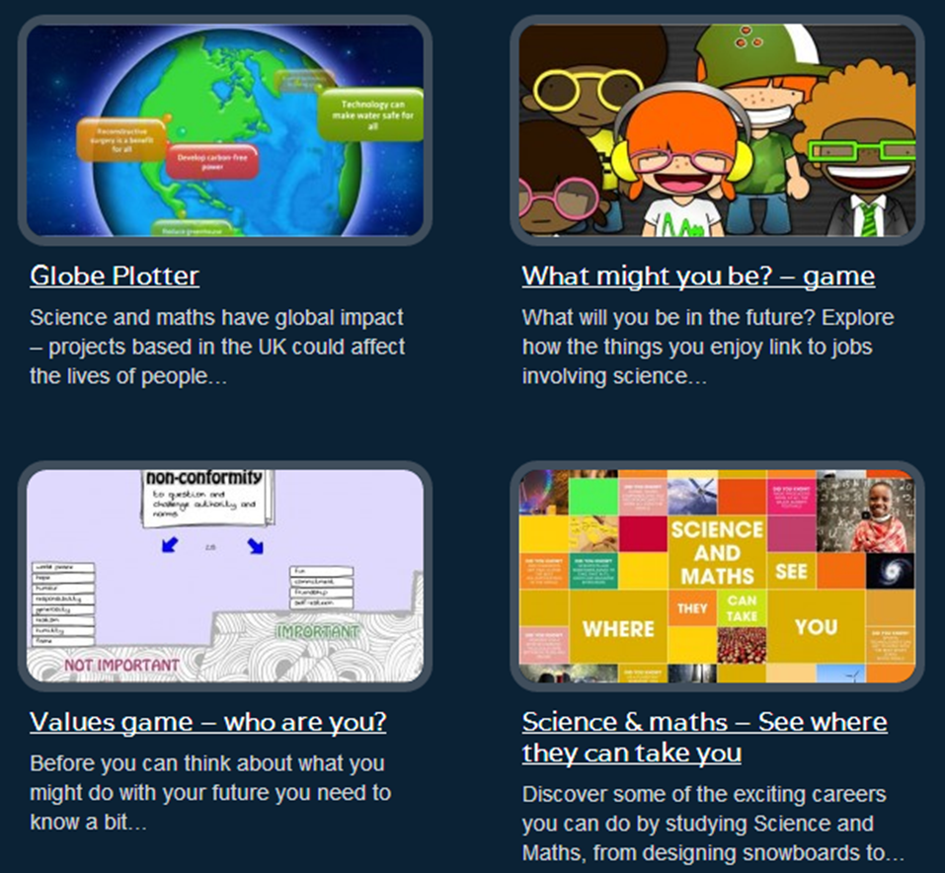
Featured in all Sections: Play
Globe Plotter: go around the world and find out about science in action.
What might you be?: how do the things you enjoy link to jobs in science?
Values Game: what is important to you?
Science and Maths – see where they can take you: exciting careers from studying science and maths.

Slide 9
Also Featured in all Sections
Work Experience: helpful information, advice and links tailored to different levels of need:
For young people the section introduces work experience and points out the benefits.
For parents, the section discusses how to prepare your child for work experience, including using the Future Morph website.
For teachers and careers staff it refers to useful organisations, work related schemes, such as The Year in Industry ,and summer activities including University Summer Schools.
Related Resources: links to other relevant sources within the site.
Related Links: takes you to useful external sites.
Register and receive updates.

Slide 10
All Sections for Young People have…..
Next Steps: appropriate advice about routes and qualifications with real life examples.
Careers Advice: where to seek help.
Quiz the Scientist: video clips of young people interviewing scientists.
FAQs: short answers to some common questions, tailored for each age group.

Slide 11
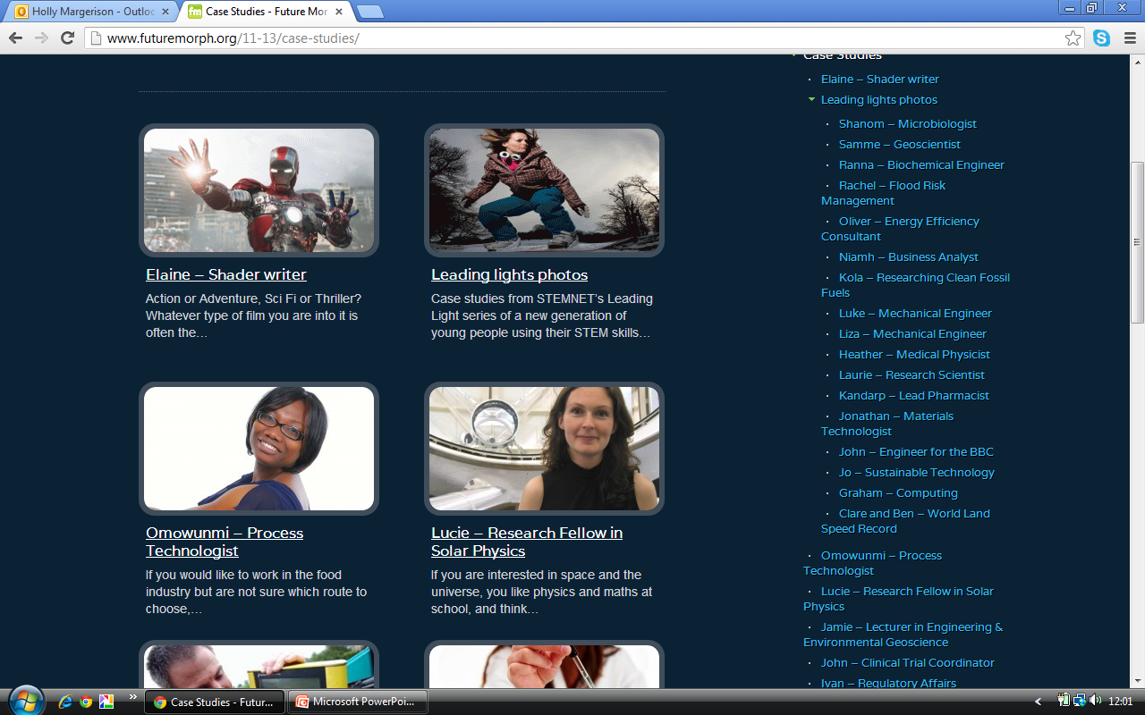
Specific Features in 11-13 Section
Case Studies: profiles of a wide variety of real life scientists.
Postcards from the Future: e-comic book about time travelling Maya’s adventures.

Slide 12
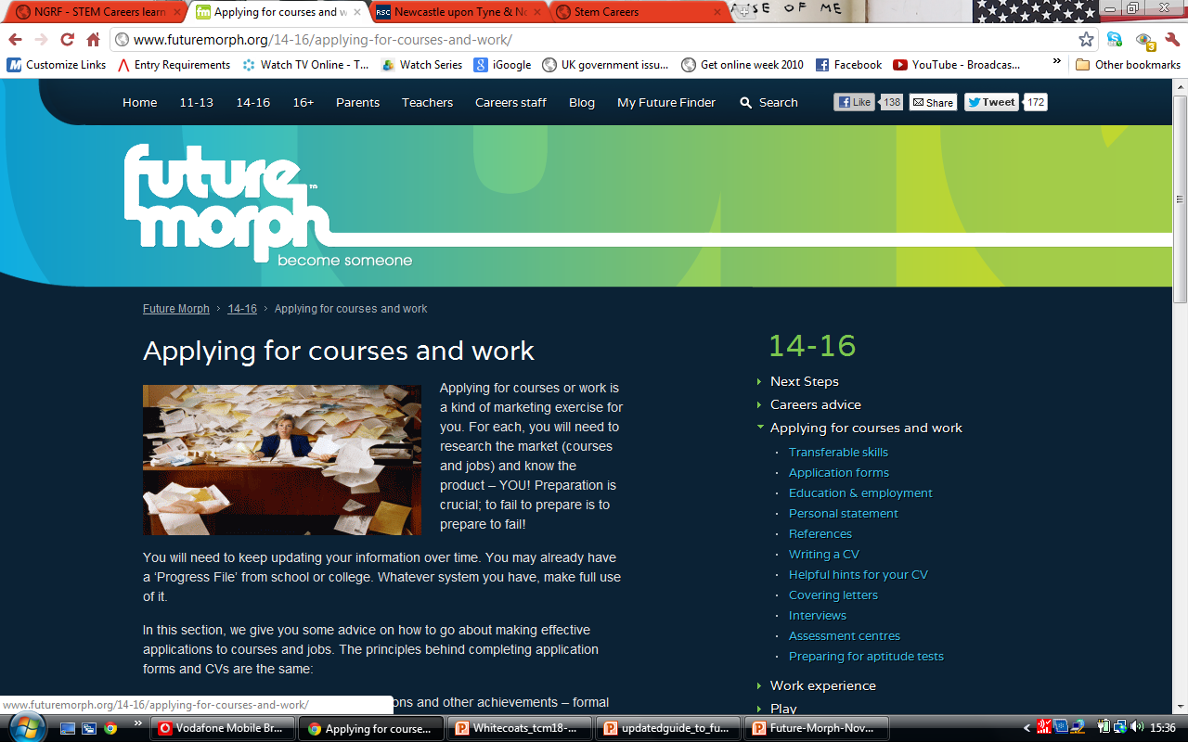
Specific Feature in14-16 & 16+ Sections
Applying for Courses and Work - a very comprehensive resource, which includes sub-sections on transferable skills, applications and interviews and much more.

Slide 13
Parent, Teacher and Careers Staff sections all have:
Future Morph and You which indicates the most useful features of the site for that particular audience. Parents link to specific information for different age groups, teachers to Top Tips for using the site and careers information and careers staff to suggestions for activities and financial advice.
Resources and Activities links to a searchable online library of posters, leaflets, websites, teaching resources etc.

Slide 14
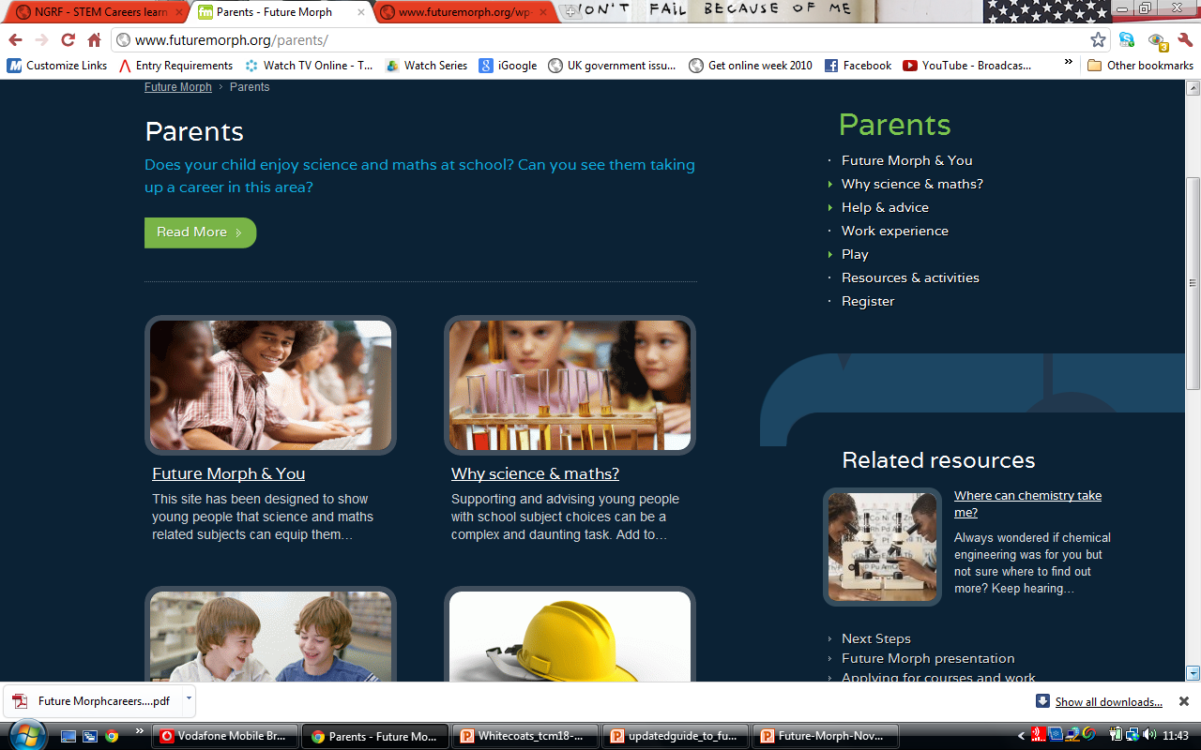
Key Pages for Parents
Why Science and Maths? considers subject choice and STEM employment prospects. It links to a quiz and articles about black scientists and women in Physics.
Help and Advice focusses on encouraging children from an early age to enjoy science and links to the STEM Careers Activity Pack

Slide 15
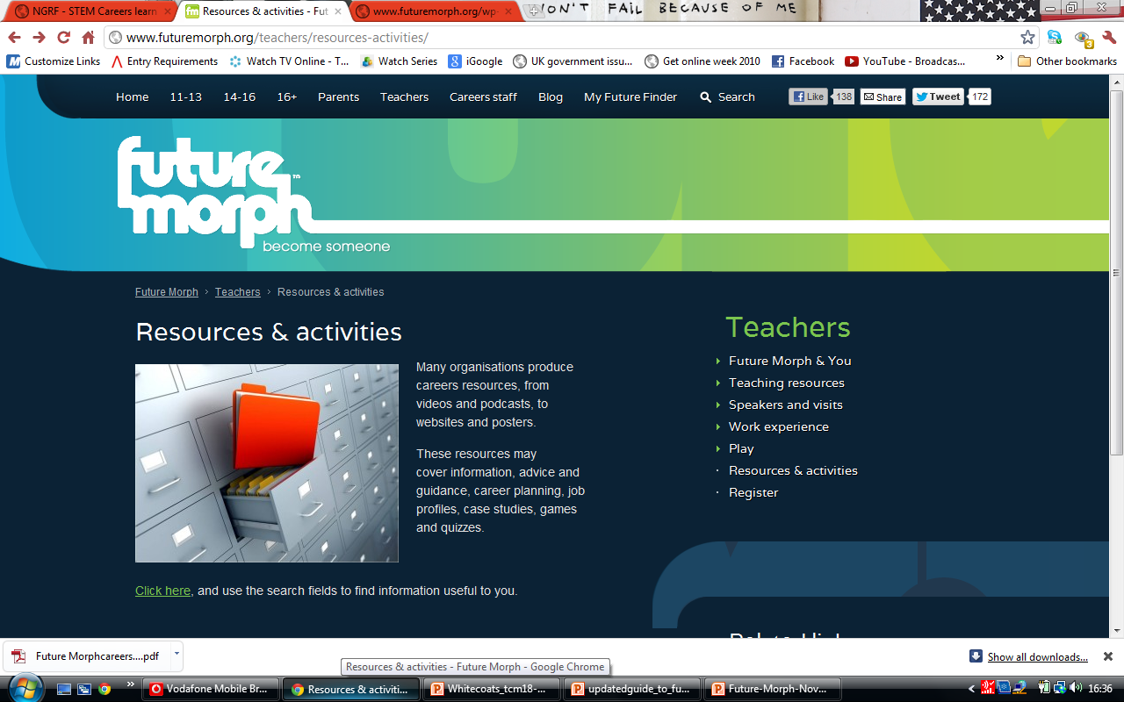
Key Pages for Teachers
Teaching Resources contains links to an extensive range of lesson plan and materials, materials for assemblies etc. for KS3 & 4.
Speakers and Visits Tips and help for organisers.

Slide 16
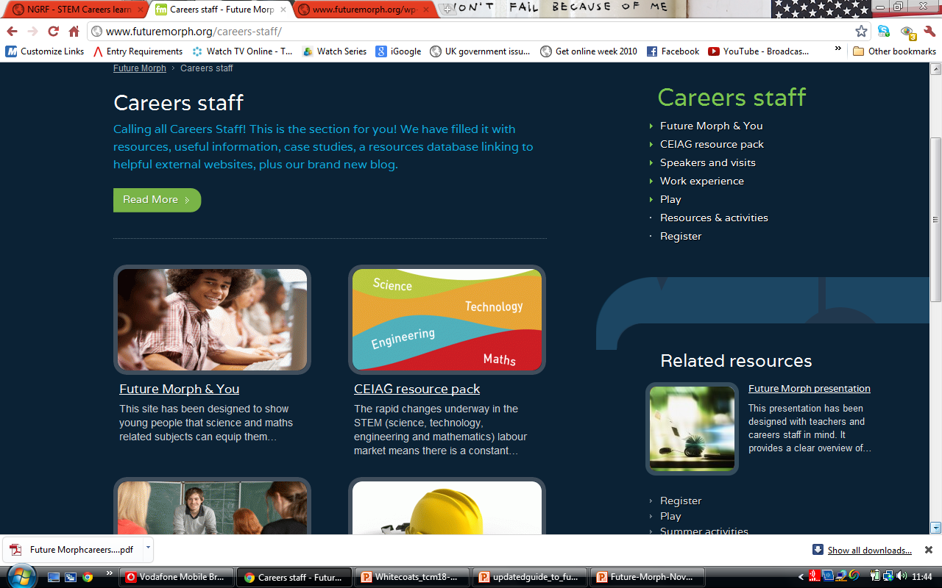
Key Pages for Careers Staff
CEIAG Resource Pack contains resources to develop STEM careers awareness and understanding of learning routes. It suggests how to collaborate to raise visibility of STEM and challenge stereotypes.
Speakers and Visits: help to inspire your students with speakers, visits and other activities.

Slide 17

Using Future Morph
Use a hook - recommend specific features.
Play some of the Future Morph online games in tutor/guidance periods.
Use materials for specially written for assemblies.
Introduce at Parents and Options evenings.
Share with Science staff and encourage them to use the Science Within Work resource physics.

Slide 18
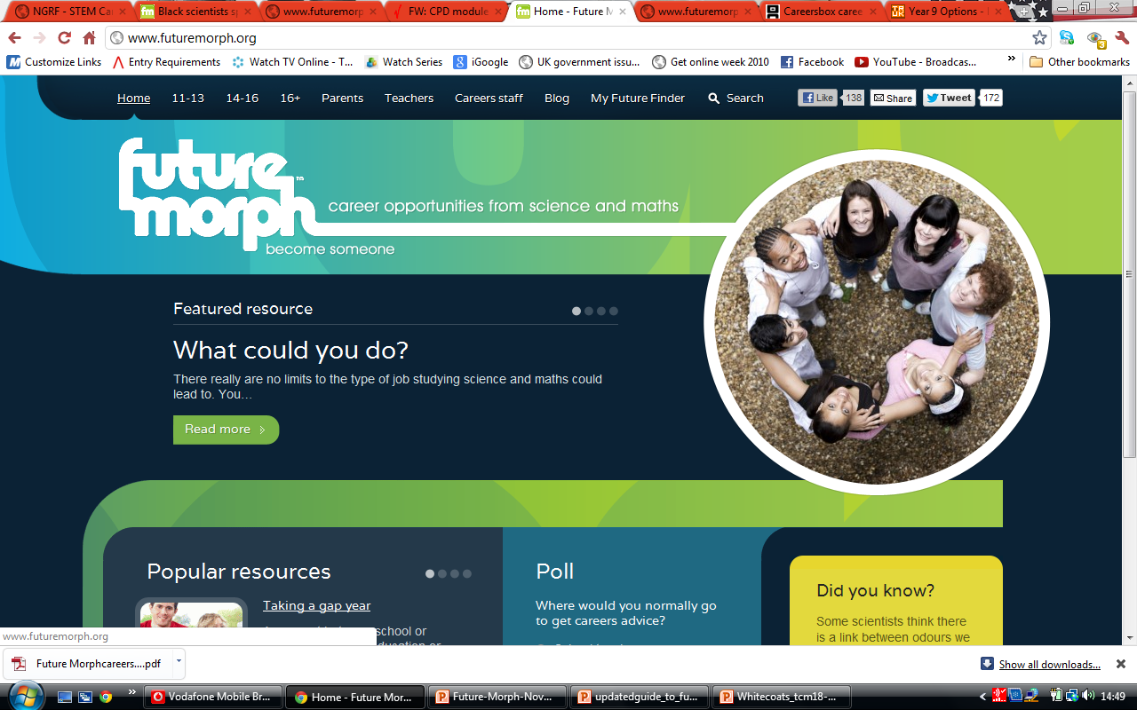
Do Students find Future Morph Useful?
Recent evaluation in 6 London schools with 300 students found that since using the site, 45% now looked at science and maths differently and 77% would recommend Future Morph to a friend.
Use Future Morph to help students ‘become someone…..’

