Slide 1


Ethnicity, Neighbourhood Deprivation and Quality of Life
An exploratory analysis of Annual Population Survey data
Anil Gumber, Sheffield Hallam University, David Owen, University of Warwick
Labour Force Survey/Annual Population Survey User Conference, London, 28th November, 2014

Slide 2
Overview
Background
ONS efforts on SWB measurement
Wellbeing status
Why this topic?
Differentials in SWB by ethnic groups
Differentials in SWB by deprivation& geography
Determinants of Wellbeing
International comparison
Research Issues

Slide 3
Societal Happiness
The importance of happiness in society is acknowledged at least as far back as the ancient Greek philosophers e.g. Aristotle
Conception of the good life for humans is one in which they function well; this involves attaining moral and intellectual virtues (Allmark 2005).
Gross Domestic Product (GDP) has been generally accepted as a measure of national economic prosperity BUT lead to widespread social inequalities
New concept of SWB emerged over the last four decades as an alternative measure of social welfare to GDP in informing public policy decisions (Layard 2005).

Slide 4
Theoretical approaches to measure SWB
Measurement of SWB and happiness has its origin in psychology but has spread into the realms of economic decision theory and behavioural economics (Layard 2005; Dolan 2011; OECD 2013).
According to various experts the happiness derived from positive psychology has been described as equivalent to life satisfaction, quality of people's lives (Helliwell, Layard and Sachs 2011) or experienced utility in microeconomics terms (Dolan 2009); whereas SWB connotes more how we feel (affective happiness) and think about life (evaluative happiness).

Slide 5
Approaches acknowledged by ONS to measure SWB
Evaluative approach asks individuals to step back and reflect on their life and make a cognitive assessment of how their life is going overall, or on certain aspects of their life.
Eudemonic approach refers to as the psychological or functioning/flourishing approach, which draws on self-determination theory and tends to measure such things as people’s sense of meaning and purpose in life, connections with family and friends, a sense of control and whether they feel part of something bigger than themselves.
Experience approach seeks to measure people’s positive and negative experiences over a short timeframe to capture people’s wellbeing on a day-to-day basis.

Slide 6
ONS Subjective wellbeing questions
Overall, how satisfied are you with your life nowadays? (Evaluative)
Overall, to what extent do you feel the things you do in your life are worthwhile? (Eudemonic)
Overall, how happy did you feel yesterday? (Experience)
Overall, how anxious did you feel yesterday? (Experience)

Slide 7
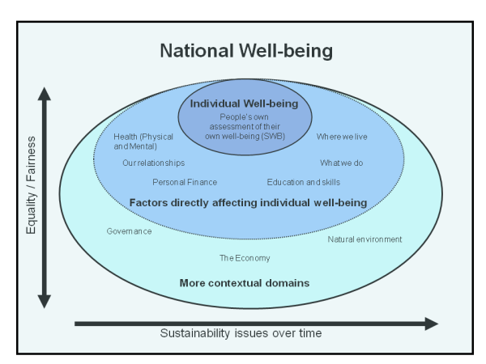
ONS Framework for Measuring National Wellbeing

Slide 8
National Wellbeing Domains
Individual wellbeing (4)
Our relationships (3)
Health (5)
What we do (5)
Where we live (4)
Personal finance (4)
Education and skills (3)
The economy (4)
Governance
  Involvement in democracy and trust in how the country is run (3)
  The natural environment (4)
In All 41 (or 39) Indicators

Slide 9
Why this topic?
UK is becoming increasingly ethnically diverse (BME share increased from 8% in 1991 to 12% in 2001 and 20% in 2011)
ONS reported SWB levels lower in unemployed, those without a life partner, certain BME groups.
Also revealed wide variations in SWB/happiness levels across geographical regions.
Depressingly all BME groups reported higher levels of anxiety than the White ethnic group.
ONS states "the differences observed across ethnic groups in SWB may in part be caused by the way that different people with different ethnic backgrounds respond to the SWB questions, but also the varied responses reflect the different circumstances that people find themselves in” (Hicks 2013:p1).

Slide 10
Objectives
1. To examine the current state of SWB/happiness across ethnic and cultural groups during 2011-12 and 2012-13.
2. To identify key variants (socioeconomic status, employment status, housing, deprivation level and other geographical factors, ageing and life-cycle attributes) overall and by ethnic groups
3. To determine the adjusted SWB/happiness levels by ethnic groups after controlling for demographic, socioeconomic, contextual and life-cycle factors.

Slide 11
SWB questions in Annual Population Surveys
APS Coverage: 155,000 households/360,000 people in UK
Items of information: their own circumstances and experiences regarding housing, employment, education, health and wellbeing; etc.
SWB
Overall, how satisfied are you with your life nowadays?
Overall, to what extent do you feel the things you do in your life are worthwhile?
Overall, how happy did you feel yesterday?
Overall, how anxious did you feel yesterday?
  Rating: 0 to 10 scale, where 0 = ‘not at all’ and 10 = ‘completely’
  No proxy response, uses both face-to-face and telephone interviews
  Coverage:165,000 people aged 16 and over
  Time period: Apr 2011-Mar 2012; Apr 2012-Mar 2013

Slide 12
Subjective wellbeing: percentage of adults reporting very low, low, medium and high ratings, 2011–12

Slide 13
Subjective wellbeing ratings (mean) by gender, 2011–12

Slide 18
Mean Anxious & Life Satisfaction Ratings by Gender

Slide 19
Mean Anxious & Life Satisfaction Ratings by Age

Slide 20
% Reported high(8-10) ratings of life satisfaction, worthwhile & happy, Very high(6-10) ratings of anxious
.

Slide 21
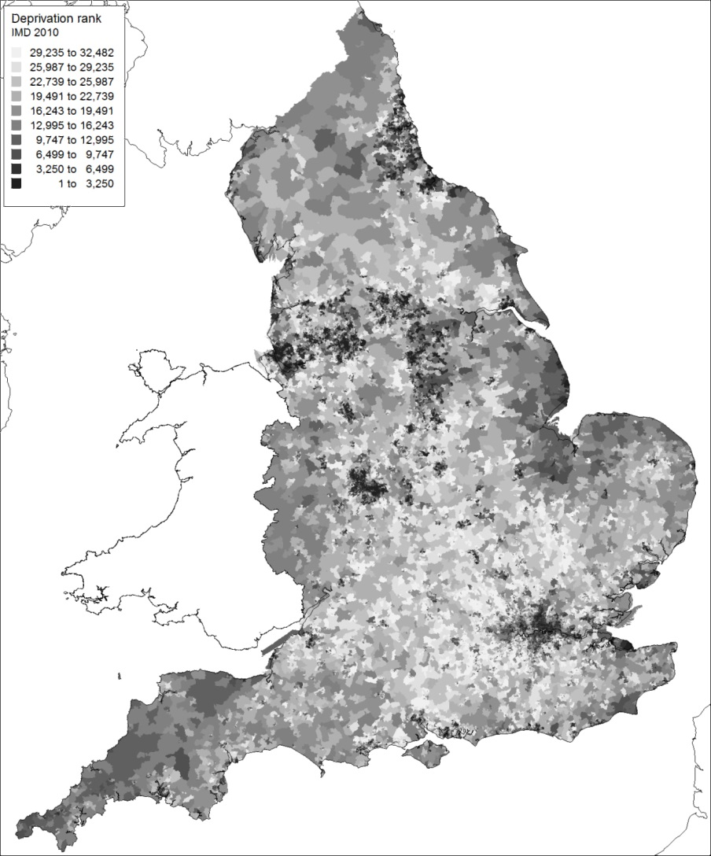
Deprivation within England, 2010
2010 Index of Multiple Deprivation for 32482 LSOAs in England.
Greatest deprivation in inner areas of large cities.
South-east corner of England least deprived.
Suburbs and commuter fringes are relatively prosperous.
Also deprivation in remoter and peripheral rural areas.

Slide 22
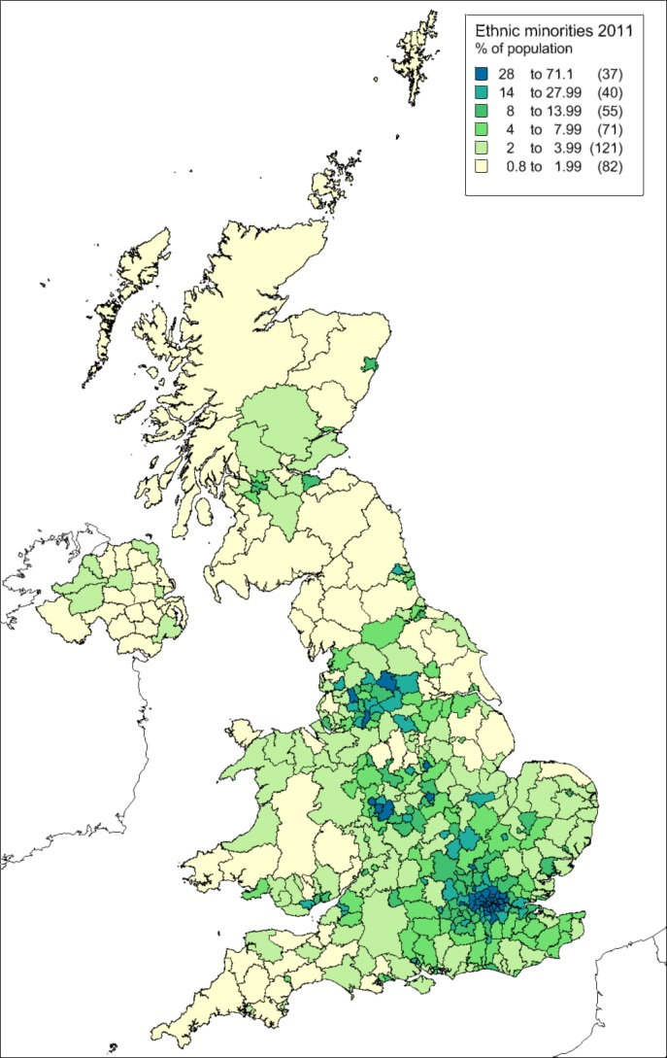
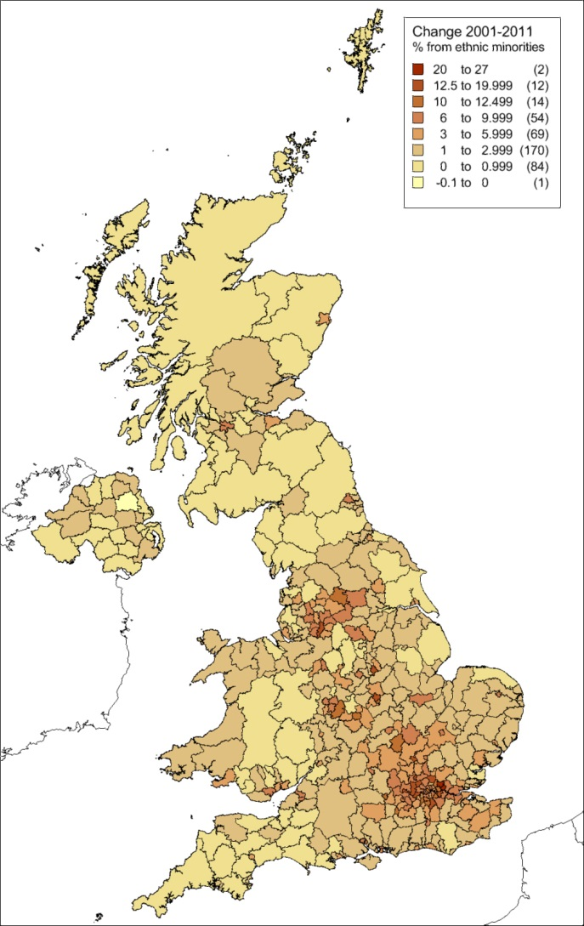
Geography of ethnic minorities

Slide 23
Minority population distribution
The ethnic minority population in 2011 was still geographically concentrated into London and the larger cities of the English midlands and Pennine belt.
There are significant populations in the commuter hinterlands of these cities and more accessible rural areas, but the ethnic minority share of the population is smallest in Northern Ireland, Wales, Scotland, eastern England, and the more rural periphery of England.
However, the ethnic minority population grew in all parts of the UK between 2001 and 2011.
The ethnic minority population spreading outwards from the traditional areas of concentration.
However, these remained the locations of fastest growth between 2001 and 2011.

Slide 24
Ethnicity and deprivation

Slide 25
Over-representation by IMD decile

Slide 26
Ethnicity and disadvantage
The preceding charts show a clear pattern of geographical concentration of people from ethnic minorities in areas of relative deprivation.
Ethnic minorities formed one-fifths of England’s population in 2011. However, they formed more than a quarter of the population in each of the two most deprived deciles and only 6.5% of the population of the two least deprived deciles.
59.7% of Bangladeshi, 52.1% of Pakistani and 48.1% of Black-African people lived in the most deprived 20% of LSOAs.
Indian and Chinese people were the least likely ethnic minorities to live in the most deprived 20% of LSOAs.
16% of Chinese, 12.9% of Indian and 12.9% of people of mixed parentage lived in the least deprived 20% of LSOAs.

Slide 27
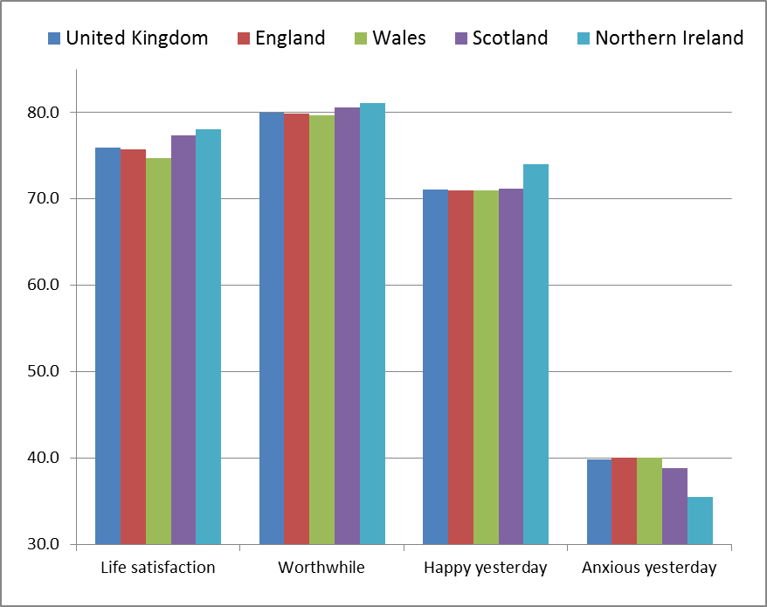
% Reported medium/high (7-10) life satisfaction, worthwhile and happy yesterday ratings and high/very high (4–10) anxious yesterday ratings by countries of the UK, 2011–12
For 'Life satisfaction', 'Worthwhile' and 'Happy yesterday', medium/high is 7 to 10 on a 11 point scale (0 is not at all and 10 is completely). For 'Anxious yesterday', medium/low is 0 to 3 on the same scale.

Slide 28
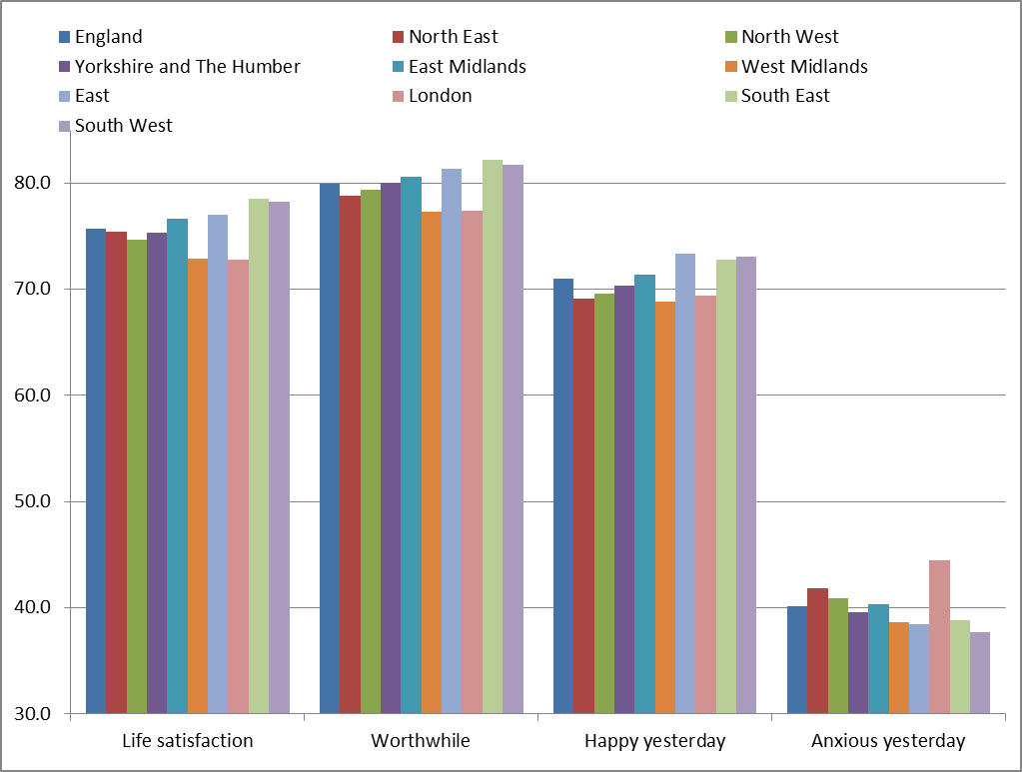
% Reported medium/high (7-10) life satisfaction, worthwhile and happy yesterday ratings and high/very high (4–10) anxious yesterday ratings by region, 2011–12

Slide 29
Mean Wellbeing Ratings by Gender and Deprivation (IMD) Quintiles, England

Slide 30
% Reported high(8-10) ratings of life satisfaction, worthwhile & happy, Very high(6-10) ratings of anxious by deprivation (IMD) quintiles, England

Slide 31
Geographical variations in Quality of Life
Scores on each indicator are most favourable in the most prosperous IMD quintiles and least favourable in the most deprived quintiles.
This pattern is similar for White, Black and Asian ethnic groups.
QoL scores are least favourable in London and the West Midlands, in which the percentage of the population from ethnic minorities is largest.
This suggests that ethnic minorities tend to live in areas of higher deprivation and lower QoL.

Slide 32
Multivariate Analyses
Dependent: High Life satisfaction, Worthwhile and Happy yesterday ratings and Very High Anxious yesterday rating
Logistic Regression Models
Model 1 (1 variable): Ethnic groups
Model 2 (3 variables): + Demographic (age, gender)
Model 3 (5 variables): + Social (marital status, education completion age, religion)
Model 4 (10 variables): + + Health Status (chronic condition, disability, limits activity, health status, smoking)
Model 5 (18 variables): + + + SES (highest education, employment type, occupation, job type, public/private, weekly pay, home ownership, benefits)
Model 6 (21 variables): + + + + Contextual (deprivation, years of residence, year of in-migration, geographical region)

Slide 33
Stepwise selection | Anxious | Happy | Life Satisfaction | Worthwhile
1 | Health status | Health status | Health status | Health status
2 | Age group | Age group | Age group | Age group
3 | Gender | Marital status | Marital status | Marital status
4 | Employment type | Employment type | Employment type | Gender
5 | Limits activity | Gender | Ethnicity | Employment type
6 | Region | Smoking | Smoking | Public/private
7 | Smoking | House ownership | House ownership | Ethnicity
8 | Edu compl age | Region | Occupation | Smoking
9 | Ethnicity | Highest edu | Gender | Occupation
10 | Marital status | Ethnicity | Edu compl age | Region
11 | Job type | Occupation | Disable | Highest edu
12 | House ownership | Disable | Job type | Edu compl age
13 | Chronic condition | Weekly pay | Weekly pay | House ownership
14 | Years of residence | Chronic condition | Region | Benefits
15 | IMD quintile | Limits activity | Highest edu | Weekly pay
16 | Highest edu | Benefits | Benefits | Job type
17 | Occupation | Job type | Chronic condition | Disable
18 | Benefits | Public/private | Years of residence | Chronic condition
19 | Public/private | Edu compl age | Limits activity | Years of residence
20 | Disable | Years of residence | Public/private | IMD quintile
21 | Weekly pay | IMD quintile | IMD quintile | Limits activity
Rejected Variables

Slide 34
 | Determinants | Base(Total)category | Anxious
1. Culture | Ethnicity | White (18) | Higher in all BME
2. Demographic | Age group | Adolescent (14) | Non-linear: inverted U shape
 | Gender | Female (2) | Lower in male
3. Social | Marital status | Single (6) | Lower in married
 | Edu. completion age | up to 15 (6) | lower in youth
 | Religion | No religion (8) | Much higher in all Non-Christian
4. Health | Health status | Very Good (5) | Rises as health deteriorates
 | Chronic condition | None (2) | Higher
 | Disability | None (2) | NS
 | Limits activity | None (2) | Higher
 | Smoking | Never (3) | Highest in Smoker
5. Economic | Employment type | Inactive (5) | Higher in Unemployed
 | Occupation | Inactive (8) | NS
 | Job type | Temporary (2) | Lower in Permanent
 | Public/private sector | Private (2) | NS
 | Weekly pay | £750 + (6) | NS
 | Benefits | None (2) | NS
 | Home ownership | Owned outright (5) | Lowest for owning outright
 | Highest education | No education (7) | NS
6. Contextual | Geographical region | London (9) | Lower in all region (except NE)
 | Years of residence | < 12 months (6) | Lower in 5-9 years residency
 | Deprivation (IMD) | Highest (5) | Higher in Q2
 | Year of in-migration | Since 2010 (9) | Higher in migrants came: 1960-2009

Slide 35
 | Determinants | Anxious (Stepwise Entry by Importance)
 |  | All | White | Asian | Black
1. Culture | Ethnicity | 10 | 12 | 11 | Rejected
2. Demographics | Age group | 2 | 2 | 4 | 5
 | Gender | 3 | 3 | 9 | Rejected
3. Social | Marital status | 10 | 10 | 6 | Rejected
 | Edu. compl age | 8 | 7 | 8 | Rejected
4. Health | Health status | 1 | 1 | 1 | 1
 | Chronic condition | 13 | 15 | Rejected | Rejected
 | Disability | Rejected | 4 | Rejected | Rejected
 | Limits activity | 5 | 13 | Rejected | Rejected
 | Smoking | 7 | 6 | Rejected | 3
5. Economic | Employment type | 4 | 5 | 5 | Rejected
 | Occupation | Rejected | Rejected | Rejected | Rejected
 | Job type | 11 | 11 | Rejected | 4
 | Public/private sector | Rejected | Rejected | 10 | Rejected
 | Weekly pay | Rejected | Rejected | Rejected | Rejected
 | Benefits | Rejected | 16 | Rejected | Rejected
 | Home ownership | 12 | 8 | 7 | 2
 | Highest education | Rejected | Rejected | Rejected | 6
6. Contextual | Region | 6 | 9 | 2 | 7
 | Year of residence | 14 | 14 | 3 | 8
 | Deprivation (IMD) | 15 | Rejected | 12 | Rejected
Number of Accepted Variables |  | 15 | 14 | 12 | 8

Slide 36
 | Determinants | Base(Total)category | Happy
1. Culture | Ethnicity | White (18) | Higher in most BME
2. Demographic | Age group | Adolescent (14) | Non-linear: U shape
 | Gender | Female (2) | Lower in male
3. Social | Marital status | Single (6) | Higher in Married, Lower in Widowed
 | Edu. completion age | up to 15 (6) | NS
 | Religion | No religion (8) | Much Lower in Muslim, Sikh
4. Health | Health status | Very Good (5) | Decreases as health deteriorates
 | Chronic condition | None (2) | Higher
 | Disability | None (2) | NS
 | Limits activity | None (2) | NS
 | Smoking | Never (3) | Lowest in Smoker
5. Economic | Employment type | Inactive (5) | Lower in Unemployed, Employees
 | Occupation | Inactive (8) | Higher in Lower Supervisor/technical
 | Job type | Temporary (2) | NS
 | Public/private sector | Private (2) | NS
 | Weekly pay | £750 + (6) | Higher in middle income
 | Benefits | None (2) | NS
 | Home ownership | Owned outright (5) | Lower for having Mortgage, Rented
 | Highest education | No education (7) | Higher in Other qualification
6. Contextual | Geographical region | London (9) | Higher in all region (except NE, WM)
 | Year of residence | < 12 months (6) | NS
 | Deprivation (IMD) | Highest (5) | NS
 | Year of in-migration | Since 2010 (9) | Lower in migrants came:1960-1999

Slide 37
 | Determinants | Happy (Stepwise Entry by Importance)
 |  | All | White | Asian | Black
1. Culture | Ethnicity | 10 | Rejected | 9 | 9
2. Demographics | Age group | 2 | 2 | 3 | 3
 | Gender | 5 | 6 | Rejected | Rejected
3. Social | Marital status | 3 | 3 | 2 | 1
 | Edu. compl age | Rejected | Rejected | Rejected | Rejected
4. Health | Health status | 1 | 1 | 1 | 2
 | Chronic condition | 14 | Rejected | 8 | Rejected
 | Disability | 12 | 10 | Rejected | Rejected
 | Limits activity | Rejected | Rejected | Rejected | Rejected
 | Smoking | 6 | 5 | 4 | 5
5. Economic | Employment type | 4 | 4 | 5 | 8
 | Occupation | 11 | Rejected | 11 | 11
 | Job type | Rejected | Rejected | Rejected | Rejected
 | Public/private sector | Rejected | Rejected | Rejected | Rejected
 | Weekly pay | 13 | 12 | Rejected | Rejected
 | Benefits | Rejected | Rejected | Rejected | 10
 | Home ownership | 7 | 8 | 11 | 4
 | Highest education | 9 | 7 | 7 | 9
6. Contextual | Region | 8 | 9 | 10 | Rejected
 | Year of residence | 14 | Rejected | Rejected | 6
 | Deprivation (IMD) | Rejected | 13 | 6 | 7
Number of Accepted Variables |  | 14 | 13 | 12 | 11

Slide 38
 | Determinants | Base(Total)category | Life Satisfaction
1. Culture | Ethnicity | White (18) | Higher in most BME
2. Demographic | Age group | Adolescent (14) | Non-linear: U shape
 | Gender | Female (2) | Lower in male
3. Social | Marital status | Single (6) | Higher in Married, Lower in Separated
 | Edu. completion age | up to 15 (6) | Declines with edu-age
 | Religion | No religion (8) | Much Lower in Muslim, Sikh
4. Health | Health status | Very Good (5) | Declines sharply as health deteriorates
 | Chronic condition | None (2) | Higher
 | Disability | None (2) | Lower
 | Limits activity | None (2) | NS
 | Smoking | Never (3) | Lowest in Smoker
5. Economic | Employment type | Inactive (5) | Lower in Unemployed, Higher in SE
 | Occupation | Inactive (8) | Higher in top occu, Lower in lower occu
 | Job type | Temporary (2) | Higher in Permanent
 | Public/private sector | Private (2) | NS
 | Weekly pay | £750 + (6) | Low in lower income
 | Benefits | None (2) | Lower
 | Home ownership | Owned outright (5) | Lower for having Mortgage, Rented
 | Highest education | No education (7) | Lower in higher qualification
6. Contextual | Geographical region | London (9) | Higher in all region (except WM)
 | Year of residence | < 12 months (6) | Higher in 1-2 years residency
 | Deprivation (IMD) | Highest (5) | NS
 | Year of in-migration | Since 2010 (9) | Much lower in migrants: 1960- 1999

Slide 39
 | Determinants | Life Satisfaction (Stepwise Entry by Importance)
 |  | All | White | Asian | Black
1. Culture | Ethnicity | 5 | 18 | 8 | Rejected
2. Demographics | Age group | 2 | 2 | 2 | 2
 | Gender | 9 | 8 | 5 | Rejected
3. Social | Marital status | 3 | 3 | 3 | 5
 | Edu. compl age | 10 | 11 | 6 | 6
4. Health | Health status | 1 | 1 | 1 | 1
 | Chronic condition | 17 | 16 | Rejected | Rejected
 | Disability | 11 | 9 | Rejected | Rejected
 | Limits activity | Rejected | Rejected | 7 | Rejected
 | Smoking | 6 | 5 | 9 | 10
5. Economic | Employment type | 4 | 4 | 4 | 4
 | Occupation | 8 | 7 | Rejected | 9
 | Job type | 12 | 12 | Rejected | 8
 | Public/private sector | Rejected | Rejected | Rejected | Rejected
 | Weekly pay | 13 | 10 | 11 | Rejected
 | Benefits | 16 | 15 | Rejected | 11
 | Home ownership | 7 | 6 | 11 | 3
 | Highest education | 15 | 14 | Rejected | 7
6. Contextual | Region | 14 | 13 | 10 | Rejected
 | Year of residence | 18 | 17 | Rejected | Rejected
 | Deprivation (IMD) | Rejected | Rejected | Rejected | Rejected
Number of Accepted Variables |  | 18 | 18 | 11 | 11

Slide 40
 | Determinants | Base(Total)category | Worthwhile
1. Culture | Ethnicity | White (18) | Higher in most BME
2. Demographic | Age group | Adolescent (14) | Non-linear: U shape
 | Gender | Female (2) | Lower in male
3. Social | Marital status | Single (6) | Higher in Married, Divorced
 | Edu. completion age | up to 15 (6) | Declines with edu-age
 | Religion | No religion (8) | Much Lower in Muslim and Sikh
4. Health | Health status | Very Good (5) | Declines sharply as health deteriorates
 | Chronic condition | None (2) | Higher
 | Disability | None (2) | Lower
 | Limits activity | None (2) | NS
 | Smoking | Never (3) | Lowest in Smoker
5. Economic | Employment type | Inactive (5) | Lower in Unemployed, Higher in SE
 | Occupation | Inactive (8) | Higher: Top 2 occu, Lower: Bottom occu
 | Job type | Temporary (2) | Higher in Permanent
 | Public/private sector | Private (2) | Lower in Private
 | Weekly pay | £750 + (6) | low in lower income
 | Benefits | None (2) | Higher
 | Home ownership | Owned outright (5) | Lower for rented
 | Highest education | No education (7) | Higher and rises with qualification
6. Contextual | Geographical region | London (9) | Higher in all region (except WM)
 | Year of residence | < 12 months (6) | Higher in 1-2 and 2-3 years residency
 | Deprivation (IMD) | Highest (5) | Higher in Q4 and Q5
 | Year of in-migration | Since 2010 (9) | Much higher in migrants: Before 1960

Slide 41
 | Determinants | Worthwhile (Stepwise Entry by Importance)
 |  | All | White | Asian | Black
1. Culture | Ethnicity | 7 | 20 | 12 | 12
2. Demographics | Age group | 2 | 3 | 3 | 5
 | Gender | 4 | 5 | 6 | 4
3. Social | Marital status | 3 | 2 | 2 | 1
 | Edu. compl age | 12 | 11 | 10 | 14
4. Health | Health status | 1 | 1 | 1 | 2
 | Chronic condition | 18 | 17 | 8 | Rejected
 | Disability | 17 | 18 | Rejected | Rejected
 | Limits activity | Rejected | Rejected | Rejected | Rejected
 | Smoking | 8 | 7 | 9 | 3
5. Economic | Employment type | 5 | 4 | 4 | 10
 | Occupation | 9 | 8 | 7 | 7
 | Job type | 16 | 15 | Rejected | Rejected
 | Public/private sector | 6 | 6 | Rejected | 11
 | Weekly pay | 15 | 14 | Rejected | 6
 | Benefits | 14 | 13 | 13 | Rejected
 | Home ownership | 13 | 12 | Rejected | Rejected
 | Highest education | 11 | 10 | 11 | 13
6. Contextual | Region | 10 | 9 | 5 | 9
 | Year of residence | 19 | 16 | Rejected | 15
 | Deprivation (IMD) | 20 | 19 | Rejected | 8
Number of Accepted Variables |  | 20 | 20 | 13 | 15

Slide 42
Adjusted Very High Anxious Rating Odds Ratio for Ethnic Minority Groups
Ethnic Groups | Anxious |  |  |  |  |  | Inferences
 | M1 | M2 | M3 | M4 | M5 | M6
White British | 1 | 1 | 1 | 1 | 1 | 1
White Irish | 1.31* | 1.31* | 1.31* | 1.28* | 1.27* | 1.23* | 4th Highest
Gypsy/Irish traveller | 3.71* | 3.68* | 3.32* | 2.73* | 2.61* | 2.61* | 1st Highest
Other White | 0.98 | 1.01 | 1.04 | 1.07* | 1.07 | 1.04
White & Black Caribbean | 1.13 | 1.14 | 1.11 | 1.05 | 1.02 | 1.01
White & Black African | 1.48* | 1.42 | 1.38 | 1.38 | 1.32 | 1.28 | Disappear
White and Asian | 1.22 | 1.25 | 1.25 | 1.23 | 1.23 | 1.21
Other mixed | 1.29* | 1.30* | 1.32* | 1.27* | 1.25* | 1.22 | Disappear
Indian | 1.19* | 1.22* | 1.30* | 1.29* | 1.29* | 1.27* | 3rd Highest
Pakistani | 1.17* | 1.23* | 1.28* | 1.17* | 1.14* | 1.14* | 6th Highest
Bangladeshi | 1.26* | 1.37* | 1.41* | 1.28* | 1.25* | 1.21* | 5th Highest
Chinese | 0.91 | 0.94 | 0.93 | 0.98 | 0.96 | 0.94
Other Asian | 1.1 | 1.11 | 1.16* | 1.14* | 1.12 | 1.09
Black African | 1.15* | 1.15* | 1.14* | 1.20* | 1.15* | 1.11* | 7th Highest
Black Caribbean | 1.18* | 1.14* | 1.09 | 1.03 | 1.02 | 0.99 | Disappear
Other Black | 1.39* | 1.36* | 1.34 | 1.35 | 1.31 | 1.27 | Disappear
Arab | 1.32* | 1.41* | 1.43* | 1.38* | 1.34* | 1.30* | 2nd Highest
Others | 1.18* | 1.19* | 1.21* | 1.19* | 1.16* | 1.12 | Disappear
Number of groups significantly different from White British | 12 | 11 | 10 | 11 | 9 | 7

Slide 43
Adjusted High Happy Rating Odds Ratio for Ethnic Minority Groups
Ethnic Groups | Happy |  |  |  |  |  | Inferences
 | M1 | M2 | M3 | M4 | M5 | M6
White British | 1 | 1 | 1 | 1 | 1 | 1
White Irish | 1.07 | 0.92 | 0.94 | 0.95 | 0.96 | 0.98
Gypsy/Irish traveller | 0.38* | 0.29* | 0.31* | 0.36* | 0.37* | 0.37* | 1st Lowest
Other White | 1.02 | 1.08 | 1.03 | 1.01 | 1.01 | 1.02
White & Black Caribbean | 0.78* | 0.72* | 0.78* | 0.81* | 0.83 | 0.84 | Disappear
White & Black African | 0.83 | 1.09 | 1.15 | 1.17 | 1.21 | 1.23
White and Asian | 0.76* | 0.72* | 0.71* | 0.72* | 0.72* | 0.74* | 2nd Lowest
Other mixed | 0.88 | 1.03 | 1.03 | 1.07 | 1.09 | 1.11
Indian | 1.09* | 1.04 | 0.93* | 0.97 | 0.97 | 0.99 | Disappear
Pakistani | 0.91 | 0.88* | 0.78* | 0.88* | 0.87* | 0.89* | 6th Lowest
Bangladeshi | 0.94 | 1.01 | 0.92 | 1.06 | 1.08 | 1.12
Chinese | 0.88 | 1.05 | 1.02 | 1.03 | 1.01 | 1.02
Other Asian | 1.1 | 1.1 | 0.99 | 1.04 | 1.05 | 1.07
Black African | 0.90* | 0.85* | 0.86* | 0.83* | 0.86* | 0.88* | 5th Lowest
Black Caribbean | 0.81* | 0.68* | 0.75* | 0.80* | 0.83* | 0.86* | 4th Lowest
Other Black | 0.74 | 0.78 | 0.84 | 0.85 | 0.88 | 0.9
Arab | 0.84 | 0.79* | 0.74* | 0.79* | 0.78* | 0.80* | 3rd Lowest
Others | 1 | 1.01 | 0.97 | 1.01 | 1.02 | 1.04
Number of groups significantly different from White British | 6 | 7 | 8 | 7 | 6 | 6

Slide 44
Adjusted High Life Satisfaction Rating Odds Ratio for Ethnic Minority Groups
Ethnic Groups | Life Satisfaction |  |  |  |  |  | Inferences
 | M1 | M2 | M3 | M4 | M5 | M6
White British | 1 | 1 | 1 | 1 | 1 | 1
White Irish | 1.16* | 0.99 | 1.00 | 1.03 | 1.04 | 1.08 | Disappear
Gypsy/Irish traveller | 0.51 | 0.48* | 0.53* | 0.73 | 0.76 | 0.76 | Disappear
Other White | 0.84* | 0.96 | 0.86* | 0.83* | 0.88* | 0.90* | 11th Lowest
White & Black Caribbean | 0.72* | 0.61* | 0.71* | 0.74* | 0.79* | 0.81* | 10th Lowest
White & Black African | 0.87 | 0.83 | 0.85 | 0.87 | 0.96 | 0.99
White and Asian | 0.54* | 0.61* | 0.57* | 0.57* | 0.56* | 0.57* | 2nd Lowest
Other mixed | 0.99 | 0.83 | 0.80* | 0.84 | 0.88 | 0.91 | Disappear
Indian | 1.05 | 0.91* | 0.72* | 0.73* | 0.75* | 0.78* | 8th Lowest
Pakistani | 1.05 | 0.73* | 0.59* | 0.66* | 0.70* | 0.72* | 7th Lowest
Bangladeshi | 0.96 | 0.58* | 0.47* | 0.54* | 0.59* | 0.63* | 5th Lowest
Chinese | 0.62* | 0.88 | 0.73* | 0.72* | 0.70* | 0.71 | Disappear
Other Asian | 1.06 | 0.95 | 0.77* | 0.79* | 0.86* | 0.90 | Disappear
Black African | 0.73* | 0.50* | 0.47* | 0.42* | 0.49* | 0.52* | 1st Lowest
Black Caribbean | 0.53* | 0.48* | 0.54* | 0.57* | 0.62* | 0.66* | 6th Lowest
Other Black | 0.79 | 0.51* | 0.53* | 0.51* | 0.56* | 0.59* | 4th Lowest
Arab | 0.98 | 0.61* | 0.51* | 0.53* | 0.56* | 0.59* | 3rd Lowest
Others | 0.86* | 0.78* | 0.68* | 0.69* | 0.76* | 0.79* | 9th Lowest
Number of groups significantly different from White British | 8 | 11 | 15 | 13 | 13 | 11

Slide 45
Adjusted High Worthwhile Rating Odds Ratio for Ethnic Minority Groups
Ethnic Groups | Worthwhile |  |  |  |  |  | Inferences
 | M1 | M2 | M3 | M4 | M5 | M6
White British | 1 | 1 | 1 | 1 | 1 | 1
White Irish | 1.06 | 1.06 | 0.98 | 1.01 | 1.01 | 1.06
Gypsy/Irish traveller | 0.57 | 0.57 | 0.50* | 0.65 | 0.69 | 0.70 | Disappear
Other White | 0.86* | 0.86* | 0.83* | 0.81* | 0.88* | 0.93* | 12th Lowest
White & Black Caribbean | 0.77* | 0.77* | 0.86 | 0.90 | 0.93 | 0.97 | Disappear
White & Black African | 0.78 | 0.78 | 0.70* | 0.70 | 0.74 | 0.77 | Disappear
White and Asian | 0.80 | 0.80 | 0.67* | 0.67* | 0.66* | 0.69* | 3rd Lowest
Other mixed | 1.22 | 1.22 | 1.06 | 1.11 | 1.15 | 1.21
Indian | 0.91* | 0.91* | 0.75* | 0.77* | 0.81* | 0.86* | 9th Lowest
Pakistani | 0.84* | 0.84* | 0.56* | 0.63* | 0.66* | 0.69* | 2nd Lowest
Bangladeshi | 0.84* | 0.84* | 0.53* | 0.59* | 0.65* | 0.71* | 4th Lowest
Chinese | 0.59* | 0.59* | 0.67* | 0.66* | 0.66* | 0.69* | 1st Lowest
Other Asian | 0.98 | 0.98 | 0.70* | 0.72* | 0.79* | 0.85* | 8th Lowest
Black African | 0.89 | 0.89 | 0.68* | 0.64* | 0.72* | 0.78* | 6th Lowest
Black Caribbean | 0.81* | 0.81* | 0.73* | 0.77* | 0.81* | 0.89* | 11th Lowest
Other Black | 1.21 | 1.21 | 0.77 | 0.77 | 0.83 | 0.89* | 10th Lowest
Arab | 0.97 | 0.97 | 0.69* | 0.73* | 0.77* | 0.82* | 7th Lowest
Others | 0.83* | 0.83* | 0.63* | 0.64* | 0.70* | 0.75* | 5th Lowest
Number of groups significantly different from White British | 8 | 8 | 13 | 11 | 11 | 12

Slide 46
Life-cycle effects on wellbeing
(Odds Ratio after adjusting for All Variables)

Slide 47
Adjusted Wellbeing by Broad Ethnic Groups and Region (Odds Ratio - Compared to London)
Wellbeing | White | Asian | Black
Anxious | Lower in All regions (except North East, North West) | Lower in W Midlands, East of England, South East | Lower in North East, Yorkshire, East of England
Happy | Higher North West, E Midlands, East of England, South East, South West | Higher in Yorkshire, East of England, South East | None significant
Life Satisfaction | Higher in all regions (except W Midlands) | Higher Yorkshire, E Midlands | None significant
Worthwhile | Higher in All regions | Higher in all regions (except W Midlands) | Higher in Yorkshire, Lower in W Midlands

Slide 48
Conclusion (1)
Most BME have reported lower wellbeing than White people.
After adjustment for demographic, social, health, economic and contextual factors, wellbeing among BME continued to remain lower than White British.
Health is the key determinant of quality of life for all ethnic groups. Smokers have most negative experience. People with chronic conditions have positive experience (but are relatively anxious).
Stage in life cycle is important – older people feel life has been worthwhile
Economic conditions influence QoL. Less economically successful groups (mainly BME) have lower quality of life scores?
After health status and demographics, Ethnicity is key determinant of Life Satisfaction and Worthwhile whereas Deprivation is the least
Fewer determinants of wellbeing in Black and Asian ethnicity compared to White (their rankings also differs)

Slide 49
Conclusion (2)
Residents of London (followed by W. Midlands) are less happy, more anxious, lower worthwhile scores and have lower life satisfaction than other regions (after controlling for other variables in regressions).
Whereas South East residents display some of the highest scores on wellbeing.
Black-African people have low satisfaction. Perhaps because many arrived as asylum-seekers and other have not had work consistent with qualifications?
Recent migrants have higher satisfaction. Why do those who arrived form the 1960s to 1990s have lower scores on QoL?
Chinese people have low scores on worthwhile, even though their scores on other measures are more positive.
Overall QoL has not changed between 2011/12 and 2012/13, so does differential by ethnic groups, but Gypsy/Irish traveller, Black have shown some improvement (which needs statistical testing).

Slide 50
Mean Anxious and Happy Ratings,
England, 2011-12 and 2012-13
.

Slide 51
Mean Life Satisfaction and Worthwhile Ratings,
England, 2011-12 and 2012-13
.

Slide 52
Limitations
Regression Results covered only England due to no access to SOA codes for Wales, Scotland and Northern Ireland.
  However England covers 84% of UK population & 96% of BME
Multivariate analysis is required to confirm changes in wellbeing between 2011/12 and 2012/13 by ethnic groups.
ONS QoL variables do not measure at household or family level which is more appropriate for BME groups.
ONS Survey is conducted in English Language thus restrict participation of people Who don't know English language.
Ethnic group classification does not distinguish the 3 Black groups at the UK level.
Use Carstairs rather than IMD because this enables closer link with neighbourhood (if ONS adds Output Area to SDS data sets).

Slide 53
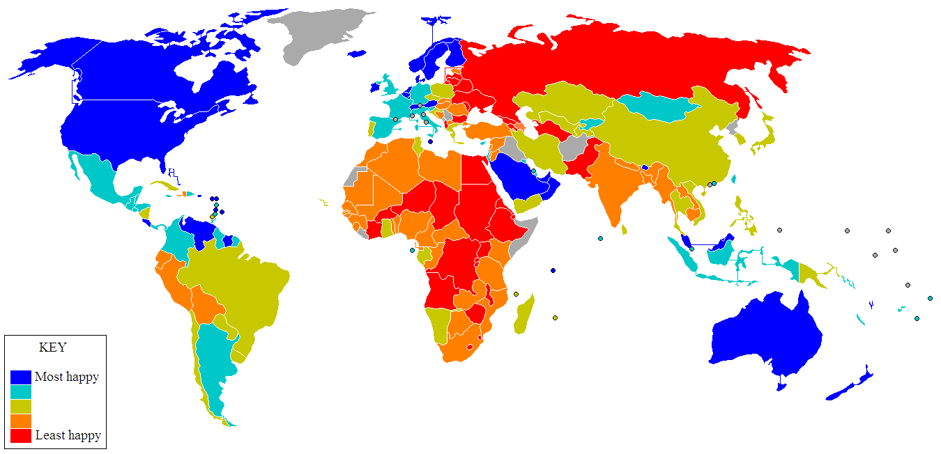

Slide 54



Thanks

