Slide 1
Variations in national identity, diversity and integration within the UK
David Owen,
Institute for Employment Research,
University of Warwick,

Slide 2
Introduction
The 2011 Census of Population provided much richer information on the ethnic and cultural diversity of the population than previously.
Questions on language ability, passports held, length of time in the UK, short-term migration and national identity were added in 2011.
These offer an alternative perspective to the established country of birth and ethnic group questions for examining the ethnic and cultural diversity of localities and for measuring social and economic integration.
A new addition was the national identity question. When the Census results were published, there was great interest in the greater percentage of the population identifying as “English” rather than “British” within England.
This coincides with a revival of nationalist politics in Scotland and England, which is challenging the integrity of the Union.

Slide 3
Content of the presentation
This paper is concerned with variations in national identity. It investigates the associations between migration, ethnicity, socio-economic status and national identity.
The Scottish referendum and the rise of UKIP have shown that economic marginalisation may be associated with some forms of nationalism.
Variations in types of national identification across the UK will be related to socio-economic structure, mobility, ethnic composition and measures of social and economic integration.
The paper will also explore how these factors may have influenced spatial patterns of voting in the 2015 general election.

Slide 4
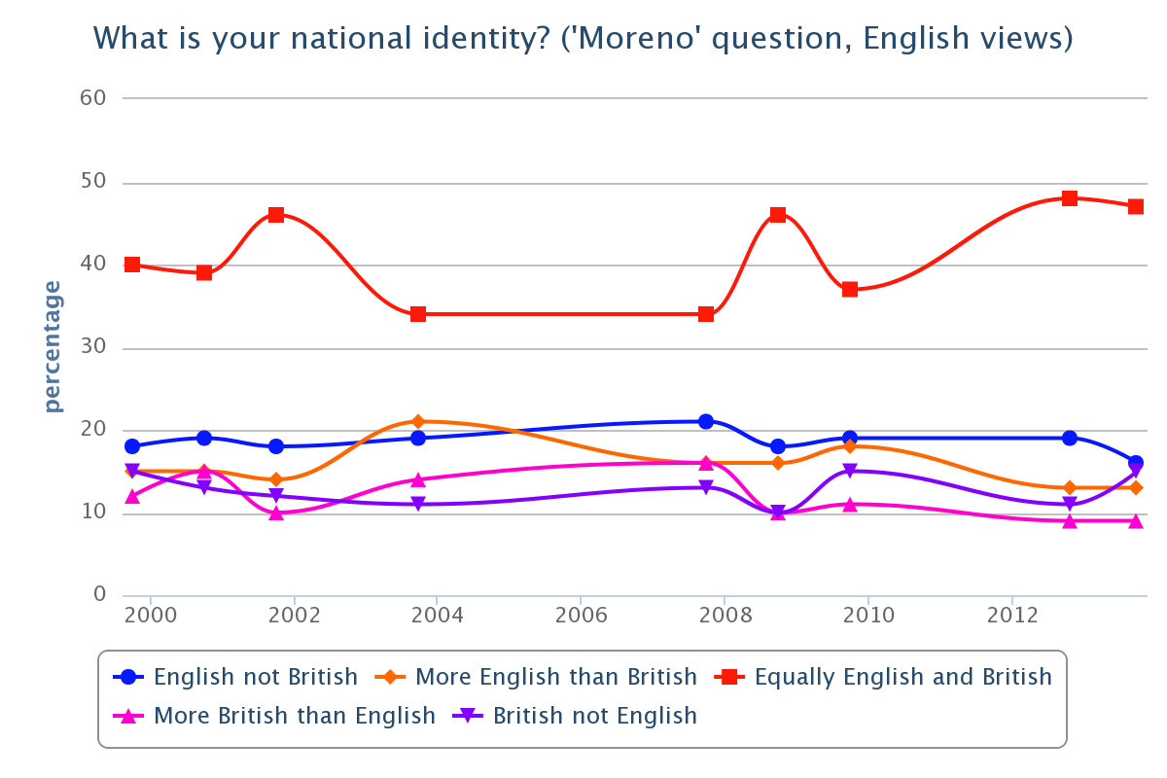
Trends in British identity
The percentage of people identifying as “English-only” in the Census came as a surprise, because the British Social Attitudes Survey had shown that about two-thirds of people said they “felt British” and this had remained fairly constant over time.
However, the “Moreno” question about national identity showed that just over a tenth felt “British not English” and about two-fifths felt “equally English and British”.
About a fifth of people felt “English, not British”.
The Census question was similar to the LFS question, and both may have prompted respondents to make a clearer statement of identity than the BSAS.

Slide 5
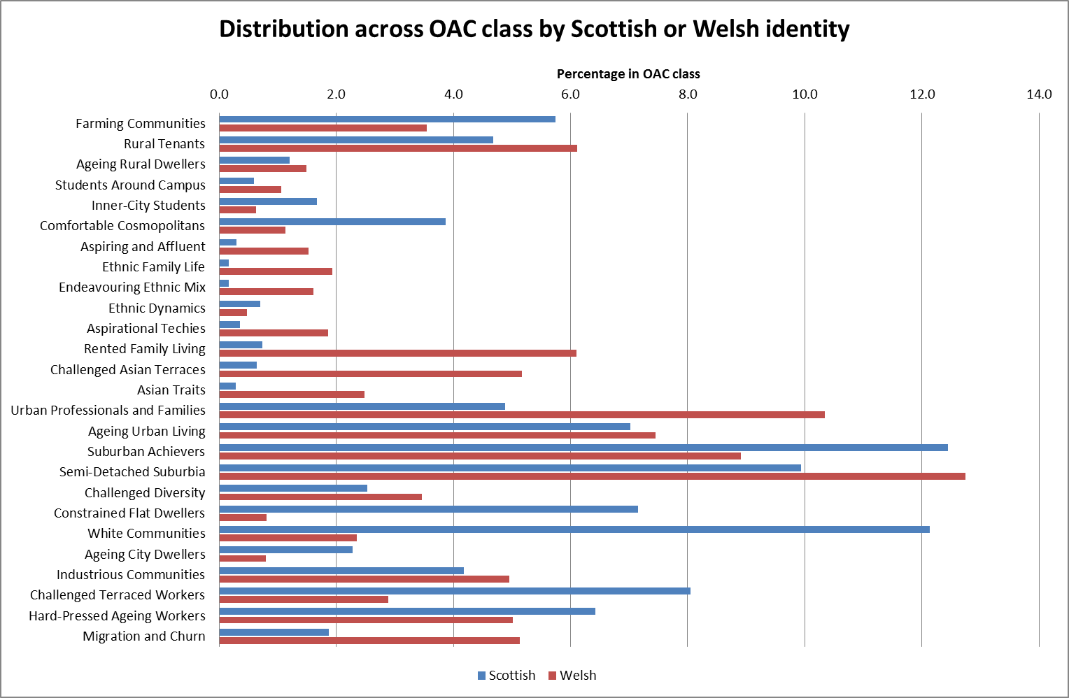
Welsh and Scottish identity by Output Area Classification group, 2014
This chart presents the distribution of people reporting their national identity to be Welsh or Scottish by group of the 2011 Output Area Classification.
In both countries, the share of the total of people choosing Welsh or Scottish identity is higher in suburban/semi-detached areas.
In Scotland, those identifying as Scottish tend to be relatively concentrated in the “white communities”, “constrained flat dwellers” and “challenged terraced workers” groups. Those with Welsh and Scottish also tend to be relatively concentrated in farming areas.
The share of both identities tends to be low in “multicultural” areas, but areas of high migration and churn in Wales have a higher share of those with Welsh identity.
This indicates some positive association between identification with the with nation and more traditional areas but also with economic stress.

Slide 6
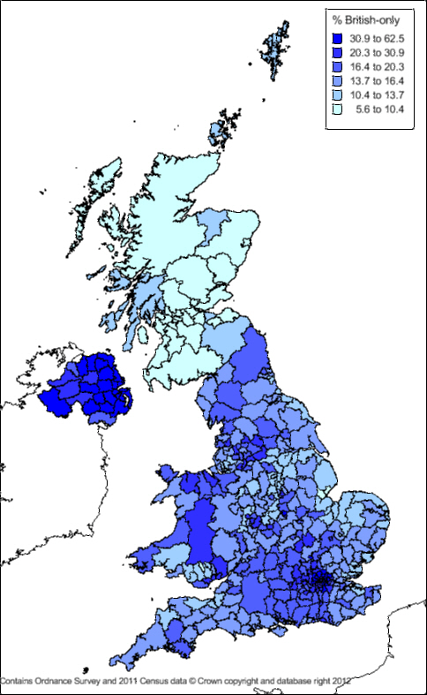
Geographical variation in “British-only” identity across the UK, 2011
“British-only” was a minority identity choice across all of the UK in 2011.
The largest percentage choosing “British only” in the 2011 Census was in Northern Ireland (reflecting Unionist political affiliation?)
The percentage “British only” was lowest by far in Scotland. In England, the lowest percentages occurred along the east coast and East Midlands. In Wales, this percentage was lowest in the South Wales Valleys.
The highest percentages choosing “British-only” were found in London and the prosperous areas in the M4 corridor.

Slide 7
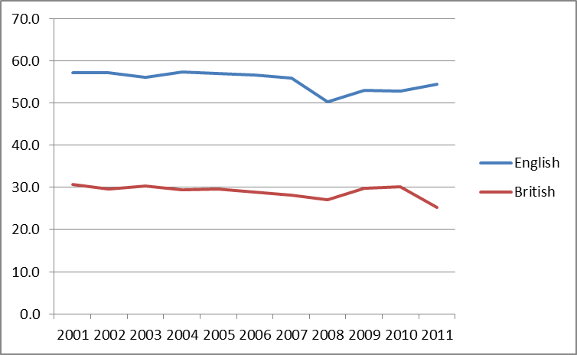
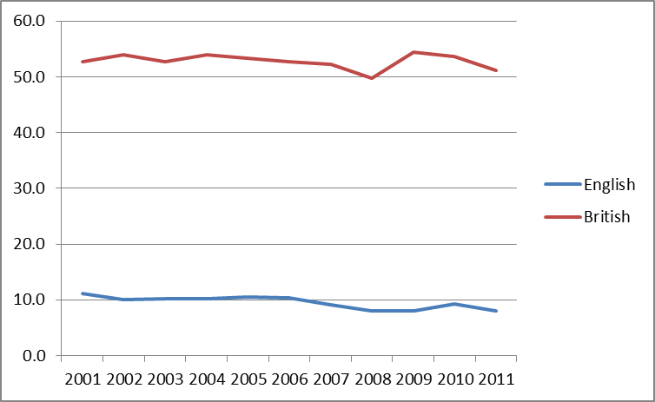
England: Trends in national identity from the Labour Force Survey, 2001-2011
White people:
Nearly three-fifths of white people in England identified as English-only throughout the period 2001 to 2011, with a tendency for this percentage to increase over time. The percentage identifying as British only was about half as great, also declining slightly over this period.
Minority ethnic groups:
Over half of people from minority ethnic groups identified as British-only, while only ten percent identified as English only, with a small decline between 2001 and 2011

Slide 8
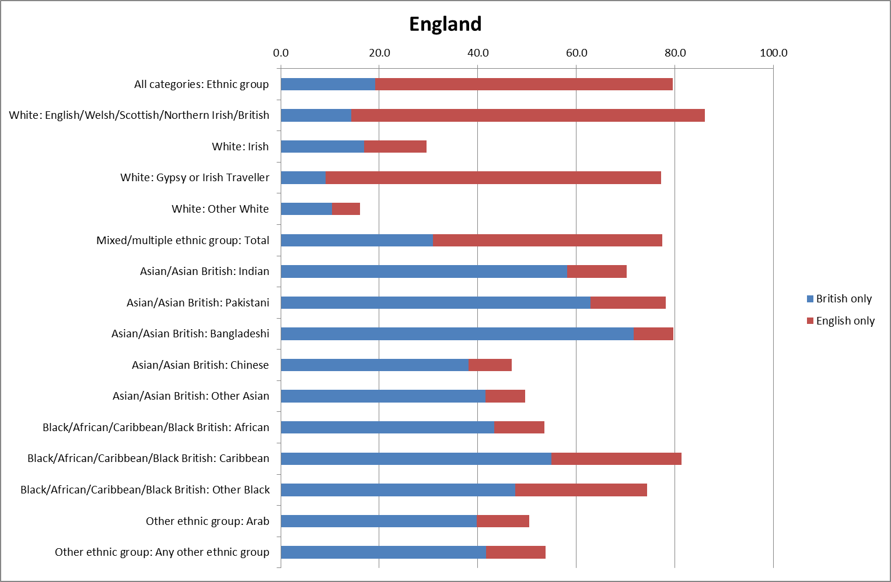
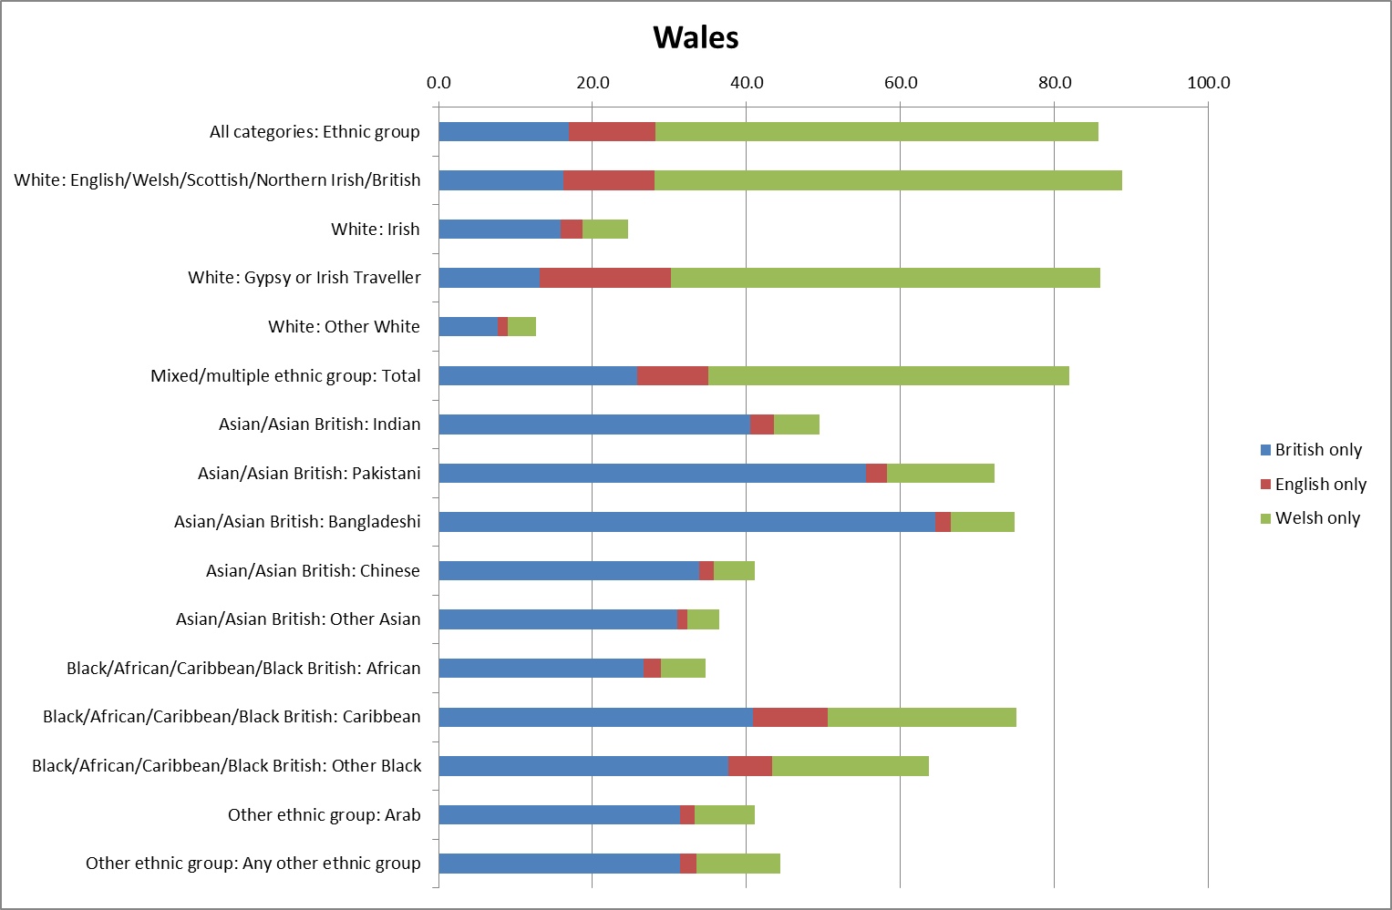
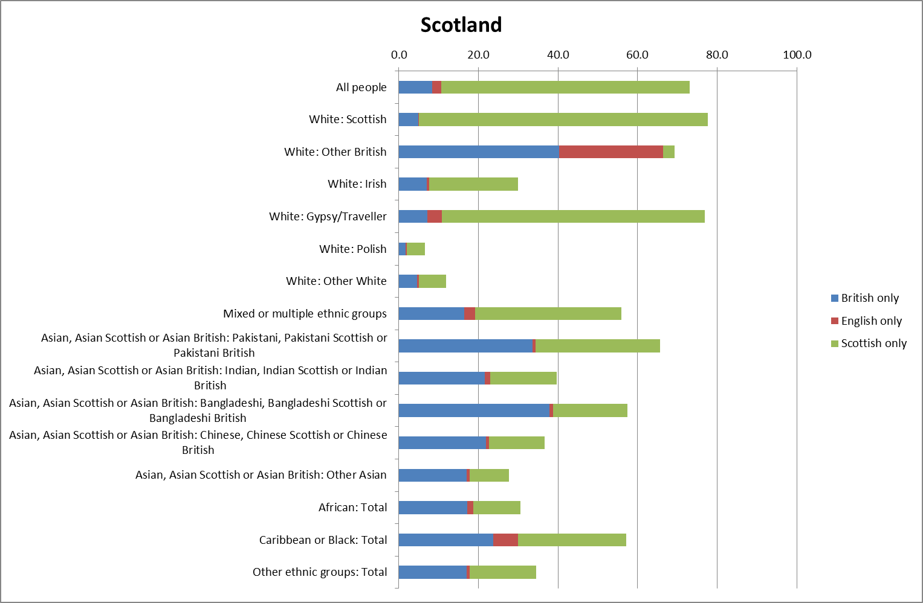
2011 Census – identification with each nation by ethnic group
For White-British people, the percentage identifying themselves as “British-only” is much smaller than that identifying with the nation in each of England, Wales and Scotland.
South Asians are the most likely to identify themselves as “British-only” in all three countries.
The percentage of all ethnic groups identifying as “British-only” is lowest in Scotland.

Slide 9
Logistic regression models for England
English-only identity
More likely for people aged 60 and over
White and mixed parentage people more likely to identify as British
People in lower supervisory, semi-routine and routine occupations more likely to identify as English
Foreign-born very unlikely to identify as English
Men more likely than women to identify as English
British-only identity
More likely for people aged under 50
Bangladeshi, Pakistani, Indian and Black people likely to identify as British
Higher-status occupations more likely to identify as British
Foreign-born with UK nationality more likely to identify as British

Slide 10
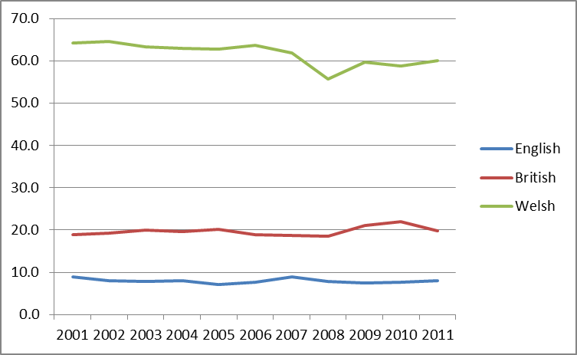
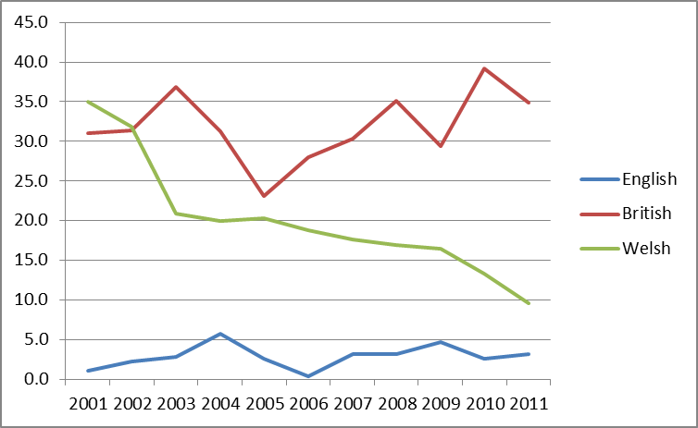
Wales: Trends in national identity from the Labour Force Survey, 2001-2011
White:
Over three-fifths identified as Welsh, and a fifth as British. Nearly a tenth identified as English. The percentage Welsh declined slightly, while the other two categories were more stable.
Minority ethnic groups:
British is the most common identity and remained stable. The percentage identifying as Welsh declined sharply over the decade. The percentage identifying as English is about half that for white people.

Slide 11
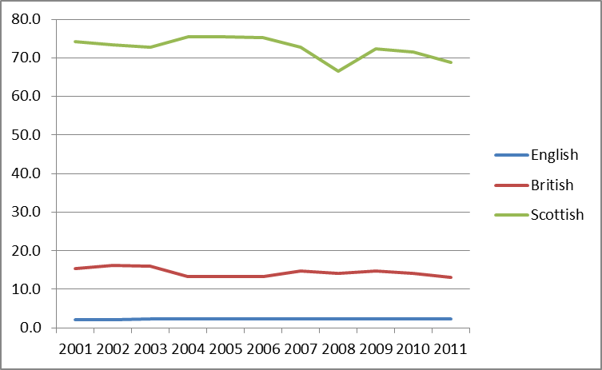
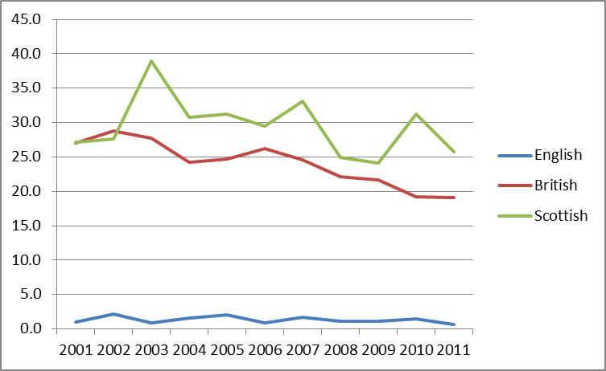
Scotland: Trends in national identity from the Labour Force Survey, 2001-2011
White:
Over 70% of White Scottish people identified as Scottish. Under a fifth identified as British, and a very small percentage identified as English. All three identities declined slightly between 2001 and 2011.
Minority ethnic groups:
Slightly more likely to identify as Scottish than British, but the latter percentage was only half that for England. The percentage identifying as British declined steadily during the decade.

Slide 12
Regression models for Wales and Scotland
Wales
People under 40 more likely to identify as Welsh than British. Older people more likely to identify as British.
White and mixed parentage people more likely to identify as Welsh than British.
South Asian and Chinese people more likely to identify as British than Welsh.
Overseas-born with British nationality more likely to be British than Welsh.
People in higher status occupations more likely to identify as British. Lower-status occupations more likely to identify as Welsh.
Scotland
People under 50 more likely to identify as Scottish than British. This tendency is strongest for the youngest people.
White people are more likely to identify as Welsh than British. All minority ethnic groups are unlikely to identify as Scottish.
Attachment to British identity is strongest for Pakistani, Chinese and Black people.
Overseas-born with British nationality more likely to be British than Scottish.
People in higher status occupations more likely to identify as British. Lower-status occupations more likely to identify as Scottish.

Slide 13
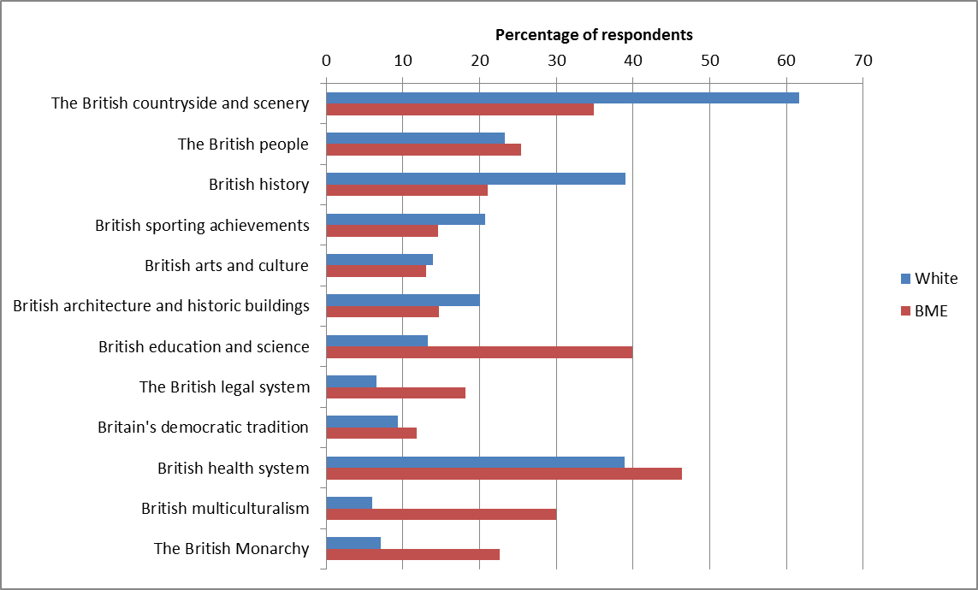
What makes people identify with Britain? “Taking Part” Survey 2013/14
Why do people from the white and minority ethnic groups give different answers when asked about national identity?
The 2013/14 Taking Part survey asked respondents “What, if anything, makes you most proud of Britain?”
There are some items of agreement between white and BME respondents – for example, around two-fifths of each mentioned the NHS, and a quarter of each mentioned “the British people”.
However, the most common answer for white people was “the British countryside”, and a higher percentage of white than BME people mentioned British history – backward looking?
BME people were much more likely than white people to cite education, multiculturalism, the monarchy and the legal system – perhaps indicating a civic / legalistic identification with Britain.

Slide 14
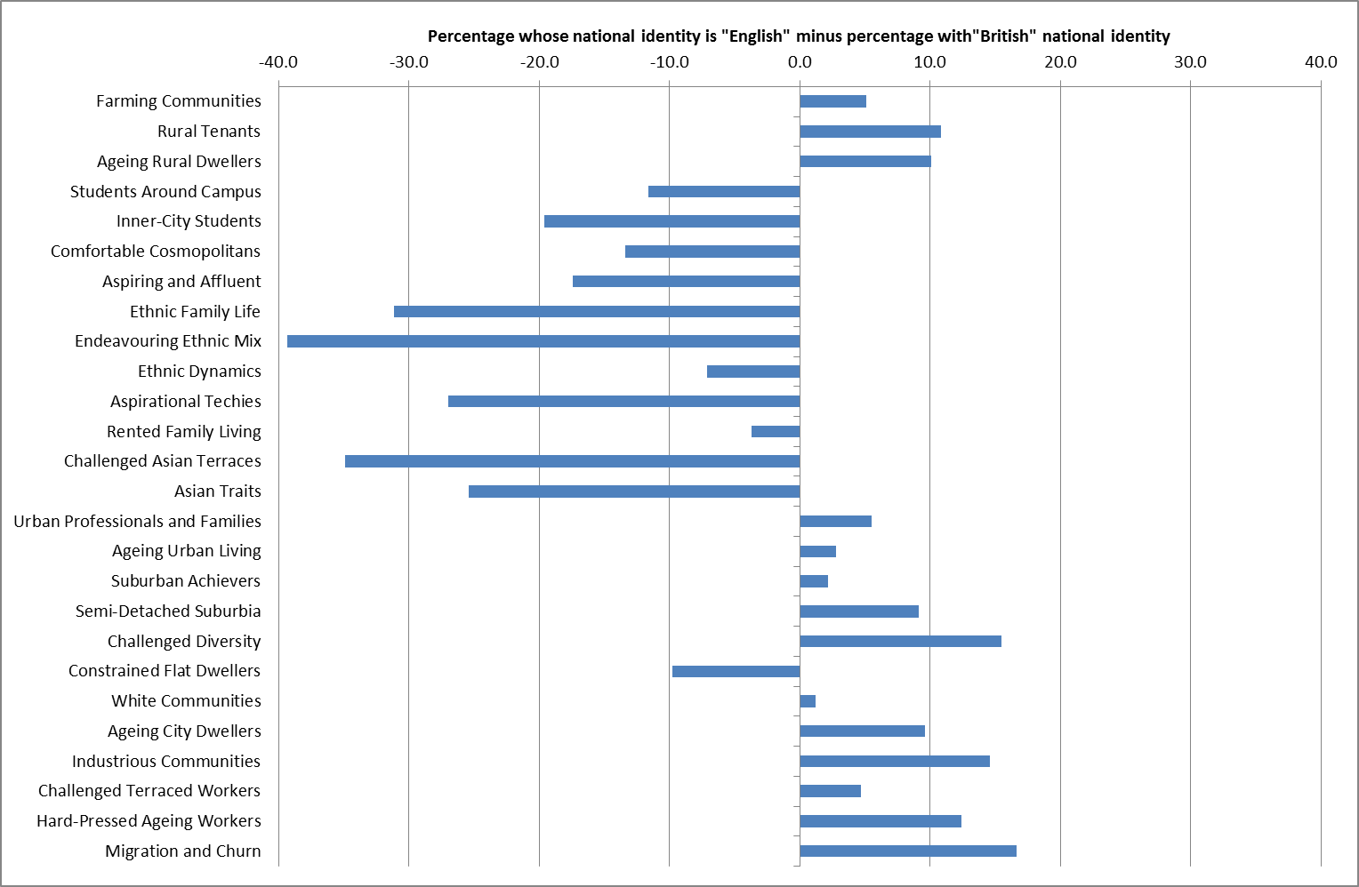
Great Britain 2014: National identity by 2011 Output Area Classification group
The Annual Population Survey includes a question on national identity. Here data for the calendar year 2014 is summarised using the 2011 Census Output Area Classification groups.
The quantity graphed is the percentage choosing the identity “English” minus the percentage identifying as “British”.
This shows some very clear contrasts:
People living in areas of high ethnic minority populations are much more likely to identify as “British” than “English”
Areas classified as “cosmopolitan” or “aspiring” or with student populations are also more likely to identify as British than English, but to a lesser extent.
In areas classified as “ageing”, “challenged”, “semi-detached”, “rural”, “industrious” and experiencing “migration and churn”, people are more likely to identify themselves as “English” rather than “British”

Slide 15
Regression modelling of geographical variations in identity
 | English |  | British
 | Beta | Significance | Beta | Significance
(Constant) |  | 0.000 |  | 0.000
% ethnic minorities | 0.443 | 0.000 | 0.241 | 0.010
% born overseas | -0.375 | 0.000 | -0.184 | 0.265
% non-UK language | 0.051 | 0.523 | -0.081 | 0.538
% witout a passport | 0.078 | 0.101 | 0.175 | 0.021
% high-status occupations | -0.141 | 0.009 | -0.006 | 0.949
% low status occupations | -0.095 | 0.174 | -0.263 | 0.017
Unemployment rate | 0.412 | 0.000 | -0.478 | 0.000
Employment rate | 0.142 | 0.000 | -0.020 | 0.708
% never worked | -0.259 | 0.001 | 0.367 | 0.003
Diversity index | -0.820 | 0.000 | 1.002 | 0.000
English and Welsh Countryside | -0.007 | 0.727 | 0.011 | 0.753
London Cosmopolitan | -0.110 | 0.000 | 0.027 | 0.475
Suburban Traits | -0.004 | 0.803 | 0.008 | 0.790
Business and Education Centres | 0.005 | 0.785 | 0.021 | 0.458
Coast and Heritage | -0.024 | 0.125 | 0.044 | 0.094
Mining Heritage and Manufacturing | -0.011 | 0.569 | 0.043 | 0.208
Mean age | 0.121 | 0.000 | 0.160 | 0.002
Wales |  |  | 0.134 | 0.000
adjusted R-square | 0.945 |  | 0.837
Regression (logit) models of the percentage identifying as “English-only” or “British-only” by local authority district were estimated.
The variables were a mixture of Census socio-economic variables and levels of the 2011 ONS classification of local authorities.
Both measures were positively associated with the minority population share. Ethnic diversity was negatively associated with the percentage English, and positively associated with the percentage British.
The percentage English was significantly lower in London Cosmopolitan while the percentage British was higher in Wales.
The unemployment rate was positively associated with the percentage English, and negatively associated with the percentage British.

Slide 16
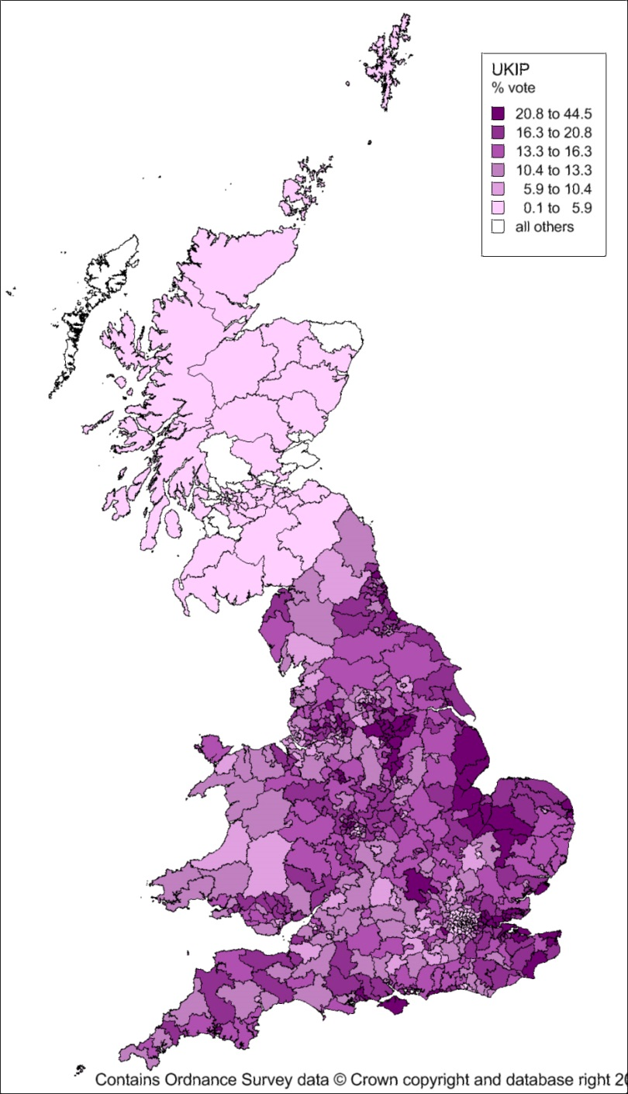
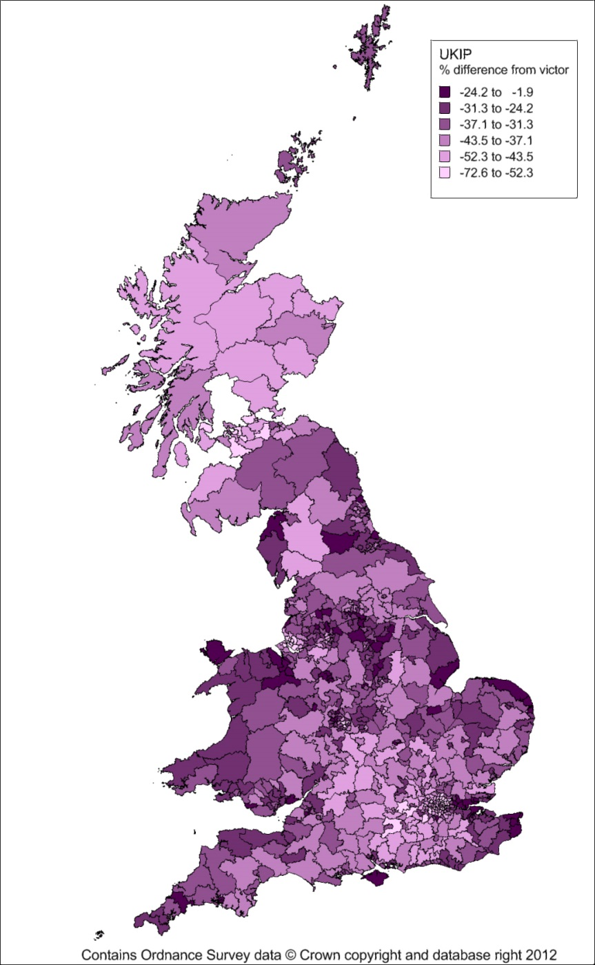
The spatial pattern of votes for UKIP in the 2015 General Election
The percentage voting for UKIP was highest in eastern England, Lincolnshire and the Wash, coastal resorts in England, struggling industrial areas of north-east England and the East and West Midlands.
The difference in share of vote from the winner emphasises not just the high vote in the coastal periphery, but the relative absence of votes in London and the economically dynamic area west of London.

Slide 17
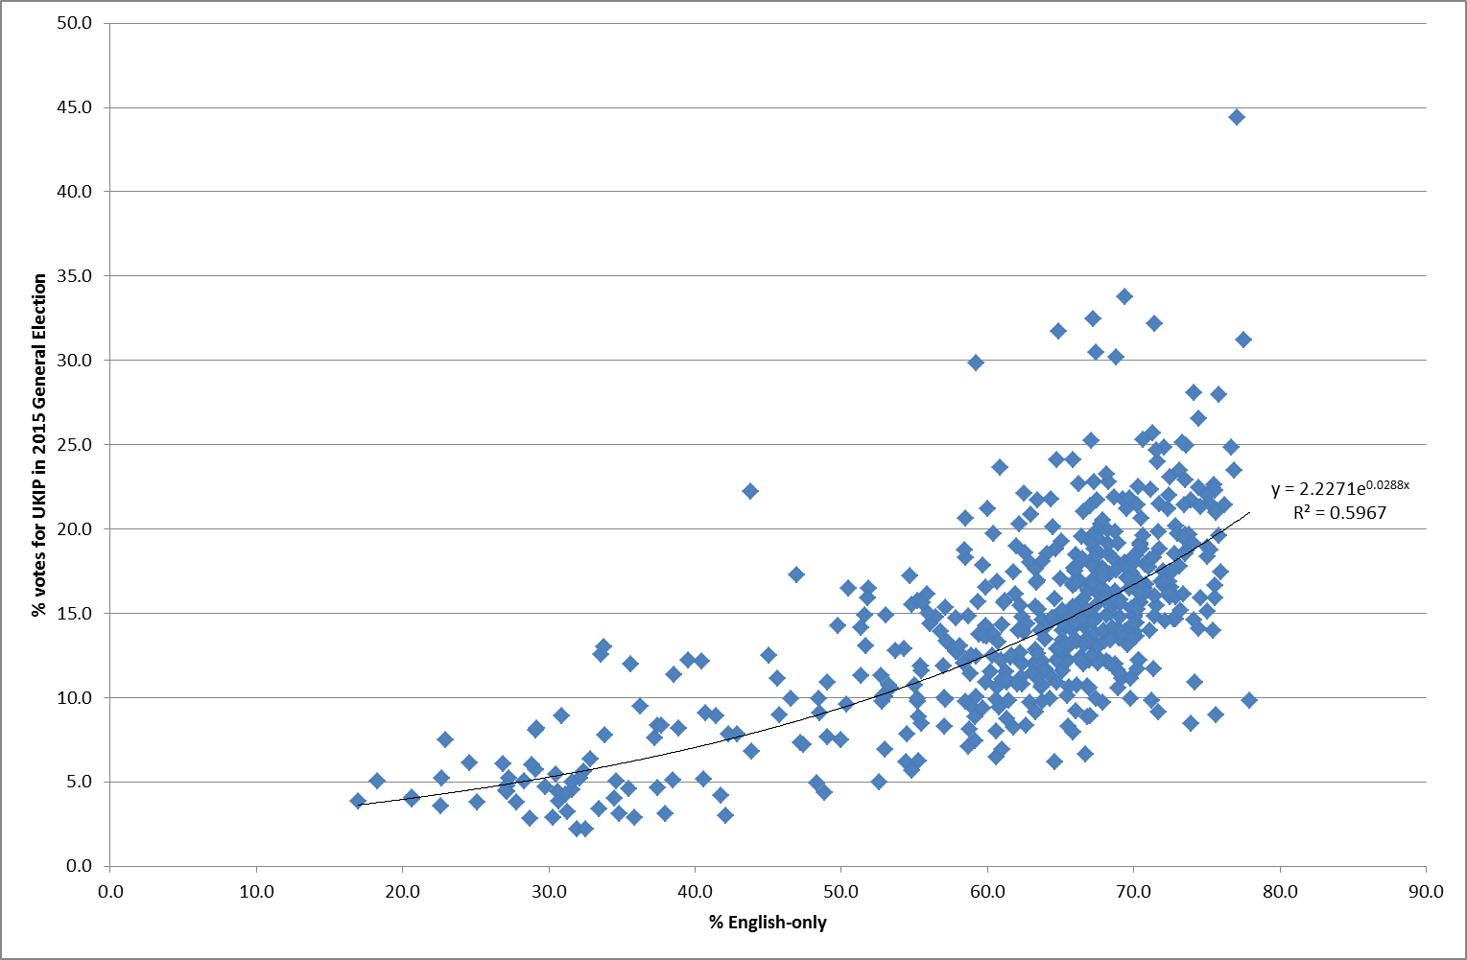
Relationship between “English-only” identity and UKIP votes
The scatter diagram indicates a positive relationship for England between the percentage of people expressing English-only national identity and the percentage of votes for UKIP at the May 2015 General Election.
The R-squared value for an exponential regression is 0.6
In a multiple regression model (adjusted R-squared of 0.684), there is a statistically significant positive relationship between the percentage voting UKIP, the percentage with English-only identity, the percentage born outside the UK and the unemployment rate.
There is a statistically significant negative association with the percentage in employment.

Slide 18
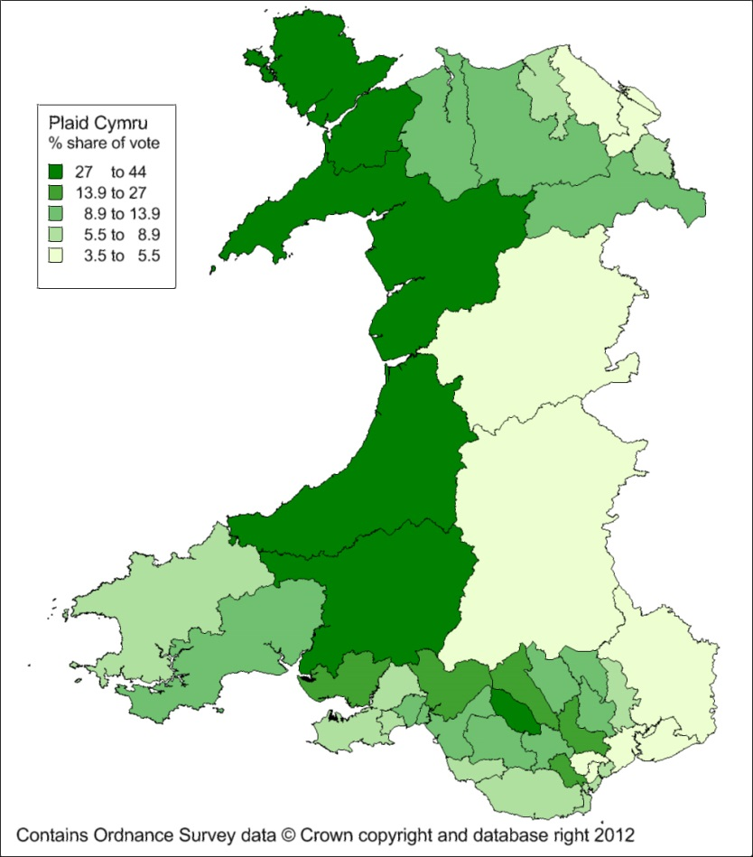
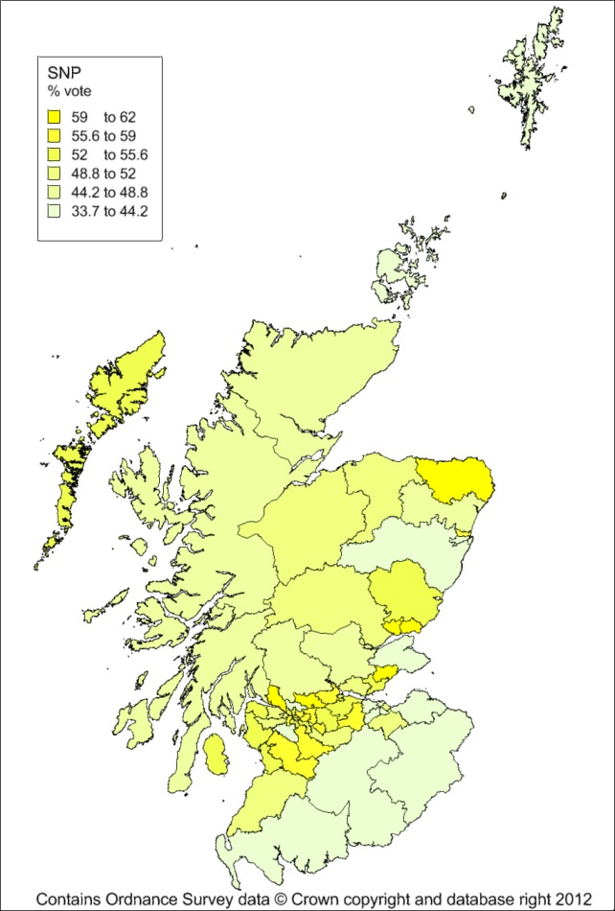
Nationalist party votes in Wales and Scotland
Wales:
Plaid Cymru only won 3 seats. Its share of the vote was highest in the west and lowest in eastern Powys, the south-east and north-east, areas with closest economic links to England. It remains strongest in its western heartlands and some parts of the South Wales Valleys and Cardiff.
Scotland:
The SNP won 56 of 59 seats. Its share of the vote ranged from 33 to 62 per cent, replacing the Labour Party in the central belt. Its share of the vote ranges from a third to over three-fifths, being highest in the urban areas.

Slide 19
Some conclusions
Linda Colley suggested that “we can plausibly regard Great Britain as an invented nation superimposed, if only for a while, onto much older alignments and loyalties” [Colley, L. (2003) Britons: forging the nation, 1707-1837. London: Pimlico, page 5].
The rise of nationalist parties in Scotland and England, the Scottish referendum, the remarkable overturning of Labour in Scotland by the SNP and the attempt to create “English Votes for English Laws” might indicate a fracturing of the union.
Survey and Census data indicate much stronger attachment to the ancient nations than the superimposed idea of Britain among white people.
However, attachment to the modern British identity is much stronger among people from minority ethnic groups, who are much more weakly attached to the individual nations of Great Britain.
There is evidence that the increased likelihood of English people identifying with England rather than Britain was a factor in the growth in the UKIP vote.
However, both English identity and UKIP voting are also associated with economic marginalisation.
Both are also associated with not being in London.

