Slide 1
Projected employment and population change in regional labour markets in the UK
David Owen, Institute for Employment Research, University of Warwick, Coventry, UK and Anne Green, City-REDI, University of Birmingham, UK

Slide 2
Introduction
Present some of the key findings from Working Futures 2017-2027 projections of regional labour market statistics in the UK – regional differentials in: - employment - output - productivity
Focus on evolution of regional differentials in industrial and occupational structure
As the population ages, the demand for new workers to replace those leaving the workforce increases – look at the pattern of “replacement demand” in the regions and nations of the UK
The outcome in terms of changes in labour market participation and unemployment

Slide 3
The Working Futures projections
The Warwick IER and Cambridge Econometrics have collaborated on economic projections since the early 1980s
Working Futures 2017-2027 is the seventh in the series of projections which take the CE multi-sectoral macroeconomic projections of the economy and produce detailed projections of employment by industry, occupation and qualifications for the nations and regions of the UK
The projection exercise is sponsored by the Department for Education (which has responsibility for England only). There is no regional level of government in England which uses the regional projections, but these are made available to anyone who wants to use them. They are about to be published by the DfE.
However, the projection exercise informs the skills planning activity of Skills and Advisory Panels - concerned with local skills policies in England.
The projections are therefore also produced for the 38 Local Enterprise Partnerships in England (and may also be produced for regions within the other countries of the UK - if commissioned by the devolved national governments).

Slide 4
Projected change in the UK labour market, 2017 to 2027 (1)
The labour force (those economically active aged 16+) is set to increase from 32.5 million in 2017 to 34.25 million by 2027 (reflecting projected increases in the size of the population as a whole)
Overall labour market participation rates (of age 16+) are projected to decline from 61.9% to 61.4%
Slow but steady output growth, combined with modest increases in labour productivity, results in a 0.3% p.a. increase in the total number of people employed in 2027 compared with 2017, representing an increase of just under a million jobs (‘expansion demands’)
An additional 9 million job openings will come about from replacing workers leaving the labour force (‘replacement demand’)
The total number of new job openings over the period will thus be 10 to 11 times greater than ‘expansion demand’

Slide 5
Projected change in the UK labour market, 2017 to 2027 (2)
The main increases in employment are expected to be focused in the private (marketed) parts of the service sector - e.g. Business and other services
Employment is projected to decline as productivity increases in Agriculture and Manufacturing.
It is projected to grow slowly in Construction and grow more slowly than the previous decade in the Trade, accommodation and transport and Business and other services sectors.
However, the Public administration, health and education sector is expected to see some of the strongest growth in both employment and GVA, supported largely by increased demand for health services as the population increases and ages
Most of the newly created jobs will be in part-time roles.
Self-employment is expected to decline slightly, accounting for just over 10% of all jobs by 2027.

Slide 6
Projected change in the UK labour market, 2017 to 2027 (3)
The trend in favour of more highly skilled, white-collar occupations is projected to continue, but with some growth in employment for a number of less skilled occupations too, as mid-level occupations decline
The supply of people holding higher-level qualifications (e.g. degrees) is projected to grow steadily to 2027, while the proportion of the labour force remaining unqualified is expected to fall to a small minority by 2027
The number of jobs in occupations typically requiring a high-level qualification is expected to continue to grow, albeit more slowly than over the previous decade
The supply of highly qualified people is projected to grow more quickly than demand for such qualifications
The projections assume that in the short to medium term, the UK leaving the European Union will have relatively modest impacts on trade, investment and migration patterns

Slide 7
Change in regional and national GVA and employment, 2007-2027
There is projected to be less regional variation in rates of output growth from 2017 to 2027 than in the preceding decade
London is projected to increase Gross Value Added (GVA) more slowly than previously, but all other regions and nations are projected to grow faster than previously
Employment, the annual average rate of change between 2017 and 2027 is projected to vary little between the nations and regions of the UK
Projected regional rates of employment growth are lower for 2017 to 2027 than for 2007 to 2017 in all regions except North-East England
Employment growth is projected to continue to be fastest in London, and slowest in northern and midland regions of England
 | GVA |  | Employment
 | Annual average rate of change
 | 2007-17 | 2017-27 | 2007-17 | 2017-27
London | 2.0 | 1.4 | 2.0 | 0.4
South East | 1.2 | 1.1 | 1.2 | 0.2
East of England | 0.9 | 1.2 | 0.9 | 0.4
South West | 0.8 | 1.2 | 0.9 | 0.3
West Midlands | 1.0 | 1.1 | 0.9 | 0.2
East Midlands | 0.7 | 1.1 | 0.8 | 0.2
Yorks & the Humber | 0.1 | 1.0 | 0.4 | 0.2
North West | 0.4 | 1.1 | 0.6 | 0.2
North East | 0.1 | 1.0 | -0.2 | 0.2
England | 1.1 | 1.2 | 1.0 | 0.3
Wales | 0.5 | 1.1 | 0.8 | 0.3
Scotland | 0.6 | 1.0 | 0.3 | 0.3
Northern Ireland | 0.5 | 1.1 | 0.3 | 0.2
UK | 1.0 | 1.2 | 0.9 | 0.3

Slide 8
Regional and national productivity differentials
Here productivity is represented as the ratio of output (GVA) to employment
Spatial differentials are marked, with highest productivity in London and South-East England and lowest productivity in Wales, North-East England and the East Midlands in 2007
While London’s productivity is projected to increase markedly by 2027, that of Wales is projected to hardly increase
The relative productivity of everywhere outside London is projected to worsen by 2027, with the deterioration greatest for Scotland
 | GVA per employee |  |  | Relative GVA/employee (UK=100)
 | 2007 | 2017 | 2027 | 2007 | 2017 | 2027
London | 64.3 | 64.3 | 71.0 | 140.9 | 140.0 | 141.6
South East | 47.5 | 47.5 | 51.9 | 104.0 | 103.4 | 103.5
East of England | 44.4 | 44.5 | 48.1 | 97.2 | 96.9 | 96.0
South West | 41.4 | 41.0 | 44.6 | 90.7 | 89.2 | 88.9
West Midlands | 40.3 | 40.5 | 44.3 | 88.3 | 88.1 | 88.4
East Midlands | 39.5 | 39.0 | 42.6 | 86.5 | 85.0 | 84.8
Yorks & the Humber | 40.7 | 39.6 | 42.9 | 89.2 | 86.2 | 85.6
North West | 42.3 | 41.4 | 44.9 | 92.6 | 90.1 | 89.6
North East | 38.7 | 40.1 | 43.5 | 84.7 | 87.3 | 86.7
England | 46.4 | 46.7 | 51.1 | 101.8 | 101.6 | 101.9
Wales | 37.7 | 36.5 | 39.6 | 82.6 | 79.4 | 79.0
Scotland | 43.6 | 44.8 | 47.9 | 95.5 | 97.5 | 95.5
Northern Ireland | 40.1 | 40.8 | 44.3 | 88.0 | 88.7 | 88.4
UK | 45.6 | 45.9 | 50.2 | 100.0 | 100.0 | 100.0

Slide 9
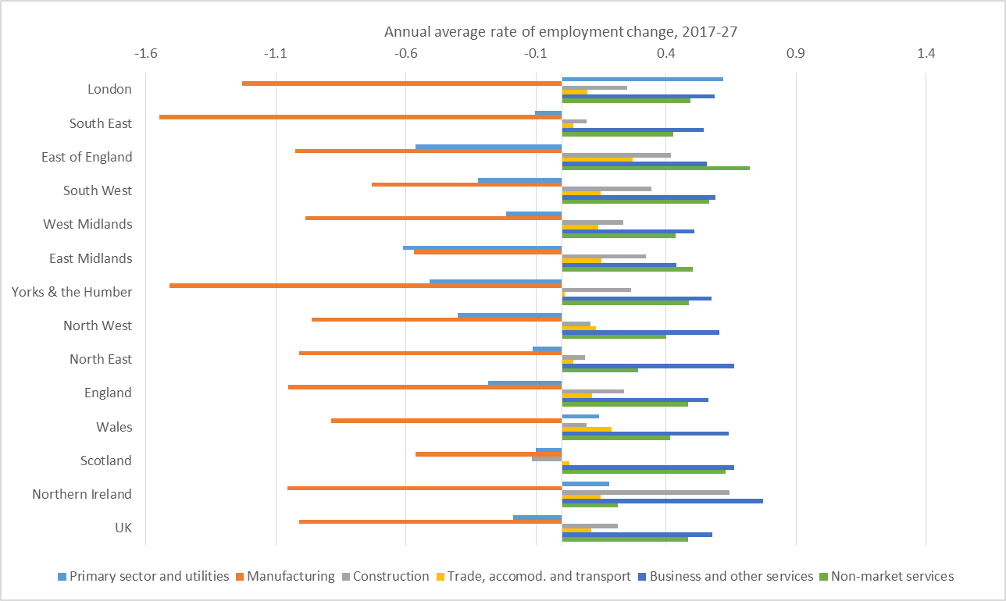
Regional employment change by industry sector 2017-27
The primary and manufacturing sectors are projected to lose employment almost everywhere
The primary sector is projected to decline fastest in the English Midlands and East
Manufacturing is projected to decline fastest in Yorkshire and the Humber
Projected employment growth in construction is fastest in Northern Ireland and the East of England
Trade, accommodation and transport is projected to grow in all parts of the UK, and fastest in the East of England
Business and other services is projected to be the fastest growing sector, particularly in Northern Ireland, North-East England and Wales
Employment is projected to grow everywhere in the non-market sector; fastest in the East and South-West of England and in Scotland

Slide 10
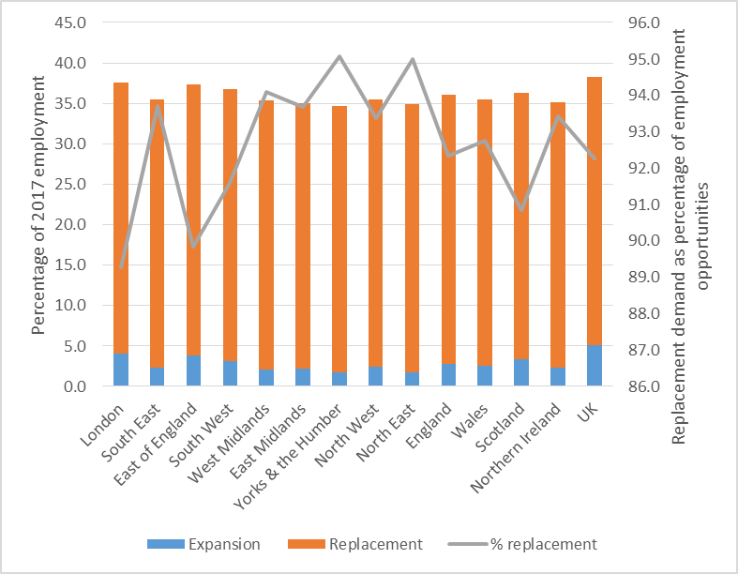
Regional pattern of replacement demand
New employment opportunities will represent more than a third of 2017 employment in all nations and regions of the UK
Expansion demand will be relatively largest in London and the East of England
It will be vastly outweighed by replacement demand in all parts of the UK
Replacement demand will be most significant in Yorkshire and the Humber, North East England and other regions of the Midlands and North of England

Slide 11
Regional and national employment change by occupation, 2017-2027
Employment growth between 2017 and 2027 is projected to be mainly in managerial, professional and associate professional occupations
There is little regional and national variation projected in rate of employment growth in higher status occupations, with the highest rates of increase projected for the East of England and Scotland
Skilled manual, machine operative & elementary occupations are projected to experience the greatest reductions in employment. The projected rate of decline is slowest in London, the East of England and Northern Ireland, and greatest in the Midlands and Yorkshire and the Humber
Job loss in administrative, customer service & caring occupations is projected to be less, and mostly concentrated in London and South-East England
 | managers, prof & tech |  | Admin, caring, sales |  | skilled, process, elementary
 | change (000s) | annual average change (%) | change (000s) | annual average change (%) | change (000s) | annual average change (%)
London | 361 | 1.0 | -74 | -0.6 | -53 | -0.4
South East | 231 | 1.0 | -51 | -0.4 | -70 | -0.6
East of England | 165 | 1.2 | -10 | -0.1 | -37 | -0.4
South West | 138 | 1.1 | -7 | -0.1 | -42 | -0.5
West Midlands | 134 | 1.1 | -15 | -0.2 | -58 | -0.7
East Midlands | 98 | 1.0 | 2 | 0.0 | -48 | -0.7
Yorks & the Humber | 111 | 1.0 | -8 | -0.1 | -57 | -0.7
North West | 151 | 1.0 | -6 | 0.0 | -60 | -0.6
North East | 46 | 1.0 | -1 | 0.0 | -25 | -0.7
England | 1437 | 1.0 | -169 | -0.2 | -448 | -0.6
Wales | 70 | 1.1 | -5 | -0.1 | -26 | -0.5
Scotland | 144 | 1.2 | -12 | -0.1 | -39 | -0.5
Northern Ireland | 34 | 1.0 | -5 | -0.2 | -9 | -0.4
UK | 1685 | 1.0 | -190 | -0.2 | -522 | -0.6

Slide 12
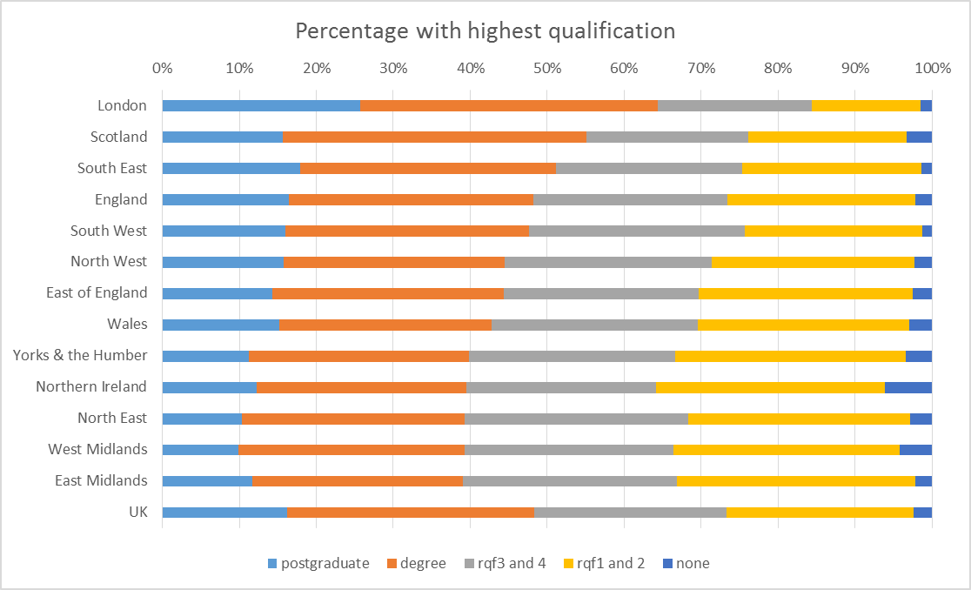
Projected qualification profile of nations and regions, 2027
By 2027, over 60% of London’s workforce is projected to hold a degree
Scotland and South-East England display the next best qualified workforces
The midlands, Yorkshire & the Humber and North-East England are projected to have the lowest percentages of degree holders
The percentage poorly qualified is projected to be highest in Northern Ireland and lowest in London, South-East and South-West England.

Slide 13
Projected change in unemployment and economic activity, 2017-27
The economic activity rate for people aged 16+ is projected to be highest in London and South-East England, and to be lowest in Wales, North-East England and Northern Ireland.
The rate is projected to decline in all nations and regions of the UK.
The decline in economic activity rate is projected to be greatest in North-East England, Northern Ireland and South-West England, and smallest in London.
The ILO unemployment rate is projected to be highest in North-East England, London, the West Midlands and Yorkshire and the Humber. It is projected to be lowest in South-East and South-West England.
The ILO unemployment rate is projected to decline slightly in South-West England and the West Midlands, but to increase elsewhere, fastest in South-East England and Wales.
 | Economic activity rate 2027 | Change, 2017-27 | ILO unemployment rate, 2027 | Change, 2017-27
London | 69.7 | -0.6 | 5.3 | 0.2
South East | 64.3 | -1.4 | 3.2 | 0.6
East of England | 63.3 | -1.2 | 3.6 | 0.2
South West | 62.3 | -1.5 | 3.3 | -0.2
West Midlands | 60.0 | -0.8 | 5.3 | -0.2
East Midlands | 60.5 | -1.4 | 4.4 | 0.1
Yorks & the Humber | 61.0 | -1.5 | 5.0 | 0.4
North West | 60.2 | -1.3 | 4.4 | 0.3
North East | 58.6 | -2.0 | 6.3 | 0.4
England | 62.9 | -1.2 | 4.4 | 0.2
Wales | 58.5 | -1.3 | 4.8 | 0.6
Scotland | 60.6 | -1.5 | 4.1 | 0.1
Northern Ireland | 59.0 | -1.6 | 4.5 | 0.4
United Kingdom | 62.4 | -1.2 | 4.4 | 0.2

Slide 14
Conclusions
The UK economy and employment is projected to grow slowly between 2017 and 2027. Established trends are broadly projected to continue, but differentials by industry and occupation are projected to be smaller than in the previous decade
The regional expression of these trends is for a slow widening of existing differentials. London is projected continue to fare best in terms of employment, gaining from new job creation, high status jobs and highly qualified workers. However, its unemployment rate is projected to increase to be one of the highest across all UK nations and regions
In the midlands and north of England, new employment opportunities are projected to be dominated by replacement of those leaving the workforce

Slide 15


For more information
David Owen:
Tel: +44(0)24 7652 4259
E-mail: d.w.owen@warwick.ac.uk
https://warwick.ac.uk/fac/soc/ier/wf6downloads
www.warwick.ac.uk/ier/
Anne Green Email: a.e.green.1@bham.ac.uk
https://www.birmingham.ac.uk/schools/business/research/city-redi/index.aspx

