Slide 1
Geographical and socio-economic patterns of under-employment in the West Midlands, UK
David Owen, Institute for Employment Research, University of Warwick Anne Green, City-REDI, University of Birmingham, UK

Slide 2
Introduction
In the context of labour shortages as the economy recovers, there is increasing concern with economic inactivity. Increased participation rates would increase labour supply, but another approach is to reduce under-employment. This paper focuses on under-employment with particular reference to variations by ethnicity.
Need to look beyond participation rates and identify the extent to which people in work are managing to achieve the amount of work they desire to undertake and whether the work they obtain is commensurate with their abilities.
The paper presents alternative measures of under-employment to illustrate the extent to which the potential labour force is not being utilised in the West Midlands Combined Authority area (Birmingham, Coventry, Dudley, Sandwell, Solihull, Walsall and Wolverhampton local authority districts) in the period 2019 to 2022.
Why focus on the ethnicity dimension?
Minority ethnic groups perform well in education and exhibit relatively high rates of participation in post-compulsory education BUT success in education does not translate to labour market success – they experience lower employment rates in aggregate.
Minority ethnic groups can provide the labour supply sought by employers – especially in the West Midlands of England, where the population grew rapidly between 2011 and 2021, especially amongst minority ethnic groups in cities.

Slide 3
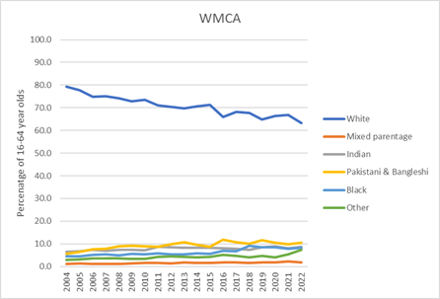
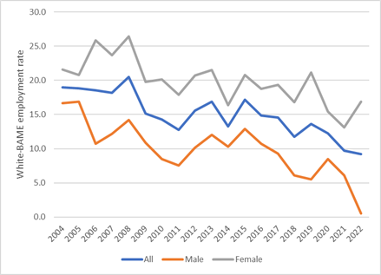
Labour market situation of BME people
In aggregate, Black and Minority Ethnic (BME) groups have higher unemployment rates and lower employment rates than white ethnic groups, and also experience lower pay rates. Their employment was more negatively impacted by the Covid-19 pandemic.
BME job seekers make more applications to get a job than their white counterparts and once unemployed, they tend to experience longer spells of unemployment.
Structural issues help explain differences in the labour market position of BME groups – for example the low participation rates of Pakistani and Bangladeshi women is related to their being more likely to stay home to provide childcare. Lower participation rates are also associated with poorer English language skills.
The BME population should not be treated as homogeneous - there are important differences between individual ethnic groups.
Indian and Chinese people experience the highest rates of educational achievement, highest employment and lowest unemployment rates. Bangladeshi, Pakistani and less populous minority groups have a relatively high percentage of poorly skilled workers. These and Black ethnic groups also experience persistently high unemployment rates.
BME ethnic groups all suffer some degree of “ethnic penalty” in the labour market

Slide 4
Structure of the paper
Aim: to quantify under-employment by ethnic groups and make recommendations to employers to address disadvantage by strengthening actions to recruit workers from under-represented groups.
Structure:
  Analysing the factors underlying the differential probability of employment and unemployment in the West Midlands Combined Authority (WMCA) area by ethnic group.
  Measuring under- and over-employment
  Measuring expected employment differentials
  Discussion of data sources and their properties
  Conclusions and application of these estimates

Slide 5
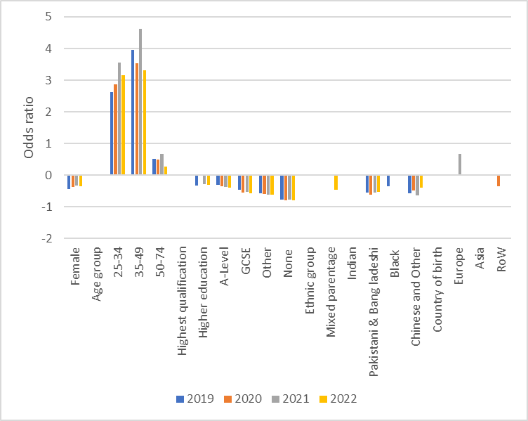
Probability of being employed
Variables for which odds ratios from
a logistic regression are statistically
Significant at 5% level
Notes:
Models were estimated for each year from 2019 to 2022. The bars represent the odds ratio, with a positive value representing a higher probability of employment and negative values a lower probability of employment. Only values statistically significant at the 5% level are presented. Nagelkerke R-square value is around 0.2 for each year.
The probability of employment was compared to that of a male aged 16 to 24 with a degree, from the white ethnic group, born in the UK.
The probability of employment was lower for women than for men in each year, but the differential was markedly smaller in 2021 and 2022 than in 2019.
People aged 35 to 49 were most likely and those aged over 50 least likely to be in employment.
Those with higher level educational qualifications were most likely to be in work. The disadvantage of those less well qualified increased as the level of highest qualification decreased.
Indian people were more likely to be employed than white people, but the difference was not statistically significant.
People from other racialised communities were less likely to be employed than white people.
Pakistani and Bangladeshi people experienced the largest degree of disadvantage in all four years.
Chinese and Other people were more disadvantaged in 2019 and 2021.
Black people were less likely than white people to be employed in all years except 2021.
People born in Europe were more likely than UK-born people to be employed, but this differential was only statistically significant in 2021.
For other countries of birth, the odds ratios were not statistically significant.
People born in Asia were more likely to be in work in 2020, but less likely to be employed in other years.
odds ratios from a logistic regression which modelled the likelihood of being in employment for people living in the West Midlands region using data from the Annual Population Survey
People born in the Rest of the World were less likely to be employed than the UK-born throughout the period.

Slide 6
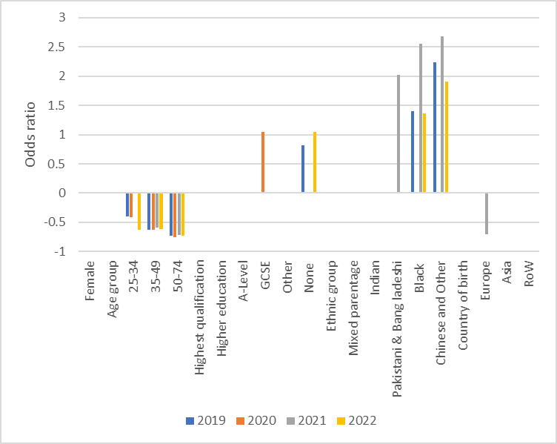

Probability of being unemployed
Notes:
The dependent variable was being unemployed (1) or not (0) for each survey member resident in the West Midlands region. The Nagelkerke R-squared value is around 0.06 to 0.08 for each year (i.e. the model predicts about a twelfth of the variability in the data) – a much less close fit than for the employment model. The statistical fit of the model is best for 2021.
Women are less likely than men to be unemployed, but the differential is not statistically significant.
People aged over 25 are less likely than younger people to be unemployed.
The differential is greatest for those aged over 50.
The poorer the level of highest educational qualification, the greater the likelihood of being unemployed. However, these differentials are only statistically significant at the 5% level for those with no educational qualifications in the years 2019 and 2022.
People from Black and Minority Ethnic groups are more likely than white people to be unemployed. The model used
The differential was greatest for people from Chinese and Other ethnic groups (who were three times more likely than white people to be unemployed) in 2021, 2019 and 2022. Black people displayed higher odds rations than Pakistani and Bangladeshi people in most years. The differential in odds ratios was not statistically significant at the 5% level for Indian people and those of mixed parentage.
People born outside the UK were less likely to be unemployed than UK-born people, but the only statistically significant differential was for the Europe-born in 2021.
Those born in Asia and the Rest of the World were more likely to be unemployed in 2020.
Thus, Black and Minority Ethnic groups experience lower employment rates and higher unemployment rates than white people. However, ethnicity is a less powerful influence than educational qualifications, age and sex. The results were similar in all four years and there is no clear evidence of improvement or deterioration of the experience of individual ethnic groups over this period.

Slide 7
Conceptualising under- and over-employment
Unemployment measures the degree of “slack” in the labour market: the number of people not in employment who want and are seeking work. However, this underestimates the level of extra capacity in the economy because some workers are not employed to their full potential.
Underemployment is the underuse of a worker because a job does not use the worker's skills, is part-time, or leaves the worker idle. There are various definitions of underemployment:
  The number of people who want to work more (Time-related underemployment)
  The number of people who are working part-time, but would like a full-time job
  The percentage of people accessing professional or high-status jobs
  People working in jobs which do not match their educational level
Conversely, the over-employed are people working more than they wish to. They want to work fewer hours, even with lower pay.
The number underemployed in the UK was 2.3 million in January to March 2002 (6.8% of all employed) rising to a maximum of 3.9 million in January to March 2014. It fell for the remainder of the decade but increased sharply during the period of Covid lockdowns before falling again to 2.1 million (6.4% of employment). These measures were operationalised using data from the Annual Population Survey for the WMCA for the period 2019 to 2022.

Slide 8
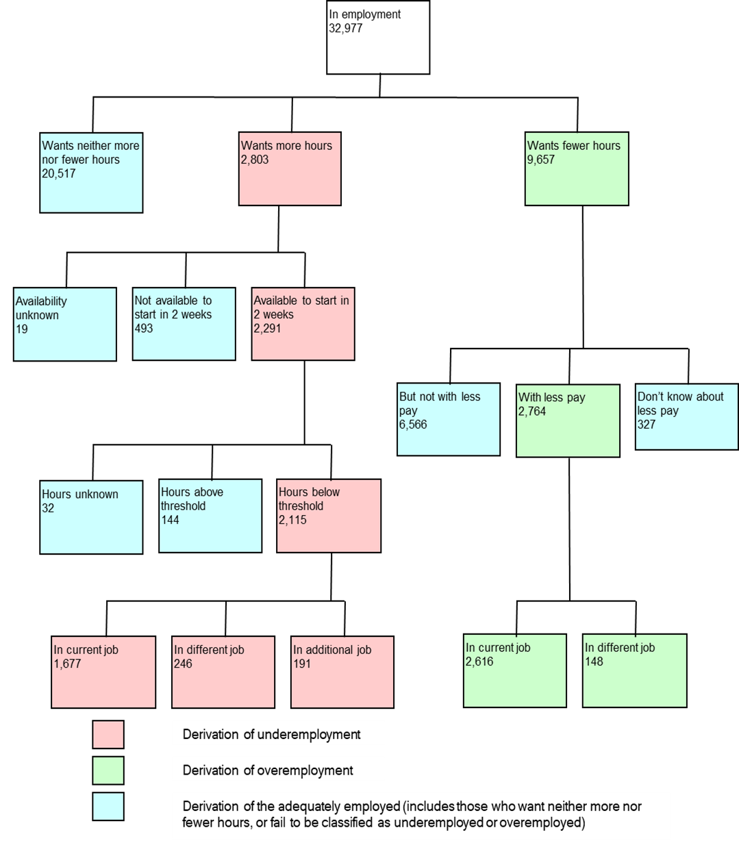
Measuring time-based under- and over-employment
Walling and Clancy (2010) define underemployment as employed persons who want to work more hours in either their existing or an additional job, are available to start in the next two weeks and are working less than a threshold number of hours (48 for those aged over 18 and 30 for those younger).
This concept of time-related underemployment can be operationalised using the Labour Force Survey variables UNDEMP (whether a person would like to work longer hours, at current basic rate of pay), UNDST (whether they could work longer hours within the next 2 weeks), TOTHRS (total hours worked in reference week) and UNDHRS (extra hours wished to work).
This measure shows that in the UK 2.8 million people (6.4% of those in employment) were not able to undertake as much work as they wanted to during the quarter January to March 2024.

Slide 9
Time-based under- and over-employment in the West Midlands region, 2019-2022
A logistic regression model was estimated for each year from 2019 to 2022 in order to identify the factors which are likely to lead to a person being under-employed. Odds ratios representing the chance of being more or less likely to be under-employed are presented for independent variables in which the coefficient was statistically significant at the 5% level.
People from BME groups a whole are twice as likely as white people to be under-employed. The differential is smaller for women than men. The percentage under-employed was lower in 2022 than 2019 for both white and minority ethnic groups.
People of mixed parentage, and those from the Bangladeshi and Black-African ethnic groups (and Black-Caribbeans in 2022) were most likely to be under-employed.
People born outside the UK are also much more likely than the UK-born to be under-employed, but less likely to be over-employed than the UK-born (excepting those from the “rest of the World”).
White people were more likely than those from minority ethnic groups to be over-employed. People of mixed parentage were most likely to be over-employed. Amongst minority ethnic groups, men were more likely than women to be over-employed. This pattern could indicate the existence of exploitation, representing the need to work longer hours in order to achieve an acceptable level of pay.
The percentage under-employed is higher for both men and women born outside the UK than for the UK-born. This might reflect the failure of employers to recognise the value of their educational qualifications.

Slide 10
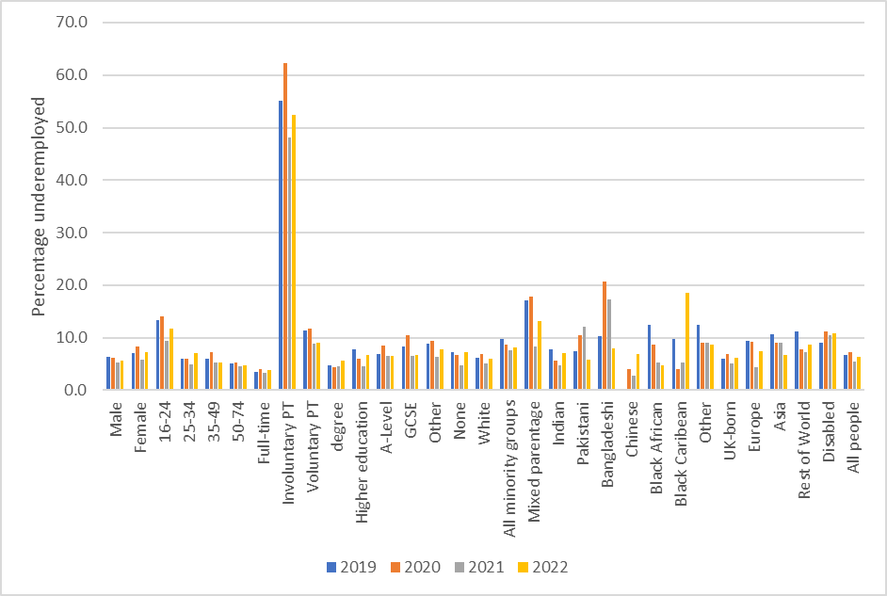
Percentage under-employed, 2019 to 2022

Slide 11
Estimating “expected” employment rates
It is possible to calculate ‘expected’ employment given the highest educational qualifications for a given population sub-group.
The level of employment is predicted by multiplying the employment rate by qualification and age for all people, against the population in each ethnic group, age and sex combination (within each local authority area). This is then summed across age and qualification level for each sex.
Under or over-employment estimates are thus the difference between the predicted value and actual employment. A positive value indicates more people employed than would be predicted from the qualification profile for that group.
Estimates are aggregated across age groups to provide an overall total for the ethnic/sex group combination.
A negative value indicates a lower rate of employment than qualifications would imply for that combination of sex and ethnic group.
This measure can thus indicate the existence of hypothetical “over”-employment (advantage) or “under-” employment (disadvantage) for an ethnic group.

Slide 12
Estimated employment deficits by ethnic group
The estimated employment deficit for BME groups for the WMCA as a whole was 54.5 thousand or 14% of employment in 2019.
By 2022 it was 38.2 thousand or 9.1%.
The deficit was larger for women than men; -25.4% in 2019 and -19.1% in 2022.
All BME groups experienced a deficit in 2019, except Indian people who experienced a 6.1% “surplus”.
Employment deficits were largest for Pakistani and Bangladeshi people, especially women.

Slide 13
Employment deficits by district for 2019
 | White | All Black and Minority Ethnic groups | Black/African/Caribbean/Black British | Indian, Pakistani, Bangladeshi or Other Asian (not Chinese) | Chinese, Mixed/multiple or Other
Birmingham | 11.0 | 11.0 | -16.2 | -14.4 | -17.5
Coventry | 5.9 | -14.6 | -18.0 | -4.8 | -90.1
Dudley | 1.9 | -21.2 | -21.4 | -13.4 | -259.8
Sandwell | 3.4 | -5.6 | -27.7 | 3.0 | -15.2
Solihull | -0.2 | 0.9 | -73.2 | 4.0 | -16.5
Walsall | 2.5 | -11.2 | -40.5 | -12.0 | -248.0
Wolverhampton | 0.2 | -0.5 | -5.2 | 9.2 | -58.5
WMCA | 6.2 | -14.0 | -15.1 | -10.8 | -25.6
Notes:
The table on the right presents the estimated employment deficit as a percentage of those employed. It reveals substantial BME under-employment in all districts of the WMCA.
The number of BME people employed in 2019 was 54.5 thousand (or 14 per cent) lower than it would have been if employment rates by qualification level matched the average for the WMCA.
White employment was higher by the same amount (representing 6.2 per cent of employment).
The rate of BME under-employment was greatest in Dudley and Coventry, and lowest in Wolverhampton, with a small degree of over-employment in Solihull (the most prosperous district).
The percentage employment deficits for broad ethnic groups were very large in some districts, because of small numbers (notably Chinese and Other).
The percentage deficit was much larger for Black than South Asian ethnic groups in Birmingham and largest in Solihull.
Percentage deficits were lowest in Wolverhampton.

Slide 14
Data sources
The analysis used three types of data:
Microdata from the Annual Population Survey for the West Midlands region.
  This was used to estimate regression models of the probability of employment and unemployment and create under- and over-employment indicators for individuals using the ONS methodology.
Commissioned tables from the APS for each year from 2019 to 2022 for the West Midlands Combined Authority area and its constituent local authority districts.
  Ethnic group was cross-tabulated by age, sex, economic status and highest educational qualification.
Data from the 2021 Census of Population for the WMCA and local authorities within it.

Slide 15
Practicality of alternative measures of under-employment
Time-based measures
These can be calculated using the LFS and APS microdata.
Such estimates can be updated as data for each quarter (LFS) or year (APS) is released, enabling time-series monitoring.
National and regional analysis can be conducted using End User Licence data.
However, analysis for smaller geographical areas requires either access to Secure versions of the data, with consequent restrictions on publishing numerical data or commissioning bespoke tables from ONS.
Because of confidentiality restrictions, analysis for areas smaller than local authority districts (in which sample sizes will be small) is not practical.
Detailed breakdowns by ethnic group may not be possible for the same reason.
Qualification-based
These measures can be calculated using LFS or APS microdata. However, small sample sizes when variables are cross-tabulated limits the detail of analysis by ethnic group and geography.
Census of Population data has the advantage of larger sample size and can be used to undertake calculations for smaller geographical areas.
However, Census data is only available decennially, limiting the ability to monitor trends over time.
Moreover, the custom table generator limits the amount of detail which can be generated. Tables with small sample sizes are suppressed.
This means that more detailed analysis requires the commissioning of tables from ONS Census Customer Services in England and Wales. Scotland and Northern Ireland have different systems for data access.

Slide 16
Conclusions
Bringing together the concepts of under- and over-employment with unemployment, employment and economic activity provides a more comprehensive perspective on the inclusion of different sub-groups of the population in the labour market and the extent to which different sub-groups are able to gain access to the type and amount of work they desire.
Patterns of under-employment by population breakdown broadly reflect patterns of unemployment and labour market participation rates.
This indicates that labour market disadvantage in unemployment rates understates deficits or advantages in the quantity of work accessed.
Labour market disadvantage is particularly pronounced amongst some minority ethnic groups – and there is scope for policy to address this.
In order to reduce differential labour market experience across ethnic groups, improving basic skills (including English language skills) is of key importance.
To help address growing labour and skills shortages, employers should also explore new/ non-traditional recruitment channels, reconsider their selection practices and redesign jobs on offer (as appropriate) to enhance their quality and attractiveness to minority groups under-represented in the workforce.
There are serious data challenges to be faced in implementing the sort of measures presented here on a regular basis at the sub-regional scale, due to the problems of small sample numbers from survey data and restrictions on analysing secure versions of these data sets.

Slide 17


For more information
David Owen:
Tel: +44(0)24 7652 4259
E-mail: d.w.owen@warwick.ac.uk
Reference:
Walling, A. and Clancy, C. (2010) Underemployment in the UK Labour Market, Economic and Labour Market Review, 4(2), pp16-24.
Acknowledgements:
This research was undertaken with Anne Green on behalf of the West Midlands Combined Authority. The SPSS code for creating the measures presented in the diagram was provided by the labour market statistics section of ONS.

