Slide 1


CASCOT Editor
Ritva Ellison
Institute for Employment Research
University of Warwick

Slide 2
Cascot Editor
Cascot Editor is a program that allows the user to create and/or modify electronic classifications for use with Cascot.
A classification is described via its structure, an index and a set of rules.

Slide 3
The Cascot Coding Engine
Cascot contains a complex coding and scoring engine.
Engine has the processing functions required to analyse word frequency and similarity between input text and index text.
It creates the list of recommendations and scores associated with each recommendation.
The engine is capable of working with any classification created using the Editor. The classification files created by the Editor contain everything that is unique to the classification. The coding engine remains the same no matter which classification is in use.

Slide 4
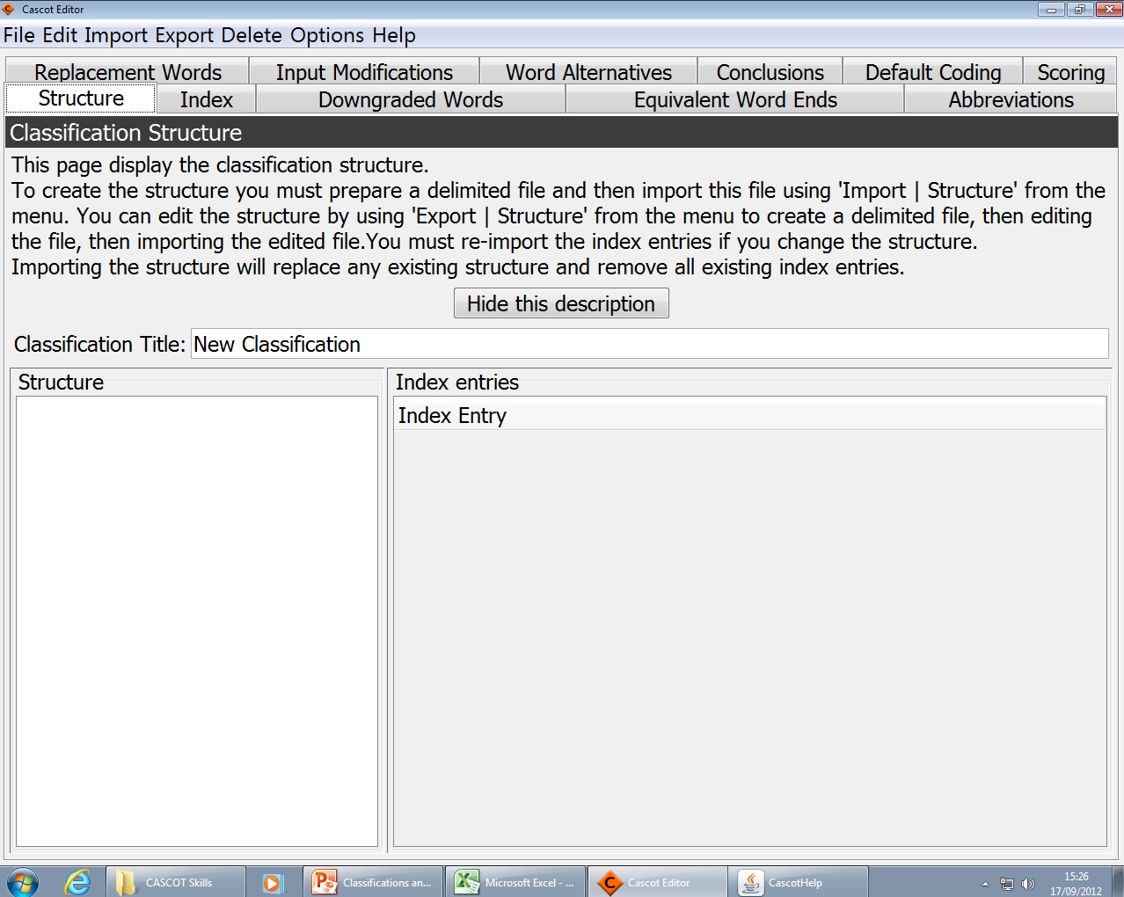
The Editor Interface

Slide 5
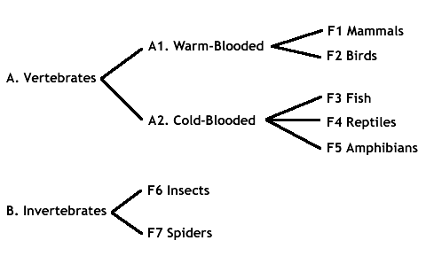
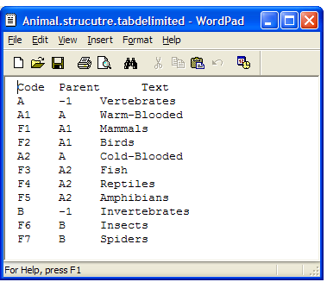
Defining the structure

Slide 6
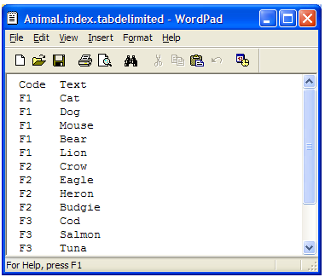
Defining the index entries

Slide 7
Defining coding rules
If “moggy”, code as Cat
If “bugdie”, replace with “Budgie”
If “fast eagle”, ignore the word “fast”

Slide 8
Rule types
Lists of words: Downgraded Words, Equivalent Word Ends
Text matching rules: Abbreviations, Replacement Words, Input Modifications, Word Alternatives, Conclusions, Default Rules

Slide 9
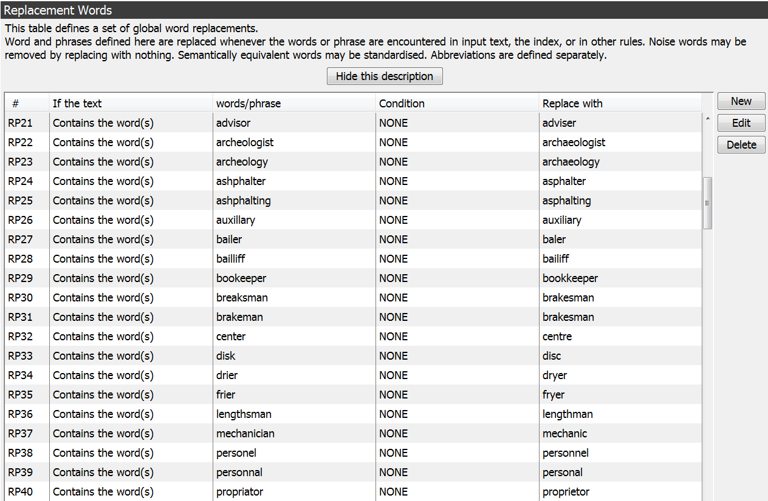
Defining rules (example from SOC2010)

Slide 10
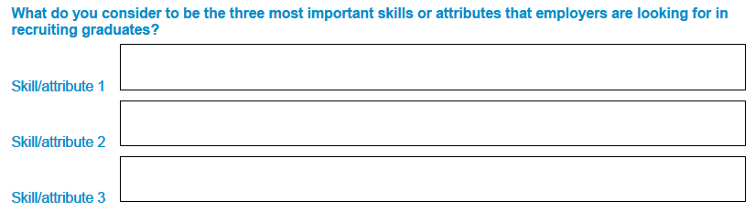
Example: making a skills classification
Questionnaire:
Textual replies describing skills need to be coded.

Slide 11
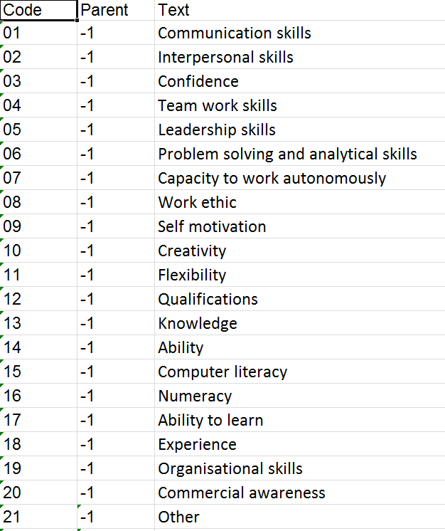
Example: making a skills classification
Define
structure

Slide 12
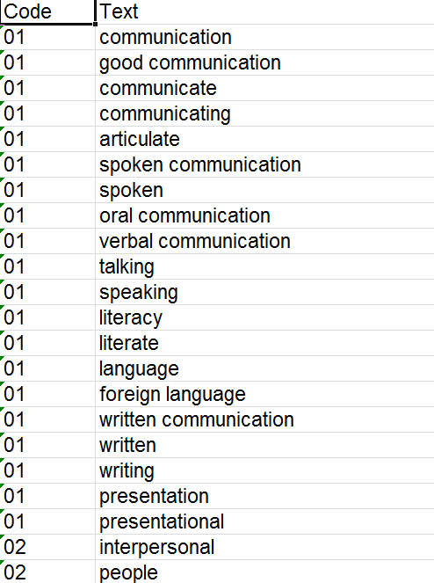
Example: making a skills classification
Define
index

Slide 13
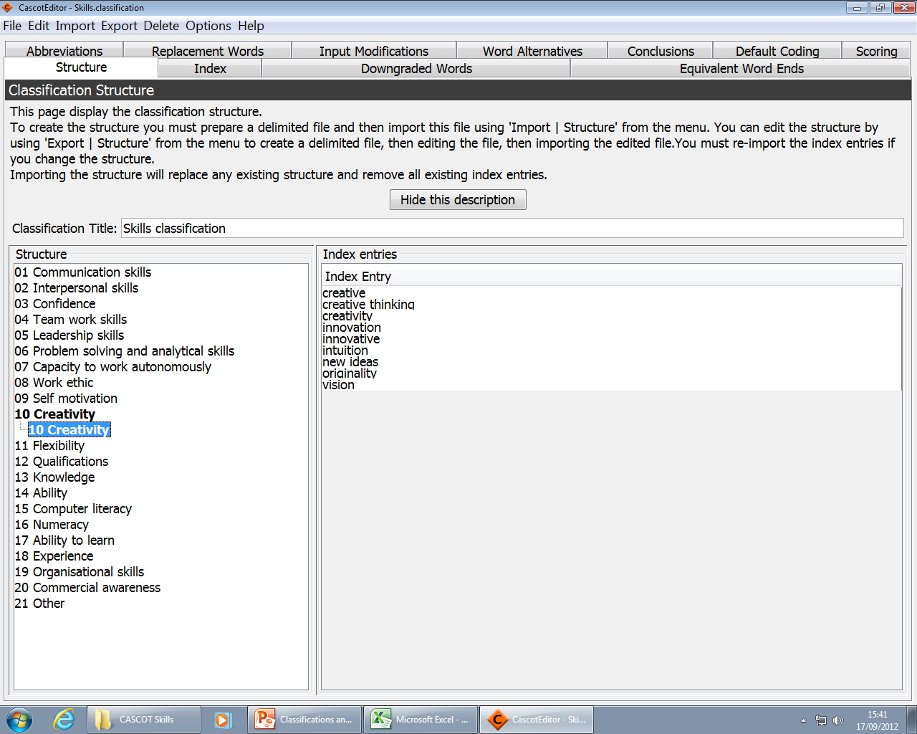
Import structure and index to Editor.
Rules are not necessary for the classification to function but they will improve performance.

Slide 14
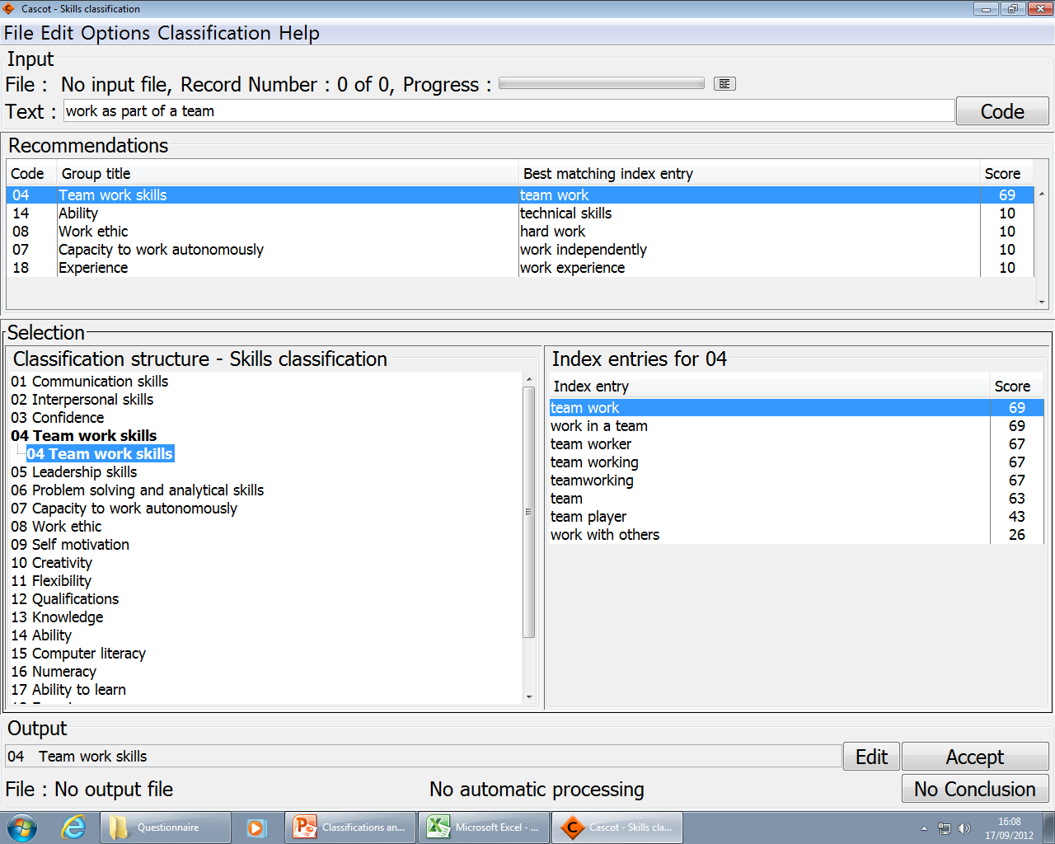
Testing the classification.

Slide 15
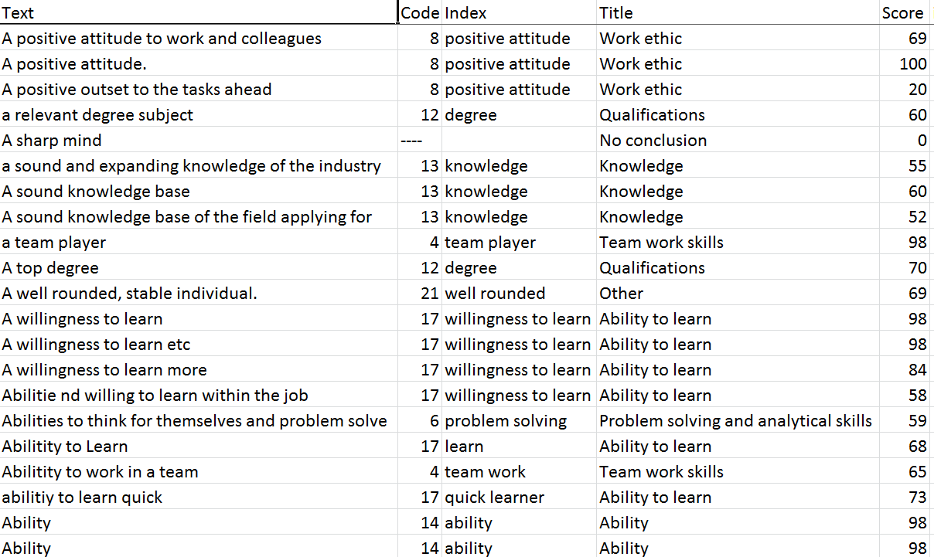
Results of automatic coding

