Slide 1
CASCOT International version 5
User Guide
Peter Elias, Margaret Birch and Ritva Ellison
Institute for Employment Research
University of Warwick
December 2014

Slide 2
What are the problems with occupation coding?
Occupation is a standard measure on all social surveys
Complicated to collect and in non-standard form
Requires harmonisation to (max) four-digit classification
Requires specialist knowledge to code accurately

Slide 3
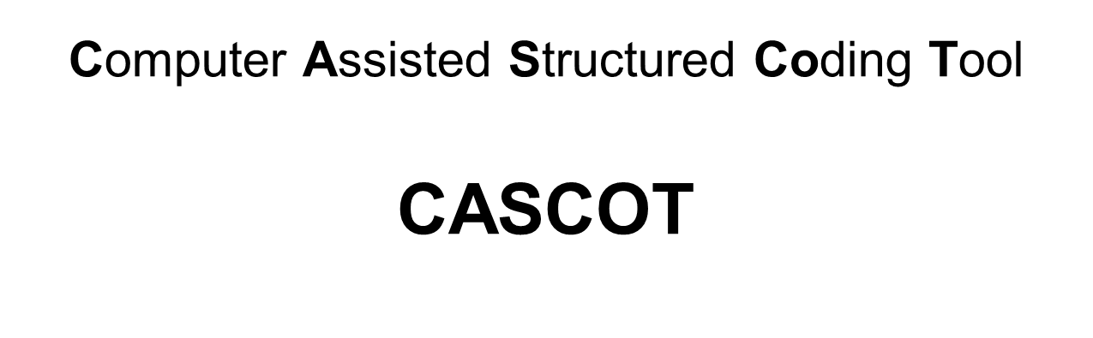


Slide 4

Computer Assisted Structured Coding Tool CASCOT
Software tool for coding text automatically or manually to structured classifications
Developed at the Institute for Employment Research 1993 -
Used by over 100 organisations (public research, private sector, statistical agencies)

Slide 5
Computer Assisted Structured Coding Tool CASCOT
Fast with a sophisticated coding engine
Allows automatic or manual coding, or mixing the two modes
Reads input from a file, writes output to a file
Desktop version, API available

Slide 6
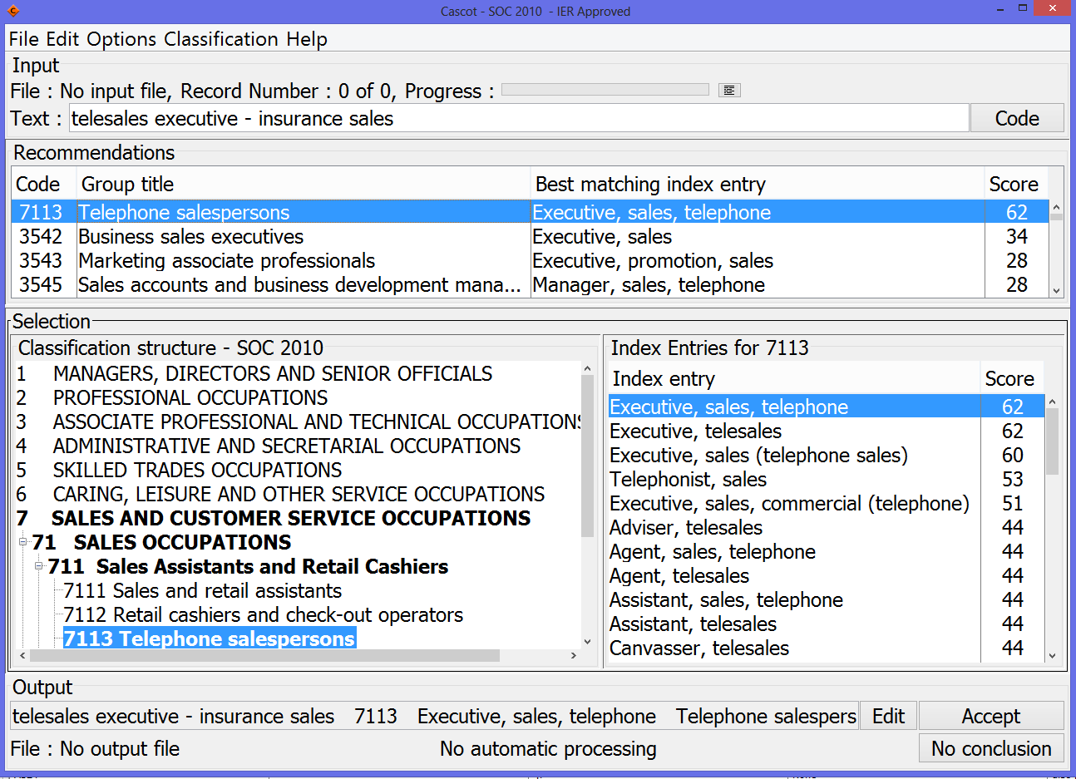
Screenshot of CASCOT with UK SOC2010

Slide 7
CASCOT structure
User Interface
English
Dutch
…
Classification
CASCOT
ISCO’08English
CASCOT
Editor
ISCO’08Slovak
-Structure
-Index
-Coding
Rules
Coding
Engine
ISIC
German
ISCED
Spanish
…

Slide 8
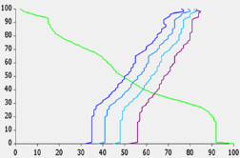
CASCOT coding and result testing
Input
(texts)
CASCOT
‘Gold standard’
codes
CASCOT
Performance
Tool
Statistics
Coding
Engine
Output(codes)
Interface
Classification

Slide 9
Coding with CASCOT

Slide 10
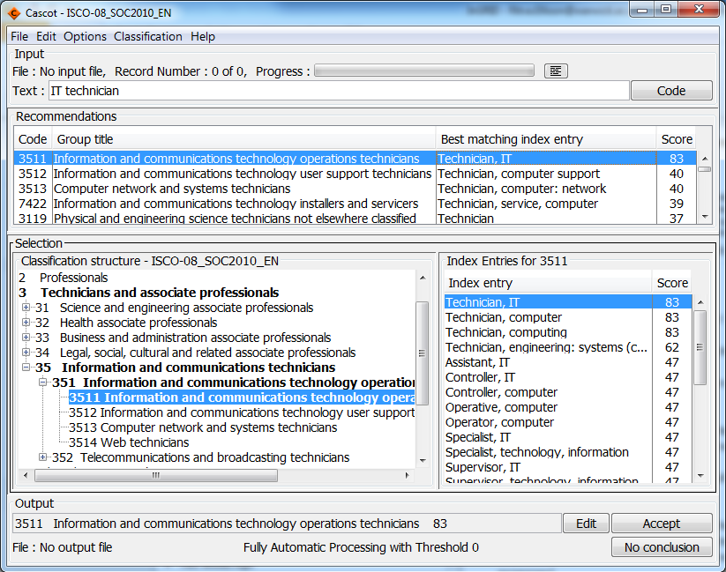
Coding with CASCOT (in brief)
Selected classification
Enter text (could be from a file)
CASCOT provides a recommendation for code but user can change it
Output can be directed to a file
User can choose output items

Slide 11
CASCOT coding information
A demonstration using UK SOC2000 classification is available on the web
Discusses the background for CASCOT development
Shows in detail how to code with CASCOT and how to use input and output files
http://warwick.ac.uk/cascot/cascot_demonstration.ppt

Slide 12
Another CASCOT coding presentation
A demonstration using UK SOC2010 classification is available on the web
Shows basic coding into UK SOC2010
Discusses classifications and large scale coding
http://warwick.ac.uk/cascot/cascot_soc2010_demo_for_web.pptx

Slide 13
CASCOT International

Slide 14
IER contracted under the DASISH project within WP3 to develop a multilingual version of CASCOT to code job titles to ISCO 08
Task 3.1 Develop software for improved coding of occupation
Task leader City University, London
CASCOT will be upgraded to provide:
• a user interface which is presented in 4-6 selected European languages;
• classification files which permit coding of text in selected languages to the appropriate national occupational classification and to ISCO’08 at four digits;
• a software tool which will facilitate evaluation of coded text files.
The software will be upgraded in such a manner to facilitate future extension by incorporating additional languages as and when relevant index material becomes available.

Slide 15
CASCOT (the international version)
A new facility within CASCOT: - to detect automatically and switch the interface language - to handle various language classification files
The international version of CASCOT has been supplied to and evaluated by national occupational experts in relevant countries

Slide 16
DASISH: CASCOT development
User interface in 8 languages:
Dutch, English, Finnish, French, German, Italian, Slovak and Spanish
ISCO-08 classification (structure, index) prepared for each country
Simultaneous coding into ISCO-08 and national code possible
Development of CASCOT Performance Tool
Raw data files from the European Social Survey (ESS) Round 6 used to validate the software
Partnership arrangements for the testing and fine-tuning by experts within each country covered by the languages in the pilot

Slide 17
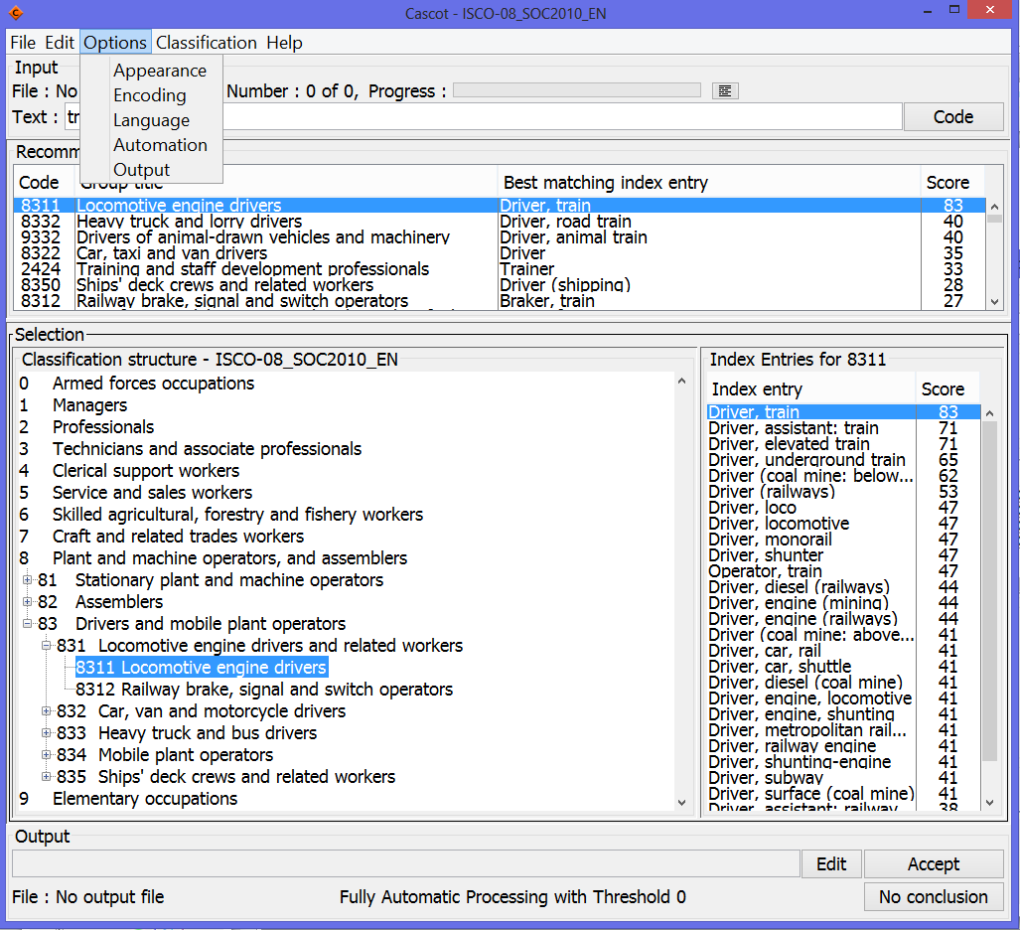
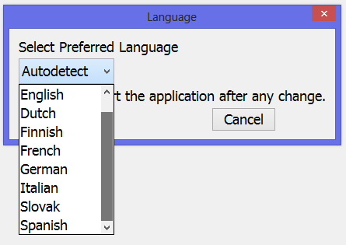
Selecting interface language
Then restart CASCOT

Slide 18
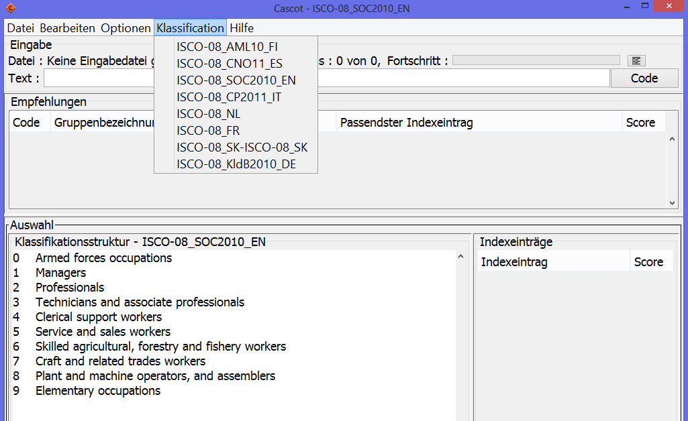
Selecting classification
Select from the menu ‘Classification’ and choose from the list. If the desired classification is not listed, select File>Open classification, navigate to the correct folder, select the desired classification file and click ‘Open’.

Slide 19
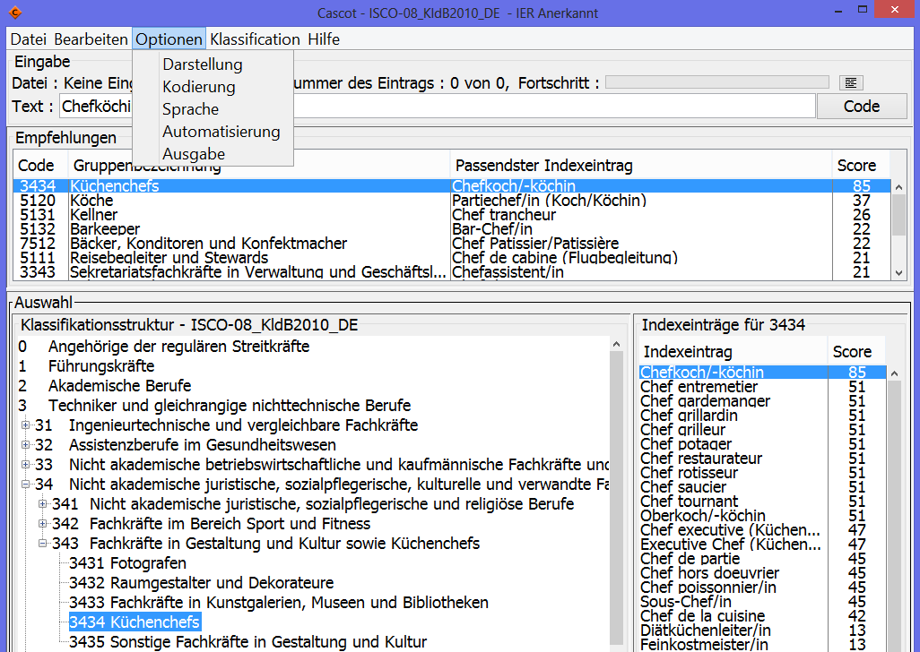
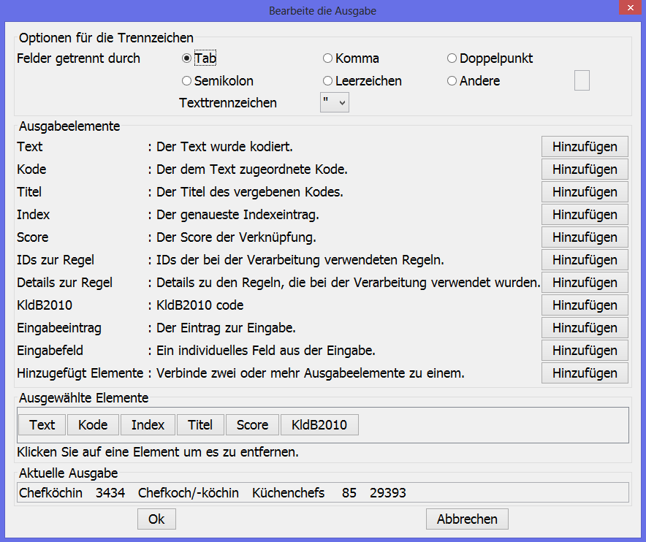
Selecting output items
Select
Options>Output
And click ‘Add’ next to the items you wish to have in the output.
NB National code can be added to the output as in this example. Current output is shown at the bottom, click ‘Ok’ to accept.
Current output

Slide 20
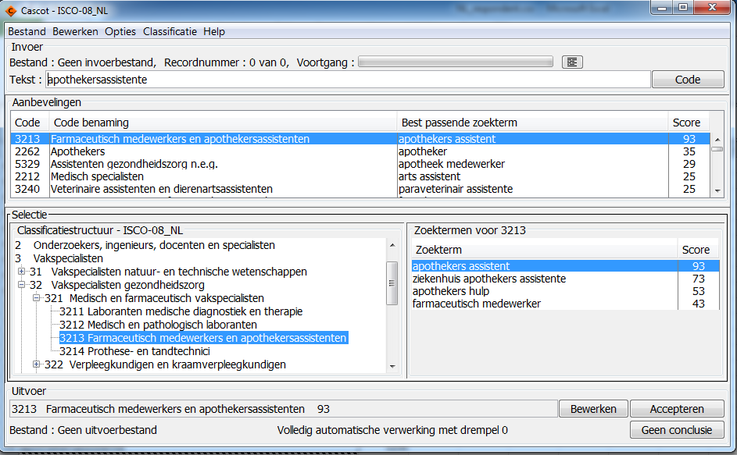
Coding in Dutch

Slide 21
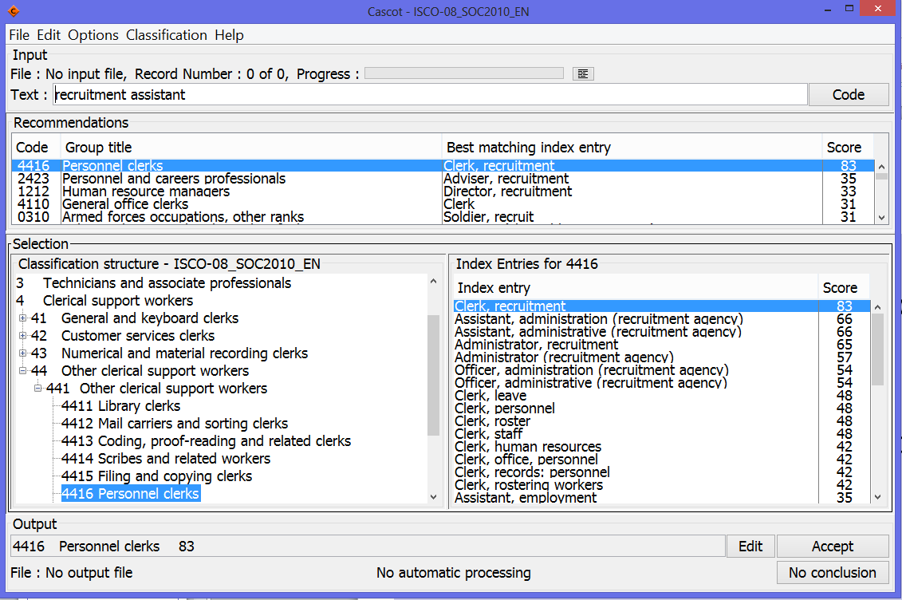
English

Slide 22
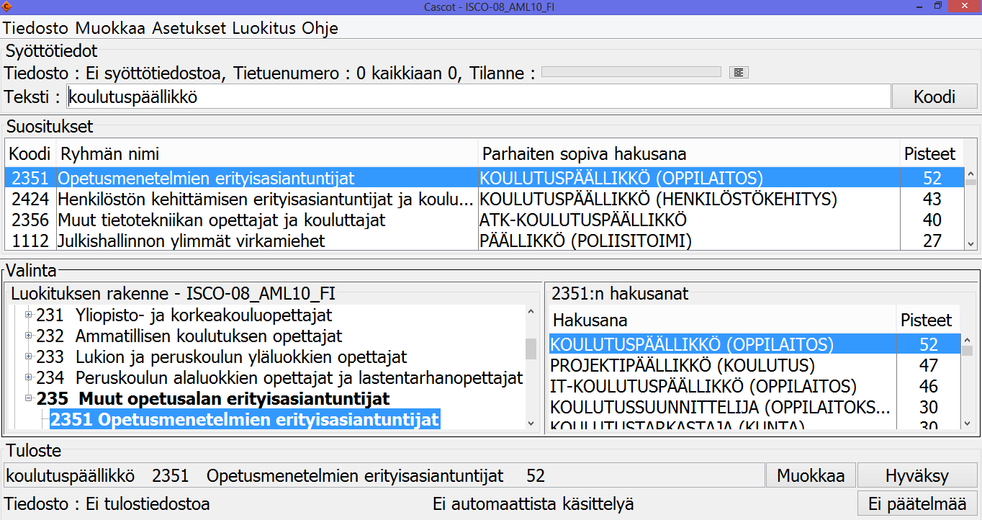
Finnish

Slide 23
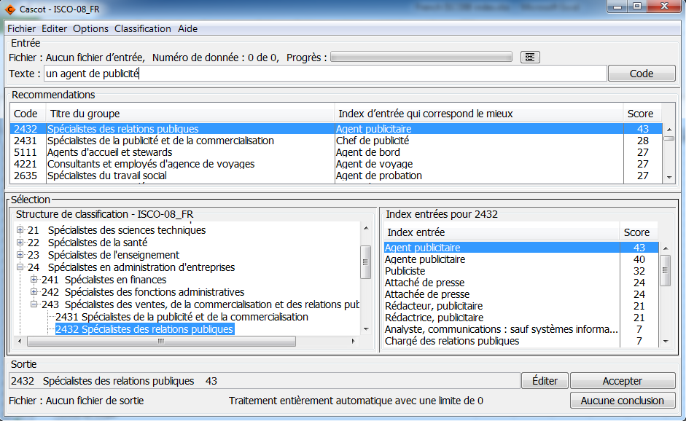
French

Slide 24
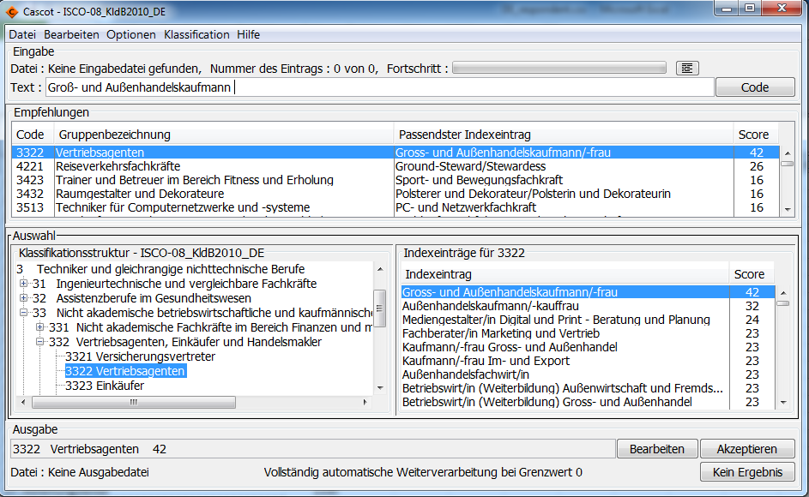
German
*
* The index is © Federal Employment Agency

Slide 25
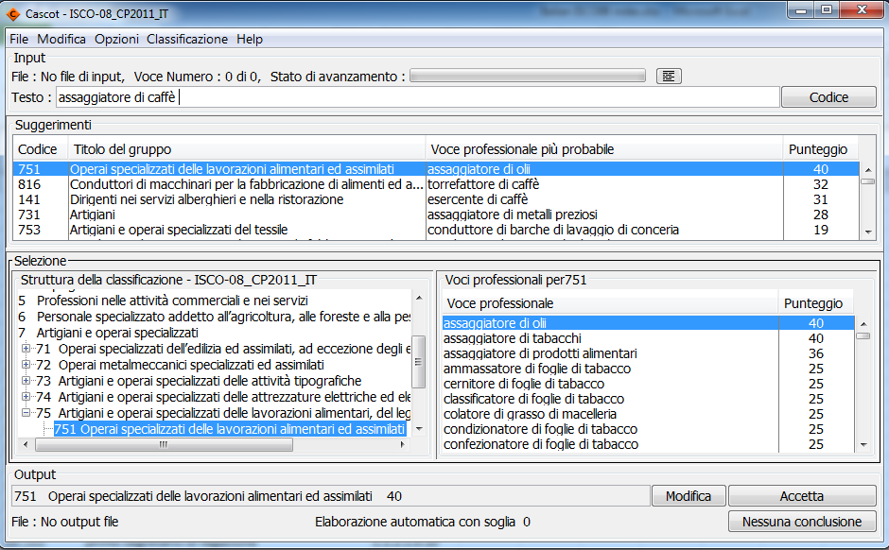
Italian

Slide 26
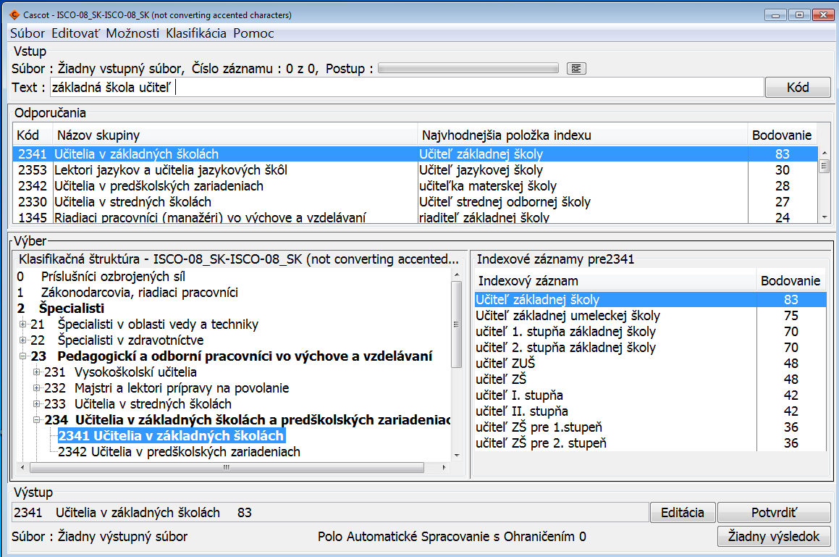
Slovak

Slide 27
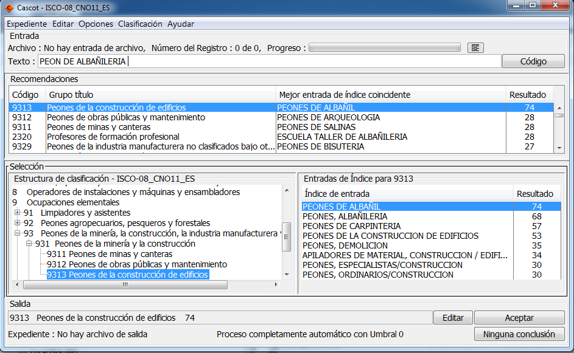
Spanish

Slide 28
CASCOT Evaluation

Slide 29
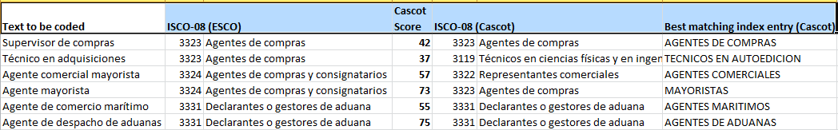
CASCOT Performance Tool
Allows the user to analyse the performance of CASCOT by comparing manually coded (“Gold Standard”) data with code produced by CASCOT for the same data.
A delimited results file is needed which should contain
a reference code, CASCOT code and CASCOT score.
The Tool shows Performance Results Display window with Performance Graph, Summary and Interactive Statistics.
Enables the user to decide what proportion is coded automatically and what is left for (labour-intensive) human intervention.

Slide 30
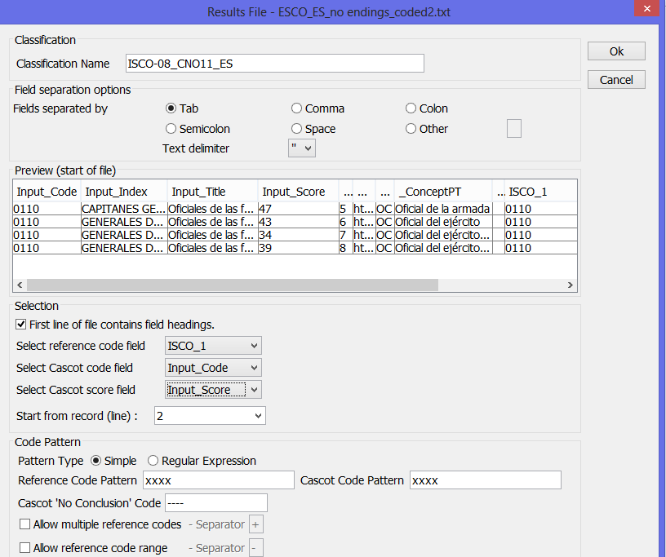
Opening a results file

Slide 31
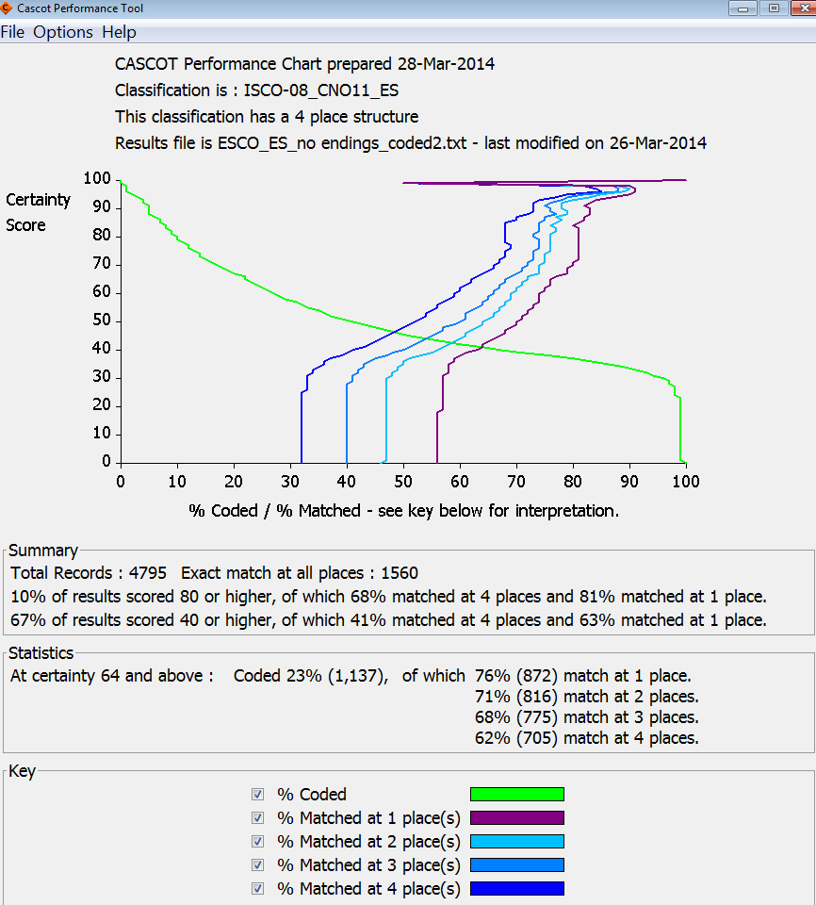
Performance Results Display
The higher up the green line stays the better the performance.
The more to the right the blue and purple lines are the better the performance.
The user can move the mouse along the certainty score line to examine performance at different levels. This can be used to determine e.g. the threshold for semi-automatic coding.

Slide 32
CASCOT International Fine-tuning

Slide 33
Fine-tuning CASCOT International
The versions in different languages could be improved by developing coding rules
Contribution needed from experts who know the language and occupation and coding rules
Rules are developed with CASCOT Editor
Resource-demanding, time-consuming for each language

Slide 34
CASCOT Editor
Users can create and modify classifications for CASCOT
Each classification has
Structure
Index
Rules for coding (optional)
Editor allows fine-tuning of the coding rules to improve CASCOT performance

Slide 35
CASCOT Editor information
A demonstration of CASCOT Editor is available on the web
Shows how to create classification files for CASCOT
Contains an example of creating a classification file for skills
http://www2.warwick.ac.uk/fac/soc/ier/software/cascot/cascot_editor_demo_for_web.pptx
NB the Editor has an extensive Help section

Slide 36
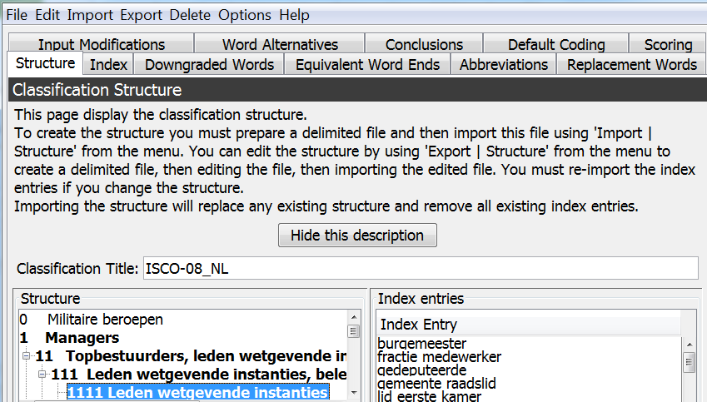
CASCOT Editor Main Screen
Dutch ISCO-08 structure and index have been imported to the Editor.
The remaining tabs are for different coding rules.

Slide 37
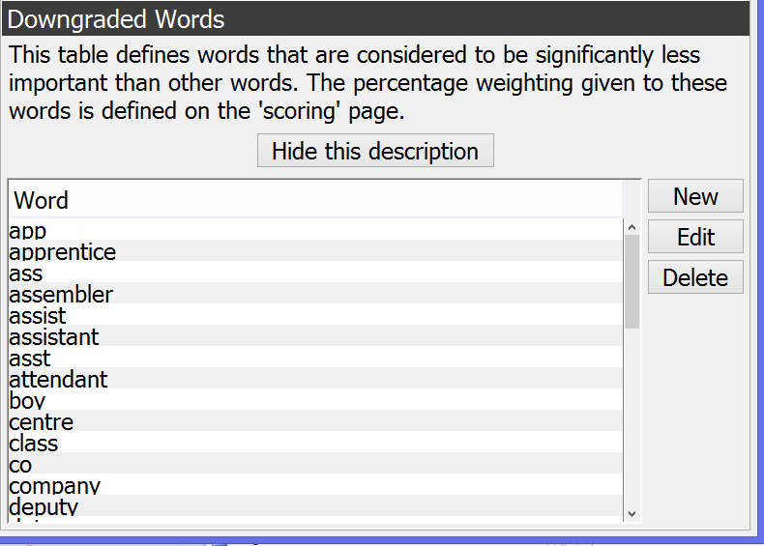
CASCOT Editor Rules – Downgraded words

Slide 38
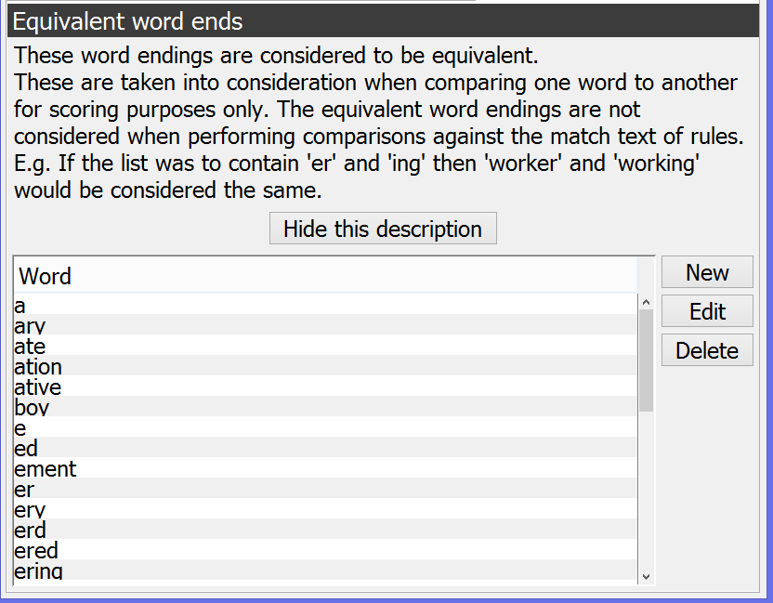
CASCOT Editor Rules – Equivalent word ends

Slide 39
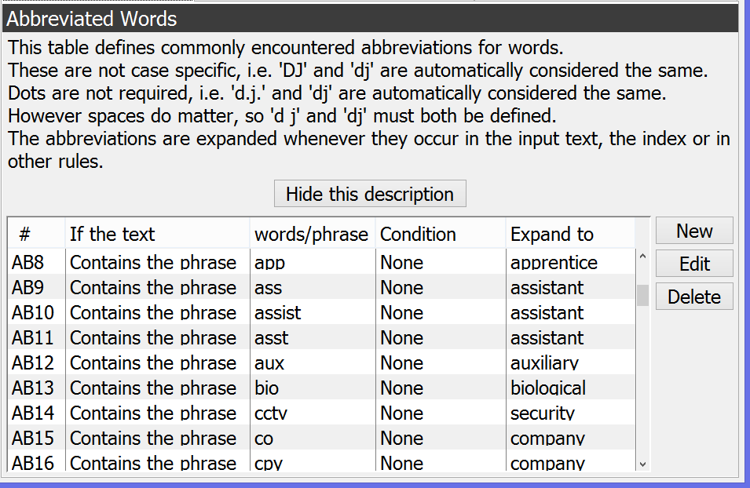
CASCOT Editor Rules – Abbreviations

Slide 40
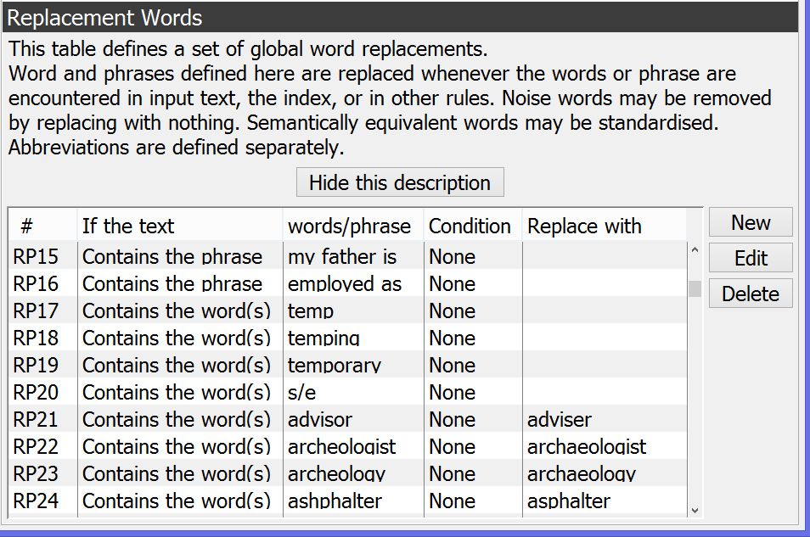
CASCOT Editor Rules – Replacement words

Slide 41
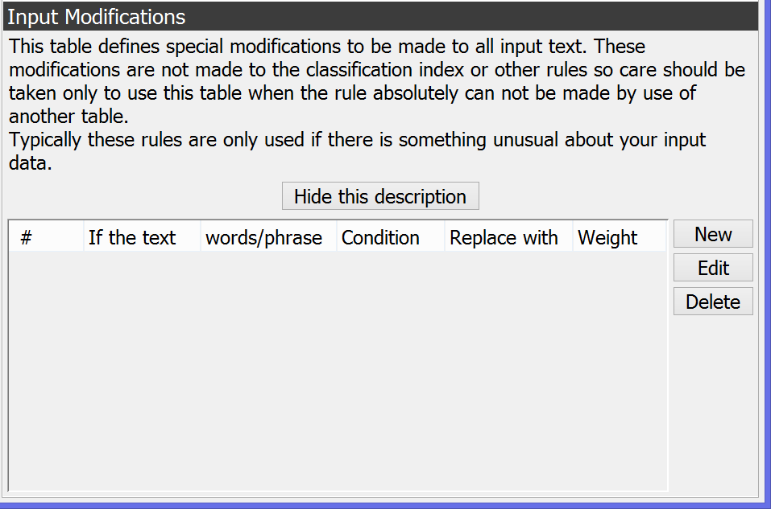
CASCOT Editor Rules – Input modifications

Slide 42
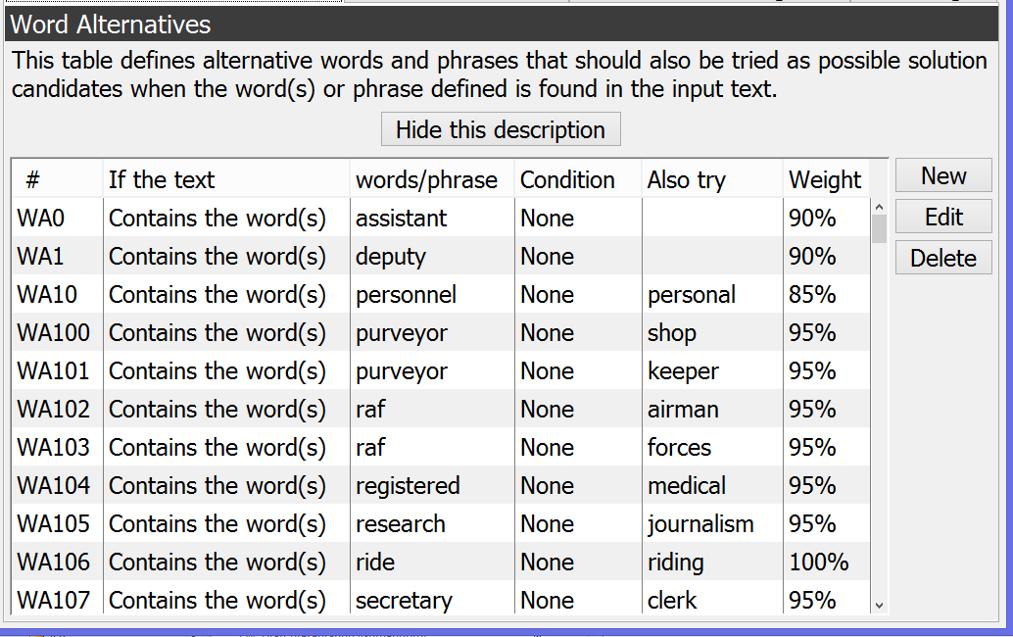
CASCOT Editor Rules – Word alternatives

Slide 43
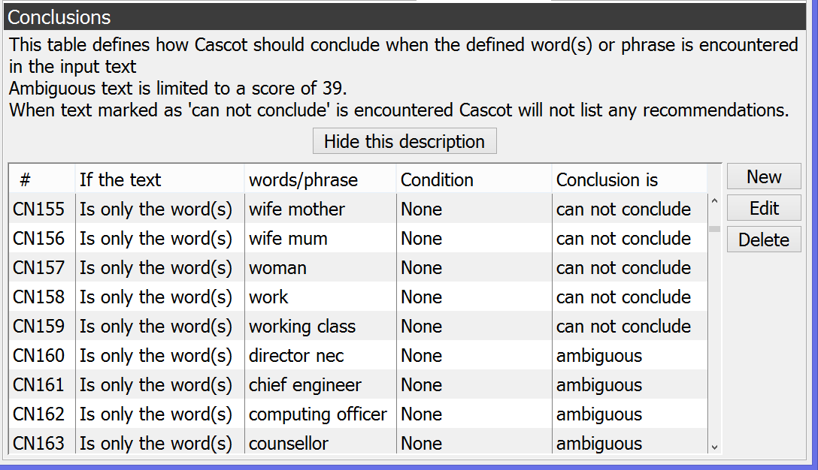
CASCOT Editor Rules – Conclusions

Slide 44
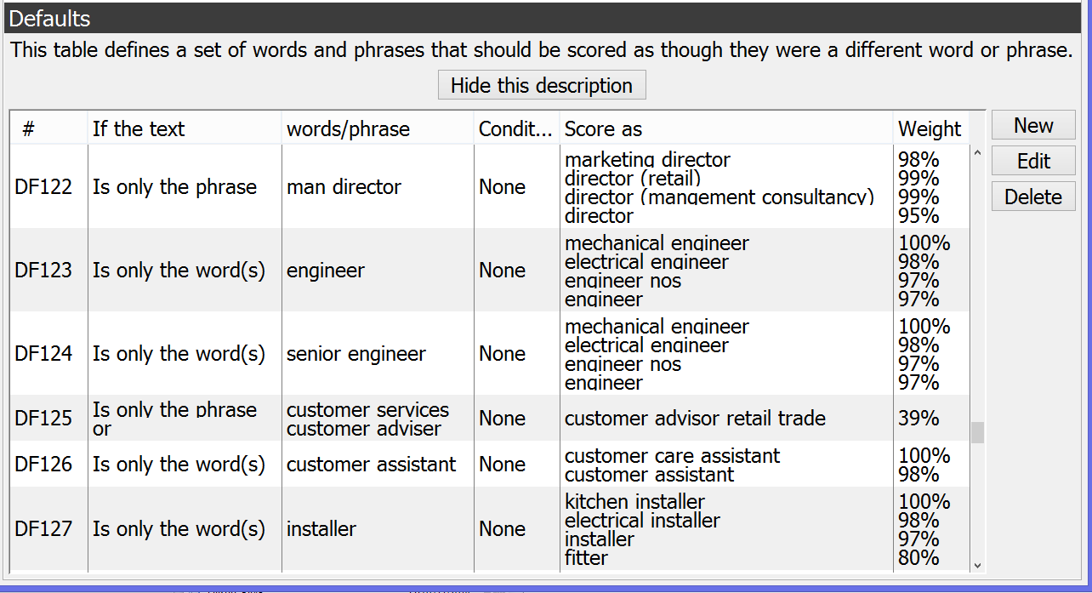
CASCOT Editor Rules – Default coding

Slide 45
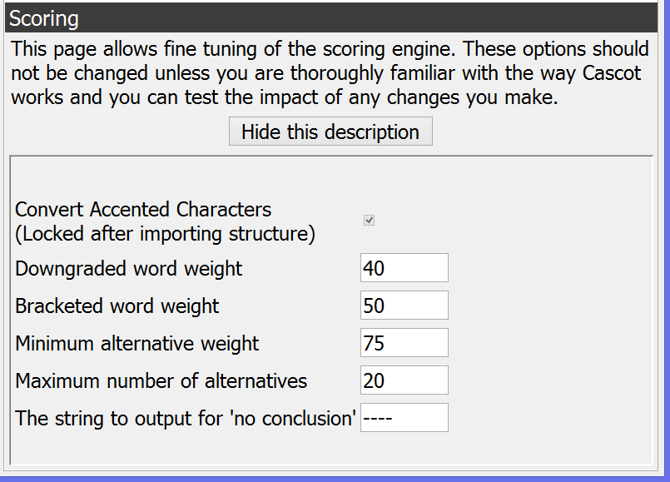
CASCOT Editor Rules – Scoring

Slide 46
Job title data for GB – some examples

Slide 47

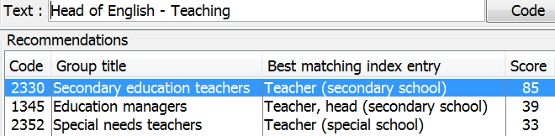
New rules for GB - 1
The problem:
Add a new Default Coding rule to improve performance
The result:
Need to test the effect of the rule thoroughly

Slide 48
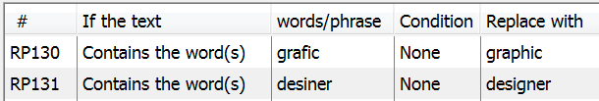
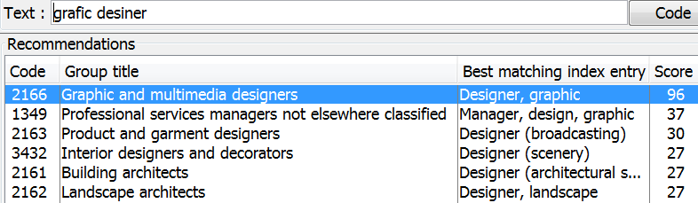
New rules for GB - 2
The problem:
Add two new Replacement Words rules:
The result:

Slide 49
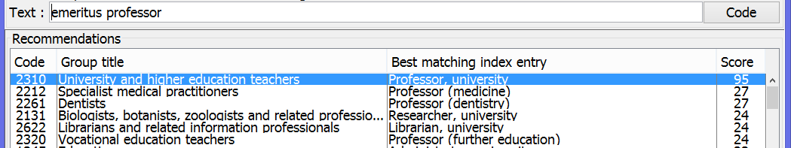
New rules for GB - 3
The problem:
Add a new Word Alternatives rule:
The result:

Slide 50
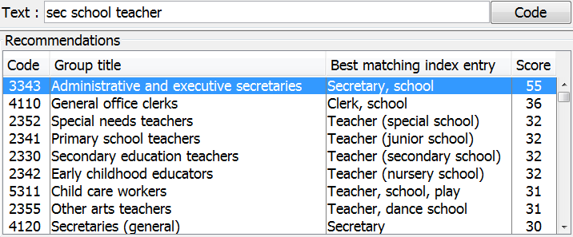
New rules for GB - 4
The problem:
Add a new Abbreviations rule AB72:
The result:

Slide 51
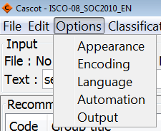
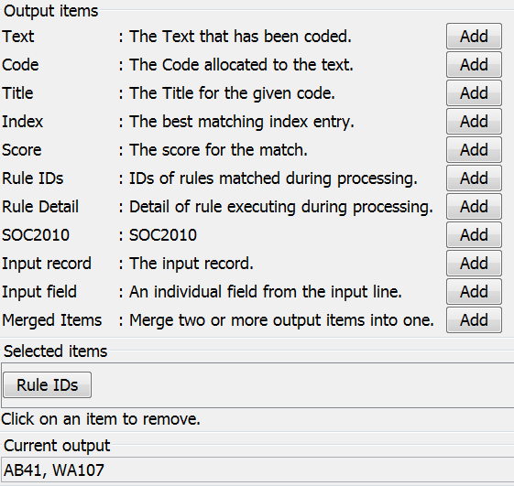
New rule did not work – why?
Check which rules were evoked
→ The rule AB72 was not used at all!

Slide 52


The rules that were actually evoked were:
AB41
As a result the input text ‘sec school teacher’ was expanded into ‘secretary school teacher’.
WA107
As a result also the text ‘clerk school teacher’ was tried.

Slide 53
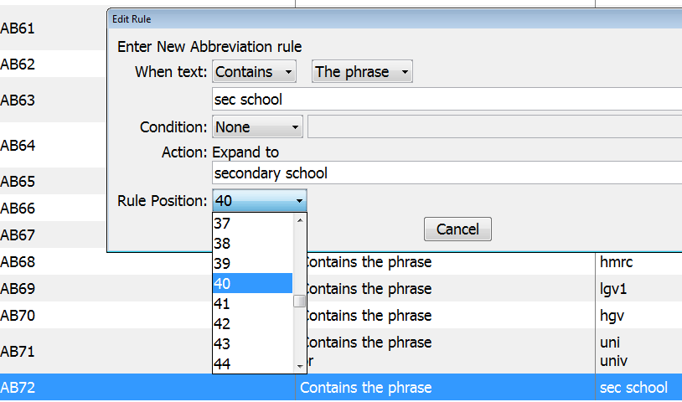
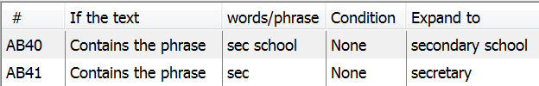
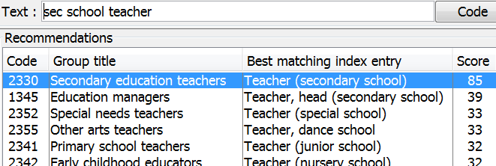
Try again!
Move the new Abbreviations rule so that it precedes the rule for ‘sec’:
The result:

Slide 54
How to create a rule
Open CASCOT and type in the problematic text
Observe the recommendations for the text
Start CASCOT Editor
Open the classification with Editor
Select the rule tab you wish to work on
Add a suitable new rule
Save classification
Start CASCOT
Open the classification that was edited
Type in the text to test the effect of the rule
Need to test the rule more widely e.g. with ‘Gold Standard’ data

Slide 55
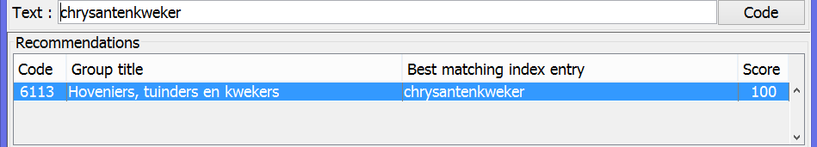
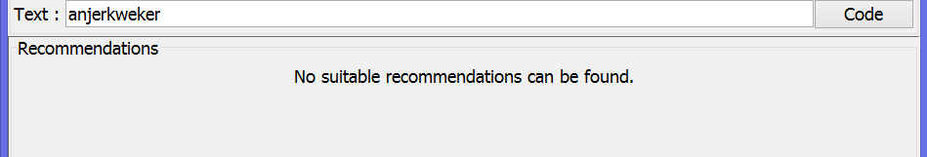
Scope for development
Compound words
Dutch example
‘kweker’ is not recognised:
→ Part-word replacement rule

Slide 56
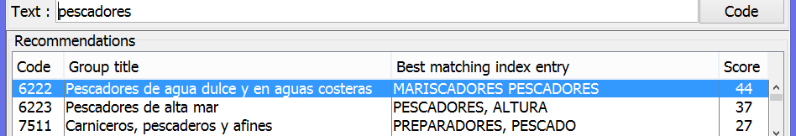
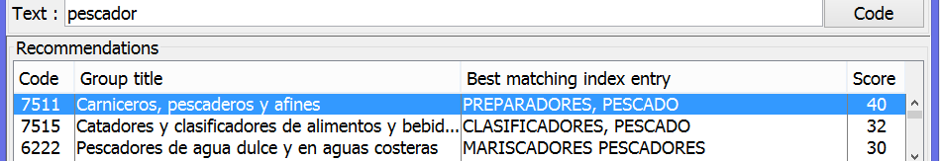
Scope for development
Equivalent word endings
Spanish example
singular form is not recognised:
→ numbering and grouping of Equivalent word endings

Slide 57
Scope for development
Processing (or not) of spaces between words
Difficult issue to resolve
Hyphenation software?

Slide 58
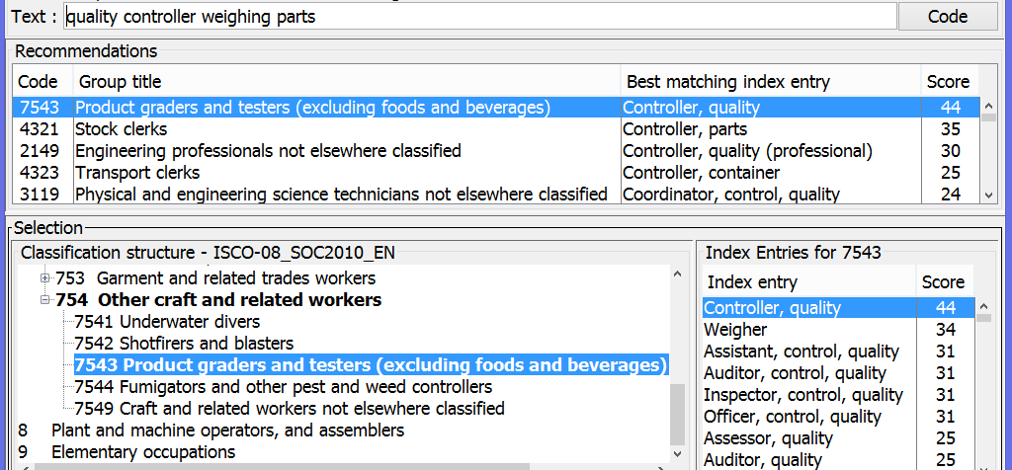
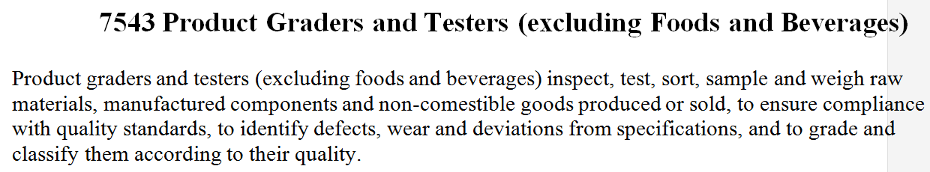
Scope for development
Text descriptions to the structure

Slide 59
How to obtain CASCOT International?
If you are a DASISH project participant please contact the Institute for Employment Research in the first instance
Otherwise complete the Purchase Order Form at http://warwick.ac.uk/cascot/purchase-new/
You will be sent an email with instructions how to download and install the software plus a licence key
The CASCOT International package will comprise of
CASCOT, CASCOT Editor and CASCOT Performance Tool
ISCO-08 classifications in all languages
UK Standard Occupational and Industrial Classifications

Slide 60

Further information
Email: M.E.Birch@warwick.ac.uk Ritva.Ellison@warwick.ac.uk Peter.Elias@warwick.ac.uk
CASCOT
www.warwick.ac.uk/cascot
Institute for Employment Research
University of Warwick
www.warwick.ac.uk/ier

