Slide 1
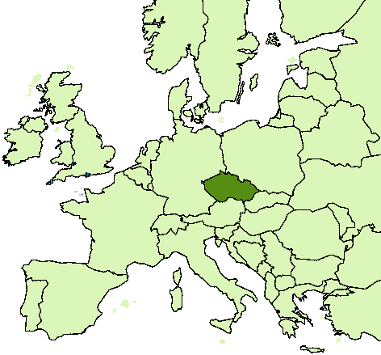
SKILL NEEDS FORECASTING IN THE CZECH REPUBLIC
Hana Zackova
zackova@nvf.cz
National Training Fund
National Observatory for Employment and Training
www.nvf.cz/observatory
www.czechfutureskills.eu

Slide 2
Czech Republic
Area | 78 866 km²
Population (2010) | 10.5 mil.
Employment (2010) | 4 885 thousands
OECD entry | 1996
EU entry | 2004

Slide 3
Small country…GLOBAL ECONOMY
CZECH REPUBLIC:
Fourth most opened EU economy
Export share on GDP around 80 %
Highly dependent on foreign demand
Highly influenced by global economy changes
Arising demographic threats
Problems in quality of education (TIMMS, PISA)
High share of employment in sectors, which are sensitive to cost of labour …
… and in which outsourcing is frequently used.

Slide 4
12 YEARS OF SKILL NEEDS FORECASTING
Skill needs forecasting in the CR started with the new millennium (1999)
First initiatives came mainly from experts and researchers, in particular on the project basis
Most of the projects contracted by the Ministry of Labour and Social Affairs and the Ministry of Education, Youth and Sport
2009 results for general public published on website

Slide 5











What do we have in Czech Republic?
ROA-CERGE MODEL
SECTOR SKILL COUNCILS, SECTOR AGREEMENTS
SECTOR STUDIES, BRANCH LABOUR MARKET (LM) ANALYSES
INFORMATION ON/FOR GRADUATES
Analysis of graduates´ LM success
Surveys on graduates skills
Information for graduates
REGIONAL COMPETITIVENESS ANALYSES AND RELATED LM AND EDUCATION STRATEGIES

Slide 6



Responsibility for forecasting
PLUS:
Employment offices,
Career Guidance Centres
Forecasting
priorities,
labour market
and
education
strategies
PLUS:
Schools, guidance system,
CVET institutions
REGIONAL AUTHORITIES

Slide 7
National Observatory of Employment and Training (NOET)
Analytic and research department of the National Training Fund (not-for-profit NGO)
Established in 1996 from ETF Initiative (analytic and reference point, 2 employees – systematic enhancement of activities)
Team – 11 experts (economy, sociology) – other than forecasting activities but lot in cooperation with other institution and external experts
Forecasting of skill needs
Research on relations between labour market and (continuing) education
National coordination of international partnerships and networks (ReferNet, Regional LM Monitoring)
Analyses of human resources as a factor of competitiveness
Data collection, surveys, ad-hoc analyses, suggestions of system measures
Activities:

Slide 8
NOET FORECASTING APPROACHES
1. Long- and medium-term forecasting
Quantitative model projections
Qualitative sector studies
2. Short term labour market trends
Monitoring of job vacancies
Predictions of unemployment rate and change in total and sector employment
3. Labour market analyses
Competitiveness of the Czech economy – Quality of human resources
Ad-hoc surveys and analyses (quality of graduates etc.)

Slide 9
Quantitative forecasting
Model ROA-CERGE
Developed in ROA (Netherlands) – since 2001 being implemented in CR
Since than methodological improvements
Time horizon: 5 years
Results:
Indicators of future labour market prospects for 27 educational groups
Extension and replacement demand for 27 educational groups and 30 occupational groups
Substitution demand, shift-share analysis

Slide 10
MODEL ROA-CERGE
Macroeconomic projection
Projection of employment by industry (15/42 sectors)
Structure of employment and unemployment by age, education, industry and occupation
Projection of graduates
Institute for information on education
NOET + Ministry of Finance /
LFS – Czech statistical office
FORJOBS
Labour market prospects for occupational and educational groups
NOET+CERGE+RILSA
Ministry of finance
Model ROA-CERGE

Slide 11
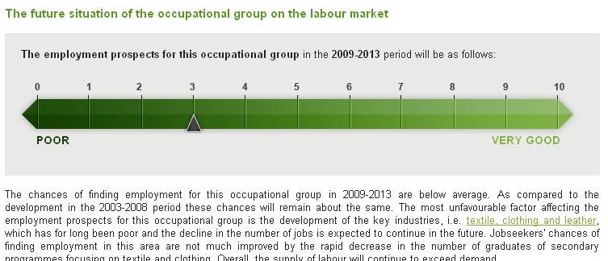
Quantitative forecasting
Notes:
11

Slide 12
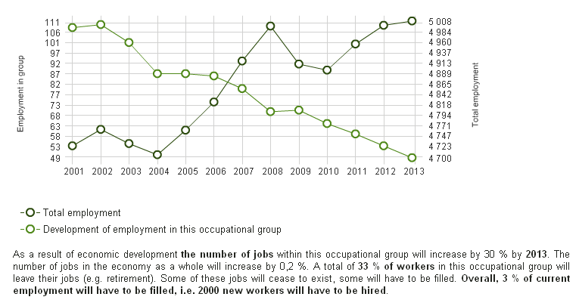
Quantitative forecasting
Notes:
12

Slide 13
Quantitative forecasting
Major advantages:
Decomposition of labour demand on replacement and expansion
components
Includes projected demographic development
Shows the outflow and inflow of workers for specific occupations
Allows to see the employment development in broader view –
declining sector doesn’t always mean lack of job opportunities
Major upgrades so far (2004-2011):
Calculation of substitute demand
Shift-share analysis
Randomisation of the outcomes and Monte Carlo method
Attractiveness of fields of study taken into account
Notes:
13

Slide 14
Quantitative forecasting
Planned upgrades
Short-term:
Increase of the number of sectors included from 15 to 40
Prepare the model for the new industrial classification CZ-NACE
Adjustments in occupational clusters
Calculation of the IFLM indicator for occupational clusters
User-friendly adjustments e.g. graphic menu improvement
Mid/Long-term:
Development of sectoral macroeconomic model (employment)
More robust LFS sample (more detailed data analysis)
Quantitative forecasting at regional level
Better information on foreign labour force – model improvements
Notes:
14

Slide 15
Quantitative forecasting
Limitations of approach
Importance of data quality of surveys – GIGA
Sample size limits the detail of results (breakdown by occupation, regional results)
Use of standard classification systems
Problem of new NACE and ISCO – break in time series
Not always reflect the current labour market reality
Cannot reflect new emerging jobs
Cannot reflect change in job description and skills in specific occupation

Slide 16



Qualitative forecasting
- SECTOR STUDIES
POWER SUPPLY INDUSTRY
Outputs of 3 sector studies with 2020 outlook and detailed analysis of employment and trends:
ELECTRONICS/ELECTROENGINEERING
ICT SERVICES

Slide 17
SECTOR STUDIES
The objective is to provide 5-15 year outlook on possible development in selected sector, including threats and opportunities regarding labour market and skill needs
Base for strategies and policies on national, sectoral and regional level
TOOLS INCLUDE:
In-depth interviews
Surveys (employers, education providers, researchers)
Data mining and analyses
Scenario thinking
Strategic sectoral balance

Slide 18
Steps of a sector study
SECTOR SELECTION:
Based on an analysis of both potentials and threats for the entire Czech economy – we choose promising or declining sectors
(in house) ANALYSIS OF SECTOR PROSPECTS: Strategic balance of factors, influencing sector (not SWOT, it is more sophisticated):
(in house) SUPPLY SIDE ANALYSIS:
ROA-Cerge model outputs, projection of school leavers etc.
(outsourced) QUALITATIVE RESEARCH: Focus Groups, Interviews
(in-house) SYNTHESIS:
Sector scenarios, recommendations, regional specifics

Slide 19
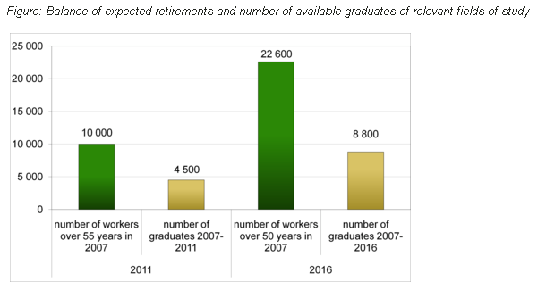
results of a sector study

Slide 20
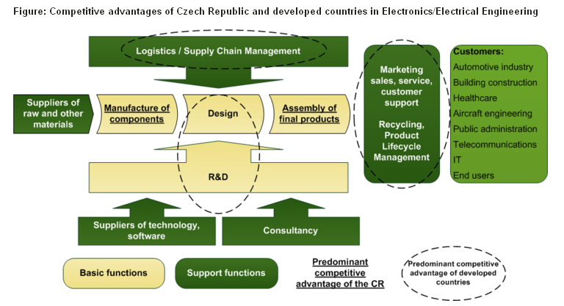
results of a sector study

Slide 21
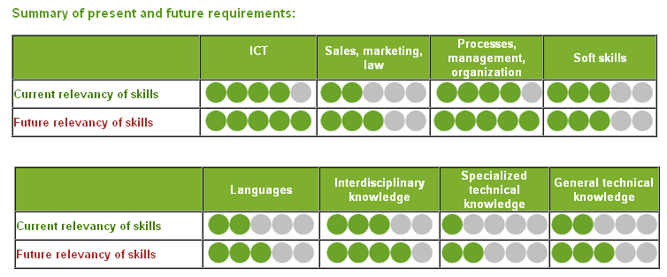
results of a sector study
IS/IT manager

Slide 22
SECTOR STUDIES – tool for
emerging jobs and skills
Qualitative methodology - tool to have an information on emerging skills and jobs
Results:
importance of transversal competencies (e.q. electronics+plastics)
Combination of technical and soft (especially business skills)
Publication – part of the sector study and ad-hoc studies on requests
Users – NQS creators, schools
But emerging skills and jobs not specific topic – included in general approach

Slide 23
Qualitative forecasting
- SECTOR STUDIES
Limitations of approach
Can reveal new things and interesting phenomenons but it is difficult to assess their scope
The trends in one sector have to be corrected by trends in the whole economy
The players in the sector are often too optimistic regarding its prospects – have their interests
The methodology has to be adopted to each sector – difficulties in comparison accross sectors
Use of standard classification usually not suitable – but than hard to combine with external data
Time and resource demanding – important to choose the right sectors (by importance, dynamics etc. – focus on purpose)

Slide 24
Short term trends
In demand for labour
Monitoring of vacancies
Combination of different sources – vacancies from labour offices and from private websites
Model for forecasting changes in employment (total and by sectors)
1 quarter horizon
Input: conjuctural survey of the Czech statistical office and similar German indices
Model for forecasting of unemployment –
Predicts cyclic changes in rate unemployment (6 months) and the rate of unemployment (2 months)
Input – data from labour offices (from vacancies monitoring) and data on economic development in sectors

Slide 25
Short term trends
In demand for labour
Limitations of approach
New methodology – needs to be evaluated
Short trends – the results must be published very quickly otherwise they are past and useless
Inputs partly from private companies – no guaranty of permanency

Slide 26

Involvement in European forecasting activities
Forecasting skill supply and demand in Europe (Cedefop) – NOET as country experts
Developing and piloting an employer survey on skill needs in Europe (Cedefop) – extended group
Transferable skills across economic sectors (DG Employment)
ForJobs (Progress programme)

Slide 27
Use of data I.
International data – Eurostat, OECD, IMD
National statistical and survey data
Labour Force Survey (qurterly – but use of averages) - CZSO
Macroeconomic data (quarterly-yearly) - CZSO
Information system on avearage earnings (quarterly/twice a year) – Trexima / Ministry of Labour
Information on graduates – administrative data – published yearly by Institute for Information on Education

Slide 28
Use of data II.
Data-mining
Job advertising websites
Supply of continuing education
NOET Surveys
Ad-hoc employer surveys (trends in hirings, quality of graduates)
In-depth interviews, expert and focus groups

Slide 29
Quality and reliability checks
Short-term
forecasting
Precise prediction
Mid- and long-term
forecasting
Warning
Reliable
Useful
(Precise)
The best way to predict the future is to create it. Peter Drucker

Slide 30
USERS
Decision makers
(European Commission, Government of the Czech Republic, Ministry of Labour and Social Affairs, Ministry of Education, Regional authorities)
Public employment service
Research institutions
(Cedefop, Czech Academy of Science, Universities)
Professional associations and interest groups
Education providers, career counsellors
General public

Slide 31
Products
Reports, studies – focus on interpretation
Combination of qualitative and quantitative approach and other data and information sources – for example:
Economic data
Labour market data from labour offices
Ad-hoc surveys (quality of graduates etc.)
Scientific articles
News
Not publishing raw data because they are not easy to interpret by non-expert users

Slide 32
PRODUCTS
Decision makers
Analyses of skill needs and skill gaps as a base for policies and priorities
(Czech Energy Strategy 2010, Project for support of science and technical fields of study 2009 ...)
Sector studies
Ad-hoc consultancy on labour market issues
Forecast of labour market balance for major occupational and educational clusters (5 year outlook)
Monitoring of CVET
Public employment service
Forecast of change in total and sectoral employment (short term)
Forecast of unemployment rate (short term)
Analyses and monitoring of job vacancies (ad hoc)

Slide 33
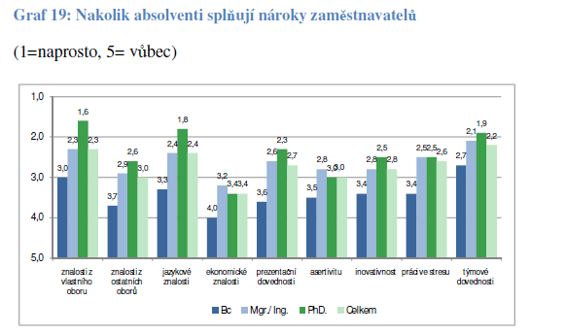
PRODUCTS
Project for support of science and technical fields of study 2009 – for the Ministry of Education – How the graduates fullfill the requierements of employers

Slide 34
PRODUCTS
Research institutions
Analyses (Transferability of skills in the EU, Demand and supply of qualified staff in Czech R&D)
Working papers (3 per year on various topics related to labour market, education system and competitiveness)
Research methodology development and Consulting
Forecast of graduates, surveys among employers
Professional associations and interest groups
Sector analyses
Forecasts of graduates, profiles of educational fields
Consulting

Slide 35
PRODUCTS
Education providers, career counselors
Database of occupations aimed at labour market prospects, attractiveness for graduates and employability (job profile cards)
General public
www.czechfutureskills.eu website
Press articles

Slide 36
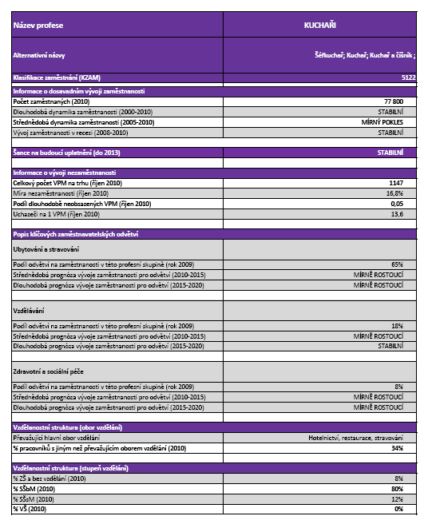
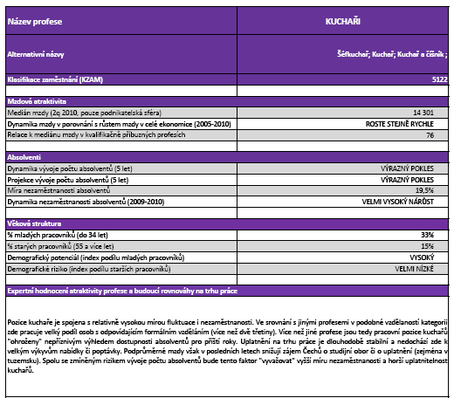
JOB PROFILES
...Example of a job profile card...

Slide 37
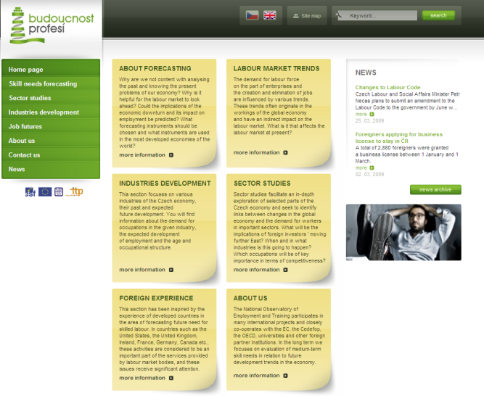
Czech Future Skills! website
Czech Future Skills! on
www.czechfutureskills.eu
Notes:
37

Slide 38
Future of future…
Future trends and aims of forecasting activities in the CR:
Setting of system – so far project-based
Regional forecasting
New sector studies
Focus on data-mining methods and their use

Slide 39
THANK YOU FOR YOUR ATTENTION!
Hana Zackova
zackova@nvf.cz
National Training Fund
National Observatory for Employment and Training
www.nvf.cz/observatory
www.czechfutureskills.eu

