Slide 1

Assessing the impact of unpaid work, work experience - and paid and unpaid internships - on Early Graduate Careers
British Sociological Association Annual Conference 2016
Global Societies, Fragmenting and Connecting
Kate Purcell
Institute for Employment Research
Charikleia Tzanakou
Department of Politics and International Studies
University of Warwick
Aston University, Birmingham,
Wednesday 6 - Friday 8 April 2016
Notes:
Health warning: This is very much work in progress. Interviews are ongoing, we are really only beginning to code up transcripts, I have changed the title from the one submitted for this presentation to have a somewhat narrower focus, focused but not restricted to work experience arrangements that were explicitly defined as internships.

Slide 2
Research questions in relation to internships, work experience and unpaid work
Conceptual issue – What ARE internships and where do they fit in the ‘pursuit of employability skills’ spectrum?
Statistical issue – there are no statistics!
Lack of reliable data – How extensive is incidence? Who does what? For how long? Where and when? Paid or unpaid? What counts?
Ethical issues – When are internships/unpaid work/work experience placements a good thing or a bad thing? What are the costs and benefits to individuals, employers and society?
Notes:
Next – what exactly constitutes an internship? (Or maybe this will already have been thoroughly defined by previous speakers, I hope!).

Slide 3
Definitions: the theory and the practice
Wikipedia: Internships for professional careers are similar in some ways to apprenticeships for trade and vocational jobs but lack of standardisation and oversight leaves the term open to broad interpretation – interns may be college or university students, high school students, or post-graduate adults. These positions may be paid or unpaid and are usually temporary…….Generally, an internship consists of an exchange of services for experience between the student and an organization.
The realities (as indicated by research findings so far…):
structured/unstructured, formal/informal, anything between one week and up to twelve months, paid, ‘facilitated’ and unpaid, sometimes involving training and development, often constituting cheap labour, ranging from wonderful opportunities to exploitation.
Offered by employers planning to recruit, as an alternative to recruiting, and as ethical professional practice/future skills investment.
Notes:
…it will be interesting to get insights on employers’ perspective on internships and work experience placements Paths2Work sub-project 4 interviews with employers..

Slide 4
Methodology
Mixed methods, drawing on two projects:
Futuretrack - national longitudinal survey for those applied in 2005/06 in FT UG programmes – 4 waves
Using wave 4 data :18-30 months after graduation provided the pool of graduates for the Paths2Work
UK domicile:14,994 graduates
Paths2Work project (ESRC) – precarious pathways of young people in the Midlands
focus on UK domiciled graduates based in the Midlands (applied to HE, studied or worked)
82 semi-structured interviews so far…
Notes:
First, a few insights from Futuretrack (where we collected an enormous among of valuable data but didn’t always ask the right questions…).

Slide 5
Which students worked to gain career-related experience?
Sandwich placements: Engineers, Business and Admin, Languages, Creative Arts and design; Medium and High Tariff HEIs and Specialist HEIs
Shorter structured placements as part of course: Medics and allied, Education, Mass Communication, Social Studies, not Highest or high-tariff unis
Paid work to gain career-related experience: Engineers, Business and Admin, Languages, Creative Art and design; Specialist HEI, Highest tariff HEI
A vacation internship with an employer: Engineering, Law, Social Studies, Specialist HEI
Unpaid work to gain career-related experience: Law, Creative Art and design, Mass Communication, Linguistics and Classics, Education: Specialist HEI and Highest Tariff HEI.
In unpaid internship after graduation: Architecture, Law
Notes:
Focus is on subject studied and type of HEI attended, both of which had significant impact

Slide 6
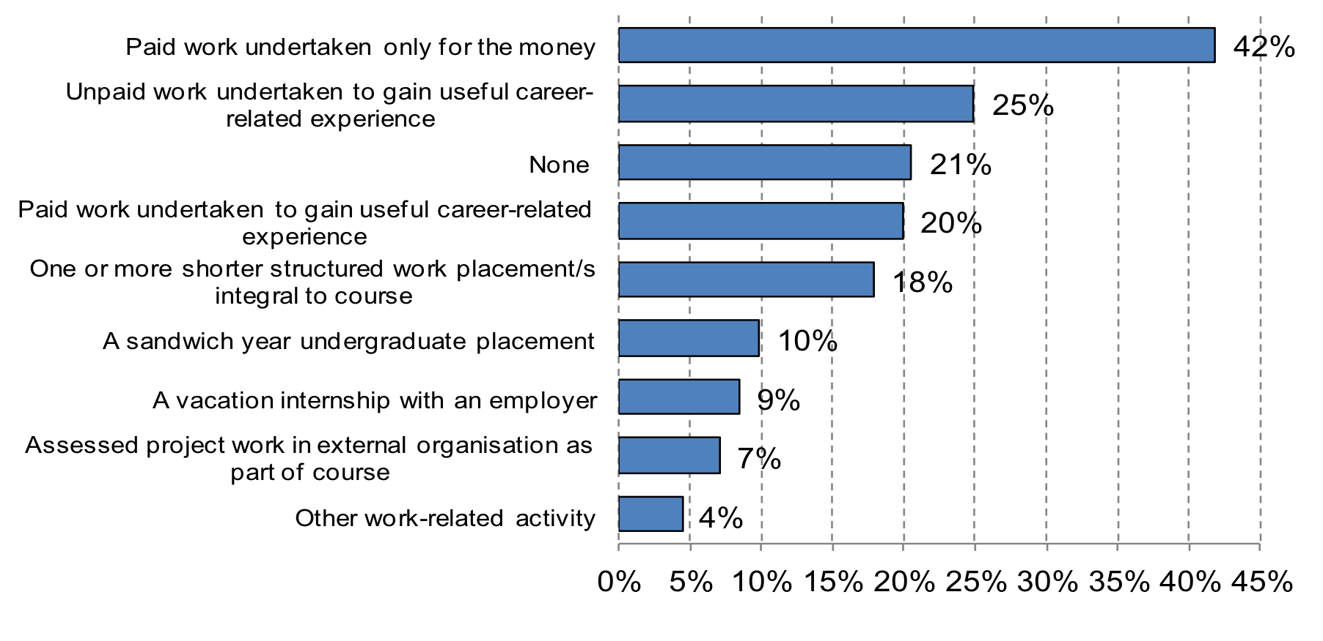
Students’ reasons for undertaking work experience during their courses
Source: Futuretrack Stage 4, all UK domiciled graduates (weighted) who have an undergraduate degree and are no longer in full time study only.
Notes:
Analysis indicated that socio-economic background was strongly related to whether students did paid work, unpaid work or voluntary work – and whether they worked for career-related reasons or simply to earn. The following slide shows SES relate to unpaid work as students.

Slide 7
Incidence of unwaged work by socio-economic background
Notes:
Self-explanatory, really!

Slide 8
Applied or intend to apply for internships by broad socio-economic background
Notes:
Ditto…but now I will move on to the qualitative work undertaken for Paths2Work…

Slide 9
How did the students access internships..?
Via university or department connections (including Careers Advisory Services)
Some (e.g. summer placements) had been competitively advertised by organisations.
Proactively, by approaching potential organisations and asking to be taken on.
By accessing mentors or via networks through whom informal arrangements could be made
Often, by drawing on more than one of these approaches.
POINTS THAT EMERGE:
Informal networks are VERY important, proactivity and persistence are VERY important, HAVING FINANCIAL SUPPORT THAT FACILITATES UNPAID WORKING IS ESSENTIAL IN MANY SECTORS…and some HEIs have better links with potential providers of both paid and unpaid opportunities than others.
Notes:
Now going to provide some examples to illustrate these points...

Slide 10
Which students access good work experience opportunities? (The crucial influence of cultural capital…)
‘Somebody gave me advice on when I was younger, was the key to getting out of university wasn’t just getting the degree, it was, you know, getting the experience. I made sure that I did, I did get experience, and I did a couple - I guess the prominent ones that were done were during the summer, while I was doing my degree. The first one was ..a week’s, a week long internship, it was unpaid… I went to London for a week and stayed at Imperial College London and it was sponsored and organised and managed by [a group of] five large solicitors and barristers in London and it was designed for undergraduates who are considering law as a degree and a career. So I spent a week there, you know, working with the various companies and learning how to debate and how law works and the life of a solicitor in the City, so that was one of them. It was completely unpaid but it was was competitively selective, I think it was only 200 people out of the country that were selected to do that for the one week, and so that was the first one….
….The second one was with [an international car hire firm]..
Male, Management with marketing
Notes:
‘.. So I obtained a summer kind of internship, paid, with them over the summer timeand I worked for them full-time throughout the summer. Following that I actually then got a part-time job with them at the weekend and subsequently worked for them throughout most of the holidays during university. I was due to actually start on their graduate getting better offer].

Slide 11
At one extreme…
“The honest answer is I wrote them a letter - an email - and they ignored me, so then my dad happened to be at a conference where one of the members of the board was speaking, he went up to him and complained that they’d ignored my email… and so the guy, the member of the board, sent – well, he asked for the email to be sent again to him, and then he forwarded it on in the organisation and then someone said “Okay I’ve got something this guy can do”.
Male, managerial, professional social background, both parents graduates, independent school, A/B grades maths and other subjects, international relations and Russian at highest tariff university.
Now Marketing officer, international global media start-up company
Notes:
This respondent was very proactive and this was the first of a series of work experiences. ‘The very first internship that I did was a [two month]n unpaid internship…got my travel, travel costs reimbursed And based on that internship plus also the fact that I’d been working er, well I’d been president of [ a very relevant student society] and done a lot of work there, I was able to get another unpaid internship, at [a development programme in the country where he did his sandwich year]. That was also unpaid, that was entirely unpaid, there was no sort of travel costs or anything covered there, and I did that for basically six months, but it was part-time, part of the time I was studying [the language], part of the time I was working there and part of the time I was teaching English, to earn money basically, to cover my costs;,those two. So and then when I got back to the UK, the organisation where I’d done my first internship,[the Third Sector Research and Policy Organisation] gave me part-time employment, so and it was all worthwhile and both those internships together were sort of both very useful learning experiences that I’m sure helped my employability’. NB Time and again, we get this cumulative stories..

Slide 12
And at the other…..
“Whilst I was at [university] I became increasingly aware that someone from my background doesn’t have as many opportunities, even when you get into a Russell Group university, as someone from a rich family, because the kind of internships that get you into the big business, they were unpaid, a lot of them… and there was no way I could ever consider doing so I couldn’t find any private sector internships that I could apply for because I couldn’t afford them. […] I’d like to have tried something in advertising and something in publishing just, you know, ‘cause that’s sort of the main areas that an English degree can lead to.”
Female, working class, neither parent has degree, state school, A/B grades/no maths, good degree.
Now Secondary school teacher in state comprehensive school.
Notes:
Not a dissatisfied graduate – she clearly enjoys her job and is good at it – but choices were restricted.

Slide 13
And an interesting combination of a post-graduation experience
[Had hard time getting job and eventually took a non-grad job because she needed to earn]’ ..I was extremely unhappy the whole time I was there because it was minimum wage, I couldn’t live away from home, I had a very difficult boss, the job was not particularly engaging or challenging, and again I wanted to go back to working within archaeology or a related sector, so at that point I was ..very unhappy….and through my mum’s connections [she worked in the Heritage industry] - the head of [a] museum, actually, offered me [an ] unpaid internship and by that point I had saved up some money so I said anything is better than my current job [so did that for three months] but obviously when that savings ran out, I had to come back home and I couldn’t afford to stay in [another city] doing that internship any longer…[Influence of mother] I have asked her, you know, when I was particularly looking for jobs, to talk to people and see if there was anything.. but she’s not the kind of person who would, you know, strong-arm people into helping me, for example, you know, she’d very much want it to be you know, on my own terms..’
Female, Archaeology
Notes:
She went on to get an admin job in a Marketing consultancy and had now been able to transfer within that organisation to a graduate marketing role, from which she hopes to build her career to be able to move at some stage to a marketing role in the Heritage sector – in which she maintains some voluntary work activity.

Slide 14
Sandwich courses and the cumulative impact of advantage
‘As part of the yearlong internship I was in touch with the graduate and intern recruiters, and he said “Yeah..have you thought about doing a summer internship as well?” and I thought “Okay, I’ll give that a try!” Didn’t particularly have to go through the full assessment, the full application process - um, it was more a few informal chats over coffee before I was offered it’.
Male, [Chris]
‘Basically, companies would come in [to the university] so I spoke to one or two companies that came and got a job to go abroad for [a leading agriculture services company]’. [ He considered that it was well paid - enough to cover costs] ‘and also to go travelling…[inter-railing at weekends] I saw a lot of Europe!’ .He learned new technical skills: ‘It was all basically web development but I also developed something that, to go forward with that they, a new way of configuring the systems, there was a fair bit of client interaction as well and supporting existing products that we had out for clients’.
Male {Adam W]
Notes:
NB Added value of overseas placements. [Most useful aspect of experience?] ‘It would have been the client interaction more than anything… it’s also just generally getting used to the type of working environment that I have every day today I suppose, you know, it’s the way to interact with colleagues, I think the fact that I went abroad was one of the bigger things I think you know, living in a foreign country, learning another language and trying to, I didn’t have to speak another language in the actual company, that was English based, but just generally I think, I learned a lot more by putting myself out there as much as I did for the job that I did, if that makes sense’.

Slide 15
‘I’ve actually had three different internships that were all unpaid or expenses only, over the course of being a student. When I was in sixth form, I had a family friend that had an advertising firm in the Midlands, so I just went and did a couple of weeks with them just kind of learning how to write advertising briefs and finding out about the industry…
[My current organisation] was one I particularly wanted to work at, so I went to them directly. I was actually travelling in Australia at the time and knew when I was coming back, so I emailed them and said I’d be willing to come in, just do some non-paid work experience when I got back and would they be interested in having me? I just emailed them my CV, a kind of bit about my background and why I was interested in advertising and what I was offering, so I could come in, I was happy to do anything for that two-week work experience period…and they got back to me and said “Yes. Would you be available on these dates? We could use the help on one of our projects.” A couple of days before I finished my placement, the team that I was working within just said “Do you want to stay for longer? We’ve got a position that we’d like to offer you..” which was a content authoring position - so just putting information on a website and they said “Yeah, did I wanna carry on and come back the following week, as an employee?”
Male, degree in Psychology, currently Account Manager in large advertising company
Notes:
“…So after that, in 2009, I had another friend who had contacts in an advertising firm that was based in London, so I offered to go down again for another two weeks. It was completely unpaid, there were no expenses or anything [but] I [wanted to work there], because some of the clients that they had, and find out a bit about their agency, so I went down to London. Thankfully I had a friend who had an apartment there so I stayed with them [sic]. And that was entirely self-funded to go down there, do my own travel and things and work on some of the work they were doing down there”.
[Interviewer:” When you say self-funded, your parents presumably helped you with this, did they?”
[Respondent] ‘Yes, so they helped me with some of the expenses and some of it I paid for myself…[..].. so later in 2009 I went and worked in a PR agency in London for a month and that actually came through [my] University. They sent an email round to say this PR firm would be looking for any graduates that would be willing to go to London for a month and work with them, almost a graduate scheme, but there was no guarantee of a job at the end of it or anything like that. So I applied for that, sent my CV, said why I would be interested in it, and ended up getting that position, so again went down to London for a month and worked for this PR firm down there’.

Slide 16
[Sandwich year placement] ‘was made available by the university and basically companies would come in [to the university] so I spoke to one or two companies that came and got a job to go abroad for [a leading agriculture services company]’. He considered that it was well paid [enough to cover costs and also to go travelling]…’.
Male, Mathematical and Computing Sciences
[2 six-month placements, one in Germany and one in the USA – one with a firm that made printed fabrics and one where it was possible to develop woven textiles skills and knowledge – both gained via comp,ex selection processes and interview programmes held at the unversity. Textles graduate, now working in the States for second of these.
‘…so the summer before my final year I was in [a major British-owned multinational], for their summer internship
[Interviewer - That would have been a paid one, wasn’t it?]
Respondent ‘Yeah, that was paid, yeah, yeah, it’s oil industry, they’ve got loads of money -, and then because I did quite well at a careers event I got in on a summer internship after my final year in [another leading Energy company]. [The first company] offered me to come like, offered me another summer internship after my final year, but I’d already organised [the second one], that was paid as well’.
Female, Geology, who had also done work experience prior to HE
Notes:
Two examples of non-exploitative internship, where both parties gained – reflecting skills and knowledge in demand in sectors where the organisations could afford to fund the interns appropriately. Almost certainly related to longer—term recruitment plans (as the second one shows).

Slide 17
Work experience helps to clarify career aspirations
‘..It galvanised the fact that I definitely wanted to work in creative and radio advertising, that was a huge thing. What I definitely didn’t want to do , effectively, was to be come a commercial radio producer. Being able to see the day-to-day workings of it – it’s fun to get involved in making an advert and getting the sound of it perfect, but actually seeing [how they worked] how flexible they have to be in terms of taking direction from people who don’t necessarily know best..I think it helped me I realise I want to be a writer…to be more innovative..[not] stifled by brand..’
Female, Media and Communications
‘that was conserving artefacts and recording and, you know, things like that, whereas that experience taught me that I want to be more involved with people,…I’m not the kind of person that wants to conserve artefacts or things like that, I’m more a person who wants to work with people and do interesting things, maybe some sort of training or teaching. [….] I did acquire skills in how to conserve objects, how to clean objects in a professional way, that I wouldn’t have done otherwise. I didn’t hate it, you know, I thought it was still interesting, and I think it was a valuable skill to have had, and I appreciated that I was given the opportunity to do it but I realised that although I enjoyed it, it wasn’t something that I wanted to do long-term’.
Female, Archaeology
Notes:
Self-explanatory

Slide 18
‘With pharmacy, we can go down a number of different routes, so say community, hospital and there’s also industry and academic pharmacy and after the four years of the pharmacy course we’ve got an internship year - so to try and get myself more sellable for that internship year I did a number of placements during the different summers…[ ] The first one I did was at a local independent community pharmacy near where I lived …first of all I did a week, I think it was a week or two weeks unpaid work experience there, and then because I really liked it and they liked me, that enabled me to get holiday work there when I went back home for Christmas and the summer..[ ] and then from there, I then looked into going into the hospital field so I did, I think, I’m just trying to think; yeah, my first hospital placement was at [a local hospital] and that was unpaid, but then that allowed me to do in my second year summer vacation to get a paid placement at [a different regional hospital]. That then led me to my third year, in which I did another free, another unpaid internship year [in a different county hospital] and then I also then did some industrial pharmaceutical company internship year:three, four, sorry - ten week placement in my second and third year summers, so I had quite busy summers.. [...]because I knew the pre-reg year would be a competitive year to get a pre-reg place and if I wanted to get one of the more competitive places, I needed to have the experience of different avenues to get that place. . So my internship year was a split industry and hospital programme and when I was applying for my internship year there were only eight industrial split pre-regs - and what enabled me to get that was doing the summer placement in industry but also the hospital experience I had in each year’.
Male, Pharmacy degree, now doing PhD
Notes:
This is an example of a very well-organised an ambitious young man who approached career-planning very systematically – and clearly had family support that enabled him to take advantage of opportunities. He is now a PhD student ‘So I did a PhD because through my undergraduate degree I became more and more aware of the interest in the pharmaceutical science, so the modules, and I also did my final year dissertation in a pharmaceutics based area, and then when I was doing my internship year in industry I knew this was the area I wanted to go into after qualifying, so I asked colleagues and my mentor what’s the best way to pursue a career in industry and they said a PhD ..[allows you to avoid]is kind of a, not a must but it allows you to go [beyond] glass ceiling so to say, you wouldn’t be able to work up past a certain level and also I realised that I was young, didn’t have any responsibilities or financial worries, I enjoyed the science aspect and gaining that knowledge and becoming an independent scientist …’
.. Also from [International Pharma Company], they gave me the opportunity to interact with international colleagues by, in the European sites by teleconferences and email, by projects I was working on and I think that’s got, that’s how I got a bit of an international flavour was that working which had, and also I was able to go to a couple of their sites to talk to other colleagues about how they got to their positions and things like that..[NB grooming for international careeer].

Slide 19
‘The [leading independent Think Tank], it gave me useful experience firstly because it allowed me to just see a bit more about how a think tank works and I was able to see how they work and, you know, how the research is designed, etc, - not so much from the actual work I was doing, but from the fact that I was sitting in the offices and I could watch what was happening and listen to what was happening and ask questions, and obviously it gave me useful experience and, in the understanding of that specific organisation which then gave me a good argument for taking on the part-time work with them…..’ [he got a second paid part-time internship]…
Interviewer: Okay, and the second internship which was sort of almost indistinguishable from a job…?’
Interviewee: ‘All the skills I learnt there, all the skills I learnt there were sort of relevant job skills, …from communicating with clients through researching profits, through to writing presentations, and writing memos and understanding specific issues, and I mean all the skills that I learnt there were relevant job skills: none of them were qualifying me to make coffee..’
Male, International Relations with Language

Slide 20
Extremes of work experience
[She wrote to a local solicitor’s firm, offering to work for experience] ‘The woman was a sole practitioner, she got in touch and said she didn’t have any full-time vacancies, she could offer me a placement for a few months….
Interviewer “ What did you actually do, on an average day..?
‘So mainly it was drafting letters that she was sending out to clients, answering phone calls, arranging post, photocopying, those sort of general sort of admin related tasks. So I was living at home at the time .. - I mean the only cost really in living were running my car, other than that I was living at home so there was no rent or anything like that...’ [So she applied to do work a voluntary advice unit]’… one of the lead volunteers …allowed me to sit in on one of his interviews with a client and then he said, “Would you be happy to do, happy to do the work we’re doing?” and I said “yes”, and then it just kicked off from there, really, and so I was doing that for a year and a half. It was quite hands on, so pretty much from, I think the first two weeks I was just sitting in with him with his clients, and then in the third week I had my own clients and I was on the rota for advice and then sometimes a client would come in …….. sometimes it would be an actual employment tribunal case, which you’d take on and do all the preparation leading up to the trial and then appear at the trial itself’.
Female, Law
Notes:
Classic Law story – where unpaid work is absolutely essential prerequisite to getting into the profession. In fact, this young woman managed to get a paralegal post as a result of these experiences and, having proved herself in that firm, is now on a proper training contract to enable her to transfer to full professional status as a solicitor. She comes from a (middle class) minority ethnic backgound, which probably explains why she did no wok experience as a student, but is likely to also have made her attractive to employers interested in increasing employment diversity.

Slide 21
Why do employers provide internships?
‘I think because it helps them with some of the kind of admin things, if it’s not worth a permanent position and if they’ve got a project at the time, or it’s a particularly busy period, it’s useful for them to have someone; and there’s almost [sic] the element of giving back to the community - you’re helping graduates get that experience - and then if it works out particularly well they find someone that they’ve seen for a month, they’ve had sight of what they can do, and then maybe offer then a position at the end’.
Interviewer: ‘So in terms of your current job, -well your previous job that led into this one - do you think ]the company] were thinking of it as a careful recruitment - a sort of “test and try”’?
Respondent: ‘I think, I think there was always the potential for that, so the account that I came and worked on was different from the one they ended up hiring me for, but it was using exactly the same skills - so I think they probably at the time were going out to recruiters and hiring people, and actually the fact that I’d come in means that they don’t have to go out to a recruiter, do an interview, pay the recruiter, they can kind of see that yes, I was there for two weeks, I could do the job…’.
Male, Advertising…’
Notes:
Self-explanatory. Next example a view from the inside, once grad had got job…

Slide 22
‘…over the summer I had an intern working with me, a graduate intern and this, because I’ve been begging for months and months to have an administrator because I can’t do everything that I need to do, and in the end my manager sort of agreed to have a graduate intern [fixed up through a scheme run by one of the local universities]. It was a good experience for her – she got some experience in the sector, the kind of sector that she wanted to be working in; well, sort of business development side of things anyway; and she walked straight out of the internship into a permanent full-time job for which, I think, the experience we gave her did really help. But ultimately it was a cheap way of getting an administrator for the summer, from our business’ point of view……that was the reason behind it really. I suppose, realistically there are companies and organisations that genuinely want to give people experience but perhaps can’t pay them as much as other staff to do it, especially in the current economic climate, but I do think there’s an element of companies using it as an opportunity for cheap labour as well’.
Female , Biological Sciences, now working as Marketing Manager for an Charity
Notes:
But it worked for the graduate too, and it is clear that this kind of opportunity does strengthen CVs, as the next slide shows, interestingly in terms of what may work better than other options…

Slide 23
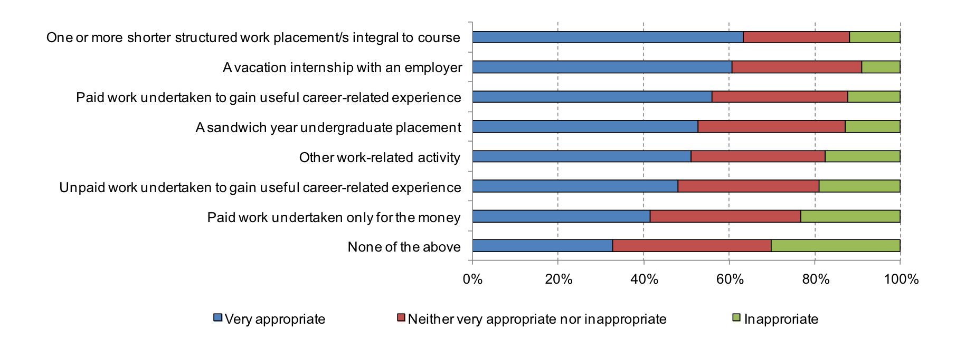
Extent to which graduates believed that their current job was appropriate for someone with their skills and qualifications
Source: Futuretrack Stage 4, all UK domiciled graduates in employment (weighted).
Notes:
Just flashing this up to show that it is the structured, paid work experience that seems to pay greatest dividends, going on the subjective assessment of the respondents. We know that those with paid work experiences are also more likely to be in graduate jobs and will also look at other indicators of ‘good job for the paper, including earnings and satisfaction with career to date

Slide 24
Emerging findings….
Contacts and networks were almost always essential to get either paid or unpaid work experience.
Subject studied and HEI attended facilitated or restricted access to opportunities (c.f. Private sector internships clustered in a few industries ).
Proactivity on the part of students and graduates themselves was nearly always essential; but proactivity was related to cultural capital, etc.
Paid internships and placements were mainly highly selective and fiercely competed for….but informal contacts could over-ride formal access protocols
Access was often cumulative…one opportunity led to another, often better opportunity.
Grads who had had experience of paid and structured work experience placements were universally enthusiastic about the advantage they had provided at the time and in terms of career development – reports on unpaid work experience more diverse.
Many excellent internships provided by charities and third sector organisations – but less likely to be paid, so disciminatory..

Slide 25


For further information about the projects, see:
http://www.warwick.ac.uk/futuretrack
http://www.warwick.ac.uk/paths2work
Or contact:
Kate.Purcell@warwick.ac.uk
Tzanakou@warwick.ac.uk

