Slide 1
Career Development
Campbell International
Human Resource Consultants
www.campbellinternational.net

Slide 2
Career Development
Kenneth Buchholtz
Bachelor Personnel Management Netherlands
Master Business Studies HRM – UL
Chartered Fellow CIPD
More than 29 years experience
17 years experience in HR in Ireland
12 years experience in HR in the Netherlands – Belgium and Germany

Slide 3
Career Development
Career Development Work from the Perspective of the HR Professional Working with Mature Career Changers

Slide 4
Career Development
In the modern business environment change is constant
Companies do not guarantee life long employment
Employees have to improve their own employability which means developing their skill set to secure future employment
An important skill is the art of finding a new positions and careers in the job market

Slide 5
Career Development
Three things are important in career development: -
Human Capital
Psychological Capital
Social Capital

Slide 6
Career Development
Human capital is the stock of competences, knowledge and personality attributes embodied in the ability to perform labour so as to produce economic values.
It is the attributes gained by a worker through education and or experience.

Slide 7
Career Development
Psychological Capital has been defined as an individual’s positive psychological state of development and is characterized by (1) having confidence (self- efficacy) to take on and put in the necessary effort to succeed at challenging tasks; (2) making a positive attribution (optimism) about succeeding now and in the future; (3) persevering toward goals and, when necessary, redirecting paths to goals (hope) in order to succeed; and (4) when beset by problems and adversity, sustaining and bouncing back and even beyond (resilience) to attain success.

Slide 8
Career Development
Social capital can only be generated collectively thanks to the presence of communities and social networks, but individuals and groups can use it at the same time. Individuals can exploit social capital of their networks to achieve private objectives and groups can use it to enforce a certain set of norms or behaviours.

Slide 9
Career Development
Career
The use of the term ‘career’ encompasses a wide range of occupational experiences, not just conventional ones. Careers don't necessarily involve promotion or progression, and they frequently cross occupational and organisational boundaries. ‘Career’ can be defined as the sequence of jobs that a person has during his or her working life.

Slide 10
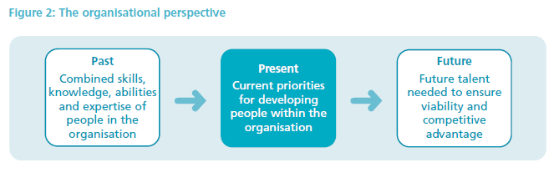
Career Development

Slide 11
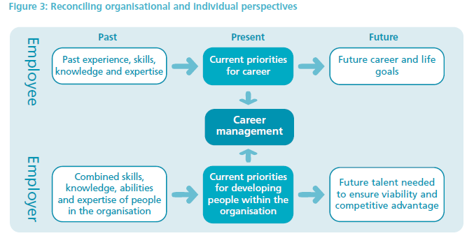
Career Development

Slide 12
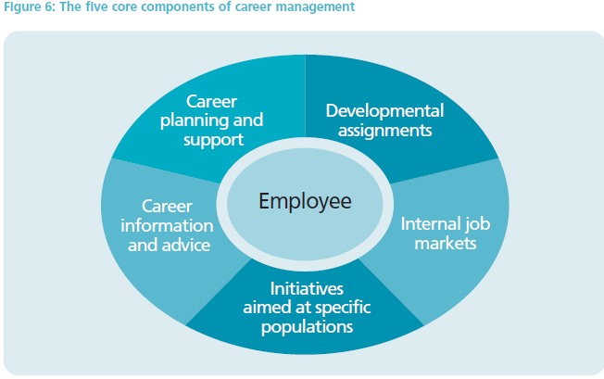
Career Development

Slide 13
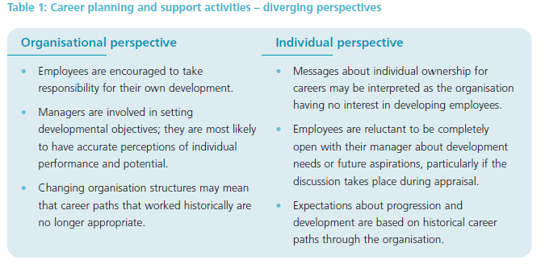
Career Development

Slide 14
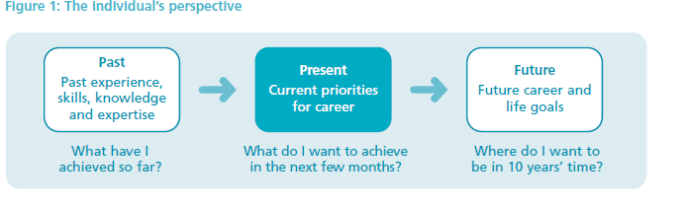
Career Development

Slide 15
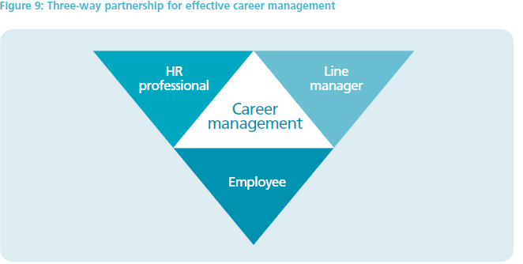
Career Development

Slide 16
Career Development
Aforementioned is the ideal situation
Most people work in the small and medium size enterprises who don’t have HR manager
People are responsible for their own career

Slide 17
Career Development
Careers can develop: -
Career Progression (upwards)
Balance off the right mix between employee and position
Stagnation (levelling off)
Redundancy – company needs less employees
Outplacement – there is a perceived performance issue
Career change – employee changes position and or company

Slide 18
Career Development
C
H
A
L
L
E
N
G
E
skills
High challenge, low skill equals worry, anxiety | High challenge, high skill equals flow
Low challenge, low skill equal apathy, boredom | Low challenge, high skill equals relaxation

Slide 19
Career Development
After working a number of years in a particular job people will associate identify themselves with this job or just do the opposite
Changing a job or career will affect: -
The losing the job
The personal reaction on this
Material consequences
Relationships with others

Slide 20
Career Development
The loss of a job
It is the loss of respect, friends, familiar surroundings a way of you have been acting for a long time
This is similar to a bereavement process which has five stages
Denial
Anger
Bargaining
Depression
Acceptance

Slide 21
Career Development
Careers Developments are part of your continued working life as: -
Economy changes constantly
Skills and qualifications keep changing
Technology keeps developing
Longer working life
Performance need constant improvements
Social networks keep changing

Slide 22
Career Development
Most important attributes in a career are: -
Passion
Psychological capital
Social capital

Slide 23
Career Development
Thanking you for your attention
Questions?

