Slide 1
Re-framing service delivery, professional practices and professional identities in UK careers work: ESRC Seminar Series
20th June 2012 John Arnold
Institute of Work Psychology
University of Sheffield

Slide 2
ESCR Seminar Series: Partners
University of Warwick:
Institute for Employment Research [lead]
Loughborough University:
School of Business and Economics

Slide 3
Aims
To foster interdisciplinary and inter-sectoral dialogue by bringing key stakeholders together to debate issues of mutual interest
To contribute to policy about the future shape of services and building workforce capacity
To deconstruct and reframe the professional identities of careers guidance and careers practitioners in the context of UK service delivery policies

Slide 4
Trialogue: 3 way – reciprocal exchange
Policy
Research
Practice

Slide 5
Objectives
Identify features of a range of practices and how each is effective in particular settings
Examine careers guidance workers’ perceptions of their actual and ideal professional roles
Explore how best to develop integrated practice that enables access to opportunity in culturally diverse and disadvantaged settings
Evaluate existing, emerging and potential uses of digital technologies to deliver enhanced careers-work practice
Suggest how emerging career theory can most usefully be embedded in developing practice

Slide 6
Six seminar topics: 2010 - 2012
UK policy and practice
Professional associations
Professional identity formation
Digital technologies
Stakeholder perspectives
Learning from others: Equality and diversity

Slide 7
Seminar venues
Autumn, 2010: University of East London
Spring, 2011: University of Glamorgan
Summer, 2011: University of Limerick
Autumn, 2011: University of West of Scotland
Spring, 2012: University of Ulster
Summer, 2012: Nottingham Trent University

Slide 8


Slide 9
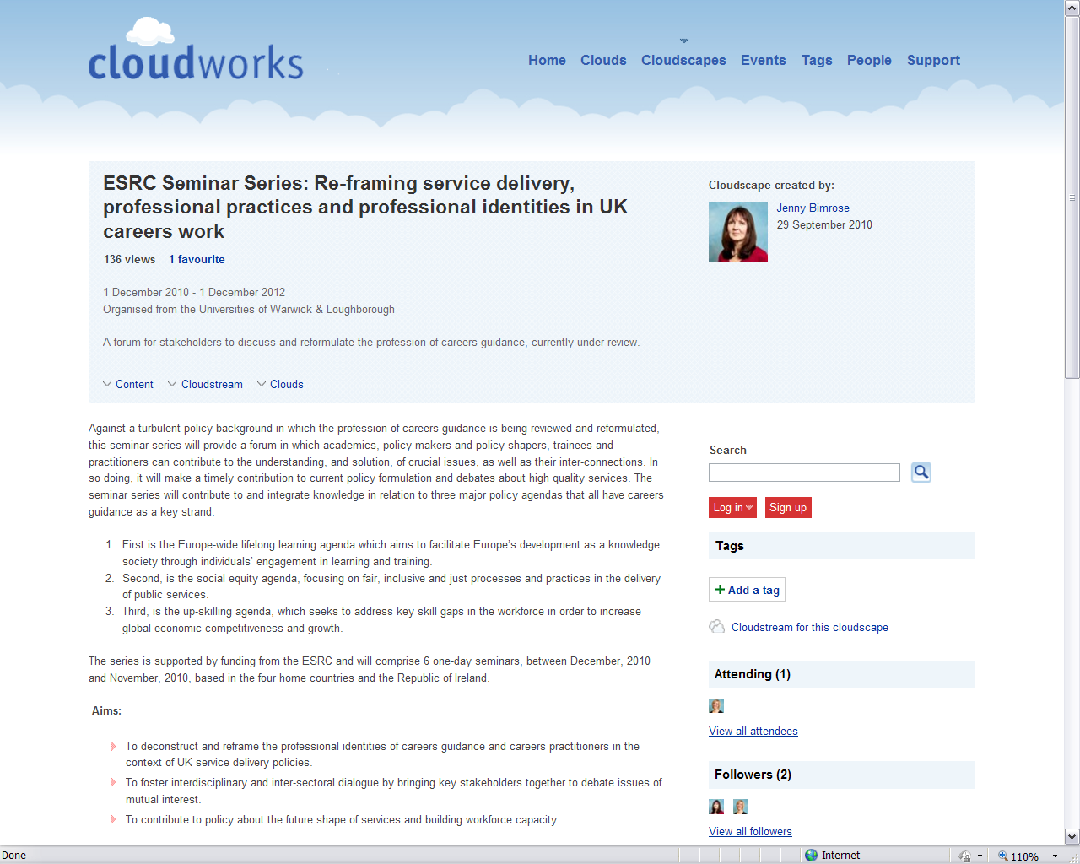
Dedicated website

Slide 10
Careers Work Innovation Website
http://www.careersinnovation.net/
Where you can find leading-edge ideas for careers

Slide 11
Thank you!
We look forward to your participation and contribution

