Slide 1
Can ‘caring’ occupations become professions? What might be lost and gained in the processes of professionalisation?
Sally Aldridge
ESRC Seminar on Careers Work in the United Kingdom
31st March 2011
Notes:
I am Sally Aldridge.
I work as Director of Regulatory Policy for the British Association of Counselling and Psychotherapy.
I have recently completed a PhD on the professionalisation of counselling in the UK.
In that research and in preparing this talk I have been struck by the similarities in the development of counselling and careers education.
Today I am going to offer you some thoughts on the these two questions.

Slide 2
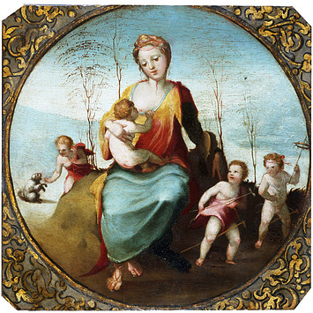
The ‘caring’ professions
Notes:
Why am I putting careers education and guidance in with the ‘caring’ professions, such as teaching, social work, nursing and the talking therapies?
It is based on personal relationships and social skills rather than an instrumental approach.
It ‘cares’ about people as individuals, not as cases or symptoms.
It can be seen as an extension of what families and friends do
It has an ideal of service and altruism above self-interest
It may be ancillary to other roles
Its workforce is predominantly female and often part time.
Many of these feature can be characterised as traditionally ‘female’
Many of these factors lead to it being characterised as a caring profession and also a semi-profession.

Slide 3
What makes a profession?
A monopoly on exclusive skills and areas of competence. No one else can do the job.
Recognition of this monopoly by the state, the public and in the workplace.
Notes:
I think that you can already see that this can present problems.
How is this monopoly and recognition to be achieved?
The Department for Education’s Careers Profession Task force report seems to me to try to address these issues – and follows the traditional model of professions and professionalisation.
What is this?

Slide 4
The traditional traits of a profession
Control over entry to the profession
Systematic theoretical knowledge
Autonomy in practice
Control over the behaviour of members
Monopoly over the activity of the profession
Long period of training
Authority recognised by client group
High social status and prestige
Socialisation of entrants
Codes of ethics and conduct
Professional association
Ideal of service for the public good
Cohesion and professional community
Profession is organised
Legitimated status
Notes:
These are the traits that traditionally have been seen as markers of a true profession.
We could spend quite a lot of time trying to work out which of these can be ticked as achieved.
I found many of them in the Health Professions' Council’s criteria for professions aspiring to statutory regulation.
We can also find many of them in the recommendations of the Department of Education’s Careers Profession Task Force
I am moving to the origins of these traits

Slide 5
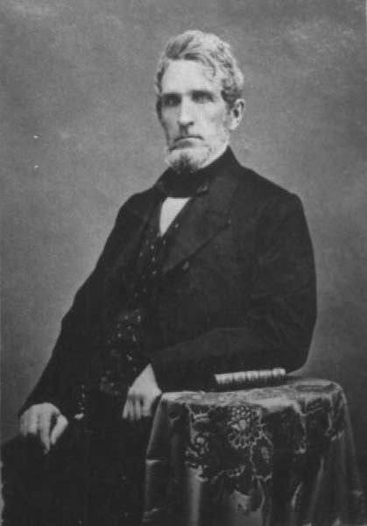
The origins of professions in the UK
Notes:
The traditional traits of a profession are derived from the idealised picture of the main 19th century professions of law, medicine and the church.
Male, full time, entered by academic qualification and very good at the socialisation of entrants.
It is this patriarchal model that still underpins statutory regulation and professional recognition in the UK.

Slide 6
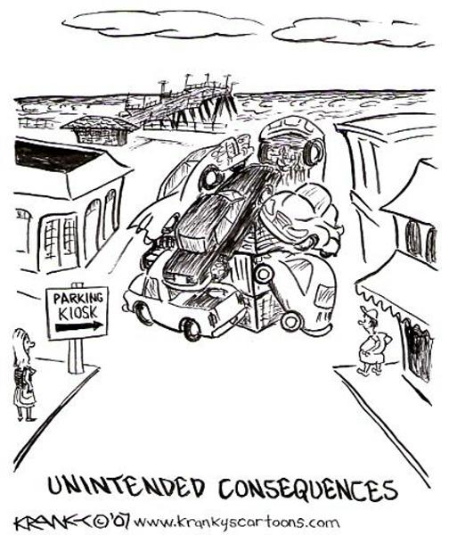
What might be lost and gained in the processes of professionalisation?
Notes:
My research and my recent experiences with the Department of Health indicate that the one thing we can be certain of is that whatever we do, there will be unintended consequences.
One example of this, that counselling and careers education share, is the decision in the 1990s of advice, guidance and counselling to enthusiastically embrace the development of NVQs.
Following from this for counselling was the decision to place itself under the EU Directive on professions for non-graduate or vocational professions which had ramifications that continue today.
This support of NVQs lead to the division of qualifications in the same field into vocational and academic and this in turn led to problems in setting entry standards to the profession.
No one could have foreseen this in the 1990s.

Slide 7
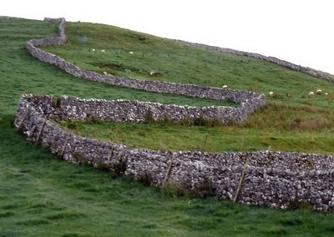
Boundary setting Unclear and permeable boundaries = insecure professional identity
Notes:
The existence in careers education of both vocational and academic qualifications, a wide range of roles and job titles, the existence of roles in which careers education is ancillary to another role all lead to problems in setting boundaries.
If you have no clear boundaries, it is almost impossible to establish a professional identity.
I think the huge number of job titles in your field is evidence of this.

Slide 8
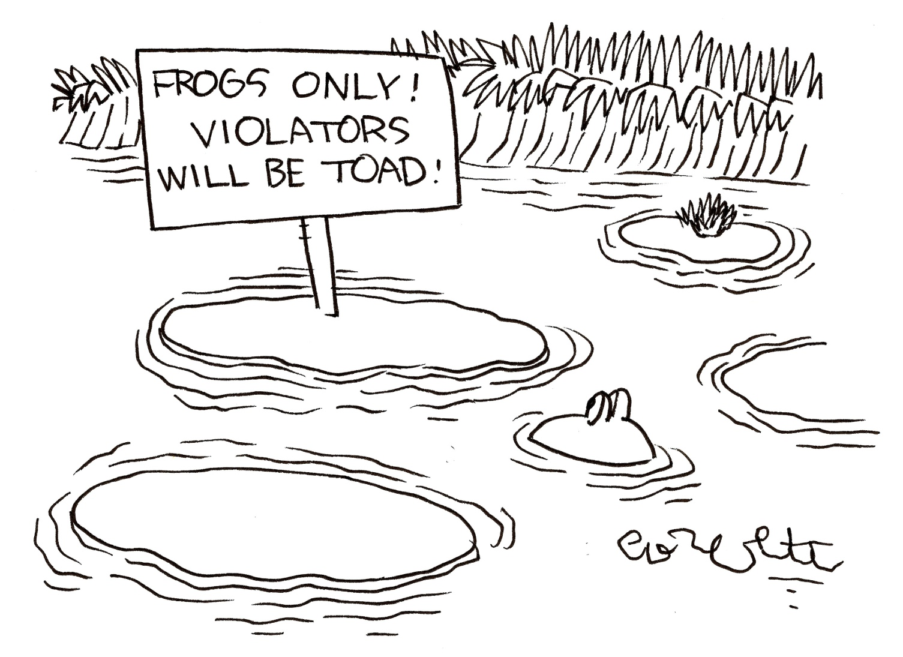
Exclusion
© CartoonStock.com
Notes:
Exclusion
Boundary setting is a polite way of saying you are inside and you are outside.
It leads to differentiation and the development or fixing of boundaries.
It is often done through the imposition of qualifications to achieve occupational closure. This can have an impact on the make up of the profession.

Slide 9
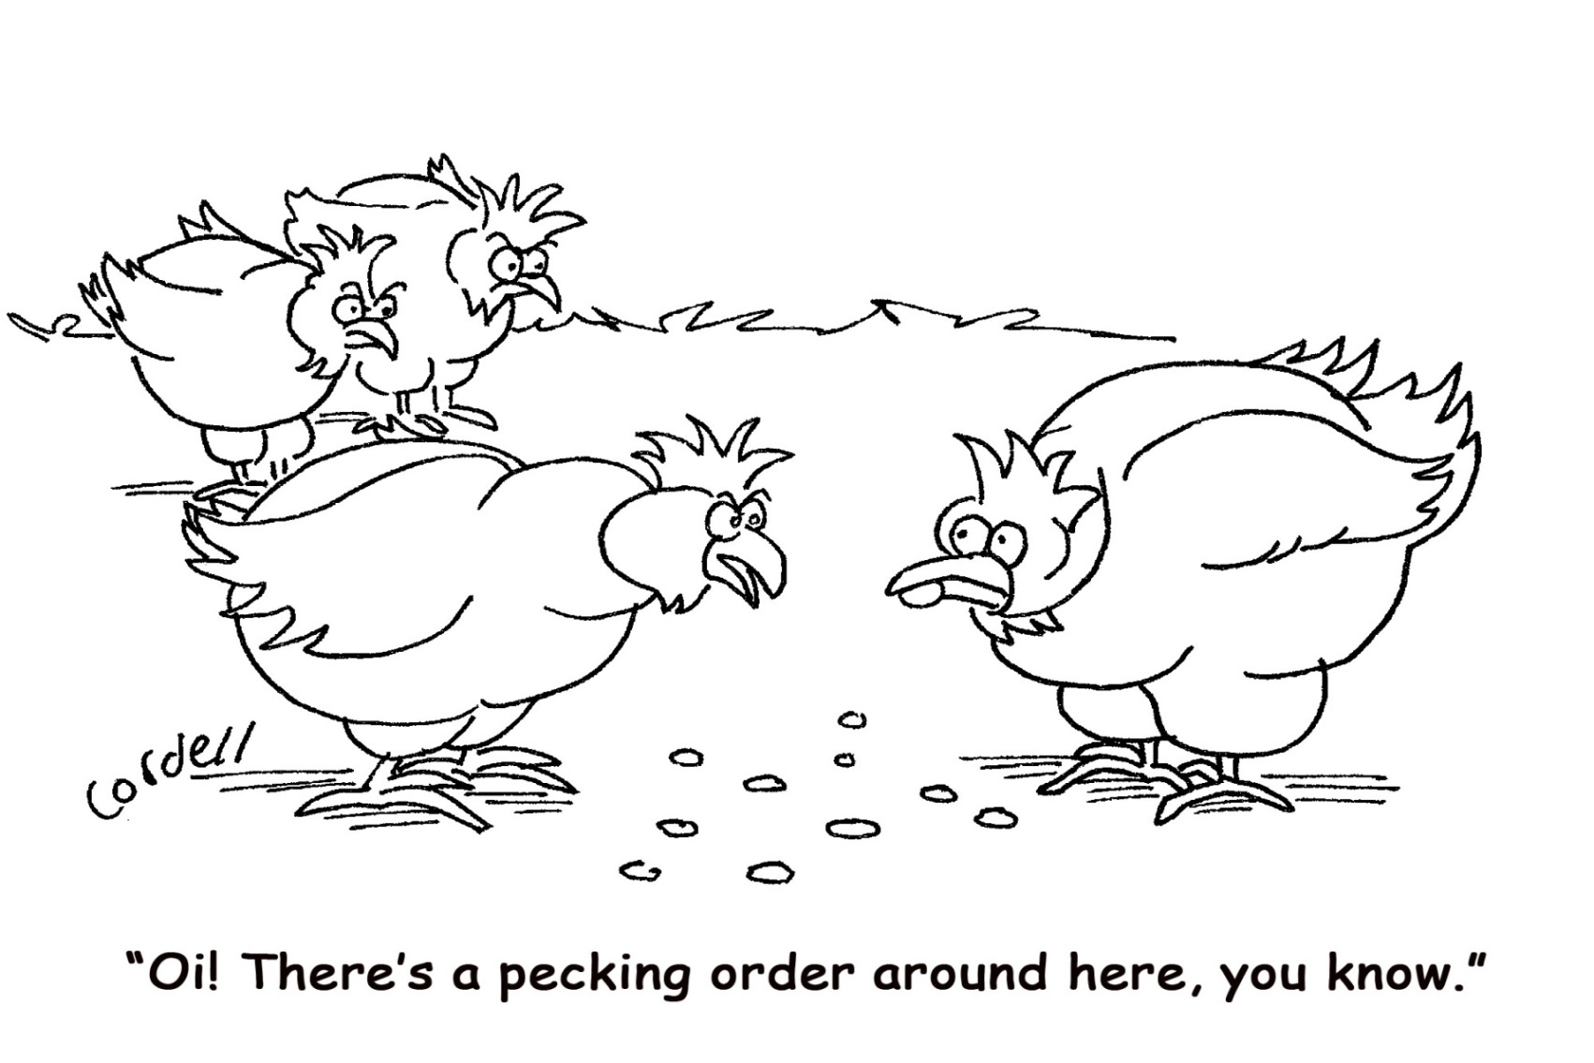
Recognition, status and reward
© CartoonStock.com
Notes:
Recognition, status and reward.
Gaining parity with existing established professions is an aim in order to gain status and financial reward. This often results in internal hierarchies.

Slide 10
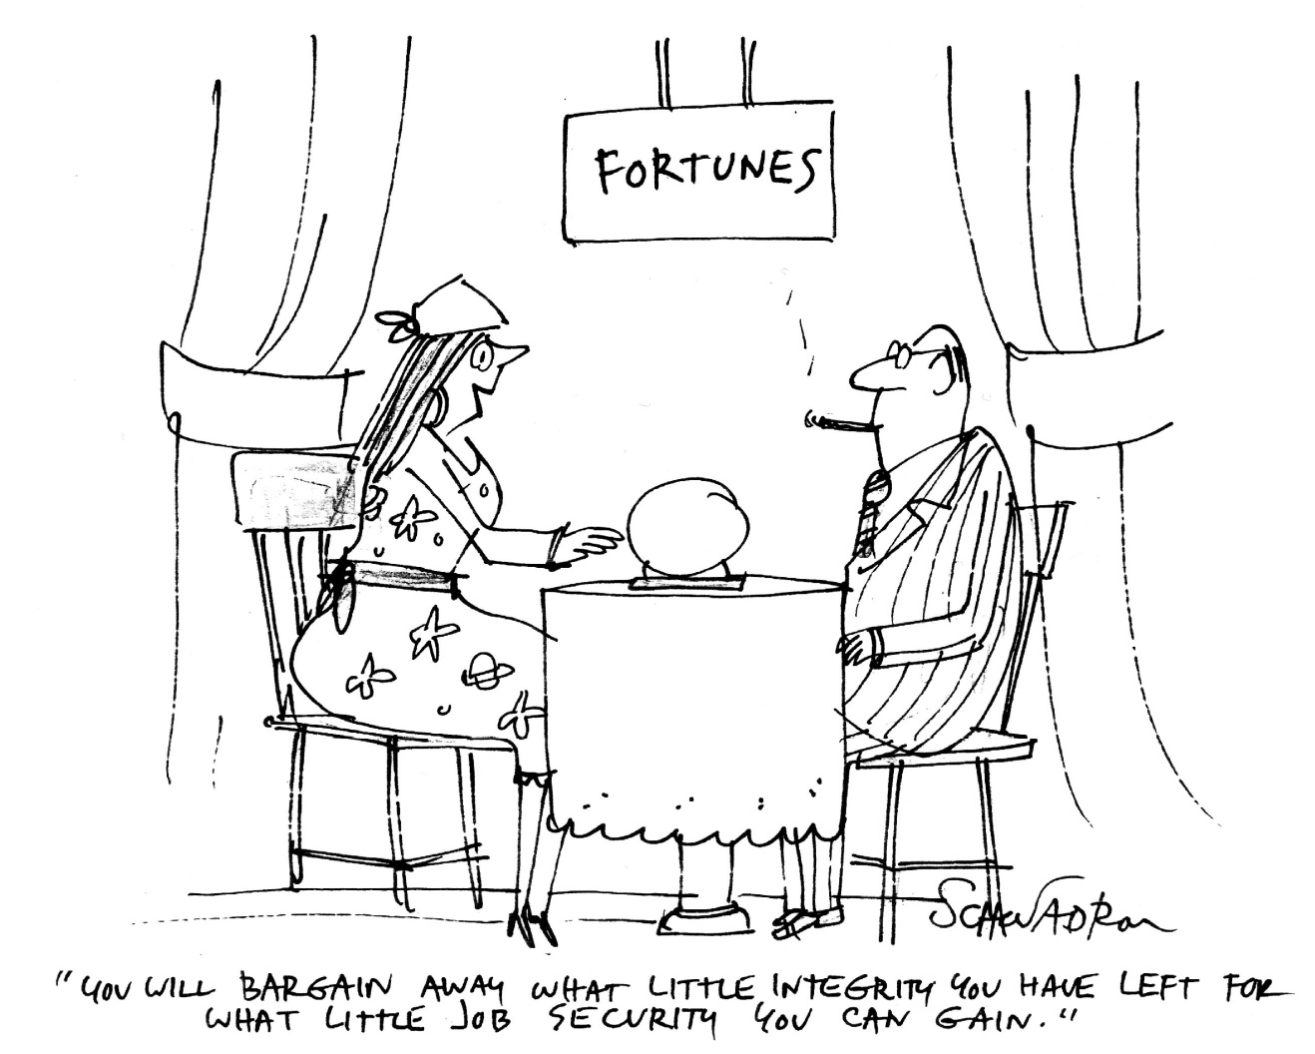
Selling out?
© CartoonStock.com
Notes:
Is pursuing professionalisation selling out?
Today this means buying into the model of profession that is still in essence patriarchal.
It can mean losing some of the values that have been held dear, for example inclusion, inter-personal skills being valued less than academic qualifications.
Caring professions find themselves used by the state as agents of normalisation, enabling the state to off load responsibility for dealing with the more difficult parts of the population.
Caring professions appear to enthusiastically embrace such partnerships with the state in the hope this will lead to recognition of their professional status. We are usually disappointed
.

Slide 11
“Do we wish to join that procession, or don’t we? On what terms shall we join the procession? And above all, where is it leading us, the procession of educated men? .... What are these professions and why should we make money out of them? Where in short is it leading us, the procession of the sons of educated men?”
Virginia Woolf, Three Guineas 1938/1966 pp.62-3
Notes:
I will end with a quote from Virginia Wolfe, written in 1938.
I hope that I have stimulated your thoughts.

