Slide 1
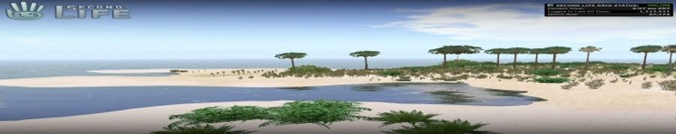
The Inter-Life Project: investigating the potential of virtual worlds to assist young people with key life changes and transitions
Professor Vic Lally
University of Glasgow
[Co-Authors: Dr Madeleine Sclater]

Slide 2
Overview
Context of Research Project
Aims & Research Questions
How we addressed the research questions
The way we worked
Profile of the young people
Theoretical perspectives informing the design of the research
Methods and Methodologies
What happened: Art and Design as a method of creative engagement
Where next?

Slide 3
Background
ESRC/EPSRC funded project called ‘Inter-Life’ (2008-2011)
Funded under phase III of the Teaching and Learning Research Programme (TLRP)
Multi-disciplinary Team (of about 10 members) including Education, Psychology, Computing Science, Art and Design
University of Glasgow, with Heriot-Watt University, Stirling University and University of Sheffield (UK)
http://www.tlrp.org/tel/inter-life/

Slide 4
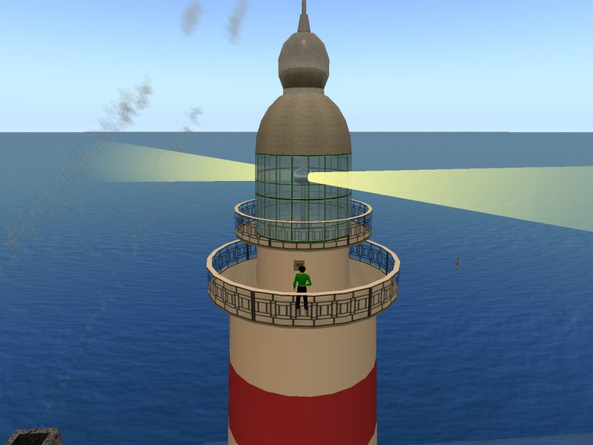
InterLife Island
Diary Room

Slide 5
Aims
Inter-Life Island is a 3D multi-user environment (based on Second Life®), with mobile device integration.
The project is about enabling young people to acquire and develop skills to enhance life transitions (educational and social transitions/formal and informal) through a range of digital creative activities [film making & photography]
The aim of the project is to investigate how 3D Virtual Worlds (such as Second Life) can be used to support the development of these skills

Slide 6
Aims
“I think a lot of educational spaces that exist are deeply constrained by social, cultural and political forces that mostly don’t want them to be exploratory spaces and have very restricted views of knowledge creation and don’t want to accommodate a mixing of the social emotional and cognitive whereas I think a lot of our learning is a mixture of all three of those...and so as an educator I was attracted to Second Life as a space where that possibility exists…(1)”

Slide 7
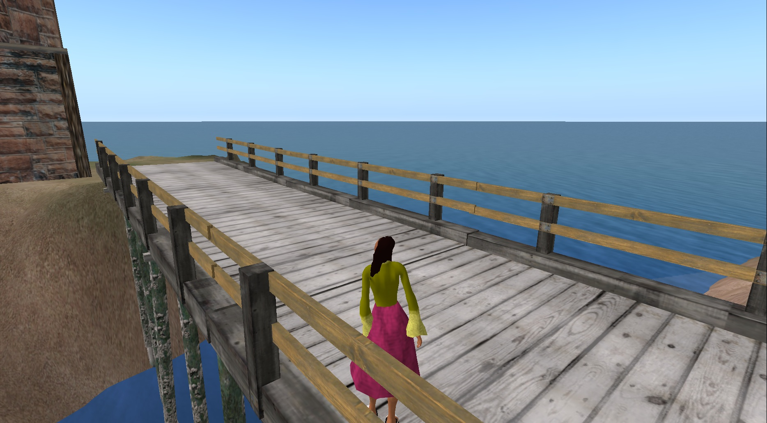
Inter-Life Island

Slide 8
High Level Research Questions….
  1. How can transitional change such as risk, conflict and goal-setting can be handled in the virtual world?
  2. How do personas develop in the real and virtual worlds, and how might the personalisation of avatars assists this? How does this map onto real life?
  3. How can the flexible use of mobile technologies be employed to enhance the skill development for transitional experiences?
  4. How can interoperability be successfully achieved between applications, documents and media?

Slide 9
And How We Address them
We set up a Virtual Research Community involving young people working in partnership with members of the research team.
We made available tools and resources to engage in personal and group projects
We supported the development of creative activities with a focus on photography and film making
We fostered collaborative activity

Slide 10
The way we worked
We gathered (researchers and young people) together in a 3D space at an agreed time and introduced ourselves
We spent time sharing aspects of our lives using photography & film, and to a lesser extent music
We co-planned an agenda of activities relating to interests, personal concerns, hobbies and issues
We conducted weekly meetings, sometimes supported by face to face contact (10-15 weeks)
There were 2 communities with whom we worked. Glasgow/Sheffield and Trinidad

Slide 11
Profile of the young people
Glasgow/Sheffield collaboration - a mixture of young people in foster care or local authority homes (15-18 years) and their carers
Trinidad – Young people (15-16 years) and their teacher
All the young people, carers and researchers had an avatar each which represented them in the 3D world.

Slide 12
Theoretical Perspectives
Sources
Communities of Practice (Wenger 1998)
Paulo Freire ‘The Pedagogy of the Oppressed’ (1970);
Karl Rogers ‘Freedom to Learn’ (1969)
Framework
We are using Activity Theory (Engestrom, 1987; 2001) as a means of providing (mostly) analytical coherence, focusing on groups of people working together in activity systems.
Notes:
Communities of Practice is about people working on a shared enterprise with shared values derived from that practice. The practice can be partly represented through the artefacts it creates.
People may be members of more than one activity system for example, Interlife, home, school. We contend that points of conflicts between activity systems may be the locus of creativity; participants might want to share issues or happenings from the school
Context in the Interlife context and this may result in creative activity.

Slide 13
Activity Theory
Helped us to focus on ‘activity systems’ and the spaces between them (boundary spaces)
Helped to conceptualise emotions and identity as part of this
Helped to focus on the development of shared objects, and – crucially – the skills, thinking and knowledge that developed alongside them

Slide 14
Methods and Methodology
Phenomenographic Techniques: Gathering accounts of young people’s lived experience on Interlife Island
Mixed Method Data Analysis: Coding of textual dialogue, interviews, young person led tours, base line questionnaires and focus groups; Social Network Analysis (SNA)
Mixed-method, data gathering (textual chat, video

Slide 15
Data Analysis
Coding a sample of workshops – beginning, middle and end
Selecting ‘critical incidents’
Developed a coding scheme to analyse data
Triangulating data with interviews and participant led tours

Slide 16
Preliminary Results
At the start of projects, analysis shows researchers leading and having a more dominant role than young people
Later workshops reveal a deeper and more independent level of creative engagement in activity by the young people – a greater sense of agency on their part.
Looking for instances of cognitive, meta-cognitive, affective and social learning

Slide 17
Preliminary Results
The results reveal the processes of research community building and the emerging social network among the participants.
The significance of these findings is set in the current dialogue about the role of technology in mediating social learning (Selwyn, 2010) and conversely the role of social learning in shaping appropriate technologies.
The results start to show how the discussion, reflection, and rehearsal with avatars actually produces realistic and positive self help resolutions.

Slide 18
Results…
A sense of place and group history was created
The environment felt authentic
Individual identity could be explored and changed through community activity and dialogue
Enhancement of positive self image occurred
Opportunities for ‘open action’ were created

Slide 19
Results…
Conflict and dialogue were stimulated in the process of building groups, conceptualising and undertaking joint projects
Exploration of emotional issues led to the motivation to find positive solutions
High level problem solving skills developed
These skills mapped across from the virtual to real worlds and back.

Slide 20
What happened
Developing Codes of Conduct on Interlife
Agenda Setting
Introducing one another
Sharing personal stories: bereavement
Co-construction of the space
Developing artefacts, tutorials, tours
Development of collaborative videos
Formation of research communities – developing new bonds

Slide 21
Developing an Agenda
Notes:
This is one of the customised spaces, a stage hosting a wide range of tools and resources. Here members of the group are sitting down to an early meeting to try and agree the use of the space.

Slide 22
Developing a Code of Conduct

Slide 23
Sharing personal stories

Slide 24
Introducing and Sharing

Slide 25
Meeting

Slide 26
Sapphire Cyberstar conducting a tour of the island
Notes:
This is Sapphire Cyberstar touring on a turtle created by someone else. In the background you can see buildings created by co-researchers and students.
Cyberstar dressed herself in the way that she wasn’t allowed to in her foster home.

Slide 27
Sapphire re-inventing herself

Slide 28
Zac creating beginners guide
Notes:
Zac was interesting in programming artefacts,but he also expressed his creativity by making a tutorial video of which these are 2 screen shots. He produces a guide on how to work and live on interlife isalnd.
These are examples - there are many others- of young people engaged in creative enterprise in order to realise their own agendas - not those of the adults they were working with. They involved the adults but the point is that they were realising their own agenda creatively.

Slide 29
Zac taking a tour of the island

Slide 30
Summary
In this project, we analyse how young people in a 'Virtual Research Community' (VRC) in InterLife, become 'co-researchers' in a suite of creative activities, supported by the Inter-Life team.
These creative activities include photography, digital film making and collage. We argue that the research community participants’ desire to express themselves creatively through these activities, can help to address social issues facing individuals and schools, where their obvious skills and potential contributions may be under-utilised.
This project investigates what happens when the Inter-Life Project helps pupils to act together in boundary spaces, harnessing and utilising the energy to develop and re-write their ‘personal narratives’
3 D worlds can be creative spaces where students and young people can take the lead supported by tutors/mentors but not lead by them. Blurring of boundaries between formal and informal learning.
Significant unrealised potential of using 3D worlds for education, guidance, and training

Slide 31
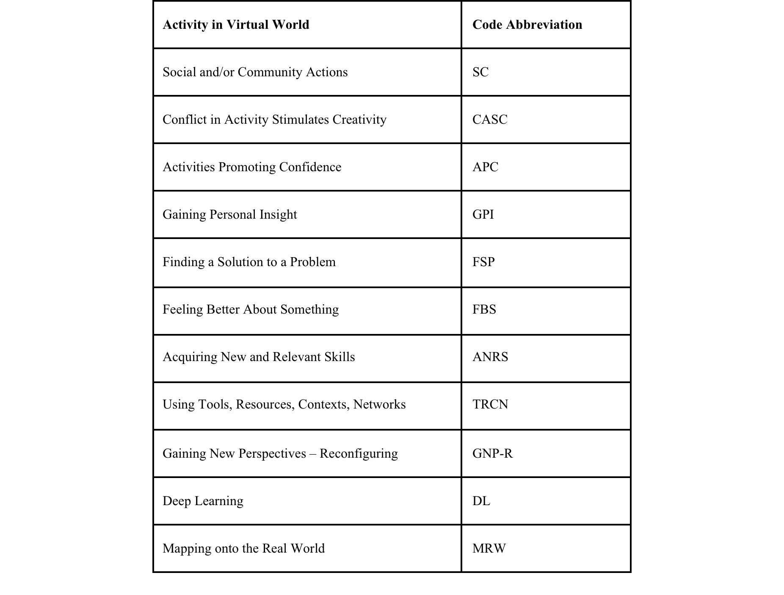
Coding Schema Showing ‘High Level’ Codes

Slide 32
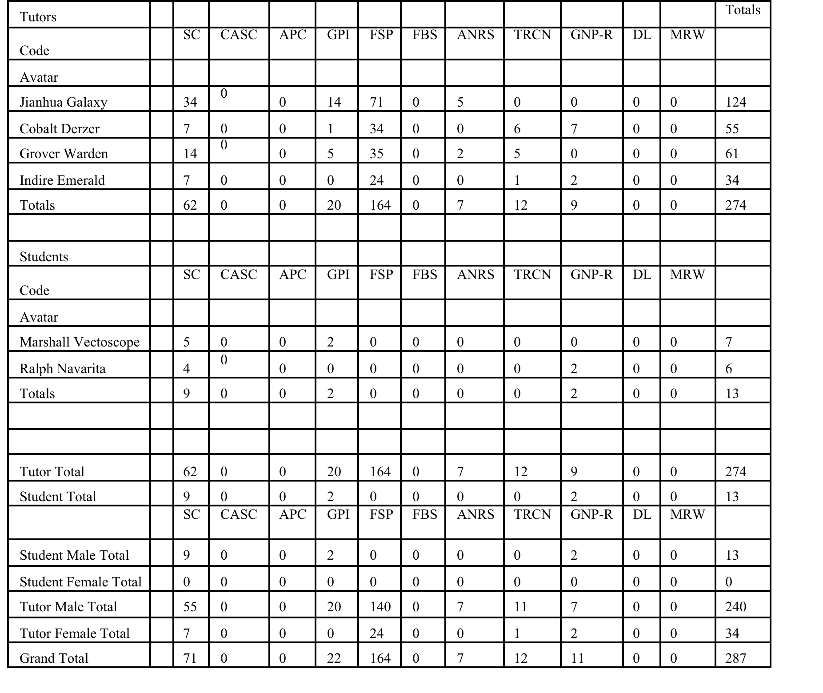
Table 1. Coded Utterance Values for Trinidad Group Workshop 1 – ‘Beginnings’ (2/03/11)

Slide 33
Figure 3. Coded Utterance Values for Students – Workshop 1

Slide 34
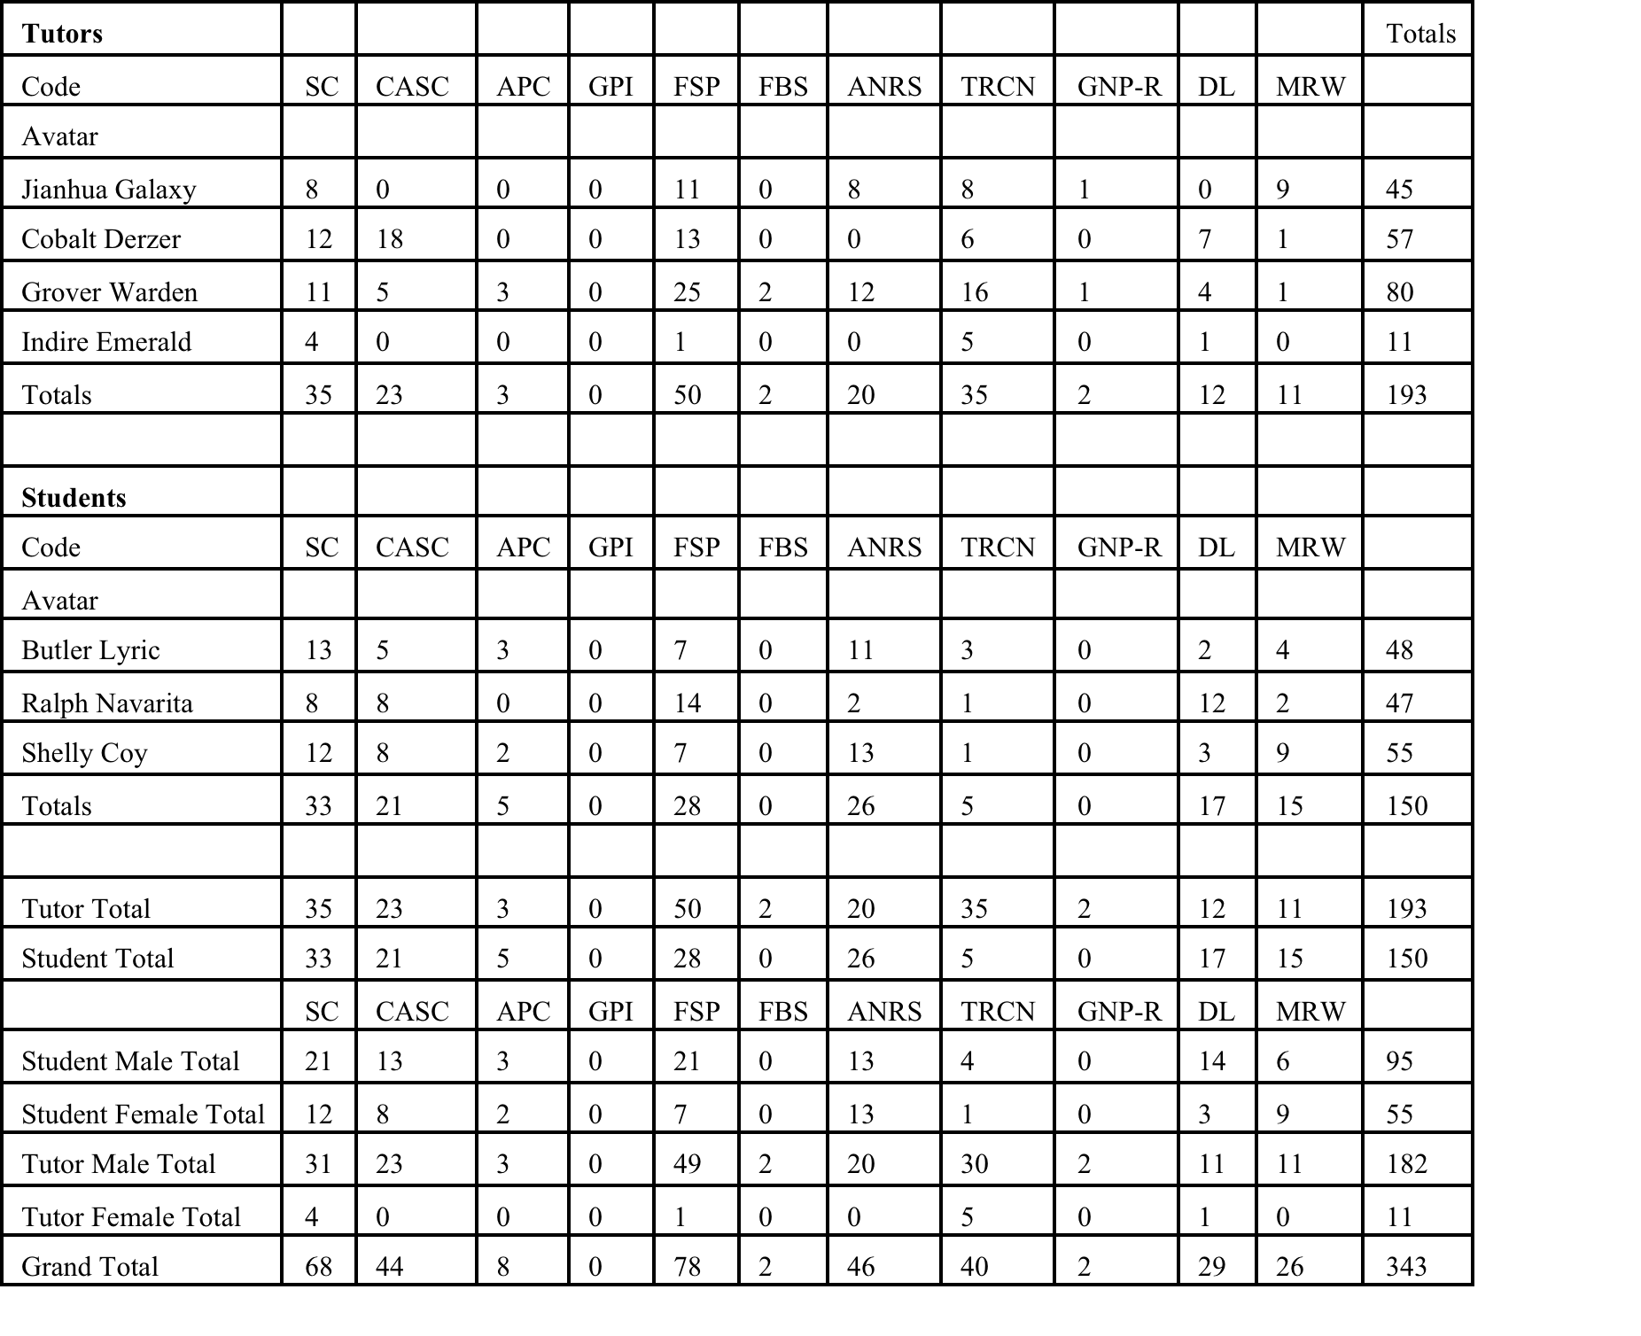
Table 2. Coded Utterance Values for Trinidad Workshop 10 – ‘Endings’ (28/06/11)

Slide 35
Figure 5. Coded Utterance Values for Students – Workshop 10

