Slide 1
ESRC Seminar
The achievement of partnership working, web-based technology and labour market information and intelligence: embedding the theory and practice of LMI into career guidance training

Slide 2
LMS, LMI, SDS, UWS and ENU…
The following presentation is in English!

Slide 3
Postgraduate Diploma in Career Guidance and Development
Offered in Scotland at the University of the West of Scotland (UWS) and Edinburgh Napier University (ENU)
Incorporates learning outcomes from the QAA Scotland Benchmark for a Qualification in Career Guidance and Development (QCGD) and is accredited by the Institute of Career Guidance
Consists of 6 modules

Slide 4
Labour Market Studies (LMS)
On both the postgraduate courses in Career Guidance and Development at ENU and UWS LMI has always been seen as an integral aspect of career guidance training and both courses have always devoted a separate module, Labour Market Studies (LMS) to this area of enquiry
“… and continues to do so irrespective of whether it is in fashion or not. People expect careers guidance practitioners to know about the Labour Market” (P Robertson Lecturer ENU 2011)

Slide 5
Labour Market Studies (LMS)
It is a module which gives career guidance the economic justification for providing its service
It reflects the LMI knowledge, skills and awareness that students will require in practice
It gives students professional knowledge and authority

Slide 6
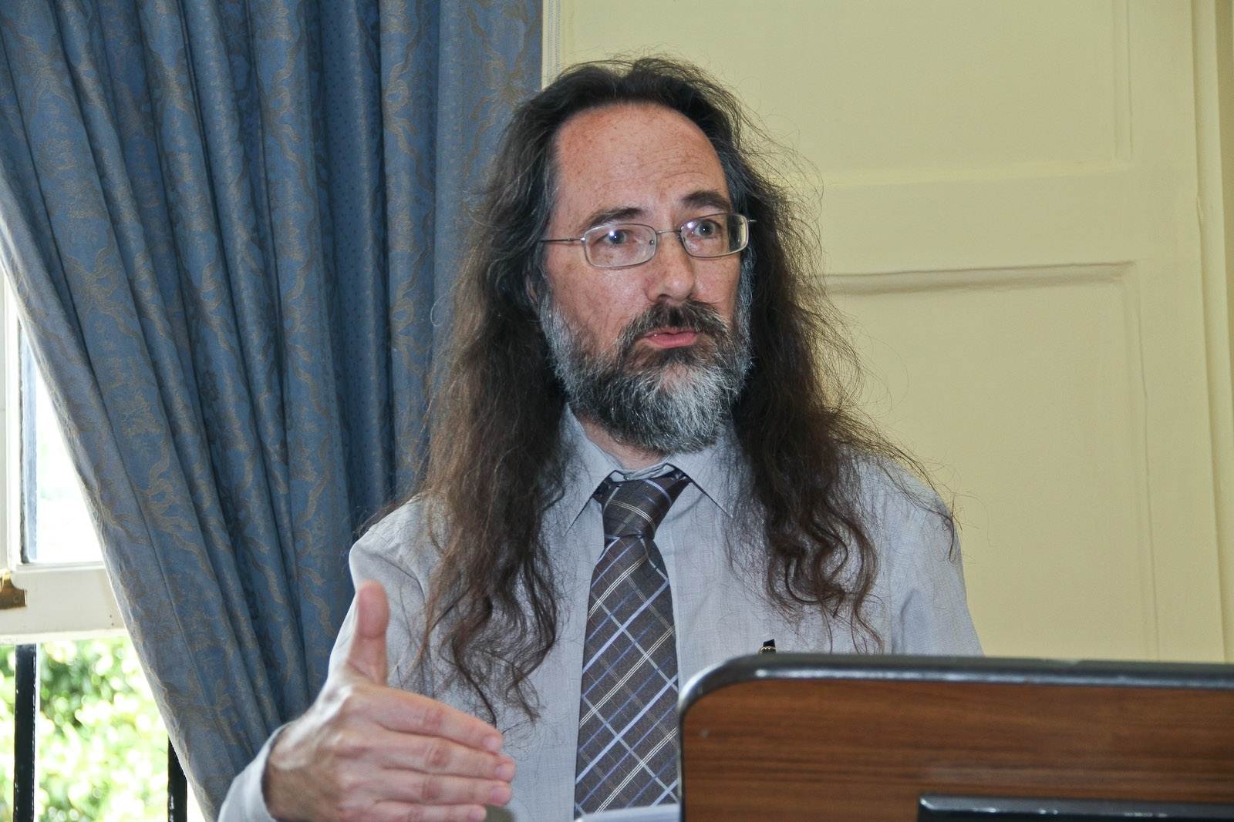
Professor Mike Danson

Slide 7
LMS directly provides
Awareness of the web-based services offered by SDS which, while recently launched in 2010, have become a principle source of LMI for practitioners and clients in Scotland, along with other UK and International data bases
Exploration and application of expert briefings and reports from the UK, Europe and elsewhere
Instruction on the LMI system by staff from SDS’s Labour Market Intelligence Hub, ‘Research Online’. This emphasises the usefulness of LMI for everyday practice as well as a research tool for a 5,000 word research project. This resource is available to both ENU and UWS courses.

Slide 8
Important development
Higher Education (HE) and SDS are embedding the sourcing, analysis and application of LMI into initial training and students are participating in the same training that staff and other partner organisations of SDS receive. With all partners using this accessible and sophisticated data, the facility can be improved by feedback from a range of users.

Slide 9
Student’s ability evidenced by
Successful completion of a research project using a range of methods which demonstrates use of web-based tools, interviewing and focus groups techniques and surveys which should highlight the implications of the results for career guidance practice.
The student’s use of LMI and its technology in interview practice and most particularly for distance learning students in the LMS discussion forum.
For some, progression to MSc or PhD

Slide 10
Increased collaboration evidenced by
Cross fertilisation of expertise between SDS staff here at UWS, supervision of SDS staff on research degrees
Delivery and participation on the LMS module is a good example of using and understanding web-based technology, partnership working, and an excellent show case of the integration of practice and theory in initial career guidance training...a Scottish government sound-bite!

Slide 11
Questions
Mark Steell: mark.steell@sds.co.uk
Janet Moffett: janet.moffett@uws.ac.uk

