Slide 1
Staying Safe Online

Slide 2
GHOST PROFILES

Slide 3
What are ghost / shadow profiles?
Collection of data Facebook collects about you that YOU haven’t actually provided yourself.
It doesn’t matter if you’re a non-Facebook user.
Notes:
What are ghost / shadow profiles?
A ghost or shadow profile is a collection of data that Facebook has collected about you that you didn’t provide yourself.
In other words, let’s say you’re a cautious social media user, and you limit what information you put online. While you may not have listed your cell phone number, if one of your connections used the “Find My Friends” feature and allowed Facebook to scan their contacts, Facebook collected all the other information about you associated with that contact.
Even if you never provided them, Facebook very likely has your alternate email addresses, your phone numbers, and your home address — all helpfully supplied by friends who are trying to find you and connect.
So if people try to find you using other details you may have, Facebook stores all that information about you.

Slide 4
Why should you care?
Notes:
Why does it matter? Why should you care?
In 2013 Facebook announced they had found a bug that revealed the personal information of 6 million users.
The leaked information, of course, included the extra information collected in the ghost profiles: emails, phone numbers, and addresses that users had no intention of sharing, all available for anyone who exploited the bug before it was fixed.

Slide 5

Non-Facebook users
You may not have a Facebook profile – but that doesn’t mean you have avoided this.
Notes:
Facebook has been the target of multiple class-action lawsuits alleging the company collects this information about non-users without their consent.
One recent lawsuit focuses not on email addresses or phone numbers, but instead “face templates”: whenever a user uploads a photo, Facebook scans all the faces and creates a “digital biometric template”.
In other words, Facebook is using math to determine who’s who in a picture, based on a scan of your features.
If you’re already a user, Facebook can suggest that your friend tag you, but if you’re not a user, Facebook attaches your “face template” information to the same ghost profile with your other contact information on it.
Even if you’ve never signed up for Facebook, you may have a profile that contains your contact info and a mathematical template of what you look like nonetheless.
Important to know that Facebook owns other social media:
Messenger
Whatsapp
INSTAGRAM

Slide 6
VPNs

Slide 7
QUIZ Q1: What is a VPN?
A type of internet connection
A network that is only accessed by a password
An encrypted network
An unencrypted network

Slide 8
QUIZ Q1: What is a VPN?
A type of internet connection
A network that is only accessed by a password
An encrypted network
An unencrypted network

Slide 9
QUIZ Q2: Using a VPN means your location can be tracked?
True or False?

Slide 10
QUIZ Q2: Using a VPN means your location can be tracked?
False

Slide 11
QUIZ Q3: What does a VPN protect you from?
Hackers
Your parents
Viruses

Slide 12
QUIZ Q3: What does a VPN protect you from?
Hackers
Your parents
Viruses

Slide 13
QUIZ Q4: Using a VPN is illegal.
True or False?

Slide 14
QUIZ Q4: Using a VPN is illegal.
False

Slide 15
What are VPNS?
Notes:
What are VPNs?
A VPN is one way to keep your online activity safe and essentially, helps you access the internet in a private and safer way. It makes sure that anything you do over the Internet is protected.
What does it protect me from?
Unsecured public Wi-Fi
Hackers
Data / identity thieves
Why should I use it?
You’re able to browse the internet more securely and it is safer! You can keep your online activity safe without anyone being able to see what you’re doing.
It also stops people from being able to locate you or your device and track you.

Slide 16
How do VPNs work?
VPN creates an encrypted connection so your data is turned into an unreadable code and hackers cannot use it.
Notes:
So how does it work?
When you use a VPN you connect the internet via a server provided by the VPN company you have chosen to use rather than through
The Internet Service Provider (ISP) such as Virgin or BT
Or your mobile phone provider such as O2, Three etc.
Or Wi-Fi.
VPN creates an encrypted connection so your data is turned into an unreadable code and hackers cannot use it.
VPN makes your internet activity untraceable by assigning a different IP address form your own to your device – you cannot be tracked back to the network you are connected to.

Slide 17
Legal?
Notes:
Are they legal?
YES!
But it all depends on HOW you use it - if you use a VPN to stream or download something illegal, then the activity is considered illegal.

Slide 18
Downsides?
Free VPNs are unsecure
Slower internet
Data limit
Notes:
Downsides?
Some VPN’s are free – to download online and the app store but they may not be as secure.
Where illegal activity takes place, not secure.
Paying for VPN would not allow you to use that.
Your internet connection may be a bit slower when using a VPN
Some VPN’s can limit your data – if you like to download large files or are into gaming, make sure the VPN service will have enough data!

Slide 19
Web Tracking

Slide 20
What is web tracking?
Notes:
Term used to describe how companies monitor your online activity so they can target advertising at you
The internet may look free on the outside but we pay for these free services in exchange for our personal data
What we search for, look at, trends, likes and dislikes are monitored – this tracked information is valuable enough to sell to companies who can then market their products and services in your favour

Slide 21

How are you tracked online?
Notes:
How can you be tracked online?
Apps
The terms and conditions in apps – which are very rarely read can grant companies access to your personal information held in your device
This personal information can involve your contact list/phone book, text messages, photographs and notes – so you are unwillingly granting a company access to information that is meant for private upkeep
It is important to read the terms and conditions or at least understand them
But this is not a problem with people, organisations and companies should make better efforts to reduce their lengthy privacy policies as well as make the terminology as accessible to all audiences as possible

Slide 22

How are you tracked online?
Notes:
Cookies
When you visit a website an identity tag is placed on your device and this is a cookie
They can be useful to remember your login details so you do not have to complete them all the time
Sometimes they pop up on apps before you enter your credentials as ‘remember me?’
They track your online browsing habits and feed information back to the website and 3rd party advertising companies who then remember your search habits and constantly promote certain goods or services from that particular website to entice you to use their site more and more

Slide 23
Why does web tracking matter?
Notes:
Why does web tracking matter?
Your information is not just being given to companies to engage with – it is also going to other companies which you do not know or engage with which renders you powerless to control who has access over your information
Companies just like to collect information about our online lives – our shopping habits, demographic etc. and sell it to other companies who sell it on too
They can use and combine this data to create an accurate picture about who you are, where you are located, who you friends are and what you look like
It is almost like stalking but online
They use the information to sell products to you of which they may feel you are interested in

Slide 24

How to stop being tracked on your browser:
Notes:
How to stop being tracked on your browser
There are many ways to do this on all search engines and you can search them online but here are two examples
Internet explorer: Open tools – Internet options – privacy tab – move the slider to the level of privacy you want to set – OK

Slide 25

How to stop being tracked on your browser:
Notes:
Chrome: Open – Settings – Show advanced settings – Send a ‘do not track’ – request with your browsing traffic – OK

Slide 26
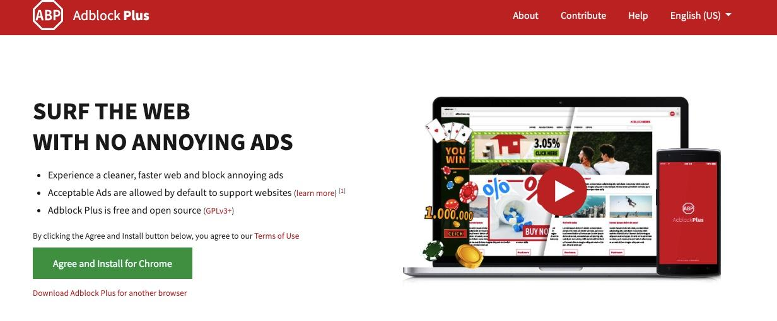
How to stop being tracked on your device:
Adblock Plus
Notes:
Being tracked on your mobile device
It is a little harder to control your privacy controls on your device
Some phones enable their locations services – for example Apple products – so even turning this off can limit the way you are being tracked
Settings: Privacy – location services ON/OFF
When downloading apps be app savvy, do not just agree to any terms and conditions – read the privacy policy before downloading to prevent getting yourself into trouble
Adblock Plus
This is a free ad-blocker service which can prevent and stop social networks like Facebook (Instagram) and Twitter from sharing data about you
https://adblockplus.org/

Slide 27
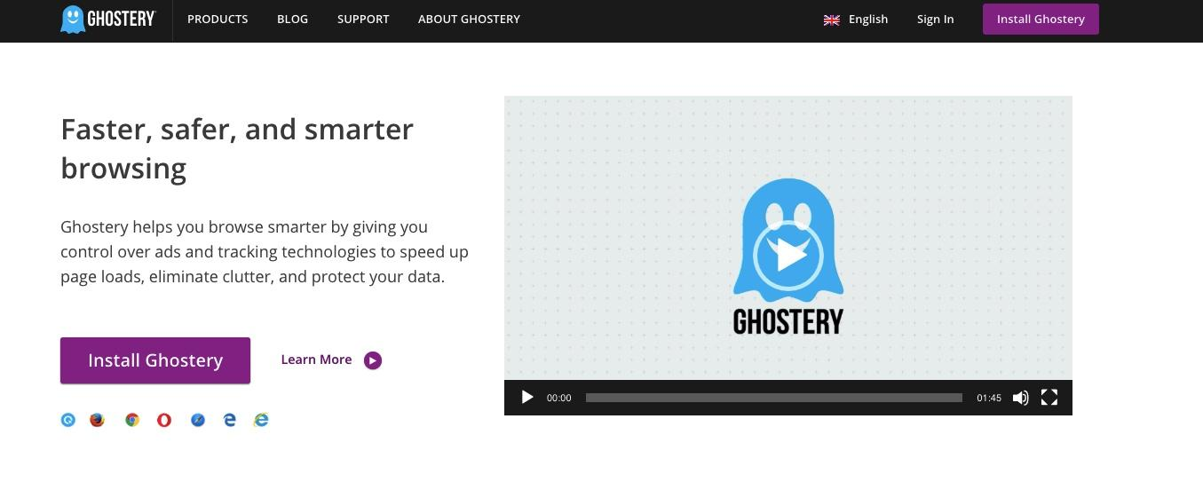
How to stop being tracked on your device:
Ghostery
Notes:
Ghostery
This is a service which blocks the invisible cookies which may be tracking your online behaviour as some companies do not explicitly state that their website contains cookies or even if they do it may not alert you
Ghostery will show you what is tracking you and you can choose whether you want to block a tracker
https://www.ghostery.com/

Slide 28

How to stop being tracked on your device:
Notes:
AdChoices
There is usually a little icon at the top of adverts when browsing online – this is the AdChoices icon and it is an identification as to whether a company is trying to target you in an advert
If you click on it, it will explain where the advert is coming from and why – you can choose to disable this for the future

Slide 29
Conclusions:
If you do not pay money for a service, companies can make money from your data
Online activity can be tracked through cookies and applications on mobile devices
You can always personalise your cookies preferences in the browser
Although mobile phone privacy security is still not up to par, it is slowly being updated and there are a few things in which you can do to protect your privacy in the settings part of your smartphone
Notes:
Conclusions
If you do not pay money for a service, it is your data in which the company is using in exchange to make money
Online activity can be tracked through cookies and applications on mobile devices
You can always personalise your cookies preferences in the browser
Although mobile phone privacy security is still not up to par, it is slowly being updated and there are a few things in which you can do to protect your privacy in the settings part of your smartphone

Slide 30
Terms and Conditions

Slide 31
WHAT ARE TERMS AND CONDITIONS?
Notes:
What are Terms and Conditions
Terms and conditions often seem like long winded and boring bits of writing
Ask how many students read the terms and conditions before continuing
They contain some very important information and avoiding to even look at them means you are signing away your ability to remain completely safe online

Slide 32
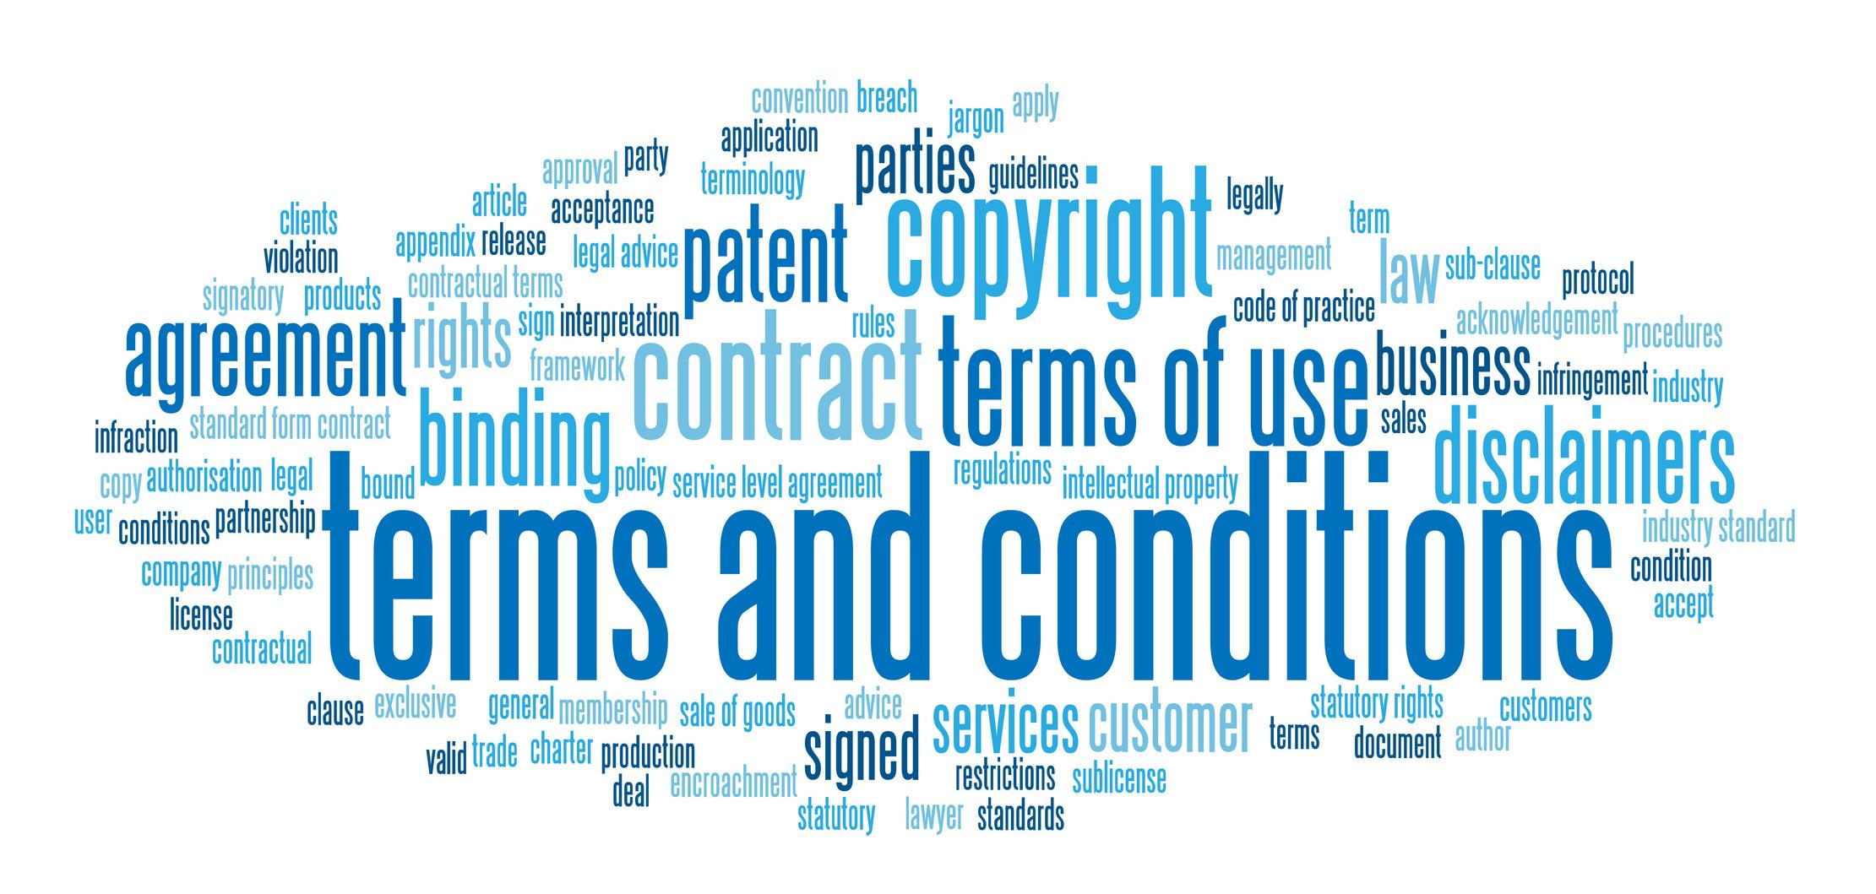
Why should you read the terms and conditions?
Notes:
Why should you read the terms and conditions
Terms and conditions involve legally binding information that you have to stick to
This means that should you abuse the terms of service the company to which the terms of service beling can prosecute you in court for serious breaches
Signing means that you consent to the way in which the company can use your data and then change their services to personally suit your internet browsing

Slide 33
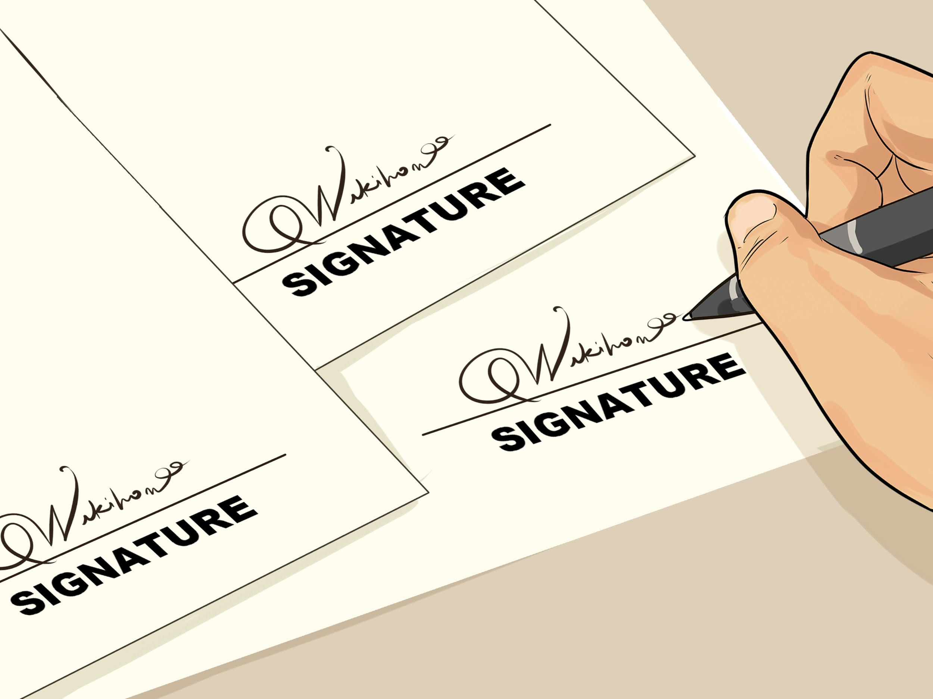
Why must you sign Terms and Conditions?
Notes:
Why must you sign terms and conditions?
They are legally binding documents and by signing you agree to use the site in the way the company wants
If you sing the terms and conditions the company can use your data the way they have written
If you then breach terms and conditions or argue against an act by the company which was written in the terms the company can take you to court and win

Slide 34

Why are terms and conditions dangerous?

Slide 35

Google Terms and Conditions
Notes:
The Google Terms and Conditions
The online version of the google terms of service, search them up easily online, are one of the easiest terms of service to navigate
You have the ability to select which area of the terms you would like to look at and see what you are signing
They also have videos which may be easier than reading all the terms and conditions
The terms are simple to read and not in a huge block of text

Slide 36

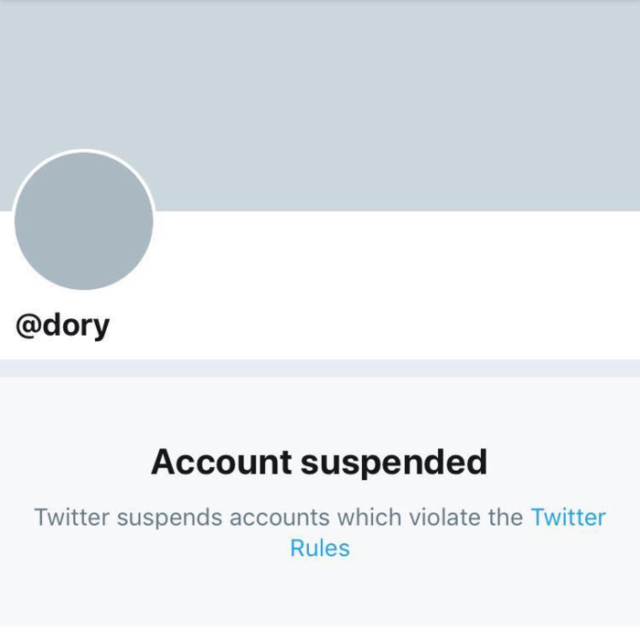
Abuse of Terms of Service
Notes:
Abuse of Terms of Service
Terms of service are not just long texts in order for companies to gain permission to use your data
They also contain guidelines on how to safely use their services, by breaching these terms the company can ban you from their services with justification because you have signed the terms
For example cheating or abuse on playstation or xbox can get you banned from their services and as you have signed them you can’t argue with the ban
Another example is twitter of facebook where abusive posts can also lead to a ban
Not reading the terms and conditions means you may not understand these actions are against the terms of service so you need to at least skim over to see rules of using a companies service

Slide 37
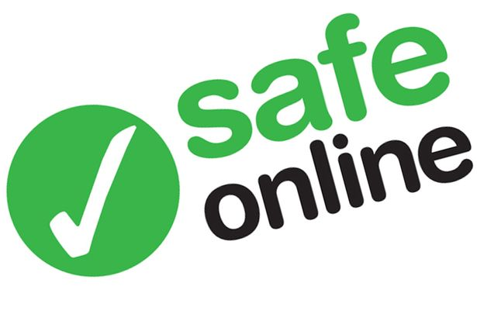
How to be safe with terms and conditions?
Read some of the terms and conditions
Use a safe VPN to protect your online privacy
Use an adblocker to stop companies getting info on you
Notes:
How to Protect Yourself from Online Terms and Conditions
Make sure you at least skim over the terms and conditions, skim reading can often be the most effective way to see the terms in particular which you find most dangerous
Not signing terms and conditions can not always be an option so to keep your data safe from companies make sure you use the ways to stay safe from web tracking and stay safe with privacy settings in order to make sure browsing the internet is safe for you

Slide 38
Is this a ban?
Using a third party website to purchase FIFA coins on Ultimate Team?
Posting messages between you and someone else without asking if you can?
Uploading a youtube video with a popular song in the background?
Sharing a controversial website online with political beliefs which others disagree with?
Notes:
Ban
Ban
Ban
Not a Ban

Slide 39
Conclusions
Being safe online involves making sure you at least skim over terms and conditions before signing
Be aware that you are giving your information by signing terms and conditions
Terms and conditions are enforceable in court
Terms and conditions are also used as guidelines on how to behave online
Notes:
Conclusions
Being safe online involves making sure you at least skim over terms and conditions before signing
Be aware that you are giving your information by signing terms and conditions
Terms and conditions are enforceable in court
Terms and conditions are also used as guidelines on how to behave online

