Slide 1
MSP SUMMER VACATION SCHEME
Binta Balogun
- 4th Year Law and Business (QLD)

Slide 2
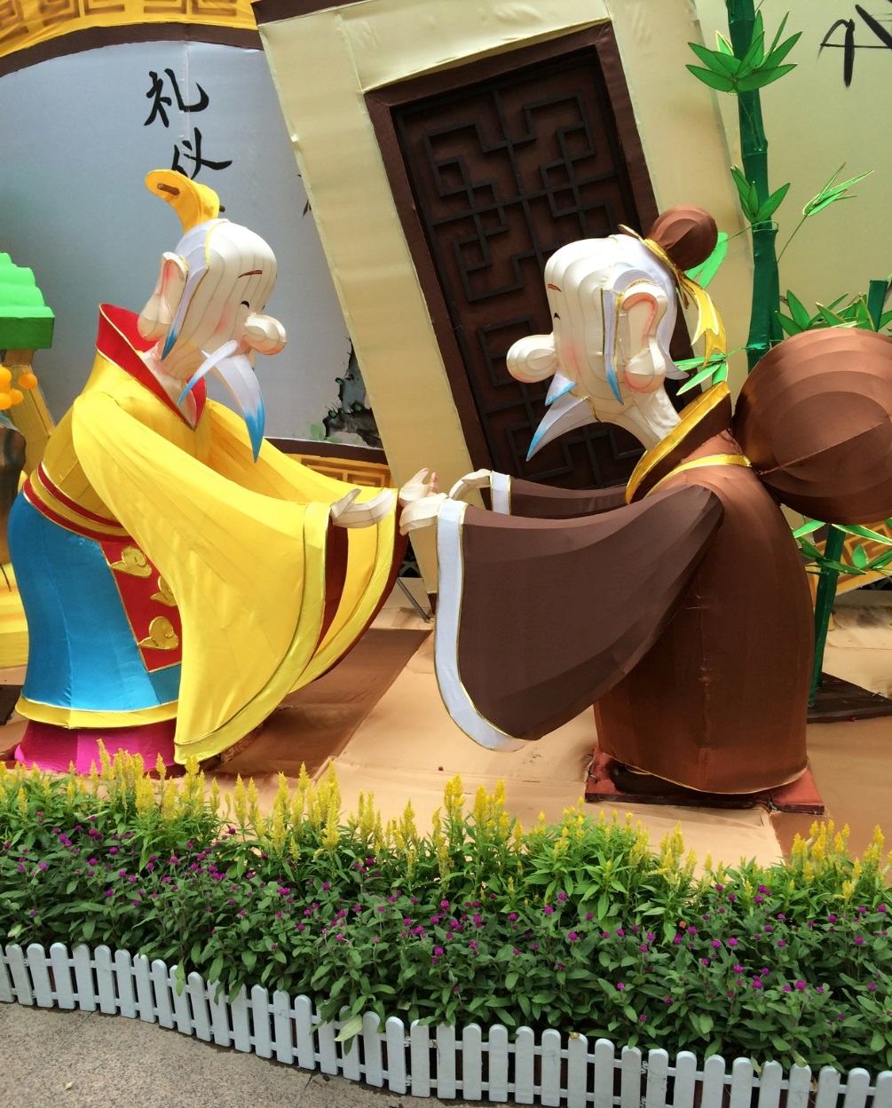
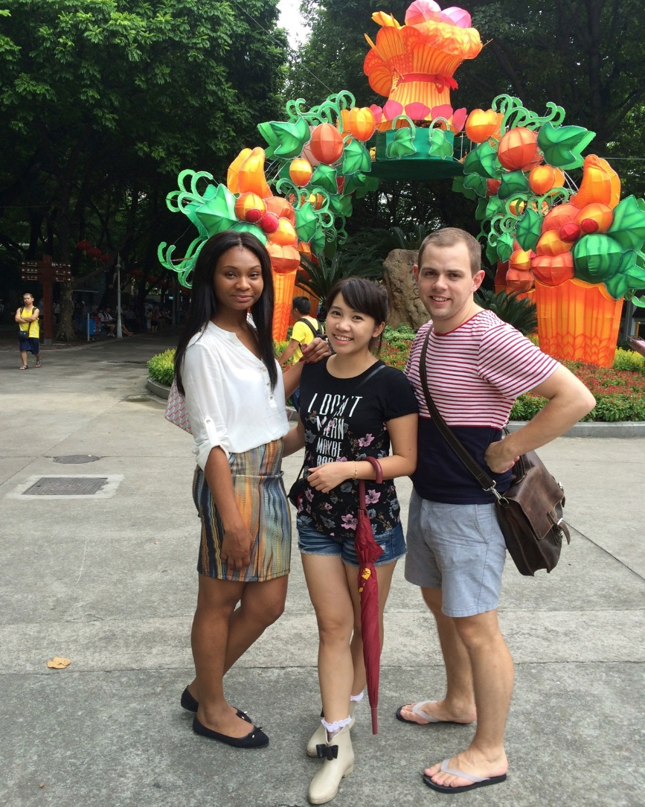
GUANGZHOU
Where was I?

Slide 3
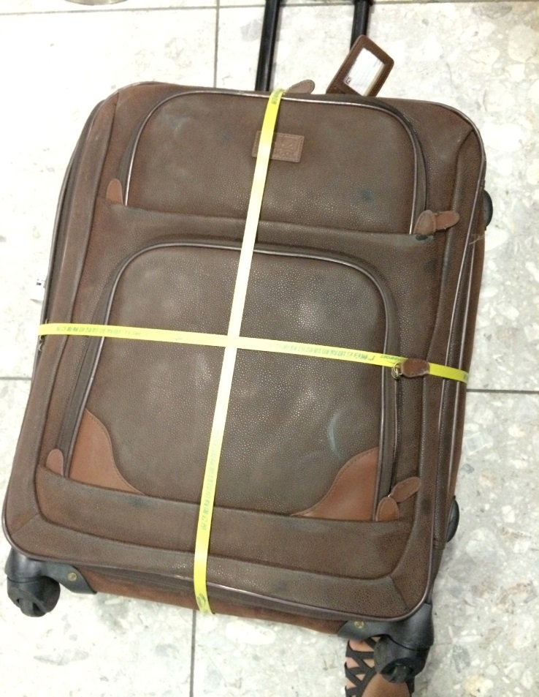
THE JOURNEY
14 HOURS!!!!

Slide 4
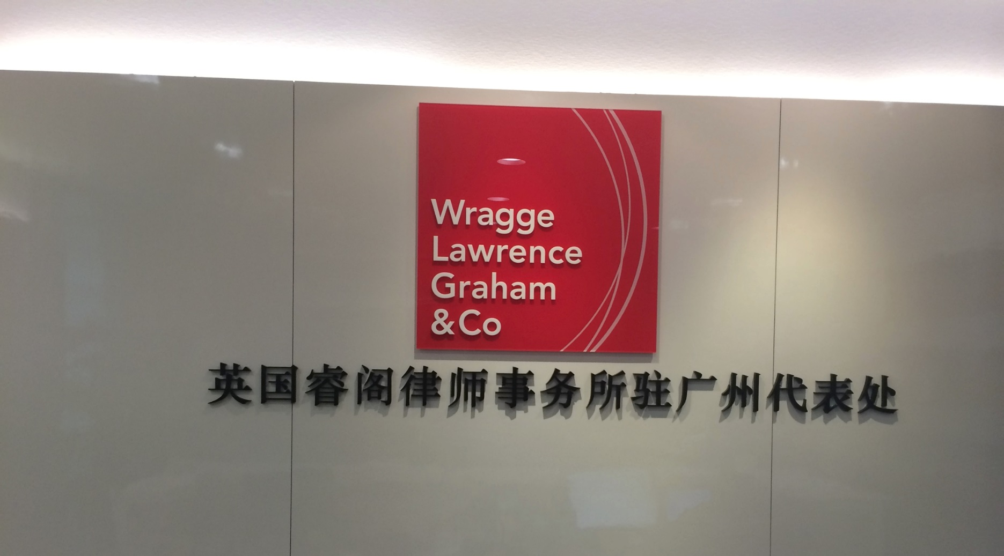
WHAT DID I DO?

Slide 5
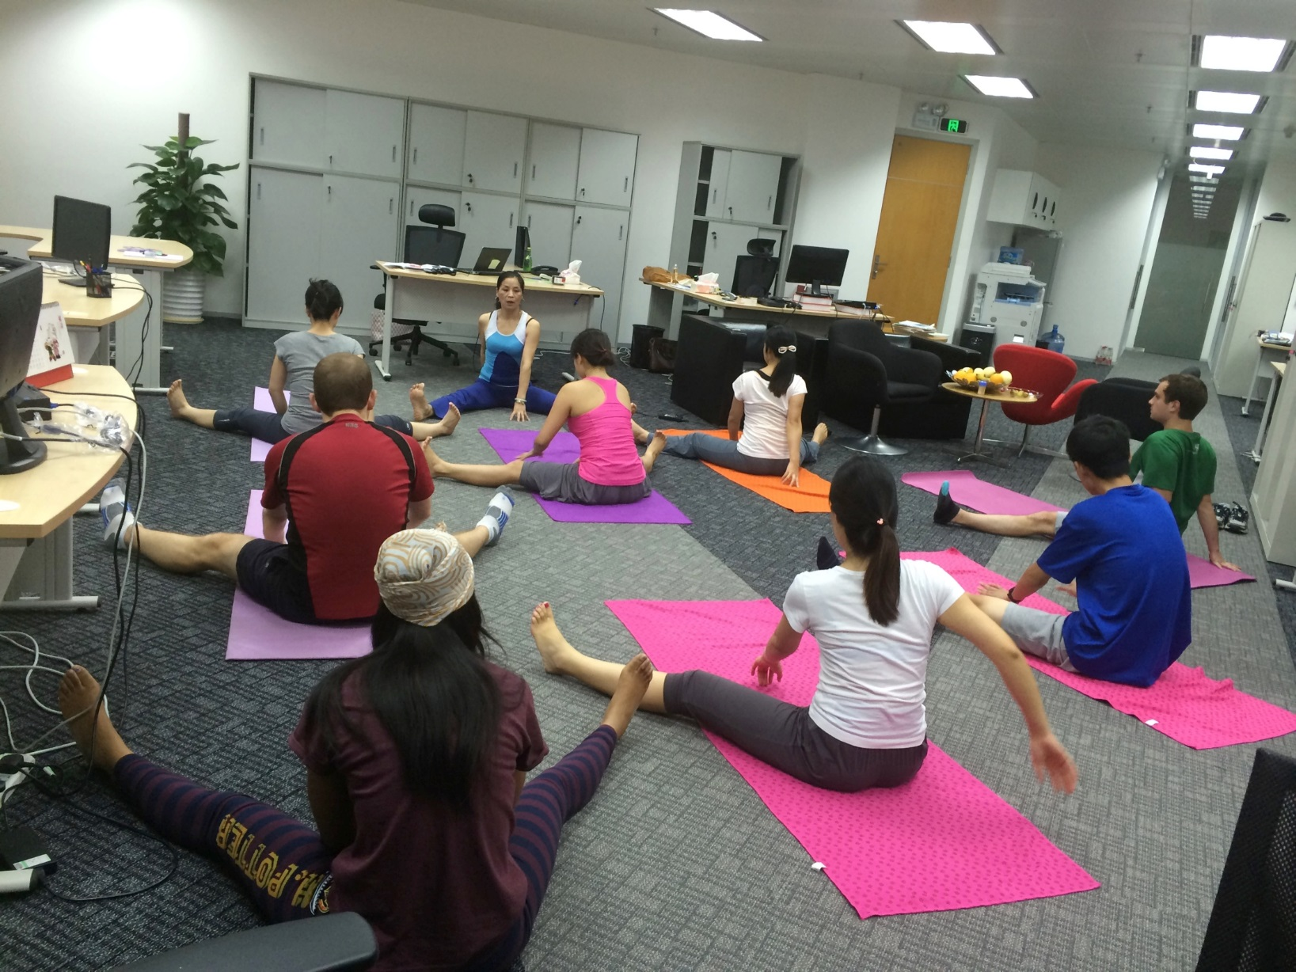
THE TEAM

Slide 6
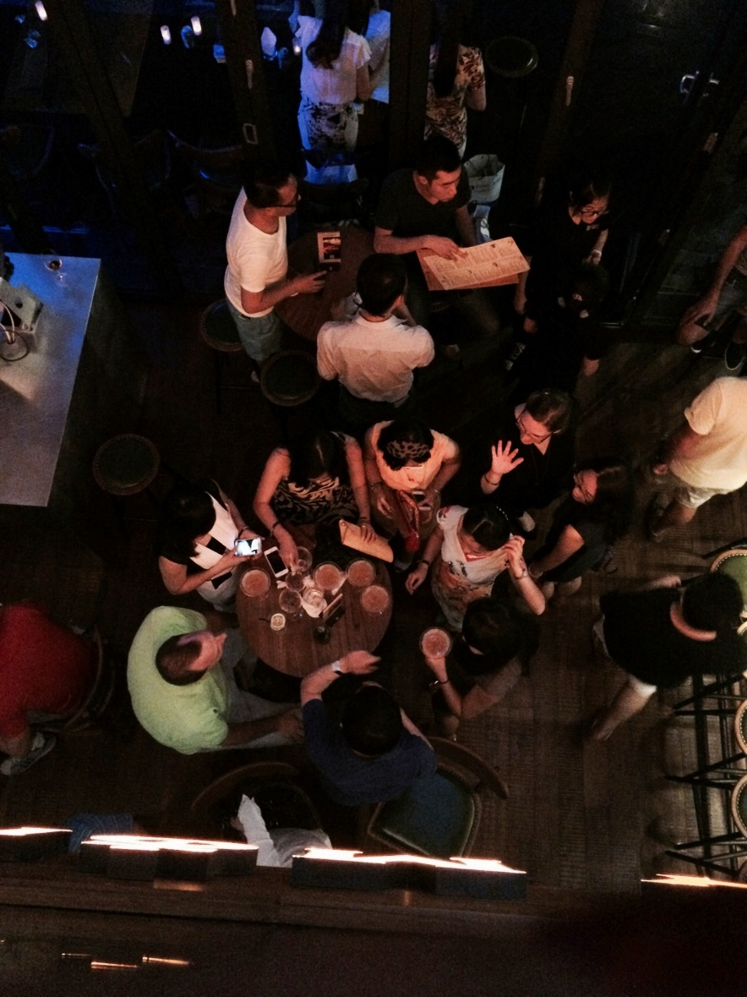
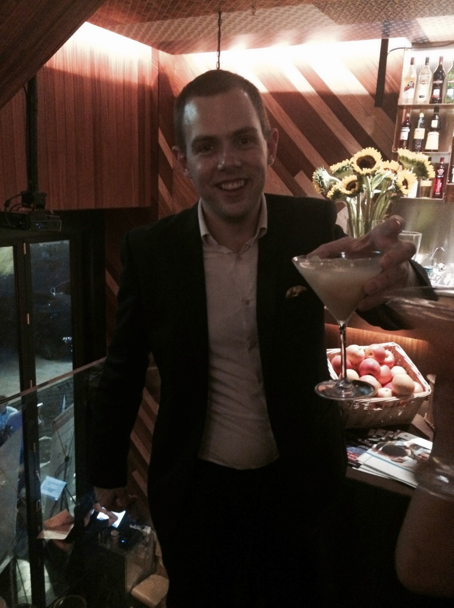
WHAT DID I DO?

Slide 7
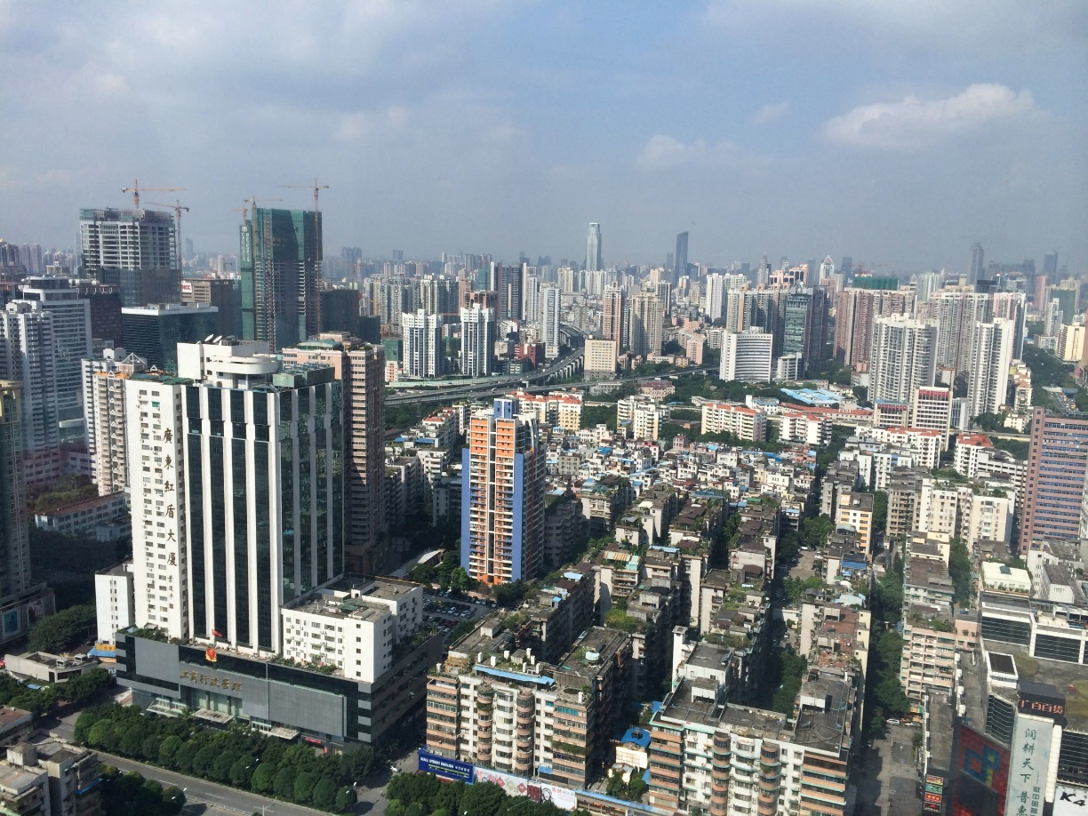
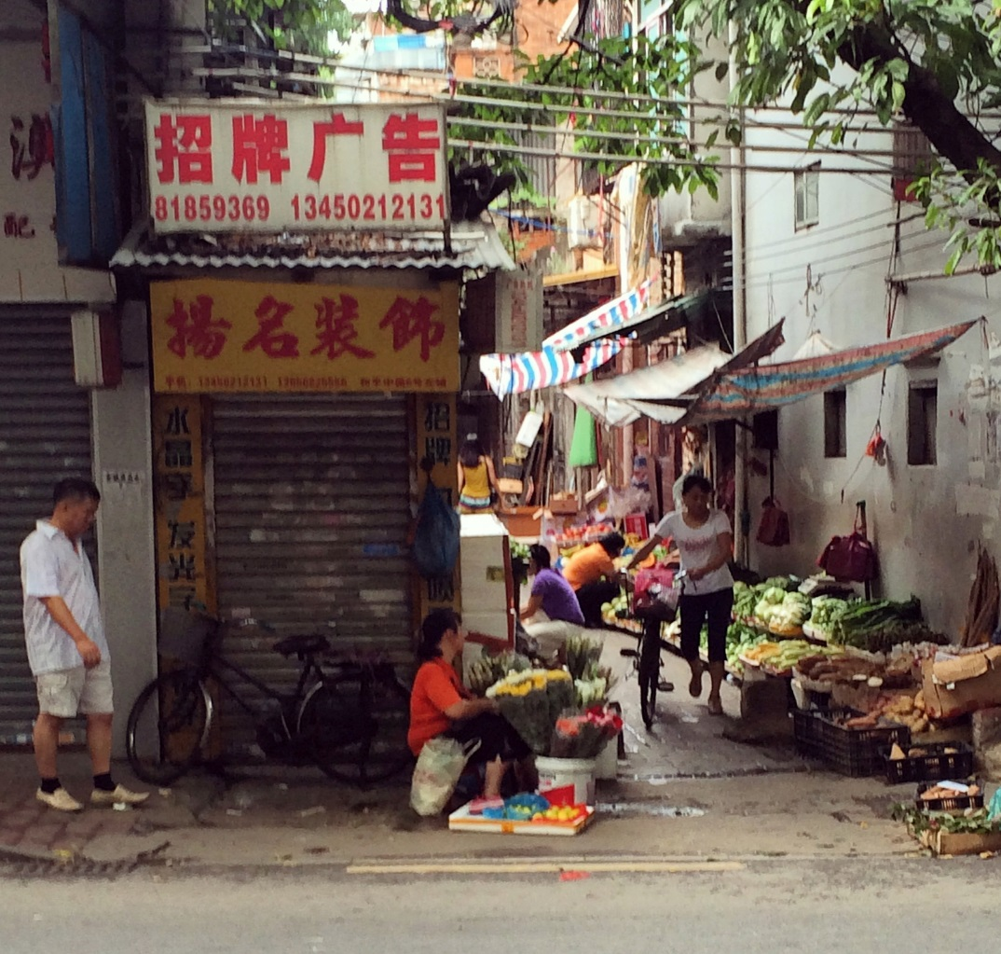
EXPERIENCES

Slide 8
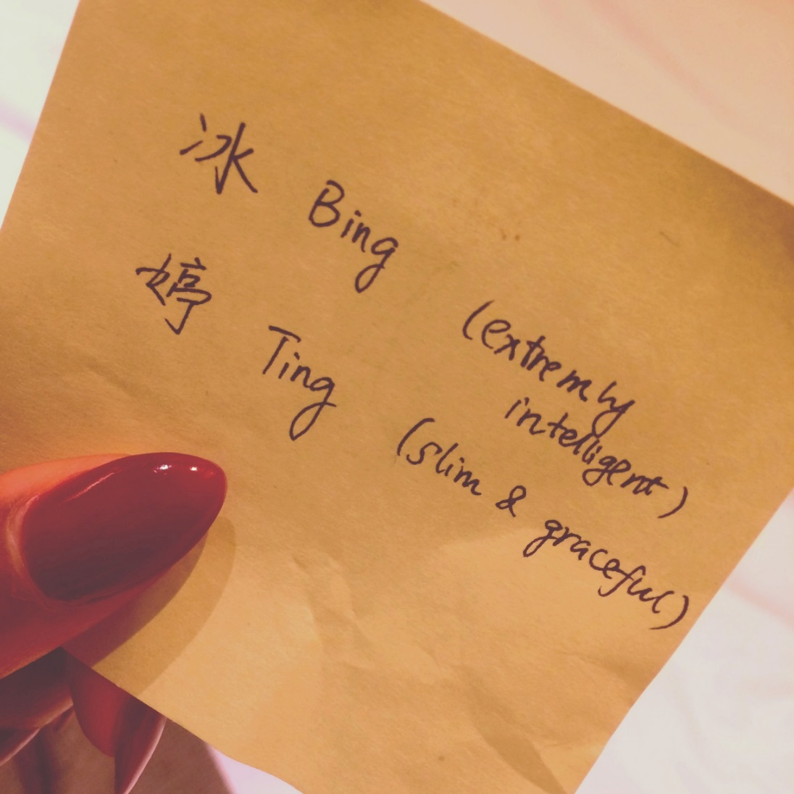
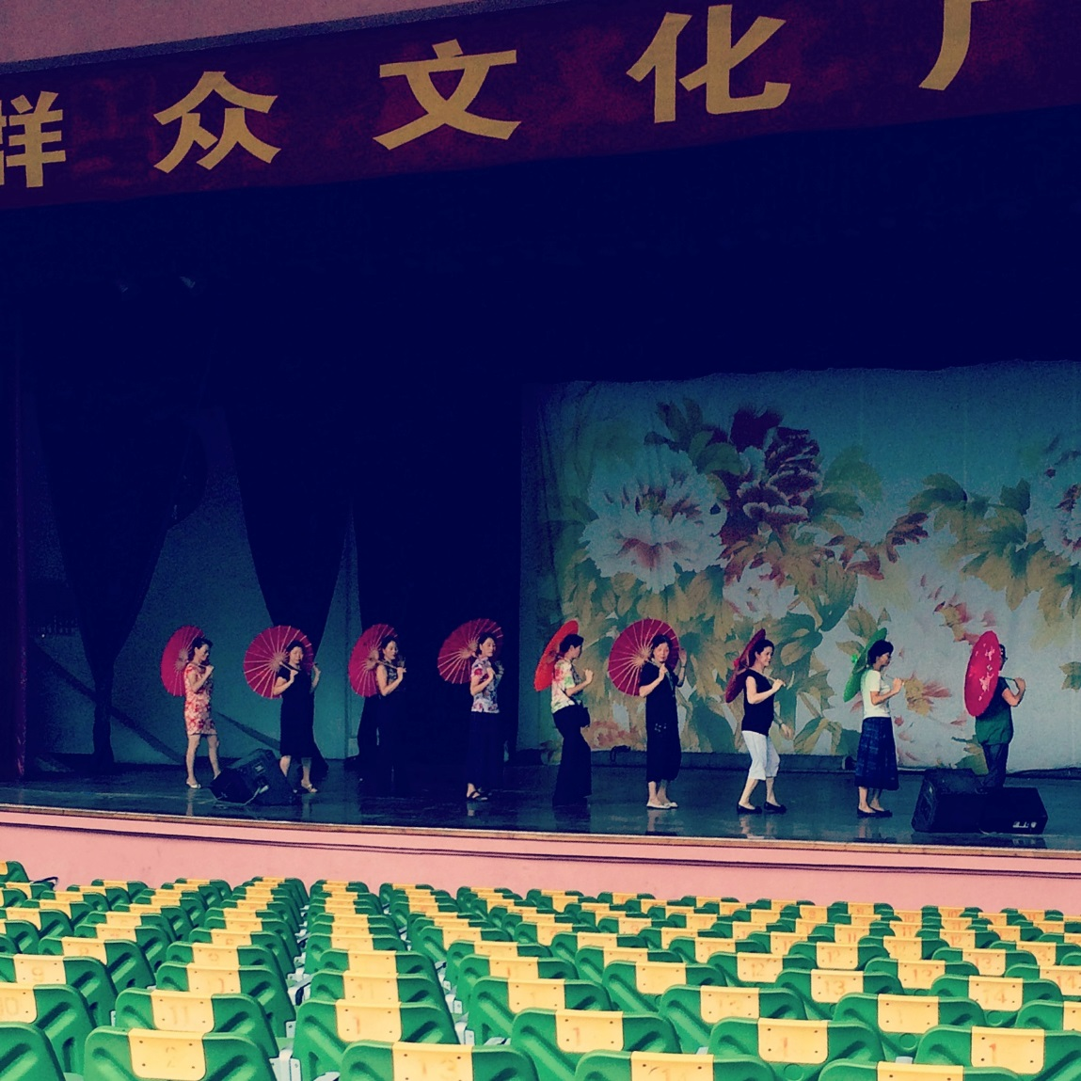
FULL CULTURAL ENRICHMENT

Slide 9
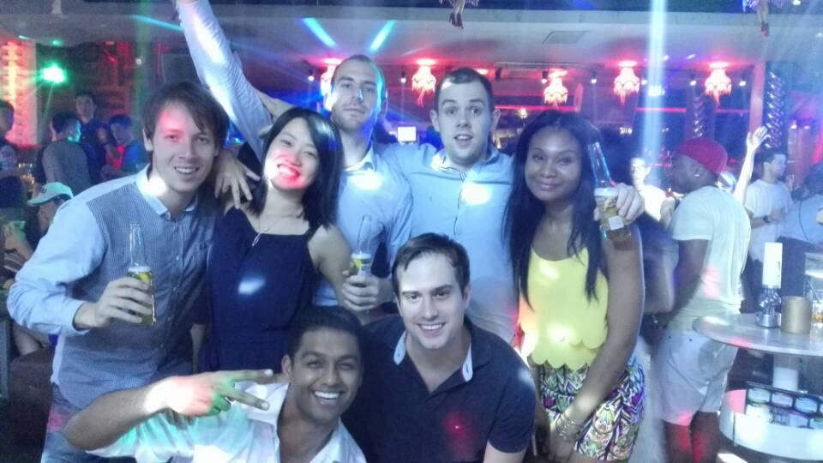
HIGHLIGHTS

Slide 10
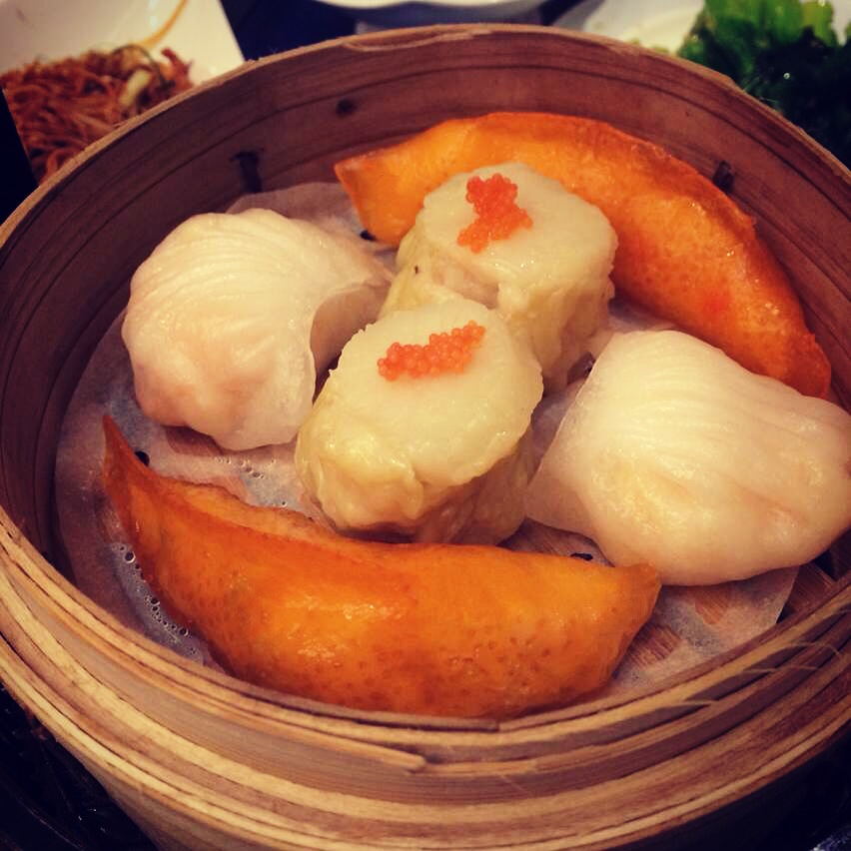
HIGHLIGHTS CONTINUED

Slide 11
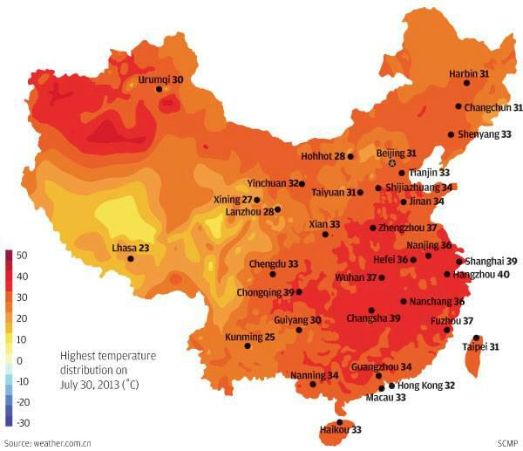
DRAWBACKS

Slide 12
What did I take from the trip?
Entrepreneurial flair
Ambition
International mindset
Networking skills
Drafting skills
Communication Skills
Negotiation Skills
GRAB EVERY OPPORTUNITY!!!

