Slide 1


The Right to Die?
How would the legalisation of euthanasia impact the existing legal framework in the UK – particularly the rights to life and autonomy?
Lidia Stan
LLB (Hons) Law | University of Warwick

Slide 2



Research Question & Methodology
Research Question:
How would the legalisation of euthanasia impact the UK legal framework — particularly the rights to life and autonomy?
Methodology: Doctrinal legal research and comparative analysis
Sources: Statutes, case law, ECHR, academic and ethical commentary
Comparative focus: Canada, Netherlands, Belgium, Switzerland

Slide 3
What is Euthanasia?
Definition
Euthanasia refers to the deliberate act of ending someone’s life to relieve suffering, usually by a medical professional.
Assisted Suicide
Criminal offence under Suicide Act 1961, s.2(1):
“A person who aids, abets, counsels or procures the suicide of another… shall be liable to imprisonment for up to 14 years.”
Action | Legal Status | Law/Case
Active euthanasia | ❌ Illegal | Murder/ Manslaughter (Common law)
Passive euthanasia | ✅ Conditionally Legal | Airedale v Bland (1993)
Assisted suicide | ❌ Illegal | Suicide Act 1961, s.2(1)
Types of Euthanasia
Voluntary – the person chooses and consents.
Non-voluntary – the person cannot consent (e.g., coma).
Involuntary – against the person’s will (legally murder).
Methods
Active – directly causing death (e.g., lethal injection).
Passive – allowing death by withholding treatment (e.g., turning off life support).

Slide 4
Why Euthanasia?
Why Now?
Support peaked above 90% in the 1990s, declined to 60s by 2023 (Guardian)
Still a majority today: 65% (~44 million people) support legal change
Law remains unchanged: Assisting suicide criminal under Suicide Act 1961
Urgent relevance: Assisted Dying for Terminally Ill Adults Bill now at its furthest point in Parliament
In Nicklinson v Ministry of Justice [2014], the Supreme Court acknowledged the suffering but ruled that only Parliament can change the law.
Why this topic? It’s a legal, ethical, and human question facing UK society today
Public Support for Assisted Dying in the UK (1997–2023)
Sources: The Sun (1997), Dignity in Dying (2019), YouGov/The Guardian (2023)

Slide 5
Human Rights in Focus
Where Human Rights and the Law on Death Collide?
ECHR Articles
Article 2 – Right to life
Article 8 – Right to private and family life
Article 3 – Prohibition of inhuman or degrading treatment
Article 14 – Prohibition of discrimination
🛡️Article 2 is often used to justify protecting life at all costs — but courts have acknowledged it doesn't prohibit assisted dying in principle.
⚖️Article 8 supports personal autonomy — including the right to decide how and when to die — but isn’t currently strong enough alone to override criminal law.
🚫Article 3 may be engaged when prolonged suffering is involved, especially where individuals are denied control over end-of-life decisions.
♿Article 14 raises concerns about discrimination — for example, those physically unable to end their lives are treated differently under the law.

Slide 6
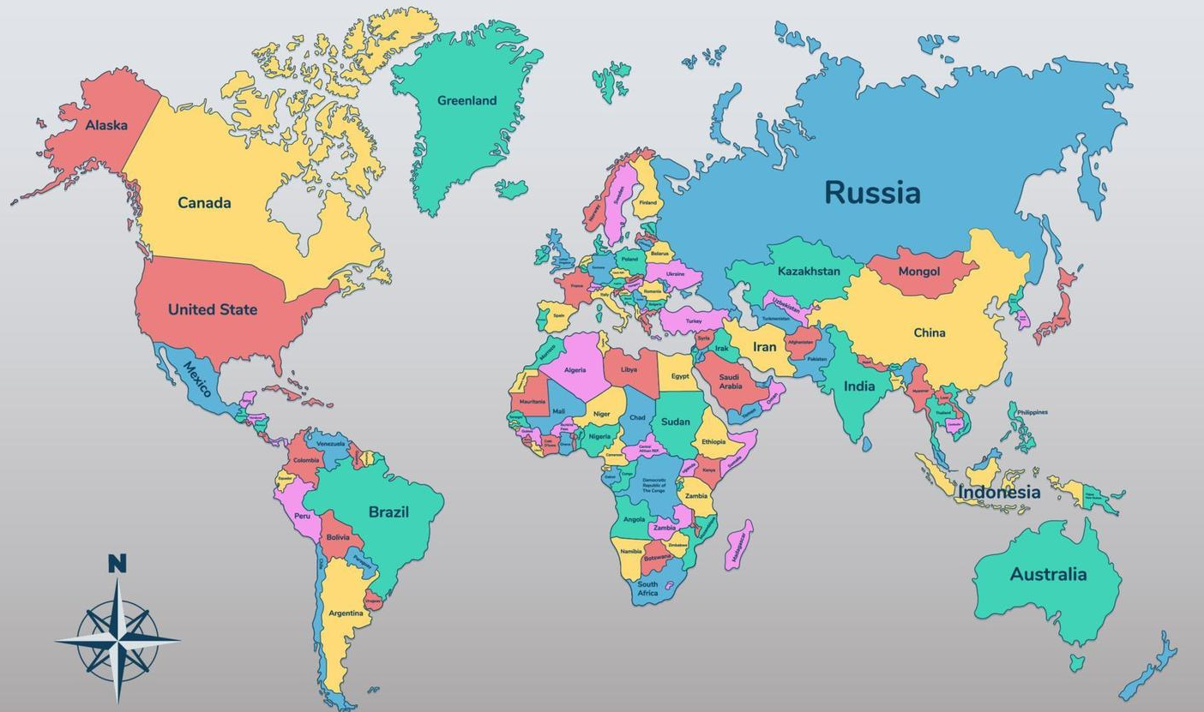




Comparative Perspectives
Canada | Belgium | Netherlands | Switzerland
MAiD legalised in 2016 | Legal since 2002 | Legal since 2002 | Permitted since 1940s
18+, competent, serious illness | Includes psychological suffering | Psychological & terminal illness | Independent orgs oversee process
Must experience intolerable suffering | No age limit in some cases | Strict eligibility review | Motive must be non-selfish
🔑 Common Themes
✔ Strict safeguards (e.g. second opinions, waiting periods)
✔ Autonomy and dignity as core legal values

Slide 7
Ethical and Religious Considerations
Sanctity of life
Divine authority
Opposition from major religions
🛐
Religious Ethics
Avoid privileging one worldview
Legal reform must be neutral and inclusive
🏛️
Religious values in political discourse
MPs vote on conscience
⚖️ Legal Tension
Legal Reform
Political Influence
Rise in secularism
Generational divide in views
✊
Secular Ethics
Autonomy and self-determination
Dignity in death
👥 Societal Shift

Slide 8

Societal Concerns
🧠 Coercion & pressure: Vulnerable people might feel obligated to choose death
♿ Disability rights: Fears that legalisation could devalue disabled lives
💰 Economic inequality: Poorer patients may feel they have fewer options
👪 Family strain: Emotional and financial pressures may influence decisions
🏥 Trust in healthcare: Worries that doctors’ roles could be compromised
• Reflect deeper anxieties about power, care, and dignity
• Marginalised groups fear being seen as burdens
• Perceived vulnerability can undermine public trust
• Safeguards alone may not address these fears
• Laws must promote equity, not just autonomy
🔍
Common Public Concerns
💡
Why These Concerns Matter

Slide 9






Pillars of Reform
• Balance Article 2 (right to life) & Article 8 (autonomy)
• Protects autonomy without compromising safety
• Reflects models from Canada and the Netherlands
• Eligibility: terminal illness, mental capacity, voluntary informed request
• Two-doctor verification & psychological evaluation
• Cooling-off period & right to withdraw
• National oversight body to review and report on cases
• Transparency and public accountability
• Conscientious objection protected for medical staff
⚖️
Legal Principles
🛡️ Safeguards
🏛️
Oversight

Slide 10

Conclusion
Balancing autonomy & life isn’t about choosing between them
Thank You
It is about protecting both
Lidia Stan
LLB (Hons) Law | University of Warwick

