Slide 1
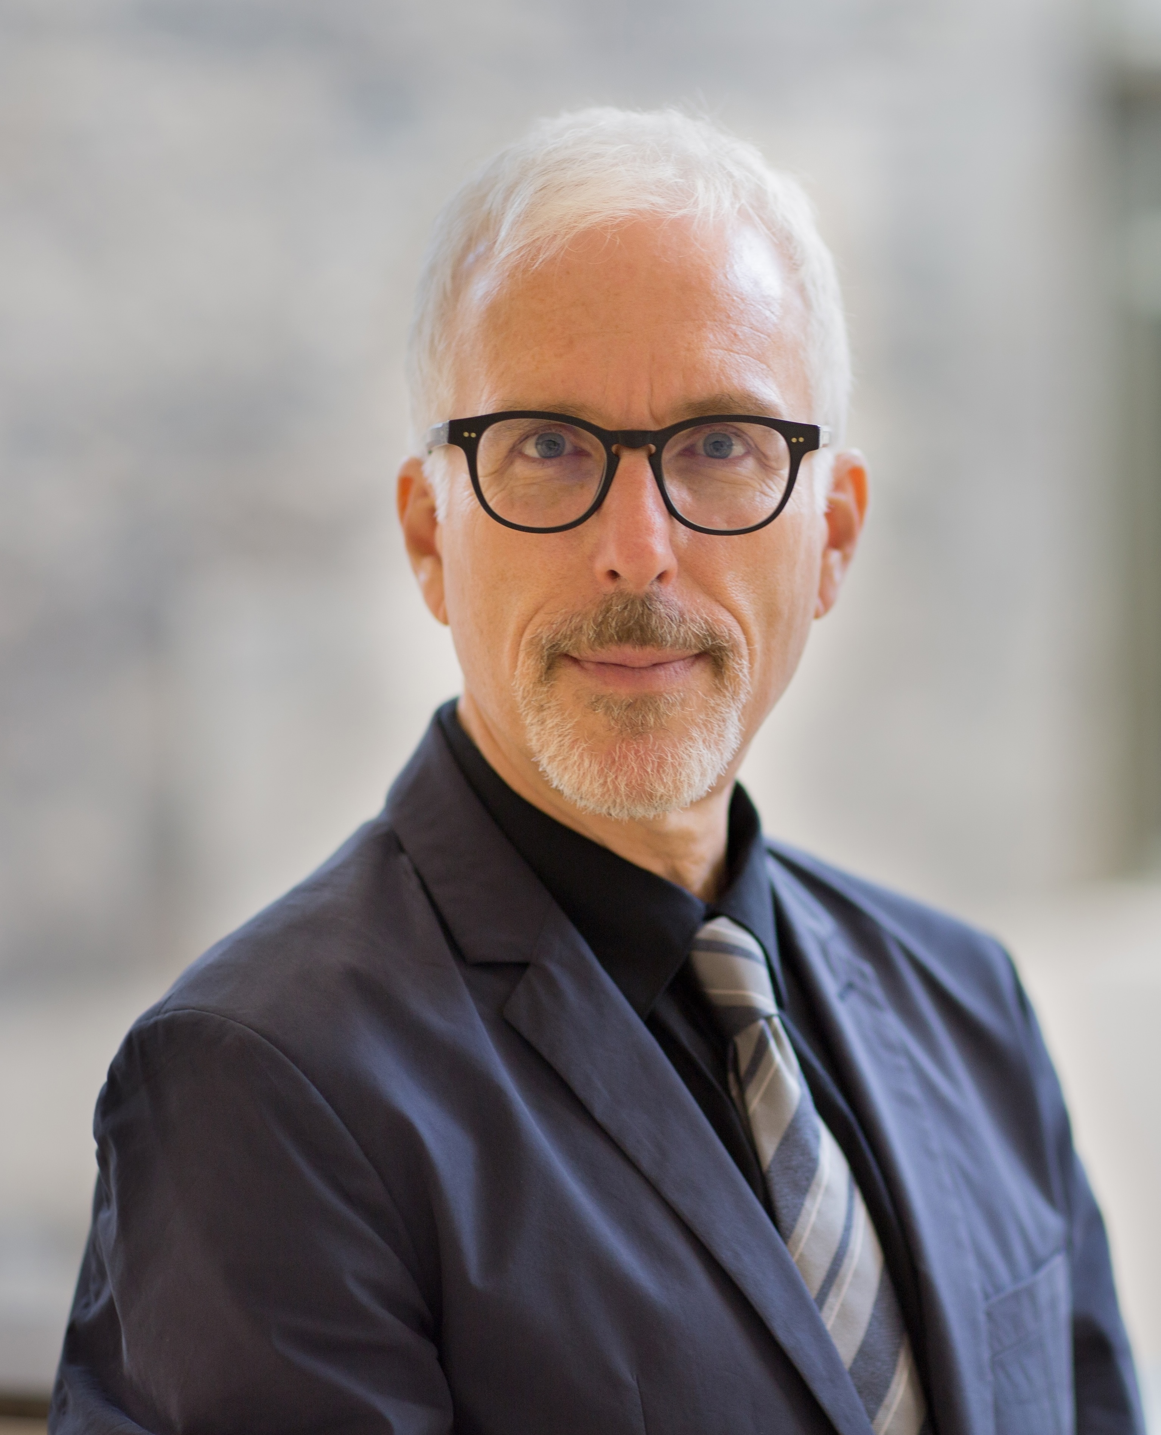





Manuscript Discussion:
The Facade of Development
Professor David Schneiderman,
Faculty of Law, University of Toronto
Monday 2 December 2024, 12.30pm – 2pm
S.2.09/ S2.12
Social Science Building
About the Event: Professor David Schneiderman will present a chapter from his forthcoming book, The Facade of Development.
Abstract:
Can international investment law can contribute to economic development? Max Weber took care to distinguish legal from economic development. Rather than being merely epiphenomenal of markets and serving only the interests of market actors, Weber sought to carve out space for the autonomous development of law that was not designed merely to serve economic interests. Though it is tempting to read Weber – as have investment law professionals – as having mapped out a pathway for economic development that simply can be copied, Weber maintains that there are no law-like patterns or master narratives that can be adopted and transplanted elsewhere. By interrogating Weber’s methods more closely, we learn that investment law professionals should not be so quick as to inflate their ideal – improving development or promoting the rule of law by signing investment treaties – with the real. They should instead be more careful about expectations arising out of investment treaty commitments and more forthright about the precise object and purpose of the investment treaty disciplines. It is not about promoting development but about vindicating the interests of foreign investors. They must, in short, stop enchanting vulnerable populations with empty promises of economic development.
About the Speaker:
Professor David Schneiderman is Professor of Law and Political Science (courtesy) at the University of Toronto where he teaches courses on constitutional law and international investment law. He is the author of over 80 articles and book chapters and, in addition, the author or editor of over a dozen books, including Constitutionalizing Economic Globalization: Investment Rules and Democracy's Promise (Cambridge UP 2008), Resisting Economic Globalization: Critical Theory and International Investment Law (Palgrave 2013), Investment Law’s Alibis: Colonialism, Imperialism, Debt and Development (Cambridge UP, 2022), and co-editor (with Gus Van Harten) of Rethinking Investment Law (Oxford UP, 2023). His newest book is entitled Constitutional Review and International Investment Law: Deference or Defiance? (Oxford UP, 2024).
For online participation, please go to the event website.
The IEL Collective and the Centre for Law, Regulation & Governance of the Global Economy (GLOBE)

