Slide 1
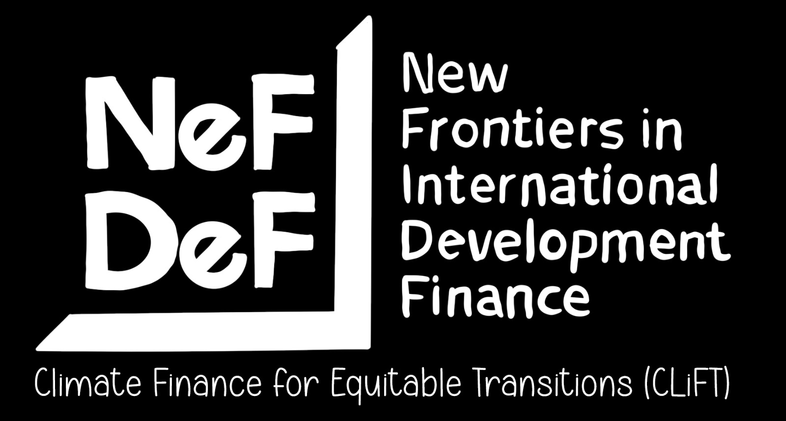
Climate Finance and the International Financial Architecture
Celine Tan
Professor of International Economic Law
School of Law, University of Warwick
celine.tan@warwick.ac.uk

Slide 2

Climate and sustainability finance is embedded within and delivered through the global financial system and the legal and regulatory framework which supports it (the international financial architecture or IFA).
Two things to unpack on the relationship between climate finance and the IFA:
Impact of the structural characteristics of the IFA on the provision, mobilisation and delivery of finance for climate and sustainable development; and
Impact of the financial instruments deployed to climate and sustainable development – terms and conditions, operational structure, etc – on the IFA

Slide 3


There are structural features of the IFA which will hinder provision, mobilisation and delivery of finance for climate action and sustainable development, including for just energy transition.
The deployment of the ‘wrong kind’ of finance without adequate fiscal and policy space and without IFA reform will heighten existing economic and financial vulnerabilities of developing countries and undermine climate action/ sustainable development goals (SDGs) and increase developing countries’ exposure and susceptibility to further financial and climate crises.

Slide 4

PRIVATE TURN IN FINANCING FOR DEVELOPMENT & CLIMATE FINANCE
Current policies and strategies of climate finance promoting market-led green transition and enabling wide-ranging structural reforms in host countries that can paradoxically constrain the fiscal, policy and regulatory space for countries to undertake nationally-owned just energy transitions.
They will have wider implications for developing countries beyond access to climate finance and can impact on local and national law and policymaking and host countries’ engagement in the broader global economy and international law.
Photo by aakashdhage on Unsplash

Slide 5

Reliance on debt instruments without significant reforms to the IFA will increase developing country indebtedness and risks greater disorderly defaults.
Deployment of ‘innovative’ financial instruments – thematic bonds, sustainability-linked bonds and loans, credit enhancement facilities (guarantees, etc) – without regulatory safeguards and without IFA reforms generate new transmission nodes for financial instability within developing countries and within the global financial system.
Lack of adequate public regulation and oversight of cross-border financial flows means that private finance remains a volatile and less sustainable source of finance for global climate action.
Limited financial safety net to support countries during financial and debt crises can lead to greater vulnerability and heighten exposure to financial, trade and climate shocks.
Financial facilities and support – eg from the IMF – during financial crises come with policy conditionalities that can exacerbate the problem and create new ones while locking down fiscal and policy space for countries to respond to crises.
Some facilities – eg the Resilience and Sustainability Trust (RST) and World Bank policy loans – can serve as mitigation through the back door or promote privatisation policies for energy transition and other climate action.
Photo: Anne Nygård on Unsplash

Slide 6
The IFA is inherently asymmetric in its governance and developing countries have less voice and representation in the international financial architecture compared to other international legal/ multilateral governance fora.
Crucially, the shift to private finance will mean moving more governance of financial flows to regulatory fora that developing countries have little control over and the allocation of capital will be determined by priorities and regulatory interests of developed countries and private actors within these jurisdictions.
Thematic bond principles set by the International Capital Markets Association (ICMA) and the thematic bond frameworks are driven by investor appetitive/ third party reviewers/ credit ratings agencies
Disclosure requirements for sustainable finance determined by developed country jurisdictions – eg the EU – and standard-setting agencies such as the International Sustainable Standards Board (ISSB)
Financial regulation of financial institutions and asset managers in major financial centres through their regulators and central banks
Examples

Slide 7

IFA is embedded within broader systemic and structural asymmetries of the international economic order – such as trade and investment rules – that will compound the governance and accountability deficits of the IFA. The creation of ‘enabling environments’ to attract private capital for climate and sustainable development finance through financial and regulatory incentives can lock-in reforms that constrain countries’ policy and regulatory space, including for climate action and sustainable development.
No multilateral framework for regulating global financial flows and coherence with environmental agreements. Policy and regulatory fragmentation is likely to impede coordinated action on climate action and sustainable financing outside the UNFCCC/ CBD and may undermine commitments and negotiations in those multilateral regimes.
Global financial system poorly aligned with sustainable development and climate action principles.
Photo by Chenyu Guan on Unsplash

Slide 8
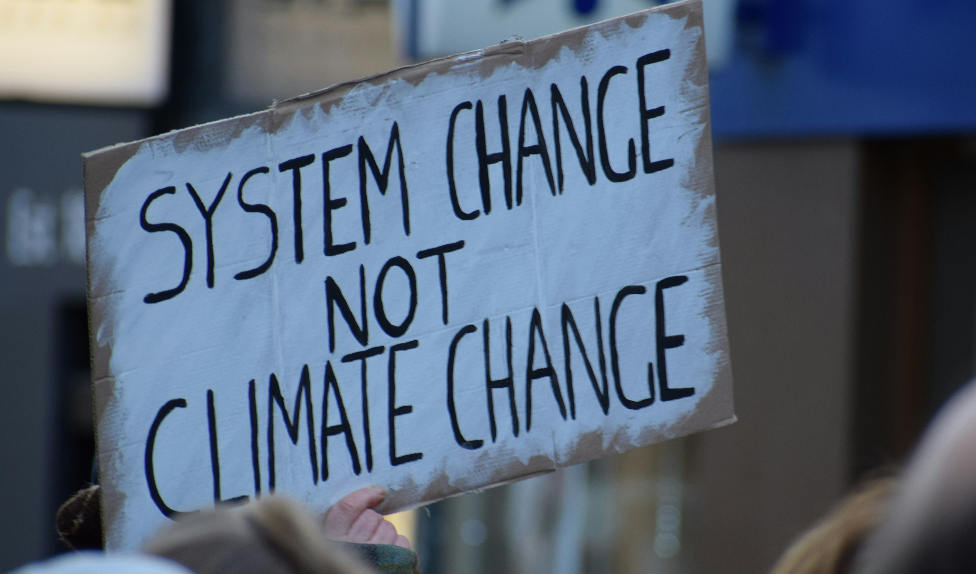
Photo by Ma Ti on Unsplash

Slide 9
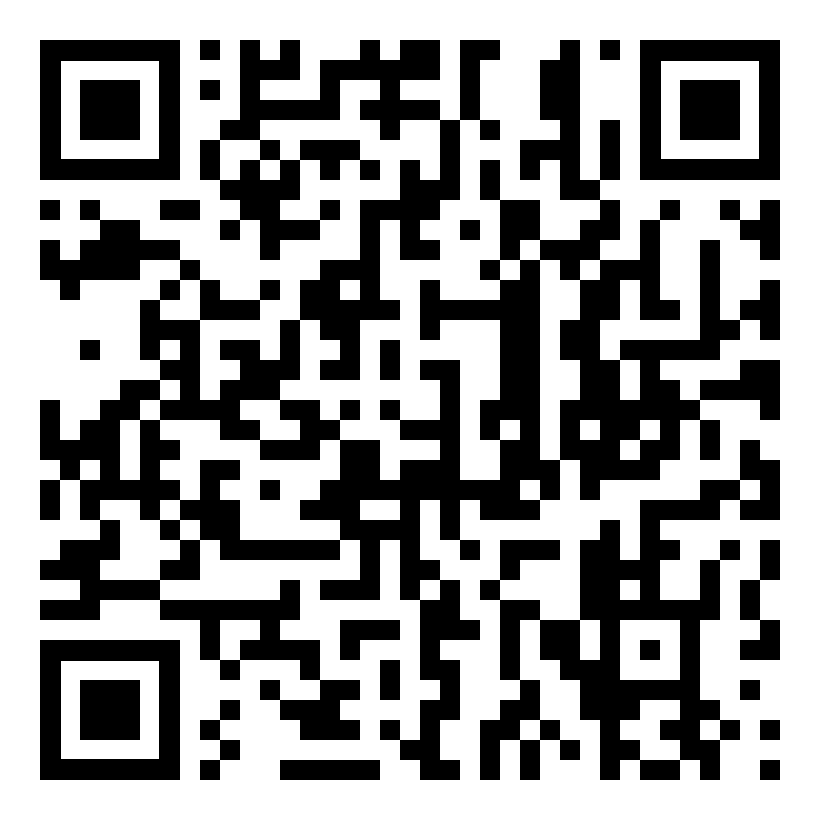


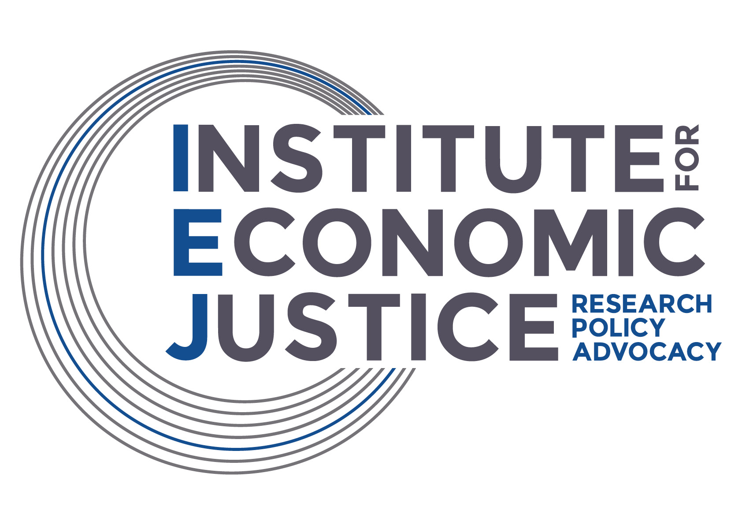


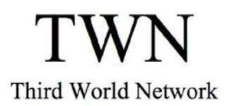




https://go.warwick.ac.uk/nefdef/climatefinance

